Slide 1

WELCOME
08
03
TO
OUR
07
06
05
04
02
01
PRESENTATION

Slide 2

Team Members
Samsun Naher Asme
Id no: 203-15-3882
Section: 57_C
08
03
07
06
05
04
02
01
Md. Rakibul Islam Shanto
Id no: 203-15-3871
Section: 57_C

Slide 3


Our Title
08
03
Early Lung Disease Detection in Urban Pollution Zones using Deep Learning
07
06
05
04
02
01

Slide 4

Abstract
Bangladesh specially Dhaka and Gazipur city become the most polluted area in the world recently. Too much dust causes lung diseases and we are trying to detect any major lung diseases using deep learning. We are using the VGG-16 deep learning architecture to develop a robust early lung disease detection system. For this architecture, after collecting the chest X-ray data, we will preprocess the images. The major diseases are lung cancer, corona, pneumonia. Sample from these diseases will be trained and the input will be check by images processing and diagnosis the problem. Comparative analysis validates the model’s efficacy. Finally, this framework aims to decrease urban pollution’s impact on public health.
07
03
06
05
08
04
02
01

Slide 5
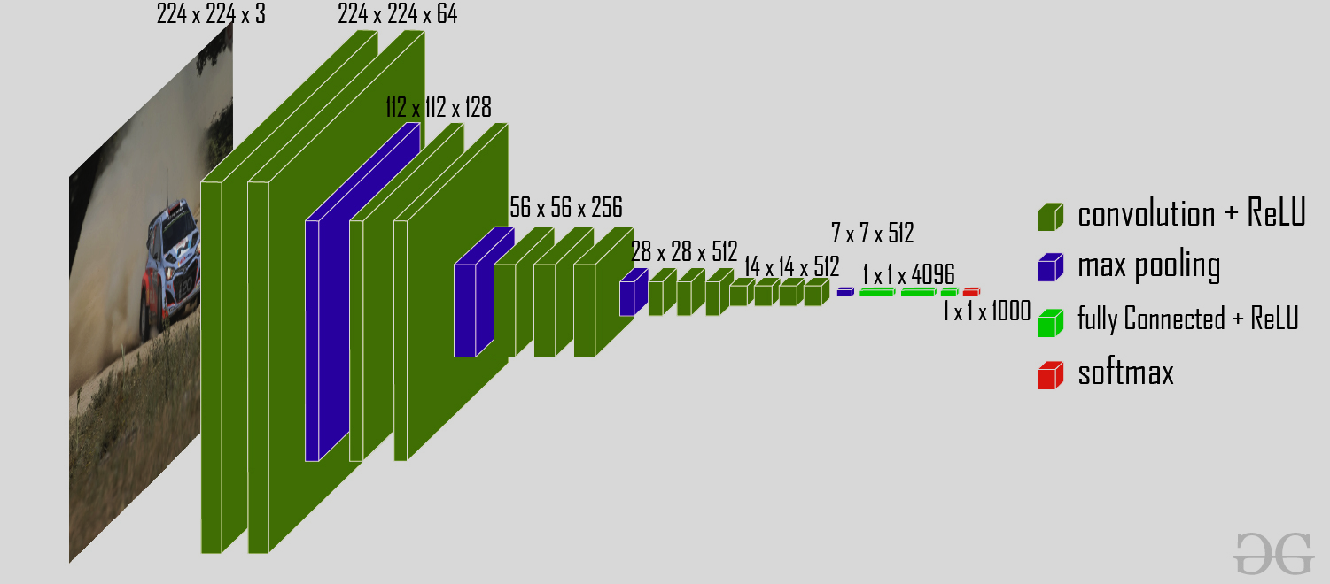

Method
VGG-16
08
04
07
03
06
05
02
01

Slide 6

Objective
Alarming levels of pollution
Respiratory disorders
Early detection
Effective treatment
Chest X-ray
The goal is to develop a strong diagnostic tool that will allow for timely medical intervention and, ultimately, will reduce the burden of respiratory infections in these severely afflicted areas.
08
03
07
06
05
04
02
01

Slide 7

Disease Prediction
Pneumonia
Tuberculosis
Lung Cancer
Bronchiectasis
Lung Abscess
08
03
07
06
05
04
02
01

Slide 8

End
THANK YOU
08
03
07
06
05
04
02
01

