Slide 1
Brain Tumor Segmentation and Classification Using Image Processing
Md. Rakibul Islam Shanto
ID : 203-15-3871
AND
Samsun Naher Asme
ID : 203-15-3882
Department : CSE
Daffodil International University
Narayan Ranjan Chakraborty
Associate Head & Associate Professor
Department Of CSE
Daffodil International University

Slide 2
Outline
Introduction
Motivation
Objectives
Research Gaps
Research Methods
Data Collection
Model Selections
Data Analysis
Result and Findings
Application of the study
Limitations
Conclusion
References
Q&A

Slide 3
Introduction
Major health threat worldwide
Second leading cancer
Advances in MRI imaging
Neural Networks and Deep Learning
Ongoing research
Focus on segmentation and classification

Slide 4
Motivation
Defend the mistakes of diagnosis
Save time and life
Helping early detection and early diagnosis

Slide 5
Objectives
Satisfy the patient
Giving professionals a friend
User friendly website

Slide 6
Research Gaps
Segmentation and Classification together
Use of novel feature extraction
Redundancy of data by data augmentation
Graph Neural Network (GNNs) implementation

Slide 7

Research Methods
Pre Processing – [25] Image Resizing, Feature Extraction
– [34] Grayscale conversion, Resizing
Segmentation – [20] CNN, U-Net
– [ 7 ] CNN based U-Net
Classification – [25] ANN, KNN, SVM
– [38] ANN, KNN, DT, SVM, NB

Slide 8
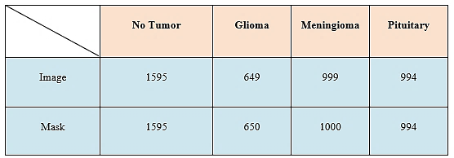
Data Collection
Kaggle Dataset
Four classes, a) No Tumor, b) Glioma, c) Meningioma, d) Pituitary

Slide 9
Model Selections
Grayscale Conversion
Resizing
Feature Extraction
Pre-Processing
Segmentation
Custom CNN
RF, ET, LOGR, GB, LDA, SVC, BC, SVM, DT, CART, KNN, NB
ANN (Artificial Neural Network)
GNN (Graph Neural Network)
Classification

Slide 10
Data Analysis
Segmentation
Image & Mask load
Resize, Normalize
Sequential model
conv2D layers
Maxpooling2D
Sigmoid (Binary C)
CNN Model Define
Train_test_spit
90-10
relu optimizer
Loss function
Accuracy metrics
Compilation Model
Testing & Calculating
Epoch 100
rkshaheds_model

Slide 11
Data Analysis
Classification
Solidity
SIFT keypoints
WH Ratio
ECL Ratio
Harris Corner
Circularity
Image load
Feature Extraction
DT
RF
SVM
KNN etc.
Train ML Model
Save & load CSV
Evaluate Model
Node Classification

Slide 12
Data Analysis
Classification
Solidity
SIFT keypoints
WH Ratio
ECL Ratio
Harris Corner
Circularity
Load data to Graph
ANN Model
GraphConvLayer
Testing
baseline_model
200 epochs
GNNNodeClassifier
Testing
gnn_model

Slide 13
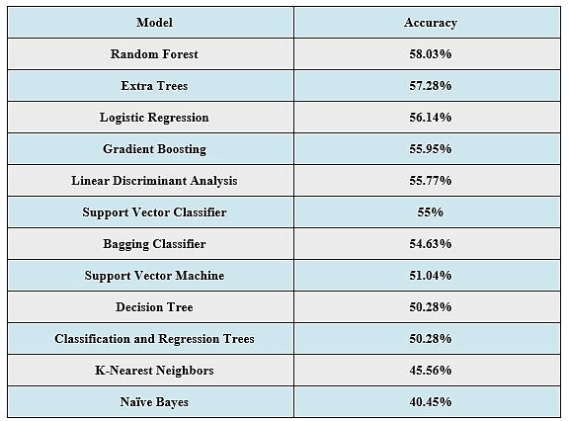
Result and Findings
Classification

Slide 14


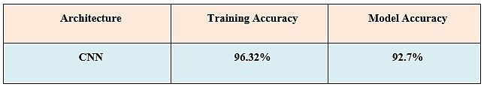
Result and Findings
Classification
Segmentation

Slide 15
Result and Findings

Slide 16
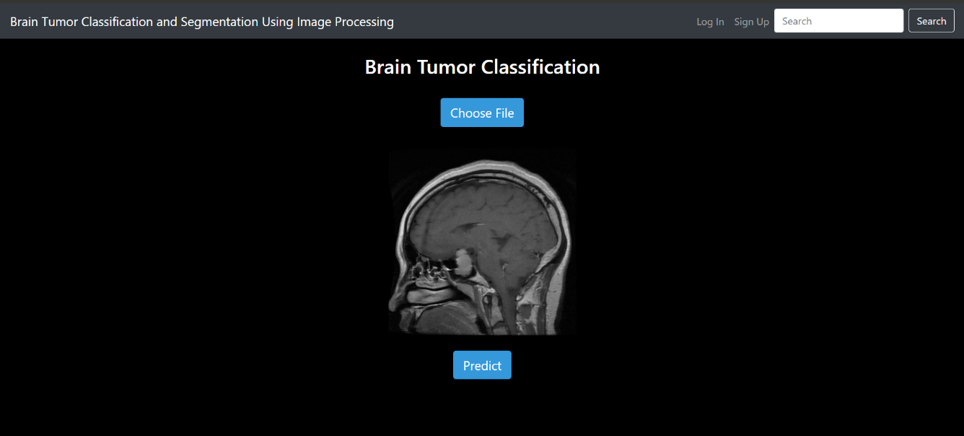
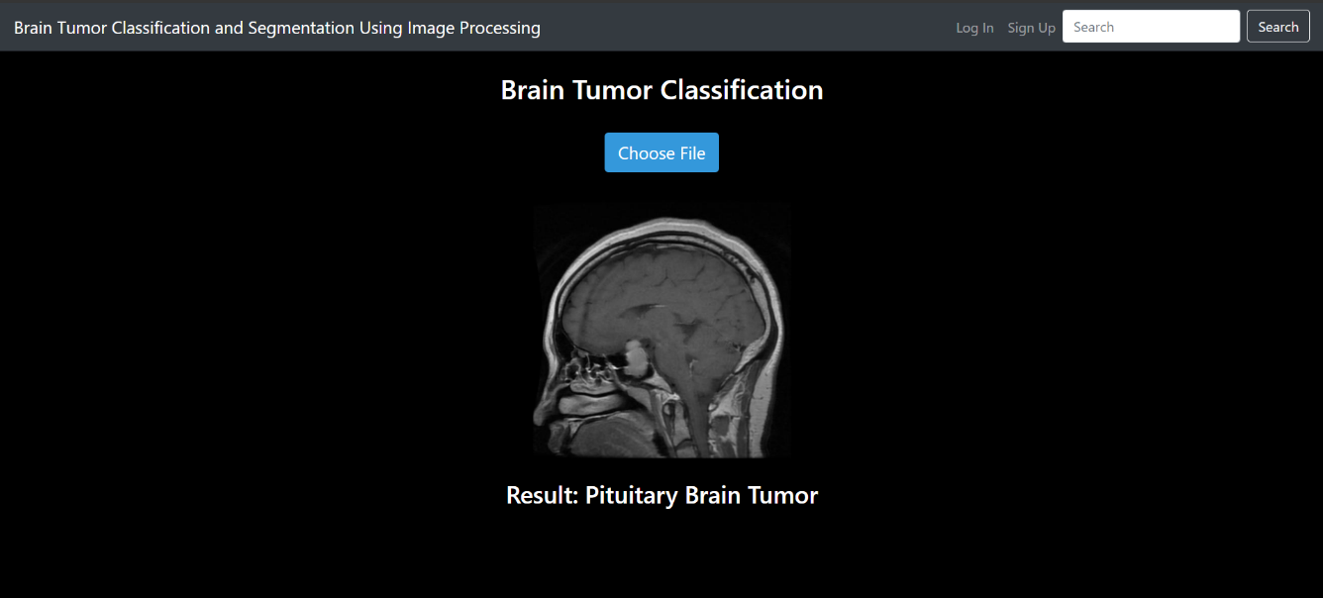
Application of the Study
Perfectly Detected

Slide 17
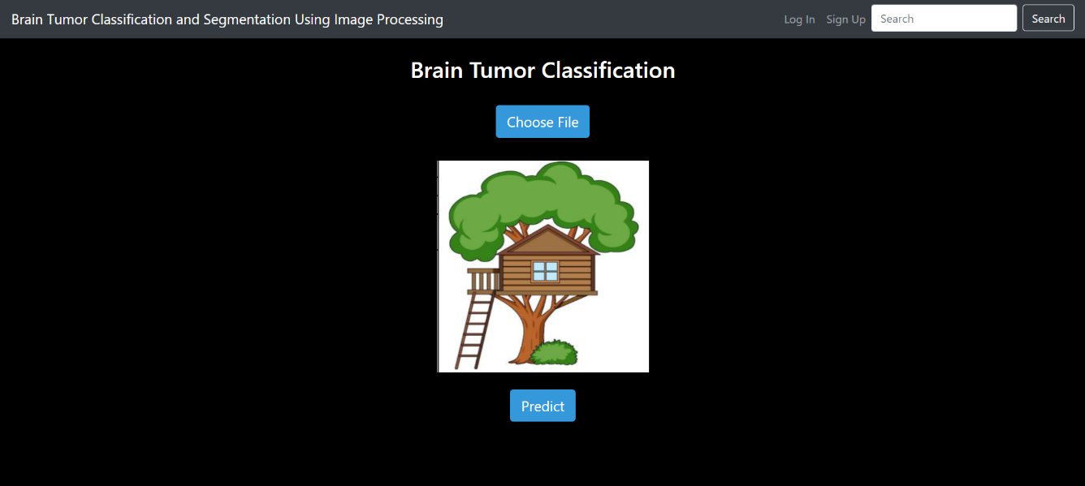
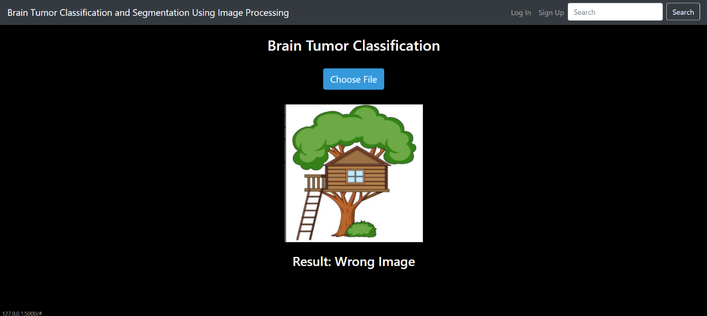
Application of the Study
Wrong Input Detection

Slide 18
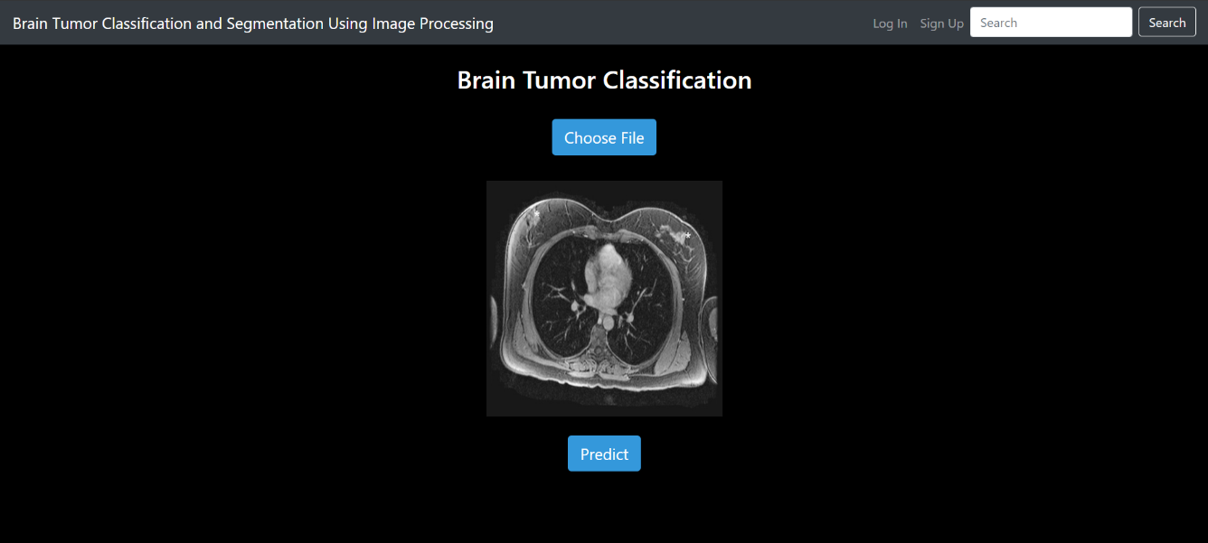
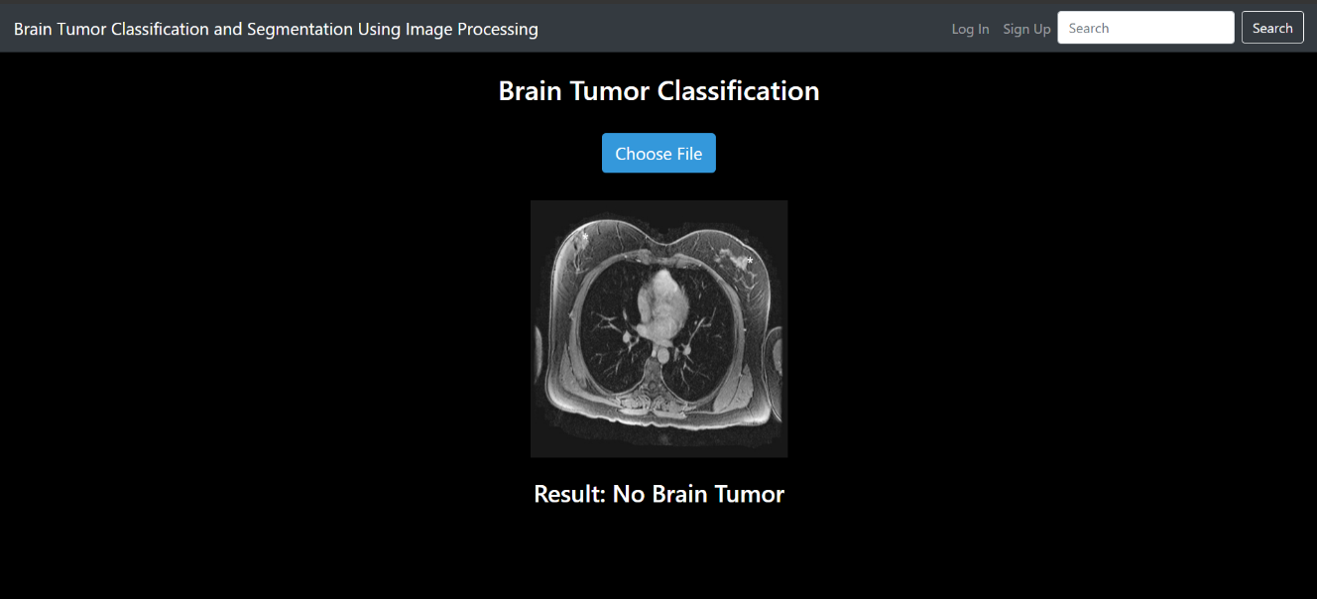
Application of the Study
Partially Detected

Slide 19
Limitations
Dataset Collection
Prediction of MRI images expect Brain
User Account
Personal Model
CT scans

Slide 20
Conclusion
Brain Tumor
Segmentation and Classification
Top performing Model
Web Application
Limitations
Enhance Online Platform
Improve Segmentation Accuracy

Slide 21
References
[1] Methil, A.S., 2021, March. Brain tumor detection using deep learning and image processing. In 2021 international conference on artificial intelligence and smart systems (ICAIS) (pp. 100-108). IEEE.
[2] Sravanthi, N.S.R.D.N., Swetha, N., Devi, P.R., Rachana, S., Gothane, S. and Sateesh, N.J.I.J.S.R.C.S.E.I.T., 2021. Brain tumor detection using image processing. International Journal of Scientific Research in Computer Science, Engineering and Information Technology, 7(3), pp.348-352.
[3] Suresha, D., Jagadisha, N., Shrisha, H.S. and Kaushik, K.S., 2020, March. Detection of brain tumor using image processing. In 2020 Fourth International Conference on Computing Methodologies and Communication (ICCMC) (pp. 844-848). IEEE.
[4] Abd Khalid, N.E., Ismail, M.F., Manaf, M.A.A., Fadzil, A.F.A. and Ibrahim, S., 2020. MRI brain tumor segmentation: A forthright image processing approach. Bulletin of Electrical Engineering and Informatics, 9(3), pp.1024-1031.
[5] Grampurohit, S., Shalavadi, V., Dhotargavi, V.R., Kudari, M. and Jolad, S., 2020, October. Brain tumor detection using deep learning models. In 2020 IEEE India Council International Subsections Conference (INDISCON) (pp. 129-134). IEEE.
[6] Sahaai, M.B., 2021. Brain tumor detection using DNN algorithm. Turkish Journal of Computer and Mathematics Education (TURCOMAT), 12(11), pp.3338-3345.
[7] Jalali, V. and Kaur, D., 2020. A study of classification and feature extraction techniques for brain tumor detection. International Journal of Multimedia Information Retrieval, 9(4), pp.271-290..
[8] Amin, J., Sharif, M., Haldorai, A., Yasmin, M. and Nayak, R.S., 2022. Brain tumor detection and classification using machine learning: a comprehensive survey. Complex & intelligent systems, 8(4), pp.3161-3183.
[9] Kumar, S., Dhir, R. and Chaurasia, N., 2021, March. Brain Tumor Detection Analysis Using CNN: A Review. In 2021 International Conference on Artificial Intelligence and Smart Systems (ICAIS) (pp. 1061-1067). IEEE.
[10] Budati, A.K. and Katta, R.B., 2022. An automated brain tumor detection and classification from MRI images using machine learning technique s with IoT. Environment, Development and Sustainability, 24(9), pp.10570-10584.

Slide 22
THANK YOU

