Slide 1
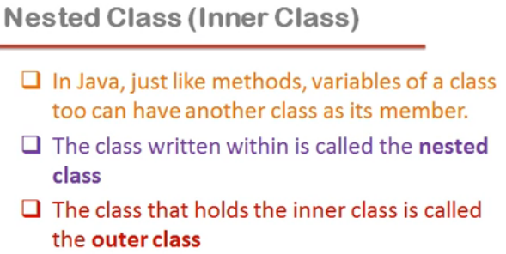

Slide 2
class Outer
{
int x;
void f1() { }
Class Inner{ }
}

Slide 3
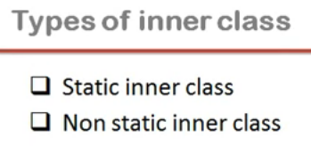

Slide 4
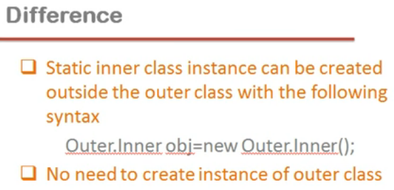

Slide 5
class Outer
{
static class Inner
{
void if1()
{
System.out.println("Inner Function");
}
}
}
public class Test
{
public static void main(String args[])
{
Outer.Inner o1 = new Outer.Inner();
o1.if1();
}
}

Slide 6
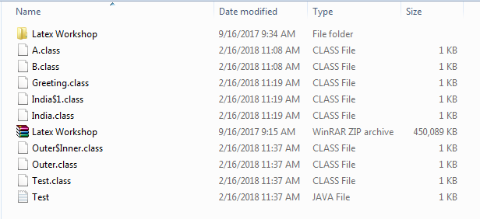
After Compile File Directory

Slide 7
class Outer
{
class Inner //Not a static class
{
void if1()
{
System.out.println("Inner Function");
}
}
}
public class Test
{
public static void main(String args[])
{
Outer.Inner o1 = new Outer.Inner(); //NOT Work
o1.if1();
}
}

Slide 8
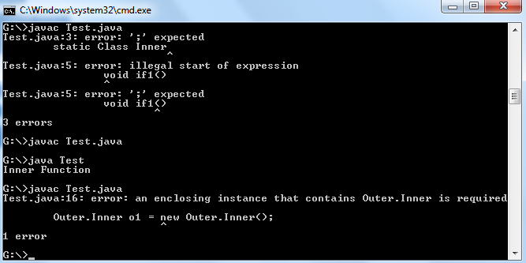

Slide 9
class Outer
{
class Inner //if non-static
{
void if1()
{
System.out.println("Inner Function");
}
}
}
public class Test
{
public static void main(String args[])
{
Outer out = new Outer();
Outer.Inner o1 = out.new Inner(); //Right Method
o1.if1();
}
}

Slide 10
Revision
class A
{
void f1()
{
System.out.println("Function-f1");
}
}
class B extends A
{
void f2()
{
System.out.println("Function-f2");
}
}
class Test
{
public static void main(String args[])
{
A a1=new B();
a1.f1(); //Will Work
a1.f2(); //Will Not Work because of
//Early Binding
}
}

Slide 11
Revision…
class A
{
void f1()
{
System.out.println(“Parent function");
}
}
class B extends A
{
void f1()
{
System.out.println(“Child Function");
}
}
class Test
{
public static void main(String args[])
{
A a1=new B();
a1.f1(); //Will call the Child Version //because of Late Binding
//in Function Overriding
}
}

Slide 12
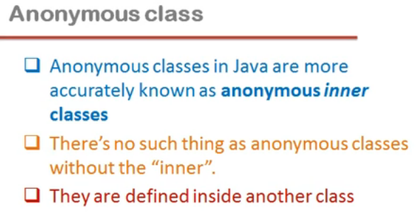

Slide 13
Anonymous Class
class Greeting
{
public void sayHello()
{
System.out.println("HELLO");
}
}
class India
{
Greeting g=new Greeting()
{
public void sayHello()
{
System.out.println("HELLO");
}
};
}
class Test
{
public static void main(String args[])
{
India ind=new India();
ind.g.sayHello();
}
}

Slide 14
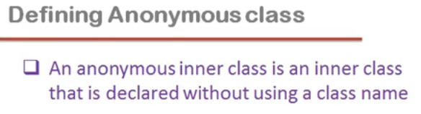

Slide 15
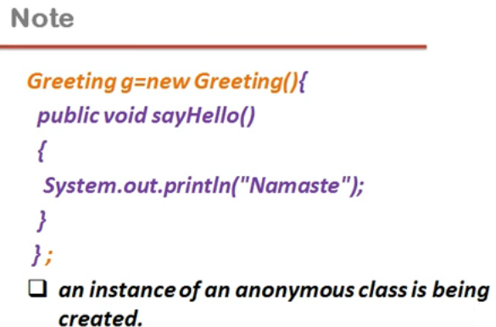

Slide 16
