Slide 1


Python

Slide 2
Overview
History
Installing & Running Python
Names & Assignment

Slide 3
Brief History of Python
Invented in the Netherlands, early 90s by Guido van Rossum
Named after Monty Python
Open sourced from the beginning
Considered a scripting language, but is much more
Scalable, object oriented and functional from the beginning
Used by Google from the beginning
Increasingly popular

Slide 4
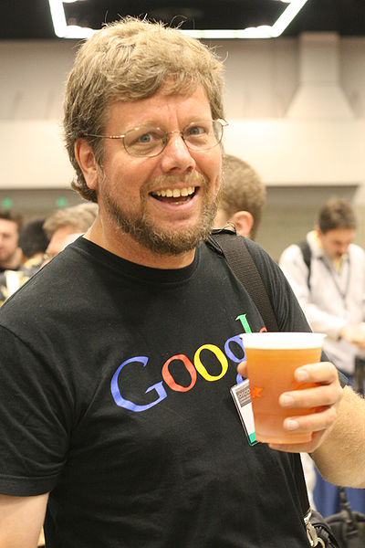
Python’s Benevolent Dictator For Life
“Python is an experiment in how much freedom program-mers need. Too much freedom and nobody can read another's code; too little and expressive-ness is endangered.”
- Guido van Rossum

Slide 5
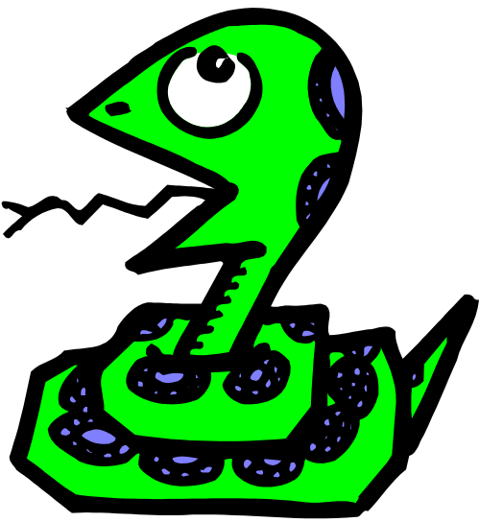
Running Python

Slide 6
The Python Interpreter
Typical Python implementations offer
both an interpreter and compiler
Interactive interface
    >>>

Slide 7
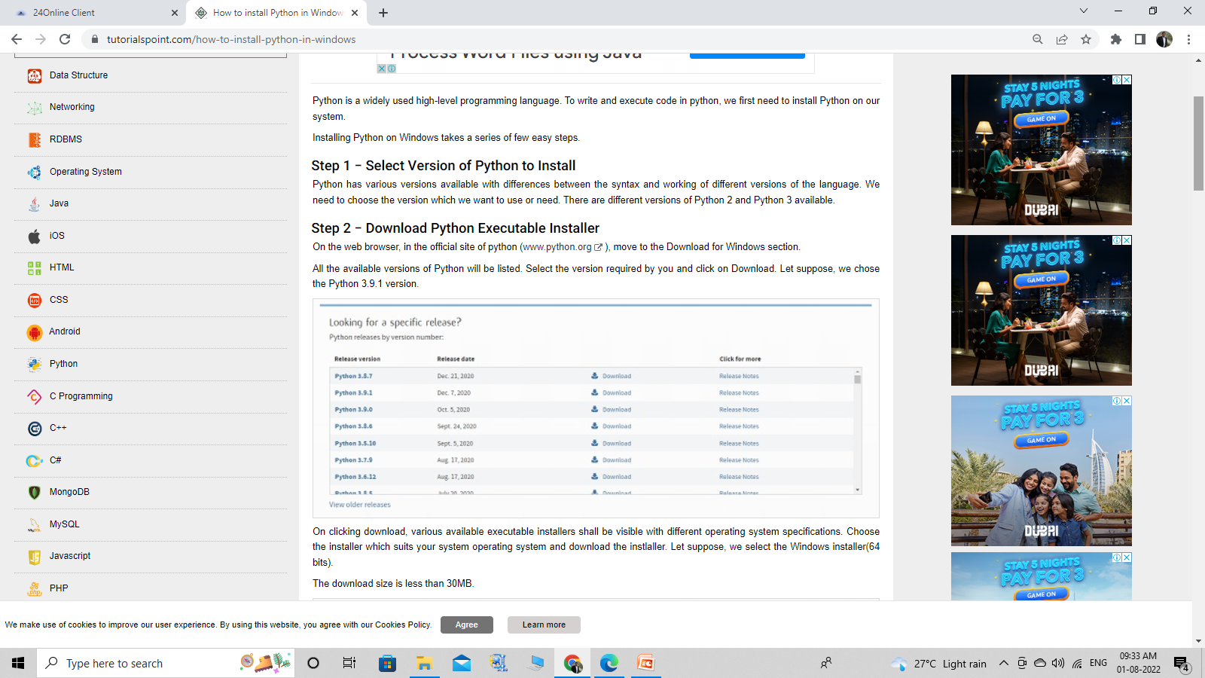
Installing

Slide 8
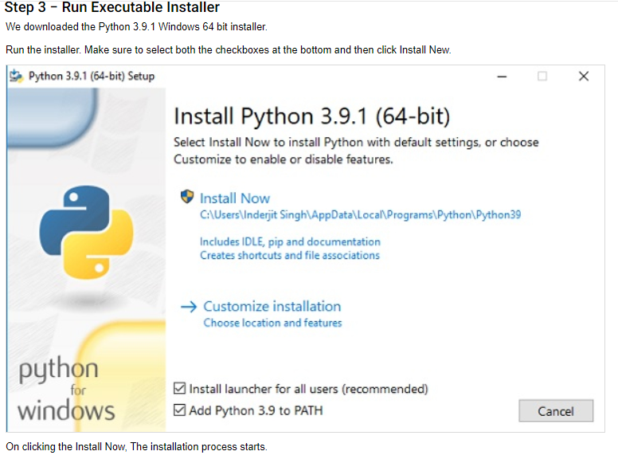

Slide 9
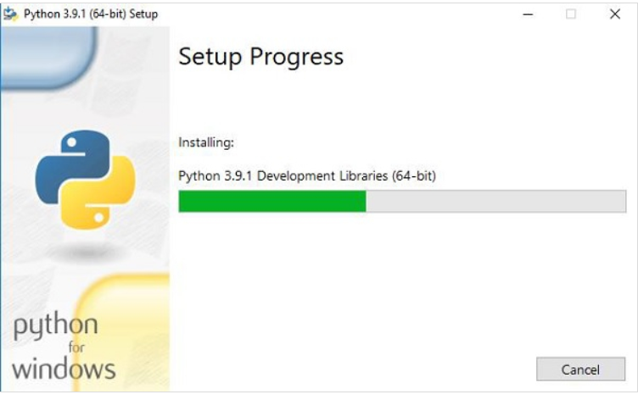

Slide 10
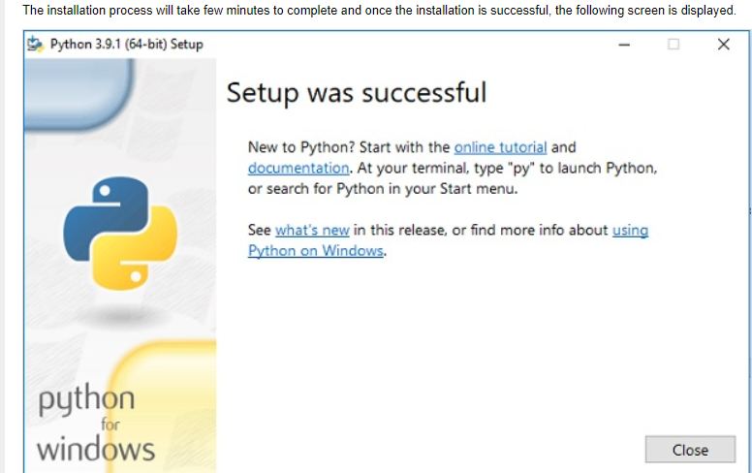

Slide 11
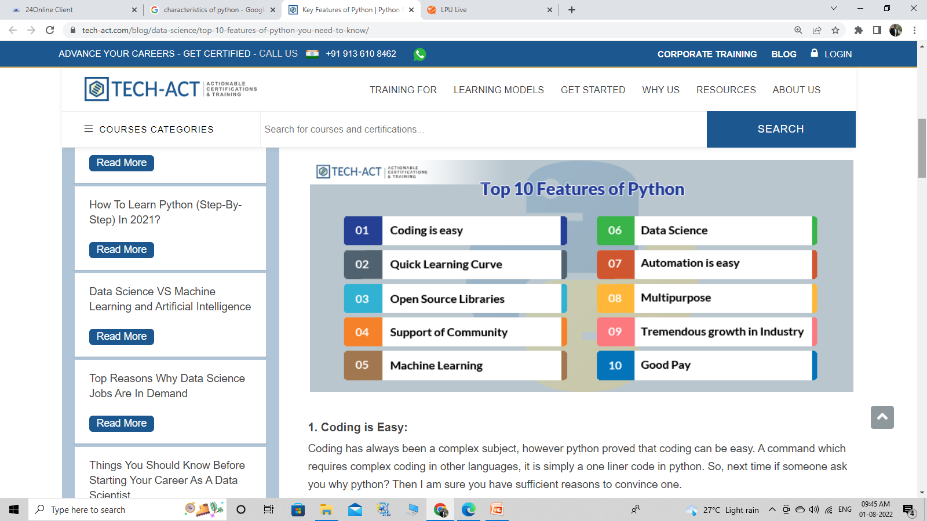

Slide 12
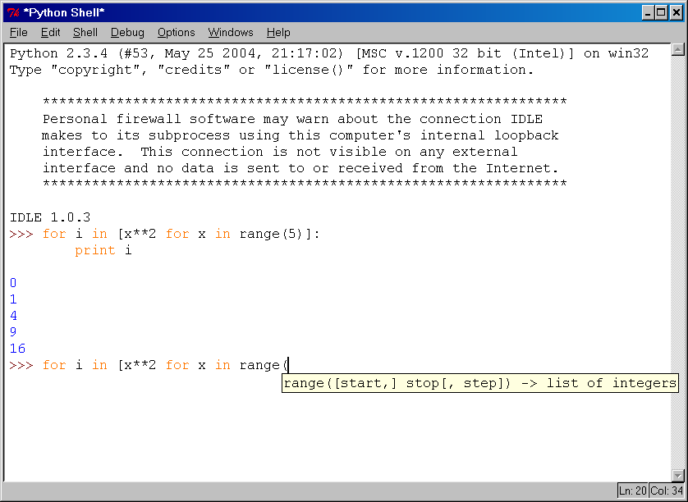
IDLE Development Environment
IDLE is an Integrated DeveLopment Environ-ment for Python, typically used on Windows
Multi-window text editor with syntax highlighting, auto-completion, smart indent and other.
Python shell with syntax highlighting.
Integrated debugger
with stepping, persis-
tent breakpoints,
and call stack visi-
bility

Slide 13

MOOC’s

Slide 14
Links
https://www.udemy.com/course/python-the-complete-python-developer-course/\
https://www.udemy.com/course/the-ultimate-python-programming-course/
https://www.coursera.org/learn/machine-learning-with-python
https://www.coursera.org/specializations/python-3-programming
https://www.coursera.org/learn/python-for-applied-data-science-ai
https://www.edx.org/learn/python
https://www.edureka.co/python-programming-certification-training

Slide 15
Continue. . .

