Slide 1
CAP-790
Unit - VI

Slide 2
Cyber-Physical System (CPS)
A cyber-physical system (CPS) or intelligent system is a computer system in which a mechanism is controlled or monitored by computer-based algorithms.
In cyber-physical systems, physical and software components are deeply intertwined, able to operate on different spatial and temporal scales, exhibit multiple and distinct behavioral modalities, and interact with each other in ways that change with context.

Slide 3
Continue..
Cyber Physical Systems (CPS) are designated as essential components of the Industrial Internet of Things (IIoT), and they are supposed to play a key role in Industry v4.0.
CPS enables smart applications and services to operate accurately and in real-time. They are based on the integration of cyber and physical systems, which exchange various types of data and sensitive information in a real-time manner.
The development of CPS is being carried out by researchers and manufacturers alike.

Slide 4
Examples
CPS involves transdisciplinary approaches, merging theory of cybernetics, mechatronics, design and process science.
The process control is often referred to as embedded systems. In embedded systems, the emphasis tends to be more on the computational elements, and less on an intense link between the computational and physical elements.
CPS is also similar to the Internet of Things (IoT), sharing the same basic architecture; nevertheless, CPS presents a higher combination and coordination between physical and computational elements.

Slide 5
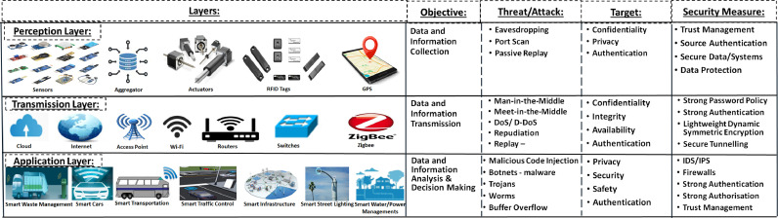
CPS Layers and Components

Slide 6
CPS security threats
CPS security threats can be classified as cyber or physical threats, as explained below, and if combined, these can result into cyber-physical threats.

Slide 7
Cyber threats
Electronic attacks are now easier to launch from any device, unlike physical attacks that require physical presence and physical tools.
Moreover, the smart meter interfacing and interconnection with other meters in the Near-me Area Network (NAN) and Home Area Network (HAN) increase its exposure to various remote threats.
Finally, electronic attacks are difficult to mitigate and overcome in the absence of the right prevention and defensive countermeasures.

Slide 8
Issues make CPS systems prone to:
Wireless Exploitation
Jamming
Reconnaissance
Remote Access
Disclosure of Information
Unauthorised Access
Interception
GPS Exploitation
Information Gathering

Slide 9
Physical threats
CPS systems are recently evolving into the industrial domain by introducing an Advanced Metering Infrastructure (AMI), and Neighbourhood Area Networks (NANs), along with data meter management systems to maintain the robustness of CPS in industrial domains. In fact, physical threats might be classified according to the following three factors:
Physical Damage
Loss
Repair

Slide 10
Threats associated with CPS systems:
Spoofing: it consists of masquerading the identity of a trusted entity by a malicious unknown source. In this case, attackers are capable of spoofing sensors, for example, by sending misleading and/or false measurements to the control center.
Sabotage: Sabotage consists of intercepting the legal communication traffic and redirecting it to malicious third party or disrupting the communication process.
Service Disruption or Denial: Attackers are capable of physically tampering with any device to disrupt a service or to change the configuration.
Tracking: Since devices are physically exposed, an attacker can gain access to a given device, and/or even attach a malicious device or track the legal ones.

Slide 11
CPS vulnerabilities are divided into three main categories
Network Vulnerabilities: include weaknesses of the protective security measures, in addition to compromising open wired/wireless communication and connections, including man-in-the-middle, eavesdropping, replay, sniffing, spoofing and communication-stack back-doors, DoS/DDoS and packet manipulation attacks.
Platform Vulnerabilities: include hardware, software, configuration, and database vulnerabilities.
Management Vulnerabilities: include lack of security guidelines, procedures and policies.

Slide 12
Causes of Vulnerabilities
Assumption and Isolation
Increasing Connectivity
Heterogeneity
USB Usage
Bad Practice
Spying
Homogeneity
Suspicious Employees

Slide 13
Cyber vulnerabilities
Open/Non-secure wired/wireless communications such as Ethernet are vulnerable to interception, sniffing, eavesdropping, wiretapping and wardialing and wardriving attacks and meet-in-the-middle attacks.
Short-range wireless communications are also vulnerable, since they can be captured, analysed, damaged, deleted or even manipulated by insiders.
Moreover, employees’ connected devices to ICS wireless network, if not secure, are prone to botnet, remote access Trojan and rootkit attacks, where their devices will be remotely controlled by an attacker.

Slide 14
Continue..
Long-range wireless communications are vulnerable to eavesdropping, replay attacks, and unauthorized access attacks.
Yet, SQL injection remains the most Web-related vulnerability since attackers can access any server database without authorization through the injection of a malicious code that keeps on running endlessly once executed without the user’s knowledge.
Since many medical devices heavily rely on wireless communications, they are prone to a large number of wireless attacks including jamming, modification and replay attacks due to the lack of encryption.

Slide 15
Physical Vulnerabilities
Physical tampering may result into misleading data in cyber-physical components. The physical exposure of ICS components is classified as a vulnerability due to the insufficient physical security provided to these components. Thus, making them prone to physical tampering, alteration, modification or even sabotage.
CPS field devices (i.e smart grids, power grids, supply chains etc.) are prone to the same ICS vulnerabilities since a large number of physical components is exposed without physical security, making them prone to physical destruction.

Slide 16
Continue..
Medical devices are vulnerable to physical access along with the possibility of installing malware into them, or even modifying the device’s configurations, risking the patient’s health.
Moreover, a physical access to any medical device is also a vulnerability since an attacker can retrieve the device’s serial number to launch targeted attacks.

Slide 17
Cyber-physical system attacks
The different types of attacks that target the different aspects of CPS systems, including cyber and physical ones:

Slide 18
Physical attacks
Infected Items
Abuse of Privilege
Wire Cuts/Taps/Dialing
Fake Identity
Stalkers
CCTV Camera Interception
Key-Card Hijacking
Physical Breach
Malicious Third Party Software Provider
Abuse of Privilege
Social Engineering

Slide 19
Cyber attacks
Eavesdropping
Cross-Site Scripting
SQL Injection
Password Cracking
Phishing
Replay
DoS/DDoS
Malicious Third Party
Watering-hole Attack
Malware
Side-Channel

Slide 20
CPS Failures
Given the different threats, attacks and vulnerabilities that the CPS domain suffers from, it is important to highlight the main failures than CPs systems suffer from.
These failures can either be minor (limited damage) or major (severe damage).

Slide 21
Continue..
Content Failure: means that the content of the delivered information is inaccurate, which would result into some functional system failure. Content failure can be either numerical or non-numerical (i.e alphabets, graphics, sounds or colours).
Timing Failure: means that the timing of information delivery (transmission/receiving) is delayed or interrupted (received/transmitted too early or too late). This would affect the decision making process and may cause data management issues.
Sensors Failure: means that the sensors are no longer functioning properly, and would seriously hinder the decision making process due to misinformation, or bringing a CPS system to a sudden halt.

Slide 22
Continue..
Silent Failure: occurs when there is no message sent or received in a distributed system.
Babbling Failure: occurs when the information is delivered, causing the system to malfunction and to operate in a babbling manner.
Budget Failure: occurs when the cost of implementing a cyber-physical system outweighs the budget set, before ever reaching the testing level. This is mainly caused by poor planning.
Schedule Failure: occurs when the schedule set for planning, testing and evaluating a given CPS is not achieved due to further upgrades, additional testing, or inadequacy for users needs.

Slide 23
Continue..
Service Failure: occurs when having an error propagates through the service interface and affects its decision making or/and normal performance ability. This failure can either cause a partial or full CPS system failure either temporarily or permanently.
Consistent/Inconsistent Failures: a consistent failure occurs when a given service is identically perceived by all CPS users. An inconsistent failure takes place when all CPS users differently perceive an incorrect service (i.e., bohrbugs, mandelbugs, heisenbugs and Byzantine failures).

Slide 24
IoT Security
IoT security is the technology segment focused on safeguarding connected devices and networks in the internet of things (IoT).
IoT involves adding internet connectivity to a system of interrelated computing devices, mechanical and digital machines, objects, animals and/or people.
Each "thing" is provided a unique identifier and the ability to automatically transfer data over a network.
Allowing devices to connect to the internet opens them up to a number of serious vulnerabilities if they are not properly protected.

Slide 25
Continue..
A number of high-profile incidents where a common IoT device was used to infiltrate and attack the larger network has drawn attention to the need for IoT security.
It is critical to ensuring the safety of networks with IoT devices connected to them.
IoT security, includes a wide range of techniques, strategies, protocols and actions that aim to mitigate the increasing IoT vulnerabilities of modern businesses.

Slide 26
What is IoT security?
IoT security refers to the methods of protection used to secure internet-connected or network-based devices.
The term IoT is incredibly broad, and with the technology continuing to evolve, the term has only become broader.
From watches to thermostats to video game consoles, nearly every technological device has the ability to interact with the internet, or other devices, in some capacity.

Slide 27
Continue..
IoT security is the family of techniques, strategies and tools used to protect these devices from becoming compromised.
Ironically, it is the connectivity inherent to IoT that makes these devices increasingly vulnerable to cyberattacks.

Slide 28
Continue..
Because IoT is so broad, IoT security is even broader. This has resulted in a variety of methodologies falling under the umbrella of IoT security.
Application program interface (API) security, public key infrastructure (PKI) authentication and network security are just a few of the methods IT leaders can use to combat the growing threat of cybercrime and cyberterrorism rooted in vulnerable IoT devices.

Slide 29
IoT security issues
The more ways for devices to be able to connect to each other, the more ways threat actors can intercept them. Protocols like HTTP (Hypertext Transfer Protocol) and API are just a few of the channels that IoT devices rely on that hackers can intercept.
The IoT umbrella doesn't strictly include internet-based devices either. Appliances that use Bluetooth technology also count as IoT devices and, therefore, require IoT security. Oversights like this have contributed to the recent spike in IoT-related data breaches.
Below are a few of the IoT security challenges that continue to threaten the financial safety of both individuals and organizations.

Slide 30
Remote exposure
Unlike other technologies, IoT devices have a particularly large attack surface due to their internet-supported connectivity.
While this accessibility is extremely valuable, it also grants hackers the opportunity to interact with devices remotely.
This is why hacking campaigns like phishing are particularly effective.
IoT security, like cloud security, has to account for a large number of entry points in order to protect assets.

Slide 31
Lack of industry foresight
As firms continue with digital transformations of their business, so, too, have certain industries and their products.
Industries such as automotive and healthcare have recently expanded their selection of IoT devices to become more productive and cost-efficient.
This digital revolution, however, has also resulted in a greater technological dependence than ever before.

Slide 32
Resource constraints
Lack of foresight isn't the only IoT security issue faced by newly digitized industries. Another major concern with the IoT security is the resource constraints of many of these devices.
Not all IoT devices have the computing power to integrate sophisticated firewalls or antivirus software. Some barely have the ability to connect to other devices. IoT devices that have adopted Bluetooth technology, for example, have suffered from a recent wave of data breaches. The automotive industry, once again, has been one of the markets hurt the most.

Slide 33
How to protect IoT systems and devices
Here are a few of the IoT security measures that enterprises can use to improve their data protection protocols.

Slide 34
Introduce IoT security during the design phase
Of the IoT security issues discussed, most can be overcome by better preparation, particularly during the research and development process at the start of any consumer-, enterprise- or industrial-based IoT device development. Enabling security by default is critical, as well as providing the most recent operating systems and using secure hardware.
IoT developers should, however, be mindful of cybersecurity vulnerabilities throughout each stage of development -- not just the design phase. The car key hack, for instance, can be mitigated by placing the FOB in a metal box, or away from one's windows and hallways.

Slide 35
PKI and digital certificates
PKI is an excellent way to secure the client-server connections between multiple networked devices. Using a two-key asymmetric cryptosystem, PKI is able to facilitate the encryption and decryption of private messages and interactions using digital certificates. These systems help to protect the clear text information input by users into websites to complete private transactions. E-commerce wouldn't be able to operate without the security of PKI.

Slide 36
Network security
Networks provide a huge opportunity for threat actors to remotely control others' IoT devices.
Because networks involve both digital and physical components, on-premises IoT security should address both types of access points.
Protecting an IoT network includes ensuring port security, disabling port forwarding and never opening ports when not needed; using antimalware, firewalls and intrusion detection systems/intrusion prevention systems; blocking unauthorized IP (Internet Protocol) addresses; and ensuring systems are patched and up to date.

Slide 37
API security
APIs are the backbone of most sophisticated websites. They allow travel agencies, for example, to aggregate flight information from multiple airlines into one location.
Unfortunately, hackers can compromise these channels of communication, making API security necessary for protecting the integrity of data being sent from IoT devices to back-end systems and ensuring only authorized devices, developers and apps communicate with APIs.
T-Mobile's 2018 data breach is a perfect example of the consequences of poor API security. Due to a "leaky API," the mobile giant exposed the personal data of more than 2 million customers, including billing ZIP codes, phone numbers and account numbers, among other data.

Slide 38
Continue..
https://www.youtube.com/watch?v=mLg95dLm-Gs

Slide 39
Additional IoT security methods
Network access control. NAC can help identify and inventory IoT devices connecting to a network. This will provide a baseline for tracking and monitoring devices.
Segmentation. IoT devices that need to connect directly to the internet should be segmented into their own networks and have restricted access to the enterprise network. Network segments should be monitoring for anomalous activity, where action can be taken, should an issue be detected.

Slide 40
Security gateways
Acting as an intermediary between IoT devices and the network, security gateways have more processing power, memory and capabilities than the IoT devices themselves, which provides them the ability to implement features such as firewalls to ensure hackers cannot access the IoT devices they connect.

Slide 41
Patch management/continuous software updates
It is critical to provide the means of updating devices and software either over network connections or through automation.
Having a coordinated disclosure of vulnerabilities is also important for updating devices as soon as possible.
Consider end-of-life strategies as well.

Slide 42
Training
IoT and operational system security are new to many existing security teams.
It is critical for security staff to keep up to date with new or unknown systems, learn new architectures and programming languages and be ready for new security challenges.
C-level and cybersecurity teams should receive regular training to keep up with modern threats and security measures.

Slide 43
Integrating teams.
Along with training, integrating disparate and regularly siloed teams can be useful.
For example, having programing developers work with security specialists can help ensure the proper controls are added to devices during the development phase.

Slide 44
Consumer education
Consumers must be made aware of the dangers of IoT systems and provided steps to stay secure, such as updating default credentials and applying software updates. Consumers can also play a role in requiring device manufacturers to create secure devices and refusing to use those that don't meet high-security standards.

Slide 45
What does "smart grid" mean?
A smart grid is an IOT-enabled application that allows utilities and their customers to exchange electricity and information.
In other words, it's the two-way data flow that makes a grid "smart."
A smart grid includes, in particular, smart meters, renewable energy resources, and smart appliances on the consumer side.
Smart grid technology includes sensors, wireless modules, networks, monitoring systems, and robust ICT infrastructures.
Major utilities are modernizing the grid to make it more efficient and reliable.

Slide 46
Why do we need a smart grid?
According to the United Nations, most people around the world already live in urban areas – some 55% of us in 2018 – and by 2050, that figure will be closer to 68%.
These populations critically depend on the reliable distribution of electricity. Brownouts or blackouts can severely impact safety and security in such urban environments.
The simple truth is that most urban electric infrastructures are aging and being pushed to their limits and beyond.
The day-to-day challenge is very often just to maintain reliability.
If we’re going to keep those cities habitable and embrace sustainable ways of generating energy and getting around, we’ll have to move to smart grids.

Slide 47
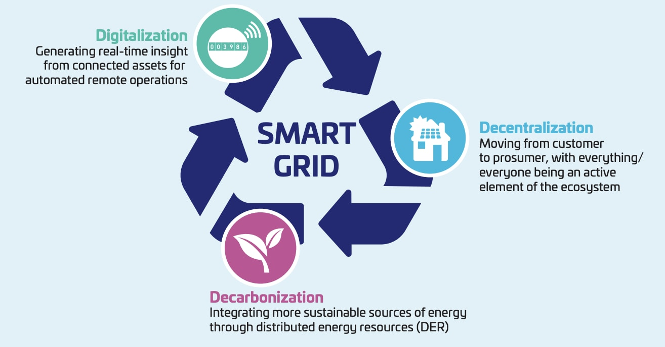
Continue..

Slide 48
Security risks, breaches and solutions
Due to the heterogeneous communication architecture of smart grids, it is quite a challenge to design sophisticated and robust security mechanisms that can be easily deployed to protect communications among different layers of the smart grid-infrastructure.
The traditional electrical power grid is currently evolving into the smart grid. A smart grid integrates the traditional electrical power grid with information and communication technologies (ICT).
Such integration empowers the electrical utility providers and consumers to improve the efficiency and the availability of the power system while constantly monitoring, controlling, and managing the demands of customers.

Slide 49
Security Objectives
Availability of uninterrupted power supply according to user requirements and integrity of communicated information
Confidentiality of user's data. We must emphasize the grid's main vulnerabilities, the various attackers and the types of attacks they can conduct and needed security solutions.
Preventive analysis, reactive security using intrusions response and mitigation is insufficient for critical CPS and like smart grids.

Slide 50
Continue..
Automating the security analysis for large and hybrid systems like smart grids. The smart grid security guidelines developed by NIST are highly detailed.
Dynamic measures for security, is the ability to provide security and Resiliency to smart grids by introducing agility to the system properties.

Slide 51
Common security risks in Smart Grids
Phishing
Denial-of-Service
Malware spreading
Eavesdropping and traffic analysis

Slide 52
What are the smart grid security challenges?
Already, hundreds of trials have taken place in the UK, Germany, the US, India – all around the world – to test systems that even allow consumers to sell directly to each other using peer-to-peer trading and smart contracts.
Besides, traditional suppliers are finding more efficient and accurate ways to read meters and issue bills.
None of this, however, can happen without robust cybersecurity in everything connected to the smart grid.

Slide 53
Continue..
An attack on smart grid systems, for example, could plunge a city into darkness.
Weak security in smart meters could result in fraud or privacy breaches.
On the other hand, strong security builds consumer trust and will help grids of the future to proliferate.

Slide 54
Smart grid cybersecurity needs standards.
“A critical element for energy stakeholders is to make sure that the assets they produce or manage are well protected and that their security can evolve,” says Willem Strabbing, Managing Director at the European Association of Smart Energy Solution Providers (ESMIG).
“We mean assets which are implemented for long periods - often more than ten years - and that are appealing for hackers to modify consumption information, to get access to private data, or to cause critical damage on global grids.
“In this context, governments or regulators are calling for specific protection protocols that could be based on strong encryption and authentication tools, protecting devices, and enabling proper security updates.”

Slide 55
Security by design is vital for the grid.
Security by design means anticipating and mitigating against threats right from the very beginning of product development and building in the ability to support devices throughout their full lifecycle.
It means ensuring firmware updates and key management for a network of millions of devices is easy.
“The biggest mistake that metering companies can make is failing to future-proof their products,”
“In particular, it can be short-sighted to lock-in with one vendor or to design meters that can´t incorporate future technologies or support updates.”

Slide 56
Beyond hacking: when things go wrong.
Smart grid cybersecurity isn’t just about keeping hackers out and personal data private, however.
It speaks to the overall smart grid's resilience.
Security in the smart grid means ensuring that all risks are managed when – inevitably – things go wrong.
"Security is a learning process," according to Michael John - Chief Information Security Officer (CISO) at WePower Network and previously the Director of Operations at the European Network for Cyber Security (ENCS) - "and smart grid security solutions will take time to develop."

Slide 57
Continue..
“Years ago, security wasn’t high on the agenda,” John says, “But everyone now has a Chief Security Officer and project leads who take care of security for new projects."
"The challenge is that legacy systems weren’t interconnected, automation has to be introduced over time, and new processes need to be in place to protect systems that were never designed to be secure.”
All of this makes a structured approach to IoT security essential.

Slide 58
4 areas to make the grid more secure
Strong digital identities: All connected devices should have their own unique digital identity, which would be used to identify each device. If all devices have their own unique identity, only that device is compromised even if a device is hacked.
Mutual authentication: This means that any two connected devices can only "speak" to one another after successfully answering a digital challenge that only those two devices know the answer to.

Slide 59
Continue..
Encryption: Data should always be encrypted when passed between devices and when it is not moving to protect it from being tampered with.
Constantly updating security: A secure smart grid should continuously evolve and update its security regularly, with keys and digital mutual authentication challenges being updated every two to three years.

Slide 60
Security breaches
Trojanhorse malware BlackEnergy
Stuxnet
WannaCry Ransomware

Slide 61
Proposed security solutions for Smart Grids
Encryption
Authentication
Malware Protection
Network Security
Remote access VPN
IDS & IPS
Site-to-site VPN
Risk and Maturity Asssements

Slide 62
IoT interoperability and the smart grid: where do we stand?
Like Rome, energy grids are not built in a day.
Multiple generations of hardware from different suppliers have to co-exist as grids evolve into distributed energy systems.
Interoperability is critical for the smart grid, as data is gathered, shared, and acted upon from all network points.

Slide 63
Continue..
As it stands, however, interoperability in the smart energy space has three dimensions:
On one side, the interoperability of components owned and managed by utilities is sufficiently implemented and offers flexibility in the utility eco-system. The threat is on the “grid edge,” where the utility space is linked to the smart home/building space.
On the grid side, there are unified protocols and data formats.
On the smart home side, there is still a wide range of different protocols and data formats.

Slide 64
What is Cloud Infrastructure Security?
Cloud infrastructure security is the practice of securing resources deployed in a cloud environment and supporting systems.
Public cloud infrastructure is, in many ways, more vulnerable than on-premises infrastructure because it can easily be exposed to public networks, and is not located behind a secure network perimeter. However, in a private or hybrid cloud, security is still a challenge, as there are multiple security concerns due to the highly automated nature of the environment, and numerous integration points with public cloud systems.

Slide 65
Public Cloud Security
In a public cloud, the cloud provider takes responsibility for securing the infrastructure, and provides tools that allow the organization to secure its workloads. Your organization is responsible for:
Securing workloads and data, fully complying with relevant compliance standards, and ensuring all activity is logged to enable auditing.
Ensuring cloud configurations remain secure, and any new resources on the cloud are similarly secured, using automated tools such as a Cloud Security Posture Management (CSPM) platform.

Slide 66
Continue..
Understanding which service level agreements (SLA), supplied by your cloud provider, deliver relevant services and monitoring.
If you use services, machine images, container images, or other software from third-party providers, performing due diligence on their security measures and replacing providers if they are insufficient.

Slide 67
Private Cloud Security
The private cloud model gives you control over all layers of the stack. These resources are commonly not exposed to the public Internet. This means that you can achieve a certain level of security using traditional mechanisms that protect the corporate network perimeter. However, there are additional measures you should take to secure your private cloud:
Use cloud native monitoring tools to gain visibility over any anomalous behavior in your running workloads.
Monitor privileged accounts and resources for suspicious activity to detect insider threats. Malicious users or compromised accounts can have severe consequences in a private cloud, because of the ease at which resources can be automated.

Slide 68
Continue..
Ensure complete isolation between virtual machines, containers, and host operating systems, to ensure that compromise of a VM or container does not allow compromise of the entire host.
Virtual machines should have dedicated NICs or VLANs, and hosts should communicate over the network using a separate network interface.
Plan ahead and prepare for hybrid cloud by putting security measures in place to ensure that you can securely integrate with public cloud services

Slide 69
Hybrid Cloud Security
Hybrid clouds are a combination of on-premise data center, public cloud, and private cloud. The following security considerations are important in a hybrid cloud environment:
Ensure public cloud systems are secured using all the best practices.
Private cloud systems should follow private cloud security best practices, as well as traditional network security measures for the local data center.
Avoid separate security strategies and tools in each environment—adopt a single security framework that can provide controls across the hybrid environment.
Identify all integration points between environments, treat them as high-risk components and ensure they are secured.

Slide 70
Accounts
Service accounts in the cloud are typically privileged accounts, which may have access to critical infrastructure. Once compromised, attackers have access to cloud networks and can access sensitive resources and data.
Service accounts may be created automatically when you create new cloud resources, scale cloud resources, or stand up environments using infrastructure as code (IaC). The new accounts may have default settings, which in some cases means weak or no authentication.

Slide 71
Servers
While a cloud environment is virtualized, behind the scenes it is made up of physical hardware deployed at multiple geographical locations. This includes physical servers, storage devices, load balancers, and network equipment like switches and routers. Here are a few ways to secure a cloud server:
Control inbound and outbound communication—your server should only be allowed to connect to networks, and specific IP ranges needed for its operations. For example, a database server should not have access to the public internet, or any other IP, except those of the application instances it serves.

Slide 72
Continue..
Encrypt communications—communications may go over public networks or within a secure private network, they should be encrypted to avoid man in the middle (MiTM) attacks. Never use unsecured protocols like Telnet or FTP. Transmit all data over HTTPS, or other secure protocols like SCP (Secure Copy) or SFTP (Secure FTP).
Use SSH keys—avoid accessing cloud servers using passwords, because they are vulnerable to brute force attacks and can easily be compromised. Use SSH keys, which leverage public/private key cryptography for more secure access.

Slide 73
Continue..
Minimize privileges—only users or service roles that absolutely need access to a server should be granted access. Carefully control the access level of each account to ensure it can only access the specific files and folders, and perform specific operations, needed for their role. Avoid using the root user—any operation should be performed using identified user accounts.

Slide 74
Hypervisors
A hypervisor runs on physical hardware, and makes it possible to run several virtual machines (VMs), each with a separate operating system.
All cloud systems are based on hypervisors. Therefore, hypervisors are a key security concern, because compromise of the hypervisor (an attack known as hyperjacking) gives the attacker access to all hosts and virtual machines running on it.
In public cloud systems, hypervisor security is the responsibility of the cloud provider, so you don’t need to concern yourself with it. There is one exception—when running virtualized workloads on a public cloud, using systems like VMware Cloud, you are responsible for securing the hypervisor.

Slide 75
Continue..
Ensure machines running hypervisors are hardened, patched, isolated from public networks, and physically secured in your data center
Assign least privileges to local user accounts, carefully controlling access to the hypervisor
Harden, secure, and closely monitor machines running the virtual machine monitor (VMM) and virtualization management software, such as VMware vSphere
Secure and monitor shared hardware caches and networks used by the hypervisor
Pay special attention to hypervisors in development and testing environments—ensure appropriate security measures are applied when a new hypervisor is deployed to production.

Slide 76
Storage
Identify which devices or applications connect to cloud storage, which cloud storage services are used throughout the organization, and map data flows.
Block access to cloud storage for internal users who don’t need it, and eliminate shadow usage of cloud services by end users.
Classify data into sensitivity levels—a variety of automated tools are available. This can help you focus on data stored in cloud storage that has security or compliance implications.

Slide 77
Continue..
Remove unused data—cloud storage can easily scale and it is common to retain unnecessary data, or entire data volumes or snapshots that are no longer used. Identify this unused data and eliminate it to reduce the attack surface and your compliance obligations.
Carefully control access to data using identity and access management (IAM) systems, and applying consistent security policies for cloud and on-premises systems.
Use cloud data loss prevention (DLP) tools to detect and block suspicious data transfers, data modification or deletion, or data access, whether malicious or accidental.

Slide 78
Database
Hardening configuration and instances—if you deploy a database yourself in a compute instance, it is your responsibility to harden the instance and securely configure the database. If you use a managed database service, these concerns are typically handled by the cloud provider.
Database security policies—ensure database settings are in line with your organization’s security and compliance policies. Map your security requirements and compliance obligations to specific settings on cloud database systems.

Slide 79
Continue..
Network access—as a general rule, databases should never be exposed to public networks and should be isolated from unrelated infrastructure.
Permissions—grant only the minimal level of permissions to users, applications and service roles. Avoid “super users” and administrative users with blanket permissions.
End user device security—security is not confined to the cloud environment. You should be aware what endpoint devices administrators are using to connect to your database.

Slide 80
Network
Use security groups to define rules that define what traffic can flow between cloud resources. Keep in mind that security groups are tightly connected to compute instances, and compromise of an instance grants access to the security group configuration, so additional security layers are needed.
Use Network Access Control Lists (ACL) to control access to virtual private networks. ACLs provide both allow and deny rules, and provide stronger security controls than security groups.

Slide 81
Continue..
Use additional security solutions such as firewalls as a service (FWaaS) and web application firewalls (WAF) to actively detect and block malicious traffic.
Deploy Cloud Security Posture Management (CSPM) tools to automatically review cloud networks, detect non-secure or vulnerable configurations and remediate them.

Slide 82
Basic blockchain security
Blockchain technology produces a structure of data with inherent security qualities.
It's based on principles of cryptography, decentralization and consensus, which ensure trust in transactions.
In most blockchains or distributed ledger technologies (DLT), the data is structured into blocks and each block contains a transaction or bundle of transactions.
Each new block connects to all the blocks before it in a cryptographic chain in such a way that it's nearly impossible to tamper with.

Slide 83
Continue..
All transactions within the blocks are validated and agreed upon by a consensus mechanism, ensuring that each transaction is true and correct.
Blockchain technology enables decentralization through the participation of members across a distributed network.
There is no single point of failure and a single user cannot change the record of transactions. However, blockchain technologies differ in some critical security aspects.

Slide 84
Public and private blockchains
Public blockchain networks typically allow anyone to join and for participants to remain anonymous.
A public blockchain uses internet-connected computers to validate transactions and achieve consensus.
Bitcoin is probably the most well-known example of a public blockchain, and it achieves consensus through "bitcoin mining." Computers on the bitcoin network, or “miners,” try to solve a complex cryptographic problem to create proof of work and thereby validate the transaction.

Slide 85
Continue..
Private blockchains use identity to confirm membership and access privileges and typically only permit known organizations to join.
Together, the organizations form a private, members-only "business network."
A private blockchain in a permissioned network achieves consensus through a process called "selective endorsement," where known users verify the transactions. Only members with special access and permissions can maintain the transaction ledger.

Slide 86
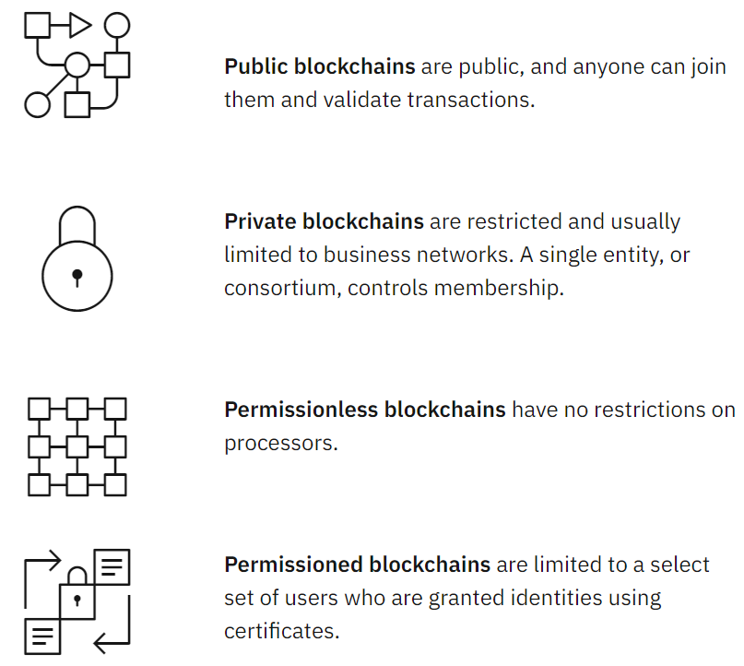
Continue..

Slide 87
Cyberattacks and fraud
While blockchain technology produces a tamper-proof ledger of transactions, blockchain networks are not immune to cyberattacks and fraud. Those with ill intent can manipulate known vulnerabilities in blockchain infrastructure and have succeeded in various hacks and frauds over the years. Here are a few examples:

Slide 88
Continue..
Code exploitation: The Decentralized Autonomous Organization (DAO), a venture capital fund operating through a decentralized blockchain, inspired by Bitcoin, was robbed of more than USD 60 million worth of ether digital currency — about a third of its value — through code exploitation.
Stolen keys: A theft of nearly USD 73 million worth of customers' bitcoins from one of the world's largest cryptocurrency exchanges, Hong-Kong-based Bitfinex, demonstrated that the currency is still a big risk. The likely cause was stolen private keys, which are personal digital signatures.

Slide 89
Continue..
Employee computer hacked: When Bithumb, one of the largest Ethereum and bitcoin cryptocurrency exchanges, was recently hacked, the hackers compromised 30,000 users' data and stole USD 870,000 worth of bitcoin. Even though it was an employee's computer that was hacked — not the core servers — this event raised questions about the overall security.

Slide 90
How fraudsters attack blockchain technology
Hackers and fraudsters threaten blockchains in four primary ways: phishing, routing, Sybil and 51% attacks.
Sybil attacks: In a Sybil attack, hackers create and use many false network identities to flood the network and crash the system. Sybil refers to a famous book character diagnosed with a multiple identity disorder.

Slide 91
Continue..
51% attacks: Mining requires a vast amount of computing power, especially for large-scale public blockchains. But if a miner, or a group of miners, could rally enough resources, they could attain more than 50% of a blockchain network's mining power. Having more than 50% of the power means having control over the ledger and the ability to manipulate it.

Slide 92
Blockchain security for the enterprise
When building an enterprise blockchain application, it’s important to consider security at all layers of the technology stack, and how to manage governance and permissions for the network. A comprehensive security strategy for an enterprise blockchain solution includes using traditional security controls and technology-unique controls. Some of the security controls specific to enterprise blockchain solutions include:
Identity and access management
Key management
Data privacy
Secure communication
Smart contract security
Transaction endorsement

Slide 93
Blockchain security tips and best practices
What is the governance model for participating organizations or members?
What data will be captured in each block?
What are the relevant regulatory requirements, and how can they be met?
How are the details of identity managed? Are block payloads encrypted? How are the keys managed and revoked?
What is the disaster recovery plan for the blockchain participants?
What is the minimal security posture for blockchain clients for participation?
What is the logic for resolving blockchain block collisions?

Slide 94
Decentralized Applications
These secure and unchangeable programs running on a decentralized network in combination with traditional front-end and back-end technologies are what we call decentralized applications (ÐApps) today.
Through some of them can be semi-centralized, a major part of activities in the truly decentralized application should happen out of a central party’s control.

Slide 95
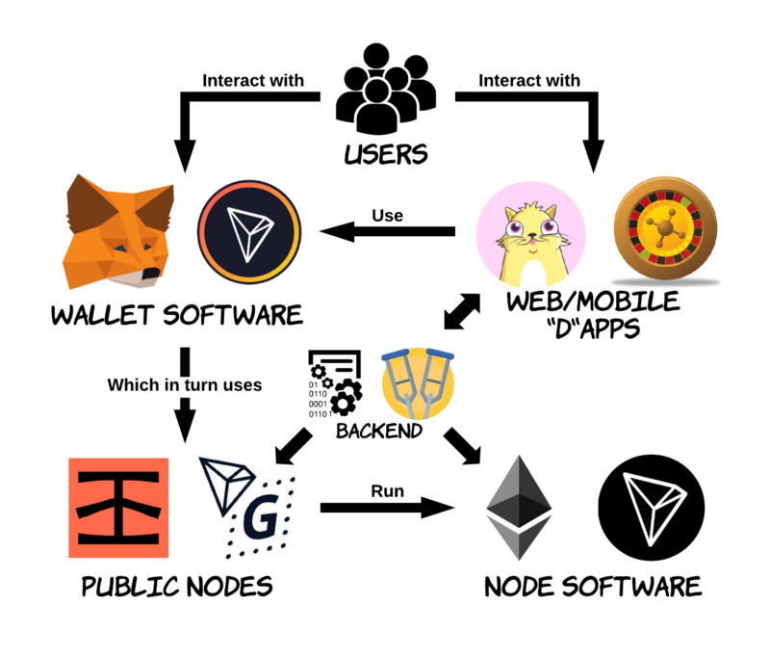
Continue..

Slide 96
Reentrancy Attack
The Reentrancy attack, probably the most famous Ethereum vulnerability, surprised everyone when discovered for the first time.
It was first unveiled during a multimillion dollar heist which led to a hard fork of Ethereum. Reentrancy occurs when external contract calls are allowed to make new calls to the calling contract before the initial execution is complete.
For a function, this means that the contract state may change in the middle of its execution as a result of a call to an untrusted contract or the use of a low level function with an external address.

Slide 97
Access Control
Access Control issues are common in all programs, not just smart contracts. One usually accesses a contract's functionality through its public or external functions.
While insecure visibility settings give attackers straightforward ways to access a contract's private values or logic, access control bypasses are sometimes more subtle.

Slide 98
Arithmetic Issues
Also known as integer overflow and integer underflow.
An overflow condition gives incorrect results and, particularly if the possibility has not been anticipated, can compromise a program’s reliability and security.
Integer overflows and underflows are not a new class of vulnerability, but they are especially dangerous in smart contracts, where unsigned integers are prevalent and most developers are used to simple int types (which are often just signed integers). If overflows occur, many benign-seeming code paths become vectors for theft or denial of service.

Slide 99
Unchecked Return Values For Low Level Calls
Also known as or related to silent failing sends, unchecked-send.
The use of low level "call" should be avoided whenever possible. It can lead to unexpected behavior if return values are not handled properly.
They will return a boolean value set to false, and the code will continue to run. This can surprise developers and, if the return value of such low-level calls are not checked, can lead to fail-opens and other unwanted outcomes. Remember, send can fail!

Slide 100
Denial of Service
Including gas limit reached, unexpected throw, unexpected kill, access control breached
Denial of service is deadly: while other types of applications can eventually recover, smart contracts can be taken offline forever by just one of these attacks.
Many ways lead to denials of service, including maliciously behaving when being the recipient of a transaction, artificially increasing the gas necessary to compute a function, abusing access controls to access private components of smart contracts, taking advantage of mixups and negligence, etc.

Slide 101
Bad Randomness
Also known as nothing is secret
Randomness is hard to get right in Ethereum. While Solidity offers functions and variables that can access apparently hard-to-predict values, they are generally either more public than they seem or subject to miners' influence. Because these sources of randomness are to an extent predictable, malicious users can generally replicate it and attack the function relying on its unpredictablility.
A smart contract uses the block number as a source of randomness for a game.

Slide 102
Front-Running
Since miners always get rewarded via gas fees for running code on behalf of externally owned addresses (EOA), users can specify higher fees to have their transactions mined more quickly.
Since the Ethereum blockchain is public, everyone can see the contents of others' pending transactions. This means if a given user is revealing the solution to a puzzle or other valuable secret, a malicious user can steal the solution and copy their transaction with higher fees to preempt the original solution.
If developers of smart contracts are not careful, this situation can lead to practical and devastating front-running attacks.

Slide 103
Time Manipulation
Also known as timestamp dependence
If a miner holds a stake on a contract, he could gain an advantage by choosing a suitable timestamp for a block he is mining.
From locking a token sale to unlocking funds at a specific time for a game, contracts sometimes need to rely on the current time. This is usually done via block.timestamp or its alias now in Solidity. But where does that value come from? From the miners! Because a transaction's miner has leeway in reporting the time at which the mining occurred, good smart contracts will avoid relying strongly on the time advertised.

Slide 104
Short Address Attacks
Short address attacks are a side-effect of the EVM itself accepting incorrectly padded arguments.
Attackers can exploit this by using specially-crafted addresses to make poorly coded clients encode arguments incorrectly before including them in transactions.
Is this an EVM issue or a client issue? Should it be fixed in smart contracts instead? While everyone has a different opinion, the fact is that a great deal of ether could be directly impacted by this issue.
While this vulnerability has yet to be exploited in the wild, it is a good demonstration of problems arising from the interaction between clients and the Ethereum blockchain.

Slide 105
Unknown Unknowns
Some of the most damaging smart contract vulnerabilities surprised everyone, and there is no reason to believe there will not be another one that will be equally unexpected or equally destructive.
As long as investors decide to place large amounts of money on complex but lightly-audited code, we will continue to see new discoveries leading to dire consequences.
Methods of formally verifying smart contracts are not yet mature, but they seem to hold great promise as ways past today's shaky status quo.
As new classes of vulnerabilities continue to be found, developers will need to stay on their feet, and new tools will need to be developed to find them before the bad guys do.

