Slide 1
Perception

Slide 2
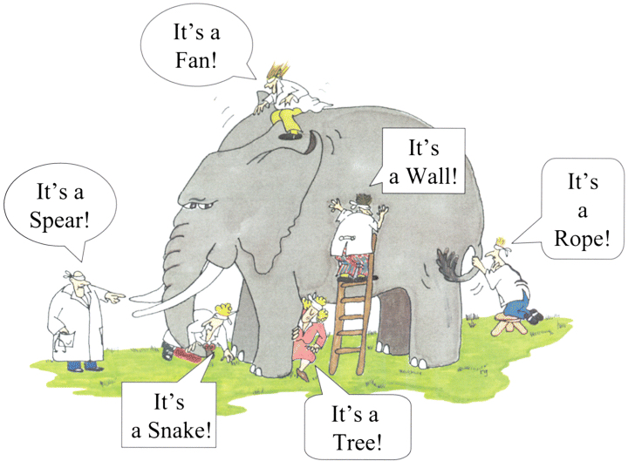

Slide 3
While our sensory receptors are constantly collecting information from the environment, it is ultimately how we interpret that information that affects how we interact with the world.
Perception refers to the way sensory information is organized, interpreted, and consciously experienced.
Perception involves both bottom-up and top-down processing.
Bottom-up processing refers to the fact that perceptions are built from sensory input.
How we interpret those sensations is influenced by our available knowledge, our experiences, and our thoughts. This is called top-down processing.

Slide 4
Perception
Although our perceptions are built from sensations, not all sensations result in perception.
In fact, we often don’t perceive stimuli that remain relatively constant over prolonged periods of time. This is known as sensory adaptation.

Slide 5
Perception
Eg.: Imagine entering a classroom with an old analog clock. Upon first entering the room, you can hear the ticking of the clock; as you begin to engage in conversation with classmates or listen to your professor greet the class, you are no longer aware of the ticking. The clock is still ticking, and that information is still affecting sensory receptors of the auditory system. The fact that you no longer perceive the sound demonstrates sensory adaptation and shows that while closely associated, sensation and perception are different.
There is another factor that affects sensation and perception: attention.

Slide 6
PROCESS OF PERCEPTION
In order to fully understand how the perception process works, we have to follow each of the following steps.
3 stages of perception process are:
Selection.
Organization.
Interpretation.

Slide 7
1. Selection
The world around us is filled with an infinite number of stimuli that we might attend, but our brains do not have the resources to pay attention to everything.
Thus, the first step of perception is the decision of what to attend to.

Slide 8
2. Organization
Once we have chosen to attend to a stimulus in the environment, the choice sets off a series of reactions in our brain.
This neural process starts with the activation of our sensory receptors (touch, taste, smell, sight, and hearing).

Slide 9
3. Interpretation
After we have attended to a stimulus, and our brains have received and organized the information, we interpret it in a way that makes sense using our existing information about the world Interpretation simply means that we take the information that we have sensed and organized and turn it into something that we can categorize.
By putting different stimuli into categories, we can better understand and react to the world around us.

Slide 10
Errors in Perception
There are some errors in perception;
Illusion.
Hallucination.
Halo Effect.
Stereotyping.
Similarity.
Horn Effect.
Contrast.

Slide 11
1. Illusion
The illusion is a false perception. Here the person will mistake a stimulus and perceive it wrongly.
For example, in the dark, a rope is mistaken as a snake or vice versa.
2. Hallucination
Sometimes we come across instances where the individual perceives some stimulus, even when it is not present. This phenomenon is known as a hallucination.
The person may see an object, person, etc. or he may listen to some voice though there are no objects and sounds in reality.

Slide 12
3. Selective Perception
Selective perception means the situation when people selectively interpret what they see on the basis of their interests, background, experience, and attitudes.
4. Halo Effect
The individual is evaluated on the basis of perceived positive quality, feature or trait.
When we draw a general impression about an individual on the basis of a single characteristic, such as intelligence, sociability, or appearance, a halo effect is operating.

Slide 13
5. Stereotyping
People usually can fall into at least one general category based on physical or behavioral traits then they will be evaluated.
When we judge someone on the basis of our perception of the group to which he or she belongs, we are using the shortcut called stereotyping.
6. Similarity
Often, people tend to seek out and rate more positively those who are similar to themselves.
This tendency to approve of similarity may cause evaluators to give better ratings to employees who exhibit the same interests, work methods, points of view or standards.

Slide 14
7. Horn Effect
When the individual is completely evaluated on the basis of a negative quality or feature perceived. This results in an overall lower rating than an acceptable rate.
Eg.: He is not formally dressed up in the office, that’s why he may be casual at work too.
8. Contrast
Rather will evaluate an employee by comparing that employee’s performance with other employees.

Slide 15
ATTRIBUTION THEORY
Attribution theory is concerned with how individuals interpret events and how this relates to their thinking and behavior.
Heider (1958) was the first to propose a psychological theory of attribution, but Weiner and colleagues (e.g., Jones et al, 1972; Weiner, 1974, 1986) developed a theoretical framework that has become a major research paradigm of social psychology.
Attribution theory assumes that people try to determine why people do what they do, i.e., attribute causes to behavior.
A person seeking to understand why another person did something may attribute one or more causes to that behavior.

Slide 16
A three-stage process underlies an attribution:
(1) the person must perceive or observe the behavior,
(2) then the person must believe that the behavior was intentionally performed,
(3) then the person must determine if they believe the other person was forced to perform the behavior (in which case the cause is attributed to the situation) or not (in which case the cause is attributed to the other person).

Slide 17
Why Is Attribution Theory Important?
Attribution theory is important for organizations because it can help managers understand some of the causes of employee behavior and can assist employees in understanding their thinking about their own behaviors.
If you can understand why you behave a certain way, and why others around you do so, then you have a better understanding of yourself, others, and your organization.
The perception of the causes of a certain behavior may affect the judgment and actions of both managers and employees. It may also play a significant role in motivation.

Slide 18
Attribution theory attempts to explain some of the causes of our behavior.
According to the theory, you want to be able to understand the reason for the actions you take and understand the reasons behind the actions other people take.
You want to attribute causes to these behaviors, which should give you some felling of control over your own behaviors and related situations.

Slide 19
When we attribute the behavior, there are three things we need to consider:
1. External cause or internal cause?
Internal cause: Internal causes are those factors that are attributed to the person being observed.
Internal causes are usually controllable.
For example, a co-worker just received a promotion. You believe the reason for her promotion was her hard work, dedication, and skills. You have thus attributed internal causes to her promotion.
External cause: External causes are attributed to factors outside of the person being observed.
External causes are often not controllable, such as luck. For example, let's say your co-worker just received a promotion. You believe she received her promotion because the owner of the company is her father.

Slide 20
2. Consistent or distinctive behavior?
When you observe a person behaving the same when he is faced with the same circumstances, the observed behavior is consistent.
Consistency is low if the person behaves differently in similar circumstances, while it is high if the person acts the same in similar circumstances.
When you are determining whether a person behaves the same way in different circumstances, you are determining whether the behavior is distinctive.
If a person behaves the same in different circumstances, then distinctiveness is low, while if the person behaves different in different circumstances, distinctiveness is high.

Slide 21
3). Consensus
Consensus is high if other people act the same way as the person observed in the same circumstances, while consensus is low if other people act differently than the person observed in the same circumstances.
An observer looks for consistency in a person’s actions.
Does the person respond the same way over time? Coming in 10 minutes late for work is not perceived in the same way for an employee who hasn’t been late for several months as it is for an employee who is late two or three times a week. The more cons

Slide 22
https://www.youtube.com/watch?v=WoTBPwMeAyo
https://www.youtube.com/watch?v=clDXz1wnJ8Q

