Slide 1
PERSONALITY

Slide 2
Personality refers to individual differences in characteristic patterns of thinking, feeling and behaving.
The study of personality focuses on two broad areas: One is understanding individual differences in particular personality characteristics, such as sociability or irritability. The other is understanding how the various parts of a person come together as a whole.
Personality, a characteristic way of thinking, feeling, and behaving.
Personality embraces moods, attitudes, and opinions and is most clearly expressed in interactions with other people. It includes behavioral characteristics, both inherent and acquired, that distinguish one person from another and that can be observed in people’s relations to the environment and to the social group.

Slide 3
Personality is stable
Your personality does not change just from one day to another, actually it changes hardly at all. If there are any changes these are very limited and slow.
Personality is made up of properties and mechanisms
Over time, many different classifications have been made in personality characteristics. Literally hundreds!
Personality is ever present

Slide 4
Determinants of Personality
The determinants of personality can be grouped in five broad categories:
  Biological Factors
  Cultural Factors
  Family Factors
  Social Factors
  Situational Factors

Slide 5
Biological Factors
Heredity
Physical stature, facial attractiveness, temperament, muscle composition and reflexes, energy level etc.
Brain
Physical Features
The fact that a person is tall or short, fat or skinny, black or white will influence the person’s effect on others and this in turn, will affect the self-concept.

Slide 6
2. Cultural Factors
Among the factors that influence personality formation is the culture in which we are raised, early conditioning, norms prevailing within the family, friends and social groups and other miscellaneous experiences that impact us.
The culture largely determines attitudes towards independence, aggression, competition, cooperation and a host of other human responses.

Slide 7
3. Family Factors
A substantial amount of empirical evidence indicates that the overall home environment created by the parents, in addition to their direct influence, is critical to personality development.

Slide 8
4. Social Factors
There is increasing recognition given to the role of other relevant persons, groups and especially organisations, which greatly influence an individual’s personality. This is commonly called the socialization process.
Socialization involves the process by which a person acquires, from the enormously wide range of behavioural potentialities that are open to him or her, those that are ultimately synthesized and absorbed.

Slide 9
5. Situational Factors
The effect of the environment is quite strong. Knowledge, skill and language are obviously acquired and represent important modifications of behavior.
According to Milgram, “Situation exerts an important press on the individual. It exercises constraints and may provide a push. In certain circumstances, it is not so much the kind of person a man is, as the kind of situation in which he is placed that determines his actions”. We should therefore not look at personality patterns in isolation.

Slide 10
Personality
6. Personality Characteristics:
Locus of Control
Self-Efficacy
Self-Esteem
Self-Monitoring
Positive/Negative Affect
Risk-Taking
Type A and Type B Personality

Slide 11
Personality
Locus of Control
The degree to which individuals perceive control over a situation being internal or external is called locus of control.
Self-Efficacy
Generalized self-efficacy refers to a belief about one’s own ability to deal with events and challenges. High self-efficacy results in greater confidence in one’s job-related abilities to function effectively on the job.

Slide 12
Self-Esteem
An individual’s self-worth is referred to as self-esteem. Individuals with high self-esteem have positive feelings about themselves. Low self-esteem individuals are strongly affected by what others think of them, and view themselves negatively.
Self-Monitoring
The extent to which people base their behavior on cues from other people and situations is self-monitoring. Individuals high in self-monitoring pay attention to what behavior is appropriate in certain situations by watching others and behaving accordingly.

Slide 13
Personality
Positive/Negative Affect
Employees with positive affect are absent from work less often. Negative affect individuals report higher levels of job stress.
Risk-Taking
People differ in their willingness to take chances. High-risk-taking managers made more rapid decisions and used less information in making their choices than low risk-taking managers.

Slide 14
Type A and Type B Personality
Type A personality: Extroverts
Type B personalities: Introverts
Type C personalities: Ambiverts
https://www.youtube.com/watch?v=acg6HivAu5E

Slide 15
THEORIES OF PERSONALITY
1. Type Theories
type theories place personalities into clearly identifiable types or categories.
personalities can be classified on the basis of body build:
According to the type theories, relationship can be established between features of the face or body and personality.
Another basis of type personalities is psychological factors:
Carl Jung had categorised personalities into introverts and extroverts usually indicating a person’s sociability and interpersonal orientation.

Slide 16
2. Trait Factor Theory
According to this theory, an individual’s personality is composed of definite pre-dispositional attributes called traits.
A trait may be defined as any distinguishable, relatively enduring way in which one individual may differ from another.
There are two trait theories - one developed by Allport and the other by Cattell.
Allport’s trait theory is based on the distinction between common traits and personal dispositions. He has identified six categories of values: religious, social, economic, political, aesthetic and theoretical as common traits which can be used to compare people.

Slide 17
Raymond Cattel: he clearly identifies two categories of traits – surface traits and source traits.
He determined thirty five surface traits by identifying a cluster of traits that are correlated; for instance, wise-foolish, affectionate-cold etc.
Cattell also identified numerous source traits such as affectothymia (good nature and trustworthy) versus sizothymia (critical and suspicious); ego strength (mature, realistic) versus emotionality and neuroticism (immature, evasive); and so on.

Slide 18
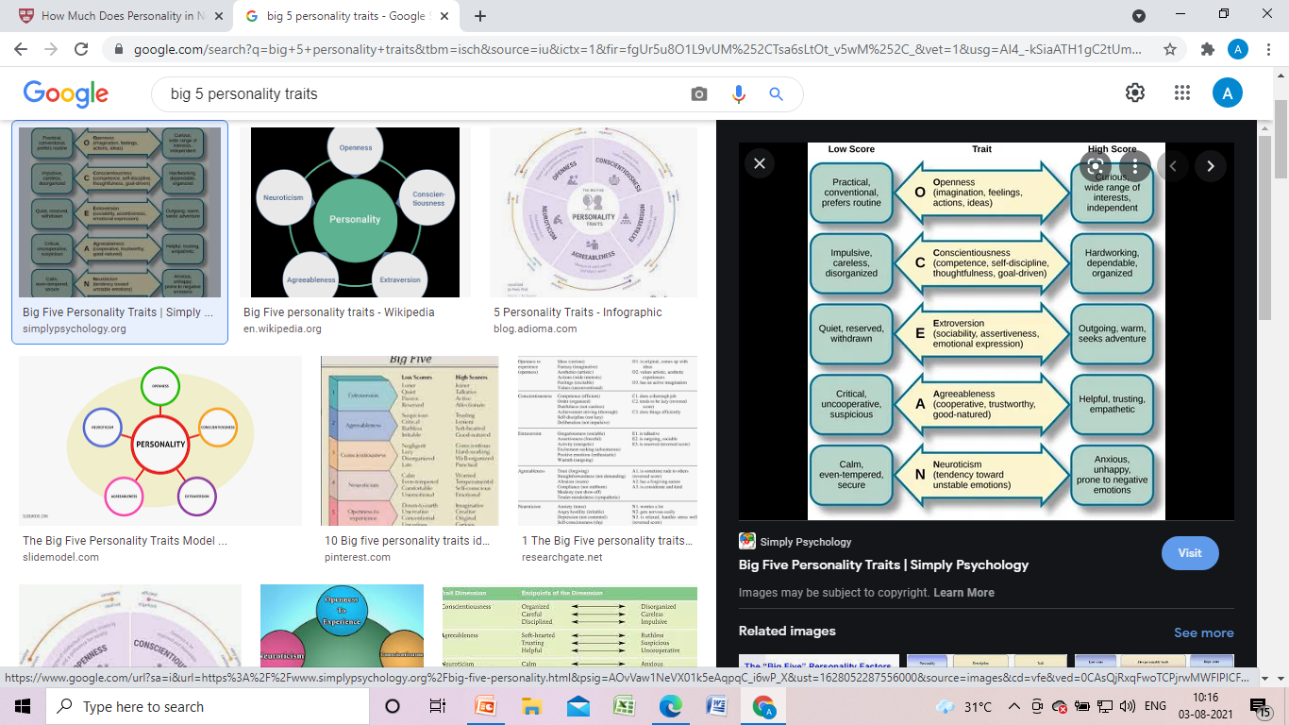

3. The Big 5 Personality Traits

Slide 19
4. Psychoanalytic theory by Sigmund Freud

Slide 20
Sigmund Freud’s Topographic Model of the Psyche
1. Consciousness
Everything that we are feeling, thinking, wishing, or paying attention to at the given moment, comes under the consciousness of our mind.
For example, suppose a boy is riding a bike; hence, the vehicles, road in her field of vision, and the horn sound he is hearing, or anything else he is experiencing at that moment such as hunger, thirst, or pain, are all present in his consciousness.

Slide 21
2. Preconsciousness
Everything that the person is not paying attention to at the given moment, but the information is readily available to enter into the conscious of the person whenever it’s required.
For example, you may not be thinking about your sibling’s mobile number at the given moment, but you’ll immediately recall the number whenever needed.

Slide 22
3. Unconsciousness
The unconscious consists of all those feelings, thoughts, or desires that the person is not aware of, but it influences almost every aspect of his/her daily life.
For example, the hatred towards a particular family member due to strict parenting, or any childhood traumatic incidents that the person doesn’t remember, but which deeply affects his/her current behaviour.

Slide 23
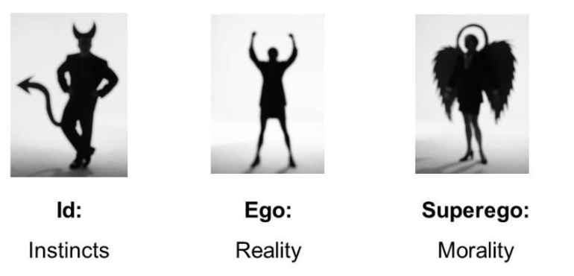
Sigmund Freud’s Structural Model of Personality
According to Freud’s psychoanalytic theory of personality, human behaviour and personality depend on the interactions among the three major components, i.e., the id, ego, and superego. Each component plays a unique and notable contribution to the human personality.

Slide 24
1. Id
This component is present from the time of birth in the people.
It involves taking instantaneous decisions without thinking much about the cause and consequences of the decisions.
Here, the decisions taken by the person are primarily from his/her unconscious part of the mind. The ‘id’ works on Freud’s pleasure principle, i.e., it focuses on fulfilling biological needs and conscious or unconscious desires such as anger, hunger, thrust.
If these needs or desires are not satisfied, it may lead to tension, stress, or anxiety.
For example, children argue to eat their favourite candy again and again without considering that it may cause them cavities.

Slide 25
2. Ego
The children’s behaviour due to the id component may be acceptable by society, but this behaviour may cause a problem when the person grows up.
Hence, the development of another component, i.e., ‘ego,’ helps people make decisions based on the reality principle.
It involves taking decisions not only based on fulfilling personal needs or desires but also considering the realistic and socially approved behaviour.
According to Freud, the primary function of the ego is to delay the needs or desires until the appropriate time, or it is realistic and acceptable.

Slide 26
3. Superego
It is the last component of personality development, and it begins to develop around the age of five.
The superego primarily works on internalized moral values or principles that we learn from our parents and society.
The superego helps us make appropriate judgments by suppressing the id’s urges and forcing the ego to work as per the moral principles rather than the realistic principles.
The superego is divided into two parts, i.e., the ego ideal and the conscience.
The ego-ideal includes the set of rules for the appropriate behaviour. Here, behaviour is influenced by the authority figures such as parents and teachers.
The conscience involves the set of rules for behaviour that are considered as bad. When we do things that are considered not appropriate according to our conscience, it may lead to bringing a feeling of guilt in us.

Slide 27
Interaction among Id, Ego, and the Superego
All the three components, i.e., id, ego, and the superego are not separate entities; they interact with each other and are equally important to decide the overall behaviour and personality of the person.
Sometimes your decisions are based on fulfilling your own needs (id), i.e., what is best for you, and sometimes they are based only on the moral principles (superego), i.e., what is best for others, or sometimes based on the reality principle (ego), i.e., what is best for you and the others.
The interaction of these three components varies at the different stages of people’s lives. The id plays an important role in taking actions to fulfil personal needs, and the ego helps in taking action in a realistic and socially acceptable way, and the superego helps to take morally appropriate decisions.

Slide 28
According to Freud, a person has a balanced personality if he/she can effectively use his/her ego to make a balance between the id and the superego.
A person with an extreme id may have an uncontrollable or impulsive personality and will try to fulfil his/her needs and desires at any cost even if it is unethical, while people with the dominant superego may have an extreme judgemental personality, and they may face difficulty in accepting things or opinions that they themselves perceive as morally wrong or unethical.

