Slide 1
Transaction Processing

Slide 2

Basic Concept of Transaction
Suppose we have to calculate total marks of a student. Then what are the steps involved in it? Get the marks in each subject (say we have 3 subjects), calculate the total and then display it. Here all the 3 steps are called as transaction and it consists of 3 small actions which cannot be further divided.

Slide 3
Transaction Introduction
Set of operations that form a single logical unit of work are called as transactions.
A transaction is a unit of program execution that accesses and possibly updates various data items.
E.g. transaction to transfer $50 from account A to account B:
    1. read(A)
    2. A := A – 50
    3. write(A)
    4. read(B)
    5. B := B + 50
    6. write(B)

Slide 4
If the database was in consistent state before a transaction, then after execution of the transaction also, the database must be in a consistent state. For example, a transfer of money from one bank account to another requires two changes to the database both must succeed or fail together.
You are working on a system for a bank. A customer goes to the ATM and instructs it to transfer Rs. 1000 from savings to a checking account.
This simple transaction requires two steps:
• Subtracting the money from the savings account balance.
• Adding the money to the checking account balance.

Slide 5
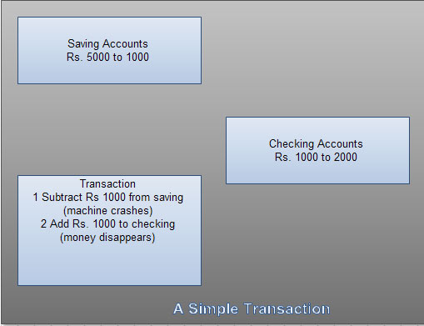

Slide 6
Processes of Transaction
read(X), which transfers the data item X from the database to a variable, also called X, in a buffer in main memory belonging to the transaction that executed the read operation.
write(X), which transfers the value in the variable X in the main-memory buffer of the transaction that executed the write to the data item X in the database.

Slide 7
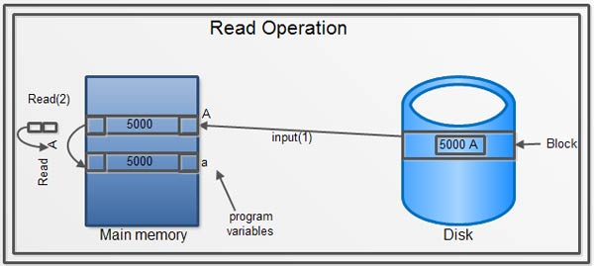
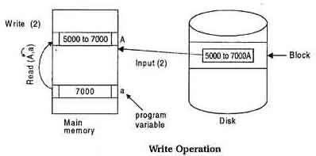

Slide 8
Transaction Properties (ACID)
A transaction has following properties:
Atomicity
Consistency
Isolation
Durability

Slide 9
ATOMICITY
  If the transaction fails after step 3 and before step 6, money will be “lost” leading to an inconsistent database state
    Failure could be due to software or hardware
  The system should ensure that updates of a partially executed transaction are not reflected in the database
  All or nothing, regarding the execution of the transaction

Slide 10
CONSISTENCY
The sum of A and B is unchanged by the execution of the transaction.
  Execution of a (single) transaction preserves the consistency of the database.
  A transaction must see a consistent database and must leave a consistent database
  During transaction execution the database may be temporarily inconsistent.
    Constraints to be verified only at the end of the transaction

Slide 11
ISOLATION
Concurrent execution of two or more transactions should be consistent is called as Isolation.
If between steps 3 and 6, another transaction T2 is allowed to access the partially updated database, it will see an inconsistent database (the sum A + B will be less than it should be).
T1 T2
  1. read(A)
  2. A := A – 50
  3. write(A)
  read(A), read(B), print(A+B)
  4. read(B)
  5. B := B + 50
  6. write(B)

Slide 12
DURABILITY
After a transaction completes successfully, the changes it has made to the database persist, even if there are system failures.
Database should be recoverable under any type of crash.

Slide 13
Example of Fund Transfer
Transaction to transfer $50 from account A to account B:
  1. read(A)
  2. A := A – 50
  3. write(A)
  4. read(B)
  5. B := B + 50
  6. write(B)

Slide 14

TRANSACTION STATES

Slide 15
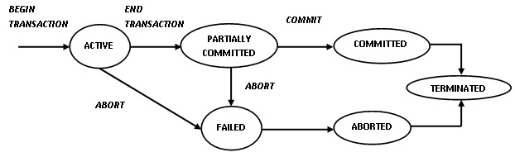

Slide 16
TRANSACTION STATES
Active – the initial state; the transaction stays in this state while it is executing
Partially committed – after the final statement has been executed.
Failed – after the discovery that normal execution can no longer proceed.

Slide 17
TRANSACTION STATES
Aborted – after the transaction has been rolled back and the database restored to its state prior to the start of the transaction. Two options after it has been aborted:
    restart the transaction
      hardware or software error
    kill the transaction
      Internal logical error
Committed – after successful completion. Once a transaction has committed, we cannot undo its effects by aborting it.

Slide 18
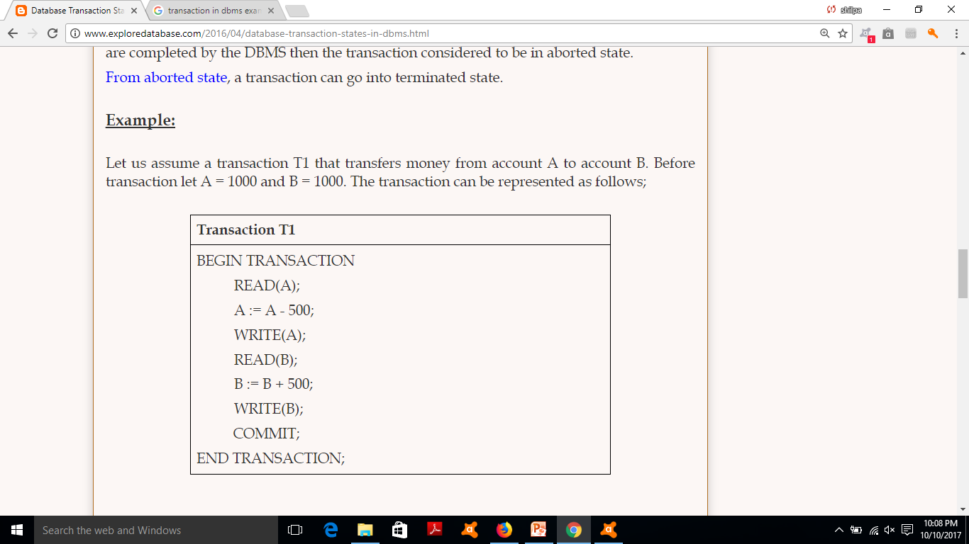
Example

Slide 19
CONCURRENT EXECUTION
Transaction processing systems usually allow multiple transactions to run parallelly.
Allowing multiple transactions to update the data concurrently causes several complications with the consistency of data.
For that, we can think that the best way of executing the transactions can be---serial execution
However, executing the multiple transactions at same time has its own benefits

Slide 20
ADVANTAGES OF CONCURRENT EXECUTION
Improved throughput and resource utilization :
  Throughput: Number of transactions executed in given amount of time.
  I/O activity and CPU activity
    One transaction can perform I/O, other can use CPU cycles for execution
Reduced Waiting time:
  In serial scheduling, a short transaction may have to wait for a preceding long transaction to complete
  Waiting time: the time for a transaction to be completed after it has been submitted for execution.

Slide 21
SCHEDULE
The execution sequence of transactions. The time order sequence of two or more transactions
Represent the chronological order in which transactions are executed in the system.
For example, Read (A) must appear before Write (A) in any transaction

Slide 22
T1 | T2
Read A | Read B
Write A | Write B
Read B | Read A
Write B | Write A
Schedule 1
T1 | T2
 | Read B
 | Write B
 | Read A
 | Write A
Read A
Write A
Read B
Write B
Schedule 2
Read A
Write A
 | Read B
 | Write B
Read B
Write B
 | Read A
 | Read A

Slide 23
TYPES OF SCHEDULES
Two types of schedules are there
  Serial
  Parallel (Concurrent)

Slide 24
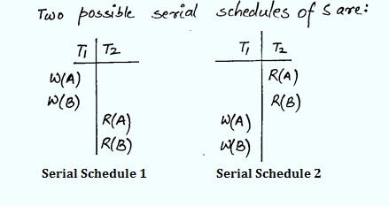
SERIAL SCHEDULE
After the commit of first transaction second transaction begins.
There is NO inconsistency in serial schedules.
It has poor throughput
It has poor resource utilization.
Eg: T1 has W(A) W(B) operations and T2 has R(A)R(B)

Slide 25

EXAMPLE SCHEDULE 1
Let T₁ transfer $50 from A ($500) to B($200), and T₂ transfer 10% of the balance from A to B.
SERIAL

Slide 26

EXAMPLE SCHEDULE 2
A serial schedule where T2 is followed by T1.
SERIAL

Slide 27
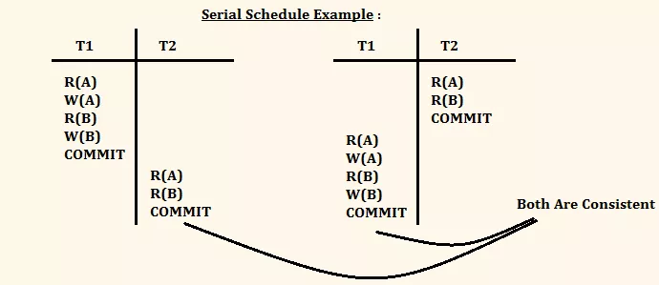
Example

Slide 28
There are two transactions T1 followed by T2 which is shown as:
T1 | T2
A=A+100
B=B-100
 | A=A*7.06
 | B=B*7.06
T1 | T2
 | A=A*7.06
 | B=B*7.06
A=A+100
B=B-100

Slide 29

PARALLEL/CONCURRENT SCHEDULE
A=1000, B= 2000
A=1000
A=950
A=950
A=950
A=95
CONSISTENT
A=855
A=855
B=2000
B=2050
B=2050
B=2050
Final sum is:
855 + 2145 = 3000
B=2145
B=2145

Slide 30

A=1000
A=950
A=1000
A=100
A=900
A=900
INCONSISTENT
B=2000
A=950
B=2000
Final sum is:
950 + 2100 = 3050
B=2050
B=2050
B=2100
B=2100

Slide 31
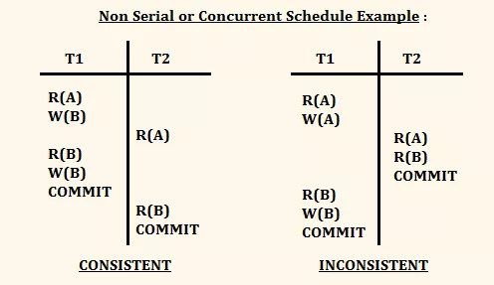
Example

Slide 32
CLASSIFICATION OF SCHEDULES
There are two types of classifications:
  Based of Recoverability
    Irrecoverable Schedule
    Recoverable Schedule
    Cascading Rollback
    Cascadeless Rollback
  Based on serializability
    Conflict Serializable Schedule
    Conflict Equivalent Schedule
    View Serializable Schedule

Slide 33
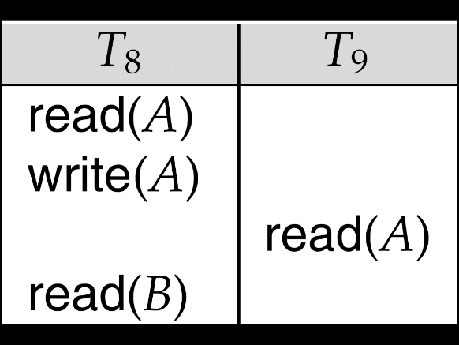
IRRECOVERABLE SCHEDULES
Irrecoverable schedule — if a transaction T_{j} reads a data item previously written by a transaction T_{i} , then the commit operation of T_{j} must appear before the commit operation of T_{i}.
The following schedule is not recoverable if T₉ commits immediately after the read
If T₈ should abort, T₉ would have read (and possibly shown to the user) an inconsistent database state. Hence, database must ensure that schedules are recoverable.
Commit
Commit

Slide 34
RECOVERABLE SCHEDULES
Recoverable schedule — if a transaction T_{j} reads a data item previously written by a transaction T_{i} , then the commit operation of T_{i} must appear before the commit operation of T_{j}.
The following schedule is recoverable if T₉ commits after the T₈
Commit
Commit

Slide 35

CASCADING ROLLBACKS
Cascading rollback – a single transaction failure leads to a series of transaction rollbacks. Consider the following schedule where none of the transactions has yet committed (so the schedule is recoverable)
If T₁₀ fails, T₁₁ and T₁₂ must also be rolled back.
Can lead to the undoing of a significant amount of work

Slide 36
CASCADELESS SCHEDULES
Cascadeless schedules — in these, cascading rollbacks cannot occur; for each pair of transactions T_{i} and T_{j} such that T_{j} reads a data item previously written by T_{i}, the commit operation of T_{i} appears before the read operation of T_{j}.
Every cascadeless schedule is also recoverable
It is desirable to restrict the schedules to those that are cascadeless.

Slide 37
SERIALIZABILITY
To ensure consistency of the database under concurrent execution.
All serial schedules are serializable schedules.
That is, the schedule should, in some sense, be equivalent to a serial schedule. Such schedules are called serializable schedules.

Slide 38
SERIALIZABILITY

Slide 39
SERIALIZABILITY
For serializability, we need to consider only two operations: READ and WRITE.
Two types of serializability is there :
  Conflict serializability
  View serializability

Slide 40
CONFLICTING INSTRUCTIONS
Consider a schedule S in which two consecutive instructions I_{i} and I_{j} of transactions T_{i} and T_{j.}
If I_{i} and I_{j} of transactions T_{i} and T_{j} refer to different data items, then we can swap I_{i} and I_{j} without affecting the results.
Instructions I_{i} and I_{j} of transactions T_{i} and T_{j} respectively, conflict if and only if both I_{i} and I_{j} access same data item Q, and at least one of them is write(Q).
1. I_{i} = read(Q), I_{j} = read(Q): No conflict.
2. I_{i} = read(Q), I_{j} = write(Q): Conflict.
3. I_{i} = write(Q), I_{j} = read(Q): Conflict
4. I_{i} = write(Q), I_{j} = write(Q): Conflict

Slide 41
CONFLICT SERIALIZABILITY
Conflict equivalent : If a schedule S can be transformed to S1 by swapping of non conflicting instructions of different transactions.
Conflict serializable : Schedule S is conflict serializable if it is conflict equivalent to a serial schedule.

Slide 42


CONFLICT SERIALIZABILITY
Schedule 3 can be transformed into Schedule 6, a serial schedule where T2 follows T1, by series of swaps of non-conflicting instructions. Therefore it is conflict serializable.
Schedule 3
Schedule 6

Slide 43

CONFLICT SERIALIZABILITY
Example of a schedule that is not conflict serializable:
We are unable to swap instructions in the above schedule to obtain either the serial schedule < T₃, T₄ >, or the serial schedule < T₄, T₃ >.

Slide 44
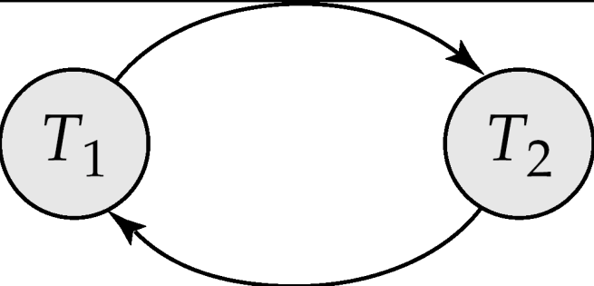
TESTING FOR SERIALIZABILITY
Consider some schedule of a set of transactions T₁, T₂, ..., T_{n}
Precedence graph — a directed graph where
  The vertices are the transactions (names of the transactions).
  There is an arc from T_{i} to T_{j} if the two transaction conflicts.
We may label the arc by the item that was accessed.
Example 1
x
y

Slide 45
EXAMPLE SCHEDULE A + PRECEDENCE GRAPH
T1 T2 T3 T4 T5
read(X)
read(Y)
read(Z)
read(V)
read(W)
read(W)
read(Y)
write(Y)
write(Z)
read(U)
read(Y)
write(Y)
read(Z)
write(Z)
read(U)
write(U)
T₁
T₂
T₄
T₃
T₅

Slide 46
TEST FOR CONFLICT SERIALIZABILITY
A schedule is conflict serializable if and only if its precedence graph is acyclic.
If precedence graph is acyclic, the serializability order can be obtained by a topological sorting of the graph.
  This is a linear order consistent with the partial order of the graph.
  For example, a serializability order for Schedule A would be
  T₅ → T₁ → T₃ → T₂ → T₄
Notes:
Calculate indegree for every transaction, start from least indegree. (indegree is edges coming in from the transaction)

Slide 47
VIEW SERIALIZABILITY
Sometimes it is possible to serialize schedules that are not conflict serializable.
View serializability provides a weaker and still consistency preserving notion of serialization.
Let S and S´ be two schedules with the same set of transactions. S and S´ are view equivalent if the following three conditions are met, for each data item Q,

Slide 48
VIEW SERIALIZABILITY
  If in schedule S, transaction T_{i} reads the initial value of Q, then in schedule S’ also transaction T_{i} must read the initial value of Q.
  If in schedule S transaction T_{i} executes read(Q), and that value was produced by transaction T_{j} (if any), then in schedule S’ also transaction T_{i} must read the value of Q that was produced by the same write(Q) operation of transaction T_{j} .
  The transaction (if any) that performs the final write(Q) operation in schedule S must also perform the final write(Q) operation in schedule S’.

Slide 49
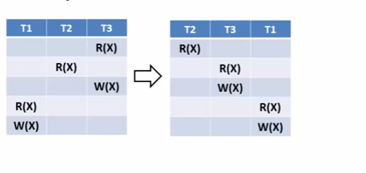
Consider example:
S S’

Slide 50
VIEW SERIALIZABILITY
A schedule S is view serializable if it is view equivalent to a serial schedule.
Every conflict serializable schedule is also view serializable.
Below is a schedule which is view-serializable but not conflict serializable.
It is equivalent to either <T3,T4,T6> or <T4,T3,T6>
Every view serializable schedule that is not conflict serializable has blind writes.(when a transaction writes a value without reading it)

Slide 51


