Slide 2
Oracle creates a memory area, known as context area, for processing an SQL statement, which contains all information needed for processing the statement
You can name a cursor so that it could be referred to in a program to fetch and process the rows returned by the SQL statement, one at a time. There are two types of cursors:
Implicit cursors
Explicit cursors
The set of rows the cursor holds is referred to as the active set.

Slide 3
Implicit Cursors
Implicit cursors are automatically created by Oracle whenever an SQL statement is executed, when there is no explicit cursor for the statement.
Programmers cannot control the implicit cursors and the information in it.
Whenever a DML statement (INSERT, UPDATE and DELETE) is issued, an implicit cursor is associated with this statement. For INSERT operations, the cursor holds the data that needs to be inserted. For UPDATE and DELETE operations, the cursor identifies the rows that would be affected.
In PL/SQL, you can refer to the most recent implicit cursor as the SQL cursor

Slide 4
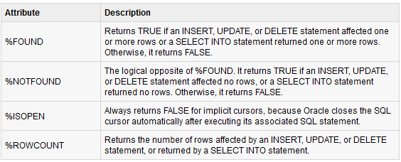
Attributes for implicit Cursors.

Slide 5
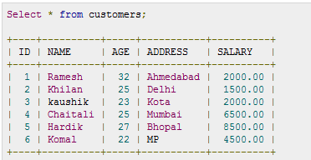
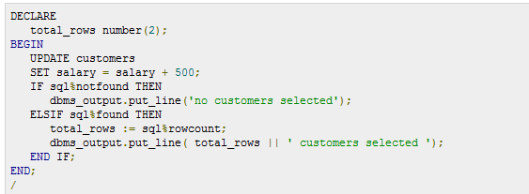

Slide 6
Explicit Cursors
Explicit cursors are programmer defined cursors for gaining more control over the context area. An explicit cursor should be defined in the declaration section of the PL/SQL Block. It is created on a SELECT Statement which returns more than one row.
Syntax:
CURSOR cursor_name IS select_statement;

Slide 7
Explicit cursor involves four steps:
Declaring the cursor for initializing in the memory
Opening the cursor for allocating memory
Fetching the cursor for retrieving data
Closing the cursor to release allocated memory

Slide 8
Declaring the Cursor:
CURSOR c_customers IS SELECT id, name, address FROM customers;
Opening the Cursor
Opening the cursor allocates memory for the cursor and makes it ready for fetching the rows returned by the SQL statement into it. For example, we will open above-defined cursor as follows:
OPEN c_customers;

Slide 9
Fetching the Cursor
Fetching the cursor involves accessing one row at a time. For example we will fetch rows from the above-opened cursor as follows:
FETCH c_customers INTO c_id, c_name, c_addr; Closing the Cursor
Closing the cursor means releasing the allocated memory. For example, we will close above-opened cursor as follows:
CLOSE c_customers;

Slide 10
