Slide 2
Triggers are stored programs, which are automatically executed or fired when some events occur. Triggers are, in fact, written to be executed in response to any of the following events:
A database manipulation (DML) statement (DELETE, INSERT, or UPDATE).
A database definition (DDL) statement (CREATE, ALTER, or DROP).
A database operation (SERVERERROR, LOGON, LOGOFF, STARTUP, or SHUTDOWN).

Slide 3
CREATE [OR REPLACE ] TRIGGER trigger_name {BEFORE | AFTER | INSTEAD OF } {INSERT [OR] | UPDATE [OR] | DELETE} [OF col_name] ON table_name [REFERENCING OLD AS o NEW AS n]
[FOR EACH ROW]
WHEN (condition)
DECLARE Declaration-statements
BEGIN
Executable-statements
EXCEPTION
Exception-handling-statements
END;

Slide 4
CREATE [OR REPLACE] TRIGGER trigger_name: Creates or replaces an existing trigger with the trigger_name.
{BEFORE | AFTER | INSTEAD OF} : This specifies when the trigger would be executed. The INSTEAD OF clause is used for creating trigger on a view.
{INSERT [OR] | UPDATE [OR] | DELETE}: This specifies the DML operation.
[OF col_name]: This specifies the column name that would be updated.
[ON table_name]: This specifies the name of the table associated with the trigger.
[REFERENCING OLD AS o NEW AS n]: This allows you to refer new and old values for various DML statements, like INSERT, UPDATE, and DELETE.
[FOR EACH ROW]: This specifies a row level trigger, i.e., the trigger would be executed for each row being affected. Otherwise the trigger will execute just once when the SQL statement is executed, which is called a table level trigger.
WHEN (condition): This provides a condition for rows for which the trigger would fire. This clause is valid only for row level triggers.

Slide 5
Example After Triggers
Restrictions
You can not create an AFTER trigger on a view.
You can not update the :NEW values.
You can not update the :OLD values.
CREATE TABLE new_employee
(
employee_id NUMBER
,employee_name VARCHAR2(1000)
,creation_date DATE
,created_by VARCHAR2(1000)
);

Slide 6
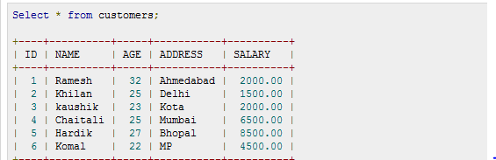
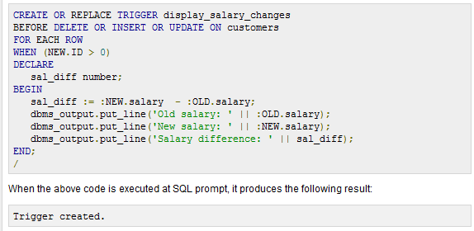

Slide 7
Triggering a Trigger
When no old data is present
INSERT INTO CUSTOMERS (ID,NAME,AGE,ADDRESS,SALARY) VALUES (7, 'Kriti', 22, 'HP', 7500.00 );
Output:Old salary:
New salary: 7500
Salary difference:

Slide 8
When old data is present
UPDATE customers SET salary = salary + 500 WHERE id = 2;
Output
Old salary: 1500 New salary: 2000 Salary difference: 500

Slide 9
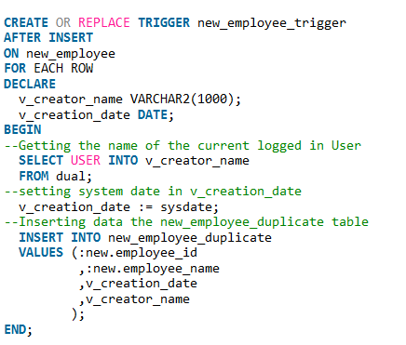

Slide 10
Five different types of events can have trigger code attached to them:
Data Manipulation Language (DML) statements
Data Definition Language (DDL) statements
Database events:Database event triggers fire whenever the database starts up or is shut down,whenever a user logs on or off, and whenever an Oracle error occurs.
INSTEAD OF
Suspended statements

Slide 11
DML Triggers
There are also many ways to actually configure DML triggers:
• Should the triggers fire once for the whole DML statement or once for each row involved in the statement?
• Should the triggers fire before or after the whole statement completes or before or after each row is processed?
• Should the triggers fire for inserts, updates, deletes, or a combination thereof?

Slide 12
DML Trigger Concepts
BEFORE trigger:A trigger that executes before a certain operation occurs, such as BEFORE INSERT.
AFTER trigger:A trigger that executes after a certain operation occurs, such as AFTER UPDATE.
Statement-level trigger:A trigger that executes for a SQL statement as a whole (which may, in turn, affect one or more individual rows in a database table).
Row-level trigger:A trigger that executes for a single row that has been affected by the execution of a SQL statement. Suppose that the books table contains 1,000 rows. Then the following UPDATE statement will modify 1,000 rows:
UPDATE books SET title = UPPER (title);

Slide 13
Creating a DML Trigger
To create (or replace) a DML trigger, use the syntax shown here:
1 CREATE [OR REPLACE] TRIGGER trigger_name
2 {BEFORE | AFTER}
3 {INSERT | DELETE | UPDATE | UPDATE OF column_list } ON table_name
4 [FOR EACH ROW]
5 [WHEN (...)]
6 [DECLARE ... ]
7 BEGIN
8 ...executable statements...
9 [EXCEPTION ... ]
10 END [trigger_name];

Slide 14
TRIGGER validate_employee_changes
AFTER INSERT OR UPDATE
ON employees
FOR EACH ROW
BEGIN
check_date (:NEW.hire_date);
check_email (:NEW.email);
END;

Slide 15
Here are some rules to keep in mind when working with NEW and OLD:
• With triggers on INSERT operations, the OLD structure does not contain any data; there is no “old” set of values.
• With triggers on UPDATE operations, both the OLD and NEW structures are populated. OLD contains the values prior to the update; NEW contains the values the row will contain after the update is performed.
• With triggers on DELETE operations, the NEW structure does not contain any data; the record is about to be erased.
• The NEW and OLD pseudo-records also contain the ROWID pseudo-column; this value is populated in both OLD and NEW with the same value.
When referencing the NEW and OLD structures within the anonymous block for the trigger, you must preface those keywords with a colon, as in:
IF :NEW.salary > 10000 THEN...
Use of referencing keyword
TRIGGER audit_update
AFTER UPDATE
ON frame
REFERENCING OLD AS prior_to_cheat NEW AS after_cheat

Slide 16
CREATE TABLE Emp_log ( Emp_id NUMBER, Log_date DATE, New_salary NUMBER, Action VARCHAR2(20));
//Create trigger that inserts row in log table after EMPLOYEES.SALARY is updated:
CREATE OR REPLACE TRIGGER log_salary_increase AFTER UPDATE OF salary
ON employees FOR EACH ROW BEGIN INSERT INTO Emp_log (Emp_id, Log_date, New_salary, Action) VALUES (:NEW.employee_id, SYSDATE, :NEW.salary, 'New Salary'); END;
/ Update EMPLOYEES.SALARY:
UPDATE employees SET salary = salary + 1000.0 WHERE Department_id = 20;
Result:2 rows updated.

Slide 17
Benefits of Triggers
Triggers can be written for the following purposes:
Generating some derived column values automatically
Enforcing referential integrity
Event logging and storing information on table access
Auditing
Synchronous replication of tables
Imposing security authorizations
Preventing invalid transactions

Slide 18
Instead of trigger
CREATE [OR REPLACE] TRIGGER trigger_name
INSTEAD OF operation
ON view_name
FOR EACH ROW
BEGIN
---Your SQL Code—
END;

Slide 19
CREATE TABLE trainer
(
full_name VARCHAR2(20)
);
CREATE TABLE subject
(
subject_name VARCHAR2(15)
);

Slide 20
INSERT INTO trainer VALUES (‘Good');
INSERT INTO subject VALUES ('Oracle');
Creation of view
CREATE VIEW vw AS
SELECT full_name, subject_name FROM trainer, subject;
Creation of trigger:
CREATE OR REPLACE TRIGGER tr_Io_Insert
INSTEAD OF INSERT ON vw
FOR EACH ROW
BEGIN
INSERT INTO trainer (full_name) VALUES (:new.full_name);
INSERT INTO subject (subject_name) VALUES (:new.subject_name);
END;

