Slide 1
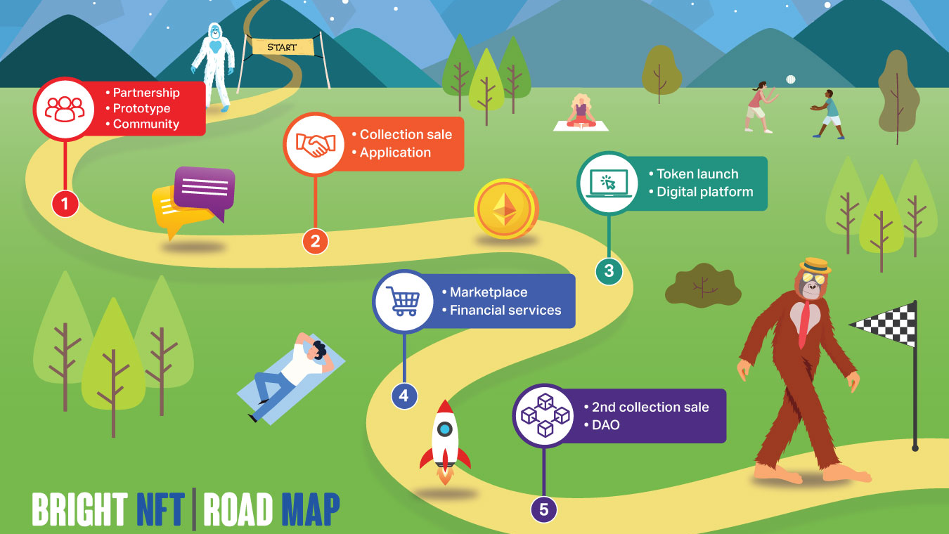

Slide 2
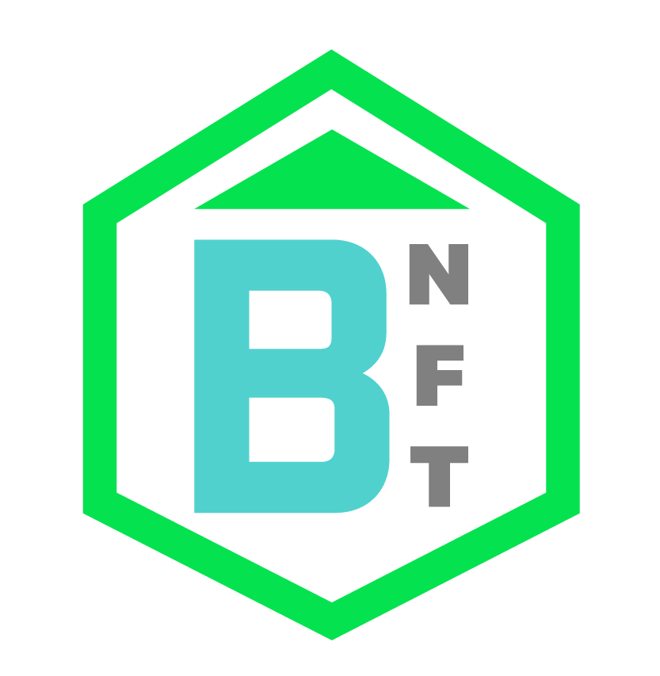
Roadmap
Stage 1: Platform technical design. Development of prototype NFTs with voice assistant features. Community formation with early supporters.
Stage 2: Strategic Partnerships. Integration of voice assistant NFTs within the Level 1 of the LinkedWeb3 platform. Whitelist Assignment. Pre-sale of the Yeti-Apes NFT collection
Stage 3: Formation of the treasury committee. Staking service development. Private pre-sale of the BNFT token. Launch of the Level 1 of the LinkedWeb3 platform (Beta version). Rewards for early users and launch of staking services.
Stage 4: Series A fundraising. Development of the Training Room. Launch of the Level 2 of LinkedWeb3. Launch of consulting services within the platform. Treasury committee update.
Stage 5: Launch of the Level 3 of LinkedWeb3 with premium members, Public Sale of the BNFT token. Upgrade of Levels 1 and 2. Development of Artificial Intelligence services for NFT projects.

Slide 3
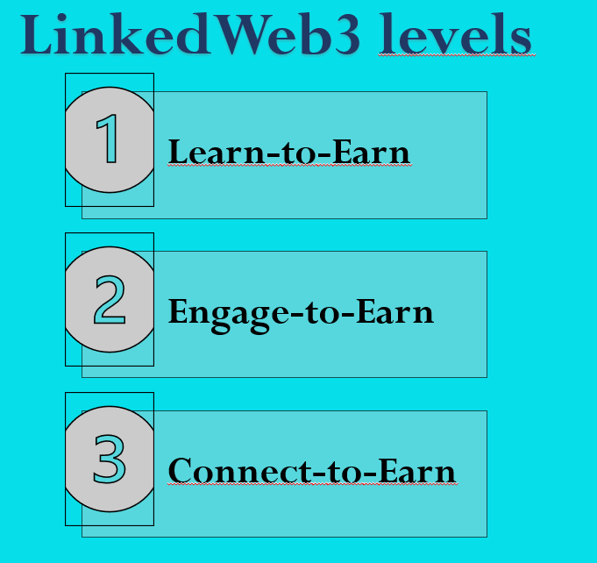
Web3 Training Journey Through Playing
Different levels of training with different layers of earning!
Each level has a premise to redeem the rewards based on new skills developed.

Slide 4



The Yeti-Apes are Intelligent Partners
These NFTs have different AI capabilities that can be unlocked as you make progress with the training.
With the purchase of the pfp NFT you immediately unlock the voice assistant feature!
Click here to have a look at our demo!

Slide 5

The BNFT Token
The BNFT token will be used for rewarding users within our platform, either by their participation, progress or by holding NFTs from the Yeti-Apes collection.
It will also act as one of the modes of exchange for purchasing and selling professional services offered by industry experts within the platform.

Slide 6
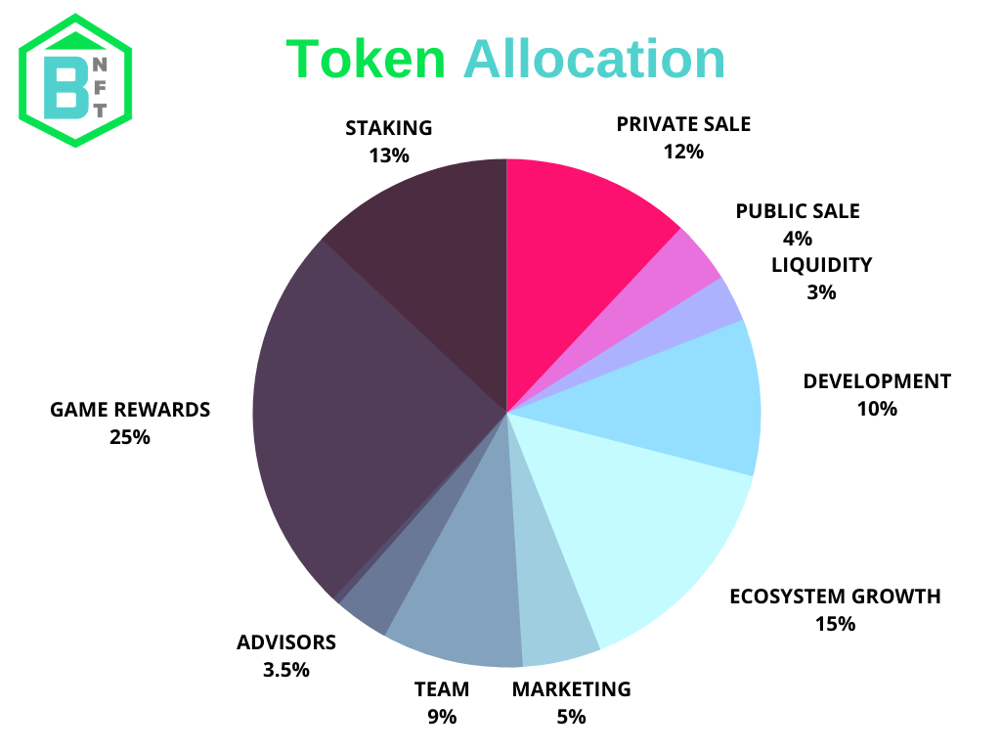
Tokenomics
Total supply of the token is 1.000.000.000

Slide 7
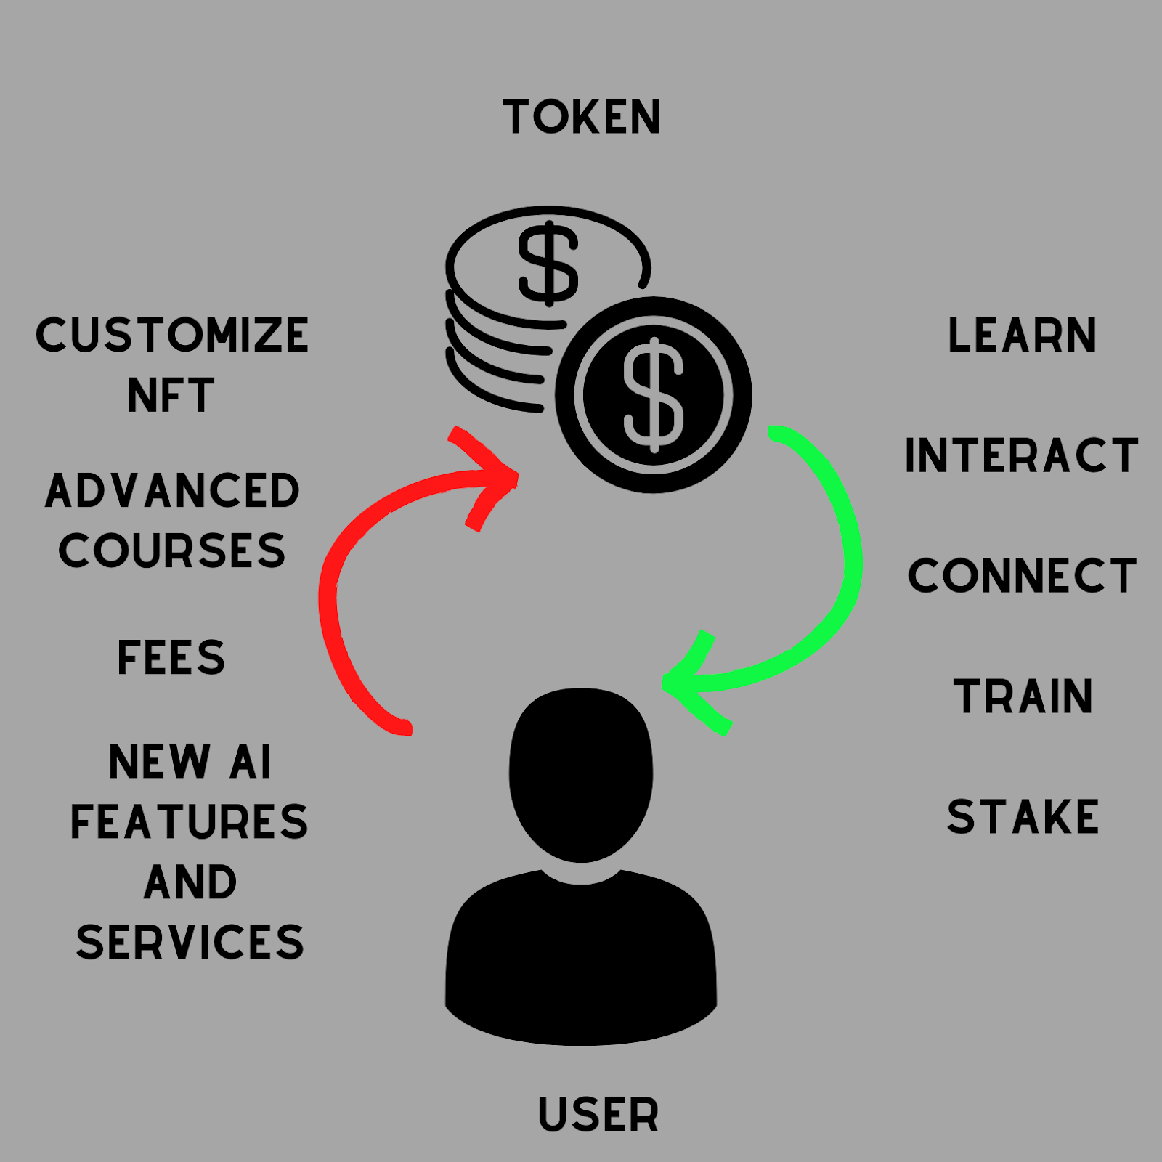
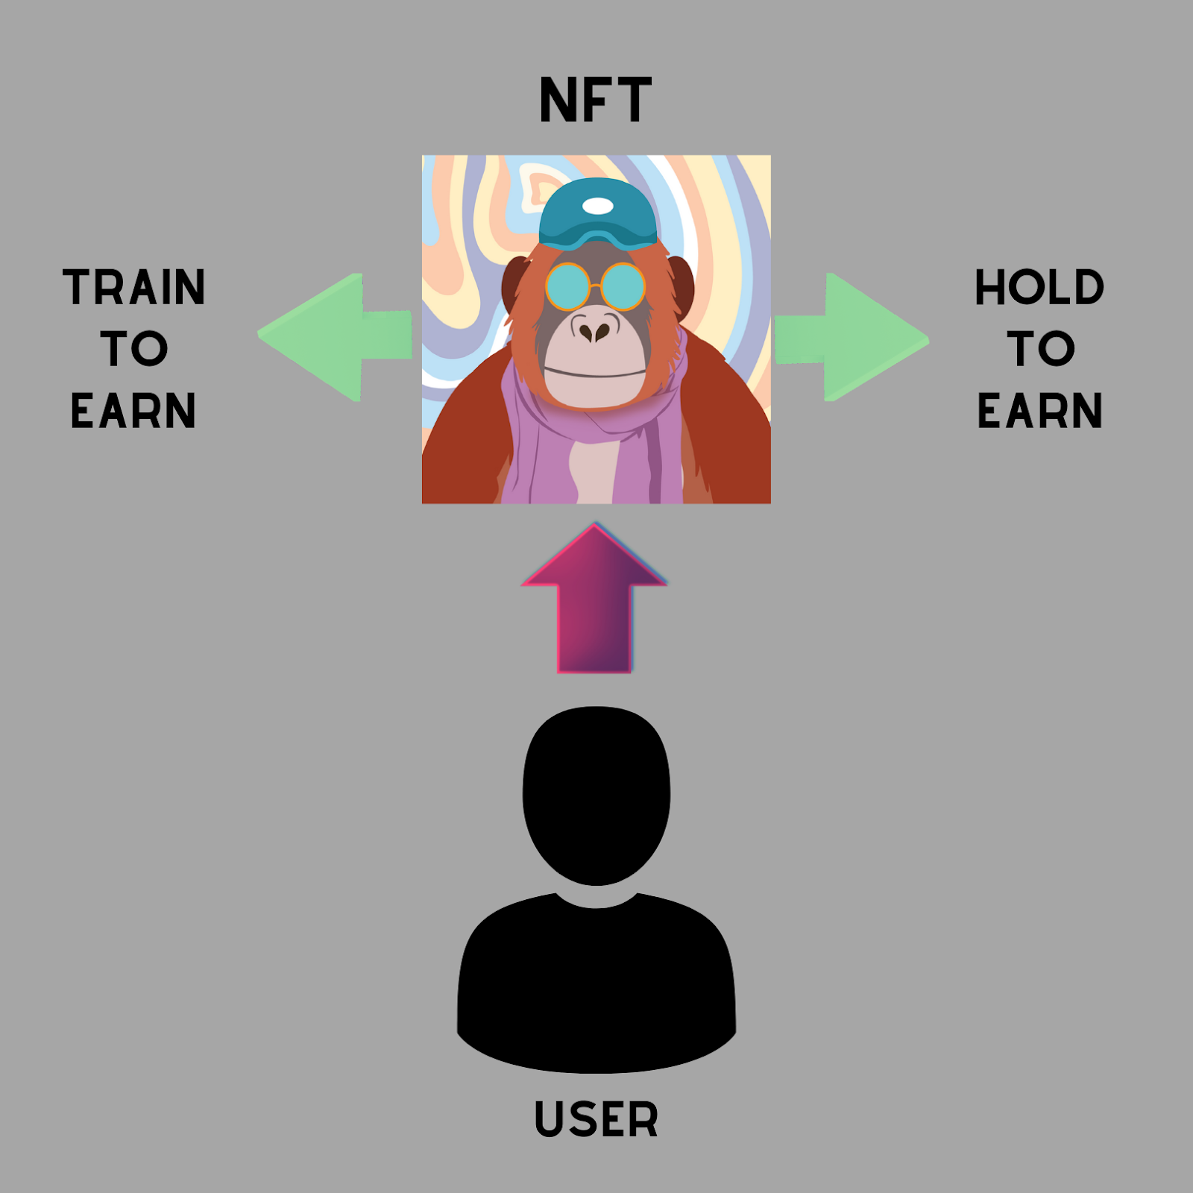
Assets Flow: a healthy economy design

