Slide 1

AUSTIN PUBLIC HEALTH
Voice-Driven AI Development
90
Workflows
MINUTES
Part 1 of 3: Setup, Introduction & Tool Overview
AI Technology Training Series
Notes:
Welcome to Part 1 of our Voice-Driven AI Development Workflows series. Today we're covering setup, introduction, and tool overview. This 90-minute session will give you the foundation to start using voice-driven development.

Slide 2
YOUR LEARNING JOURNEY
Three Sessions to Transform Your Workflow
TODAY
01
02
03
Setup & Tool Overview
Build a Web App
Complete Build Method
Put it all together
End-to-end project
Meeting transcription app
Voice-driven development
Agent-to Agent
Long Horizon Tasks
Voice input tools
AI coding assistants
Enterprise configuration
Security fundamentals
Setup Voice Tooling
Real exercises
Troubleshooting tips
Productivity shortcuts
Github / CICD / Planning / Spec Dev
Instant deployment
90 minutes
90 minutes
90 minutes
Notes:
Here's our roadmap for the full series. Today is Part 1 focusing on understanding the tools. Part 2 will be hands-on practice with your own projects. Part 3 culminates in building a real meeting transcriber application together.

Slide 3
150
"
words per minute speaking
The keyboard is a bottleneck between your thoughts and your code.
40
Voice removes that bottleneck.
words per minute typing
Voice-Driven AI Toolkit Research
Work at the speed of thought
Notes:
The key insight here is that we think faster than we type. Voice-driven development closes that gap. Keyboards are a bottleneck. Voice input lets you work at the speed of thought.

Slide 4
WHY IT MATTERS
Key Benefits
01
02
03
04
Ergonomic
Productivity
Multitasking
Accessibility
RSI prevention
Reduced physical strain
Accessibility support
Faster iteration cycles
Speak ideas as you think
Reduce context switching
Code while reviewing docs
Hands-free operation
Think out loud naturally
Mobility accommodations
Inclusive workflows
Alternative input paths
Notes:
Four key benefits: Ergonomic benefits for anyone typing all day. Productivity gains from faster iteration. Multitasking when your hands are free. Accessibility opens development to more people.

Slide 5
10 min
Why Voice-Driven Development
10 min
Voice Tools Landscape
PART 1 OF 3
Today's
Agenda
10 min
Security & PHI Considerations
15 min
SuperWhisper Setup & Configuration
20 min
Custom Mode Workshop
10 min
Live Demonstration
90 minutes to understand, choose, and configure your voice tools
15 min
Next Steps & Q&A
Workshop materials & exercises available for independent practice
Notes:
Here's our agenda for today. Note the time allocations - we'll focus on voice tools and SuperWhisper configuration. Workshop materials are available for independent practice.

Slide 6

SECTION 02
Voice Input Tools
The Acoustic Layer
8
6
3
SuperWhisper
Wispr Flow
Comparison
20 minutes
Notes:
Section 2: Now we're getting into the tools. The acoustic layer captures your voice and turns it into text.

Slide 7
PLATFORM SUPPORT
PRIMARY RECOMMENDATION
W
Windows 10/11
SuperWhisper
Launched Dec 2025
AI-powered voice to text with local processing option
M
macOS 13+
Apple Silicon optimal
What It Is
Desktop app using OpenAI's Whisper models. Offers both local (on-device) and cloud processing options. 100+ languages supported.
iOS / iPadOS
i
Same license covers mobile
Free
$8.49/mo
$249
Basic models included
Pro subscription
Lifetime option
Local Processing Available: Use on-device models for complete privacy. Voice data never leaves your machine when using local models.
Local models = Safe for PHI and sensitive data
Notes:
SuperWhisper is our primary recommendation. Works on Mac, Windows, and iOS. Key: it offers BOTH local AND cloud processing. Free tier includes local models - completely privacy-safe for PHI.

Slide 8
DATA FLOW ARCHITECTURE
Why Local Processing Matters
LOCAL PROCESSING (SuperWhisper)
Your Voice
->
SuperWhisper
->
Text Output
->
Your App
NO CLOUD
(On Your Device)
CLOUD PROCESSING (Traditional)
Your Voice
->
Cloud Server
->
Text Output
->
Your App
DATA LEAVES
(3rd Party)
Government Benefits
Security Benefits
Key Insight
No BAA required for voice data
No data egress concerns
Simplified compliance posture
IT-friendly deployment
Voice never leaves device
Works offline / air-gapped
No vendor data retention
Full audit control
Voice data is biometric and sensitive. Local processing means you maintain complete control over where your data goes.
Notes:
This diagram shows why local processing matters. With SuperWhisper's local models, the entire flow stays on your machine. For PHI and sensitive data, use local models only.

Slide 9
PLATFORM SUPPORT
CROSS-PLATFORM OPTION
NOW ON WINDOWS
Wispr Flow
M
macOS
Native app available
Context-aware voice input for Mac, Windows, and iOS
W
Windows 10/11
What It Is
Full feature support
An intelligent voice-to-text tool that understands context. It knows if you're coding, writing email, or chatting - and formats output accordingly.
i
iOS / Web
Mobile + browser access
Free Tier
$15/mo Pro
Cloud Only
2,000 words/week
Unlimited dictation
Requires internet
KEY DIFFERENTIATOR
Context awareness - Wispr Flow detects your current app and adjusts formatting. Code in VS Code, prose in Word.
Note: All processing is cloud-based. Privacy Mode = zero data retention (see next slides)
Notes:
Wispr Flow is the cross-platform alternative. Works on Mac, Windows, and iOS. Free tier with 2000 words per week. Context awareness auto-detects which app you're using. IMPORTANT: Wispr Flow is CLOUD-ONLY.

Slide 10
!
WHAT PRIVACY MODE ACTUALLY DOES
Zero Data Retention
IMPORTANT LIMITATION
With Privacy Mode ON:
Wispr Flow is Cloud-Only
Audio/transcripts NOT stored on servers
Data NOT used for model training
Processed then immediately deleted
Unlike SuperWhisper, Wispr Flow does NOT offer local/on-device processing. All audio is sent to cloud servers.
With Privacy Mode OFF (default):
Audio/transcripts may be stored
Data may be used for AI training
History accessible in your account
FOR GOVERNMENT/PHI USE:
Wispr Flow's Privacy Mode provides zero retention but audio still goes to cloud. For true local processing where audio never leaves your device, use SuperWhisper with local models instead.
What This Means:
Audio always leaves your device
Requires internet connection
Not suitable for air-gapped environments
Wispr Compliance: SOC 2 Type II, HIPAA-ready, ISO 27001 certified
Notes:
CRITICAL limitation for government users. Unlike SuperWhisper, Wispr Flow does NOT offer local processing. Privacy Mode means zero data retention - but audio IS still sent to cloud servers. For true local processing, use SuperWhisper.

Slide 11
HEAD-TO-HEAD COMPARISON
SuperWhisper vs Wispr Flow
Feature
SuperWhisper
Wispr Flow
Platforms
Mac, Windows, iOS
Mac, Windows, iOS, Web
Processing
Local OR Cloud (you choose)
Cloud Only (no local option)
Privacy Mode
Audio stays on device (local)
Zero retention (still cloud)
Cost
Free / $8.49/mo / $249 lifetime
Free (2K words/wk) / $15/mo Pro
Context Awareness
Super Mode (adapts to app)
Advanced (auto-detects app)
Works Offline?
Yes (with local models)
No (requires internet)
Best For
PHI/govt, offline, privacy-first
Power users, context-switching
CHOOSE SUPERWHISPER IF:
CHOOSE WISPR FLOW IF:
You handle PHI or sensitive data, need true local processing, want offline capability, or prefer lifetime pricing.
You want best-in-class context formatting, always have internet, and can accept cloud processing with zero retention.
Notes:
Side-by-side comparison. KEY DIFFERENCE: SuperWhisper offers true local processing - audio never leaves your device. Wispr Flow is cloud-only - even with Privacy Mode, audio goes to servers. SuperWhisper for PHI.

Slide 12
DECISION GUIDE
Which Voice Tool Should I Use?
START: Do you handle PHI or sensitive government data?
YES - Need Local Processing
NO - Cloud OK
What's your platform?
What features do you need?
Mac
Windows
Linux
Basic
Context
Free
SuperWhisper
Wispr Flow
SuperWhisper
Wispr Flow
Mac/Windows
Privacy Mode ON
Simple + Local
Smart Features
Linux only: Use Wispr Flow with Privacy Mode
Budget: Native OS dictation works for casual use
QUICK PICK: Government/PHI = SuperWhisper | Power User = Wispr Flow (Privacy Mode) | Linux = Wispr Flow
Notes:
Decision flowchart. If you handle PHI or sensitive data, SuperWhisper with local models is the clear choice. Wispr Flow is excellent for non-sensitive work where you want context-aware formatting.

Slide 13
FREE LOCAL MODELS
Audio never leaves your device. PHI-safe out of the box with the free tier.
WORKSHOP DECISION
CROSS-PLATFORM
Why SuperWhisper
for This Workshop
Works on Mac, Windows, and iOS. Same experience across your devices.
CUSTOM MODES
3 free custom modes let us build application-specific workflows together.
AUTO-ACTIVATION
We're moving forward with SuperWhisper because it offers the privacy controls required for government health work.
Modes switch automatically based on your active application.
Wispr Flow is excellent for non-sensitive work, but it's cloud-only. For PHI compliance, we need local processing. (BAA option is available)
Notes:
This is why we're using SuperWhisper for this workshop: free local models that are PHI-safe out of the box, cross-platform support, and custom modes we can build together.

Slide 14

SECTION 8
Security & Compliance
Understanding Data Flows and PHI Handling
10 minutes
Notes:
Section: Security and compliance - critical for government work.

Slide 15
DATA SECURITY
Data Flow Awareness
Understanding where your data goes
LOCAL (SAFE)
CLOUD (VERIFY)
PUBLIC (CAUTION)
Your Device Only
Enterprise Approved
Not for PHI
SuperWhisper local models
Ollama local models
Local file operations
macOS dictation (on-device)
Azure OpenAI (with BAA)
Azure AI Foundry
GCC/GCC-High endpoints
GitHub Enterprise
Wispr Flow (cloud-based)*
OpenAI/Anthropic direct
ChatGPT/Claude.ai free
Default OS dictation
TYPICAL VOICE WORKFLOW DATA FLOW
Voice Input
->
Local Whisper
->
AI Processing*
->
Local Code
*Wispr Flow Privacy Mode = zero retention, but audio still sent to cloud servers
Always know where your data flows before including sensitive information
Notes:
Data flow awareness diagram. Green is local and safe. Blue is your Azure tenant - verify BAA status. Red/Yellow is public cloud - Wispr Flow is cloud-based even with Privacy Mode.

Slide 16
SAFE FOR PHI
SuperWhisper with local models (FREE tier works!)
Ollama with local models
Azure OpenAI with BAA in place*
Air-gapped systems
!
NOT SAFE FOR PHI (without approval)
Wispr Flow (cloud-based, even with Privacy Mode)
Direct OpenAI/Anthropic API calls
Consumer AI tools (ChatGPT, Claude.ai free)
Default OS cloud dictation
PHI Handling Guide
Protected Health Information requires special handling. Know your boundaries.
PHI INCLUDES
Names, dates, addresses, SSN, medical record numbers, health conditions, test results, provider information, any data that could identify a patient
*Always verify BAA status with your compliance team before use
Notes:
PHI guidance: SAFE tools include SuperWhisper with local models (free tier works!) and Azure with BAA. CAUTION with Wispr Flow - Privacy Mode means zero retention but audio still goes to cloud.

Slide 17
CHECKLIST
Before Using AI Tools
RESOURCES
INITIAL SETUP
BEFORE EACH USE
Questions?
Verified tool is IT-approved
Does prompt contain PHI?
Contact IT Security
Understand data flow (local vs cloud)
Is the endpoint appropriate?
PHI Incident?
Report immediately to Privacy Officer
API keys stored securely (env vars)
Any credentials in code?
New Tool Request?
Local transcription enabled
Review AI output before committing
Submit through IT approval process
Know escalation path for issues
Test generated code thoroughly
Security is everyone's responsibility
Notes:
Security checklist. Before starting: verify tool configuration, check privacy mode, confirm endpoint routing. Before each use: consider data sensitivity, choose appropriate tool.

Slide 18

PART 3 • HANDS-ON SECTION
SuperWhisper Deep Dive
Configure SuperWhisper for your specific workflow. We'll walk through setup, custom modes, and optimization together.
Initial Setup
Custom Modes
Context Awareness
Notes:
Part 3: Now we're getting into the hands-on portion. This is where we'll actually configure SuperWhisper for your specific workflows.

Slide 19
HANDS-ON
Initial Setup Walkthrough
HOTKEY OPTIONS
First Launch - Grant Permissions
Hold-to-Record: Speak while holding
Toggle Mode: Press once to start/stop
Push-to-Talk: Classic PTT style
1
Microphone access + Accessibility (for paste)
2
Select Your Default Model
Start with "Fast" for quick testing (local, free)
PRO TIP
Hold-to-Record gives you precise control. Release to instantly process and paste. Most natural for short commands.
3
Configure Recording Hotkey
Default: Option+Space (Mac) or Alt+Space (Win)
FIRST MODEL DOWNLOAD
Test Your First Dictation
Local models download on first use (~100-500MB). Wait for download to complete before testing.
4
Open any text field, hold hotkey, speak, release
Verify Local Processing
STATUS INDICATOR
5
Gray = Idle state
Red = Recording
Gold = Processing
Check Settings → confirm "Local" model selected
Notes:
Initial setup walkthrough. Five steps from installation to your first successful dictation. Key: select a local model first for privacy, then test to confirm it works.

Slide 20
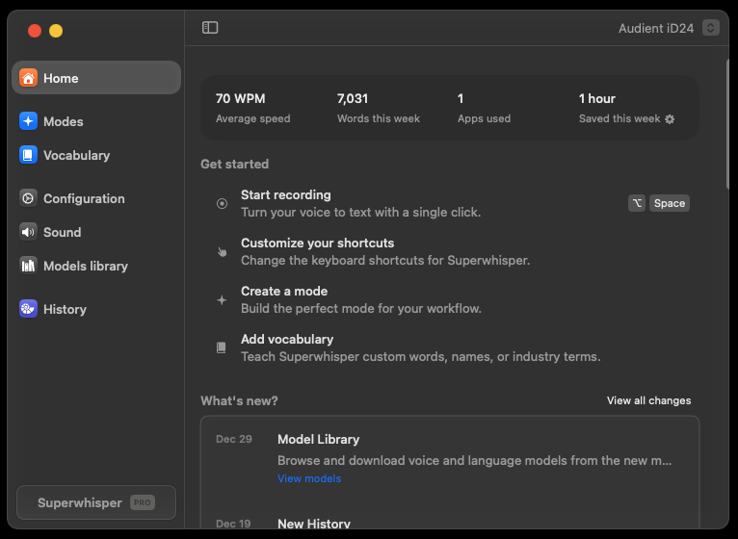

Slide 21
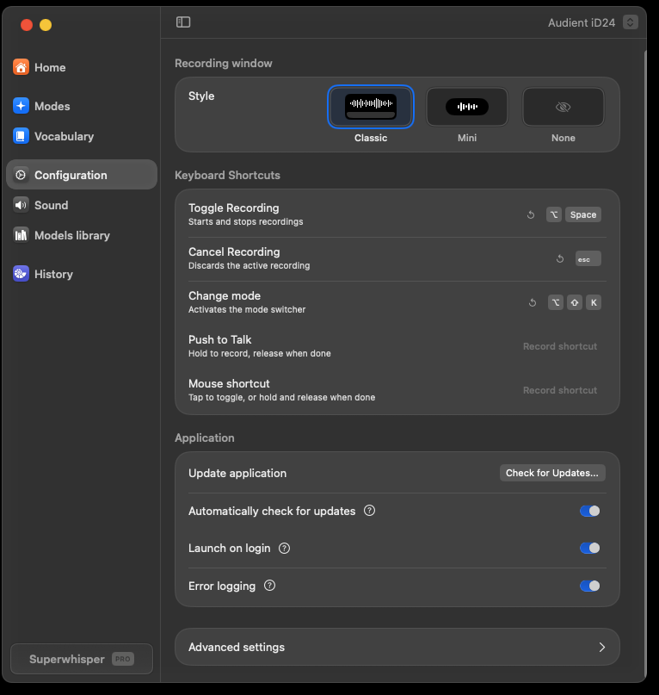

Slide 22
CUSTOM MODE PROMPTS
Writing Effective AI Instructions
PROMPT STRUCTURE
KEY ELEMENTS
BEST PRACTICES
<role>
1. ROLE STATEMENT
Define who the AI is. Sets the foundation for all processing.
DO
You are a professional email editor
✓ Be explicit and specific
✓ Include 2-3 examples
✓ Use modular sections
✓ Test with your voice
✓ Iterate and refine
</role>
<instructions>
2. CLEAR INSTRUCTIONS
Format the User Message into a
professional email with proper
greeting and signature
Explicit actions to take with the dictated text. Be specific.
3. REQUIREMENTS LIST
AVOID
</instructions>
Bullet points of constraints and style guidelines.
<requirements>
✗ Vague instructions
✗ Conflicting directives
✗ Too many requirements
✗ No examples
✗ Untested prompts
Keep tone professional
Use clear paragraphs
Include appropriate sign-off
4. EXAMPLES (2-3)
</requirements>
Show input → output pairs. Dramatically improves accuracy.
CONTEXT REFERENCES
TELL AI IT'S DICTATED
XML TAGS NOTE
"The User Message contains dictated speech. Please format..."
XML tags improve clarity with advanced models. Some local models may struggle with them - test your results.
Use "User Message" for dictated text,
"Application Context" for current app,
"Clipboard Context" for copied text
Notes:
Writing effective AI instructions. The XML structure helps organize your prompt: role defines who the AI is, instructions specify what to do, requirements list constraints. Examples dramatically improve accuracy.

Slide 23
ADVANCED FEATURES
Context Awareness & Mode Switching
THREE CONTEXT TYPES
FOUR WAYS TO SWITCH MODES
AUTO-ACTIVATION SETUP
APPLICATION CONTEXT
1. KEYBOARD SHORTCUTS
EXAMPLE RULES
Knows which app is active (VS Code, Teams, Chrome, etc.)
Assign unique shortcuts per mode
Configure in Settings → Keyboard
VS Code → "Coding Mode"
Teams → "Chat Mode"
Outlook → "Email Mode"
Chrome → "Browse Mode"
Slack → "Slack Mode"
Captured: After voice processing, before AI
SELECTED TEXT CONTEXT
2. MENU BAR / SYSTEM TRAY
Passes highlighted text to AI for reference or transformation
Click SuperWhisper icon → Select mode
Visual indicator shows current mode
Captured: Exactly when recording starts
HOW TO SET UP
CLIPBOARD CONTEXT
3. AUTO-ACTIVATION RULES
1. Edit your custom mode
2. Go to Advanced Settings
3. Add Auto-Activation Rule
4. Select app or enter URL pattern
Uses recently copied content as reference material
Auto-switch when specific apps are active
e.g., VS Code → Coding Mode
Captured: 3 sec before OR during recording
SUPER MODE NOTE
4. DEEP LINKS
POWER USER TIP
Super Mode enables ALL three by default. Custom modes let you choose which to enable.
superwhisper://mode/[name]
Integrate with Alfred, Raycast, scripts
Combine auto-activation with context awareness for fully adaptive dictation workflows.
Notes:
Context awareness lets your modes adapt. Application context detects which app is active, selected text passes highlighted content, clipboard provides reference material. Auto-activation means the right mode engages automatically.

Slide 24
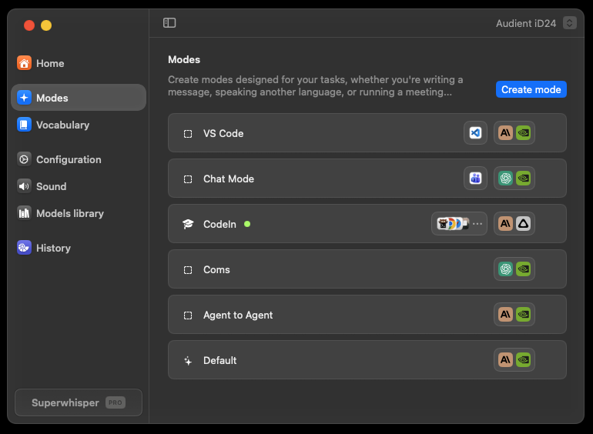

Slide 25
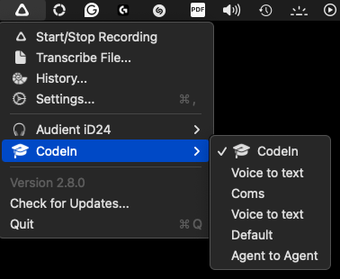

Slide 26
RECOGNITION SETTINGS
HOW TO CONFIGURE
Vocabulary & Replacements
ACCESS VOCABULARY
1. Click menu bar icon
2. Open Settings
3. Go to "Vocabulary" tab
4. Add words or replacements
VOCABULARY WORDS
Help AI recognize custom terms DURING transcription
Use for: Acronyms, names, brand names, technical terms, non-English words
REPLACEMENT BEHAVIOR
REPLACEMENTS
Case-insensitive matching
"todo" matches "ToDo", "TODO", "Todo"
Output appears exactly as you specify
Works 100% reliably (not AI-dependent)
Auto-correct text AFTER transcription (programmatic, not AI)
Use for: Persistent errors, expanding abbreviations, formatting fixes
EXAMPLE REPLACEMENTS
"todo" → "TODO"
"use state" → "`useState`"
"APH" → "Austin Public Health"
MODEL COMPATIBILITY
Vocabulary hints work with most models.
Exception: Nova and Parakeet models don't support vocabulary hints.
VOCABULARY TIP
Keep vocabulary list SHORT. Too many words can confuse the AI transcription model.
Prefer replacements over vocabulary for consistent results
Notes:
Vocabulary and replacements fine-tune recognition. Vocabulary helps the AI recognize custom terms during transcription. Replacements correct errors after transcription - programmatic and 100% reliable.

Slide 27
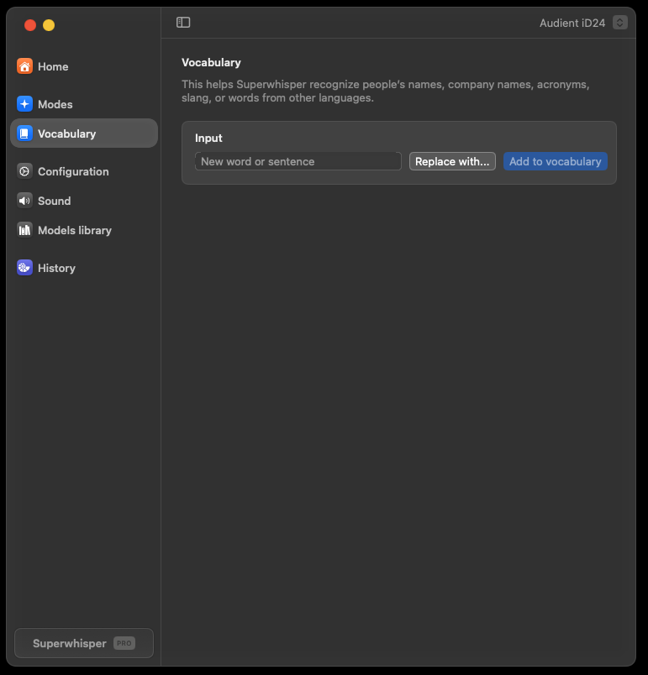
Choose if you want to add an item to vocabulary to improve recognition, or you want to use a word or phrase as a replacement trigger.

Slide 28
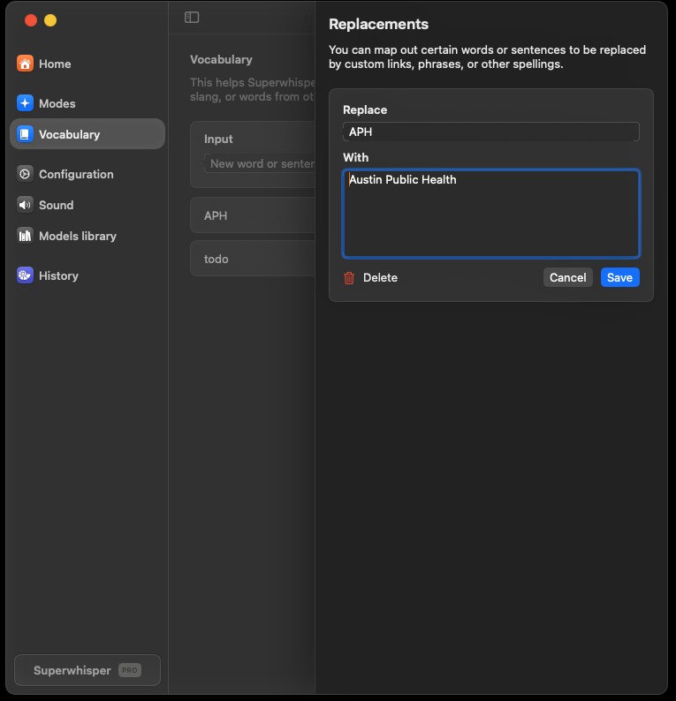
Enter content and save

Slide 29
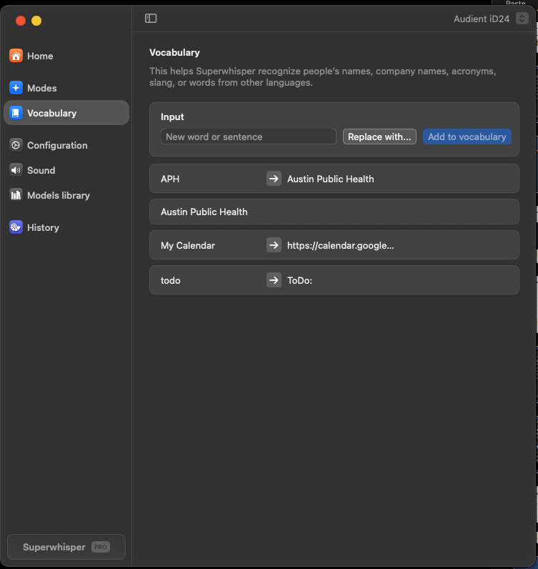
You can add words to the vocabulary, setup up replacements, even swapping words and phrases for links.
Vocabulary can also be used as a macro to insert whole content blocks or segments.

Slide 30
PART 4 • WORKSHOP
Custom Mode Workshop
Build application-specific modes for your daily workflow. We'll create modes for coding, email, chat, and more.
Agentic Coding
Teams Chat
Email Writer
Claude Code
Browser Mode
We'll provide pre-built prompts you can use immediately
Notes:
Part 4: Workshop time. We'll build five practical custom modes together. Each one is designed for a specific application context. You'll leave with ready-to-use configurations.

Slide 31
MODE 1 OF 5
SAMPLE AI INSTRUCTIONS
Prompt Enrichment
Mode
<role>
You are a prompt engineer preparing input for AI assistants
</role>
<instructions>
The User Message is raw dictated speech.
Reformat it as a clear, effective prompt
ready to paste into an AI tool.
USE CASE
</instructions>
<requirements>
Transform raw spoken thoughts into well-structured prompts for ANY AI tool: Claude, ChatGPT, Cursor, Copilot, etc.
Clarify intent and scope
Add structure (numbered steps if complex)
Preserve technical terms exactly
Remove filler words ("um", "like", etc.)
Keep the user's voice and intent
KEY INSIGHT
</requirements>
SuperWhisper is an input method,
not a code generator. It prepares
your prompts for another AI to execute.
RAW SPEECH
ENRICHED PROMPT
"okay so um I need like a function that takes a list of users and filters them by um you know active status and then sorts by last login date"
Create a function that:
1. Takes a list of users
2. Filters to only active users
3. Sorts by last login date (descending)
AUTO-ACTIVATION
ChatGPT / Claude.ai
Cursor AI input
Copilot Chat
Any AI prompt field
Flow: Speak naturally → SuperWhisper enriches → Paste to AI tool → AI executes
Notes:
Prompt Enrichment Mode - the KEY insight. SuperWhisper is an INPUT METHOD, not a code generator. This mode transforms your rambling speech into clear, structured prompts ready to paste into ANY AI tool - Claude, ChatGPT, Cursor, whatever you use.

Slide 32
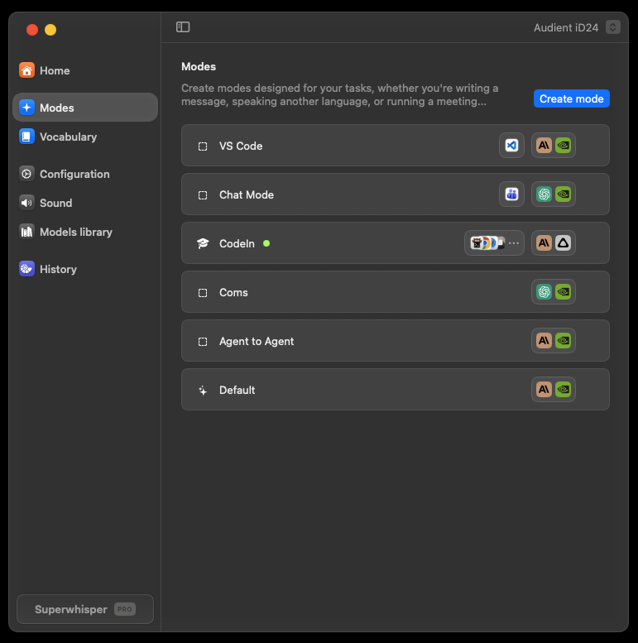
Under Modes –
click Create mode

Slide 33
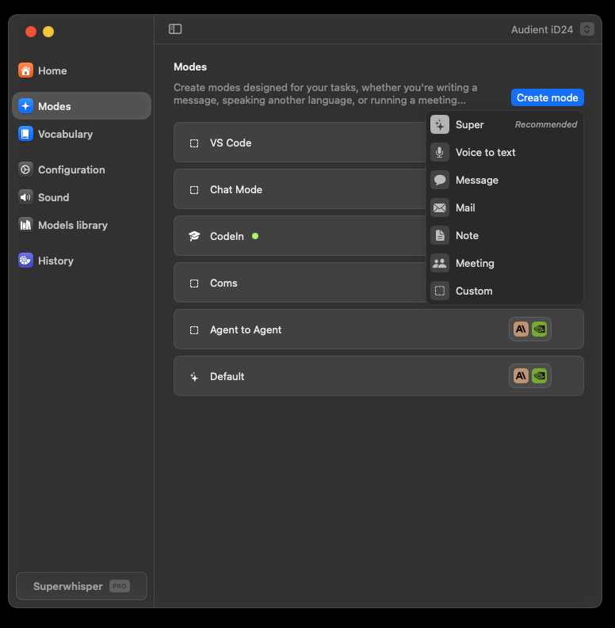
There are some great default modes, but we want to select Custom
Click custom

Slide 34
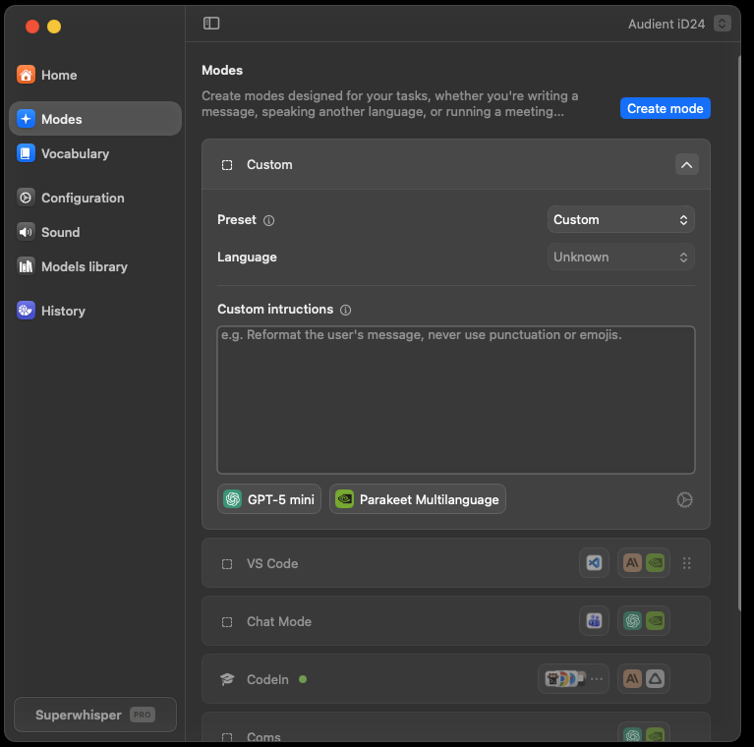
The Prompt box. This is instructions that will be passed to the LLM model.
Model Selector
Config menu
As of the Jan 2026 release clicking anywhere on the model selector or the gear icon will open the SAME menu.
1
2
3

Slide 35
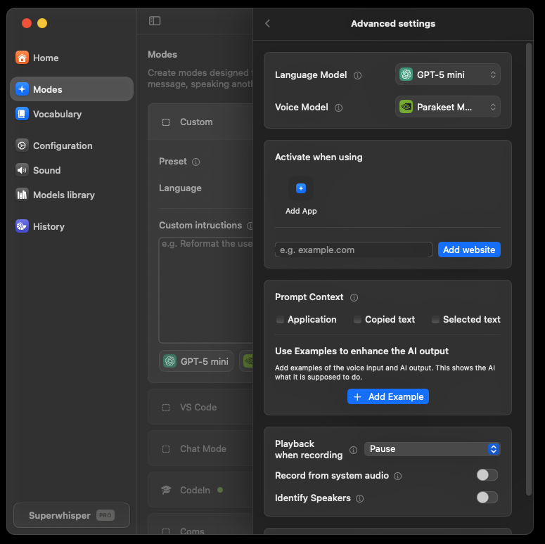
We are going to add an App Trigger
Click Add App

Slide 36
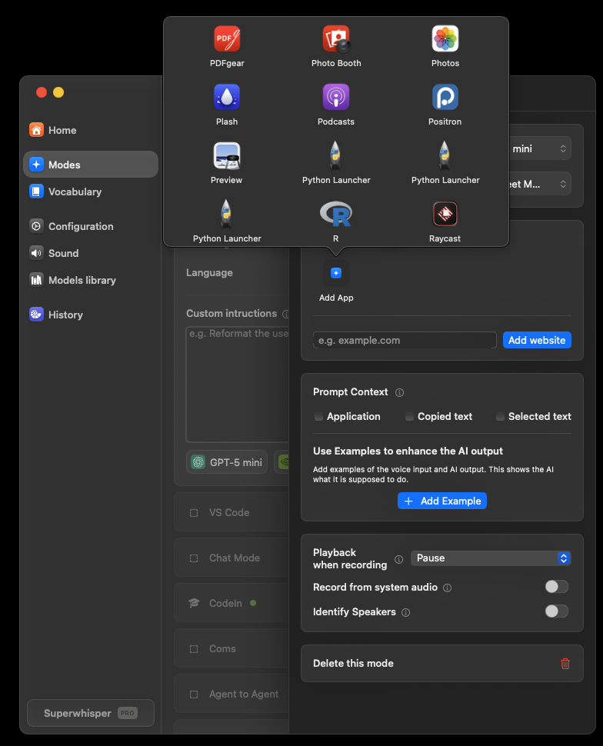
Scroll through the list
Find an app you have installed – anything will do for this , but if you have an AI app like GPT, Claude, Gemini select it.

Slide 37
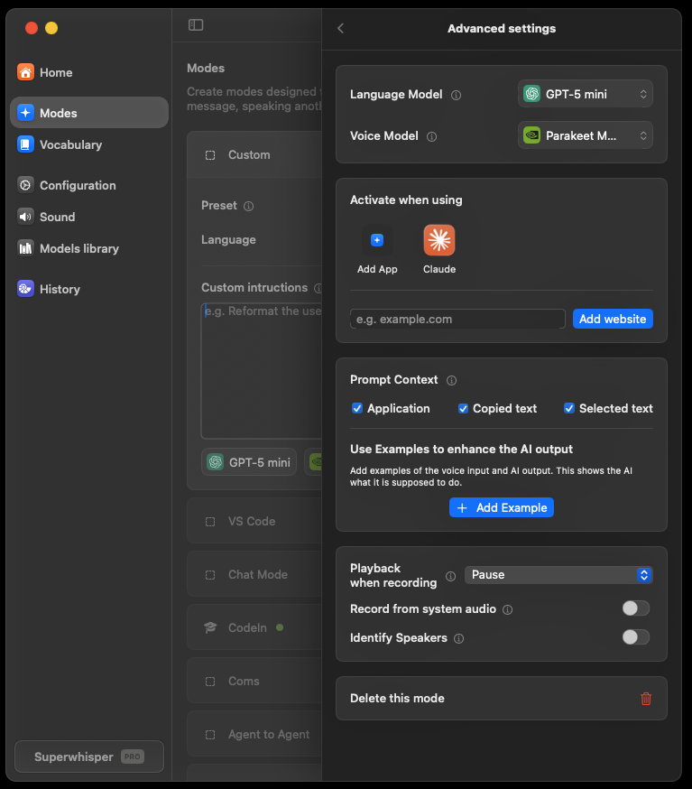
I picked Claude.
(You can choose more than 1 app for the mode)
Then include context – select the boxes.
Optional Settings:
I use pause playback in case I have YouTube or Spotify in the background.
You can also use modes like custom meeting transcribers.

Slide 38
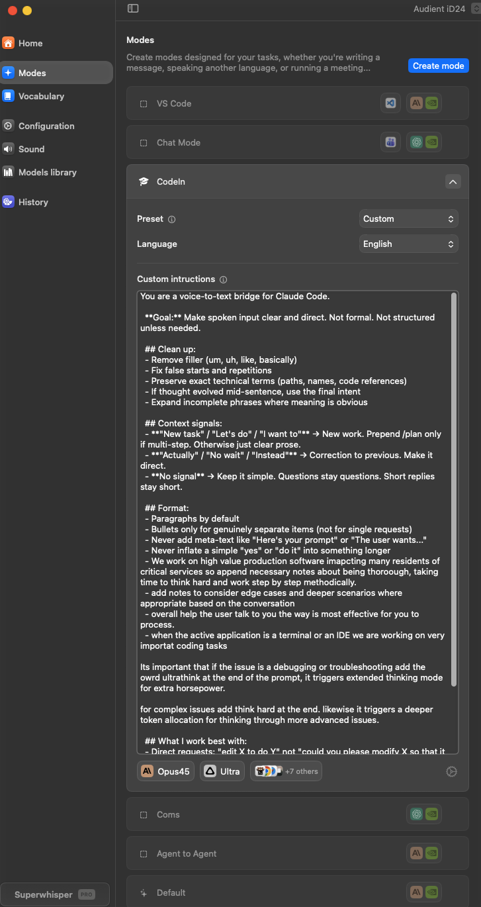
You can make your modes as complex or simple as you wish, the UI will expand.
That’s It! Your first custom mode is ready for a spin ☺

Slide 39
MODE 2 OF 5
SAMPLE AI INSTRUCTIONS
Microsoft Teams
Chat Mode
<role>
You are a workplace chat assistant
</role>
<instructions>
Format the User Message for Teams chat.
Keep it conversational but professional.
Messages should feel natural, not formal.
USE CASE
Quick, professional chat messages. Maintains conversational tone while keeping it workplace-appropriate.
</instructions>
<requirements>
Short, direct messages (no essays)
Professional but friendly tone
Handle @mentions as usernames
No formal greetings/signatures
Add appropriate punctuation only
CONTEXT SETTINGS
✓ Application Context (detect Teams)
○ Selected Text (optional)
○ Clipboard Context (optional)
</requirements>
EXAMPLE INPUT
EXAMPLE OUTPUT
AUTO-ACTIVATION
"hey can you let Sarah know that the meeting got moved to three PM and we'll need her to bring the quarterly report"
Hey @Sarah, heads up - the meeting got moved to 3 PM. Can you bring the quarterly report?
Microsoft Teams
Slack (optional)
Discord (optional)
Pro tip: Say "at Sarah" to get @Sarah. The AI learns to convert spoken mentions to proper format.
Note: Teams has no native dictation.
Notes:
Microsoft Teams Chat Mode - perfect for workplace messaging. Teams has no native dictation, so SuperWhisper fills this gap. Short, professional messages. Watch how 'at Sarah' converts to '@Sarah' mentions.

Slide 40
MODE 3 OF 5
SAMPLE AI INSTRUCTIONS
Professional
Email Mode
<role>
You are a professional email editor
</role>
<instructions>
The User Message is dictated speech.
Format into a professional email with:
- Appropriate greeting
- Clear paragraphs
- Professional closing
USE CASE
Transform rambling dictation into well-structured, professional emails. Perfect for busy schedules.
</instructions>
<requirements>
Professional but warm tone
Structure logically
Use my name for signature
If Selected Text exists, treat as
email being replied to
CONTEXT SETTINGS
✓ Application Context (detect Outlook)
✓ Selected Text (reply context)
○ Clipboard Context (optional)
</requirements>
EXAMPLE OUTPUT
EXAMPLE INPUT
Hi Dr. Martinez,
I wanted to follow up on the data request we discussed last week...
Best regards,
[Your Name]
"okay so I need to follow up with Dr Martinez about the data request we talked about last week and ask if she got the files I sent and when she thinks she can get back to me with her analysis"
AUTO-ACTIVATION
Microsoft Outlook
Gmail (browser)
Apple Mail
Uses your name from system context
Reply tip: Select the email you're replying to, then dictate. AI will format appropriately.
Notes:
Professional Email Mode - transforms rambling dictation into structured emails. Select text before dictating to treat it as the email you're replying to. Great for quick responses.

Slide 41
MODE 4 OF 5
SAMPLE AI INSTRUCTIONS
Claude Code
Terminal Mode
<role>
You format dictation for Claude Code prompts
</role>
<instructions>
The User Message is a dictated prompt for
Claude Code. Clean it up and format as a
clear instruction. Keep technical terms
exactly as spoken.
USE CASE
Detailed prompts and instructions for Claude Code. Dictate complex requests instead of typing them.
</instructions>
<requirements>
Preserve technical accuracy
Structure into clear steps if needed
No greeting or pleasantries
Ready to paste directly to Claude
If Clipboard has an error, reference it
CONTEXT SETTINGS
</requirements>
✓ Application Context (detect terminal)
○ Selected Text (optional)
✓ Clipboard (error messages)
EXAMPLE INPUT
EXAMPLE OUTPUT
"okay I need you to look at the auth middleware in the source API folder and add rate limiting so that it blocks more than one hundred requests per minute per IP address and also log any blocked attempts"
In src/api/authMiddleware, add rate limiting:
- Max 100 requests/min per IP
- Log all blocked attempts
- Include timestamp and IP in logs
AUTO-ACTIVATION
Terminal.app / iTerm2
Windows Terminal
Warp
Workflow: Copy error → Dictate "fix this error" → Paste to Claude Code
Benefit: Voice is perfect for detailed prompts.
Notes:
Claude Code Terminal Mode - optimized for giving detailed prompts to Claude. Voice is perfect for complex instructions. Copy an error to clipboard, dictate 'fix this error', paste to Claude.

Slide 42
ADVANCED PATTERN
SAMPLE AI INSTRUCTIONS
Agentic Handoff
Mode
<role>
You prepare task specifications for AI coding agents
</role>
<instructions>
Convert the User Message into a structured task.
Include: objective, scope, constraints, success criteria.
</instructions>
USE CASE
<requirements>
Prepare structured task handoffs for autonomous AI coding agents like Claude Code, Aider, or Cursor Agent.
Clear, actionable objective
Reference files from Selected Text if provided
Include Clipboard context if relevant
Specify what NOT to change if mentioned
</requirements>
THE PATTERN
Raw speech describing a task
↓
Structured task specification
↓
AI agent executes autonomously
RAW SPEECH
STRUCTURED HANDOFF
"okay so there's a bug in the user dashboard where the charts aren't loading and I think it's something to do with the API call timing and we need to fix it but don't touch the CSS because design just approved that"
Objective: Fix chart loading bug in user dashboard
Likely cause: API call timing issue
Scope: JS/API logic only
Constraint: Do NOT modify CSS
Success: Charts load correctly
CONTEXT SETTINGS
WHY THIS MATTERS
WORKFLOW
✓ Application Context
✓ Selected Text (file/code context)
✓ Clipboard (errors, references)
AI agents work better with structured tasks than rambling instructions.
Select relevant code → Dictate task → Paste to Claude Code → Agent executes
Notes:
Agentic Handoff Mode - the advanced pattern. This takes prompt enrichment further, specifically for AI coding agents. Instead of just cleaning up your speech, it structures your task with objective, scope, constraints, and success criteria. AI agents perform significantly better with structured specifications.

Slide 43
Try it yourself
Context Switching in Action
WHAT TO WATCH FOR
Tasks to try:
MODE INDICATOR
Watch the menu bar - mode name changes automatically when switching apps.
1
Open VS Code → Coding Mode activates
Dictate: "Create a function to validate email"
OUTPUT FORMAT
Same spoken input produces different formatted output based on context.
2
Switch to Teams → Chat Mode activates
Dictate: "Hey team the feature is ready for review"
PROCESSING SPEED
Local models: instant processing. No network delay.
3
Open Outlook → Email Mode activates
Dictate: "Follow up on our meeting about the project"
NATURAL SPEECH
No special commands needed - just speak naturally.
4
Open Terminal → Claude Code Mode activates
Dictate: "Add error handling to the auth module"
QUESTIONS?
Stop me anytime during the demo if you want to see something specific.
Notes:
Context switching demo - the magic of auto-activation. Watch the menu bar indicator as I switch from VS Code to Teams to Outlook to Terminal. Same hotkey, same natural speech, output adapts.

Slide 44
SECTION 9
Next Steps
Preparing for Part 2
5 minutes
Notes:
Section: Wrapping up and preparing for Part 2.

Slide 45
1
Install your voice tool
SuperWhisper (Mac) or WhisperFlow (Windows/Linux)
HOMEWORK
2
Install Claude Code
Pre-Work
for Part 2
npm install -g @anthropic-ai/claude-code
3
Set up authentication
Run claude and complete OAuth or API key setup
4
Have a project ready
Complete these before our next session for the best hands-on experience.
Any codebase you want to experiment with
5
Practice voice input
Try dictating emails or notes to get comfortable
Notes:
Pre-work for Part 2: Install SuperWhisper, set up your custom modes based on what we learned today, identify a project to work on, bring questions.

Slide 46
PREVIEW
Coming in Part 2: Hands-On Practice
01
02
03
Real Exercises
Your Projects
Tips & Troubleshooting
Voice-driven refactoring
Test generation
Documentation updates
Bug fixing workflows
Work on your own code
Real-world scenarios
Team-specific patterns
Custom workflows
Common pitfalls
Optimization tricks
Voice command patterns
Debug techniques
Part 2 is all hands-on - bring your laptop and a project you want to improve
Notes:
Part 2 preview: Real hands-on exercises with your own projects. We'll troubleshoot issues together and share tips. You'll leave with working tools integrated into your workflow.

Slide 47
1/3
AUSTIN PUBLIC HEALTH
COMPLETE
Thank You
Part 1 Complete
Today
Setup & Tool Overview
Next
Questions? Reach out anytime.
Hands-On Practice
See you in Part 2: Hands-On Practice
Final
Build a Transcriber
Notes:
Thank you! Part 1 of 3 complete. Workshop materials and exercises are available for independent practice. Questions? See you in Part 2!

