Slide 1

AUSTIN PUBLIC HEALTH
Voice-Driven AI Development
90
Workflows
MINUTES
Part 1 of 3: Setup, Introduction & Tool Overview
AI Technology Training Series
Notes:
Welcome to Part 1 of our Voice-Driven AI Development Workflows series. Today we're covering setup, introduction, and tool overview. This 90-minute session will give you the foundation to start using voice-driven development.

Slide 2
YOUR LEARNING JOURNEY
Three Sessions to Transform Your Workflow
TODAY
01
02
03
Setup & Tool Overview
Build a Web App
Complete Build Method
Put it all together
End-to-end project
Meeting transcription app
Voice-driven development
Agent-to Agent
Long Horizon Tasks
Voice input tools
AI coding assistants
Enterprise configuration
Security fundamentals
Setup Voice Tooling
Real exercises
Troubleshooting tips
Productivity shortcuts
Github / CICD / Planning / Spec Dev
Instant deployment
90 minutes
90 minutes
90 minutes
Notes:
Here's our roadmap for the full series. Today is Part 1 focusing on understanding the tools. Part 2 will be hands-on practice with your own projects. Part 3 culminates in building a real meeting transcriber application together.

Slide 3
150
"
words per minute speaking
The keyboard is a bottleneck between your thoughts and your code.
40
Voice removes that bottleneck.
words per minute typing
Voice-Driven AI Toolkit Research
Work at the speed of thought
Notes:
The key insight here is that we think faster than we type. Voice-driven development closes that gap. Keyboards are a bottleneck. Voice input lets you work at the speed of thought.

Slide 4
WHY IT MATTERS
Key Benefits
01
02
03
04
Ergonomic
Productivity
Multitasking
Accessibility
RSI prevention
Reduced physical strain
Accessibility support
Faster iteration cycles
Speak ideas as you think
Reduce context switching
Code while reviewing docs
Hands-free operation
Think out loud naturally
Mobility accommodations
Inclusive workflows
Alternative input paths
Notes:
Four key benefits: Ergonomic benefits for anyone typing all day. Productivity gains from faster iteration. Multitasking when your hands are free. Accessibility opens development to more people.

Slide 5
10 min
Why Voice-Driven Development
10 min
Voice Tools Landscape
PART 1 OF 3
Today's
Agenda
10 min
Security & PHI Considerations
15 min
SuperWhisper Setup & Configuration
20 min
Custom Mode Workshop
10 min
Live Demonstration
90 minutes to understand, choose, and configure your voice tools
15 min
Next Steps & Q&A
Workshop materials & exercises available for independent practice
Notes:
Here's our agenda for today. Note the time allocations - we'll focus on voice tools and SuperWhisper configuration. Workshop materials are available for independent practice.

Slide 6

SECTION 02
Voice Input Tools
The Acoustic Layer
8
6
3
SuperWhisper
Wispr Flow
Comparison
20 minutes
Notes:
Section 2: Now we're getting into the tools. The acoustic layer captures your voice and turns it into text.

Slide 7
PLATFORM SUPPORT
PRIMARY RECOMMENDATION
W
Windows 10/11
SuperWhisper
Launched Dec 2025
AI-powered voice to text with local processing option
M
macOS 13+
Apple Silicon optimal
What It Is
Desktop app using OpenAI's Whisper models. Offers both local (on-device) and cloud processing options. 100+ languages supported.
iOS / iPadOS
i
Same license covers mobile
Free
$8.49/mo
$249
Basic models included
Pro subscription
Lifetime option
Local Processing Available: Use on-device models for complete privacy. Voice data never leaves your machine when using local models.
Local models = Safe for PHI and sensitive data
Notes:
SuperWhisper is our primary recommendation. Works on Mac, Windows, and iOS. Key: it offers BOTH local AND cloud processing. Free tier includes local models - completely privacy-safe for PHI.

Slide 8
DATA FLOW ARCHITECTURE
Why Local Processing Matters
LOCAL PROCESSING (SuperWhisper)
Your Voice
->
SuperWhisper
->
Text Output
->
Your App
NO CLOUD
(On Your Device)
CLOUD PROCESSING (Traditional)
Your Voice
->
Cloud Server
->
Text Output
->
Your App
DATA LEAVES
(3rd Party)
Government Benefits
Security Benefits
Key Insight
No BAA required for voice data
No data egress concerns
Simplified compliance posture
IT-friendly deployment
Voice never leaves device
Works offline / air-gapped
No vendor data retention
Full audit control
Voice data is biometric and sensitive. Local processing means you maintain complete control over where your data goes.
Notes:
This diagram shows why local processing matters. With SuperWhisper's local models, the entire flow stays on your machine. For PHI and sensitive data, use local models only.

Slide 9
PLATFORM SUPPORT
CROSS-PLATFORM OPTION
NOW ON WINDOWS
Wispr Flow
M
macOS
Native app available
Context-aware voice input for Mac, Windows, and iOS
W
Windows 10/11
What It Is
Full feature support
An intelligent voice-to-text tool that understands context. It knows if you're coding, writing email, or chatting - and formats output accordingly.
i
iOS / Web
Mobile + browser access
Free Tier
$15/mo Pro
Cloud Only
2,000 words/week
Unlimited dictation
Requires internet
KEY DIFFERENTIATOR
Context awareness - Wispr Flow detects your current app and adjusts formatting. Code in VS Code, prose in Word.
Note: All processing is cloud-based. Privacy Mode = zero data retention (see next slides)
Notes:
Wispr Flow is the cross-platform alternative. Works on Mac, Windows, and iOS. Free tier with 2000 words per week. Context awareness auto-detects which app you're using. IMPORTANT: Wispr Flow is CLOUD-ONLY.

Slide 10
!
WHAT PRIVACY MODE ACTUALLY DOES
Zero Data Retention
IMPORTANT LIMITATION
With Privacy Mode ON:
Wispr Flow is Cloud-Only
Audio/transcripts NOT stored on servers
Data NOT used for model training
Processed then immediately deleted
Unlike SuperWhisper, Wispr Flow does NOT offer local/on-device processing. All audio is sent to cloud servers.
With Privacy Mode OFF (default):
Audio/transcripts may be stored
Data may be used for AI training
History accessible in your account
FOR GOVERNMENT/PHI USE:
Wispr Flow's Privacy Mode provides zero retention but audio still goes to cloud. For true local processing where audio never leaves your device, use SuperWhisper with local models instead.
What This Means:
Audio always leaves your device
Requires internet connection
Not suitable for air-gapped environments
Wispr Compliance: SOC 2 Type II, HIPAA-ready, ISO 27001 certified
Notes:
CRITICAL limitation for government users. Unlike SuperWhisper, Wispr Flow does NOT offer local processing. Privacy Mode means zero data retention - but audio IS still sent to cloud servers. For true local processing, use SuperWhisper.

Slide 11
HEAD-TO-HEAD COMPARISON
SuperWhisper vs Wispr Flow
Feature
SuperWhisper
Wispr Flow
Platforms
Mac, Windows, iOS
Mac, Windows, iOS, Web
Processing
Local OR Cloud (you choose)
Cloud Only (no local option)
Privacy Mode
Audio stays on device (local)
Zero retention (still cloud)
Cost
Free / $8.49/mo / $249 lifetime
Free (2K words/wk) / $15/mo Pro
Context Awareness
Super Mode (adapts to app)
Advanced (auto-detects app)
Works Offline?
Yes (with local models)
No (requires internet)
Best For
PHI/govt, offline, privacy-first
Power users, context-switching
CHOOSE SUPERWHISPER IF:
CHOOSE WISPR FLOW IF:
You handle PHI or sensitive data, need true local processing, want offline capability, or prefer lifetime pricing.
You want best-in-class context formatting, always have internet, and can accept cloud processing with zero retention.
Notes:
Side-by-side comparison. KEY DIFFERENCE: SuperWhisper offers true local processing - audio never leaves your device. Wispr Flow is cloud-only - even with Privacy Mode, audio goes to servers. SuperWhisper for PHI.

Slide 12
DECISION GUIDE
Which Voice Tool Should I Use?
START: Do you handle PHI or sensitive government data?
YES - Need Local Processing
NO - Cloud OK
What's your platform?
What features do you need?
Mac
Windows
Linux
Basic
Context
Free
SuperWhisper
Wispr Flow
SuperWhisper
Wispr Flow
Mac/Windows
Privacy Mode ON
Simple + Local
Smart Features
Linux only: Use Wispr Flow with Privacy Mode
Budget: Native OS dictation works for casual use
QUICK PICK: Government/PHI = SuperWhisper | Power User = Wispr Flow (Privacy Mode) | Linux = Wispr Flow
Notes:
Decision flowchart. If you handle PHI or sensitive data, SuperWhisper with local models is the clear choice. Wispr Flow is excellent for non-sensitive work where you want context-aware formatting.

Slide 13
FREE LOCAL MODELS
Audio never leaves your device. PHI-safe out of the box with the free tier.
WORKSHOP DECISION
CROSS-PLATFORM
Why SuperWhisper
for This Workshop
Works on Mac, Windows, and iOS. Same experience across your devices.
CUSTOM MODES
3 free custom modes let us build application-specific workflows together.
AUTO-ACTIVATION
We're moving forward with SuperWhisper because it offers the privacy controls required for government health work.
Modes switch automatically based on your active application.
Wispr Flow is excellent for non-sensitive work, but it's cloud-only. For PHI compliance, we need local processing. (BAA option is available)
Notes:
This is why we're using SuperWhisper for this workshop: free local models that are PHI-safe out of the box, cross-platform support, and custom modes we can build together.

Slide 14

SECTION 8
Security & Compliance
Understanding Data Flows and PHI Handling
10 minutes
Notes:
Section: Security and compliance - critical for government work.

Slide 15
DATA SECURITY
Data Flow Awareness
Understanding where your data goes
LOCAL (SAFE)
CLOUD (VERIFY)
PUBLIC (CAUTION)
Your Device Only
Enterprise Approved
Not for PHI
SuperWhisper local models
Ollama local models
Local file operations
macOS dictation (on-device)
Azure OpenAI (with BAA)
Azure AI Foundry
GCC/GCC-High endpoints
GitHub Enterprise
Wispr Flow (cloud-based)*
OpenAI/Anthropic direct
ChatGPT/Claude.ai free
Default OS dictation
TYPICAL VOICE WORKFLOW DATA FLOW
Voice Input
->
Local Whisper
->
AI Processing*
->
Local Code
*Wispr Flow Privacy Mode = zero retention, but audio still sent to cloud servers
Always know where your data flows before including sensitive information
Notes:
Data flow awareness diagram. Green is local and safe. Blue is your Azure tenant - verify BAA status. Red/Yellow is public cloud - Wispr Flow is cloud-based even with Privacy Mode.

Slide 16
SAFE FOR PHI
SuperWhisper with local models (FREE tier works!)
Ollama with local models
Azure OpenAI with BAA in place*
Air-gapped systems
!
NOT SAFE FOR PHI (without approval)
Wispr Flow (cloud-based, even with Privacy Mode)
Direct OpenAI/Anthropic API calls
Consumer AI tools (ChatGPT, Claude.ai free)
Default OS cloud dictation
PHI Handling Guide
Protected Health Information requires special handling. Know your boundaries.
PHI INCLUDES
Names, dates, addresses, SSN, medical record numbers, health conditions, test results, provider information, any data that could identify a patient
*Always verify BAA status with your compliance team before use
Notes:
PHI guidance: SAFE tools include SuperWhisper with local models (free tier works!) and Azure with BAA. CAUTION with Wispr Flow - Privacy Mode means zero retention but audio still goes to cloud.

Slide 17
CHECKLIST
Before Using AI Tools
RESOURCES
INITIAL SETUP
BEFORE EACH USE
Questions?
Verified tool is IT-approved
Does prompt contain PHI?
Contact IT Security
Understand data flow (local vs cloud)
Is the endpoint appropriate?
PHI Incident?
Report immediately to Privacy Officer
API keys stored securely (env vars)
Any credentials in code?
New Tool Request?
Local transcription enabled
Review AI output before committing
Submit through IT approval process
Know escalation path for issues
Test generated code thoroughly
Security is everyone's responsibility
Notes:
Security checklist. Before starting: verify tool configuration, check privacy mode, confirm endpoint routing. Before each use: consider data sensitivity, choose appropriate tool.

Slide 18

PART 3 • HANDS-ON SECTION
SuperWhisper Deep Dive
Configure SuperWhisper for your specific workflow. We'll walk through setup, custom modes, and optimization together.
Initial Setup
Custom Modes
Context Awareness
Notes:
Part 3: Now we're getting into the hands-on portion. This is where we'll actually configure SuperWhisper for your specific workflows.

Slide 19
HANDS-ON
Initial Setup Walkthrough
HOTKEY OPTIONS
First Launch - Grant Permissions
Hold-to-Record: Speak while holding
Toggle Mode: Press once to start/stop
Push-to-Talk: Classic PTT style
1
Microphone access + Accessibility (for paste)
2
Select Your Default Model
Start with "Fast" for quick testing (local, free)
PRO TIP
Hold-to-Record gives you precise control. Release to instantly process and paste. Most natural for short commands.
3
Configure Recording Hotkey
Default: Option+Space (Mac) or Alt+Space (Win)
FIRST MODEL DOWNLOAD
Test Your First Dictation
Local models download on first use (~100-500MB). Wait for download to complete before testing.
4
Open any text field, hold hotkey, speak, release
Verify Local Processing
STATUS INDICATOR
5
Gray = Idle state
Red = Recording
Gold = Processing
Check Settings → confirm "Local" model selected
Notes:
Initial setup walkthrough. Five steps from installation to your first successful dictation. Key: select a local model first for privacy, then test to confirm it works.

Slide 20
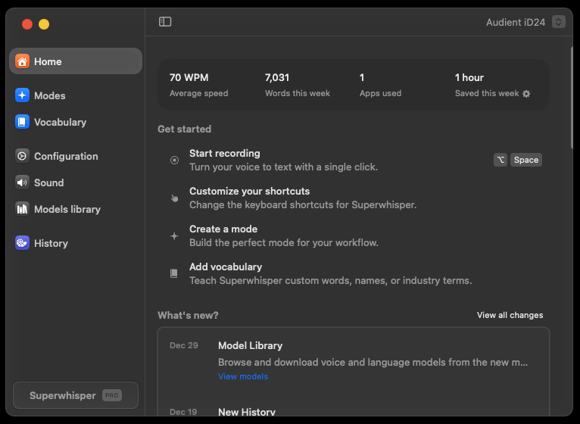

Slide 21
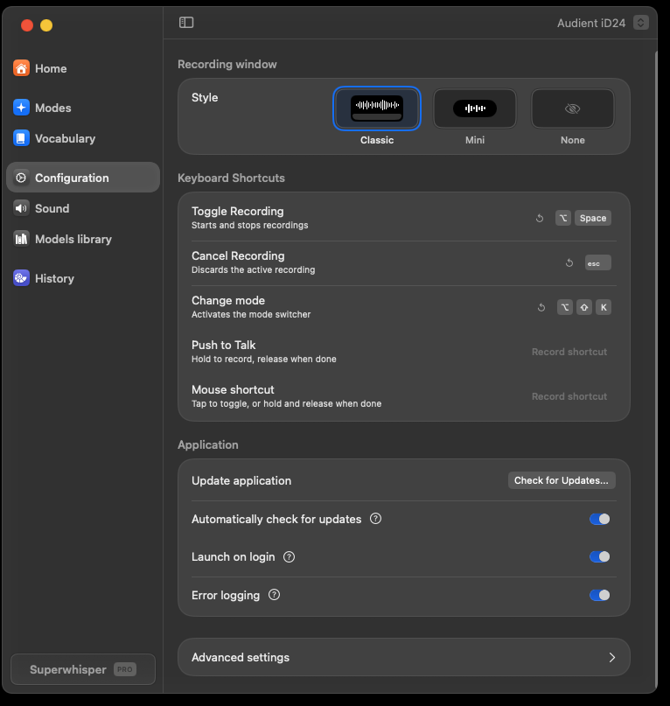

Slide 22
CUSTOM MODE PROMPTS
Writing Effective AI Instructions
PROMPT STRUCTURE
KEY ELEMENTS
BEST PRACTICES
<role>
1. ROLE STATEMENT
Define who the AI is. Sets the foundation for all processing.
DO
You are a professional email editor
✓ Be explicit and specific
✓ Include 2-3 examples
✓ Use modular sections
✓ Test with your voice
✓ Iterate and refine
</role>
<instructions>
2. CLEAR INSTRUCTIONS
Format the User Message into a
professional email with proper
greeting and signature
Explicit actions to take with the dictated text. Be specific.
3. REQUIREMENTS LIST
AVOID
</instructions>
Bullet points of constraints and style guidelines.
<requirements>
✗ Vague instructions
✗ Conflicting directives
✗ Too many requirements
✗ No examples
✗ Untested prompts
Keep tone professional
Use clear paragraphs
Include appropriate sign-off
4. EXAMPLES (2-3)
</requirements>
Show input → output pairs. Dramatically improves accuracy.
CONTEXT REFERENCES
TELL AI IT'S DICTATED
XML TAGS NOTE
"The User Message contains dictated speech. Please format..."
XML tags improve clarity with advanced models. Some local models may struggle with them - test your results.
Use "User Message" for dictated text,
"Application Context" for current app,
"Clipboard Context" for copied text
Notes:
Writing effective AI instructions. The XML structure helps organize your prompt: role defines who the AI is, instructions specify what to do, requirements list constraints. Examples dramatically improve accuracy.

Slide 23
ADVANCED FEATURES
Context Awareness & Mode Switching
THREE CONTEXT TYPES
FOUR WAYS TO SWITCH MODES
AUTO-ACTIVATION SETUP
APPLICATION CONTEXT
1. KEYBOARD SHORTCUTS
EXAMPLE RULES
Knows which app is active (VS Code, Teams, Chrome, etc.)
Assign unique shortcuts per mode
Configure in Settings → Keyboard
VS Code → "Coding Mode"
Teams → "Chat Mode"
Outlook → "Email Mode"
Chrome → "Browse Mode"
Slack → "Slack Mode"
Captured: After voice processing, before AI
SELECTED TEXT CONTEXT
2. MENU BAR / SYSTEM TRAY
Passes highlighted text to AI for reference or transformation
Click SuperWhisper icon → Select mode
Visual indicator shows current mode
Captured: Exactly when recording starts
HOW TO SET UP
CLIPBOARD CONTEXT
3. AUTO-ACTIVATION RULES
1. Edit your custom mode
2. Go to Advanced Settings
3. Add Auto-Activation Rule
4. Select app or enter URL pattern
Uses recently copied content as reference material
Auto-switch when specific apps are active
e.g., VS Code → Coding Mode
Captured: 3 sec before OR during recording
SUPER MODE NOTE
4. DEEP LINKS
POWER USER TIP
Super Mode enables ALL three by default. Custom modes let you choose which to enable.
superwhisper://mode/[name]
Integrate with Alfred, Raycast, scripts
Combine auto-activation with context awareness for fully adaptive dictation workflows.
Notes:
Context awareness lets your modes adapt. Application context detects which app is active, selected text passes highlighted content, clipboard provides reference material. Auto-activation means the right mode engages automatically.

Slide 24
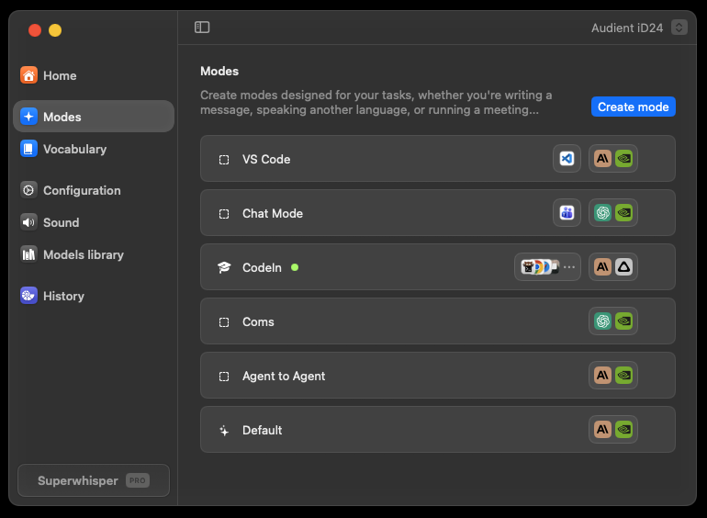

Slide 25
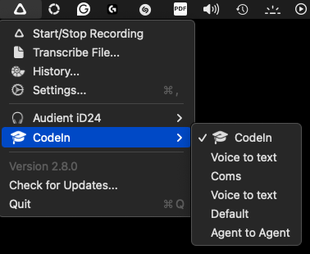

Slide 26
RECOGNITION SETTINGS
HOW TO CONFIGURE
Vocabulary & Replacements
ACCESS VOCABULARY
1. Click menu bar icon
2. Open Settings
3. Go to "Vocabulary" tab
4. Add words or replacements
VOCABULARY WORDS
Help AI recognize custom terms DURING transcription
Use for: Acronyms, names, brand names, technical terms, non-English words
REPLACEMENT BEHAVIOR
REPLACEMENTS
Case-insensitive matching
"todo" matches "ToDo", "TODO", "Todo"
Output appears exactly as you specify
Works 100% reliably (not AI-dependent)
Auto-correct text AFTER transcription (programmatic, not AI)
Use for: Persistent errors, expanding abbreviations, formatting fixes
EXAMPLE REPLACEMENTS
"todo" → "TODO"
"use state" → "`useState`"
"APH" → "Austin Public Health"
MODEL COMPATIBILITY
Vocabulary hints work with most models.
Exception: Nova and Parakeet models don't support vocabulary hints.
VOCABULARY TIP
Keep vocabulary list SHORT. Too many words can confuse the AI transcription model.
Prefer replacements over vocabulary for consistent results
Notes:
Vocabulary and replacements fine-tune recognition. Vocabulary helps the AI recognize custom terms during transcription. Replacements correct errors after transcription - programmatic and 100% reliable.

Slide 27
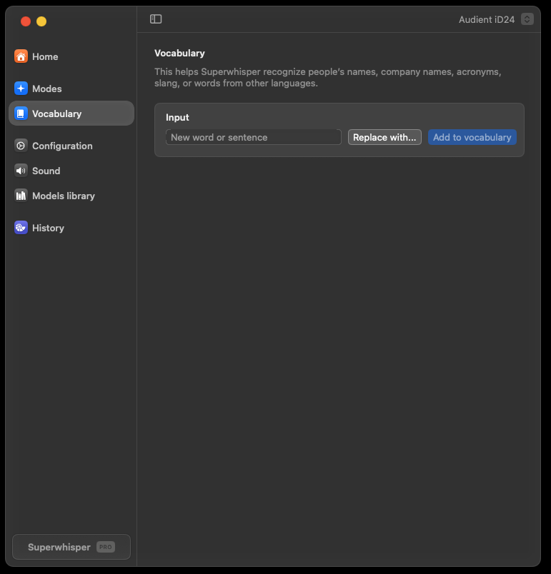
Choose if you want to add an item to vocabulary to improve recognition, or you want to use a word or phrase as a replacement trigger.

Slide 28
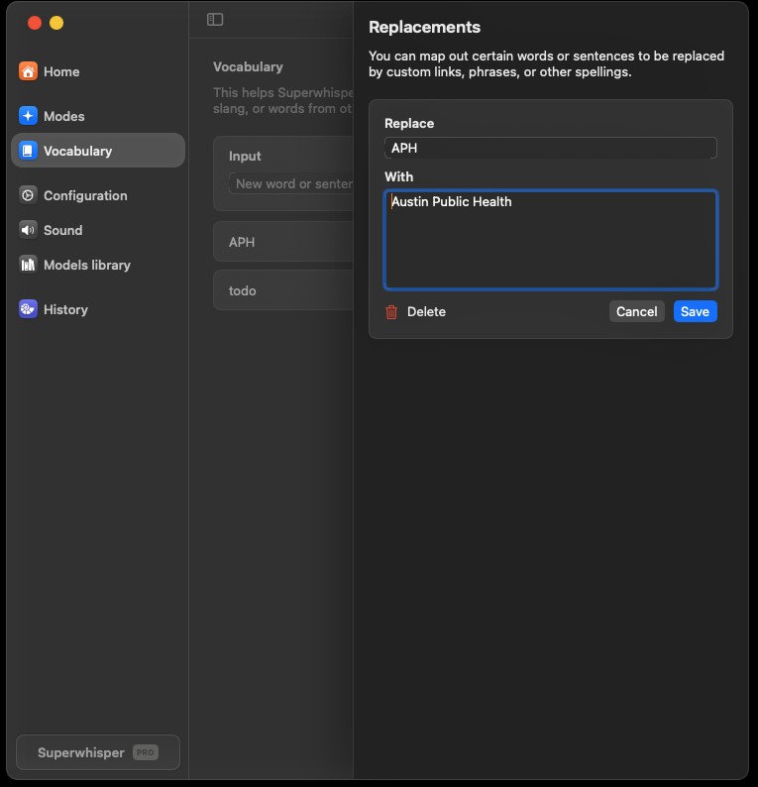
Enter content and save

Slide 29
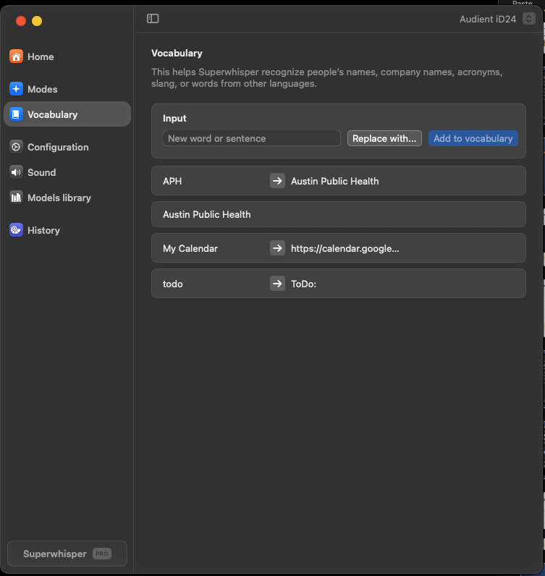
You can add words to the vocabulary, setup up replacements, even swapping words and phrases for links.
Vocabulary can also be used as a macro to insert whole content blocks or segments.

Slide 30
PART 4 • WORKSHOP
Custom Mode Workshop
Build application-specific modes for your daily workflow. We'll create modes for coding, email, chat, and more.
Agentic Coding
Teams Chat
Email Writer
Claude Code
Browser Mode
We'll provide pre-built prompts you can use immediately
Notes:
Part 4: Workshop time. We'll build five practical custom modes together. Each one is designed for a specific application context. You'll leave with ready-to-use configurations.

Slide 31
MODE 1 OF 5
SAMPLE AI INSTRUCTIONS
Prompt Enrichment
Mode
<role>
You are a prompt engineer preparing input for AI assistants
</role>
<instructions>
The User Message is raw dictated speech.
Reformat it as a clear, effective prompt
ready to paste into an AI tool.
USE CASE
</instructions>
<requirements>
Transform raw spoken thoughts into well-structured prompts for ANY AI tool: Claude, ChatGPT, Cursor, Copilot, etc.
Clarify intent and scope
Add structure (numbered steps if complex)
Preserve technical terms exactly
Remove filler words ("um", "like", etc.)
Keep the user's voice and intent
KEY INSIGHT
</requirements>
SuperWhisper is an input method,
not a code generator. It prepares
your prompts for another AI to execute.
RAW SPEECH
ENRICHED PROMPT
"okay so um I need like a function that takes a list of users and filters them by um you know active status and then sorts by last login date"
Create a function that:
1. Takes a list of users
2. Filters to only active users
3. Sorts by last login date (descending)
AUTO-ACTIVATION
ChatGPT / Claude.ai
Cursor AI input
Copilot Chat
Any AI prompt field
Flow: Speak naturally → SuperWhisper enriches → Paste to AI tool → AI executes
Notes:
Prompt Enrichment Mode - the KEY insight. SuperWhisper is an INPUT METHOD, not a code generator. This mode transforms your rambling speech into clear, structured prompts ready to paste into ANY AI tool - Claude, ChatGPT, Cursor, whatever you use.

Slide 32
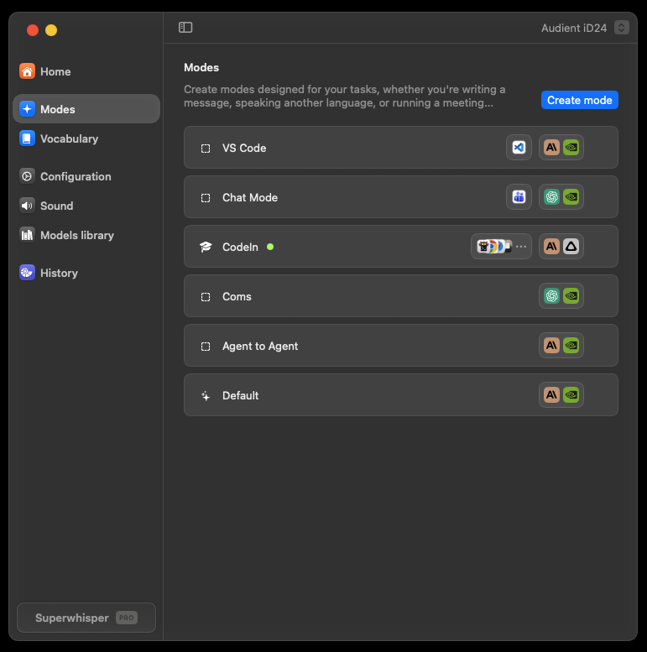
Under Modes –
click Create mode

Slide 33
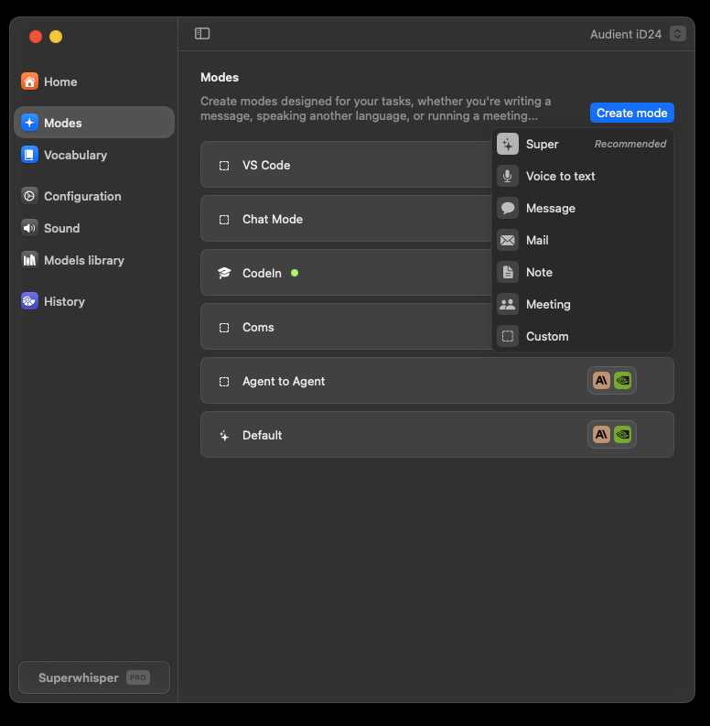
There are some great default modes, but we want to select Custom
Click custom

Slide 34
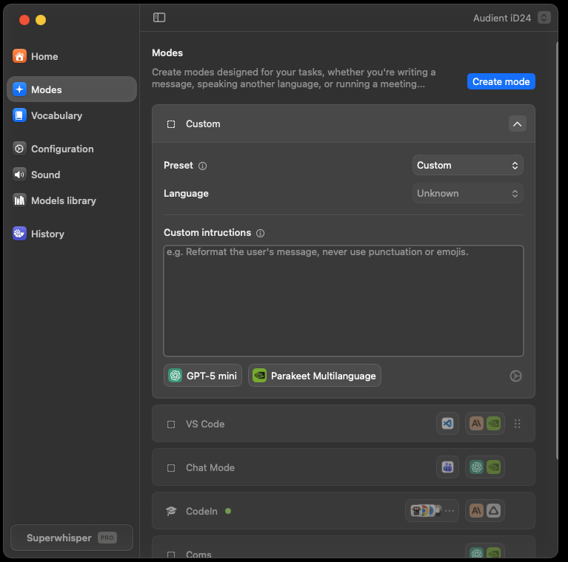
The Prompt box. This is instructions that will be passed to the LLM model.
Model Selector
Config menu
As of the Jan 2026 release clicking anywhere on the model selector or the gear icon will open the SAME menu.
1
2
3

Slide 35
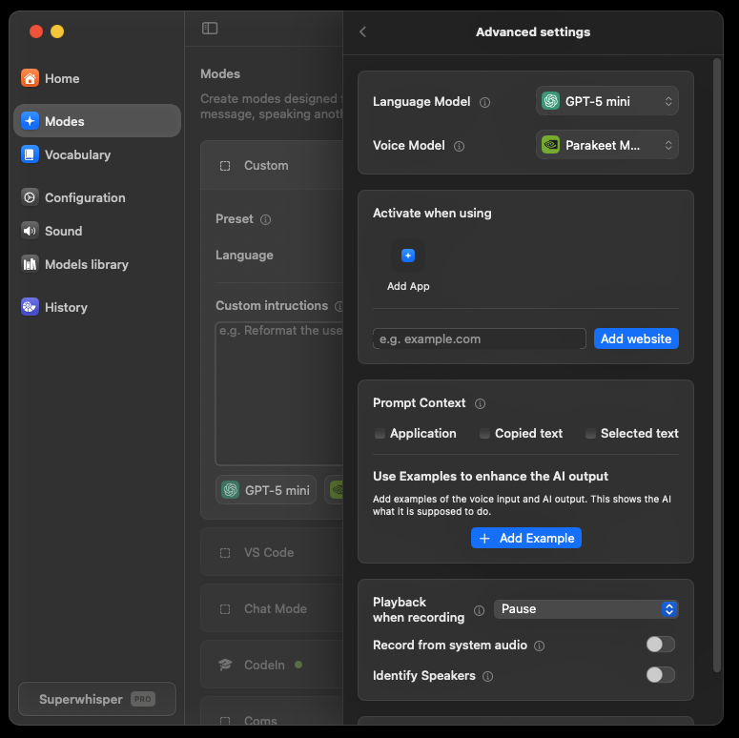
We are going to add an App Trigger
Click Add App

Slide 36
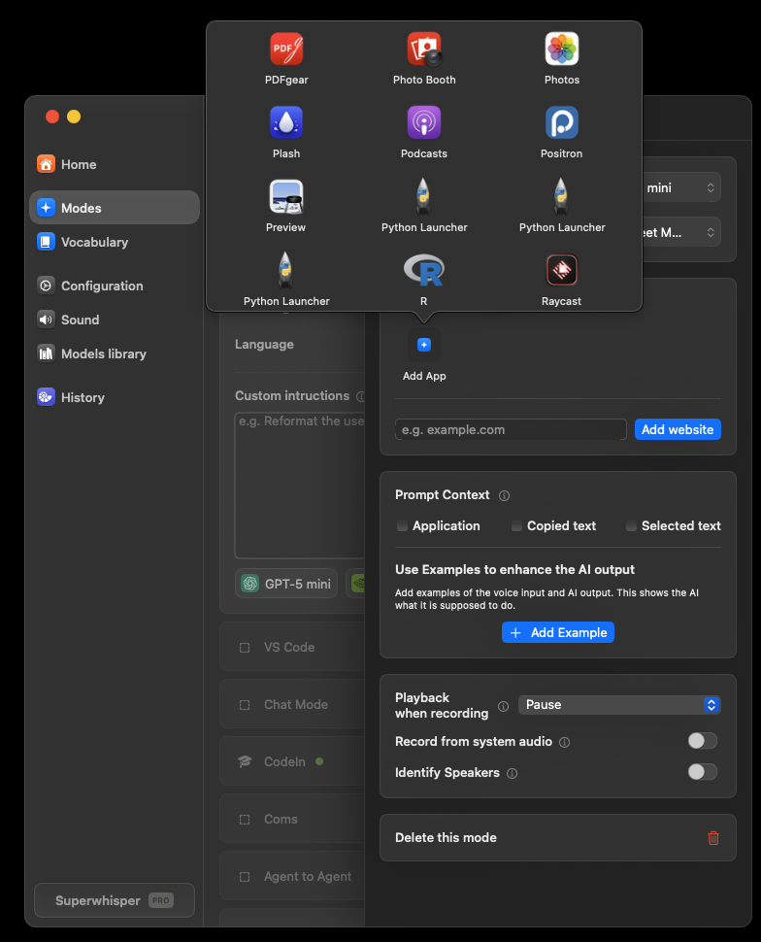
Scroll through the list
Find an app you have installed – anything will do for this , but if you have an AI app like GPT, Claude, Gemini select it.

Slide 37
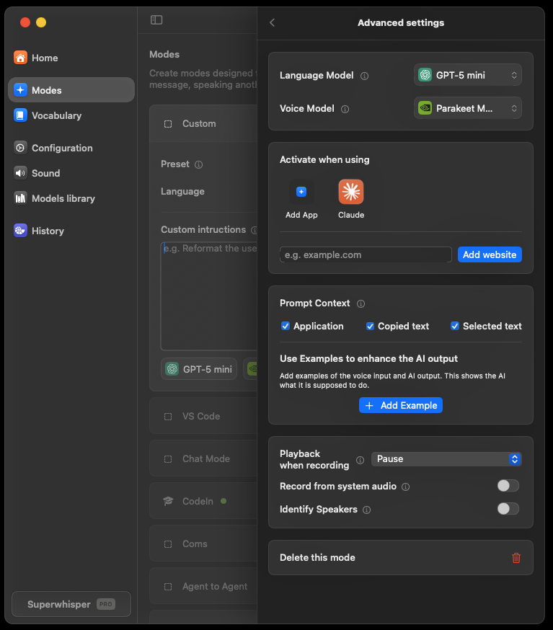
I picked Claude.
(You can choose more than 1 app for the mode)
Then include context – select the boxes.
Optional Settings:
I use pause playback in case I have YouTube or Spotify in the background.
You can also use modes like custom meeting transcribers.

Slide 38
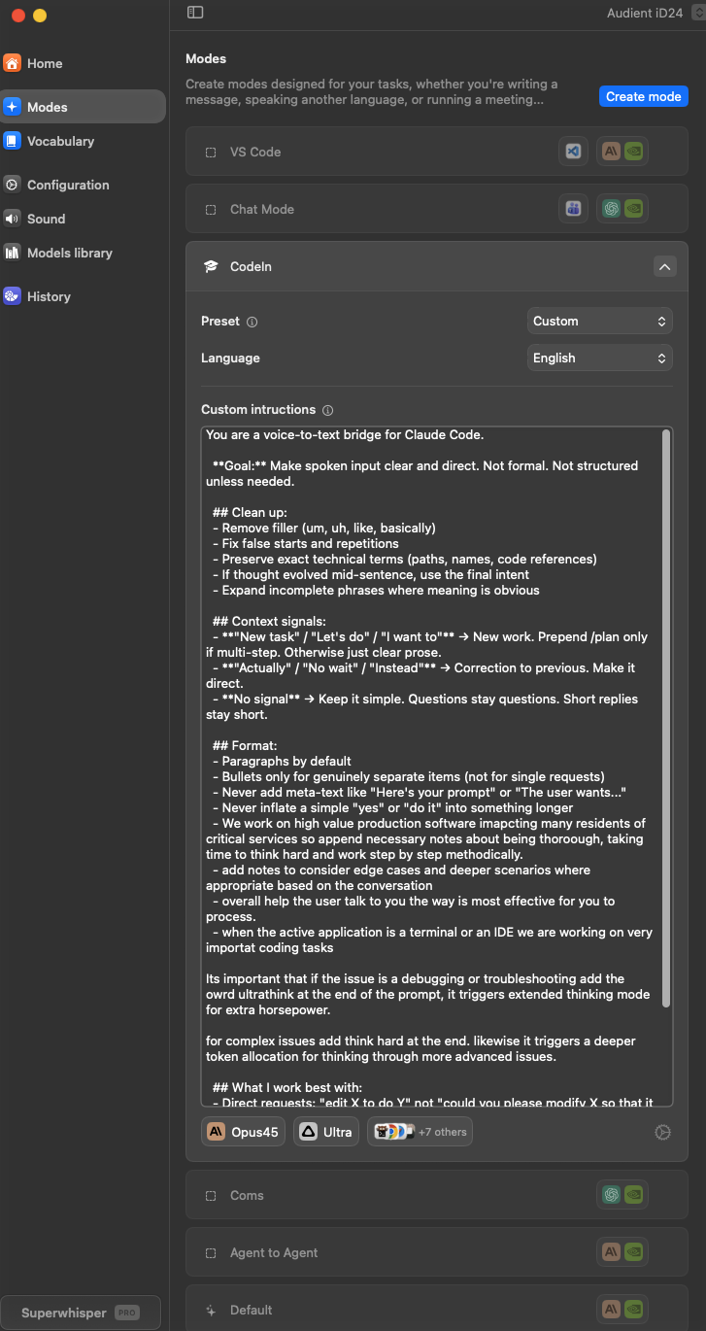
You can make your modes as complex or simple as you wish, the UI will expand.
That’s It! Your first custom mode is ready for a spin ☺

Slide 39
MODE 2 OF 5
SAMPLE AI INSTRUCTIONS
Microsoft Teams
Chat Mode
<role>
You are a workplace chat assistant
</role>
<instructions>
Format the User Message for Teams chat.
Keep it conversational but professional.
Messages should feel natural, not formal.
USE CASE
Quick, professional chat messages. Maintains conversational tone while keeping it workplace-appropriate.
</instructions>
<requirements>
Short, direct messages (no essays)
Professional but friendly tone
Handle @mentions as usernames
No formal greetings/signatures
Add appropriate punctuation only
CONTEXT SETTINGS
✓ Application Context (detect Teams)
○ Selected Text (optional)
○ Clipboard Context (optional)
</requirements>
EXAMPLE INPUT
EXAMPLE OUTPUT
AUTO-ACTIVATION
"hey can you let Sarah know that the meeting got moved to three PM and we'll need her to bring the quarterly report"
Hey @Sarah, heads up - the meeting got moved to 3 PM. Can you bring the quarterly report?
Microsoft Teams
Slack (optional)
Discord (optional)
Pro tip: Say "at Sarah" to get @Sarah. The AI learns to convert spoken mentions to proper format.
Note: Teams has no native dictation.
Notes:
Microsoft Teams Chat Mode - perfect for workplace messaging. Teams has no native dictation, so SuperWhisper fills this gap. Short, professional messages. Watch how 'at Sarah' converts to '@Sarah' mentions.

Slide 40
MODE 3 OF 5
SAMPLE AI INSTRUCTIONS
Professional
Email Mode
<role>
You are a professional email editor
</role>
<instructions>
The User Message is dictated speech.
Format into a professional email with:
- Appropriate greeting
- Clear paragraphs
- Professional closing
USE CASE
Transform rambling dictation into well-structured, professional emails. Perfect for busy schedules.
</instructions>
<requirements>
Professional but warm tone
Structure logically
Use my name for signature
If Selected Text exists, treat as
email being replied to
CONTEXT SETTINGS
✓ Application Context (detect Outlook)
✓ Selected Text (reply context)
○ Clipboard Context (optional)
</requirements>
EXAMPLE OUTPUT
EXAMPLE INPUT
Hi Dr. Martinez,
I wanted to follow up on the data request we discussed last week...
Best regards,
[Your Name]
"okay so I need to follow up with Dr Martinez about the data request we talked about last week and ask if she got the files I sent and when she thinks she can get back to me with her analysis"
AUTO-ACTIVATION
Microsoft Outlook
Gmail (browser)
Apple Mail
Uses your name from system context
Reply tip: Select the email you're replying to, then dictate. AI will format appropriately.
Notes:
Professional Email Mode - transforms rambling dictation into structured emails. Select text before dictating to treat it as the email you're replying to. Great for quick responses.

Slide 41
MODE 4 OF 5
SAMPLE AI INSTRUCTIONS
Claude Code
Terminal Mode
<role>
You format dictation for Claude Code prompts
</role>
<instructions>
The User Message is a dictated prompt for
Claude Code. Clean it up and format as a
clear instruction. Keep technical terms
exactly as spoken.
USE CASE
Detailed prompts and instructions for Claude Code. Dictate complex requests instead of typing them.
</instructions>
<requirements>
Preserve technical accuracy
Structure into clear steps if needed
No greeting or pleasantries
Ready to paste directly to Claude
If Clipboard has an error, reference it
CONTEXT SETTINGS
</requirements>
✓ Application Context (detect terminal)
○ Selected Text (optional)
✓ Clipboard (error messages)
EXAMPLE INPUT
EXAMPLE OUTPUT
"okay I need you to look at the auth middleware in the source API folder and add rate limiting so that it blocks more than one hundred requests per minute per IP address and also log any blocked attempts"
In src/api/authMiddleware, add rate limiting:
- Max 100 requests/min per IP
- Log all blocked attempts
- Include timestamp and IP in logs
AUTO-ACTIVATION
Terminal.app / iTerm2
Windows Terminal
Warp
Workflow: Copy error → Dictate "fix this error" → Paste to Claude Code
Benefit: Voice is perfect for detailed prompts.
Notes:
Claude Code Terminal Mode - optimized for giving detailed prompts to Claude. Voice is perfect for complex instructions. Copy an error to clipboard, dictate 'fix this error', paste to Claude.

Slide 42
ADVANCED PATTERN
SAMPLE AI INSTRUCTIONS
Agentic Handoff
Mode
<role>
You prepare task specifications for AI coding agents
</role>
<instructions>
Convert the User Message into a structured task.
Include: objective, scope, constraints, success criteria.
</instructions>
USE CASE
<requirements>
Prepare structured task handoffs for autonomous AI coding agents like Claude Code, Aider, or Cursor Agent.
Clear, actionable objective
Reference files from Selected Text if provided
Include Clipboard context if relevant
Specify what NOT to change if mentioned
</requirements>
THE PATTERN
Raw speech describing a task
↓
Structured task specification
↓
AI agent executes autonomously
RAW SPEECH
STRUCTURED HANDOFF
"okay so there's a bug in the user dashboard where the charts aren't loading and I think it's something to do with the API call timing and we need to fix it but don't touch the CSS because design just approved that"
Objective: Fix chart loading bug in user dashboard
Likely cause: API call timing issue
Scope: JS/API logic only
Constraint: Do NOT modify CSS
Success: Charts load correctly
CONTEXT SETTINGS
WHY THIS MATTERS
WORKFLOW
✓ Application Context
✓ Selected Text (file/code context)
✓ Clipboard (errors, references)
AI agents work better with structured tasks than rambling instructions.
Select relevant code → Dictate task → Paste to Claude Code → Agent executes
Notes:
Agentic Handoff Mode - the advanced pattern. This takes prompt enrichment further, specifically for AI coding agents. Instead of just cleaning up your speech, it structures your task with objective, scope, constraints, and success criteria. AI agents perform significantly better with structured specifications.

Slide 43
Try it yourself
Context Switching in Action
WHAT TO WATCH FOR
Tasks to try:
MODE INDICATOR
Watch the menu bar - mode name changes automatically when switching apps.
1
Open VS Code → Coding Mode activates
Dictate: "Create a function to validate email"
OUTPUT FORMAT
Same spoken input produces different formatted output based on context.
2
Switch to Teams → Chat Mode activates
Dictate: "Hey team the feature is ready for review"
PROCESSING SPEED
Local models: instant processing. No network delay.
3
Open Outlook → Email Mode activates
Dictate: "Follow up on our meeting about the project"
NATURAL SPEECH
No special commands needed - just speak naturally.
4
Open Terminal → Claude Code Mode activates
Dictate: "Add error handling to the auth module"
QUESTIONS?
Stop me anytime during the demo if you want to see something specific.
Notes:
Context switching demo - the magic of auto-activation. Watch the menu bar indicator as I switch from VS Code to Teams to Outlook to Terminal. Same hotkey, same natural speech, output adapts.

Slide 44
TOOL SETUP GUIDE
Claude Code
WHAT YOU'LL LEARN
Installation & model selection
Setup, Configuration &
Core Features
Slash commands & planning mode
Sub-agents for parallel work
Skills, MCP servers & hooks
Plugins & distribution
Part of the Voice-Driven AI Development series
Anthropic's agentic coding tool for terminal and IDE integration
Notes:
Welcome to the Claude Code setup guide. This is part of our Tool Setup series — we'll follow the same pattern for Cursor, VS Code, and other AI coding tools. Today we're covering installation, core features, and how to customize Claude Code for your workflow.

Slide 45
GETTING STARTED
Installation
& Setup
INSTALLATION STEPS
MACOS / LINUX
# Install via npm (Node.js 18+ required)
npm install -g @anthropic-ai/claude-code
# Or use the official installer
curl -fsSL https://claude.ai/install.sh | sh
PREREQUISITES
macOS, Linux, or Windows
Anthropic API key or
Claude Pro/Max subscription
FIRST RUN
SUPPORTED PLATFORMS
1. Run claude in terminal
2. Authenticate via browser
3. Select your model
4. Navigate to project folder
5. Start coding with voice!
Terminal (standalone CLI)
VS Code extension
JetBrains IDEs
Any terminal emulator
VERIFY INSTALL
GET HELP
UPDATE
claude --version
claude --help
npm update -g
5-minute setup process
Notes:
Installation is straightforward. You can use npm or the official installer script. After installation, run 'claude' in your terminal to authenticate. The first time, you'll be asked to log in via browser and select your default model. Five minutes and you're ready to go.

Slide 46
CONFIGURATION
AVAILABLE MODELS
Model
Selection
Claude Opus 4
BEST FOR
Most capable • Complex reasoning • Highest quality
Architecture, debugging
THE CHOICE
Claude Sonnet 4 DEFAULT
BEST FOR
Different models for different tasks. Choose based on complexity, speed, and cost.
Balanced • Fast • Cost-effective
Daily coding tasks
Claude Haiku 3.5
BEST FOR
HOW TO CHANGE
Fastest • Lowest cost • Quick tasks
Simple edits, exploration
/model
or press Shift+M
ENTERPRISE OPTIONS
Amazon Bedrock and Google Vertex AI instances available for organizations with existing cloud relationships.
TIP: SUB-AGENT MODEL OVERRIDE
Sub-agents can use different models — use Haiku for exploration, Opus for planning
Sonnet is the default — best balance
Notes:
Model selection is your first real decision. Sonnet is the default and handles most tasks well. Use Opus when you need deep reasoning — architecture decisions, complex debugging. Haiku is great for quick exploration tasks. Key insight: sub-agents can use different models, so you can use Haiku for exploration while keeping Sonnet for your main coding work.

Slide 47
CORE FEATURE
Slash
Commands
BUILT-IN COMMANDS
/plan — Enter planning mode
/model — Switch models
/compact — Summarize context
/clear — Reset conversation
/help — Show all commands
/config — Open settings
/review — Code review mode
/cost — Show token usage
WHAT THEY ARE
Manual commands you invoke by typing /command in the prompt.
CUSTOM COMMANDS
CREATE YOUR OWN
HOW TO ACCESS
# Add markdown files to:
.claude/commands/my-command.md
# Then invoke with:
/project:my-command
Type / to see all available commands
Tab to autocomplete
Arrow keys to navigate
TEAM SHARING
USE CASE
Commit .claude/commands/ to git — everyone gets the same commands
Standard prompts for PRs, commits, code review templates
Foundation for customization
Notes:
Slash commands are manual commands you invoke by typing /command. Built-in commands include /plan for planning mode, /model to switch models, /compact to summarize context. The real power: create custom commands by adding markdown files to .claude/commands/. Commit these to git and your whole team gets the same commands.

Slide 48
KEY WORKFLOW
WHY PLANNING MODE MATTERS
Planning
Mode
Read
Think
Iterate
Explore codebase
without changes
Design approach
before committing
Refine plan with
feedback
THE CONCEPT
Think before you code. Plan mode lets you design your approach before making changes.
EXAMPLE WORKFLOW
# Enter planning mode
/plan
"I need to add user authentication.
Review the codebase and propose an approach."
# Claude explores, then presents plan
# You approve or refine
# Exit plan mode to implement
HOW TO ENTER
/plan command
Shift+Tab twice
Start prompt with "plan"
CONTEXT BENEFIT
BEST PRACTICE
Uses sub-agents for exploration — keeps main context clean
For PRs, always plan first — iterate on approach before writing code
Always plan before PRs
Notes:
Planning mode is THE key workflow pattern. Before making any code changes, especially for PRs, enter planning mode with /plan or Shift+Tab twice. Claude will explore the codebase using sub-agents, keeping your main context clean. Think through your approach, iterate on the plan, then exit to implement. This prevents wasted effort and keeps context optimized.

Slide 49
PARALLEL WORK
Sub-Agents
BUILT-IN SUB-AGENTS
Explore
Plan
Bash
Fast codebase scanning. Uses Haiku for speed. Returns findings to main thread.
Architecture planning. Reads full context. Designs implementation approach.
Command execution. Runs shell commands. Reports results back.
WHAT THEY ARE
Specialized agents that work in parallel, each with their own context window.
CUSTOM SUB-AGENTS
WHY USE THEM
CREATE IN .claude/agents/
Keep main context clean
Parallel task execution
Specialized capabilities
Different models per task
.claude/agents/my-agent.md
# Define: name, description, model,
# available tools, and instructions
MODEL STRATEGY
CONTEXT TIP
Haiku for exploration, Sonnet for coding, Opus for architecture
Offload exploration to sub-agents — save main context for actual changes
Context management is key
Notes:
Sub-agents are specialized agents that work in parallel. Built-in ones include Explore for fast codebase scanning, Plan for architecture, and Bash for command execution. Each sub-agent has its own context window, so exploration doesn't bloat your main thread. You can create custom sub-agents in .claude/agents/ with specific models, tools, and instructions.

Slide 50
AUTO-DISCOVERY
Skills
SKILLS VS SLASH COMMANDS
SLASH COMMANDS
SKILLS
Manual invocation
You type /command
Explicit workflow triggers
Best for: specific actions
Automatic activation
Context-based matching
Always-on capabilities
Best for: domain expertise
THE KEY DIFFERENCE
Unlike slash commands, skills activate automatically when task context matches.
SKILL FILE STRUCTURE
HOW THEY WORK
.claude/skills/react-patterns.md
# Description (for matching)
"Use for React component development"
# Instructions (loaded when matched)
"Follow these patterns..."
1. You give a task
2. Claude reviews skill descriptions
3. Matching skills auto-load
4. Instructions apply automatically
USE CASE
TEAM BENEFIT
Domain-specific patterns, coding standards, framework guidelines
Commit to git — entire team gets consistent AI behavior
No manual invocation needed
Notes:
Skills are the automatic counterpart to slash commands. Instead of invoking them manually, skills activate automatically when your task context matches their description. Store them in .claude/skills/ as markdown files. Claude reads the description, and if it matches what you're doing, the skill's instructions are automatically applied. Great for domain-specific patterns and coding standards.

Slide 51
INTEGRATIONS
MCP
Servers
CONFIGURATION SCOPES
LOCAL
PROJECT
GLOBAL
~/.claude.json
.claude/
User config
Private to you, current project only
Shared via git with team
Available across all projects
MODEL CONTEXT PROTOCOL
Open standard for AI-tool integrations. Connect Claude to databases, APIs, and services.
EXAMPLE: ADD GITHUB MCP
# In your claude config:
{
"mcpServers": {
"github": {
"command": "npx",
"args": ["@anthropic/mcp-github"]
}
}
}
WHAT MCP ENABLES
Database queries
API integrations
File system access
External services
POPULAR SERVERS
SECURITY NOTE
GitHub, PostgreSQL, Slack, Notion, Google Drive, Linear
MCP servers can access external data — review permissions carefully
Hundreds of pre-built servers
Notes:
MCP — Model Context Protocol — is an open standard for AI-tool integrations. It lets Claude Code connect to databases, APIs, and external services. Configure MCP servers at three levels: local (private to you), project (shared via git), or global (all projects). Popular servers include GitHub, PostgreSQL, Slack, and Notion. Plugins can also include MCP servers that start automatically.

Slide 52
ADVANCED
Hooks
HOOK TYPES
PreToolUse
PostToolUse
Before tool execution. Can block calls, validate permissions.
After tool execution. Log results, inject metrics.
WHAT THEY ARE
Deterministic code that runs at specific points in Claude's execution pipeline.
PermissionRequest
AgentCompletion
When permission dialog shown. Auto-approve or deny.
When agent finishes. Clean up resources, validate outputs.
WHY USE HOOKS
Transparency & auditability
Security enforcement
Cost tracking
Policy compliance
USE CASES
SECURITY
COMPLIANCE
Block sensitive file access, enforce allowed directories
Audit logging, cost tracking, usage reports
KEY INSIGHT
Hooks transform Claude from black-box executor → transparent, auditable infrastructure
Enterprise-grade control
Notes:
Hooks are for advanced users — deterministic code that runs at specific points in Claude's execution. PreToolUse runs before any tool call — you can block sensitive operations. PostToolUse runs after — useful for logging. PermissionRequest intercepts permission dialogs. AgentCompletion runs when an agent finishes. Hooks transform Claude from a black box into transparent, auditable infrastructure.

Slide 53
DISTRIBUTION
Plugins
HOW PLUGINS WORK
Install
Enable
Active
THE BIG PICTURE
/plugin install
Auto or manual
MCP servers start
Plugins bundle everything together: commands, agents, MCP servers, hooks. One install.
EXAMPLE: INSTALL A PLUGIN
# Browse available plugins
/plugin list
# Install specific plugin
/plugin install @anthropic/github-plugin
# Plugin's MCP servers start automatically
WHAT PLUGINS BUNDLE
Slash commands
Sub-agents
MCP servers
Hooks
ADVANTAGE
CREATE YOUR OWN
One command vs. manual config of commands + agents + MCP + hooks
Package your team's setup as a plugin for instant onboarding
Share complete setups instantly
Notes:
Plugins bundle everything together: slash commands, sub-agents, MCP servers, and hooks. One install command sets up an entire integrated environment. When you enable a plugin, its MCP servers start automatically. This is perfect for team onboarding — package your team's entire setup as a plugin and new developers can install it instantly.

Slide 54
SUMMARY
Key
Takeaways
ESSENTIAL PRACTICES
1
2
Plan Before Code
Manage Context
Use /plan for PRs. Think first, implement second.
Use sub-agents for exploration. Keep main thread for changes.
THE BIG IDEA
Claude Code is more than a coding assistant — it's customizable AI infrastructure.
3
4
Customize Your Setup
Match Model to Task
CORE FEATURES
Add skills for domain patterns. Share via .claude/ folder.
Haiku for speed, Sonnet for balance, Opus for complexity.
Models (Opus/Sonnet/Haiku)
Slash Commands
Planning Mode
Sub-Agents
VOICE + CLAUDE CODE
SuperWhisper voice input → structured prompts → Claude Code execution
The complete voice-driven development stack.
Skills (auto-discovery)
MCP Servers
Hooks (enterprise)
Plugins (distribution)
Notes:
Key takeaways: Plan before you code — always use /plan for PRs. Manage your context — sub-agents keep the main thread clean. Customize with skills for domain expertise. Match models to tasks. And remember: Claude Code + SuperWhisper voice input creates the complete voice-driven development stack we're building toward in this series.

Slide 55
Structuring Projects for Voice-First AI Development
10
A 10-Phase Workflow
PHASES
From idea to deployment using voice-driven AI agents
Session 2 Deep Dive
Notes:
Welcome to this guide on structuring projects for voice-first AI development. This 10-phase workflow takes you from initial idea all the way to deployment, with your voice driving the entire process.

Slide 56
OVERVIEW
The 10-Phase Voice-First Workflow
1
2
3
4
5
GitHub Repo
Brainstorm
Deep Research
Planning
MVP Prototype
Foundation
Ideation
Discovery
Strategy
Experiment
6
7
8
9
10
Documentation
PRD Creation
Agentic Mode
Review Cycle
Deployment
Standards
Specification
Execution
Refinement
Ship It
PHASES 1-5
PHASES 6-7
PHASES 8-10
Discovery and experimentation. High human involvement, lots of voice interaction with the agent.
Formalization. Lock in standards so the agent can work autonomously later.
Execution mode. Agent does heavy lifting. You review and ship.
Key Insight: The first 7 phases are investment. They enable phases 8-10 where the agent becomes highly autonomous.
Notes:
Here's the overview of all 10 phases. Notice how they flow from foundation through development to deployment. Each phase builds on the previous one. The key insight: structure enables autonomy. The more you invest upfront, the more your AI agent can do independently.

Slide 57
PHASE 1 OF 10
VOICE COMMANDS TO START
Create a
GitHub Repo
"Create a new repo for this project"
gh repo create project-name --public --clone
"Initialize with a basic structure"
Creates README, .gitignore, src/, docs/
THE PRINCIPLE
Everything lives in Git. Always. This is non-negotiable for voice-first development.
COMMIT FREQUENCY
BRANCH STRATEGY
Tell your agent: "Commit after each significant change." Small, frequent commits beat monolithic ones.
Start simple: work on main for solo projects. Add branches when collaborating or experimenting.
WHY FIRST?
BEST PRACTICE
Agent commits frequently
Creates natural checkpoints
Enables rollback on mistakes
Documents project evolution
Have the agent commit after: new files created, features completed, bugs fixed, documentation added. Each commit is a restore point.
NEW TO GIT?
Session 2: We'll cover repo setup templates and best practices in detail.
Don't worry if you don't have templates set up yet. We'll cover repo structure, CLAUDE.md files, and agent-friendly project layouts in Session 2.
Notes:
Phase 1: Always start with a GitHub repo. This isn't optional. Every conversation, every iteration gets committed. Your git history becomes your safety net. Commit early, commit often - aim for commits every few minutes during active development.

Slide 58
PHASE 2 OF 10
HOW TO BRAINSTORM WITH AN AGENT
Brainstorming
Session
1. STREAM OF CONSCIOUSNESS
2. ASK FOR PUSHBACK
Just talk. Describe what you're imagining. Don't worry about structure or completeness.
"What am I missing?" "What problems do you see?" Let the agent challenge your assumptions.
EXAMPLE VOICE PROMPTS
THE GOAL
"I'm thinking about building a tool that..."
"The main problem I want to solve is..."
"My users would be people who..."
"What do you think about this approach?"
Kick around the idea with your agent. This is collaborative ideation, not specification.
FOLLOW-UPS
"Can you poke holes in that idea?"
"What similar products exist?"
"How would you scope an MVP?"
DISCUSS
What's the core intent?
Who is the audience?
What are the objectives?
What would success look like?
SAVE THE OUTPUT
DON'T SKIP THIS
Ask the agent to summarize the brainstorm into a markdown file. Commit it to the repo.
Rushing to code without brainstorming leads to building the wrong thing. Investment here saves time later.
Voice is perfect for brainstorming
Notes:
Phase 2: Brainstorming with your AI agent. This is divergent thinking time. No idea is too wild. Let the agent push back and challenge assumptions. Save everything to a brainstorming markdown file - this becomes input for later phases.

Slide 59
PHASE 3 OF 10
THREE RESEARCH DIMENSIONS
Deep Research
Phase
1
Subject Matter Research
Deep dive into the domain. What does the agent need to know to build this well?
2
Best Practices & Patterns
Current industry standards. How are the best teams solving similar problems?
THE MISSION
Launch comprehensive research efforts. Build deep context before building anything.
Competitive Landscape
3
What products exist? What works well? What gaps can you fill?
RESEARCH TARGETS
VOICE PROMPT EXAMPLE
Subject matter expertise
Current best practices
Industry landscape
Competitive products
"Research the current state of [topic]. Look at what tools exist, how teams are solving this, and what the best practices are. Save your findings to docs/research/"
OUTPUT FORMAT
Markdown files in docs/research/: competitive-analysis.md, best-practices.md, domain-knowledge.md. These become context for later phases.
Key: Save all research artifacts to the repo.
Notes:
Phase 3: Deep research across three dimensions. Technical feasibility - can it be built? Market analysis - what already exists? Reference implementations - how have others solved similar problems? Your agent can search, summarize, and synthesize. Save findings to docs/research/.

Slide 60
PHASE 4 OF 10
PLANNING WITH YOUR AGENT
Planning
Session
DELIVERABLES FRAMEWORK
What - Name the deliverable
Why - Its core objective
How - High-level approach
Success - How we'll know it works
Dependencies - What it needs
Priority - Order of building
THE OBJECTIVE
Define what you're building. Not the full spec yet, just clear deliverables and their purposes.
EXAMPLE VOICE PROMPT
"Based on our brainstorming and research, let's define what we're actually building. List out the key deliverables, what each one needs to accomplish, and how we should sequence building them."
PLANNING OUTPUTS
KEEP IT LOOSE
SAVE IT
List of deliverables
Objective for each
Success criteria
Initial build plan
This isn't the final spec. You'll refine during prototyping. Focus on direction, not details.
docs/planning/deliverables.md becomes input for later phases and PRD creation.
AVOID OVER-PLANNING
Don't try to spec everything now. The next phase (MVP Prototype) is specifically for experimenting and learning. Planning is a compass, not a map.
This is strategy, not specification
Notes:
Phase 4: Planning session. Now we define what we're actually building. Use the deliverables framework: What, Why, How, Success criteria, Dependencies, Priority. This isn't the full spec yet - that comes later. This is strategy, not specification.

Slide 61
PHASE 5 OF 10
THE PROTOTYPING MINDSET
MVP Prototype
Round
Speed
Learn
Iterate
Build quickly. Don't over-engineer. The goal is to see what works.
Each iteration teaches you something. Bugs are data points.
Refine through cycles. Each version gets closer to the vision.
THE OBJECTIVE
Build fast, break things, learn. First creation cycle focuses on experimentation, not perfection.
EXAMPLE VOICE PROMPT
"Let's start building the MVP. Focus on the core user flow first — I want something I can actually click through and test. Don't worry about edge cases yet, just get the happy path working."
MVP FOCUS AREAS
DO
DON'T
Core functionality first
UI/UX experimentation
Bug discovery & fixes
Design iteration
Build fast, test often, embrace failure as learning, commit frequently
Perfect code style, handle all edge cases, write comprehensive tests yet
PROTOTYPE OUTPUT
A working (rough) version you can interact with. This becomes the foundation for documentation standards in Phase 6.
Expect to throw away 50% of this code
Notes:
Phase 5: MVP Prototype. Build fast, break things, learn. The goal is speed and experimentation, not perfection. Expect to throw away half of this code. That's fine - you're learning what works. Bugs are data points.

Slide 62
PHASE 6 OF 10
DOCUMENTATION ARTIFACTS
Documentation
& Standards
UI/UX PATTERNS
DESIGN LANGUAGE
NARRATIVE GUIDELINES
Component naming conventions
Layout grid decisions
Color palette rationale
Typography scale
Voice and tone guide
Interaction patterns
Error messaging style
Iconography rules
User journey story
Feature priorities
What we're NOT building
Success metrics
THE OBJECTIVE
EXAMPLE VOICE PROMPT
Capture what you learned from prototyping. Define the rules that will guide all future development.
"Based on what we built in the prototype, let's document our design standards. Create a design-system.md that captures the UI patterns, component styles, and interaction behaviors we want to maintain going forward."
WHY THIS MATTERS
DOCS FOLDER STRUCTURE
docs/
design-system.md
architecture.md
narrative.md
KEEP IT LIVING
AI agents need context
Consistency across iterations
Prevents design drift
Speeds future decisions
These docs evolve. Update them as you learn. Stale documentation is worse than none.
FEEDS INTO NEXT PHASE
Your documentation becomes the foundation for the PRD. The more thorough this phase, the better your specification will be.
Document everything in markdown
Notes:
Phase 6: Documentation and standards. After prototyping, you know what patterns work. Capture them. UI/UX patterns, design language, narrative guidelines. These markdown files become context for your agent. The more thorough this phase, the better your PRD will be.

Slide 63
PHASE 7 OF 10
PRD
Creation
PRD CREATION OPTIONS
SPEC KIT
PLANNING MODE
MANUAL + AI
AI-native PRD generator. Feed it your docs, get structured spec output. Built for this workflow.
Use Claude's planning mode to iteratively build the PRD through conversation.
Write structure yourself, use AI to fill sections and refine language.
THE OBJECTIVE
Best for: Complex projects
Best for: Medium projects
Best for: Simple projects
Create the definitive specification document that guides all future agentic work.
EXAMPLE VOICE PROMPT
"Using everything in our docs folder — the design system, architecture notes, and narrative guidelines — create a comprehensive PRD. Include user stories, technical specs, and clear acceptance criteria for each feature."
PRD COMPONENTS
Feature specifications
Technical requirements
User stories & flows
Acceptance criteria
QUALITY INDICATORS
OUTPUT
Testable acceptance criteria, clear scope boundaries, no ambiguous requirements
docs/PRD.md — this file becomes the primary reference for agentic iteration
The PRD is your agent's instruction manual
Notes:
Phase 7: PRD Creation. This is where you create the definitive specification. Options include Spec Kit for complex projects, Claude's planning mode for medium projects, or manual writing with AI assistance. The PRD becomes your agent's instruction manual.

Slide 64
PHASE 8 OF 10
THE AGENTIC WORKFLOW
Agentic
Iteration Mode
Point at PRD
"Read the PRD and implement the user authentication feature according to spec"
THE OBJECTIVE
Agent Executes
Let the agent execute substantial work autonomously. All setup pays off here.
Reads spec, references design system, writes code, creates tests, commits work
WHAT ENABLES THIS
You Review
Clear PRD specification
Design system context
Well-structured codebase
Established patterns
Check the output, provide feedback, request refinements — all via voice
AUTONOMY UNLOCKED
COMMIT OFTEN
Agent can work for extended periods without constant guidance. Your setup enables this.
Request commits after each feature. Small, frequent commits make review easier.
This is where the magic happens
Notes:
Phase 8: Agentic Iteration Mode. This is where all your setup pays off. Point your agent at the PRD and let it execute substantial work autonomously. It reads the spec, references your design system, writes code, creates tests, commits work. You provide vision, it does heavy lifting.

Slide 65
PHASE 9 OF 10
THE REVIEW LOOP
Iterative
Review Cycle
Test
Speak
Iterate
Run it, click through it, break it
Verbal feedback on what needs fixing
Agent implements, you test again
THE OBJECTIVE
Review, refine, repeat. Verbal feedback guides the agent through multiple polish cycles.
EXAMPLE VOICE FEEDBACK
"The login form works but the error messages are too harsh. Soften the language to match our narrative guidelines. Also, the submit button needs more padding — it feels cramped."
REVIEW PRIORITY
BE SPECIFIC
REFERENCE DOCS
1. Functionality first
2. User experience
3. Visual polish
4. Edge cases
"The button is too small" → "Add 8px padding to the submit button"
"Match the design system" → Agent checks design-system.md
KNOW WHEN TO STOP
Diminishing returns are real. Ship when it's good enough. Perfect is the enemy of deployed.
Multiple iterations are normal
Notes:
Phase 9: Iterative Review Cycle. Test, speak, iterate. Your verbal feedback guides the agent through multiple polish cycles. Be specific in your feedback. Reference your documentation. Know when to stop - perfect is the enemy of deployed.

Slide 66
PHASE 10 OF 10
CLI-ACCESSIBLE DEPLOYMENT PLATFORMS
Deployment
Vercel
Railway
Supabase
Azure
Frontend & Edge
Full-Stack Apps
Database & Auth
Enterprise
vercel deploy
railway up
supabase db push
az webapp up
THE OBJECTIVE
Push from local to cloud. Voice-driven deployment through CLI-accessible platforms.
EXAMPLE VOICE PROMPT
"Deploy this to Vercel. Set the environment variables from our .env.example, run the build, and give me the deployment URL when it's live."
DEPLOYMENT CHECKLIST
Environment variables set
Build passes locally
Tests green
README updated
WHY CLI MATTERS
POST-DEPLOY
All these platforms have CLIs your agent can access through shell environments. No clicking required.
Test the live URL, verify functionality, then celebrate. You built something real.
DON'T FORGET
Update README with deployment instructions. Future you (and collaborators) will thank present you.
Ship it!
Notes:
Phase 10: Deployment. Push from local to cloud using CLI-accessible platforms. Vercel, Railway, Supabase, Azure - all have CLIs your agent can access. Voice-driven deployment through shell environments. Update your README with deployment instructions.

Slide 67
SUMMARY
WHAT MAKES THIS WORK
Key
Takeaways
1
2
Commit Early & Often
Document Everything
Git history is your safety net. Small, frequent commits make everything reversible.
Markdown files are context for your agent. The more you document, the smarter it gets.
THE BIG IDEA
Structure enables autonomy. The more you invest upfront, the more your agent can do independently.
3
4
THE 10 PHASES
Voice is Your Interface
Iterate Relentlessly
1. GitHub Repo
2. Brainstorming
3. Deep Research
4. Planning Session
5. MVP Prototype
Speak naturally, give context, be specific. Your voice drives the entire workflow.
Perfect doesn't exist. Ship early, learn fast, improve continuously.
FROM IDEA TO DEPLOYMENT
6. Documentation
7. PRD Creation
8. Agentic Iteration
9. Review Cycle
10. Deployment
This workflow turns a voice conversation into a shipped product.
Your agent does the heavy lifting. You provide the vision.
Notes:
Key takeaways: Commit early and often - git is your safety net. Document everything - markdown files are context for your agent. Voice is your interface - speak naturally, give context, be specific. Iterate relentlessly - ship early, learn fast, improve continuously. This workflow turns a voice conversation into a shipped product.

Slide 68
SECTION 9
Next Steps
Preparing for Part 2
5 minutes
Notes:
Section: Wrapping up and preparing for Part 2.

Slide 69
1
Install your voice tool
SuperWhisper (Mac) or WhisperFlow (Windows/Linux)
HOMEWORK
2
Install Claude Code
Pre-Work
for Part 2
npm install -g @anthropic-ai/claude-code
3
Set up authentication
Run claude and complete OAuth or API key setup
4
Have a project ready
Complete these before our next session for the best hands-on experience.
Any codebase you want to experiment with
5
Practice voice input
Try dictating emails or notes to get comfortable
Notes:
Pre-work for Part 2: Install SuperWhisper, set up your custom modes based on what we learned today, identify a project to work on, bring questions.

Slide 70
PREVIEW
Coming in Part 2: Hands-On Practice
01
02
03
Real Exercises
Your Projects
Tips & Troubleshooting
Voice-driven refactoring
Test generation
Documentation updates
Bug fixing workflows
Work on your own code
Real-world scenarios
Team-specific patterns
Custom workflows
Common pitfalls
Optimization tricks
Voice command patterns
Debug techniques
Part 2 is all hands-on - bring your laptop and a project you want to improve
Notes:
Part 2 preview: Real hands-on exercises with your own projects. We'll troubleshoot issues together and share tips. You'll leave with working tools integrated into your workflow.

Slide 71
1/3
AUSTIN PUBLIC HEALTH
COMPLETE
Thank You
Part 1 Complete
Today
Setup & Tool Overview
Next
Questions? Reach out anytime.
Hands-On Practice
See you in Part 2: Hands-On Practice
Final
Build a Transcriber
Notes:
Thank you! Part 1 of 3 complete. Workshop materials and exercises are available for independent practice. Questions? See you in Part 2!

