Slide 1


Slide 2
Welcome!

Slide 3
Trevor Zettersten

Slide 4
Sean Chase

Slide 5
What is
?

Slide 6


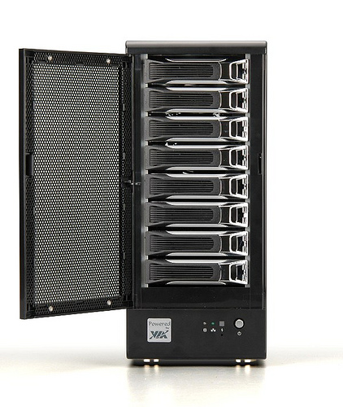
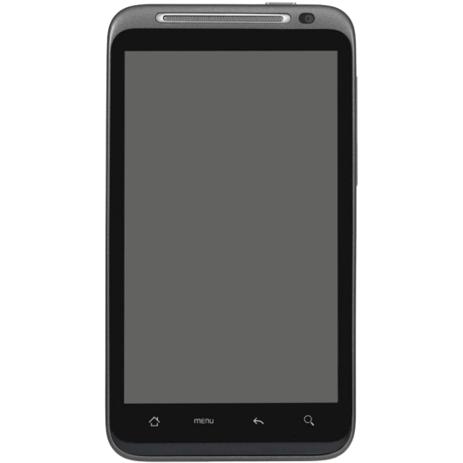
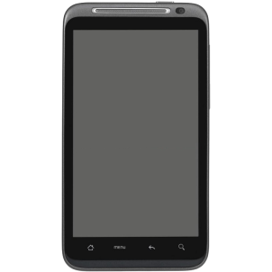


Slide 7
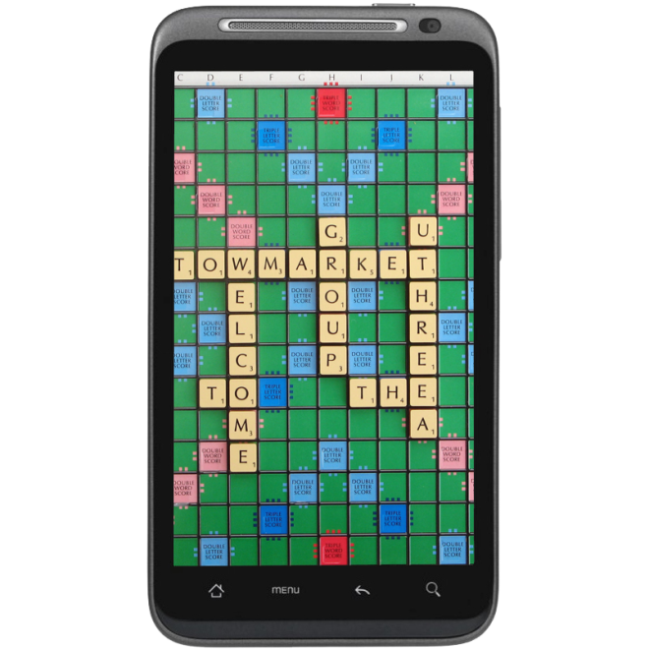

Slide 8
How BlueMesh Will Work
s
^
(Almost)

Slide 9
User
Application
BlueMesh
Service
Object
Router
Object
Client
Thread
Server
Thread
Read/Write
Thread
Read/Write
Thread
Read/Write
Thread
. . .

Slide 10
First Iteration

Slide 11
We are TESTING!

Slide 12
We are finalizing our API!

Slide 13



Slide 14
Thanks!
Sean O’Sullivan
Moorthy
Zachary Clapper
RCOS members and mentors

Slide 15
Questions?

