Slide 1


Slide 2
ROSS Vehicular
Traffic Model

Slide 3


Slide 4
What is BlueMesh?

Slide 6
Why BlueMesh?

Slide 7
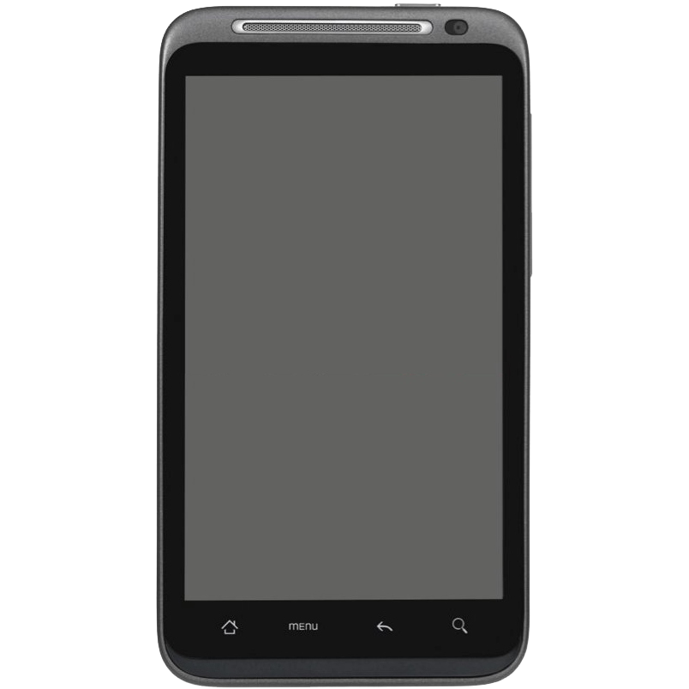

Slide 8
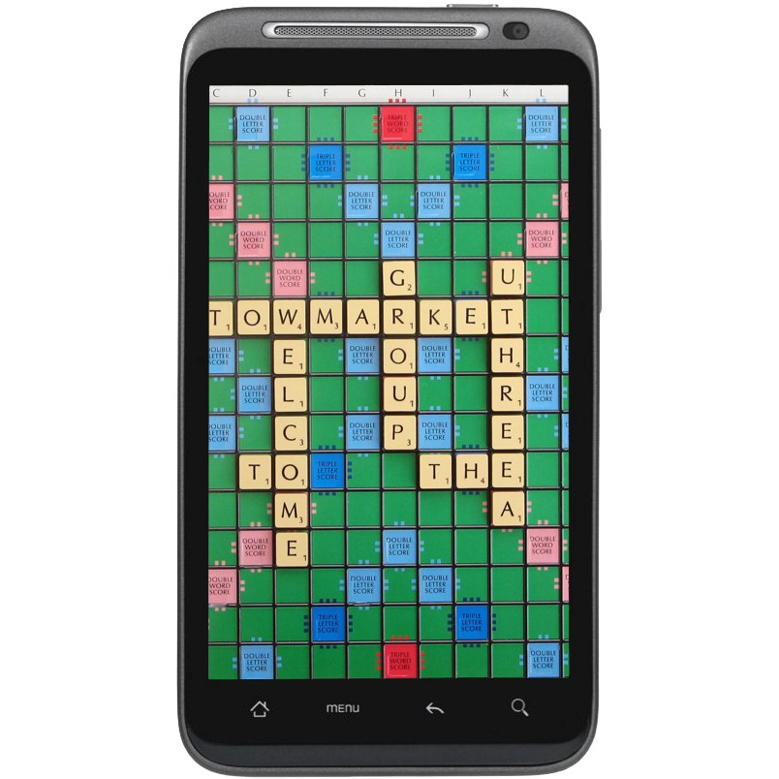

Slide 9


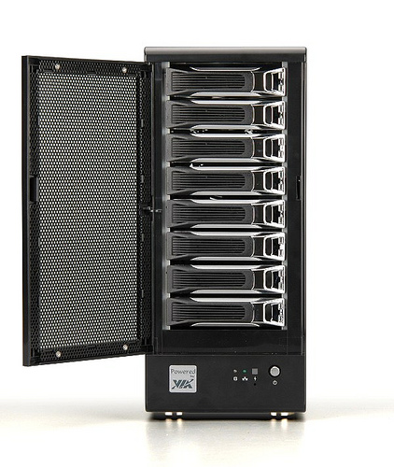
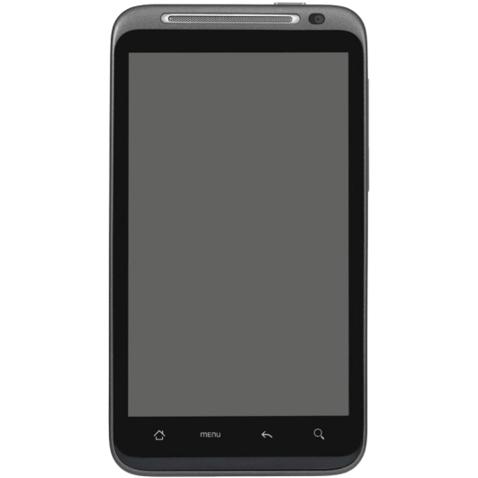
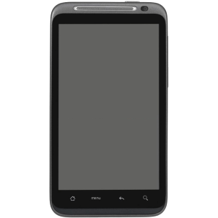


Slide 10
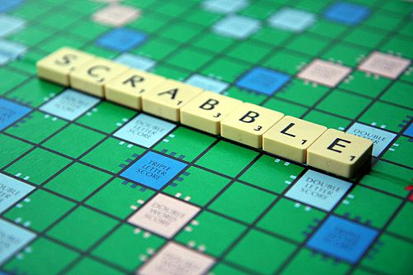

Slide 11
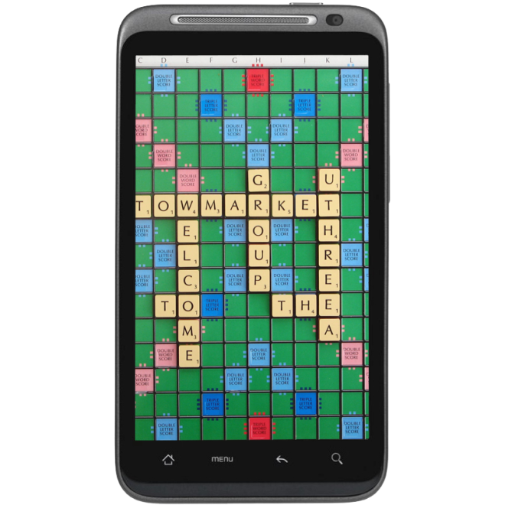

Slide 12
Goals

Slide 13
Problems so far

Slide 14
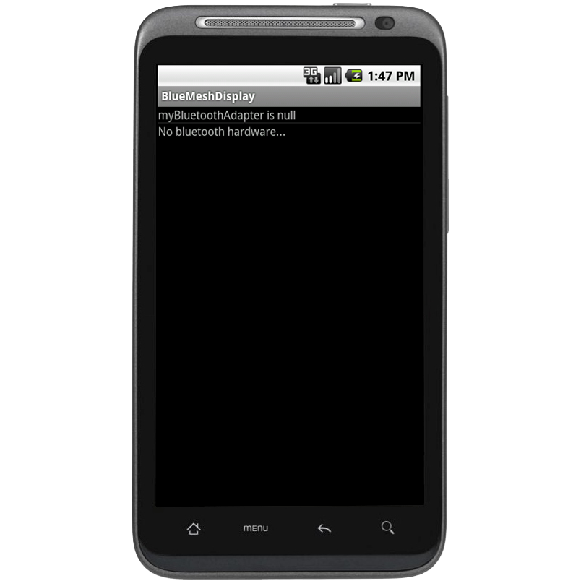

Slide 15
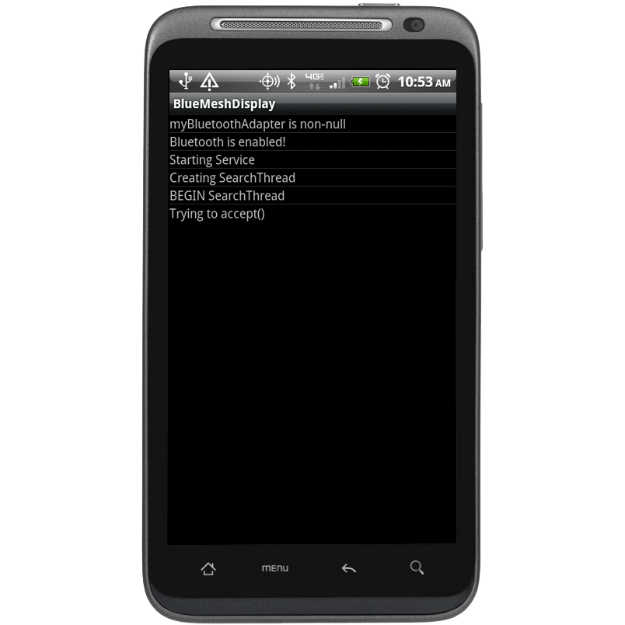

Slide 16
Thanks!
Sean O’Sullivan
Moorthy
RCOS members and mentors

Slide 17
Questions?

