Slide 1


Slide 2
Live Demo :D

Slide 3
How are we doing thus far?

Slide 4
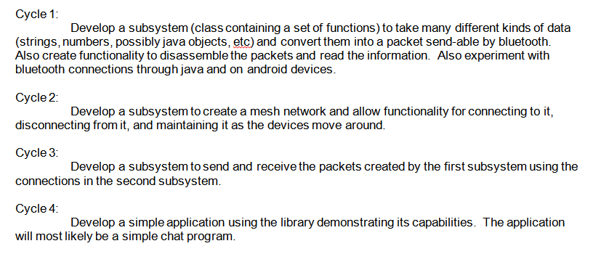

Slide 5
So what took so long?

Slide 6
Learning Android development… kind of

Slide 7
Thread
Activity
(remember me?)
BLUETOOTH BLOCKING CALL!
Thread
Threads
Threads
BLUETOOTH BLOCKING CALL!

Slide 8
Android’s Bluetooth API
Bluetooth API

Slide 9
Lack of good documentation
and examples
LOTS of blocking calls ☹

Slide 10
When I look into the future,
it's so bright it burns my eyes.
-Oprah Winfrey

Slide 11
Thanks to
Moorthy
Sean O’Sullivan
Asher Glick
RCOS Mentors and Members

Slide 12
Questions?

