Slide 1


Computer Vision and Neural Machine Interface for Upper Limb Prostheses
Team members:
Abdelrahman Hamza
Ghadir Moemen
Hanna Nabil
Mostafa Elwafa
Supervised by:
Dr. Meena AbdelMaseeh

Slide 2
Agenda
GP sponsor: IHub.
Problem definition.
System design.
Integration algorithm.
Approach.
Future sight
Gained skills.
Gantt chart.

Slide 3
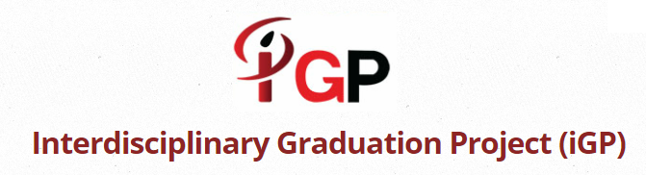

GP sponsor: IHub

Slide 4
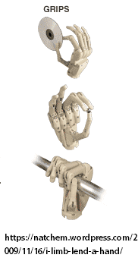
Problem definition
Amputation problem and
current status.
Transradial amputation: a story of
dexterous control.
EMG:
>Signal loss due to muscle atrophy.
Solution: hybrid control to
restore minimum function.

Slide 5
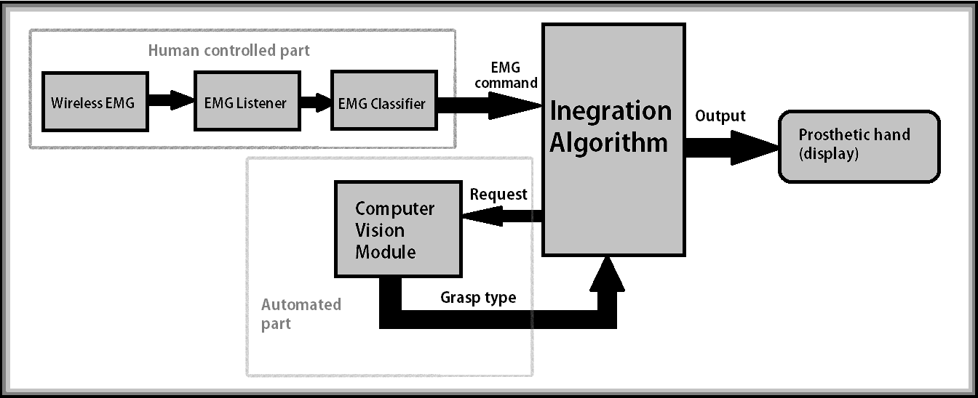
System design

Slide 6
Integration algorithm
EMG commands:
Restart, confirm, cancel, turn off.
CV grasp types:
Pinch, neutral, tripod, pronated.
Prosthetic hand modes:
Rest, preshape, grasp, release.

Slide 7
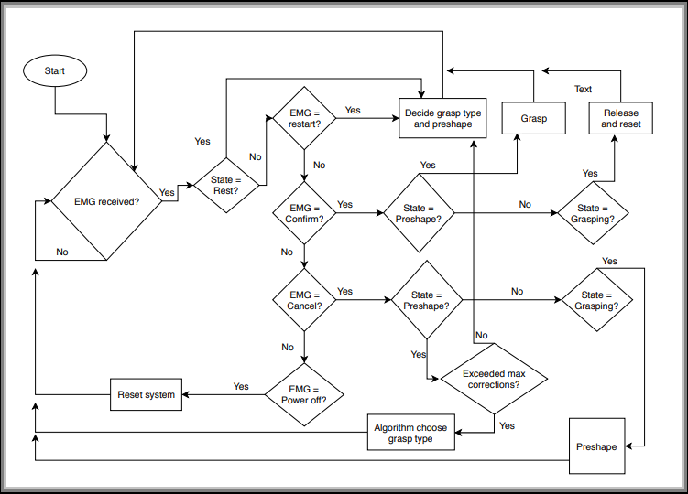
Integration algorithm
Notes:
Explain states.

Slide 8
Approach (Artificial Intelligence)
Limitaions?
> Expensive computationally and
undeterministic.
Fit to the problem?
> Too many factors.
> Biovariability.
> Scaling.

Slide 9
System Implementation
Raspberry-Pi 3 (Python 2)
TensorFlow for Raspberry
Open-MYO
PC ( python 3 )
TensorFlow Fow Windows
Myo-Python
Myo officially supports Windows

Slide 10
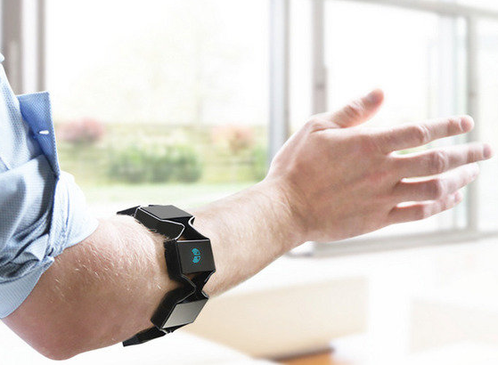
Online Scenario
EMG Real-time Module
EMG Training
EMG Testing

Slide 11
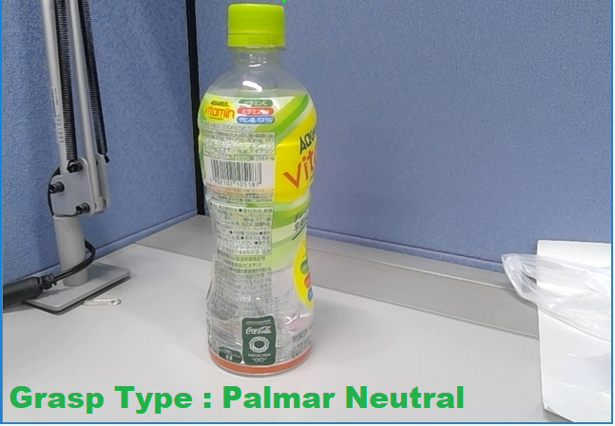
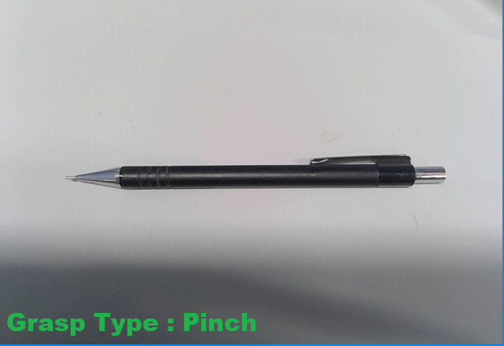
Online Scenario
Computer Vision Real-time Module

Slide 12
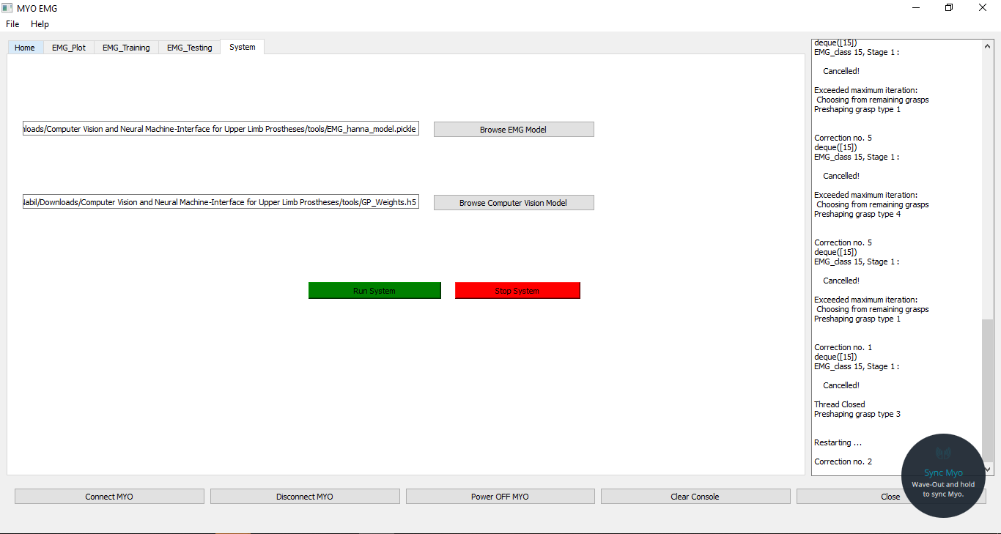
Semi Real-time System

Slide 13
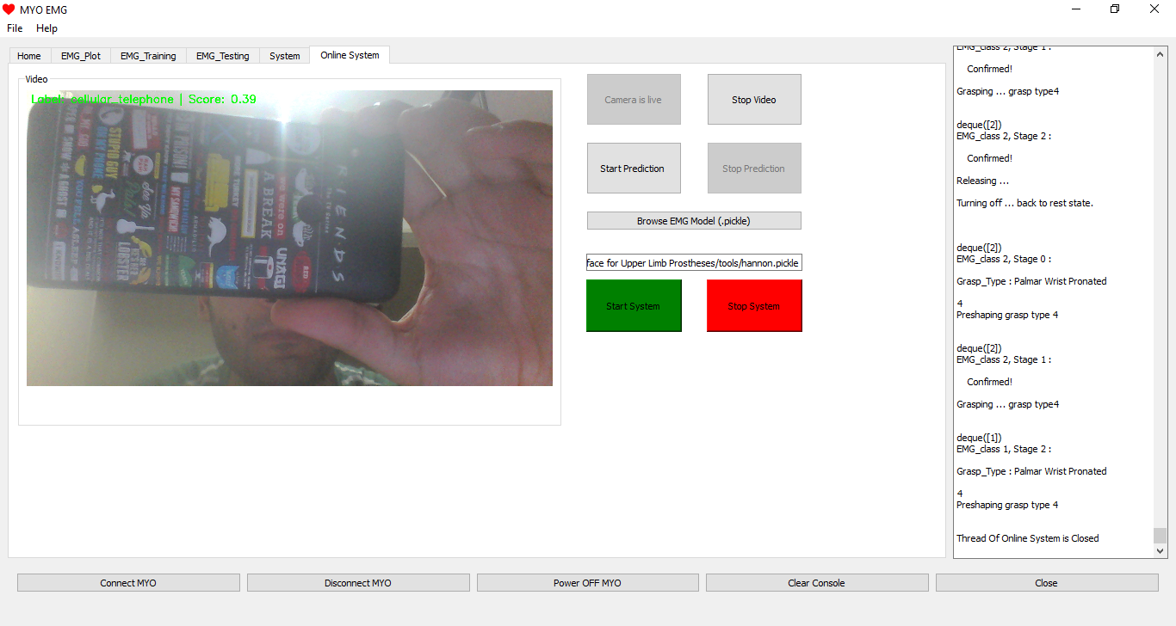
Real-time System

Slide 14
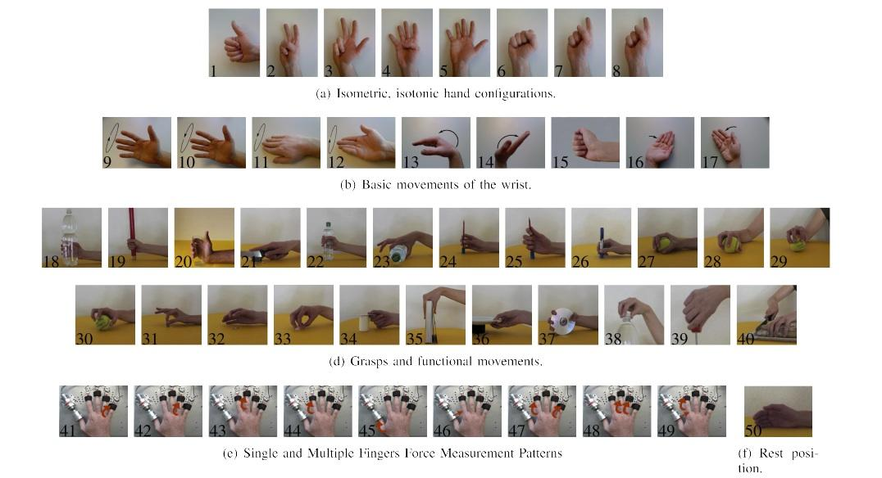
EMG Module: Dataset
NInaPro Dataset

Slide 15
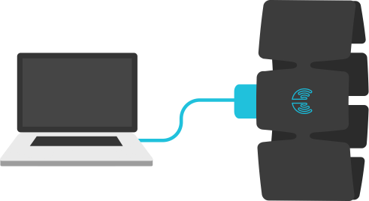
EMG Module: Dataset
Collecting own Dataset using MYO armband.

Slide 16
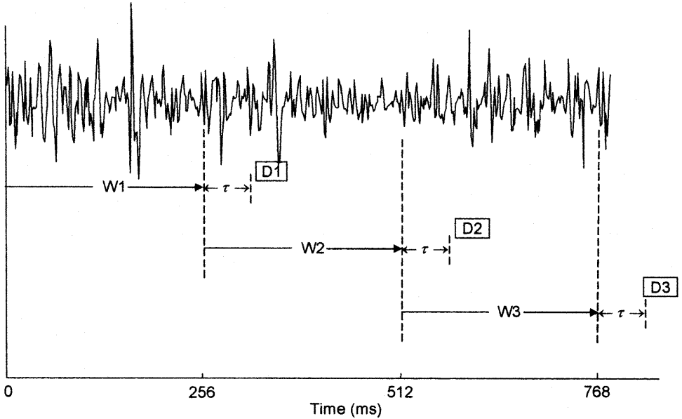
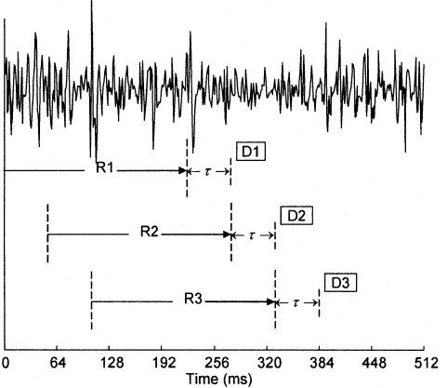
EMG Module: Methodology
Windowing of MES
Overlapping Increased Accuracy

Slide 17
EMG Module: Pipeline
Preprocessing:
Filtration and Normalization.
Features extraction:
Time domain features (MAV,ZC ,SSC,WL )
Classification:
KNN
SVM

Slide 18
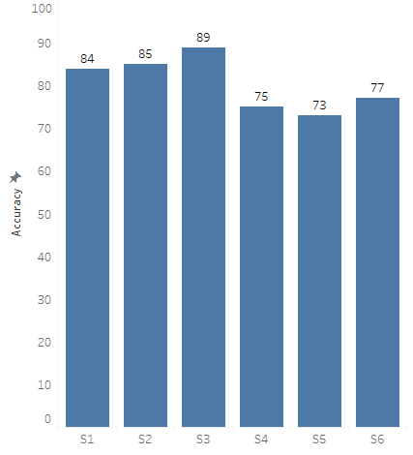
EMG Module: Results
Results of NINAPRO dataset

Slide 19
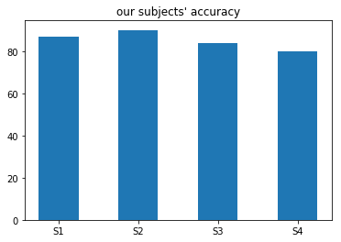
EMG Module: Results
Results of our dataset

Slide 20
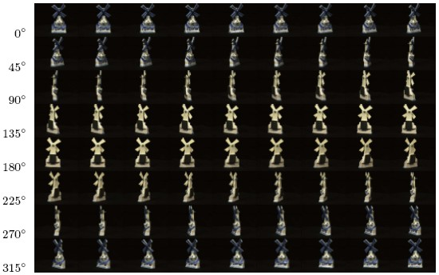
CV Module: Dataset
Amsterdam Library of Object Images (ALOI)

Slide 21
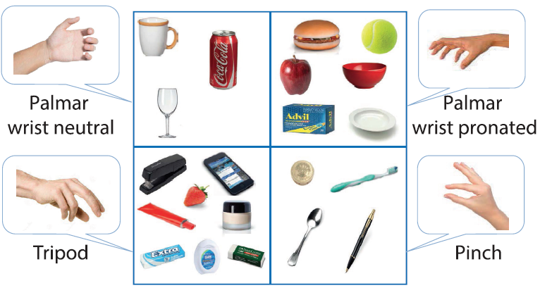
CV Module: Methodology

Slide 22
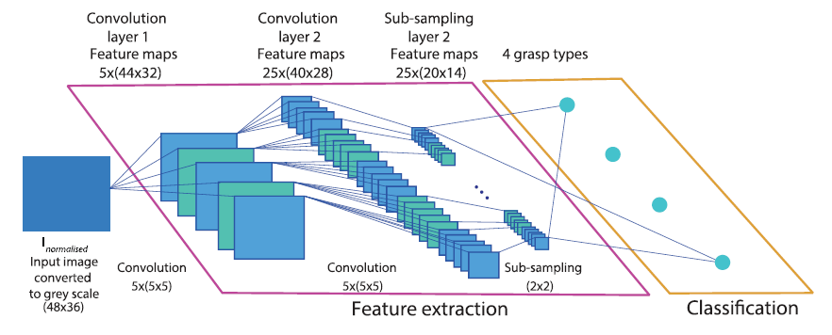
CV Module: Architecture

Slide 23
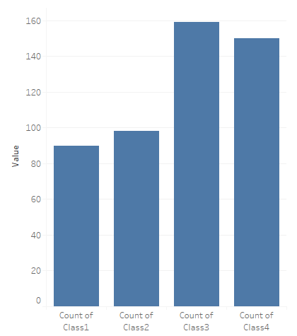
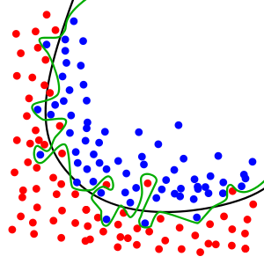
CV Module: Common Problems
Imbalanced Classes
Suggested Solution: Re-Sampling the Dataset.
Overfitting
Suggested Solution: Dropout Regularization.

Slide 24
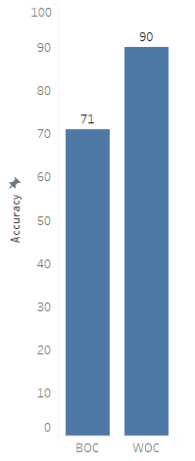
CV Module: Results

Slide 25
Future sight
CV module:
> Zooming effect.
> Multilayered network.
System functionality:
> Add proportional control.
> Add feedback loop.

Slide 26
Gained skills
Project management:
> Time management, teamwork, cost management … etc.
> Research and guided self learning.
Professional programming.
Data science and engineering.
Working within a multidisciplinary environment.

Slide 27
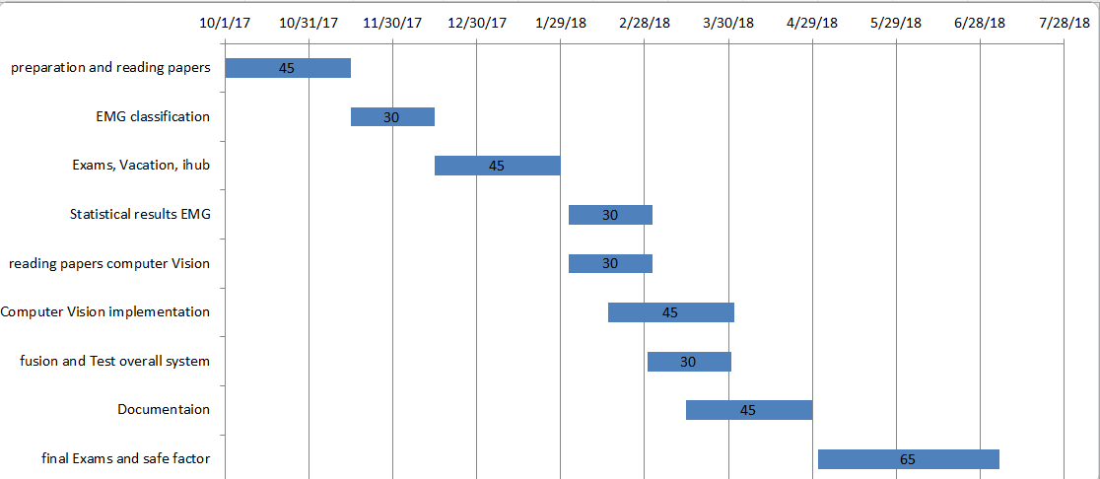
Gantt chart

Slide 28
Team Contribution
 | Hamza | Ghadir | Hanna | Mostafa
Research and Reading | / | / |  | /
EMG Module | / |  |  | /
CV Module | / | /
Integration |  | / | /
Real-Time System |  |  | / | /
Result Visualization | / |  |  | /
Troubleshooting |  | / | /
IHub | / | / | / | /
External Communication |  | /
GUI |  |  | /
Documentation | / | / | / | /

