Slide 1


Computer Vision and Neural Machine Interface for Upper Limb Prostheses
Team members:
Abdelrahman Hamza
Ghadir Moemen
Hanna Nabil
Mostafa Elwafa
Supervised by:
Dr. Meena AbdelMaseeh

Slide 2
Agenda
GP sponsor: IHub.
Problem definition.
System design.
Integration algorithm.
Approach.
Future sight
Gained skills.
Gantt chart.

Slide 3
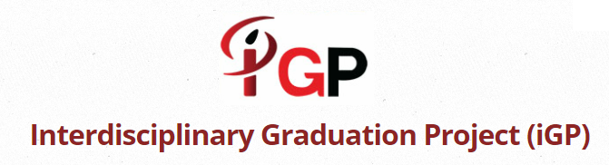

GP sponsor: IHub

Slide 4
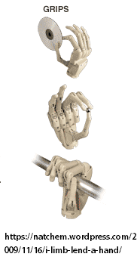
Problem definition
Amputation problem and
current status.
Transradial amputation: a story of
dexterous control.
EMG:
>Signal loss due to muscle atrophy.
Solution: hybrid control to
restore minimum function.

Slide 5
System parameters
EMG commands:
Initiation, confirm, cancel, power off.
CV grasp types:
Pinch, neutral, tripod, pronated.
Prosthetic hand modes:
Rest, preshape, grasp, release.

Slide 6
Video

Slide 7
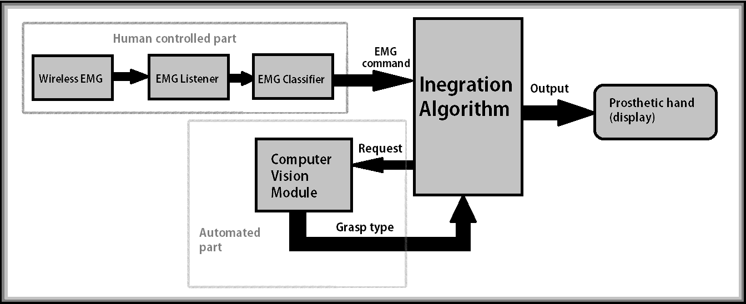
System design

Slide 8
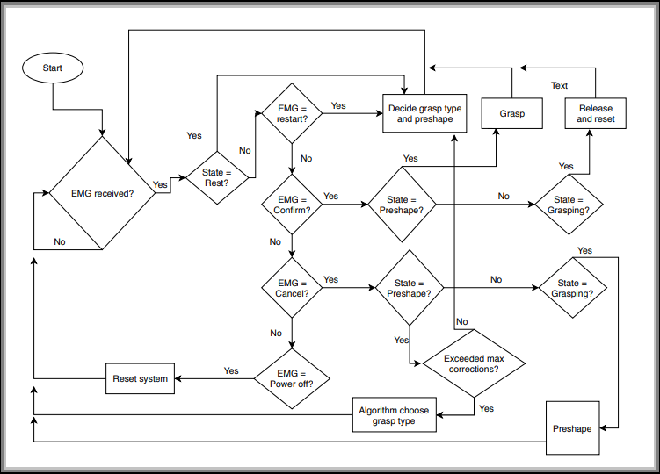
Integration algorithm
Notes:
Explain states.

Slide 9
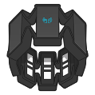
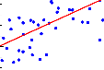
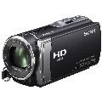
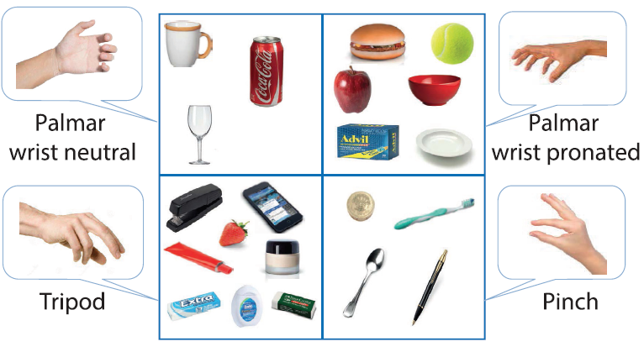
Real-time System
Computer Vision Classifier
EMG Acquisition
EMG Classifier
Camera Orders
Grasp Type
MYO ArmBand
Machine Learning Model
System Power ON
Confirmation
Cancellation
System Power OFF
Pinch
Palmar Neutral
Tripod
Palmar Pronated
TensorFlow
Finger Spread
Wrist Extension
Wrist Ulnar Deviation
Rest

Slide 10
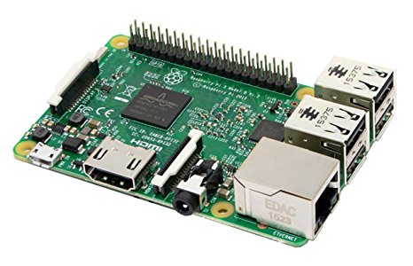
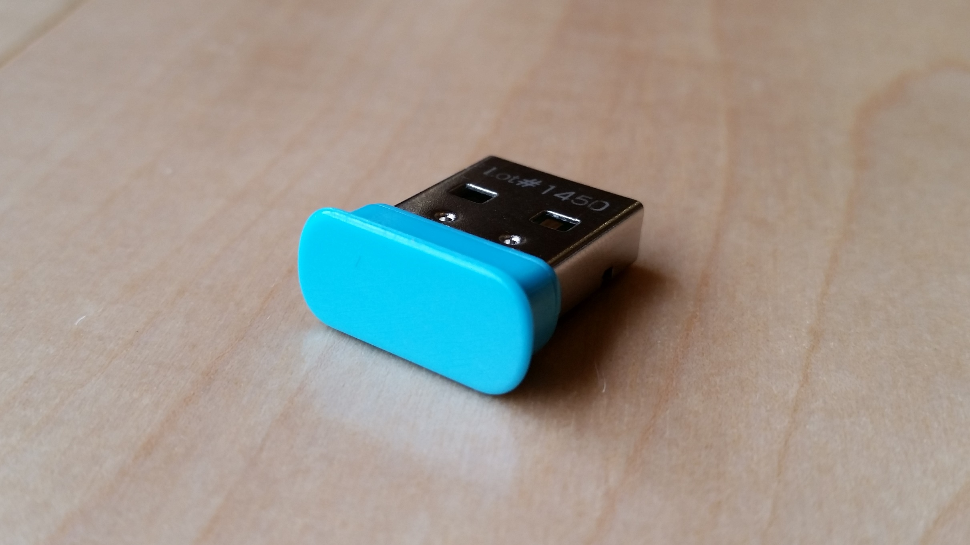
System Implementation
Components
Raspberry-Pi 3 Model B
MYO ArmBand
Raspberry Bluetooth
USB Camera
PC:
MYO ArmBand
MYO USB Bluetooth
HD Webcam Camera

Slide 11
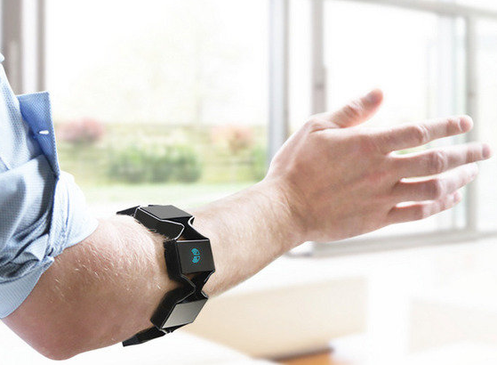
EMG Acquisition in Real-time
EMG Real-time Module
EMG Training
EMG Testing

Slide 12
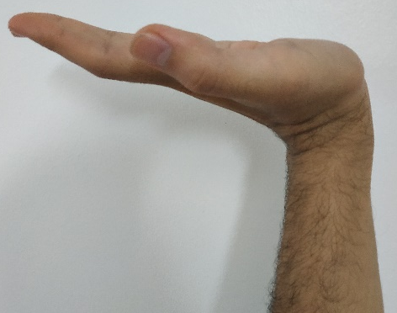
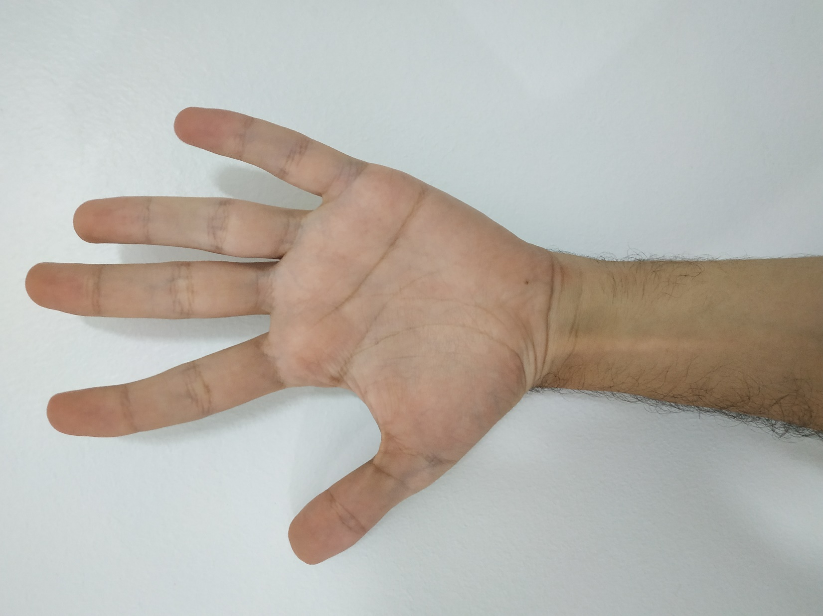
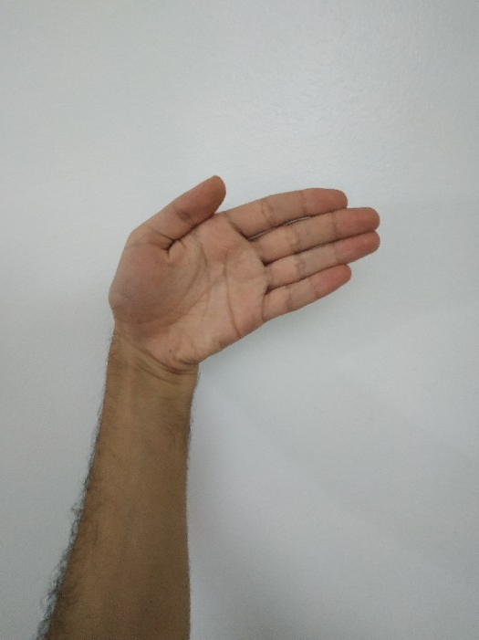
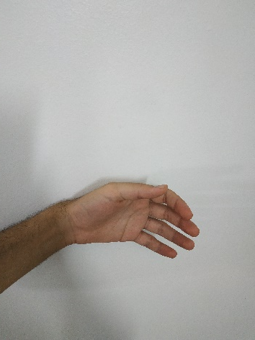
EMG Classifier
Fin

Slide 13
TensorFlow
F

Slide 14
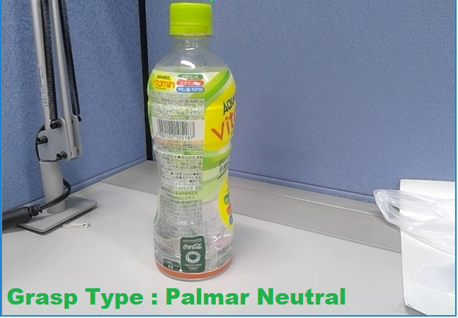
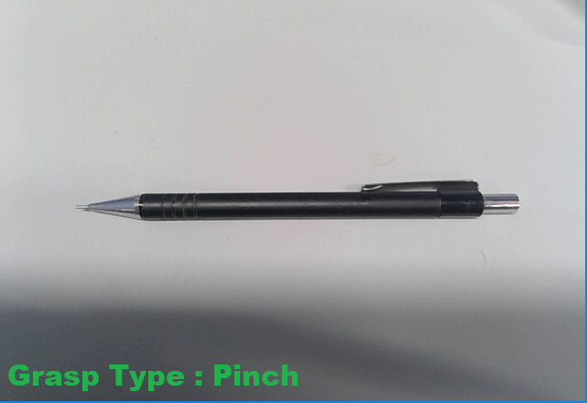
Computer Vision Results
Computer Vision Real-time Module

Slide 15
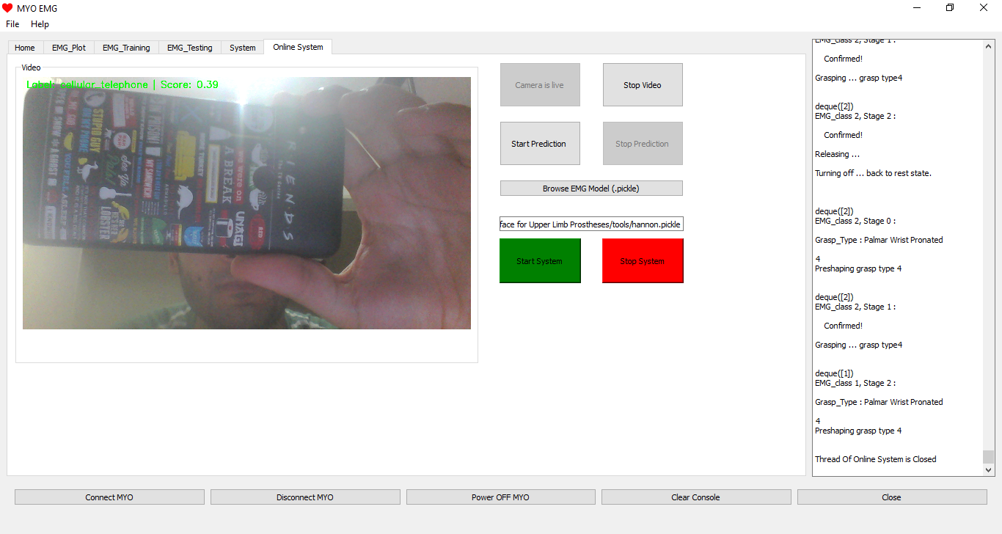
System Graphical User Interface

Slide 16
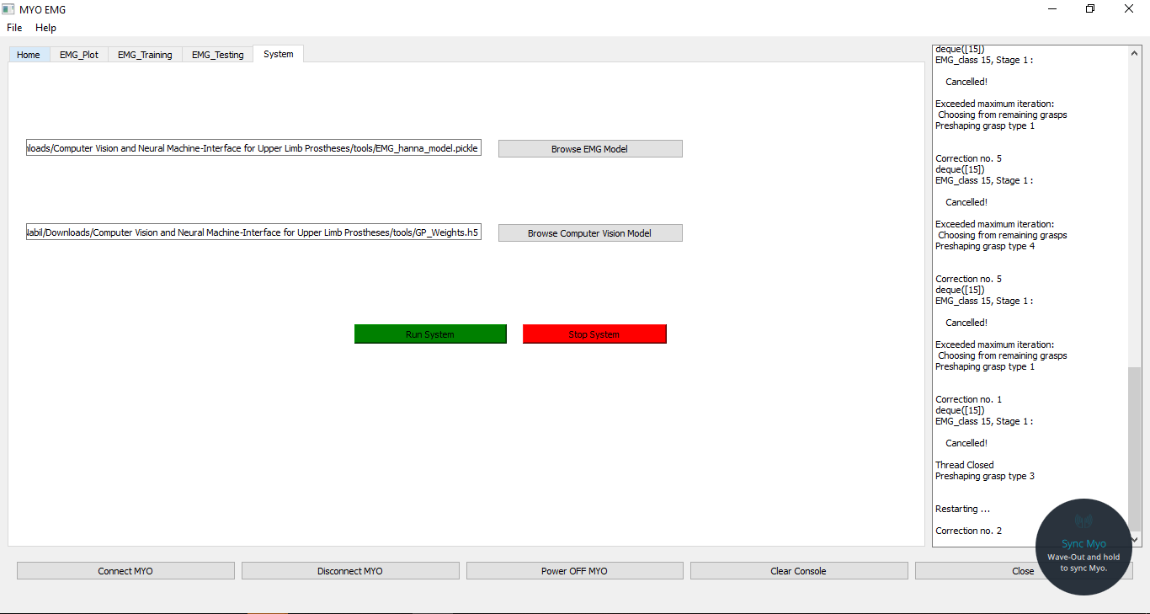
Semi Real-time System

Slide 17
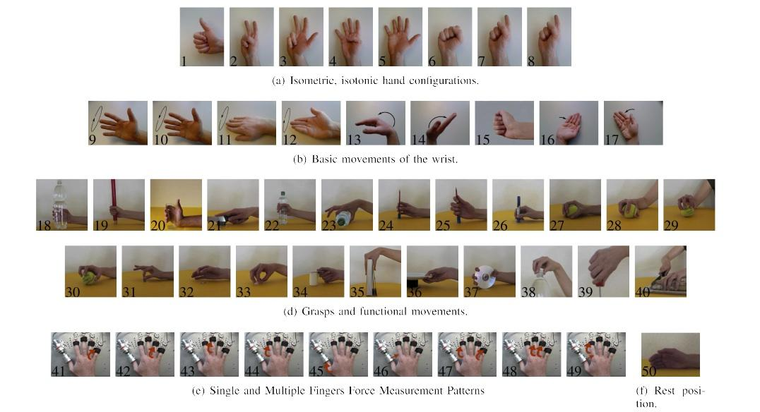
EMG Module: Dataset
NInaPro Dataset

Slide 18
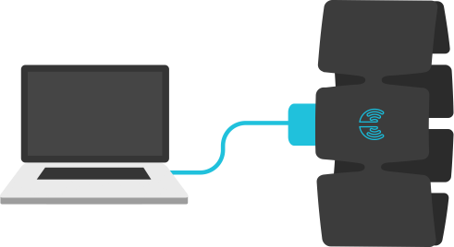
EMG Module: Dataset
Collecting own Dataset using MYO armband.

Slide 19
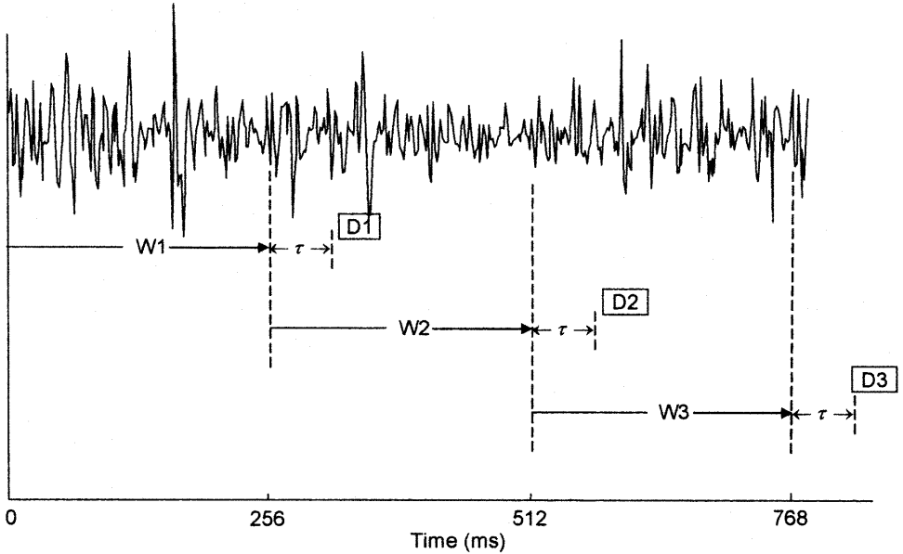
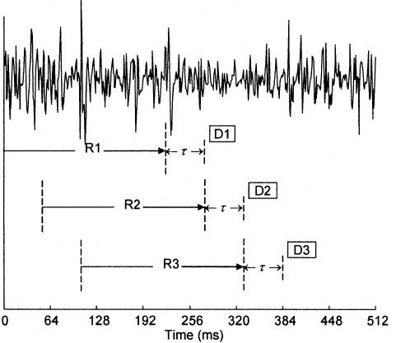
EMG Module: Methodology
Windowing of MES
Overlapping Increased Accuracy

Slide 20
EMG Module: Pipeline
Preprocessing:
Filtration and Normalization.
Features extraction:
Time domain features (MAV,ZC ,SSC,WL )
Classification:
KNN
SVM

Slide 21
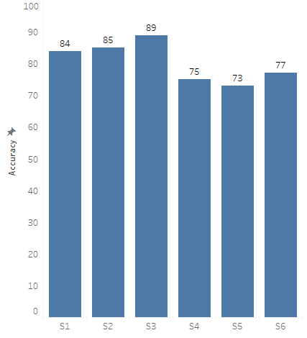
EMG Module: Results
Results of NINAPRO dataset

Slide 22
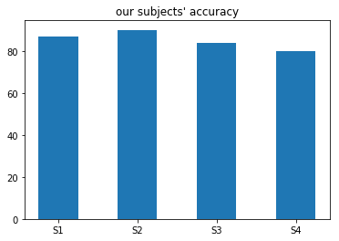
EMG Module: Results
Results of our dataset

Slide 23
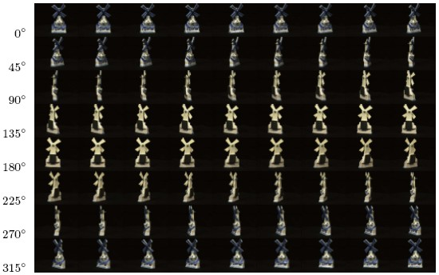
CV Module: Dataset
Amsterdam Library of Object Images (ALOI)

Slide 24
CV Module: Methodology

Slide 25
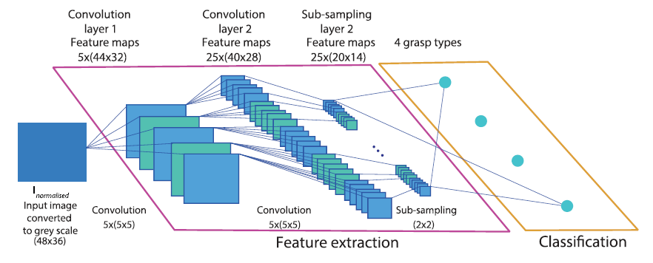
CV Module: Architecture

Slide 26
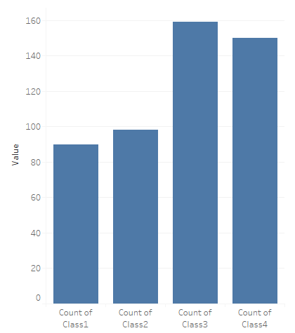
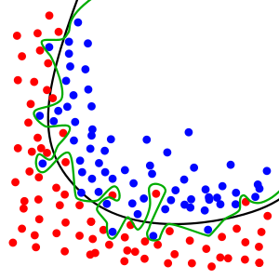
CV Module: Common Problems
Imbalanced Classes
Suggested Solution: Re-Sampling the Dataset.
Overfitting
Suggested Solution: Dropout Regularization.

Slide 27
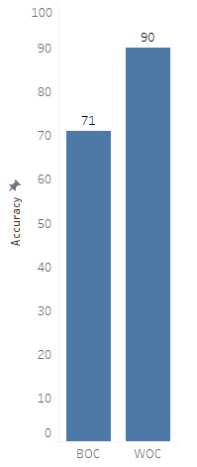
CV Module: Results

Slide 28
Future sight
CV module:
> Zooming effect.
> Multilayered network.
System functionality:
> Add proportional control.
> Add feedback loop.

Slide 29
Gained skills
Project management:
> Time management, teamwork, cost management … etc.
> Research and guided self learning.
Professional programming.
Data science and engineering.
Working within a multidisciplinary environment.

Slide 30
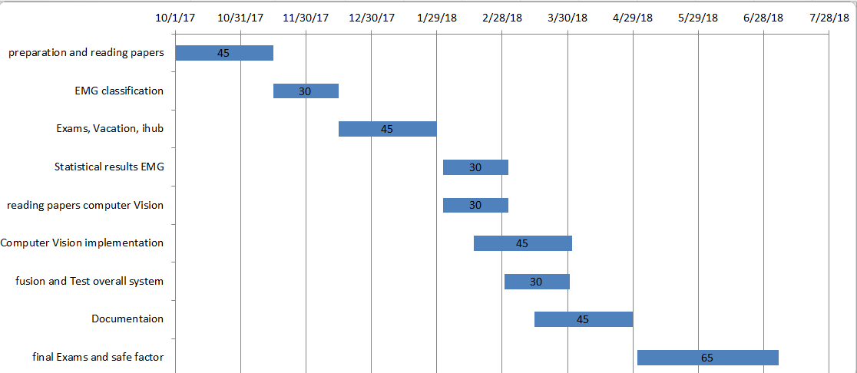
Gantt chart

Slide 31
Team Contribution
 | Hamza | Ghadir | Hanna | Mostafa
Research and Reading | / | / |  | /
EMG Module | / |  |  | /
CV Module | / | /
Integration |  | / | /
Real-Time System |  |  | / | /
Result Visualization | / |  |  | /
Troubleshooting |  | / | /
IHub | / | / | / | /
External Communication |  | /
GUI |  |  | /
Documentation | / | / | / | /

