Slide 1
Midwest JS 2018
Blockchains for
Fun and Profit

Slide 2

Zac Delventhal
Sawtooth Maintainer
Hyperledger Ambassador
github.com/delventhalz
@delventhalz

Slide 3
What is a Blockchain?
Notes:
Poll the room: miner, crypto-builder, Ethereum, Fabric?

Slide 4
What is a Blockchain?
A blockchain is a growing list of records, called blocks, which are linked using cryptography.
Each block contains a cryptographic hash of the previous block and transaction data (generally represented as a merkle tree root hash).
Wikipedia

Slide 5
What is Hashing?
Creates a deterministic, fixed-length, digest of some arbitrary data
Even slightly different data produces a completely different hash
sha256('Hello, World!')
// dffd6021bb2bd5b0af676290809ec3a53191dd81c7f70a4b28688a362182986f
sha256('Hello, World?')
// f16c3bb0532537acd5b2e418f2b1235b29181e35cffee7cc29d84de4a1d62e4d

Slide 6
Basic Blockchain Structure
Hashes link discrete "blocks"
of data
Hash is generated by combining the data with previous hash
"Genesis" block only one allowed to have no previous hash
Immutable. Cannot alter blocks without altering every later block
data: ''
hash: 'e3b0c4'
data: 'foo'
hash: 'b7d0fc'
previous: 'e3b0c4'
data: 'baz'
hash: 'b5d6f2'
previous: 'e3b0c4'
data: 'bar'
hash: '27513c'
previous: 'b7d0fc'
'b7d0fc'
sha256(data + previous) // first six chars displayed

Slide 7
Signing
(Secp256k1)
Public Key
Public Key
Basically 32 random bytes
Did public key and signature come from the same private key?
Private Key
Everything except private key is shared
? ? ?
Signature
Signature
Blockchain updates made in atomic "transactions"
Is this the exact same data that was signed?
Data
Transaction
Data
Transaction

Slide 8
Consensus
Use a lottery to determine who gets to create the next block
Always prefer "longest" chain, bad actors need 51% control
...
...
...
Bitcoin and Ethereum use Proof of Work to randomly choose a "leader"
Sawtooth features Proof of Elapsed Time (and others)

Slide 9
Distributed Applications
Notes:
Poll the room: miner, crypto-builder, Ethereum, Fabric?

Slide 10
What is a Distributed Application?
A program which relies on multiple nodes in a peer-to-peer network (i.e. a blockchain) to perform certain tasks
Also referred to in some contexts as a "smart contract"
May be fully custom or rely on one of the emerging general purpose blockchain platforms like Ethereum or Sawtooth
Insufferably abbreviated "dApp"

Slide 11
Why a Blockchain?
Share data between mutually distrusting entities
No reliance on trusted third parties
Immutable transaction history
High availability
Crash fault tolerant
Byzantine fault tolerant
Liveness

Slide 12
Why NOT Blockchain?
Wrong use case:
Internal-only business model
A centralized blockchain is just bad database
Active areas of research:
Transaction throughput
"Private" transactions

Slide 13

Bitcoin
A digital currency, the first to solve the double-spend problem without a trusted third party
Invented the concept of a blockchain
Faces scaling issues, very difficult to upgrade

Slide 14
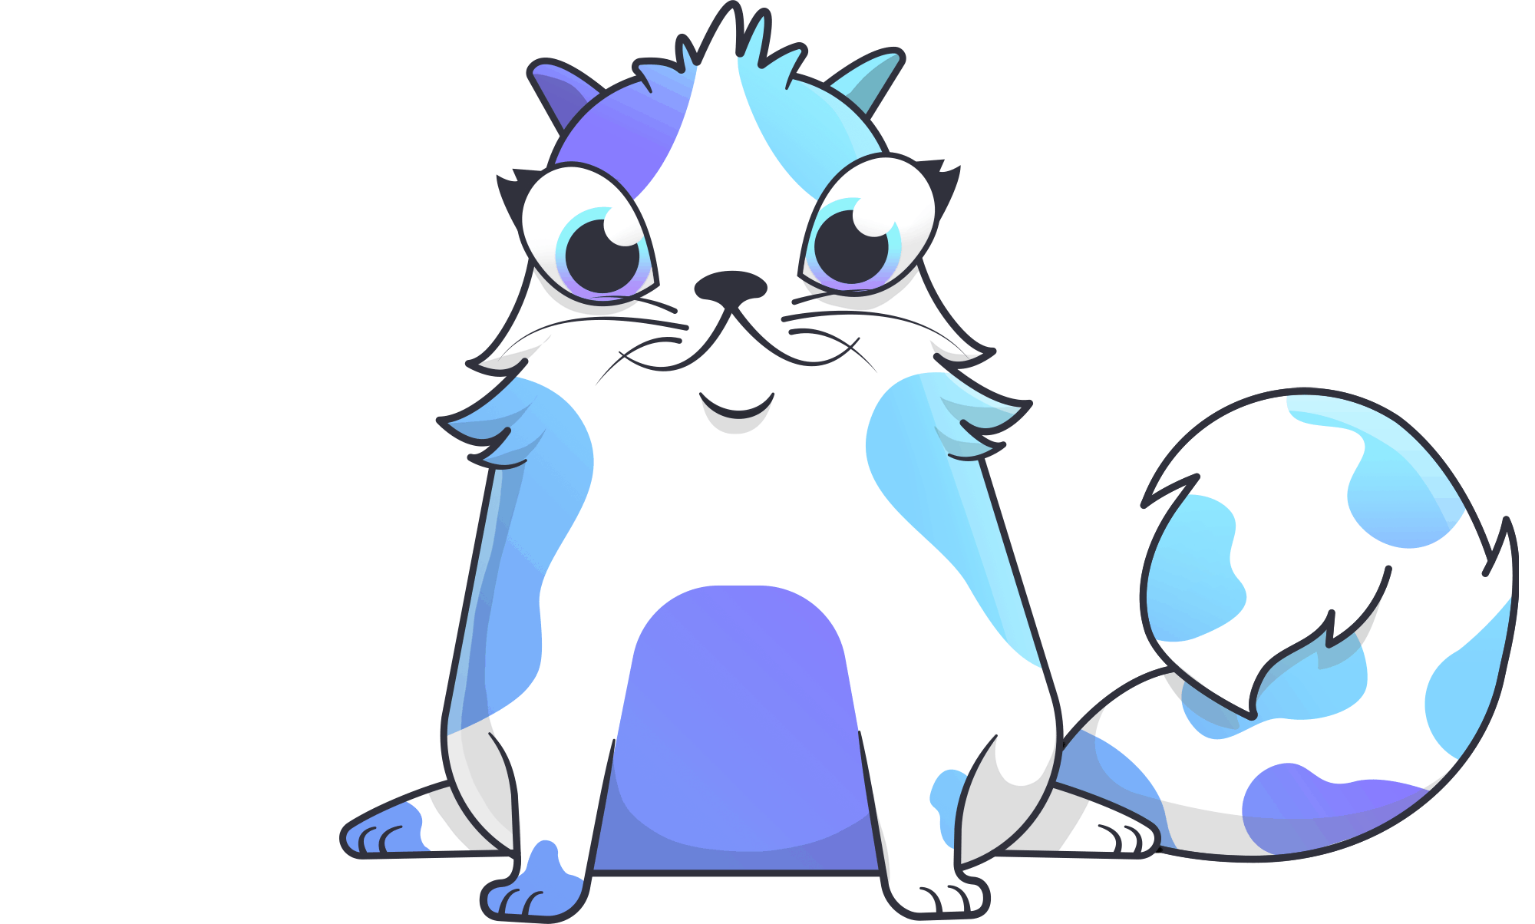
Cryptokitties
Collect, breed, and sell unique immutable digital cats
One of the first blockchain games
Introduced the concept of "cryptocollectibles"
Built on Ethereum

Slide 15

Sovrin
Decentralized digital identities
Goal is to be a portable global replacement for all online
identity verification
Relies on zero knowledge proofs to limit the visibility of sensitive information

Slide 16
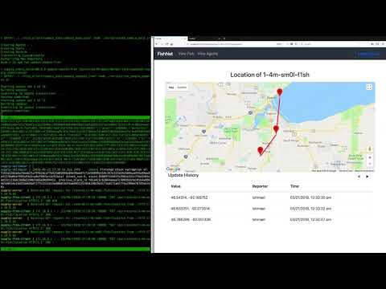
Sawtooth Supply Chain
Track the provenance of assets from production to consumption
Global agreement on data like location, certifications, and ingredients
Built on Hyperledger Sawtooth

Slide 17
What is Sawtooth?

Slide 18
Hyperledger Sawtooth
Began as a hardware experiment in Intel's labs
Contributed to Linux Foundation as a part of Hyperledger
General purpose blockchain platform
Designed as a permissioned blockchain for consortiums
Not tied to specific hardware

Slide 19
What is a Permissioned Blockchain?
Targeted at small(ish) groups
Endpoints are restricted, not available to the general public
Not centralized
No single canonical peer-to-peer network (deploy your own!)
No need for a currency
(different incentives)

Slide 20
Why use Sawtooth?
Highly modularized
Designed to scale:
On-chain settings
Smart contracts
Parallel transaction processing
Byzantine Fault Tolerance (PoET)
Global state
Develop in a variety of languages:
Javascript
Python
Rust
Solidity (Ethereum VM)
Go
Java

Slide 21
Architecture
Sawtooth Node
Validator
Client
REST API
Transaction Processor
State
Signs transactions
Encodes payloads
Reads state data
GET state with HTTP / JSON
POST transactions with HTTP / octet-stream
Decodes and validates payloads
Writes (and reads) state data
Validates transactions
Mediates state access

Slide 22
Processor vs Contract
Client
App logic is off-chain
Must manually deploy TPs to all participants
Transaction processor model is faster, simpler
App logic is on-chain
Deployment and updates are far easier
More scalable
Client
Validator
Validator
State
State
Contract
Transaction Processor
Seth / Sabre
Contract

Slide 23
Building a Sawtooth App

Slide 24
The Client
Can be simple or complex:
a CLI
a web app
a whole ecosystem with its own custom REST API and a local copy of state in a database
Responsible for:
encoding payloads
creating and signing transactions and batches
submitting transactions
fetching and displaying state data for users

Slide 25
Transactions and Batches
Batch
Encoded as Protobufs
Every transaction in a batch must be valid, or the batch is invalid
Family name/version designate a transaction processor
Inputs/outputs are the addresses in state you expect to read/write
header bytes
headerSignature string
transactions [ Transaction ]
BatchHeader (deserialized)
signerPublicKey string
transactionIds [ string ]
Transaction
header bytes
headerSignature string
payload bytes
TransactionHeader (deserialized)
batcherPublicKey string
signerPublicKey string
familyName string
familyVersion string
inputs [ string ]
outputs [ string ]
dependencies [ string ]
nonce string
payloadSha512 string

Slide 26
Transaction Processor
Communicates with validator over ZMQ
The SDK handles most of the networking details
Handles transactions specific to one " transaction family"
Implements an apply() method called for each transaction

Slide 27
apply()
Both transaction processors and Sabre smart contracts follow this pattern
Receives a transaction request and a state context with access methods
apply (txn, context) {
try {
const entity = handle(decode(txn.payload))
} catch (err) {
throw new InvalidTransaction(err)
}
return context.setState({ [getAddress(entity)]: encode(entity) })
}

Slide 28
The Merkle Tree
hash(00, ff)
00
State stored in a "merkle tree" or "hash tree" so it can be verified
The leaves hash some data, and each parent hashes its children all the way up to the state root hash
Each node is addressed with a single byte (i.e. two hex characters)
Any arbitrary data can be stored at any address you like, but consider how prefixes can be used to quickly fetch child nodes
hash(1c, e3)
00 00
hash(09, a4)
00 ff
hash(Data1)
00 00 1c
hash(Data2)
00 00 e3
hash(Data3)
00 ff 09
hash(Data4)
00 ff a4
Data1
Data2
Data3
Data4

Slide 29
Addressing Example
 | Namespace | Type | Owner (optional) | Identifier
owner | sha512('pets').slice(0, 6) | '00' | -- | sha512(name).slice(0, 62)
pet | sha512('pets').slice(0, 6) | '01' | sha512(owner).slice(0, 16) | sha512(name).slice(0, 46)
102fe1 | 01 | 408b27d3097eea5a
'pets' |  | 'alice'
102fe1 | 01
'pets'
102fe1
'pets'
102fe1 | 01 | 408b27d3097eea5a | 1f443e224ee0de0afdc46cd68820de1494687677bed1d3
'pets' |  | 'alice' | 'fido'
102fe1 | 00 | 408b27d3097eea5a46bf2ab6433a7234a33d5e49957b13ec7acc2ca08e1a13
'pets' |  | 'alice'
name: 'alice'
name: 'bob'
name: 'alice'
name: 'bob'
name: 'rex'
owner: 'alice'
name: 'fido'
owner: 'alice'
name: 'snuggles'
owner: 'bob'
name: 'rex'
owner: 'alice'
name: 'fido'
owner: 'alice'
name: 'snuggles'
owner: 'bob'

Slide 30
YARRRRRRRR
(demo)

Slide 31
Links
GitHub
github.com/hyperledger/sawtooth-core
Docs
sawtooth.hyperledger.org
Chat
chat.hyperledger.org/channel/sawtooth
Talk Like A Pirate
github.com/delventhalz/pirate-talk
Hyperledger Cryptomoji
github.com/hyperledger/education-cryptomoji

Slide 32
That's it! Thank you!
Questions?

