Slide 1
Chapter 1
Network Security Overview

Slide 2
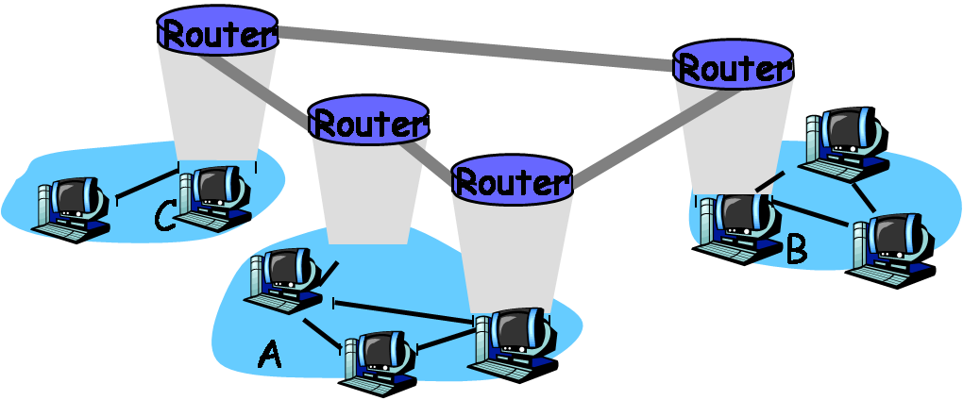
Why Is Security Important?
Internet – Public network
– Build on TCP/IP
Store and Forward technology

Slide 3
Chapter 1 Outline
1.1 Mission and Definitions
1.2 Common Attacks and Defense Mechanisms
1.3 Attacker Profiles
1.4 Basic Security Model
1.5 Security Resources

Slide 4
Mission and Definitions
What is data?
  Any object that can be processed or executed by a computer
Two states of data
  transmission state
  storage state

Slide 5
Tasks of Network Security
  Data confidentiality
    including data in transmission and storage states
  Data integrity
    including data in transmission and storage state
  Data non-repudiation
  Data availability

Slide 6
Loopholes, Flaws, and Defects
  Software
  Protocol design
  System configurations
Passive Defense: Who and Where?
  Multiple-layer defense mechanism
Broader Scope - Information Security

Slide 7
Chapter 1 Outline
1.1 Mission and Definitions
1.2 Common Attacks and Defense Mechanisms
1.3 Attacker Profiles
1.4 Basic Security Model
1.5 Security Resources

Slide 8
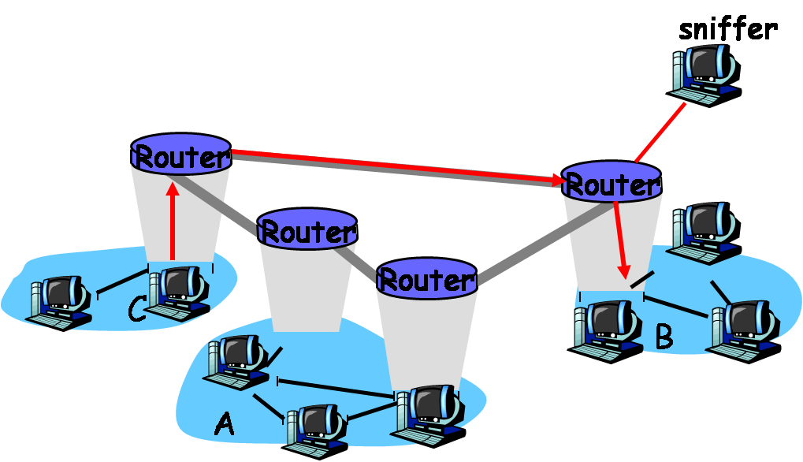
Eavesdropping
Common packet sniffers: TCPdump, Wireshark
Solution - Encrypt Data

Slide 9
Cryptanalysis
Cryptanalysis
  Find useful information from ciphertext data
  e.g. analyze statistical structure
Defense method
  Use longer keys and stronger encryption algorithm

Slide 10
Password Pilfering
Password Pilfering
  Password protection is often the first defense line
    probably the only defense available in the system
  Methods to pilfer user password:
    Guessing
    Social engineering
    Dictionary attacks
    Password sniffing

Slide 11
Guessing
Easiest, particularly on short or default passwords
10 most commonly-used passwords (ref. PC Magazine):
    password
    123456
    qwerty (which are keys below 123456 on standard keyboard
    abc123
    letmein
    monkey
    myspace1
    Password1
    Blink182
    The user’s own first name

Slide 12
Social Engineering
Methods of using social skills to pilfer secret information
  Physical Impersonation
  The attacker pretends to be another person to delude the victim
    (See example on page 6 from textbook)
  Phishing
  The most common form of mass social engineering attacks in recent years
  Disguised email messages or masquerade web sites
  See the next slide for a real phishing example verbatim (note the typos in the phishing email), where the link in the email is a trap

Slide 13
Date: Fri, 5 Oct 2007 16:11:46 -0700
  From: US Bank SCD-Verify@usbank.com
  Subject: US Bank – Internet Online Access is Locked – October 5, 2007 at 12:23:05 PM
  Dear US Bank Customer,
We’re sorry, but you reached the maximum number of attempts allowed to login into your US Bank account. For your protection, we have locked your account.
Consequently, we placed a temporary restriction on your account. We did this to protect your account from any fraudulent activity.
Please click below and complete the steps to Remove Limitations. This allows us to confirm your identity and unlock your US Bank online account
http://www4-usbank.com/
If we do no receive the appropriate account verification within 48 hours, then we will assume this US Bank account is fraudulent and will be suspented.
  US Bank, Member FDIC. @2007 US Bank Corporation. All Rights Reserved.

Slide 14
In general, any phishing email would contain a link to a bogus Web site, called a phishing site
Other forms
  Collect recycled papers from recycling bins
  Web browser pop up a window asking for user login
Defense Method – Anti-phishing extensions of web browsers are emerging technology for detecting and blocking phishing sites

Slide 15
Dictionary Attacks
  Only encrypted passwords should be stored in a computer system
    in UNIX/Linux:
    passwords are stored in a file named shadows under directory /etc
    in Windows XP:
    passwords are stored in a file named SAM, which is stored in the system’s registry

Slide 16
A typical dictionary attack proceeds as follows:
Obtain information of user names and the corresponding encrypted passwords
Run the encryption routine used by the underlying system on all dictionary words, names, and dates
Compare each output obtained from step 2 with the encrypted passwords obtained from step 1. If a match presents, a user password is found
Constructing a Rainbow table helps to reduce the table size and make the computation manageable

Slide 17
Rainbow Table
r is a reduction function
h is a cryptographic hash function
w₁₁ is a given password. Apply h and r alternatively to obtain a chain of passwords that are different pairwise:
where, w_{1i} = r(h(w_{1,i-1} ), i = 2,3,…,n₁ and store (w₁₁, h(w_{1n1}))
Select w_{j1} not occurred in previous chains
Password | Hash value
w₁₁ w₂₁ … w_{k1} | h(w_{1 n1}) h(w_{2 n2}) … h(w_{k nk})
Repeat this procedure k times generating k rows in the rainbow table

Slide 18


Let f: A→B and g: B→A be two functions. Let y∈ B and i ≥ 0.
Define:
Let Q₀ be an encrypted value of a password w. That is, Q₀ = h(w). If
for some i ≥ 0 and some j with 1 ≤ j ≤ k and i ≤ j, then w is possible to appear in the jth chain of w_{j1},…w_{j,nj} .

Slide 19
  Algorithm to find w in a rainbow table:
    Set Q₁ ← Q₀ and t ← 0. Let n = max{n₁,…,n_{k}}
    Check if there is a 1 ≤ j ≤ k such that Q₁ = h(w_{j,nj}) and t ≤ n. If yes, goto step 3; otherwise, goto step 4
    Apply r and h alternatively on w_{j1} for 0 ≤ i ≤ j times until
    w_{j,ni} = (r ○ h)^{i}(w_{j1}) is generated such that h(w_{j,ni}) = Q₀ . If such a w_{j,ni} is found, return w = w_{j,ni}; otherwise, goto step 4
    Set Q₁ ← h(r(Q₁)) and t ← t + 1. If t ≤ n then goto step 2. Otherwise, return “password not found.” (the rainbow table doesn’t contain the password whose hash value equals Q₀ )

Slide 20
Password Sniffing
Password sniffers are software programs, used to capture remote login information such as user names and user passwords
Defense Method – encrypt all message, include login information, using, e.g., SSH and HTTPS
Cain & Abel, a password recovery tool, can capture and crack encrypted password for the Microsoft Operating System

Slide 21
Password Protection
  Rules to help protect passwords from pilfering:
  Use long passwords, with a combination of letters, capital letters, digits, and other characters such as $,#,@. Do not use dictionary words, common names and dates.
  Do not reveal your passwords to anyone you do not know. Do not submit to anyone who acts as if he has authority. If you have to give out your password, do so face to face.
  Change passwords periodically and do not reuse old passwords.
  Do not use the same password for different accounts.
  Do not use remote login software that does not encrypt user passwords and other important personal information.
  Shred all discarded papers using a good paper shredder.
  Avoid entering any information in any popup window, and avoid clicking on links in suspicious emails.

Slide 22
Other User-Authentication Methods
  Use biometrics of unique biological features – connect biometric devices to a computer, such as fingerprint readers and retina scanners
  Use authenticating items – electronic passes authenticated by the issuer.
  Authentication using user passwords is by far the easiest method

Slide 23
Identity Spoofing
Identity spoofing attacks allow attackers to impersonate a victim without using the victim’s passwords
    Man-in-the-middle attacks.
    Message replays
    Network spoofing attacks
    Software exploitation attacks

Slide 24
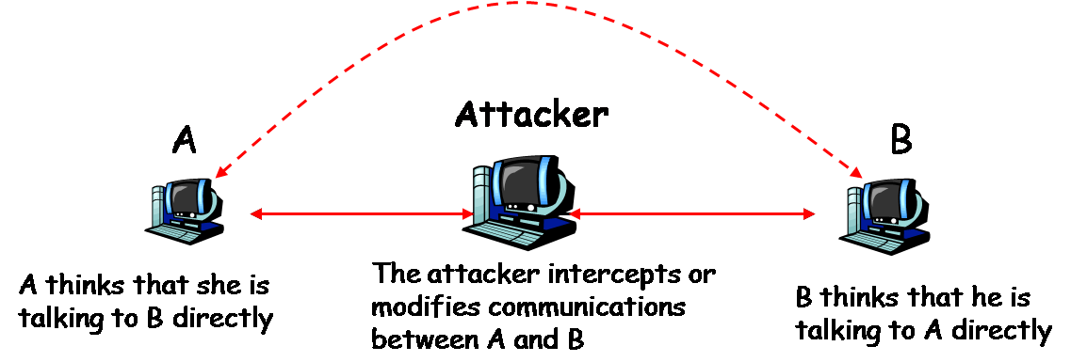
Man-in-the-middle Attacks
  Compromise a network device (or installs one of his own) between two or more users. Using this device to intercept, modify, or fabricate data transmitted between users.
Defense measures – encrypting and authenticating IP packets

Slide 25
Message Replays
The attacker first intercepts a legitimate message, keeps it intact, and then retransmits it at a later time to the original receiver
For example, an attacker may intercept an authentication pass of a legitimate user, and use it to impersonate this user to get the services from the system
Defense Mechanisms –
Attach a random number to the message. This number is referred to as nonce
Attach a time stamp to the message
The best method is to use a nonce and a time stamp together

Slide 26
Network Spoofing
  IP spoofing is one of the major network spoofing techniques
  SYN flooding
    The attacker fills the target computer’s TCP buffer with a large number of crafted SYN packets
    Purpose: Make the target computer unable to establish connection (i.e., to mute the computer)
  ARP spoofing, which is also known as ARP poisoning

Slide 27
SYN flooding
    Attacker fills the target computer’s TCP buffer with a large volume of crafted SYN packets, making the target computer unable to establish connections with other computers
    Attacker sends to the target computer a large number of crafted SYN packets
    The victim’s computer is obliged to send an ACK packet to the crafted source IP address contained in the SYN packet
    Because the crafted source IP address is unreachable, the victim’s computer will never receive the ACK packet it is waiting for, making the crafted SYN packet remain in the TCP buffer
    The TCP buffer is completely occupied by the crafted SYN packets

Slide 28
  TCP Hijacking
    V is a company computer
    Alice, an employee of the company, is going to remote logon to V
    Her TCP connection with V may be hijacked as follows:
    Alice sends a SYN packet to V for remote login
    The attacker hijacts this packet, and uses SYN flooding to mute V so that V can’t complete the three-way handshake
    The attacker predicts the correct TCP sequence number for the ACK supposed to be sent from V to Alice. The attacker then crafts an ACK packet with the sequence number and V’s IP address and sends it to Alice
    Alice verifies the ACK packet and sends an ACK packet to the attacker to complete this handshake
    The TCP connection is now established between Alice and the attacker, instead of between Alice and V

Slide 29
  ARP Spoofing
  The attacker changes the legitimate MAC address of a networked computer to a different MAC address chosen by the attacker
  Defense method –
  Check MAC address and domain names

Slide 30
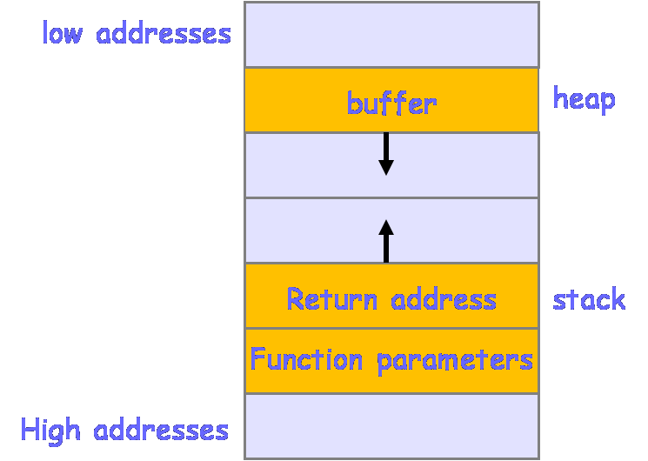
Buffer-Overflow Exploitation
Buffer-Overflow Exploitation
Buffer overflow, a.k.a. buffer overrun, is a common software flaw. Buffer overflow occurs if the process writes more data into a buffer area than it is supposed to hold
It is possible to exploit buffer overflows to redirect the victim’s program to execute attackers’ own code located in a different location. Such attacks often exploit function calls in standard memory layout, where the buffer is placed in a heap and the return address of the function call is placed in a stack

Slide 31
General steps of buffer-overflow attack:
Find a program that is prone to buffer overflows (e.g. programs using functions that do not check bounds are good candidates)
Figure out the address of the attacker’s code
Determine the number of bytes long enough to overwrite the return address
Overflow the buffer that rewrites the original return address of the function call with the address of the attacker’s code
Defense method – Always add statements to check bounds when dealing with buffers in a program

Slide 32
Repudiation
In some situations the owner of the data may want to deny ownership of the data to evade legal consequences
  He may argue that he has never sent or received the data in question
Defense method –
  Use stronger encryption and authentication algorithms

Slide 33
Intrusion
An unauthorized user gains access to someone else’s computer systems. Configuration loopholes, protocol flaws, and software side effects may all be exploited by intruders
Intrusion detection is a technology for detecting intrusion incidents. Closing TCP and UDP ports that may be exploited by intruders can also help reduce intrusions
IP scans and Port scans are common hacking tools. However, it can also help users to identify in their own systems which ports are open and which ports may be vulnerable.

Slide 34
Traffic Analysis
The purpose is to determine who is talking to whom by analyzing IP packets. Even if the payload of the IP packet is encrypted, the attacker may still obtain useful information from analyzing IP headers
Defense method – Encrypt IP headers. But an IP packet with an encrypted IP header cannot be routed to destination. Thus, network gateways are needed
  Network gateway also protects internal network topology

Slide 35
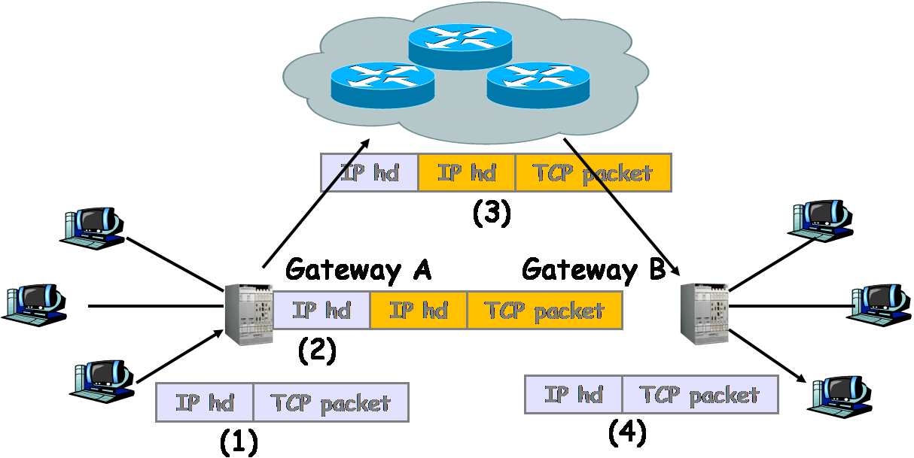
(1) Sender forwards an IP packet to gateway A. (2) gateway A encrypts sender’s IP packet and routes it to the next router in the Internet. (3) The IP packet from Gateway A is delivered to gateway B. (4) Gateway B removes its header, decrypts the encrypted IP packet of the sender, and forwards it to the receiver.

Slide 36
Denial of Service Attacks
To block legitimate users from getting services they can normally get from servers
  DoS – launched from a single computer
  DDoS – launched from a group of computers

Slide 37
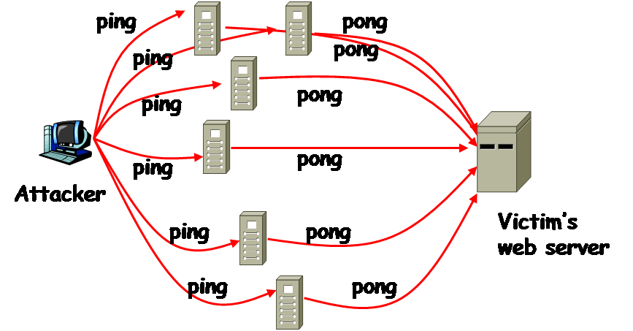
DoS
SYN flooding is a typical and effective technique used by DoS attacks. The smurf attack is another typical type of DoS attacks
Attacker sends an excessive number of crafted ping requests to a large number of computers within a short period of time, where the source IP address in the crafted ping request is replaced with the victim’s IP address. Therefore, each computer that receives the crafted ping request will respond to the victim’s computer with a pong message.

Slide 38
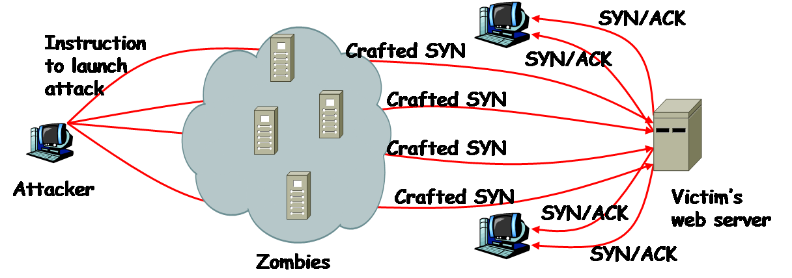
DDoS
  A typical DDoS attack proceeds as follows:
  Compromise as many networked computers as possible
  Install special software in the compromised computers to carry out a DoS attack at a certain time later; these computers are called zombies
  Issue an attack command to every zombie computer to launch a DoS attack on the same target at the same time

Slide 39
Spam Mail
Spam mails are uninvited email messages, which may be commercial messages or phishing messages
While not intended to bring the user’s computer out of service, spam mails do consume computing resources
Spamming also occurs in Web search engines, Instant Messaging, blogs, mobile phone messaging, and other network applications
Defense method – spam fillers are software solutions to detect and block spam mails from reaching the user’s mailbox

Slide 40
Malicious Software
Software intended to harm computers is malicious software. Malicious software is also referred to as malware
    Virus
    Worms
    Trojan horses
    Logic bombs
    Backdoors
    Spyware

Slide 41
Viruses and Worms
  A computer virus is a piece of code that can reproduce itself
      It is not a standalone program, and so it must attach itself to a host program or file
      A host program or file that contains a virus is called an infected host
  A computer worm is also a piece of code that can reproduce itself. Unlike a virus, a worm is a stand alone program
    Defense method –
  Do not download software from untrusted Web sites or other sources
  Do not open any executable file created by someone you do not know
  Make sure software patches are installed and up to date

Slide 42
Trojan Horse
Trojan horses are software programs that appear to do one thing, but secretly also do other things
Trojan horses often disguise themselves as desirable and harmless software applications to lure people to download them
Defense method – The same measures of combating viruses and worms can also be used to combat Trojan horses. Virus scans can also detect, quarantine, and delete Trojan horses

Slide 43
Logic Bombs
Logic bombs are subroutines or instructions embedded in a program. Their execution are triggered by conditional statements
Defense method –
Employers should take good care of their employees, so that none would be tempted to place a logic bomb
Project managers should hire an outside company or form a special team of reviewers from a different group of people other than the developer to review the source code
Relevant laws should be established so that employees who planted logic bombs will face criminal charges

Slide 44
Backdoors
Backdoors are secret entrance points to a program
They may be inserted by software developers to provide a short cut to enter a password-protected program when attempting to modify or debug code
Defense method – Check source code by an independent team

Slide 45
Spyware
Spyware is a type of software that installs itself on the user’s computer
Spyware is often used to monitor what users do and harass them with popup commercial messages
    Browser Hijacking – a technique that changes the settings of the user’s browsers
    Zombieware – software that takes over the user’s computer and turns it into a zombie for launching DDoS attacks or into a relay which carries out harmful activities such as sending spam email or spreading viruses.

Slide 46
Spyward can also do a list of other things, including
Monitoring – monitor and report to a web server or to the attacker’s machine a user’s surfing habits and patterns
Password sniffing – sniff user passwords by logging users’ keystrokes using a keystroke logger
Adware – software that automatically displays advertising materials on the user’s computer screen
    Defense method – use anti-spyware software to detect and block spyware

Slide 47
Chapter 1 outline
1.1 Mission and Definitions
1.2 Common Attacks and Defense Mechanisms
1.3 Attacker Profiles
1.4 Basic Security Model
1.5 Security Resources

Slide 48
Hackers
Hackers
Computer hackers are people with special knowledge of computer systems. They are interested in subtle details of software, algorithms, and system configurations
  Black-Hat Hackers – hack computing systems for their own benefit
  White-Hat Hackers – hack computing systems for the purpose of searching for security loopholes and developing solutions
  Grey-Hat Hackers – wear a white hat most of the time, but may also wear a black hat once in a while
When discovering security vulnerabilities in a software product, white-hat hackers and grey-hat hackers would often work directly with the vendors of products to help fix the problems

Slide 49
Script Kiddies
Script kiddies are people who use scripts and programs developed by black-hat hackers to attack other people’s computers
Even though they do not know how to write hacking tools or understand how an existing hacking tool works, script kiddies could inflict a lot of damage

Slide 50
Cyber Spies
Collecting intelligence through intercepted network communications is the job of cyber spies
Countries have intelligence agencies
Military organizations have intelligence units
They intercept network communications and decipher encrypted messages

Slide 51
Vicious Employees, Cyber Terrorists and Hypothetical Attackers
Vicious Employees
Vicious employees are people who intentionally breach security to harm their employers
Cyber Terrorists
Cyber terrorists are terrorists who use computer and network technologies to carry out their attacks and produce public fear
Hypothetical Attackers
  black-hat hackers
  script kiddies
  greedy cyber spies who are willing to betray their countries or organizations for monetary benefits
  vicious employees

Slide 52
Chapter 1 outline
1.1 Mission and Definitions
1.2 Common Attacks and Defense Mechanisms
1.3 Attacker Profiles
1.4 Basic Security Model
1.5 Security Resources

Slide 53
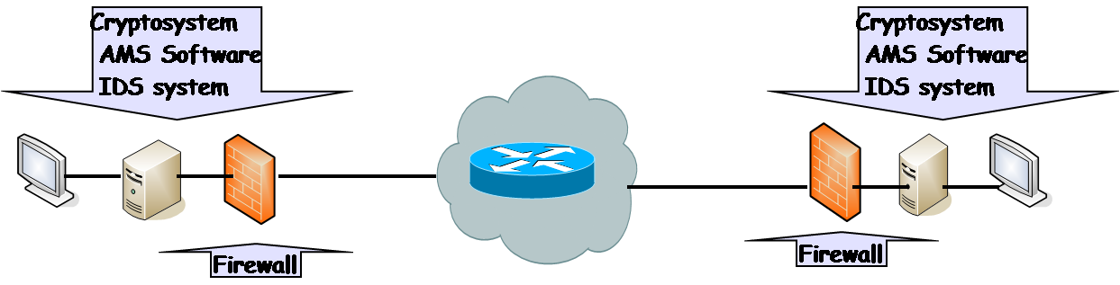
Basic Security Model
The basic security model consists of four components: cryptosystems, firewalls, anti-malicious-software systems (AMS software), and intrusion detection system (IDS)

Slide 54
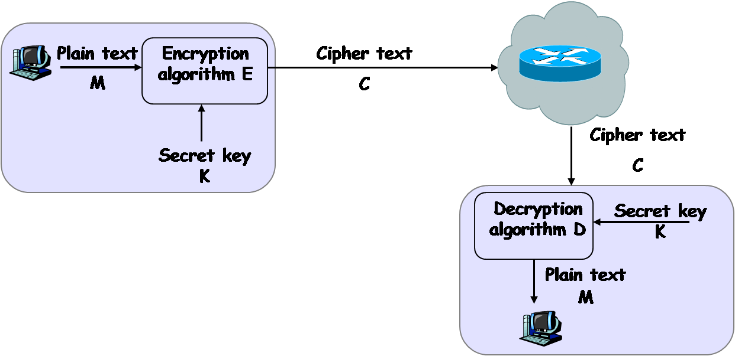
Network model of cryptosystem

Slide 55
Chapter 1 outline
1.1 Mission and Definitions
1.2 Common Attacks and Defense Mechanisms
1.3 Attacker Profiles
1.4 Basic Security Model
1.5 Security Resources

Slide 56
Example Security Resources
CERT
  www.cert.org
SANS Institute
  www.scans.org
Microsoft Security
  www.microsoft.com/security/default.mspx
NTBugtraq
  www.ntbugtraq.com

