Slide 1
Bitcoin Theory for Wallet-operators
Part3: transactions, outputs and change-addresses
There is much to know about bitcoin. Here, we’ll focus only on the things relevant for practical wallet-operation.

Slide 2






How a real-world tx look like
A transaction is like a message signed with a private key
Other than implied in the last section, there is no balance on a specific address
You rather control “ouputs” which are the coins someone sent to you at a certain point in time
These outputs can be understood as the coins you’re holding. Unlike regular coins, those have complete different denominations
If you create a transaction, you’re refering to existing outputs. These are the inputs of the transaction.
These funds get sent to a (or more) addresses. These are called the outputs of the transaction
So technically, a transaction is a element with inputs and outputs where the sum of the outputs is smaller than the sum of the inputs
Inputs
Outputs
10 BTC
5 BTC
10 BTC
3 BTC
1.999 BTC
4 BTC
Transaction Fee = 0.0001 BTC
The difference between input
and outputs is the transaction-fee
paid to the miner

Slide 3







Creating a Transaction (1/7)
An input is a reference to an (yet unspent, but soon spent) output
If an output is consumed by an input of another tx, it cannot be consumed again
So inputs are either consumed, or not. They are either part of the utxo-set, or not (unspent transaction output)
This begs the question: What if I don’t want to spend the whole output but rather only a fraction?
Inputs
Outputs
2 BTC
Inputs
Outputs
5 BTC
2 BTC
1 BTC
2 BTC
5 BTC
Inputs
Outputs
1.5 BTC
2 BTC
5 BTC
Inputs
Outputs
1.5 BTC
5 BTC
Notes:
Output to Bitcoin-addresses
But input is not simply from an address
Input needs funding and funding is coming from other transactions
So let’s search for transactions which send bitcoins to my addresses

Slide 4
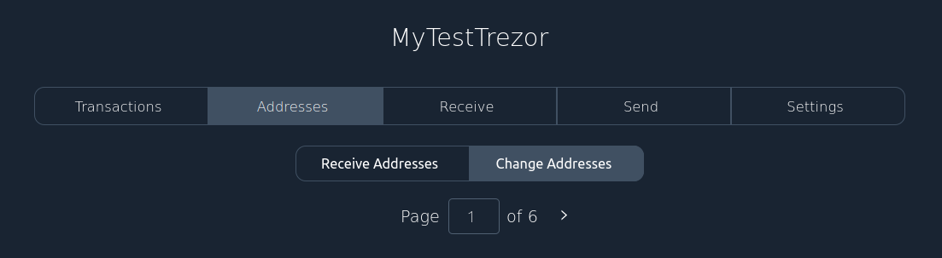
Change addresses
If an input cannot be consumed entirely, the unconsumed amount goes with an extra-output back to the address of the wallet creating the transaction
This is usually hidden in the send-dialog but the Addresses tab shows both address-types separated from each other
Notes:
Output to Bitcoin-addresses
But input is not simply from an address
Input needs funding and funding is coming from other transactions
So let’s search for transactions which send bitcoins to my addresses

Slide 5
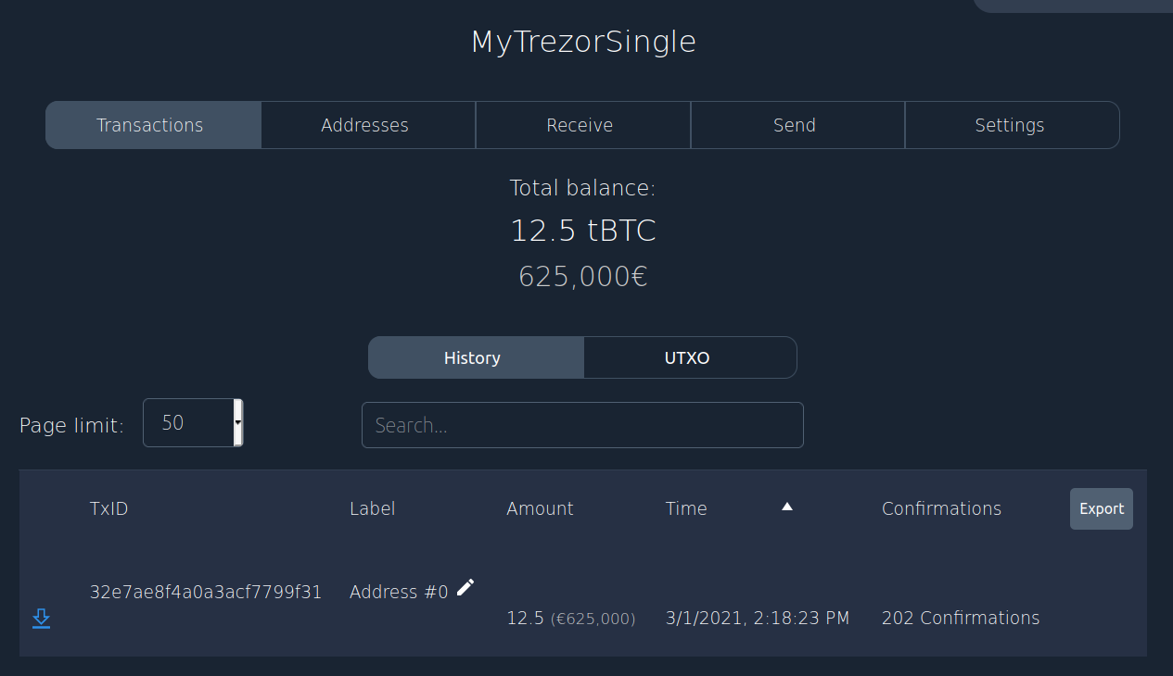
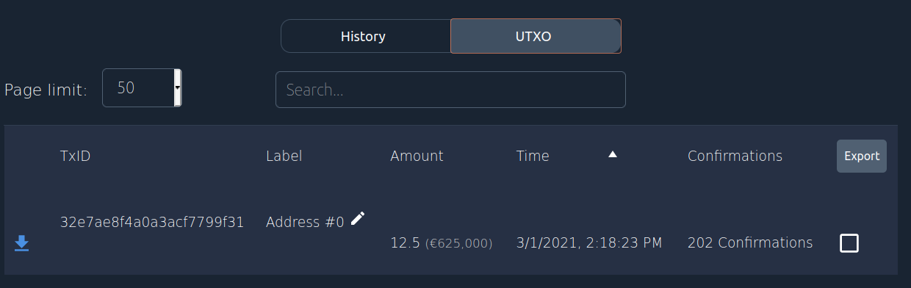
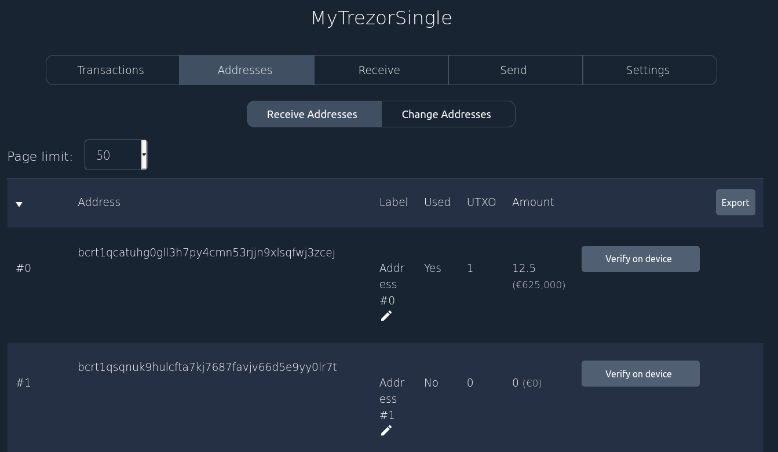
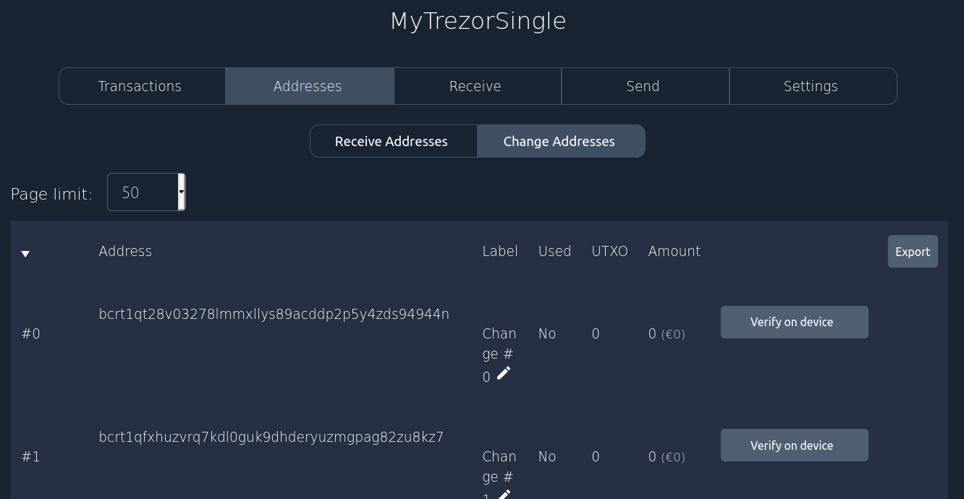
Example – initial status
You have 12.5 BTC in your wallet
These are all within one UTXO
So the history is only listing that one transaction, utxo looks very similar
The address-tab shows your distribution of your utxos over your addresses. Remember, you can (but should not) reuse addresses
Change-addresses are existing but don’t hold any balance

Slide 6
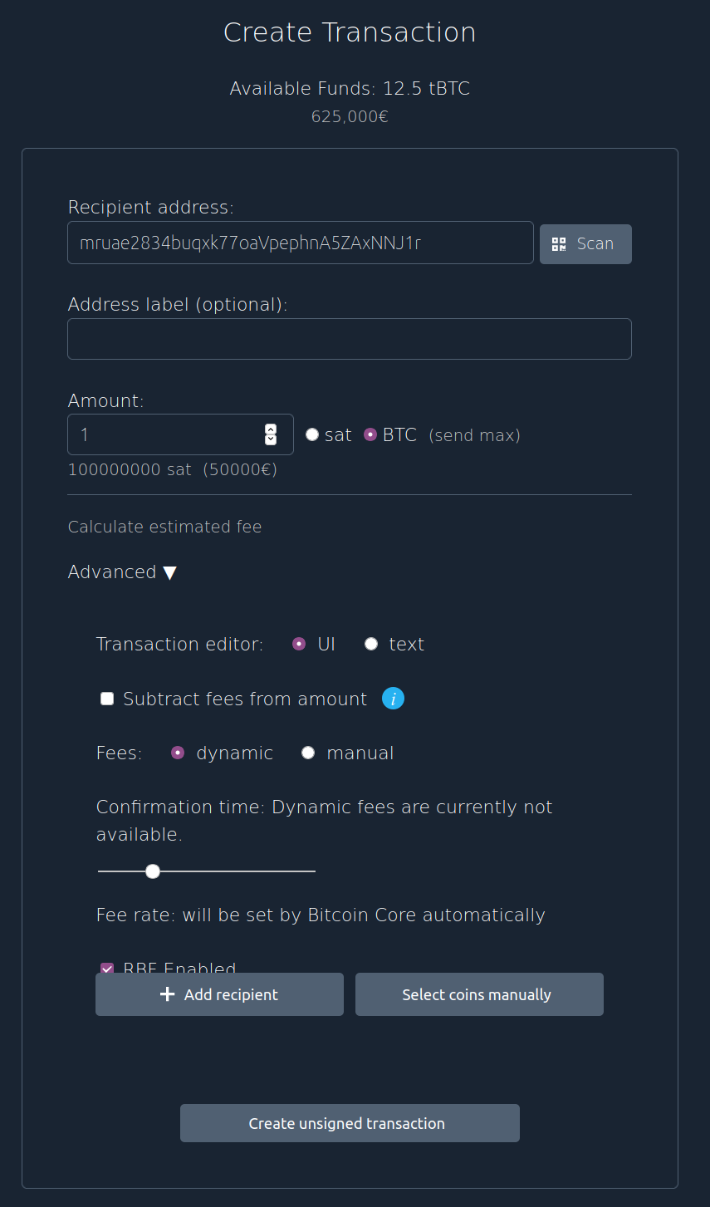
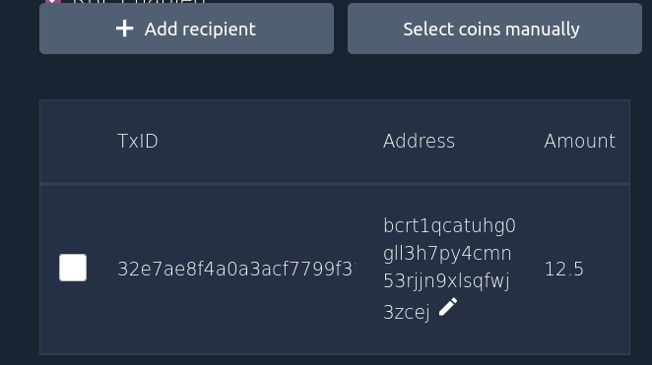
Example – Send transaction
Now we send 1 btc to some recipient address
Who should pay the fees? Check the box if it’s the recipient.
On mainnet, you’ll get an idea how long the transaction will need to get into a block. Adjust the fee accordingly.
There is no mention of change-addresses as this will be done automatically
“Add a recipient” will add new outputs
“Select coins manually” will allow you to granually decide which UTXOs you want to use
Selecting the coins wouldn’t make
too much sense as you only have
one utxo

Slide 7
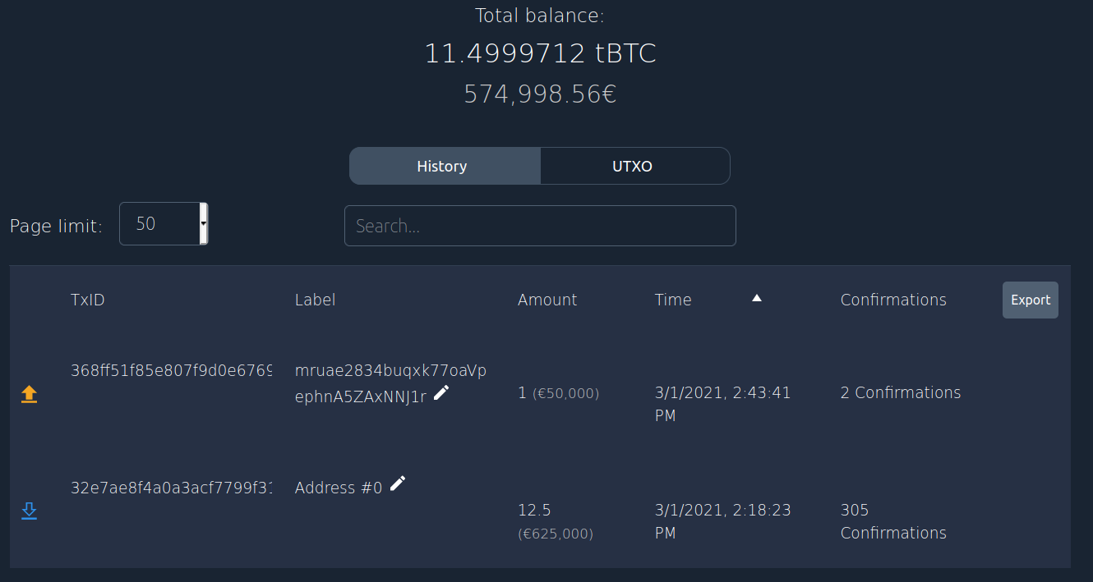
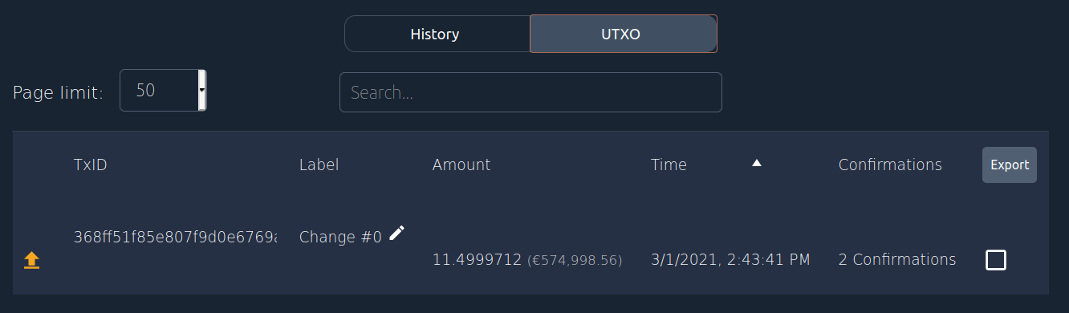
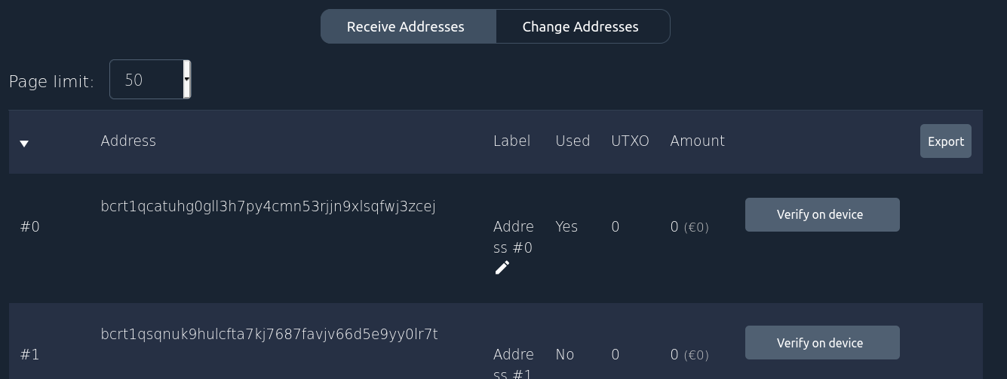
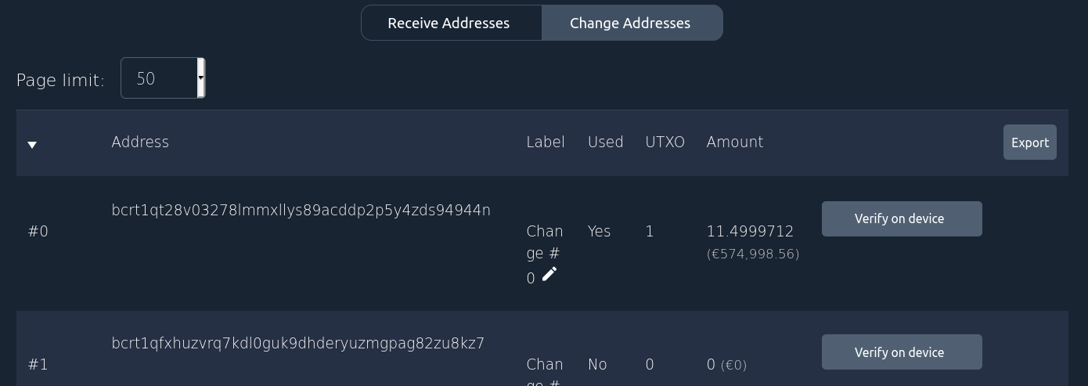
Example – status afterwards
Now you balance has reduced. You have 12.5 -1 - fees BTC in your wallet
Two transactions are in the history, one incoming, one outgoing
The receive-addresses has now an empty balance. All your funds are now in the change-address

