Slide 1
HD-Wallets, derivation-pathes, address-types
There is much to know about bitcoin. Here, we’ll focus only on the things relevant for practical wallet-operation.

Slide 2
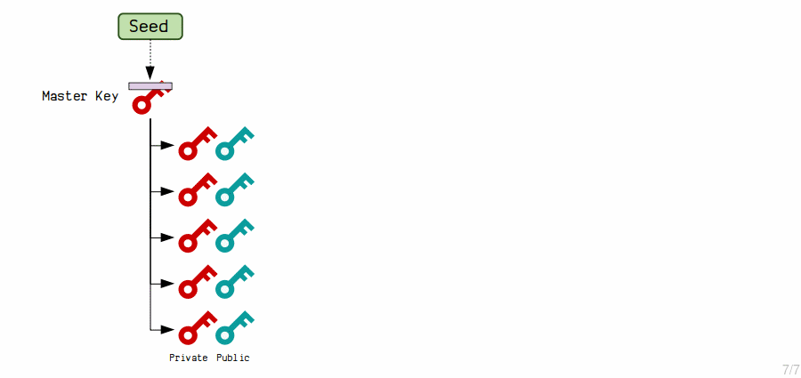
Problem with single addresses
It’s entirely possible to reuse single addresses but ...
The blockchain is public and all your transactions are visible on that address (Privacy-issue)
You’re not only compromising privacy of yourself, but also the that of your counterparties
When an utxo is spent from an address, it’s public-key get revealed. This is limiting the security of the still existing funds on that address
Therefore, it’s discouraged to reuse addresses. You should use/create new addresses for every single transaction
Also, private keys are quite bad to remember
Sure, you can create new addresses all the time but then you need to backup, whenever you create a new address.
As an alternative, BIP-32 specifies HD-Wallets. They generate new addresses automatically out of a single master-seed.

Slide 3
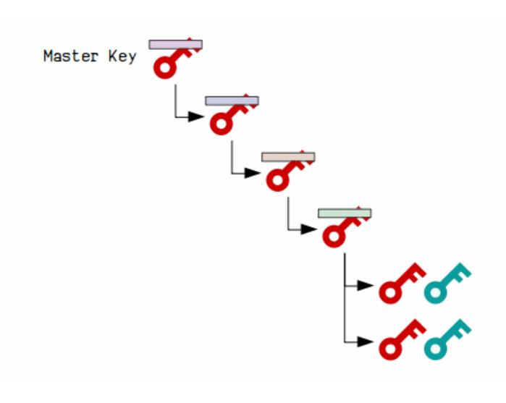
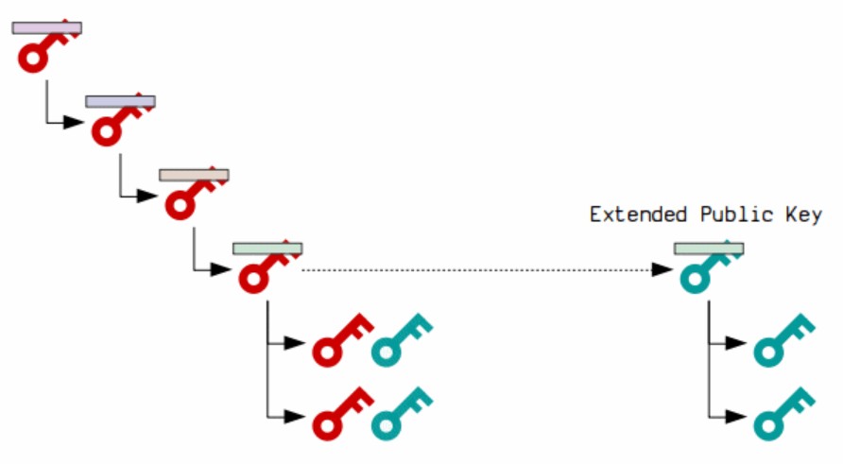
Hierarchical and xpubs?
HD-wallets are also hierarchical. This means that a generated key can also create subkeys which itself create keys again.
The real killer-featurethough, is the the ability to create an extended Publik-key (xpub). This key can generate the same public-keys than the private-key but only the public part.

Slide 4
Extended Public Keys
Xpubs are incredible useful because you don’t need to keep the same security than for public keys
The security-problem transforms into a privacy-issue
So in practise, you give specter-desktop an xpub and Specter can figure out your balance, no matter how much addresses you’re using without knowing the private-key (and the security-implications this brings)
But how can you specify a specific key?
How does you get from an existing master-key to a key which then generates the individual keys?
Especially as the Wallet is hierarchical?
So we need a way to determine a “path” from the master-key to the wallet
That’s done by derivation-pathes

Slide 5
From xpubs to derivation pathes
Xpubs are incredible useful because you don’t need to keep the same security than for public keys
The security-problem transforms into a privacy-issue
So in practise, you give specter-desktop an xpub and Specter can figure out your balance, no matter how much addresses you’re using without knowing the private-key (and the security-implications this brings)
But how can you specify a specific key?
How does you get from an existing master-key to a key which then generates the individual keys?
Especially as the Wallet is hierarchical?
So we need a way to determine a “path” from the master-key to the wallet
That’s done by derivation-pathes (bip-43, bip-44, bip-83)
So a seed combined with a specific derivation-path ends up in a specific wallet
Example for a derivation-path:
m/0/1/3'
Let’s look at this example a bit closer

Slide 6
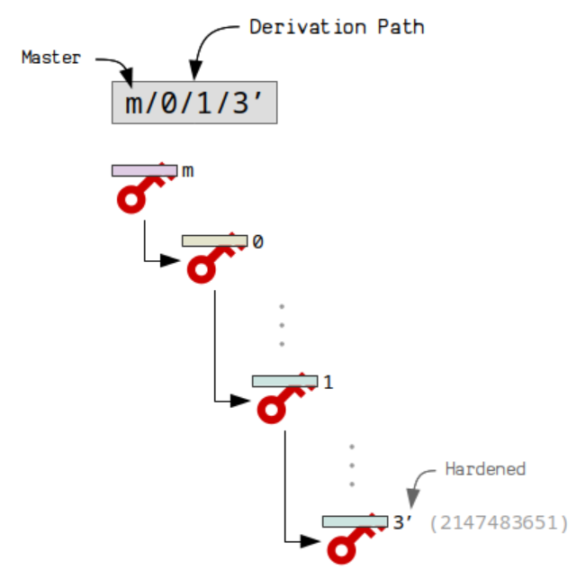
derivation pathes - example
But how can you specify a specific key?
How does you get from an existing master-key to a key which then generates the individual keys?
Especially as the Wallet is hierarchical?
So we need a way to determine a “path” from the master-key to the wallet
That’s done by derivation-pathes (bip-43, bip-44, bip-83)
So a seed combined with a specific derivation-path ends up in a specific wallet
Example for a derivation-path:
m/0/1/3'
Let’s look at this example a bit closer

Slide 7
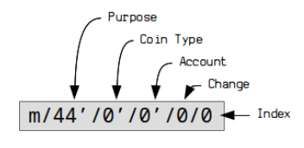
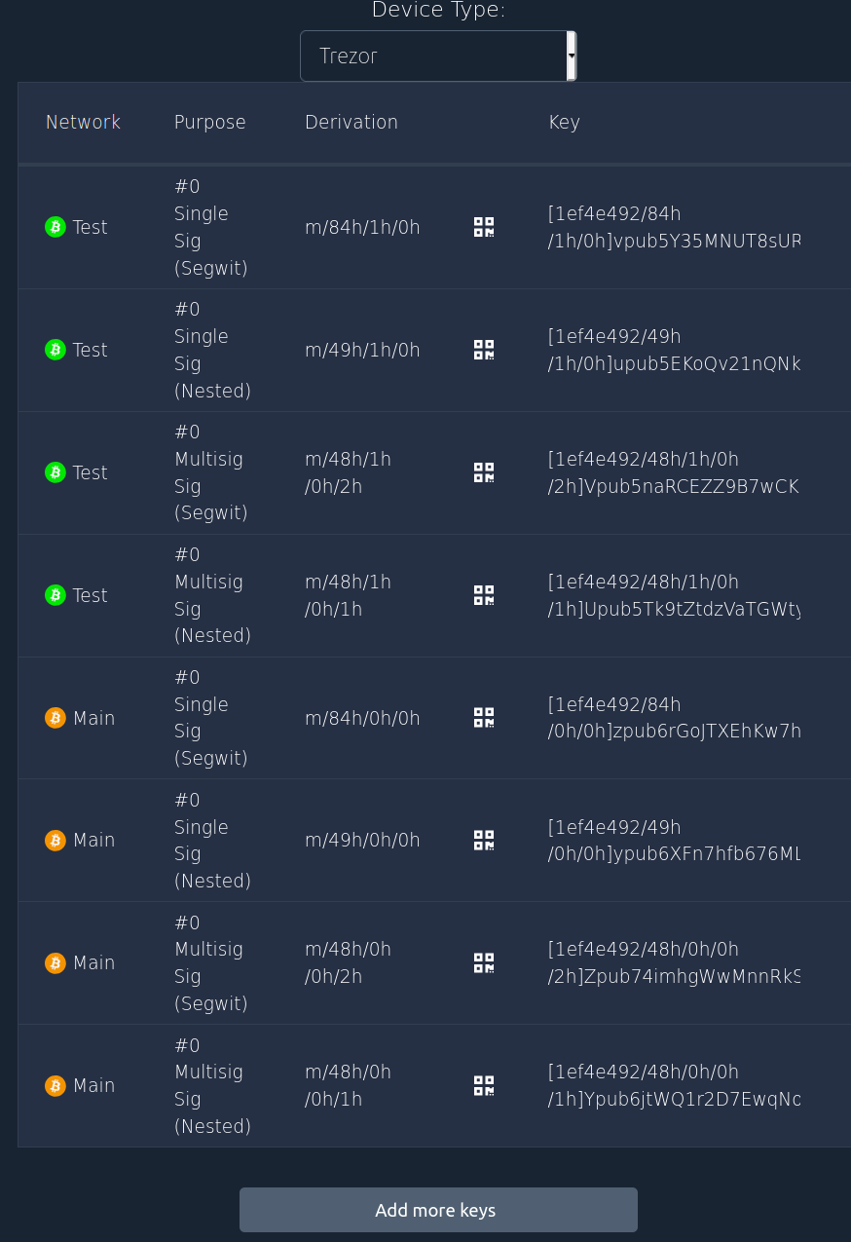
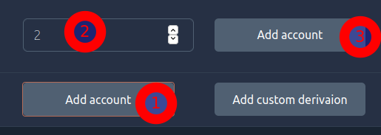
Xpub - Examples
Possible purposes
  84h (Single-Sig-Segwit) (for bc1addresses)
  48h (Multi-Sig-Segwit)
  …
Cointypes might be 0h for main-net and 1h for testnet/regtest and maybe other test networks
The account is YOUR level you can use in order to separate accounts from one another.
The receiver-addresses and change-addresses are separated on an extra level
The last one is the index which separates one address from another

Slide 8
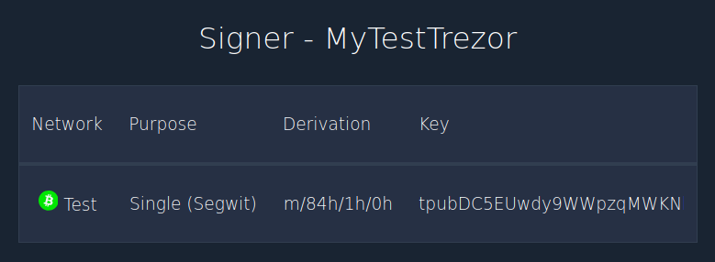
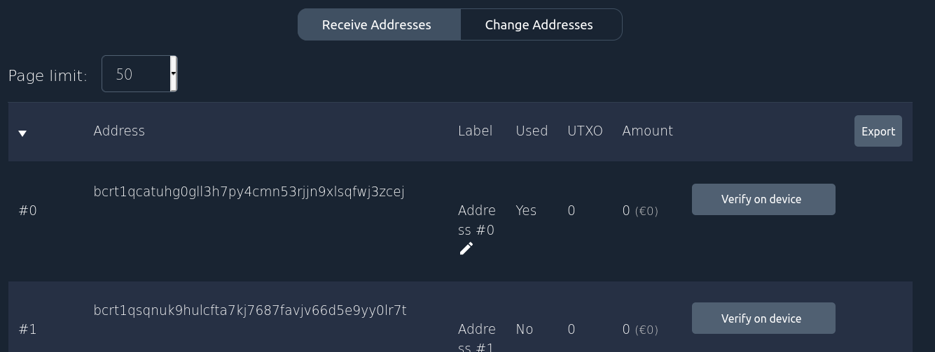
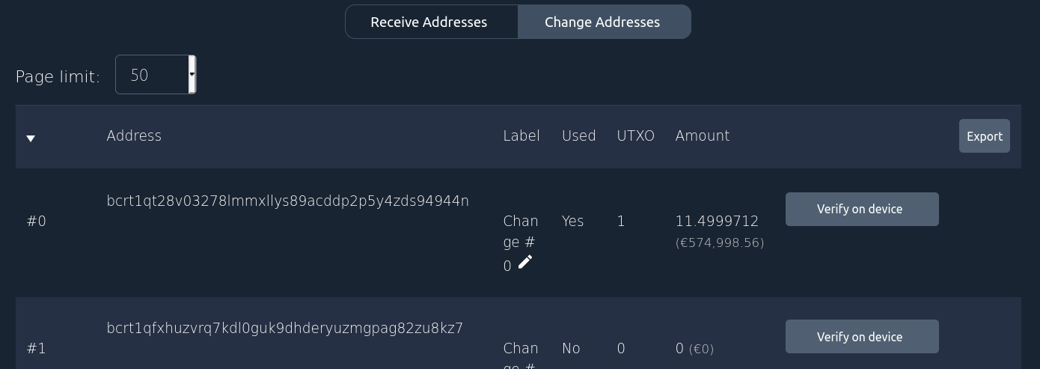
Derivation Path – example
Let’s look at one example from the unit before this
The wallet is a Single-sig segwit-wallet on the testnet and no account has been used (0) ==> m/84h/1h/0h
So each address can be described via it’s derivation-path. This way if you click on “verify on device”, specter-desktop will communicate to the hardware-wallet which address is exactly meant
m/84h/1h/0h/1/0
m/84h/1h/0h/0/1

Slide 9
Exercise – seed-creation with mnemonic

