Slide 1
Bitcoin Theory for Wallet-operators
Part2: Public/private cryptography and tx-signing
There is much to know about bitcoin. Here, we’ll focus only on the things relevant for practical wallet-operation.

Slide 2
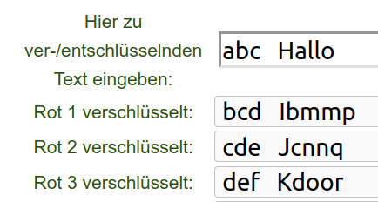
Asymetric vs. Symetric encryption
Symetric encryption:
  Example: ROTx
  The key for encryption is the same then for decryption
Asymetric Encryption:
  The key is split up in a private and a public part
  What’s encrypted with one key can only get decrypted with the other key (and vice versa)
https://www.thomas-kuehn.de/geocaching/rot.php

Slide 3
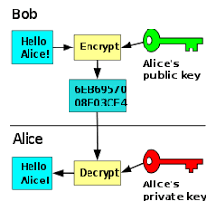
Asymetric Encryption
Alice creates a keypair and passes the public-part to Bob
Bob uses the public-key to encrypt a message and passes the encrypted message to Alice
Alice uses her private key to decrypt the message again
But Bitcoin does not use encryption. In Bitcoin it’s about signing messages
Notes:
- Alice generiert ein Schlüsselpaar und gibt Bob den öffentlichen Schlüssel
- Mithilfe dieses Schlüssels verschlüsselt Bob die Nachricht und gibt sie an Alice weiter
- Alice verwendet den privaten Schlüssel um die Nachricht zu entschlüsseln
- Bitcoin verwendet keine Verschlüsselung

Slide 4
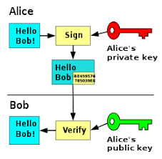
Asymetric Signing
Alice creates a keypair and passes the public-part to Bob
Alice uses the private-key to encrypt a message and passes the encrypted message and the cleartext-message to Bob
Bob uses the public key of Alice to decrypt the message again
Bob compares the decrypted message with the clear-text-message
The encrypted message becomes an electronic signature
Notes:
- Das Verfahren kann auch als Unterschrift verwendet werden
- In dem Fall verschlüsselt Alice eine Nachricht mit ihrem priv. Schlüssel

Slide 5
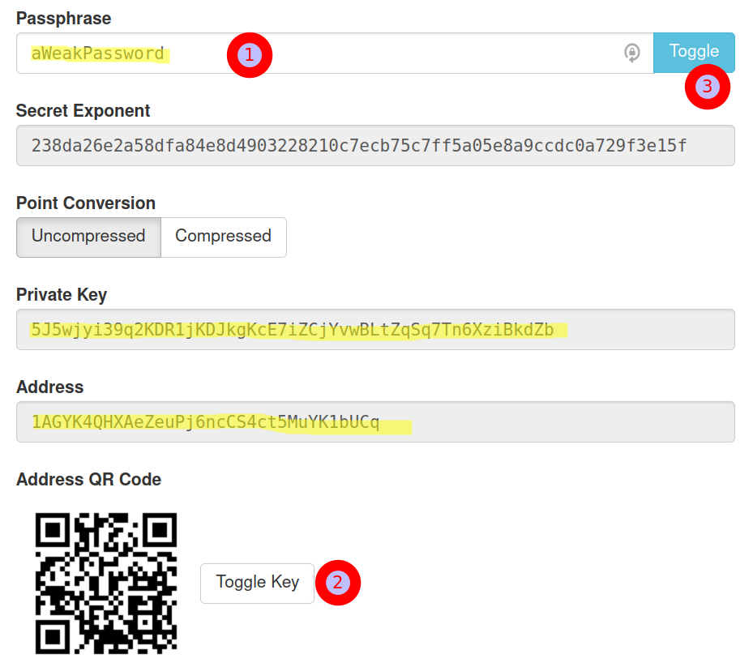
Exercise: Create a bitcoin-key
https://brainwalletx.github.io/#generator
1: Choose a more or less weak password
2: “toggle key” in order so see the “private key”
3: toggle to see the password in cleartext
Result:
  The “Private key” is your private-key
  The address is your public-key

Slide 6
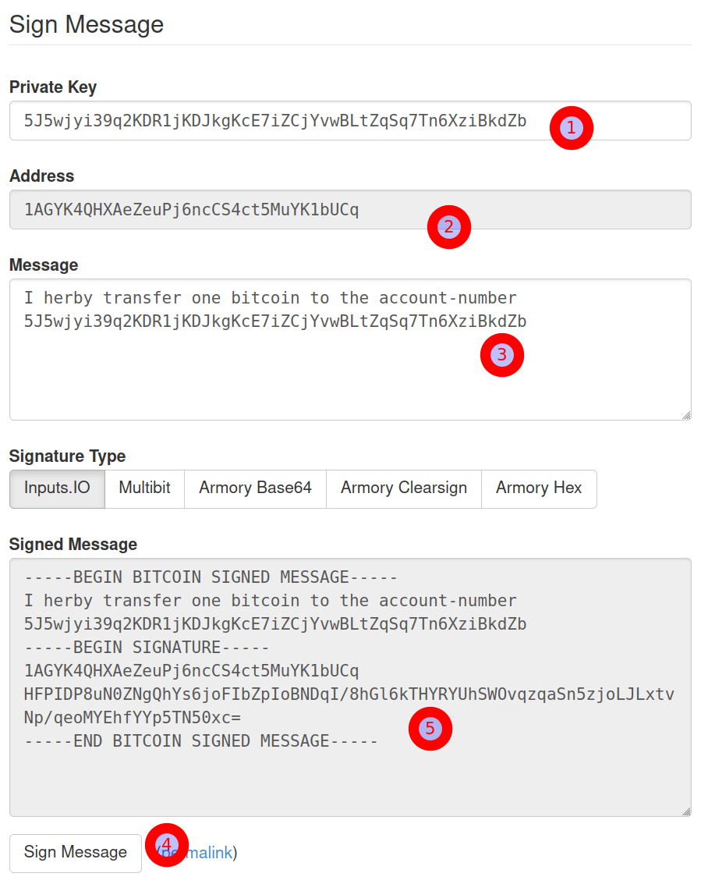
Exercise: Sign a message
https://brainwalletx.github.io/#sign
1: copy the private key into this field
2: note how the address get calculated automatically from the private key
3: type in your message. N
4: click “sign message”
5: The signed message get calculated
  The cleartext-message
  The address from which this message have been created
  The encrypted message

Slide 7
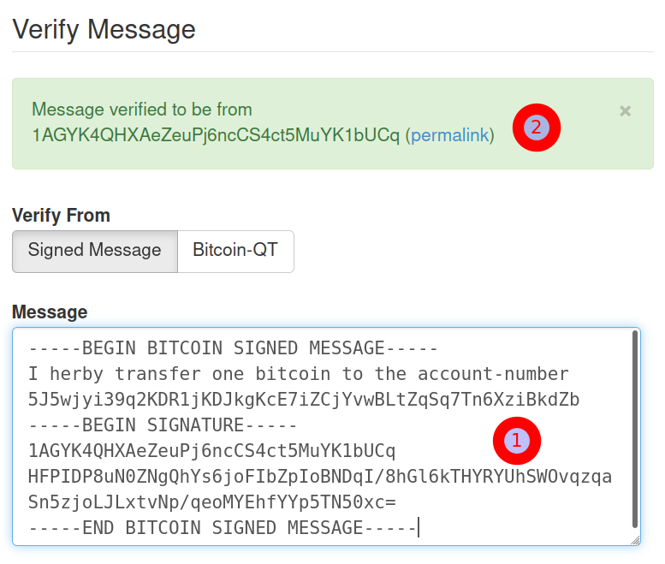
Exercise: Verify the message
https://brainwalletx.github.io/#verify
Maybe transfer the message to your neighbour
1: paste the message here
3: You get feedback whether the message could be verified
Try tampering the message and realize how the message is no longer verified
The example-message might be human readable and it might be a simplification of a transaction
A real transaction need to be machine-readable
And it needs to be verified on a different level: Is the addresss 1AGYK4QHXAeZeuPj6ncCS4ct5MuYK1bUCq in possession of this amount?
Is the receiver address a valid bitcoin-address?

Slide 8
Conclusion
There is no place where bitcoin is stored but you can unlock them with your private keys
Security of that private-key is therefore most essential

