Slide 1
Security, Risk-management and Operational Security
There is much to know about bitcoin. Here, we’ll focus only on the things relevant for practical wallet-operation.

Slide 2
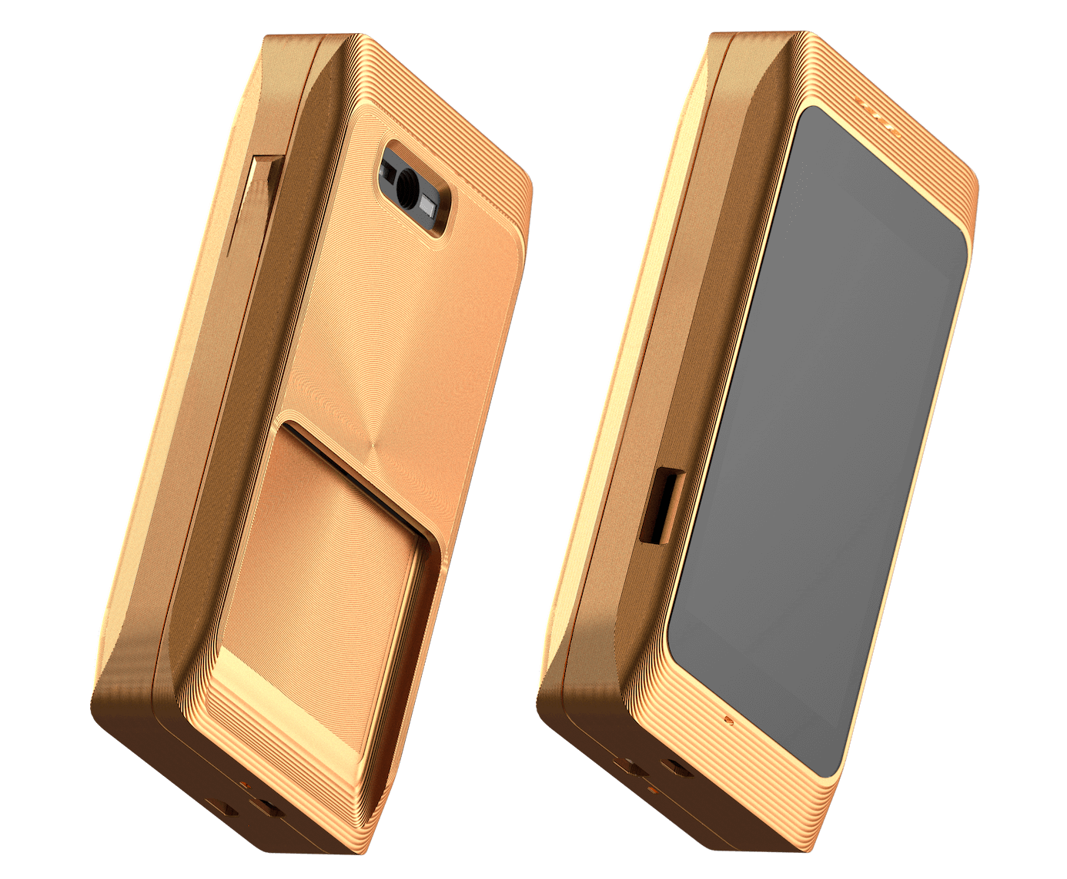
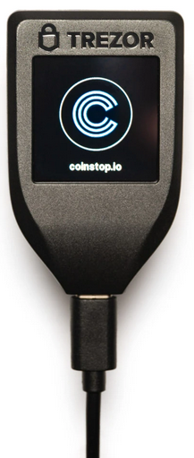
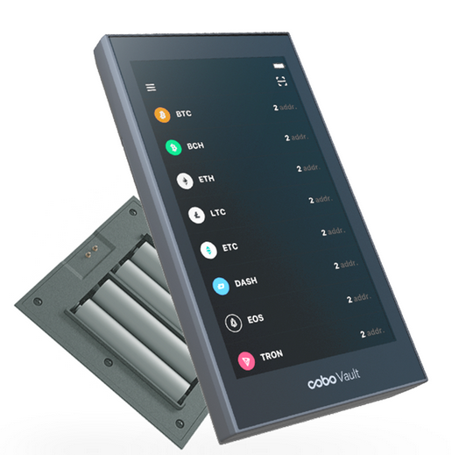
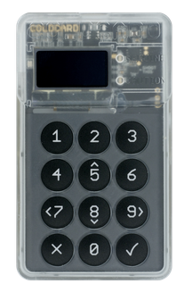
Reasons for hardwarewallets
Your funds have been stored on a hotwallet which is a wallet on a computer which is connected to the internet
Although that might be fine for smaller funds, it’s not acceptable for bigger ones
Hardwarewallets (HWW) are special devices which are not connected to the internet and ideally as much separated from a computer as possible
However, some information need to be transferred back and forth. So the HWW must be able to sign a transaction
Popular ways to transfer that information is:
  USB-connected, e.g. Trezor (most insecure)
  Transfer via SD-card (Coldcardwallet)
  Transfer via QR-codes (Specter + Cobo Vault)

Slide 3
Reasons for Multisig
A hardwarewallet is a single-point-of-failure:
  Loosing the device and the backup means loosing the funds
  The owner of the device is capable of spending all the fund
So with Multisignature-Wallets, you can mitigate that by requiring that a quorum of devices (e.g. 2 out of 3 devices) need to sign the transaction to make it a valid transaction
Different Hardware-Vendors mitigate supply-chain attacks where the vendor of the HWW built in a security-flaw which he’ll use after some time to steal the funds
With Multisig, an attacker must break multiple redundant systems to steal the funds

Slide 4
Reasons for your own node
Most HWW-vendors provide a backend service where you can see your funds, create your transactions (which gets signed than with your HWW)
Using these services has privacy-implications:
  The service knows about your funds
  The services knows about your IP-address
Apart from that, that service could stop working basically any time and/or asking for Data (e.g. name/address/ssn) which you don’t want to give away
Using an own bitcoin-node mitigates all these issues. Specter-desktop only works with your own node
However, operating an own node is resource-intensive

Slide 5
Security First
Not only having funds on an internet-connected computer is a risk. Dealing with your seed on paper is as well
Laser-microphones can listen through windows
A Mobile-Phone could take photos or switch on the microphone without you knowing it
Take care whenever you deal with your Mnemonic, your passphrase or other sensitive data like xpubs and private keys

Slide 6
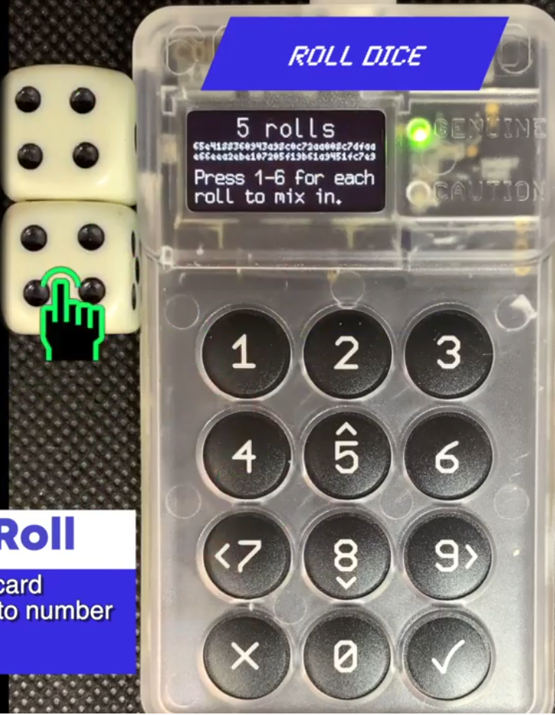
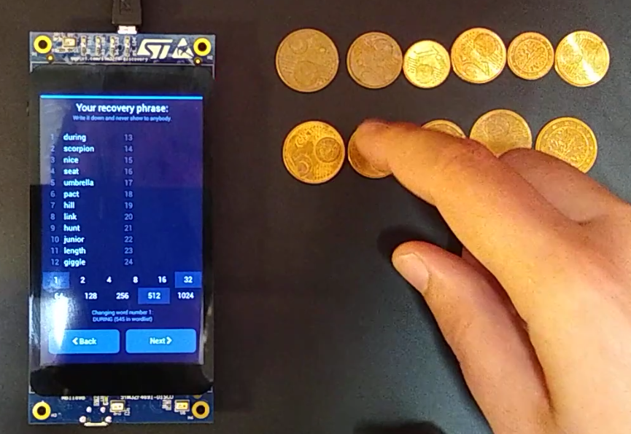
Seed Creation Security
A special point in time is the creation of the Seed/Mnemonic
How do you know that the random seed-creation-process is really random?
The solution here is to add additional “entropy” (random-data). This is possible with all major Hardware-wallets:
  Specter-Wallet provides that with coins
  Coldcard and Cobo-Vault provide that with dices
Don’t create your seed without additional entropy and make sure no one is spoofing on you while you creating your seed

Slide 7
Risk-modeling
Being aware of major risks to your funds is essential for your security.
A systematic threat-modeling has been created by Christopher Allen in his SmartCustody Book
So major threats according to him are:
  Loss by acts of god
  Loss by computer error -
  Loss by crime/theft/other attacks
  Loss by seizure
  Loss by mistakes
Most of these threats can be mitigated. Sometimes, the mitigation of some risks increase the risk of other threats. It’s idividually different which threats are actively mitigated and which ones are more or less accepted

Slide 8
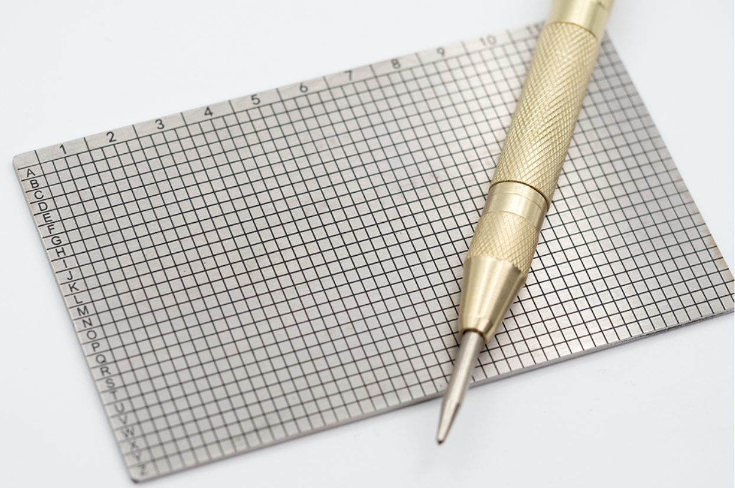
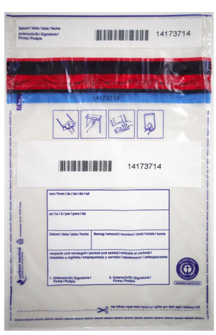
Mitigation patterns
Your backup should be secured to fire/floods, store them on steelplates in vaults
In order to detect unauthorized access, use tamper-proof bags

