Slide 1
Specter & Cobo Multisig
There is much to know about bitcoin. Here, we’ll focus only on the things relevant for practical wallet-operation.

Slide 2
Specter Multisig
Multisignature makes your Cold-Storage much more secure
To prepare for Multisig, you have to think about your Qorum: How man seeds/devices are there in total and how many signatures do you need to make a transaction able to spend
Most often used quorums are e.g. 2/3 or 3/5. Discussing the best quorum for you is not part of this exercise.
In this exercise we’ll use a simple 2/2 quorum to make it easy
We’ll use a Specter-DIY and a Cobo-Vault on testnet
We assume that the Specter-DIY Device has already been created on Specter-Desktop

Slide 3
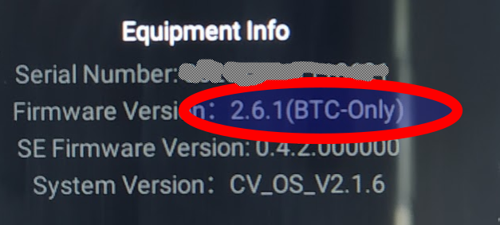
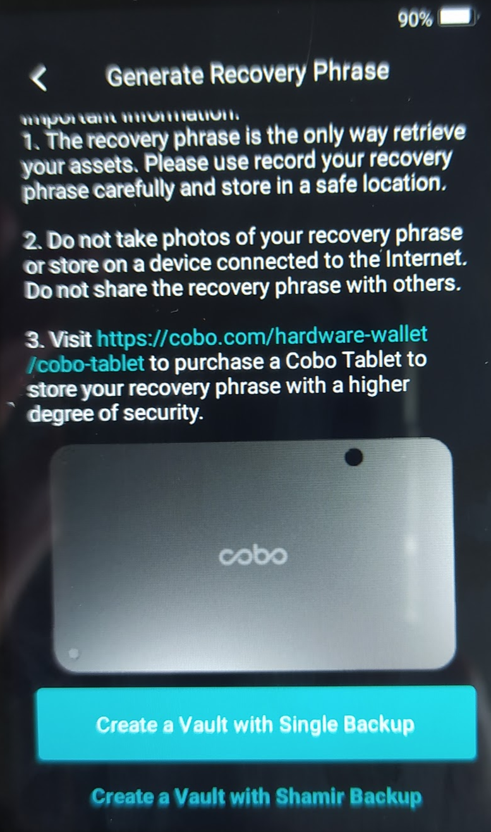
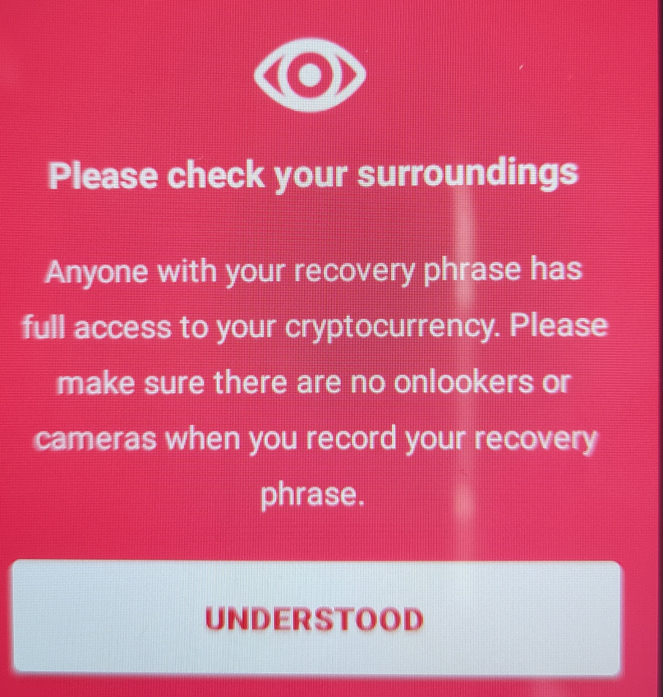
Cobo-Vault key considerations
In order to use Dices to insert entropy in Cobo-Vault, you need at least Version 1.2.1 of the Firmware. Also, it’s recommended to use a bitcoin-only-firmware. Update the firmware to the newest one is also recommended
You can create a vault with Shamir Backup. This will enable the splitup of this key into more parts. Whether that make sense is not part of this exercise.
You can only create Mnemonics with 24 words. 12 words are enough already from a security point of view but 24 words might make sense if you want to splitup this key in two or three parts. This is also out of the scope of this exercise
Check this video to setup and take the warning seriously!

Slide 4
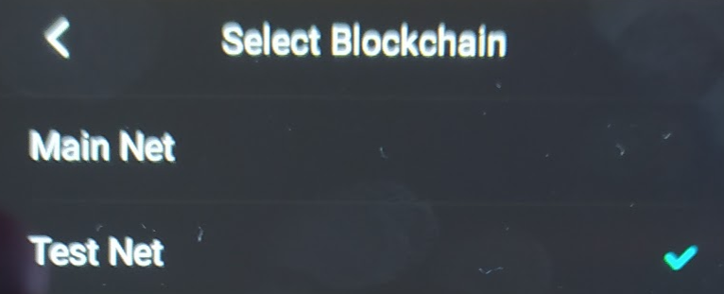
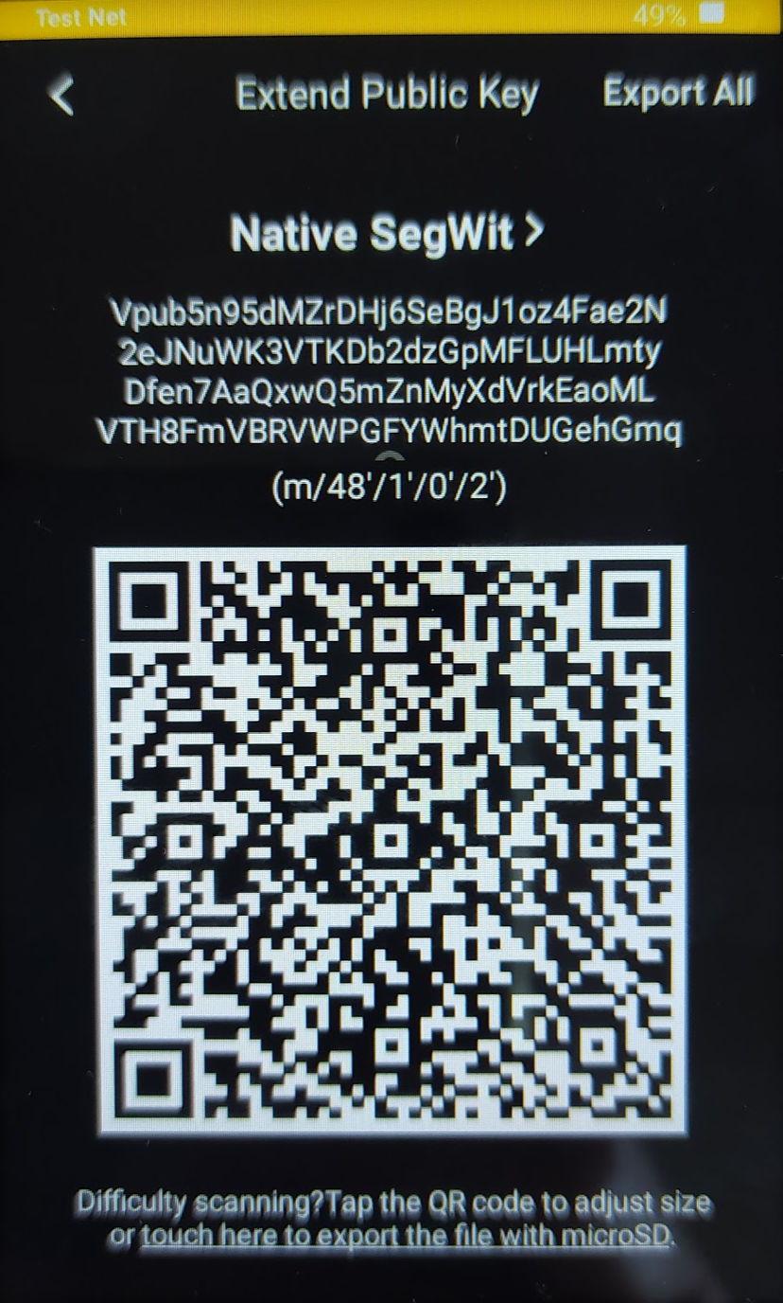
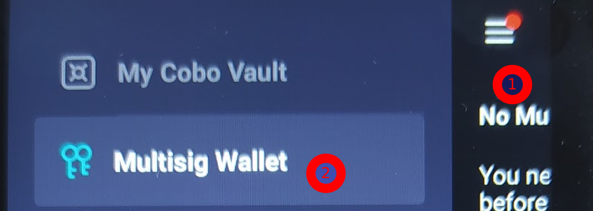
Create Cobo-Vault Device
We assume here, that you have a already initialised Cobo-Vault, make sure you chose “testnet” in Settings/Blockchain
Click the 3 lines (1), choose “Multisig Wallet” (2) and the three dots (upper-right) and choose “Show/Export XPUB”
On Specter-desktop “Add Device” → Cobo, give it a name and “Scan QR code” → the content from the cobo-device ( Derivation-Path m/48h/1h/0h/2h)

Slide 5
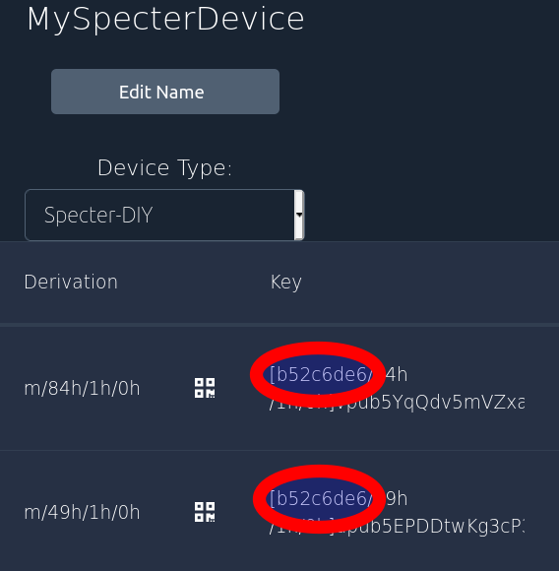
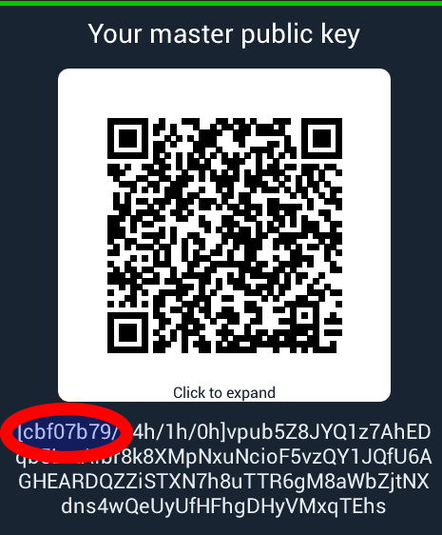
Multisig and Passphrases
Remember that we have set a passphrase for the singlesig device. However for Multisig-devices, passphrases are possible, but security-theater if you don’t take the storage-requirements into account
So by default, we don’t use a Passphrase for a Multisig-Device
Therefore, we need to remove the passphrase and add the resulting seed again as another device
On Specter-DIY got to Setting → “BIP-39 password” and simply click “done” which means an empty passphrase
If you choose “Master sublic keys” → “single key”, you’ll realize that the fingeprint of the master-seed has changed: cbf07b79 instead of b52c6de6. That’s exactly the use-case for the master-seed-fingerprint

Slide 6


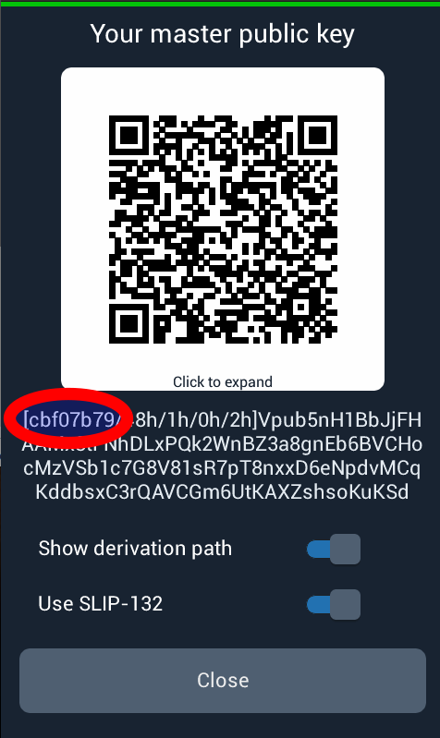
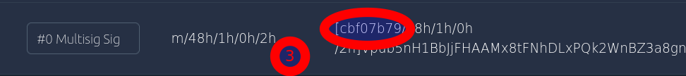
Import Multisig xpub from Specter
If you follow the exercises so far, we don’t have yet a multisig-key imported from Specter-DIY
Make sure you have chosen “testnet” in settings → Switch network
Click “Master public keys“(1) → “Multisig” (2)
In Specter-desktop, Choose your Specter-Device → “Add more keys” and scan the QR-code from Specter-DIY
Make sure you have now a key with the derivation-Path m/48/1h/0h/2h (3) and the right master-seed-fingerprint
I’ll call the device “MySpecterDeviceNP” for “No passphrase”

Slide 7
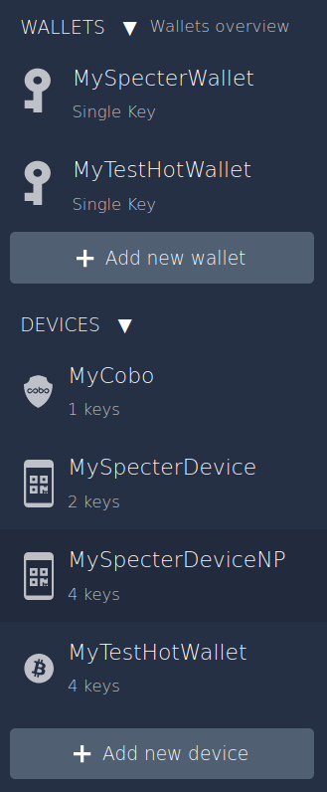

Create Multisig Wallet
So now you should have 4 Devices and 2 Single-Sig Wallets (from the former exercises)
Add a new Wallet, choose “Multisignature Wallet”
Pick the two devices you want to have (Cobo + MySpecterDeviceNP) and continue
Pick the quorum 2 / 2
“Create the Wallet”,
save the backup: This is much more important in a multisig-wallet than on a singlesig as you can’t recover your wallet if one of the devices/seeds is lost without this
… and “Continue”
In the next step, you need to export the created wallet to each of the two devices

Slide 8
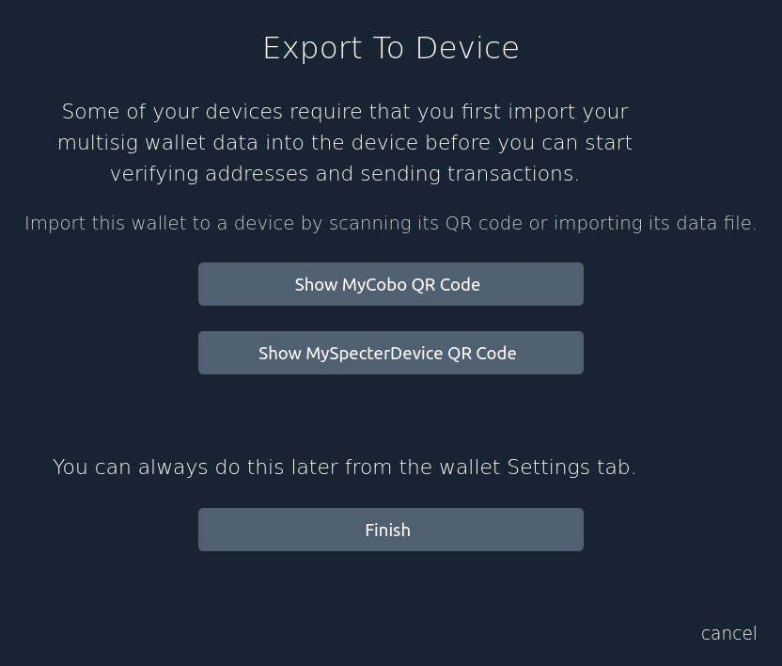
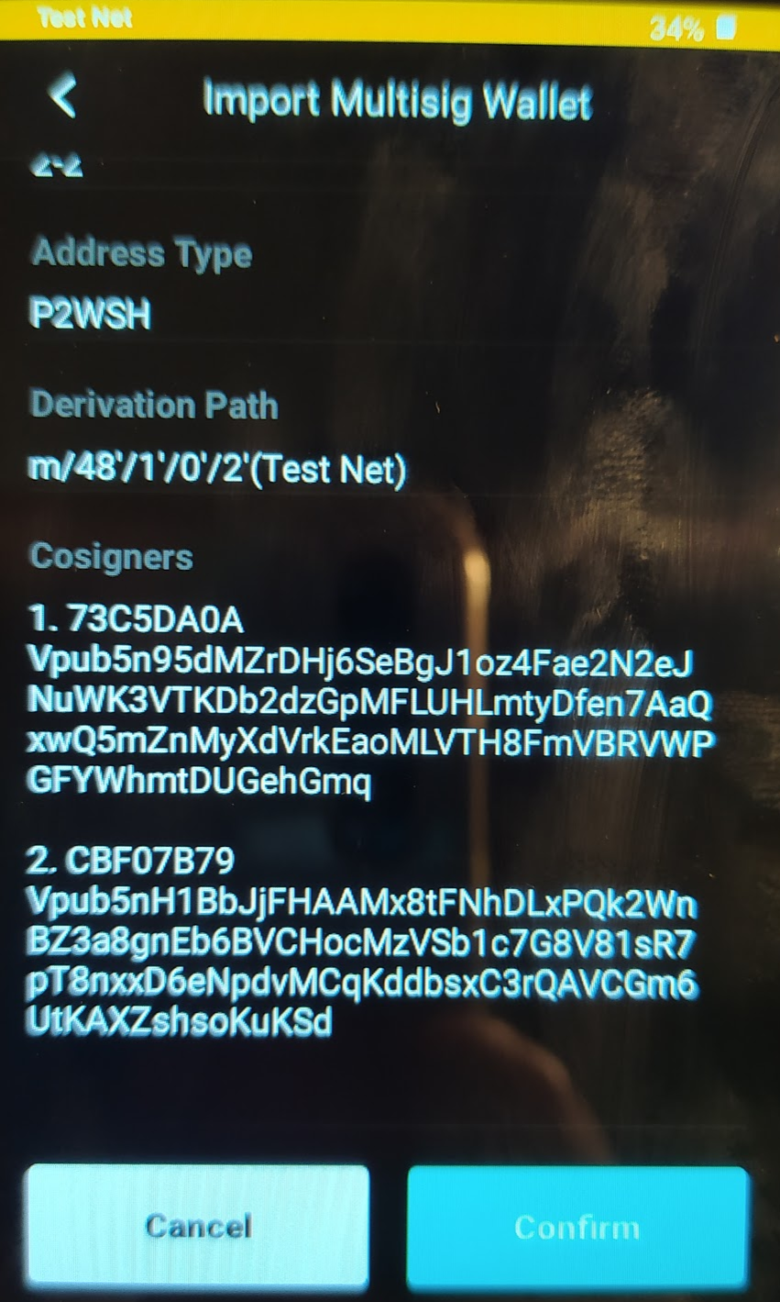
Create Multisig Wallet
So now you should have 2 Devices and 2 Single-Sig Wallets (from the former exercises)
“Click MyCobo QR Code”
In Cobo choose “Multisig Wallet” → Dots → “Import Multisig Wallet” → Scan (upper right)
Be sure to check all the details (fingerprints + xpubs of the cosigners) with the content of the backup-PDF and confirm

Slide 9
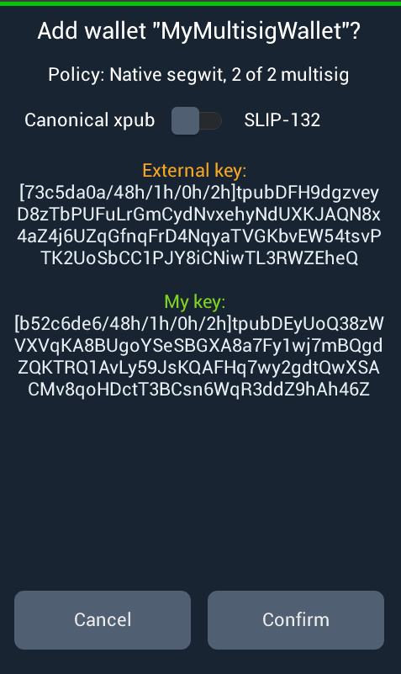
Create Multisig Wallet
Same thing now with Specter-DIY
Click “MySpecterDevice QR Code”
In Specter “Scan QR code”
Be sure to check all the details (fingerprints + xpubs of the cosigners) with the content of the backup-PDF and confirm

Slide 10
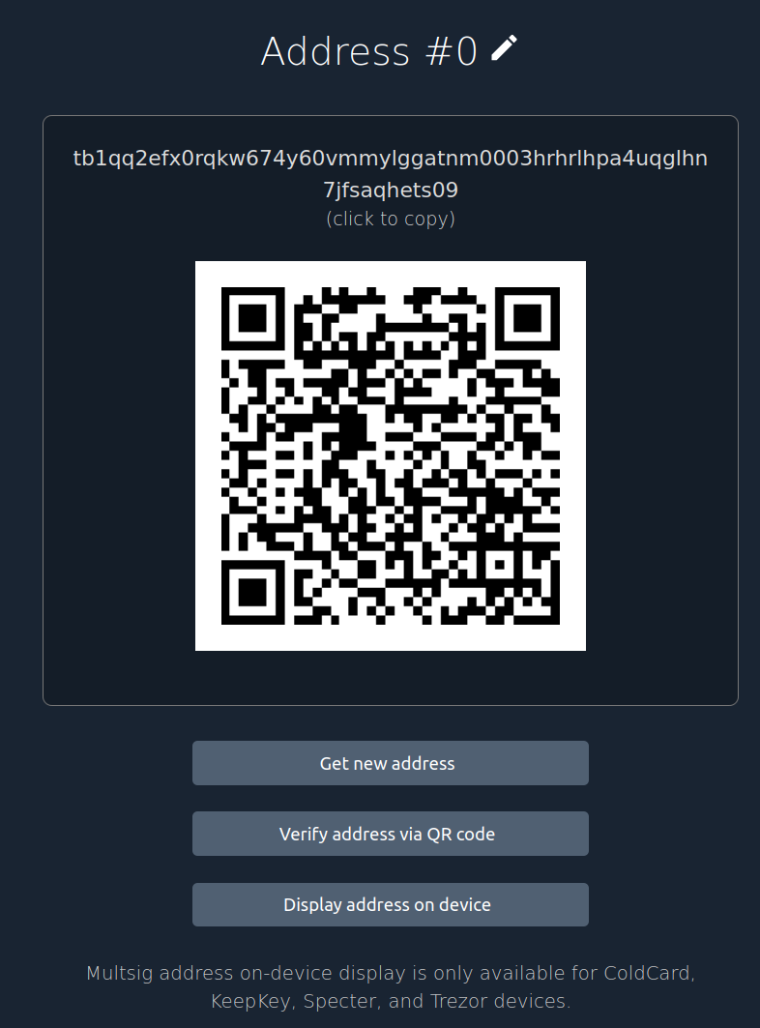
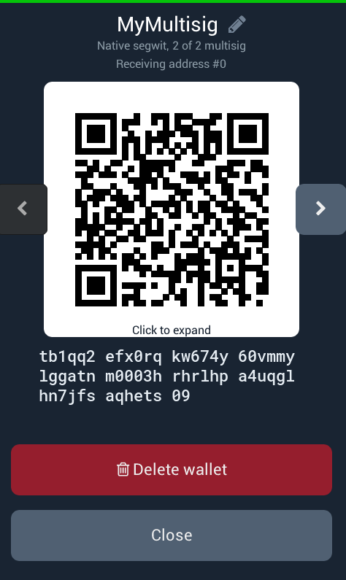
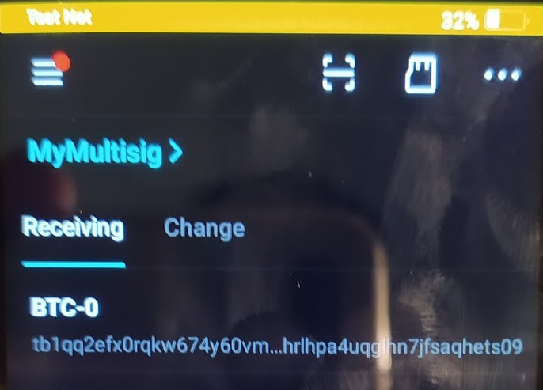
Receive Funds
Same as single-sig-receiving, you have to verify the receive-address, at best, on both devices
You can do that either by showing the addresses on the HWW and comparing it to what is shown on specter-desktop (Cobo) or alternatively “Verify address via QR code”
On specter-desktop, choose the wallet and click the receive-tab
In Specter-DIY, it’s “Wallets” → MyMultisig
On Cobo it’s “Multisig Wallet”
Compare the addresses and then send funds to it

Slide 11
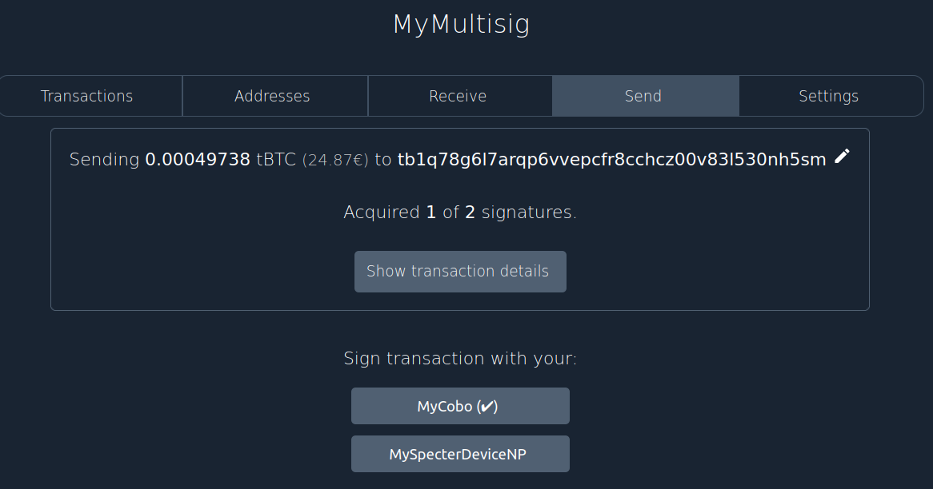
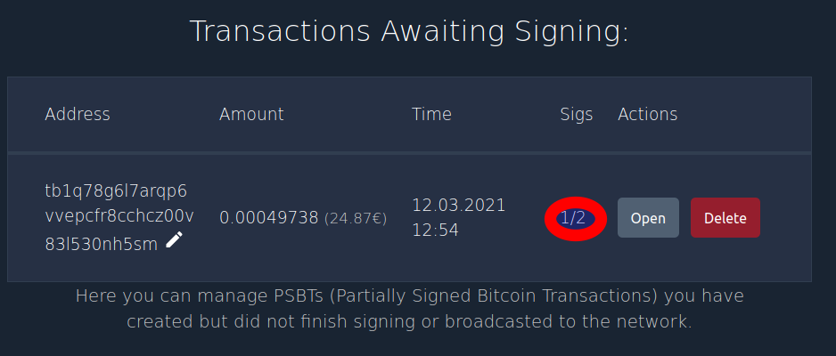
Sending Funds
A Multisig-Wallet can be imported on multiple Specter-desktop instances
It’s not necessary but it’s possible. Such kind of setup is popular if you don’t want a central server but as many laptops as you have people operating the HWW
A scenario where you send money from this wallet on a single specter-desktop, might be a bit boring.
Look at the screenshot on the side which shows a “half-signed” tx which has been signed by a cobo but not yet by the specter
You should be able to easily do that tx

Slide 12
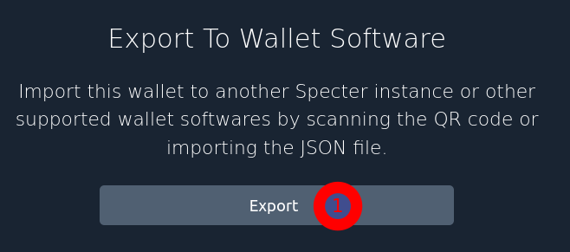
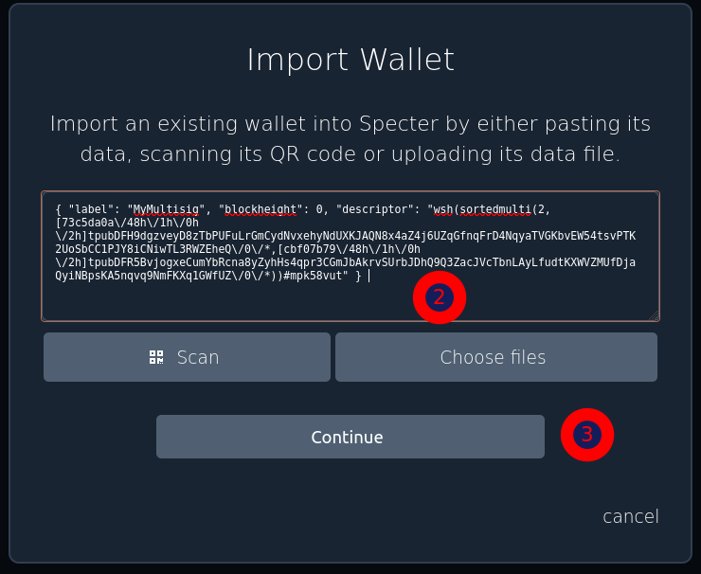
Second specter-desktop - Send
Now let’s take the tx from the last slide and assume that it should be signed on some other specter, e.g. your neighbours one
Choose your MultiSigWallet → Settings → Export and click Export, then “Copy Wallet Data”
The data is now on your clipboard. Paste this data e.g. via Telegramm/WhatsApp/Email (consider privacy concerns) to your colleague
On the othe Specter-desktop instance create a new wallet and then “import from wallet software”
Paste the data in there and click continue (if you don’t have a second specter-instance, change the label otherwise you won’t be able to do the import)

Slide 13
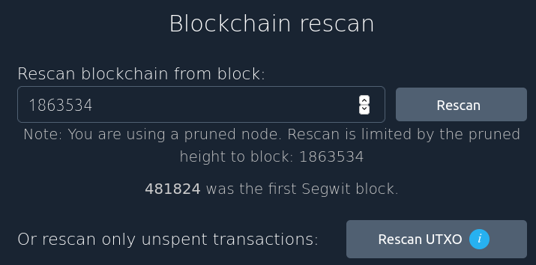
Second specter-desktop
It’s important to understand here, that in order for specter-desktop to know about the history of transactions for imported wallets, it’s necessary to “scan the blockchain” for the addresses created by that wallet
Scanning takes time the more of the blockchain needs to be scanned. For a fresh wallet, only the last part of the blockchain needs to be scanned. A very old wallet might need to have the whole blockchain scanned
If you import a wallet, the rescan might start autmatically with the right blockheight (the position in the blockchain)
However, it’s possible to also manually rescan in the wallet→ Settings → Advanced
But there is more to it ...

Slide 14
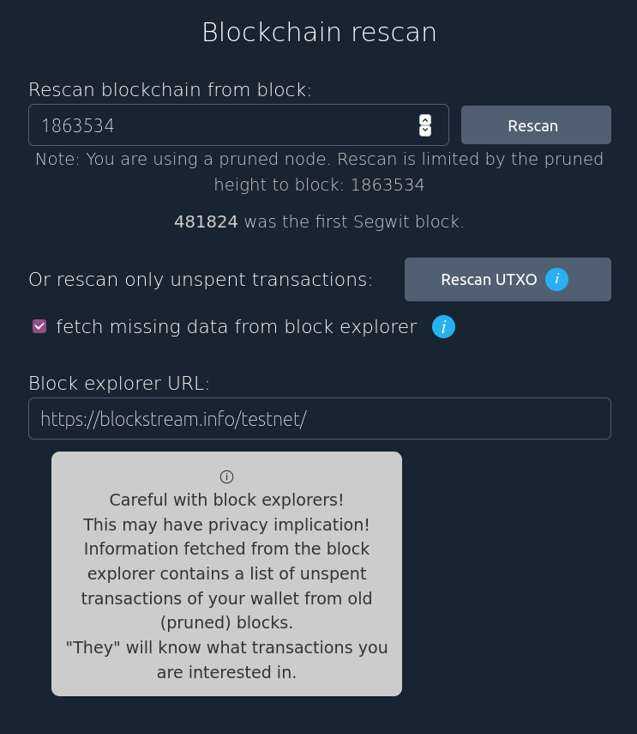
Second specter-desktop
There are two type of nodes existing:
  Full-nodes store the whole blockchain
  Pruned-nodes only store a part of it
  Both store the full set of UTXOs (the unspent coins)
As the screenshot shows, you can only scan so far with a pruned node. You will see your whole balance (consider the keypool details below) but you won’t see the history of old transaction
This can be fixed by getting that data from a public Block-Explorer Service but that has privacy implications: “They will know what transactions you are interested in.”

Slide 15
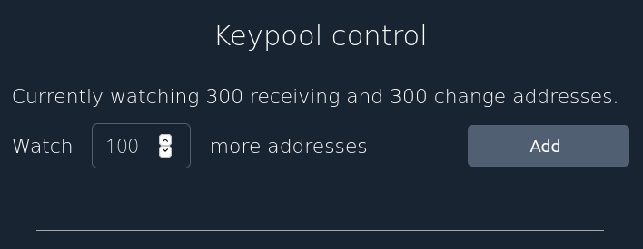
Second specter-desktop
Importing bigger wallets has also yet another implications: A wallet has potentially infinite number of addresses. How many of them should the scan-process search for existing funds?
The answer is: 300 by default. But what if you have an even bigger wallet with more than 300 used addresses?
You can add more addresses as you see fit also in the advanced tab
Surely if you do that, you have rescan the blockchain again

Slide 16
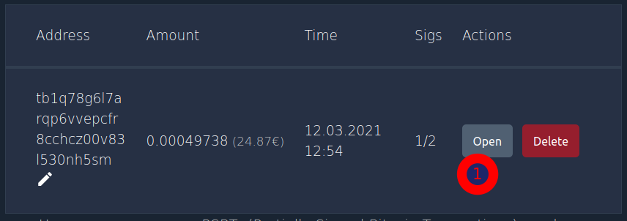
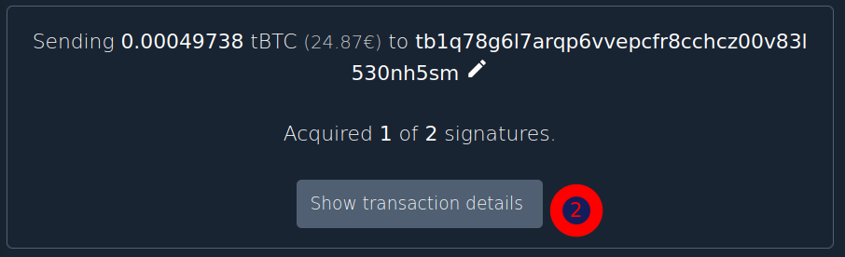
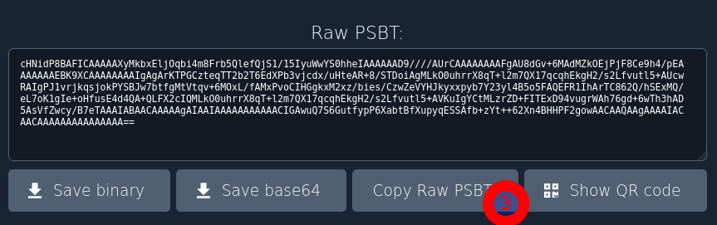
Second specter-desktop
Let’s assume you have imported your wallet successfully. Now you want to sign the half-signed transaction from the exercise before on that second specter-desktop
So open the tx (1), show the details (2) and copy the raw PSBT (3)
PSBT is an abbreviation for “Partially signed Bitcoin Tx”
Copy that data to your colleague (WhatsApp/Telegramm …)
So then on the other side ...

Slide 17
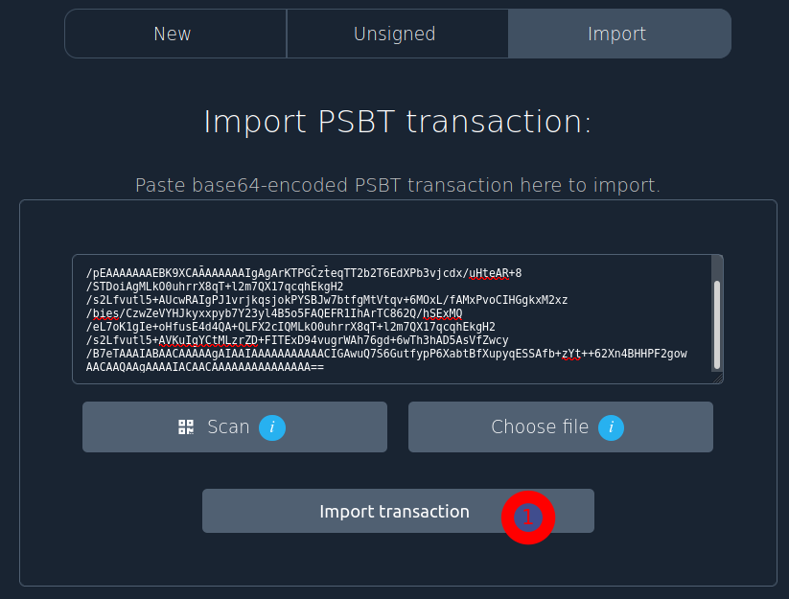
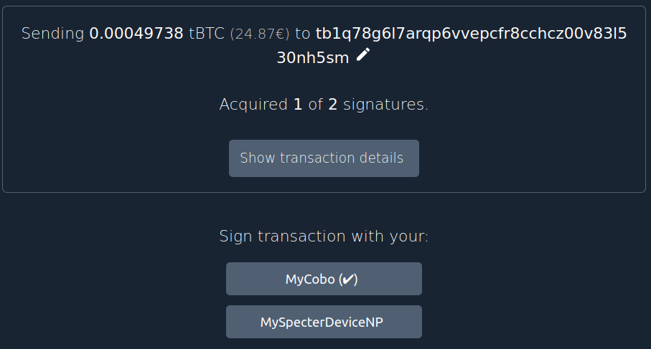
Second specter-desktop
Choose the wallet → Send → Import and paste the data into the field
Click “Import transaction” (1)
Now you’ll see the exact same view in your second specter-desktop. Should be easy now to sign it with your specter ...

Slide 18
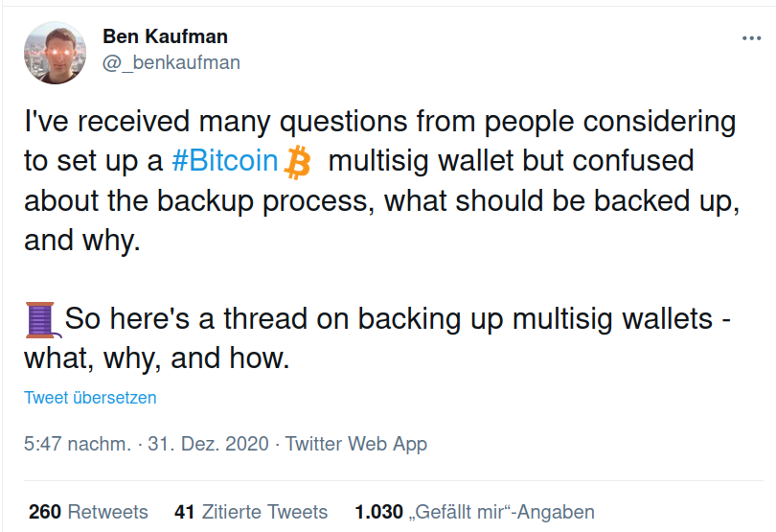
Multisig considerations

Slide 19
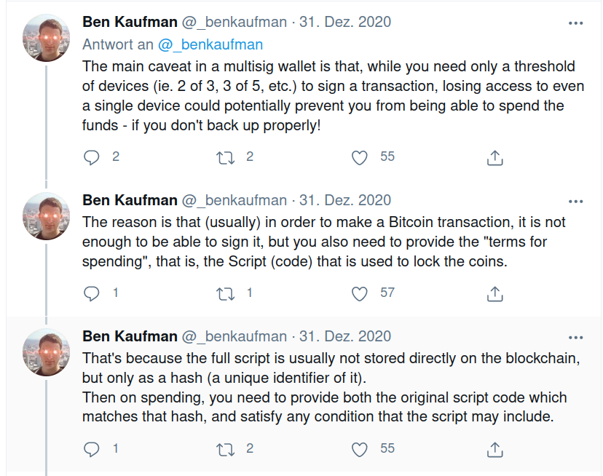
Multisig considerations

Slide 20
Multisig considerations

