Slide 1
Lunchtalk: How the Bitcoin Protocol actually works
Kim Neunert (hybris P&T Infrastructure)
Researching Bitcoin since about December 2014
May 2017

Slide 2
Agenda
Some VERY limited Context
Jan Möller ‘s slides How the bitcoin actually works
Q&A

Slide 3
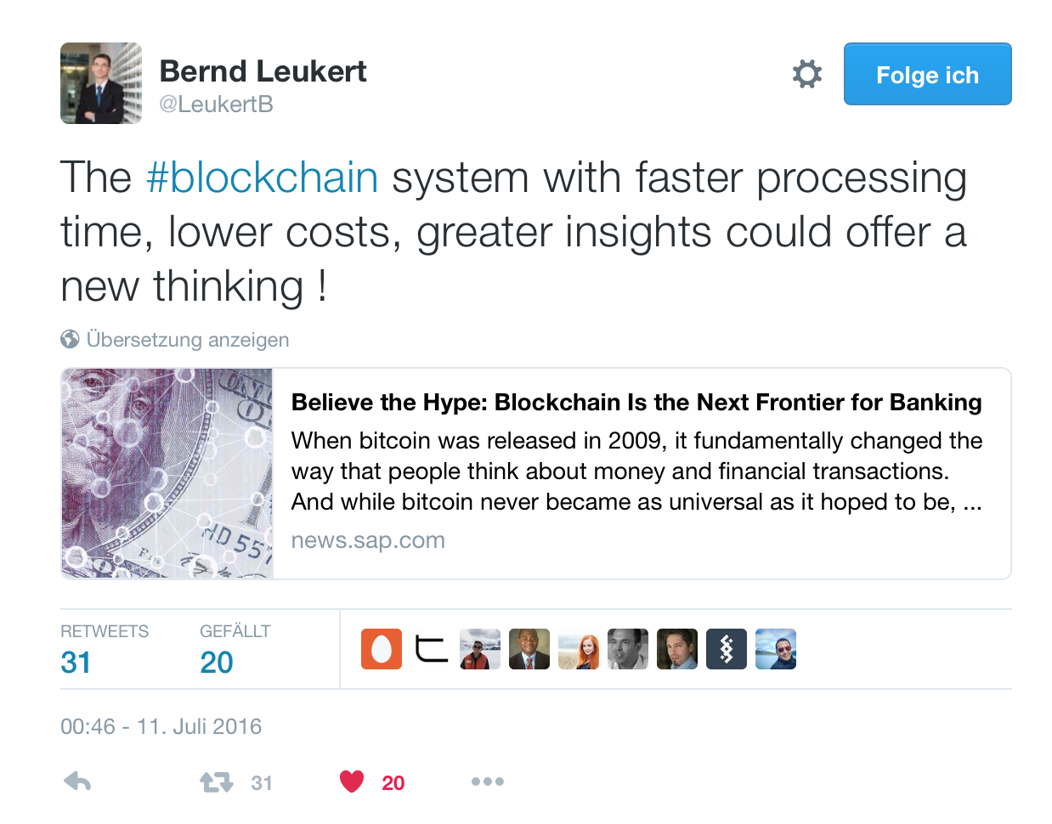

Slide 4
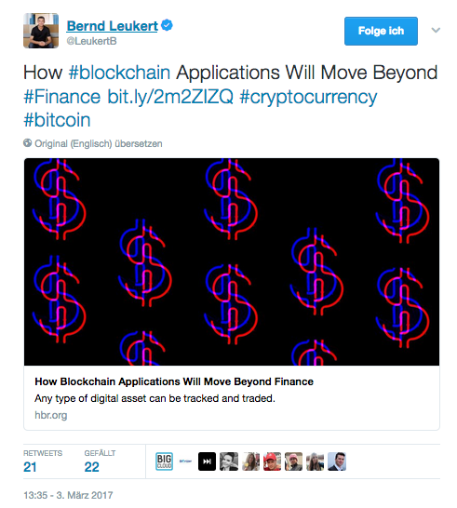

Slide 5
Context and Approach
Bitcoin/Blockchain is important
Understanding the technology is a challenge itself
Understanding the social/economical/technical whatever implications is yet another challenge
Be sceptical about anyones claims on what the bitcoin/blockchain is or not is
Start investigating yourself, start with the technical fundamentals ….

Slide 6

HOW THE BITCOIN PROTOCOL
ACTUALLY WORKS
Jan Møller
Mycelium
Notes:
Slides are borrowed from Jan Möller
I asked him, he’s happy me using the slides

Slide 7
How Does Bitcoin Actually Work?
This talk is not about the political or
economical impact of Bitcoin.
This talk is not about how to buy, sell, spend, or secure your bitcoins.
This talk is about how Bitcoin actually works.
…you know… nerdy stuff!

Slide 8
How it Started
White paper published November 2008 by
Satoshi Nakamoto
"Bitcoin: A Peer-to-Peer Electronic Cash System"
Working implementation published 3 months
later as an open source project.
Notes:
Released into a cryptographic mailing-list
Topic of the mailinglist was “make a totally decentralised money” kind of holy grail
Roughly 10 pages paper
No one believed him
He implemented that idea, network started
Disappeared in 2010, but he was not needed anymore

Slide 9
What is Bitcoin?
Bitcoin is the name of a p2p protocol
Allows a network of computers to govern all the rules of Bitcoin
Bitcoin is a unit of account
Like Euro, Danish Kroner, or gold coins
Bitcoin is a payment System
You can send value between accounts in the Bitcoin network
Notes:
A p2p protocol where the members of the network
Have a full copy of the blockchain
validates the rules of payments
and enforce the rules
A unit of account,
8 decimal digits, a satoshi is 0,00000001 Btc
Transfer bitcoin from one account/bitcoin address to another in transactions

Slide 10
Properties of Common Digital Payment
Systems
No Counterfeiting
YOU can't increase money supply at will
No Double Spending
YOU can't spend the same value more than once
Transaction irreversibility
YOU can't undo a transaction
Notes:
So here are some important properties of payment-systems
You cannot print money, that would be counterfeiting!
You cannot send the same money to two different people
You cannot go back in time and simply undo a transaction
However, all of these payment-system are centralised so there is someone who can do these things
Money printing by central banks
If banks wants, they reverse transaction as they will because money is more or less entries in centralised SQL Databases
(well for Credit-card you have 2 weeks time but after that … no longer possible)

Slide 11
Properties of Bitcoin
No Counterfeiting
NOBODY can increase money supply at will
Transaction irreversibility
NOBODY can undo a transaction
No Double Spending
NOBODY can spend the same value more than once
Notes:
We will only have 21 Millions bitcoin ever in existence
If a transaction is done, No one can ever undo them again (Let’s look at the details later)
Also no double-spending (edge-cases will look later)

Slide 12
Bitcoin Solves Two Things
Eliminates trust in a central authority
You trust the rules of a protocol enforced by mathematics and cryptography
Distribution of funds
How to distribute value when you create a new currency?
Notes:
No central authority needed
Trust in mathematics and cryptography

Slide 13
Distribution of Funds
Every 10 minutes since inception a “random”
node in the Bitcoin network receives a reward.
The reward started at 50 bitcoins, and halves every 4 years

Slide 14
Notes:
In 2013 we see the first halving, so after that you have only 25 bitcoins
In 2017 on the graph is supposed to be a second halving, but that was actually last Saturday
So you see that about 75% of the bitcoins are already created

Slide 15
The Block Chain
The big invention that makes Bitcoin work
The block chain is a database containing historical records of all the transactions that ever occurred in the network.
Every full node in the network has a copy that they
keep up to date and verify.
Some nodes extend the block chain, they are called
miners.
Notes:
The heart of the intervention is the blockchain
A public database where all the transactions are recorded
The databases gets replicated and copied to all the member-nodes
The member-nodes will check each of them this database so that rules are enforced
So now … how does a new block come into existence?

Slide 16










Block 0
Block 1
Block N-1
Block N
Genesis
Block
. . .
Think of it as a big accounting book.
Every block is a page in the book.
Anyone can try to add a page to the book to get a reward
… but it is computationally hard to do so
Problem: We want a new block to appear
every 10 minutes on average.
Notes:
Blockchain, well a chain of blocks
So everyone can try to add a new block at the end of the chain
So the challenge is now that we somehow need to make that predictable:
We need one of these blocks every 10 minutes on average
So how does that work? We need cryptography for that:
Hashfunctions

Slide 17
Introducing SHA-256
Cryptographically secure one-way hash
function.
Takes any input and produces a 32 byte output.
Flipping one bit in the input gives a different
randomly distributed output.
Sha256(“GOTO”) = e38c772d4940e4e059430cd25b797923
bfe139db8b74831e062b409a97ca63ff
Sha256(“TOGO”) = 52031acdcfba3318c4daafcd3bc30a56
be3a455dfa59128d72bcf74ef52491bb

Slide 18







Block 0
Block 1
Block N-1
Block N
Genesis
Block
. . .
How to create a new block?
Version
Previous Block Hash
Merkle Root Time Stamp Bits
Nonce
80 byte header
Block Hash = Sha256( Sha256(Header) ) But there is a catch…
Block Header
Transactions
Payload
Variable size
Notes:
How does a block looks like?
Header and payload … payload are all the transactions
The relevant thing here is the Block-header
Contains the sha256 hash of the previous Block-Hash
There are some things in the header … calculate the hash and you’re done ... However
Here is a catch

Slide 19





Block hash must be below the target difficulty
Version
Previous Block Hash
Merkle Root Time Stamp Bits
Nonce
create header
make nonce random 3 calculate block hash 4 is it below the target?
☺ we are done
☹ goto 2
Transactions
Block# 321511 ~ 250,000,000 GH/s
00000000000000001fb68313c9728ec3728686a632ad36c31fe9a9bf4b112362
Notes:
Block must be below the target difficulty!
What does that mean?
Simple said, the difficulty is more or less the number of zeros the hash must have in the beginning of the value
So it’s not trivial to have that result. So you can vary a value in the bloch-header and that is the nonce-field
You can vary the nonce-value and put in a random-value calculate … check ... Redo
Because a lot people do that in parallel, we can solve the problem
However, miners change over time, sometimes more sometimes less miners
We have to vary the difficulty according to the hashrate of the network

Slide 20
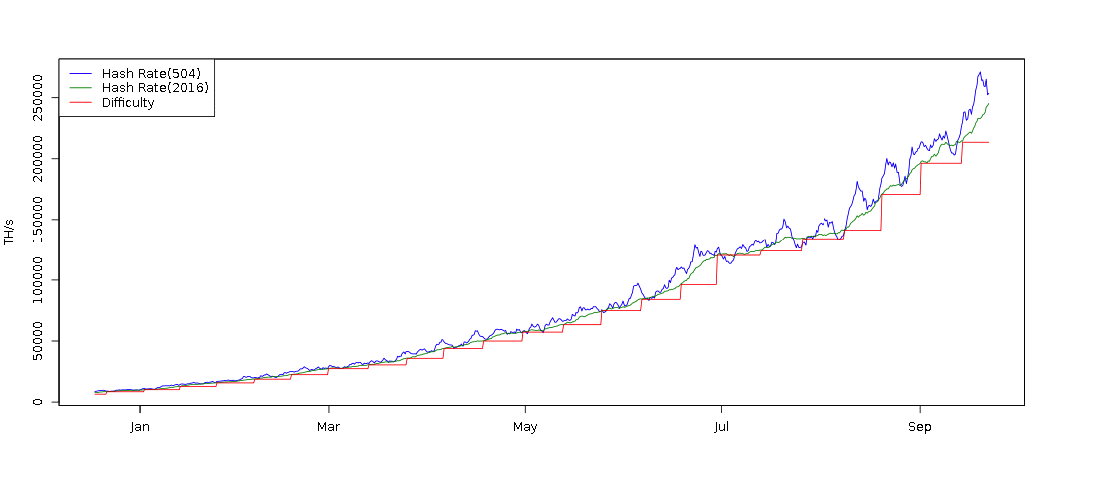
The Difficulty Adapts
Notes:
The network adapts the difficulty based on the hash-rate
Every 2 weeks the networks checks wether
More or less than 10 mins are used to find the solution in average
If less → reduce the difficulty
If more than 10 mins → increade the dificulty
Because of that, on average → 10 mins

Slide 21
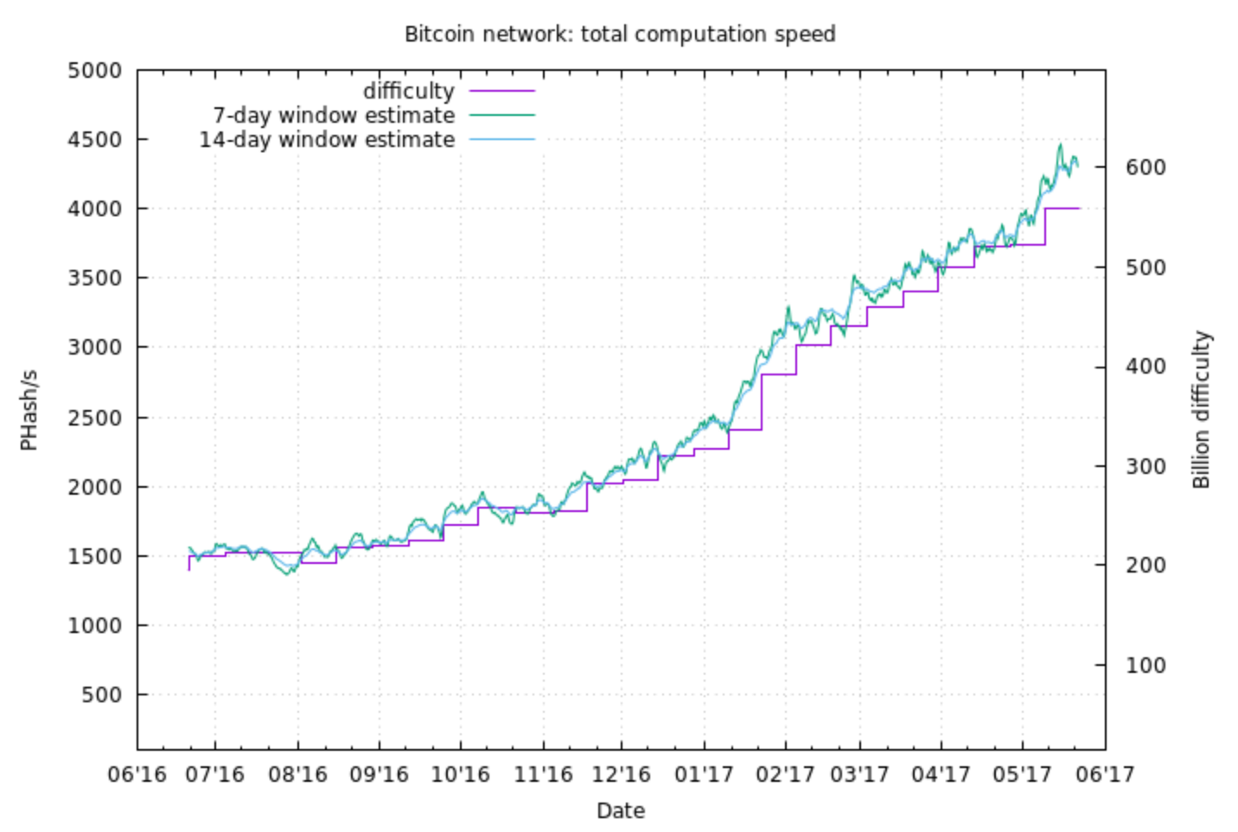

Slide 22
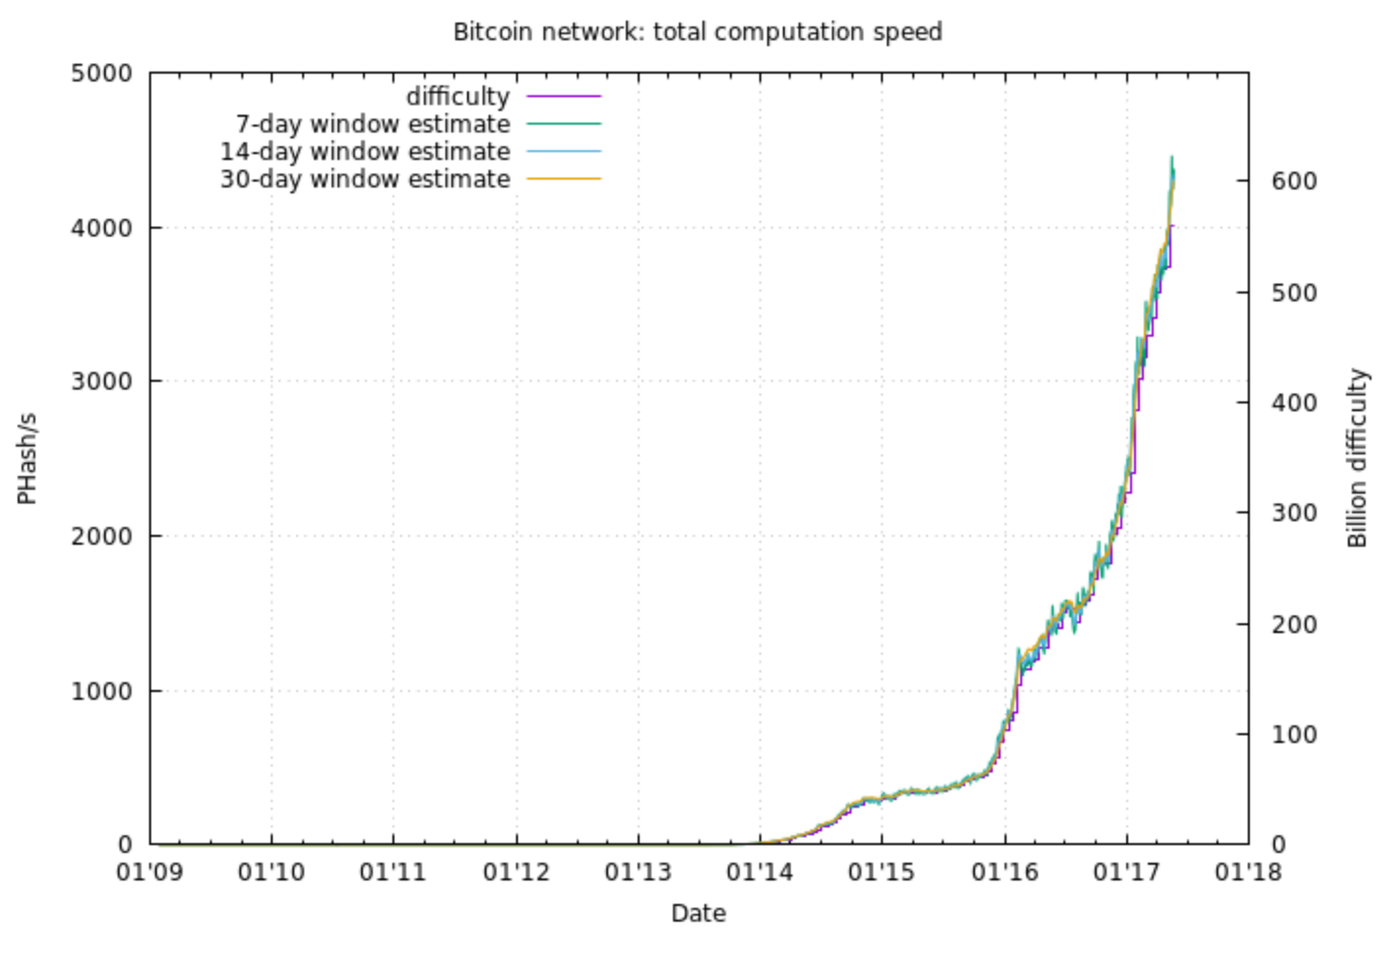
Difficulty May 2017

Slide 23


































Block Propagation
Notes:
If you’ve found a solution, you want to propagate your solution
So if you’ve propagated your solution, all the miners will stop working on their block
Start working on the new block
Because the longest chain wins. That’s the rule.
So smaller chains will be ignored.
So if the solution is now found in two different parts of the network, you have a fork

Slide 24










Forks are Normal (1)
Block N’
Block N-2
Block N-1
. . .
Block N’’

Slide 25
Block Propagation
N‘
N‘‘
Notes:
If you’ve found a solution, you want to propagate your solution
So if you’ve propagated your solution, all the miners will stop working on their block
Start working on the new block
Because the longest chain wins. That’s the rule.
So smaller chains will be ignored.
So if the solution is now found in two different parts of the network, you have a fork

Slide 26
Block Propagation
N‘
N‘
N‘
N‘
N‘
N‘
N‘
N‘‘
N‘
N‘
N‘‘
N‘
N‘‘
N‘‘
N‘‘
N‘‘
N‘‘
N‘‘
N‘‘
Notes:
If you’ve found a solution, you want to propagate your solution
So if you’ve propagated your solution, all the miners will stop working on their block
Start working on the new block
Because the longest chain wins. That’s the rule.
So smaller chains will be ignored.
So if the solution is now found in two different parts of the network, you have a fork

Slide 27


Forks are Normal (2)
Block N’
Block N-2
. . .
Block N-1
Block
N+1
Block N’’
The longest chain wins!
Notes:
Eventually, they will find a new block and now one chain is longer than the other
Everyone agreed again on the new longest chain
The longest chain wins
So that’s it about distribution of new bitcoins and mining

Slide 28
Bitcoin Public/Private Keys
A Bitcoin uses Elliptic Curve cryptography
A private key is 32 random bytes
A public is computed from a private key
There is no encryption in Bitcoin, only signing
Notes:
So now let’s go to the transactions
So the public/private-keys are some kind of bank-account
Think of it like ssh-public-private keys.
Keep the private part … well ... private

Slide 29
Bitcoin Addresses
A Bitcoin addresses is a bit like a bank account.
1Kk18SN6WRPTEXbXBm3dZSzEw7NdbChyc9
Calculated from a public key (simplified)
Base58Check(RIPEMD-160( Sha256( public key ) ) )
Nobody knows who owns which addresses
Value is moved between addresses using
transactions.
Notes:
For some reason the public-key is not used as bank-account but bitcoin-addresses
Pay-2-pubkey and, with 3 prefix pay to scripthash

Slide 30
Bitcoin Addresses
A Bitcoin addresses is a bit like a bank account.
1Kk18SN6WRPTEXbXBm3dZSzEw7NdbChyc9
Calculated from a public key (simplified)
Base58Check(RIPEMD-160( Sha256( public key ) ) )
Nobody knows who owns which addresses
Value is moved between addresses using
transactions.
Notes:
For some reason the public-key is not used as bank-account but bitcoin-addresses

Slide 31







Transactions (simplified)
A Bitcoin transaction sends value from one set
of addresses to another
Inputs
Outputs
5 BTC
10 BTC
Transaction Hash =
Sha256( Transaction Data)
3 BTC
2 BTC
4 BTC
Notes:
Input from three different addresses and output to 2 other addresses
… also the transaction-hash gives you an ID of the transactions
Hoewer, that is simplified, so let’s have a closer look ...

Slide 32




Creating a Transaction (1/7)
Transaction
Inputs
Outputs
10 BTC
Notes:
Output to Bitcoin-addresses
But input is not simply from an address
Input needs funding and funding is coming from other transactions
So let’s search for transactions which send bitcoins to my addresses

Slide 33






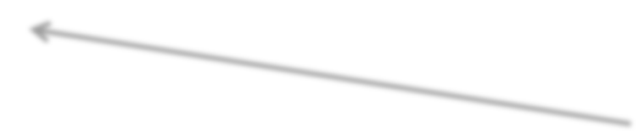



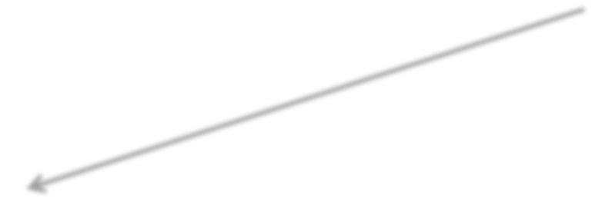









Creating a Transaction (2/7)
Inputs
Outputs
1 BTC
Transaction
5 BTC
Inputs
Outputs
10 BTC
Inputs
Outputs
7 BTC
3 BTC
Inputs
Outputs
4 BTC
2 BTC

Slide 34

Creating a Transaction (4/7)
Inputs
Outputs
1 BTC
Transaction
5 BTC
Inputs
Outputs
10 BTC
2 BTC
Inputs
Outputs
7 BTC
3 BTC
Inputs
Outputs
4 BTC
2 BTC
Notes:
Here we are, we’ve found 3 transactions and we now referring to 3 distinct outputs of these 3 transations
So we need to spend the whole output. So either a output is used or not.
That means that I need an additional output for the difference: 2BTC
Change-address, I can redirect that money to one of my addresses: change-outputs (can be spent later)
Just like if you get change back in real-life if you use a 10 Dollar bill and get 2 dollars back as change

Slide 35

Creating a Transaction (4/7)
Inputs
Outputs
1 BTC
Transaction
5 BTC
Inputs
Outputs
10 BTC
1.999 BTC
Inputs
Outputs
7 BTC
3 BTC
Transaction Fee = 0.0001 BTC
Inputs
Outputs
4 BTC
2 BTC
Notes:
So nothing is for free … spam-resistence ... Incentive for miners in order to mine my transaction
So the difference of the output and the input is for the miner

Slide 36

Creating a Transaction (5/7)
Inputs
Outputs
1 BTC
Transaction
5 BTC
Inputs
Outputs
10 BTC
1.999 BTC
Inputs
Outputs
7 BTC
3 BTC
Transaction Fee = 0.0001 BTC
Inputs
Outputs
4 BTC
2 BTC
Notes:
In order to proof that I can do that transacion, I have to sign each input
… with the private key of that address where the corresponding output is coming from
https://en.bitcoin.it/wiki/Transaction#Pay-to-PubkeyHash

Slide 37
Creating a Transaction (6/7)
Inputs
Outputs
1 BTC
Transaction
5 BTC
Inputs
Outputs
10 BTC
1.999 BTC
Inputs
Outputs
7 BTC
3 BTC
Transaction Fee = 0.0001 BTC
Inputs
Outputs
4 BTC
2 BTC

Slide 38



Creating a Transaction (7/7)
Inputs
Outputs
1 BTC
Transaction
5 BTC
Inputs
Outputs
10 BTC
1.999 BTC
Inputs
Outputs
7 BTC
3 BTC
Inputs
Outputs
Bitcoin Network
4 BTC
2 BTC
Notes:
3 times

Slide 39
Transaction Relaying
Receive transaction from peer
Verification (simplified):
Verify that the signatures are sound
Verify that the inputs are unspent
Verify that the sum of outputs <= sum of inputs
Relay transaction to other peers

Slide 40



















Block 0
Block 1
Block N-1
Block N
Genesis
Block
. . .
Block N+1
Version
Previous Blockhash
Merkle Root
Time Stamp Bits
Nonce
Unconfirmed Transactions
Transactions
Notes:
All the uncorfirmed transactions are collected by the miners
They select these transactions which they would like to introduce into the next block (fees!)
That’s actually now the payload of the block
Part of theblock-header is the merkle-root of all the transactions
(think about a hash of hashes of all the transactions)
Calculates the merke-root … then varies the nonce and start trying to mine ... When found ... Block propagated
Everyone sees that these ouputs are spent so that i’m not really able to respend it

Slide 41

Transactions in Forks (1)
Block N’
Block N-2
Block N-1
My Transaction
. . .
Block N’’

Slide 42

Transactions in Forks (2)
Block N’
Block N-2
. . .
Block N-1
My Transaction
Block
Block N’’
N+1
The longest chain wins!
Notes:
Let’s revisit forks
So miners can decide differently … one adds it ... Another don’t and we have now a fork
However it will be in one chain only once ... And eventually the longest chain wins
That’s the reason for the 6 blocks rule (sell icecream or sell a car)

Slide 43
Block Chain Tech is New
Trustless decentralized ordering of events
LOTS of stuff is going on ... Cambrian explosion
Notary services
Smart Contracts / Ethereum
ZCash, Monero and hundreds of other Blockchains
Segwit & Lightning network
Sidechains
Blocksize discussion
....

Slide 44





Properties of Bitcoin (1/3)
No Counterfeiting
“NOBODY” can increase money supply at will
Block 0 Block 1 Block N-1
Block N
Genesis Block
. . .
You are competing with the biggest distributed computer the world has seen.
If you can beat it, it just gets harder.
Notes:
All blocks get validated
They get only in the chain when they are sound and playing by the rules
This is also eventually true if the chain splits because only the longest chain counts (eventually)
EVENTUALLY

Slide 45















Properties of Bitcoin (2/3)
Transaction irreversibility
“NOBODY” can undo a transaction
Original
Transaction
Block N’
Block N-2 Block N-1
. . .
Block N+1
Block N’’
Requires a 51% attack
Reversed
Transaction
Notes:
If you want to undo a transaction, you need to make an alternative reality chain longer than the chain you’re attacking.
Requires more than 50% of the hashing network

Slide 46







Properties of Bitcoin (3/3)
No Double Spending
NOBODY can spend the same value more than once
Block N-2 Block N-1 Block N
. . .
Two transactions spending the same outputs

Slide 47
Q&A

