Slide 1
Mnemonic, Seeds and HD-Wallets
There is much to know about bitcoin. Here, we’ll focus only on the things relevant for practical wallet-operation.

Slide 2
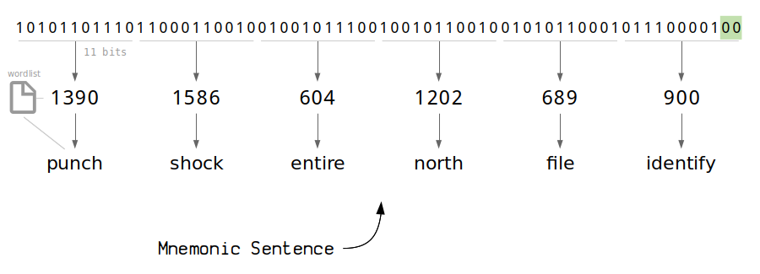
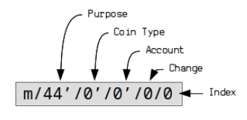
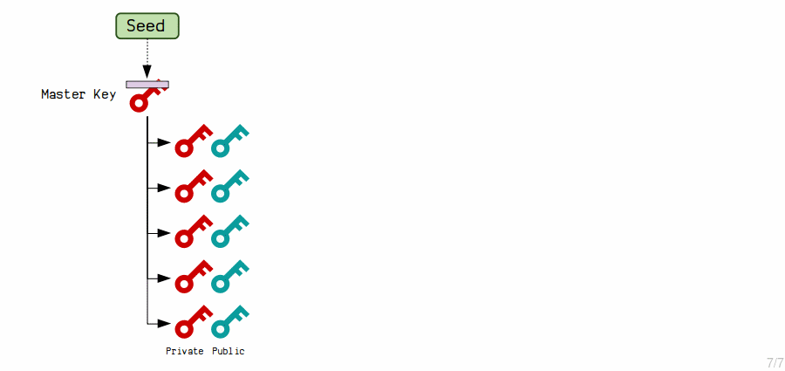
How do we get to a master-key (seed)
A seed is just a long (hexadecimal) number but quite difficult to remember for human beings
Example: c5cfe128312b5848f242f373fa658d7135a89ef8db1f645e05b3b703548cdcd5e20043ac81c769606b9601421701e86a5dcd128f1035779a6009b522f02ff06e
So BIP 39 is a way how to map such a number to a mnemonic (12 words) and the other way around
The words are standardized coming from a fixed list
Optionally, you can use a passphrase which is not coming from a fixed list. This allows you to “encrypt” the mnemonic. Typically you store mnemonic and passphrase in different places
From the master-key, you “choose” a derivation-path to get to your wallet
You can try it out at https://iancoleman.io/bip39/
+ passphrase

Slide 3
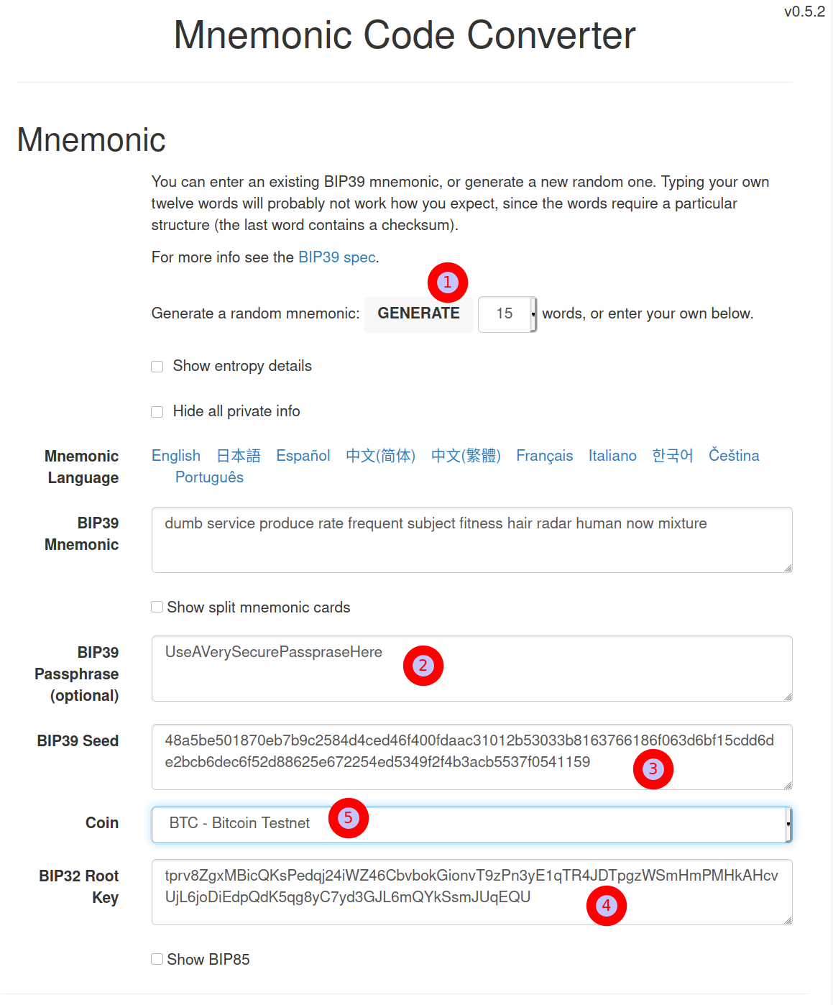
Exercise – seed-creation with mnemonic
Visit https://iancoleman.io/bip39/
Click “Generate” (1), this will create a random number and transforms it to the Mnemonic
As an alternative, use an already existing (TEST !!!) seed, e.g.
ghost ghost ghost ghost ghost ghost ghost ghost ghost ghost ghost machine
Or, as shown on the screenshot:
dumb service produce rate frequent subject fitness hair radar human now mixture
Choose a passphrase, in this example UseAVerySecurePasspraseHere
Watch how the BIP39 (3) seed and also the Root-key (4) changes
Choose “Bitcoin Testnet” (5)
Based on the root-key, we’ll now create wallet/addresses with the help of a derivation-path
Take a note of both: Your Mnemonic and the passphrase, you’ll need it later when reproducing the same thing in specter-desktop

Slide 4
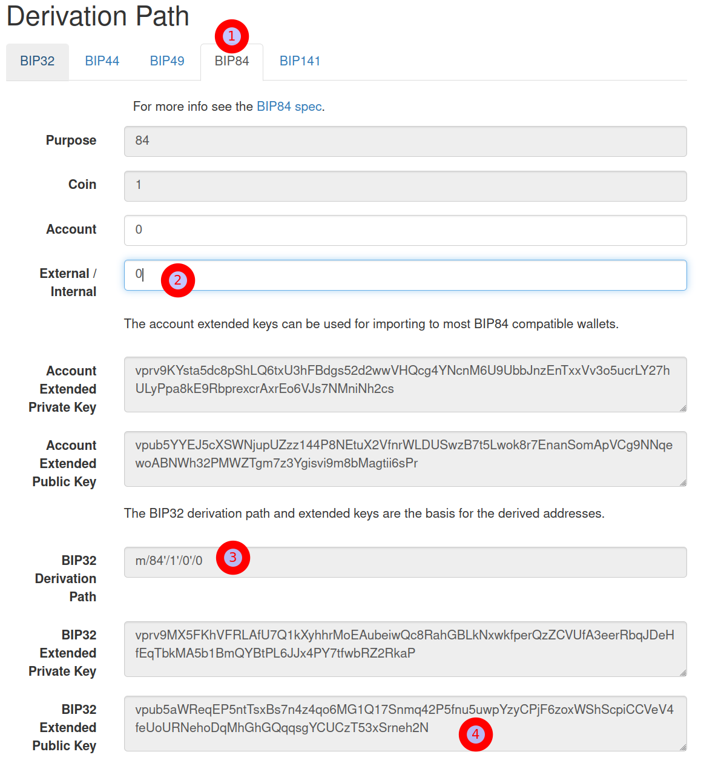
Exercise – From Seed to Wallet
Via Derivation-Path
Let’s choose a Single Segwit wallet, clicking on “BIP84” (1)
Either keep the 0 (receive-addresses) or choose 1 (for change-addresses) (2)
Watch how private- and the Extended Public changes
Take a note on the derivation-path (3) , this is the third element you need to know to get to your wallet
Take note on the Extended Public Key (4). The first 10 and the last 3 digits are enough. You will use that later to get confidence reproducing this on specter-wallet
Now let’s have a look at the created keys/addresses from this wallet

Slide 5
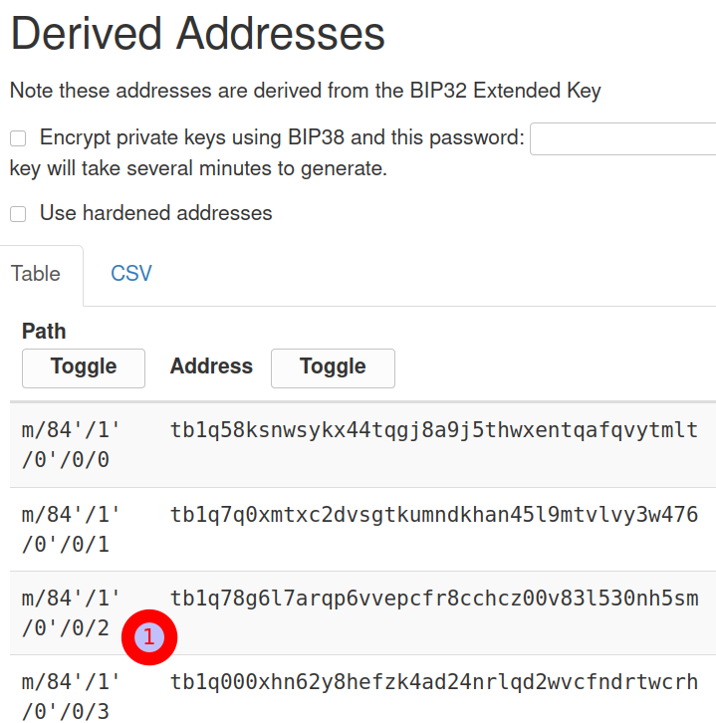
Exercise – From Wallet to addresses
Everything is already set:
  The mnemonic (12 words) is the starting point
  It’s encrypted via the passphrase
  With a derivation-path, we come to our wallet (in this case we needed also to specify whether we’re interested in receive- or change-addresses)
As a result, we get a list of addresses which has an index at the very end of the path
Take a note of a specific address, e.g. the 3rd one (with index 2 – stupid computers start to count with 0):
tb1q78g6l7arqp6vvepcfr8cchcz00v83l530nh5sm

Slide 6

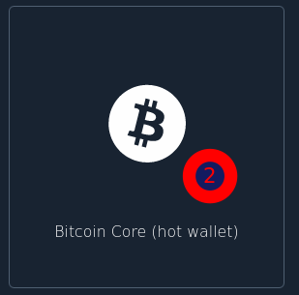
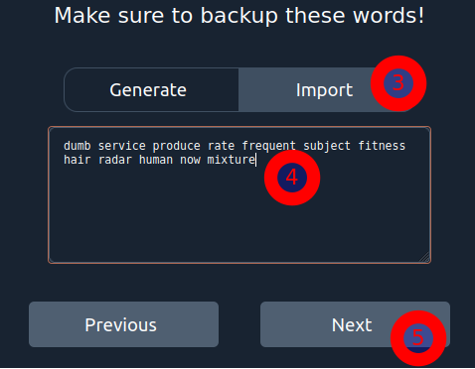
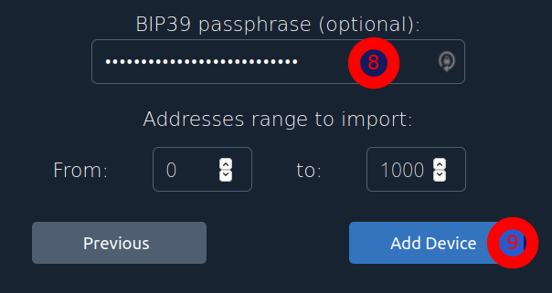
Recreating the seed on specter (device)
Being confident that the math is working is quite important to store huge amounts of value with bitcoin/specter
So in order to reproduce the Wallet we created before, let’s do this again on specter
Depending on whether you have a hardware-wallet or not, the procedure is a bit different whereas the principles are the same. Let’s assume you don’t have a hardwarewallet yet
So in this case we assume a blank specter, connected to a testnet-node
add a new device (1) , and choose “Bitcoin Core (Hot wallet)” (2)
Click on import (3) and type in/copy your seed (4) + Next (5)
Type in a name for your device, click on advanced and paste your passphrase (8) and add your device (9)
You can directly click on “Create Single key wallet” for the wallet creation (or also cancel and do it in an extra-step). Let’s cancel for now

Slide 7
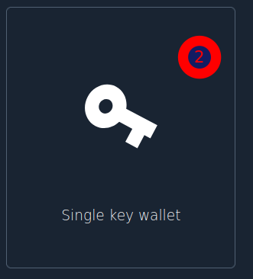
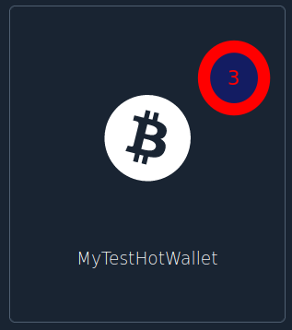

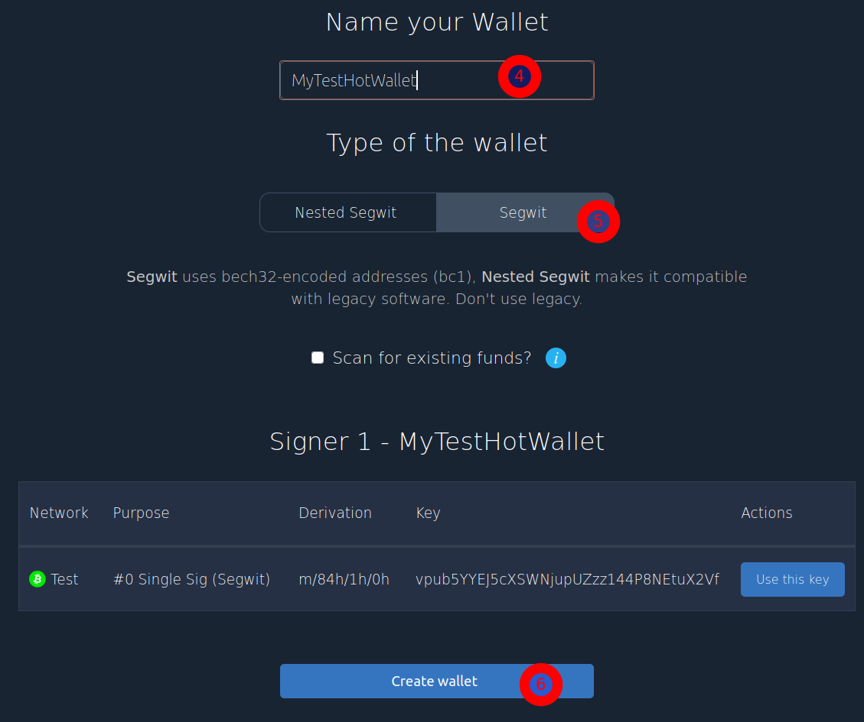
creating the wallet on specter
Click on “Add new wallet”, choose “Single key wallet”
Choose your device, mine is called “MyTestHotWallet”
Give it a name and check whether segwit is correct. It is as we have chosen the derivation path m/84h/…
Click on “Create wallet”
You can cancel the backup PDF for now
So now let’s compare the addresses

Slide 8
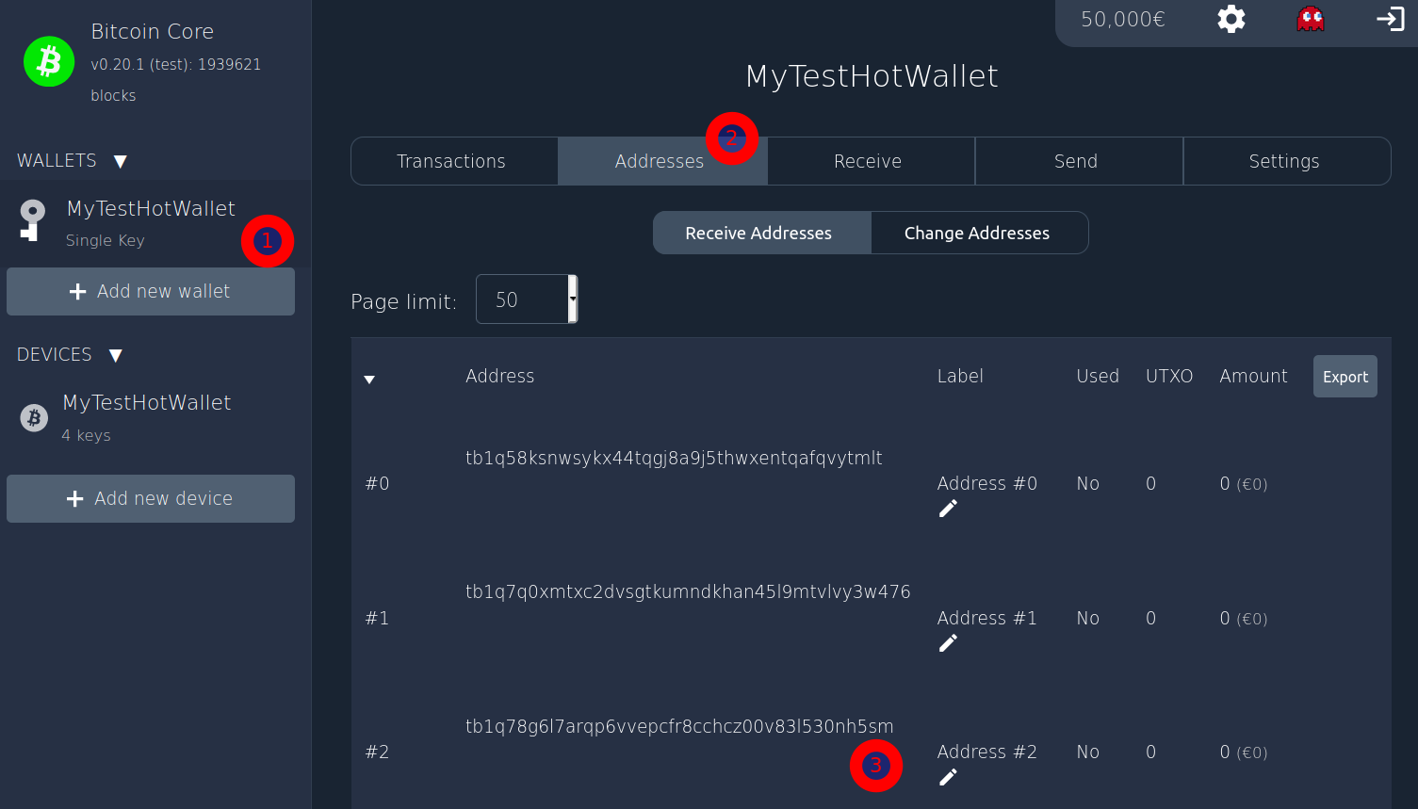
Recreating the seed on specter (device)
Choose your wallet on the right hand side
Click on addresses
Verify that the address #2 is the same than the one you’ve created with the iancoleman-page
If you chose “external”, have a look in the change-address tab
Summary
We’ve created a seed with a passphrase and verified that with the same Derivation-Path the created addresses are the same
This is an extreme good indication that the setup is working but the ultimative test is the so known “penny-test”

Slide 9
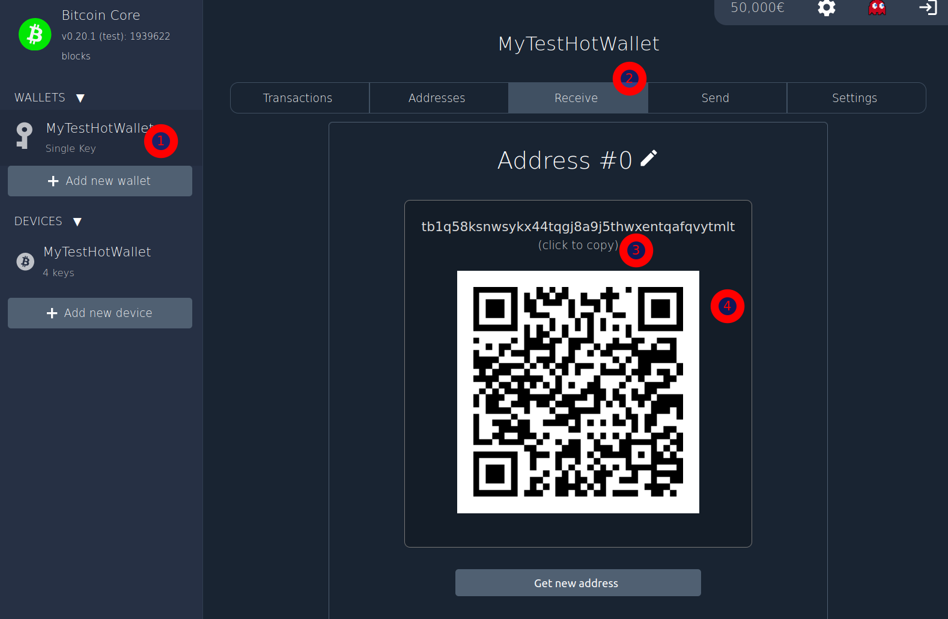
Pennytest - Receive
In order to validate that you can receive and send funds from your newly created wallet, let’s do a pennytest: Sending a “penny” in and sending it out again
We assume that the trainer is sending the funds in, but you have to pass him the address securely.
There could be a “Man-in-the-middle-attack” where someone is exchanging the address on the way from the device to the one using it to send funds
Choose your wallet (1) and click on “Receive” (2)
If you have a hardwarewallet, you should verify the address in it (we skip that here)
You can either copy the address (3) or copy the QR-Code (hovering over the QR-code and click 4)

Slide 10
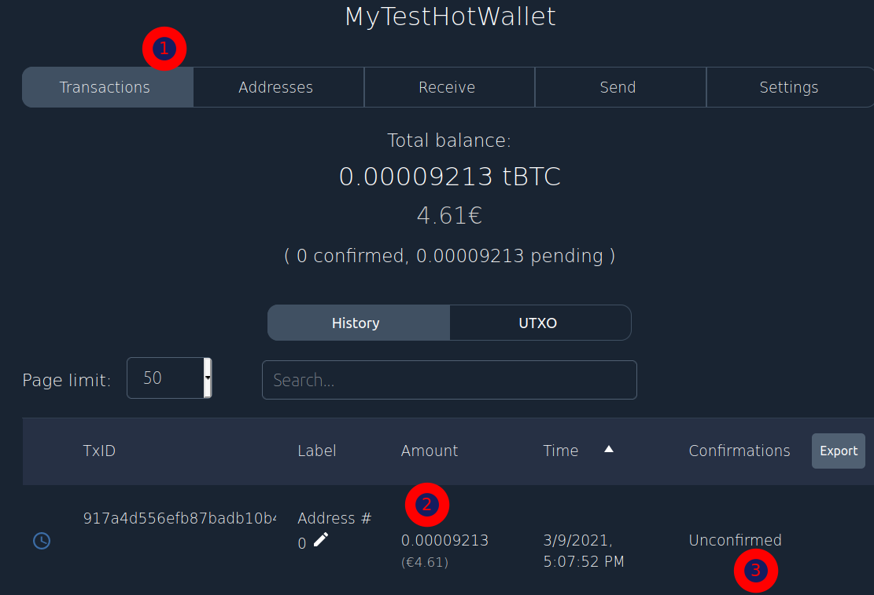
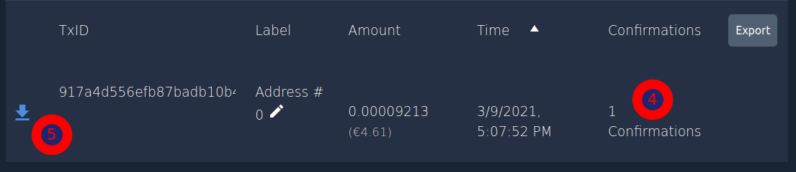
Pennytest
After the funds has been sent by the trainer, click on transactions (1).
Soon, a transaction should be popping up
Realize the amount of the transaction (2) and that it’s unconfirmed
The blue-clock-symbol symobolize that
After some time, the transaction gets confirmed. The number of blocks are shown (4) and the symbol changes to a blue downward-arrow (5)
The bigger the amount, the more confirmations are necessary. Usually 6 confirmations are enough

Slide 11
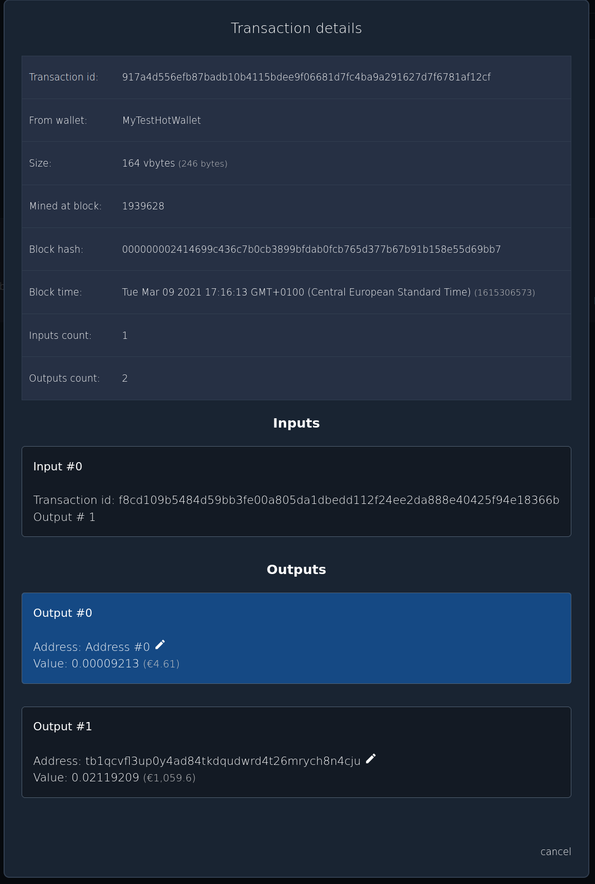
Pennytest
Click on the transaction-ID in order to open the detail-view for this transaction
Here you can see more details about it
The ID, which wallet it belongs to, the size and in which block is has been mined and details about the block it was incorporated to
As discussed before, it also lists the inputs and the outputs of this transaction
The Input is the transaction-ID and the output-index within that transaction
There are two outputs, one going to our address, the other one is the change-address from the wallet this fund has been transferred from

Slide 12
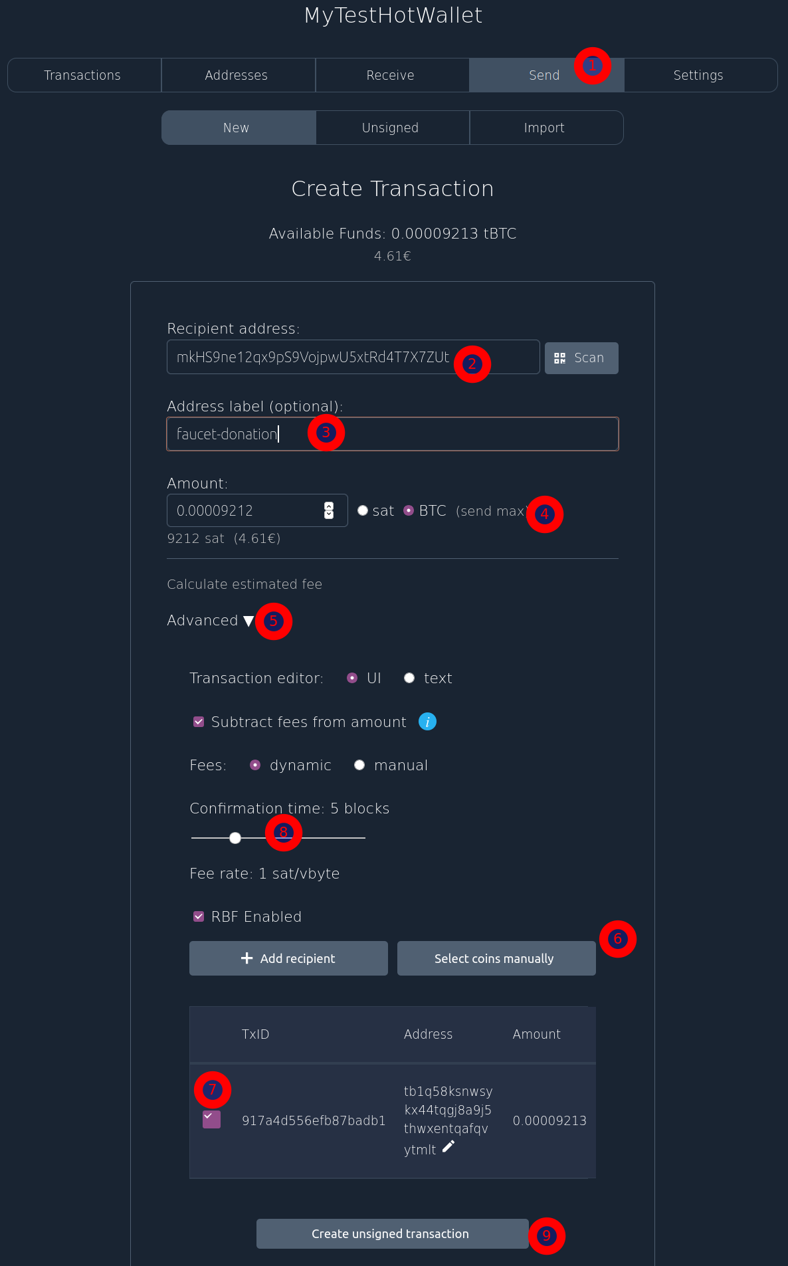
Pennytest
Let’s send the fund to some other address, click on your “Send” (1)
Insert the recipient-address. Let’s take a donation-address from a testnet-faucet (2):
mkHS9ne12qx9pS9VojpwU5xtRd4T7X7ZUt
You can label the address to get a better understanding later on: “faucet-donation” (3)
You can either click on “send max” (4) but maybe let’s be more specific and choose the UTXO you want to spend
Click on “Advanced” (5) and “Select coins manually” (6) and select the only UTXO we have (7)
Verify the fees and slide the slider to get a confirmation within 2 blocks (8)
Click “Create unsigned transaction” (9)
As Specter is built on the idea of Multisignature, it’s always a two-step process. First creating the transaction, then signing it

Slide 13
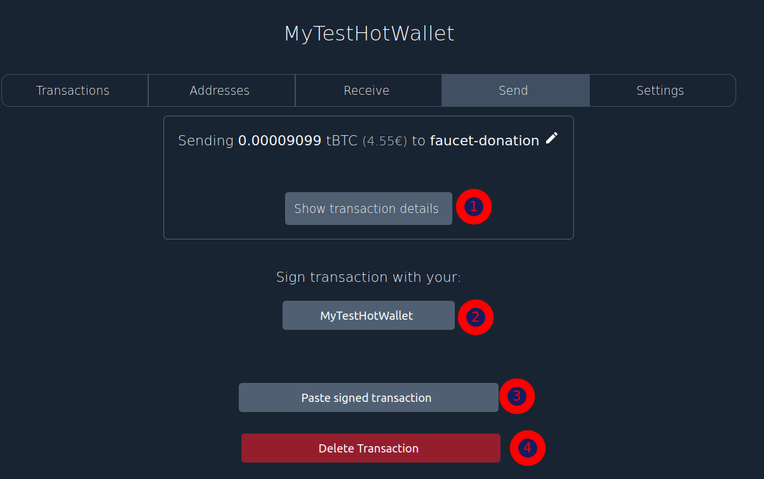
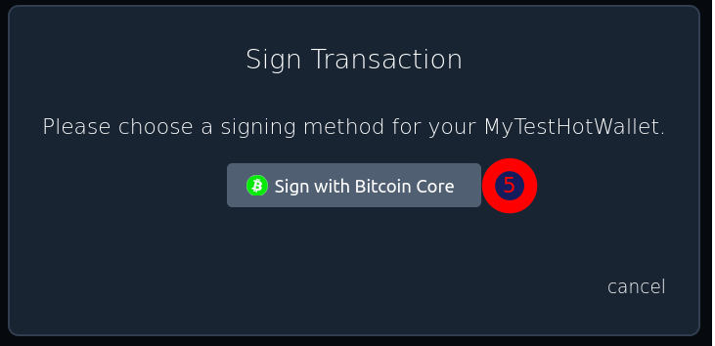
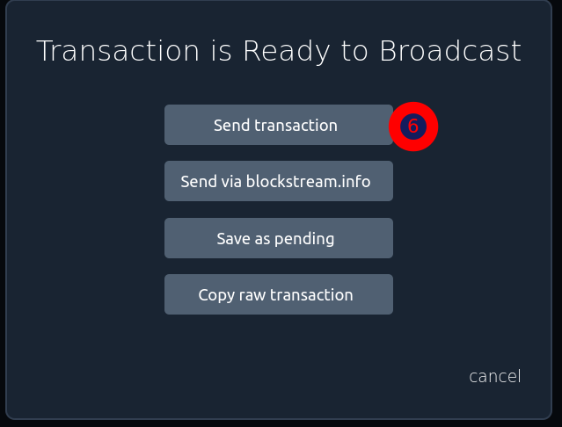
Pennytest
In this view, you can review the details which shows you a very similar view than we saw before (1)
You can sign the transaction (2)
But you could also paste the signed transaction in here which only makes sense in a multisig setup (3)
Or delete the transaction again (4)
So let’s sign it.
… and send the transaction (6)

Slide 14
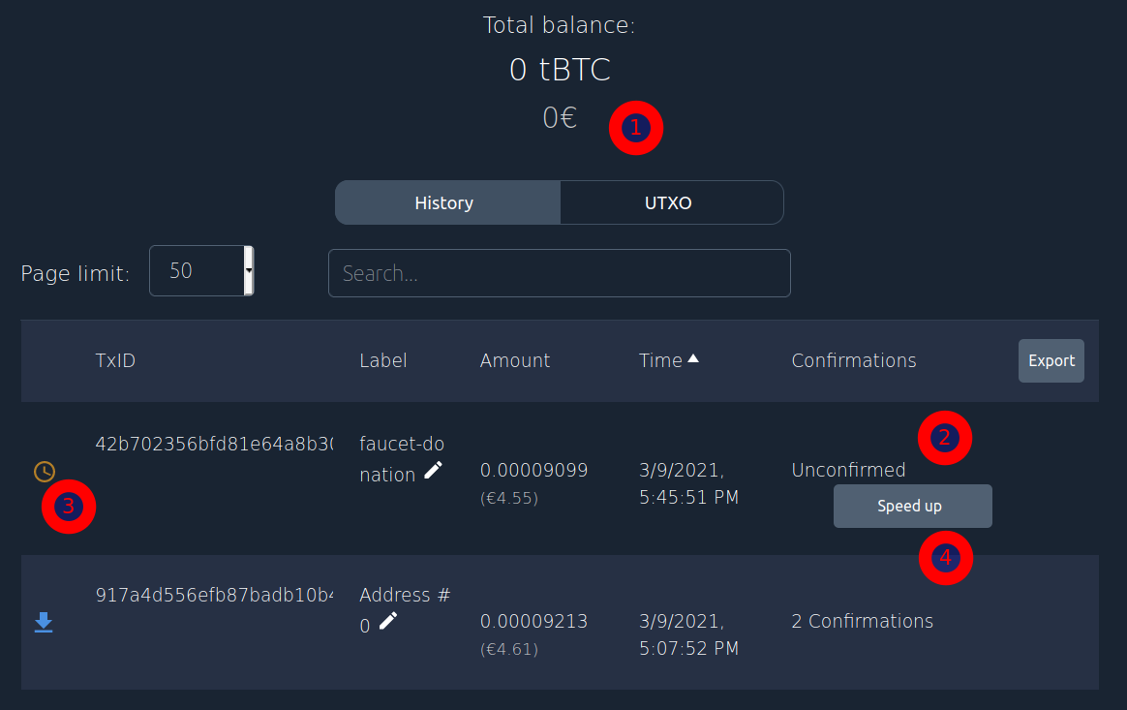
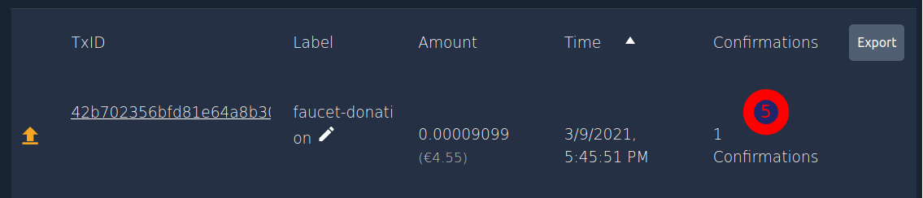
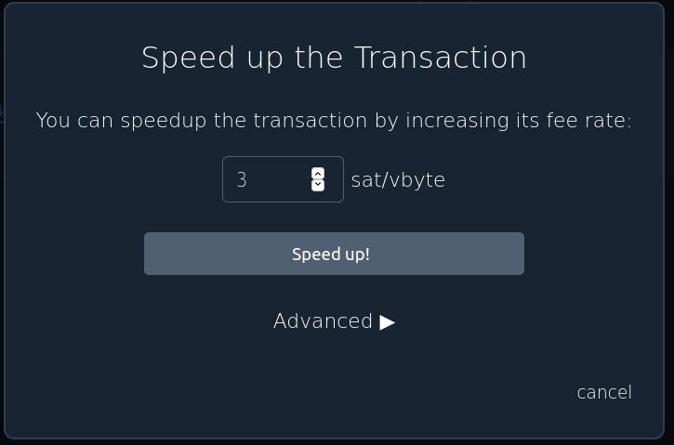
Pennytest
So now our balance is 0 again (1)
We have two transactions in our transaction-view
The new transaction is at the top, it’s unconfirmed (2) and the symbol is an orange-clock (3)
If the transaction doesn’t get confirmed in a reasonable time, you could “Speed up”(4) the transaction /by raising the fee)
After some time, it should get confirmed (5)

