Slide 1
Decred
On-chain Analytics
An overview of what Hybrid PoW/PoS consensus looks like on-chain
By Checkmate
@_checkmatey_

Slide 2
Decred On-chain
The Decred chain has a very different ‘HODLer’ signature on-chain that that of Bitcoin.
For Bitcoin, high conviction HODLing shows up as a single withdrawal transaction followed a period of dormancy.
For Decred, the hybrid PoW/PoS consensus ticket system mean high conviction HODLing has coins moving

Slide 3
Decred On-chain
On-chain Analysis is about dissecting the Psychology and Behaviour behind network transactions.
Example actions related to Decred:
Action | Psychology | Signals
Ticket Purchase | Strong Desire to Hold | Bullish
Increasing Tx Volume | Demand for Blockspace | Bullish
Price Below Subsidy Income | Network Income Stress | Bearish
Difficulty Squeeze | Miner Income Stress | Bearish

Slide 4
Realised Price and MVRV Ratio

Slide 5
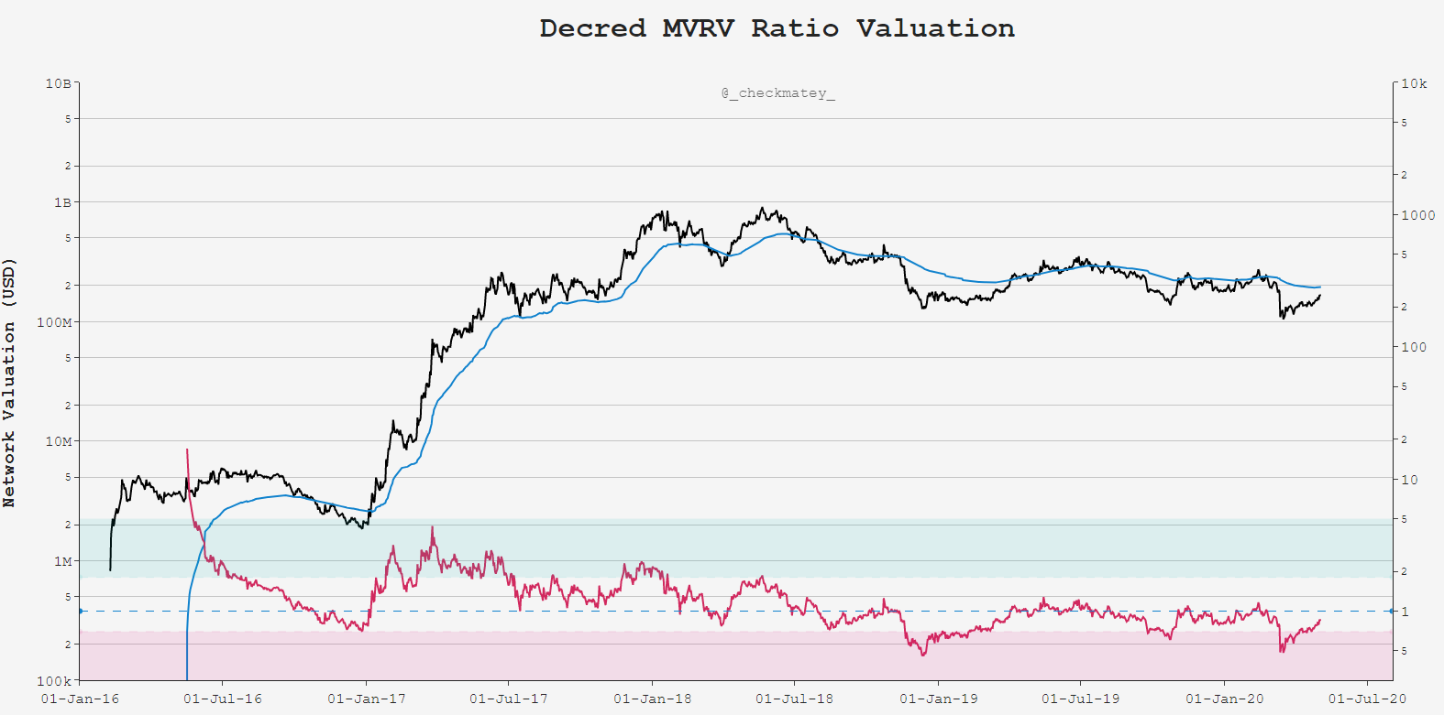
Realised Price
(The Mean)
MVRV = 1.0
Psychology: Ticket Demand as a measure of Cost Basis, Support in Bull, Resistance in Bear

Slide 6
Steep Gradient Up
= High Demand
MVRV = 1.0
Psychology: Ticket Demand as a measure of Cost Basis, Support in Bull, Resistance in Bear

Slide 7
Steep Gradient
Capitulation ←→ Accumulation
MVRV = 1.0
Psychology: Ticket Demand as a measure of Cost Basis, Support in Bull, Resistance in Bear

Slide 8
Points of Likely Mean Reversion
MVRV = 1.0
Psychology: Ticket Demand as a measure of Cost Basis, Support in Bull, Resistance in Bear

Slide 9
142-Day Sum of USD Ticket Value

Slide 10
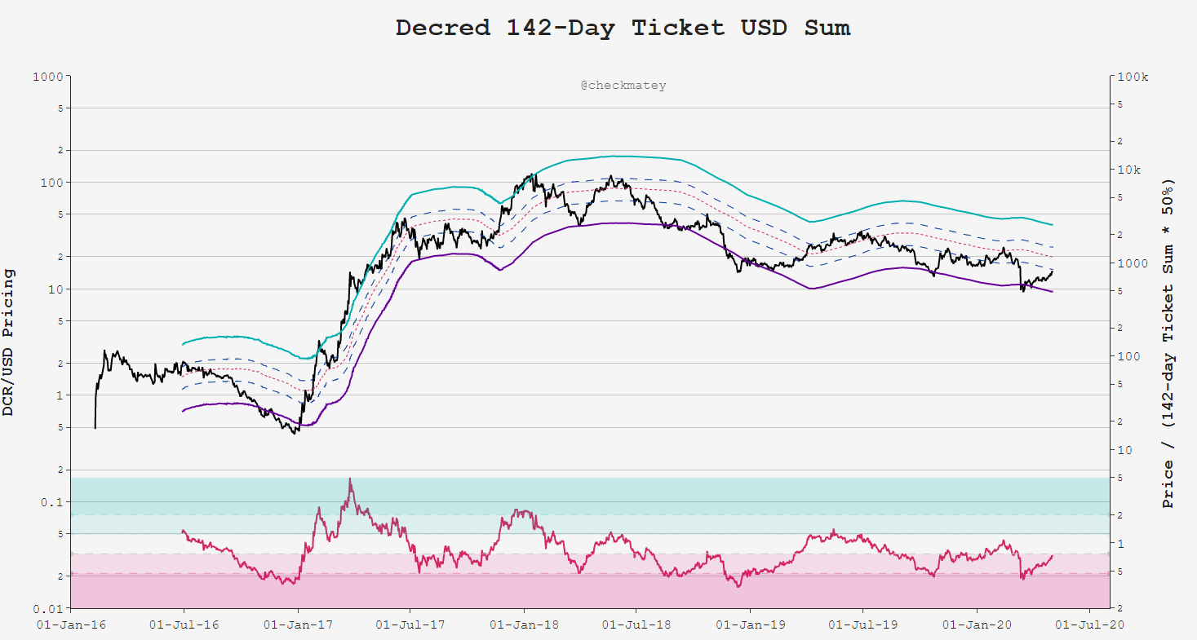
142-day Sum of USD in Tickets
Coin Supply
x61.8%
x50.0%
x38.2%
x23.6%
Psychology: Ticket purchase suggests strong belief (ceiling) on future price appreciation

Slide 11
142-day Sum of USD in Tickets
Coin Supply
x61.8%
x50.0%
x38.2%
x23.6%
Tops as Price → Ticket Demand
Psychology: Ticket purchase suggests strong belief (ceiling) on future price appreciation

Slide 12
142-day Sum of USD in Tickets
Coin Supply
x61.8%
x50.0%
x38.2%
x23.6%
Bottoms as Price → 23.6% Ticket Demand
Psychology: Ticket purchase suggests strong belief (ceiling) on future price appreciation

Slide 13
Block Subsidy Models

Slide 14
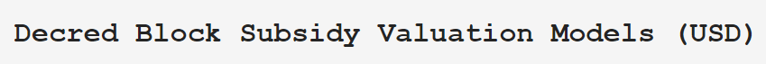
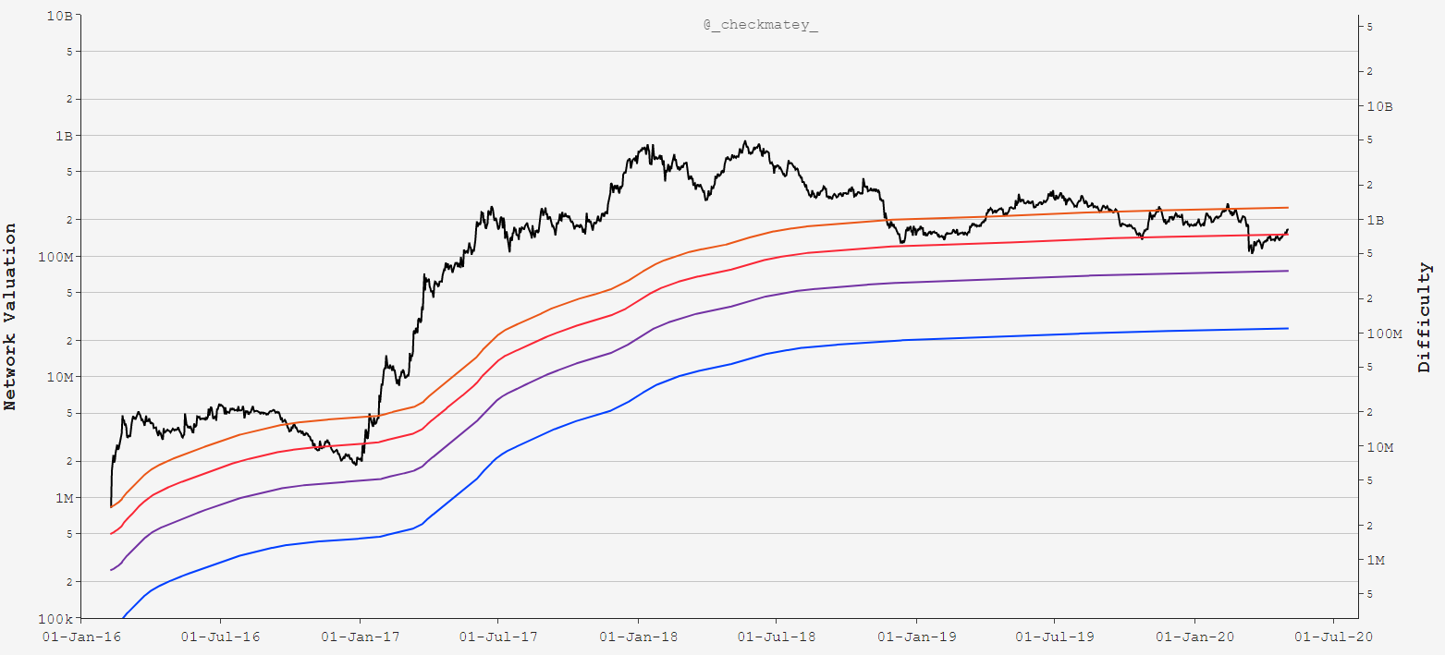
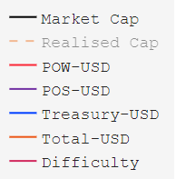
Decred Network
Cumulative Income
Psychology: Aggregate network ‘cash-flow’ represents an incentive cost-basis for each party

Slide 15
Network Aggregate Income Underwater
Psychology: Aggregate network ‘cash-flow’ represents an incentive cost-basis for each party

Slide 16
Miners Underwater
Increased Sell Pressure
Psychology: Aggregate network ‘cash-flow’ represents an incentive cost-basis for each party

Slide 17
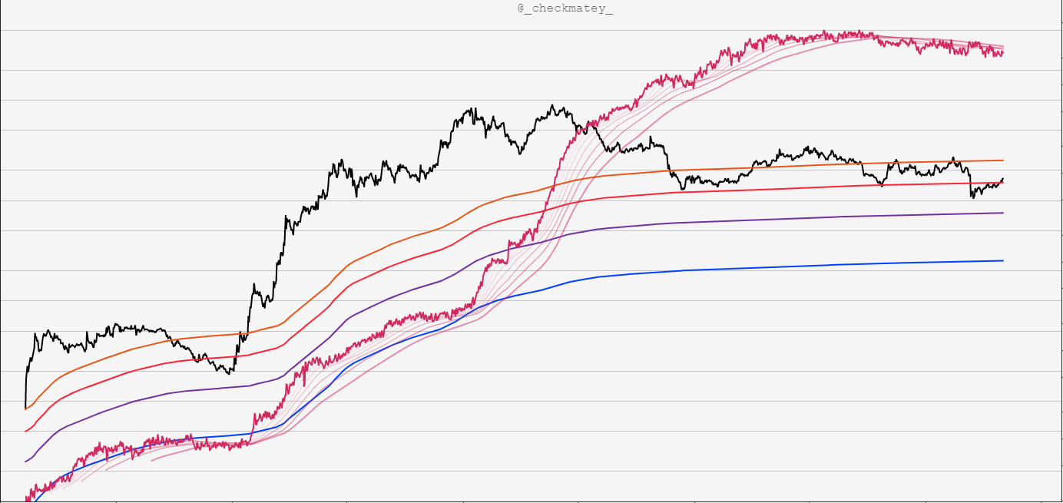
Difficulty Ribbon Confirms Miner Squeeze
Psychology: Aggregate network ‘cash-flow’ represents an incentive cost-basis for each party

Slide 18
Transaction Demand

Slide 19
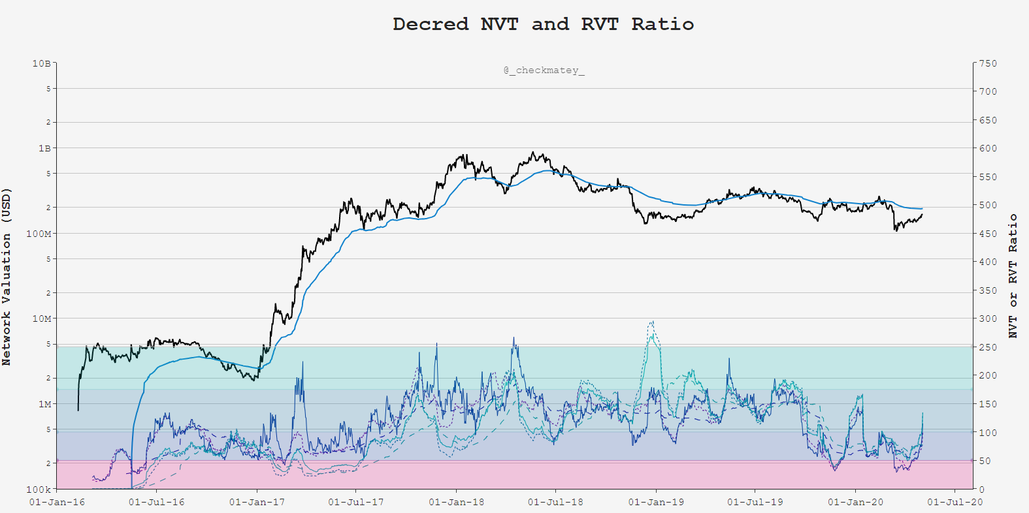
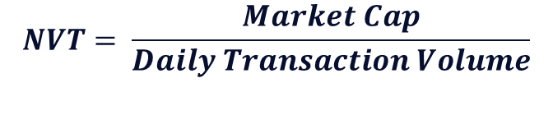
$$NVT= \frac{Market Cap}{Daily Transaction Volume}$$
Psychology: Compare transactional demand for Block-space to network valuation

Slide 20
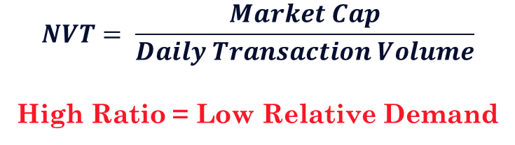
$$NVT= \frac{Market Cap}{Daily Transaction Volume}$$
High Ratio = Low Relative Demand
Psychology: Compare transactional demand for Block-space to network valuation

Slide 21
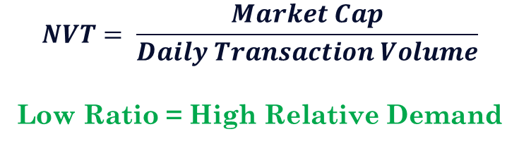
$$NVT= \frac{Market Cap}{Daily Transaction Volume}$$
Low Ratio = High Relative Demand
Psychology: Compare transactional demand for Block-space to network valuation

Slide 22
$$NVT= \frac{Market Cap}{Daily Transaction Volume}$$
Low Ratio = High Relative Demand
Privacy Mixing Live
Psychology: Compare transactional demand for Block-space to network valuation

Slide 23
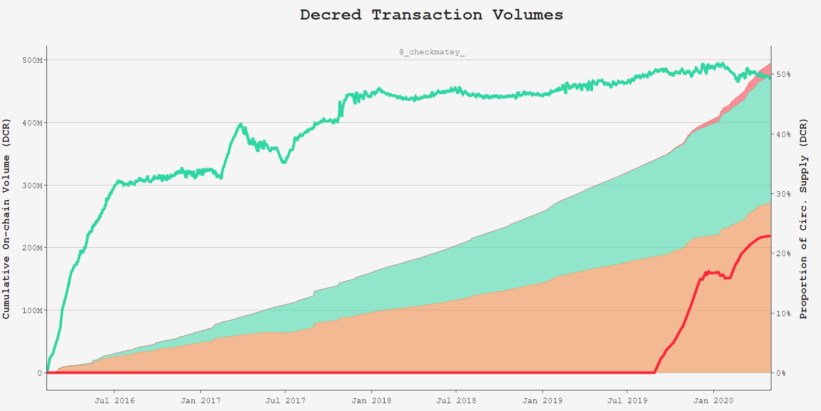
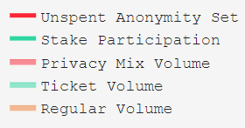
Demand for Privacy Mixing Increases
Tx Throughput

Slide 24
50% of Supply Staked in Tickets
23% of Supply Mixed and Unspent

Slide 25
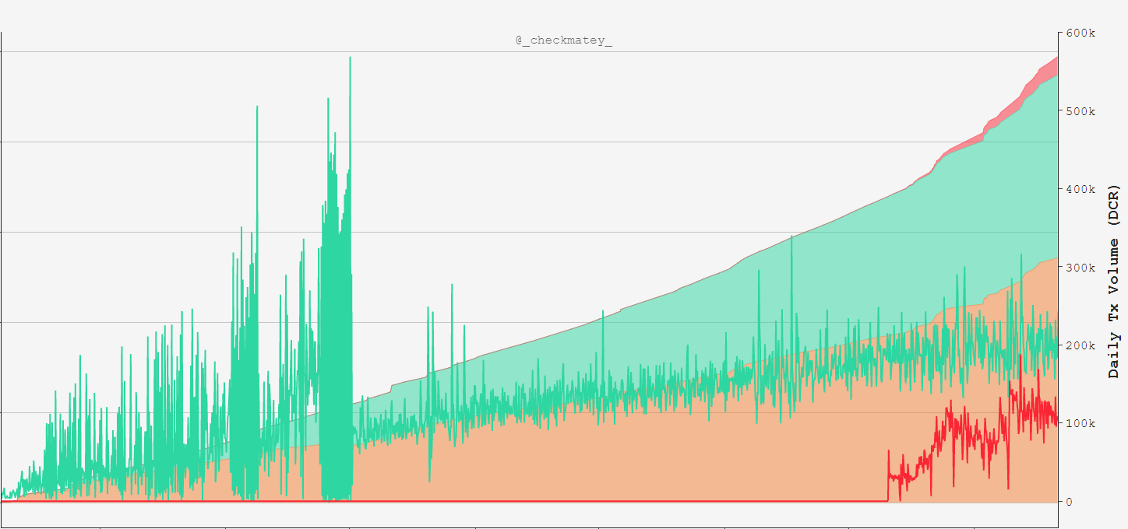
192k DCR in Tickets per day
110k DCR Mixed per day

Slide 26
Summary
The Decred blockchain has a unique blend of:
Machine Consensus in Proof-of-Work
Human Consensus in Proof-of-Stake
Holding DCR and participation in governance via tickets is a very high conviction signal of Network Sentiment.
Cost Basis models provides insight into the economic stress or euphoria for various stakeholder and participants.

