Slide 1
Decred Charting Suite
Guidelines
The following slides present the input calculations and a sample chart for metrics to be presented as a Decred charting suite.
Raw data is sourced and analysed in python (pandas) from Coinmetrics Community API and dcrdata (via TinyDecred)
Plotly open source charting library is used to develop and embed charts
Metric calculations are assumed to be in a pandas table and operational logic is presented as would be performed in dataframe analysis (i.e. multiplied meanse multiplied by value on the same row).

Slide 2
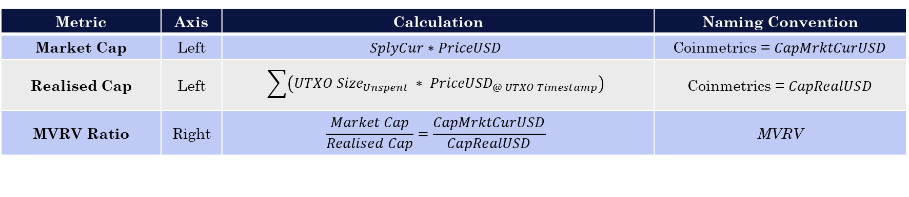
MVRV Ratio
CHART #01
The MVRV Ratio provides a measure of the relative distance between the market cap and the realised cap. For Decred, this behaves as an oscillator for seeking periods of under and overvaluation through bull and bear cycles.
Note – This chart can also be presented as Price and Realised Price by dividing Market Cap and Realised Cap by Circulating Supply, respectively
Metric | Axis | Calculation | Naming Convention
Market Cap | Left | $$SplyCur∗PriceUSD$$ | Coinmetrics = $CapMrktCurUSD$
Realised Cap | Left | $$\sum{\left({UTXO Size}_{Unspent} ∗ {PriceUSD}_{@ UTXO Timestamp}\right)}$$ | Coinmetrics = $CapRealUSD$
MVRV Ratio | Right | $$\frac{Market Cap}{Realised Cap}=\frac{CapMrktCurUSD}{CapRealUSD}$$ | MVRV

Slide 3
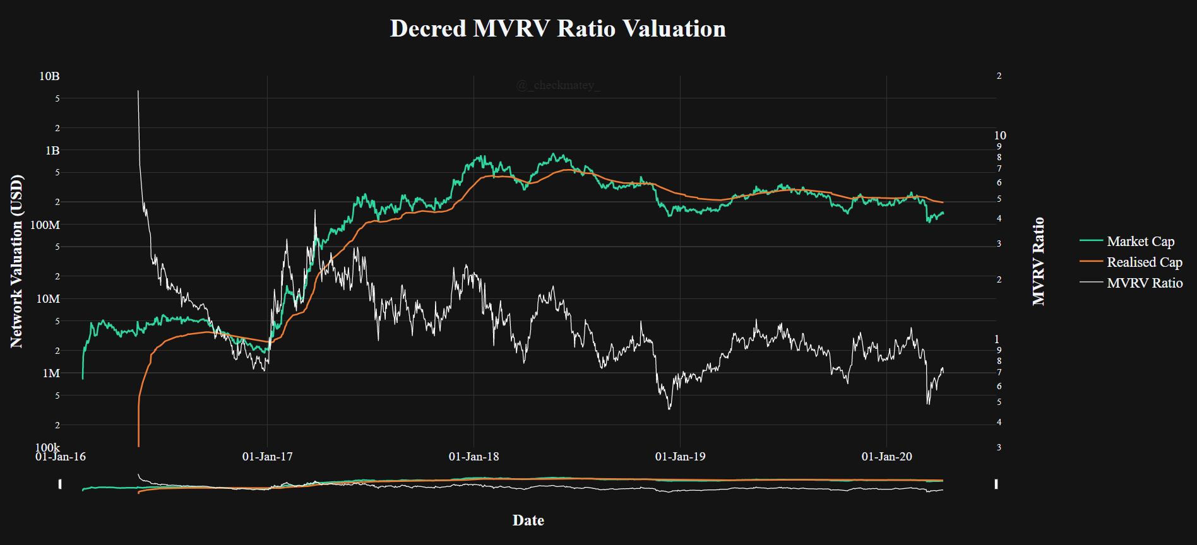
CHART #01

Slide 4
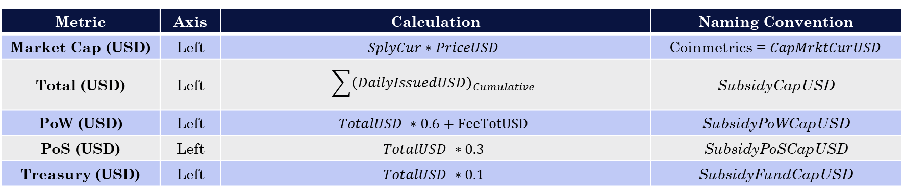
Block Subsidy Models (USD)
CHART #02
The Block Subsidy model developed by @permabullnino presents the cumulative sum of all Decred block rewards issued by the protocol to PoW Miners, PoS Stakeholders, the Treasury and on aggregate. This model represents the aggregate break-even protocol valuation for all stakeholders with a cost basis denominated in USD.
Metric | Axis | Calculation | Naming Convention
Market Cap (USD) | Left | $$SplyCur∗PriceUSD$$ | Coinmetrics = $CapMrktCurUSD$
Total (USD) | Left | $$\sum{{\left(DailyIssuedUSD\right)}_{Cumulative}}$$ | SubsidyCapUSD
PoW (USD) | Left | $$TotalUSD ∗0.6+FeeTotUSD$$ | SubsidyPoWCapUSD
PoS (USD) | Left | $$TotalUSD ∗0.3$$ | SubsidyPoSCapUSD
Treasury (USD) | Left | $$TotalUSD ∗0.1$$ | SubsidyFundCapUSD

Slide 5
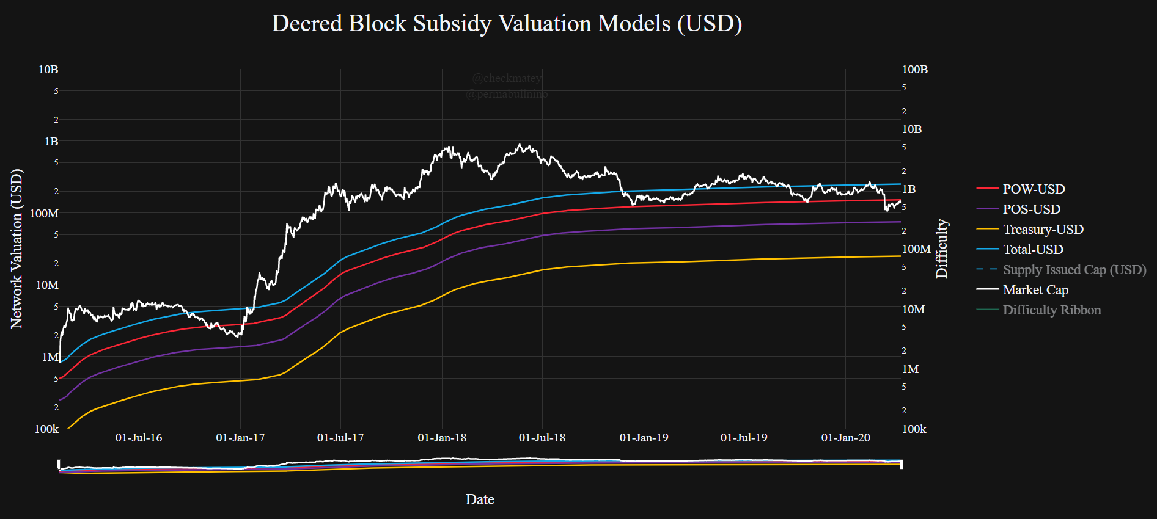
CHART #02

Slide 6
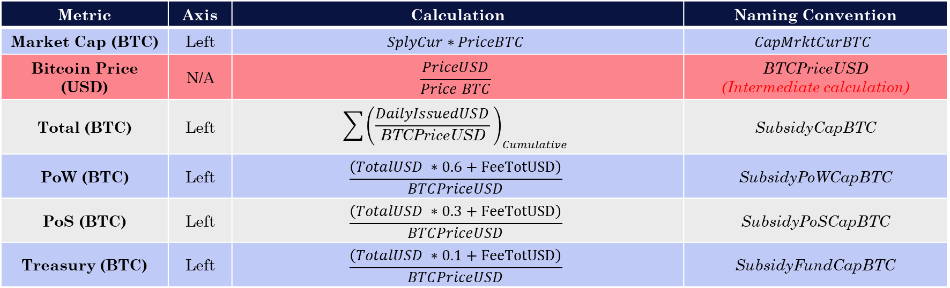
Block Subsidy Models (BTC)
CHART #03
The Block Subsidy model developed by @permabullnino presents the cumulative sum of all Decred block rewards issued by the protocol to PoW Miners, PoS Stakeholders, the Treasury and on aggregate. This model represents the aggregate break-even protocol valuation for all stakeholders with a cost basis denominated in BTC.
Metric | Axis | Calculation | Naming Convention
Market Cap (BTC) | Left | $$SplyCur∗PriceBTC$$ | $$CapMrktCurBTC$$
Bitcoin Price (USD) | N/A | $$\frac{PriceUSD}{Price BTC}$$ | BTCPriceUSD (Intermediate calculation)
Total (BTC) | Left | $$\sum{{\left(\frac{DailyIssuedUSD}{\text{BTCPriceUSD}} \right)}_{Cumulative}}$$ | SubsidyCapBTC
PoW (BTC) | Left | $$\frac{\left(TotalUSD ∗0.6+FeeTotUSD\right)}{BTCPriceUSD}$$ | SubsidyPoWCapBTC
PoS (BTC) | Left | $$\frac{\left(TotalUSD ∗0.3+FeeTotUSD\right)}{BTCPriceUSD}$$ | SubsidyPoSCapBTC
Treasury (BTC) | Left | $$\frac{\left(TotalUSD ∗0.1+FeeTotUSD\right)}{BTCPriceUSD}$$ | SubsidyFundCapBTC

Slide 7
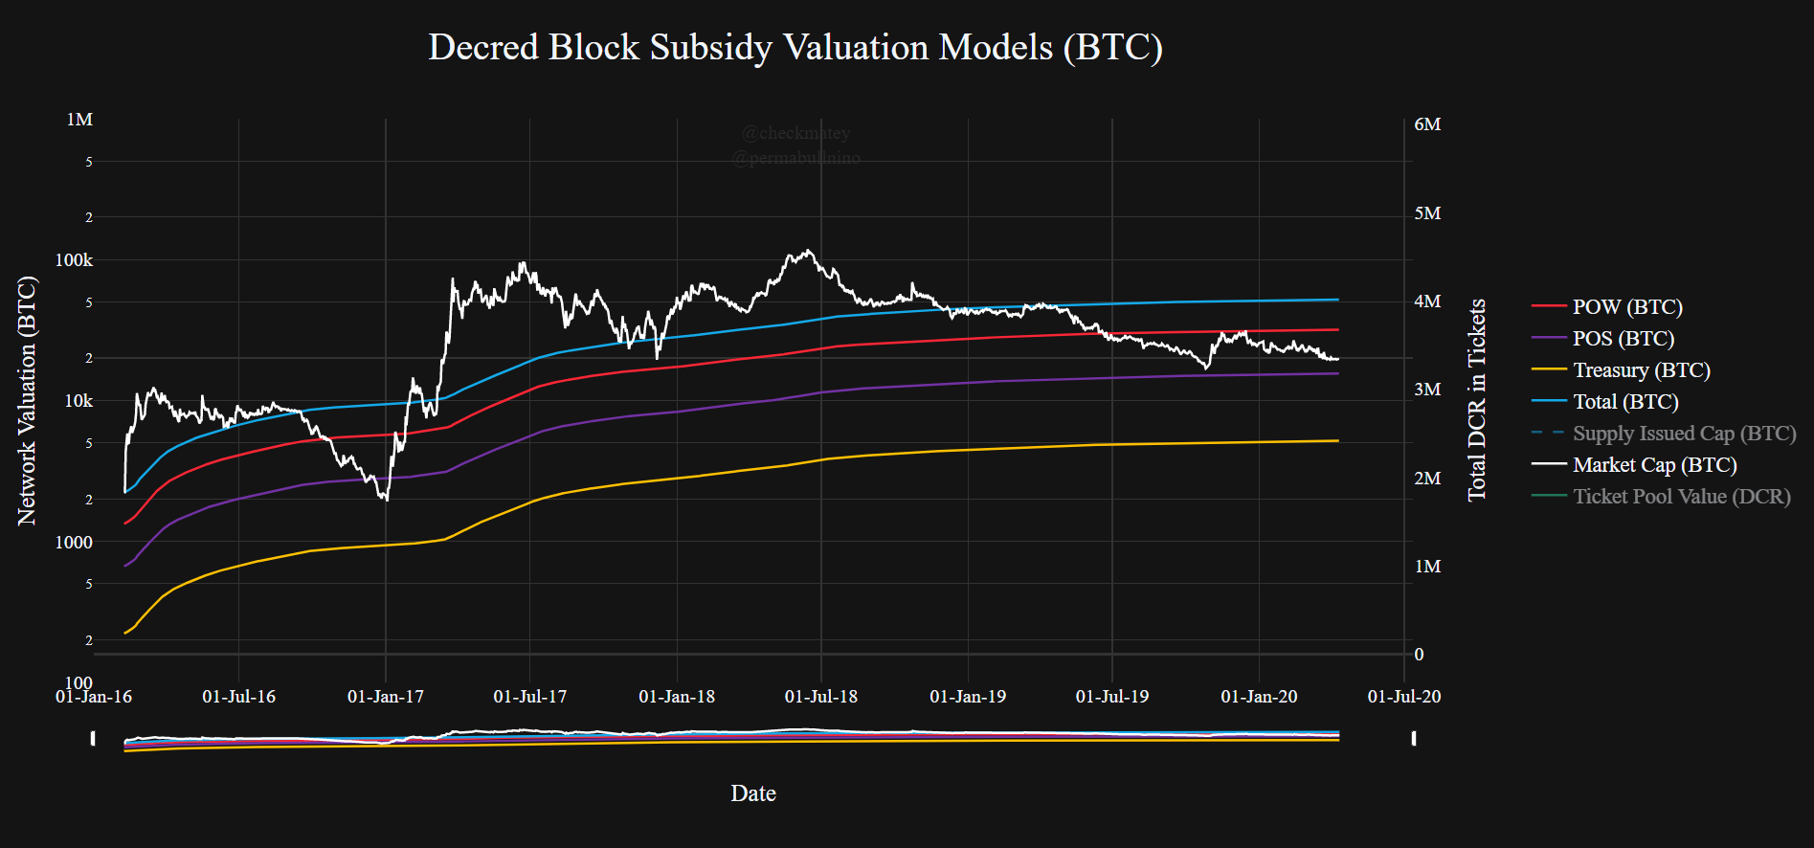
CHART #03

Slide 8
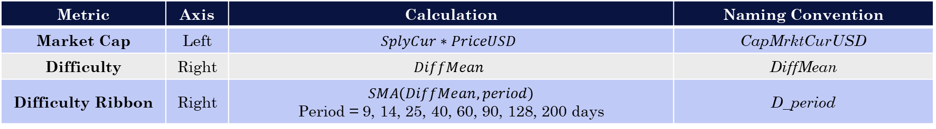
Difficulty Ribbon
CHART #04
The difficulty ribbon was developed by Willy Woo (@woonomic) as a series of moving averages applied to protocol mining difficulty. During periods of hash-rate expansion, the ribbon will trend higher
Metric | Axis | Calculation | Naming Convention
Market Cap | Left | $$SplyCur∗PriceUSD$$ | CapMrktCurUSD
Difficulty | Right | $$DiffMean$$ | DiffMean
Difficulty Ribbon | Right | $$SMA\left(DiffMean, period\right)$$ Period = 9, 14, 25, 40, 60, 90, 128, 200 days | D_period

Slide 9
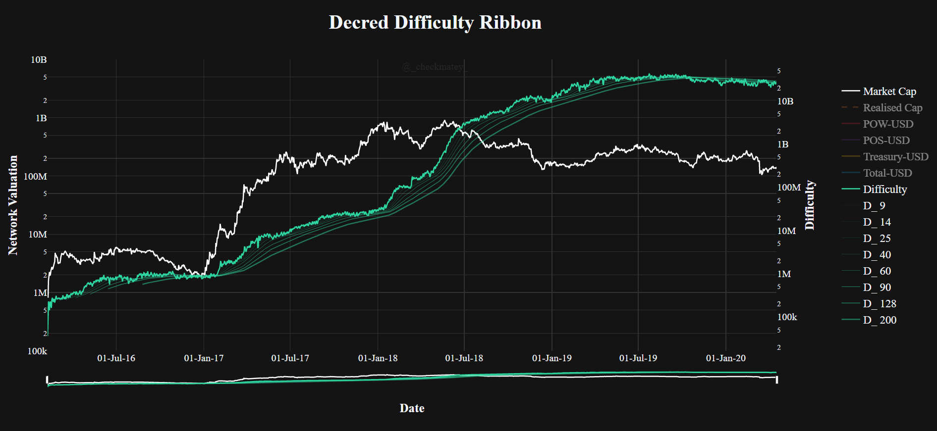
CHART #04

Slide 10
X
CHART #05
Desc
Note –
Metric | Axis | Calculation | Naming Convention

Slide 11
CHART #05

Slide 12
X
CHART #06
Desc
Note –
Metric | Axis | Calculation | Naming Convention

Slide 13
CHART #06

Slide 14
X
CHART #07
Desc
Note –
Metric | Axis | Calculation | Naming Convention

Slide 15
CHART #07

