Slide 1
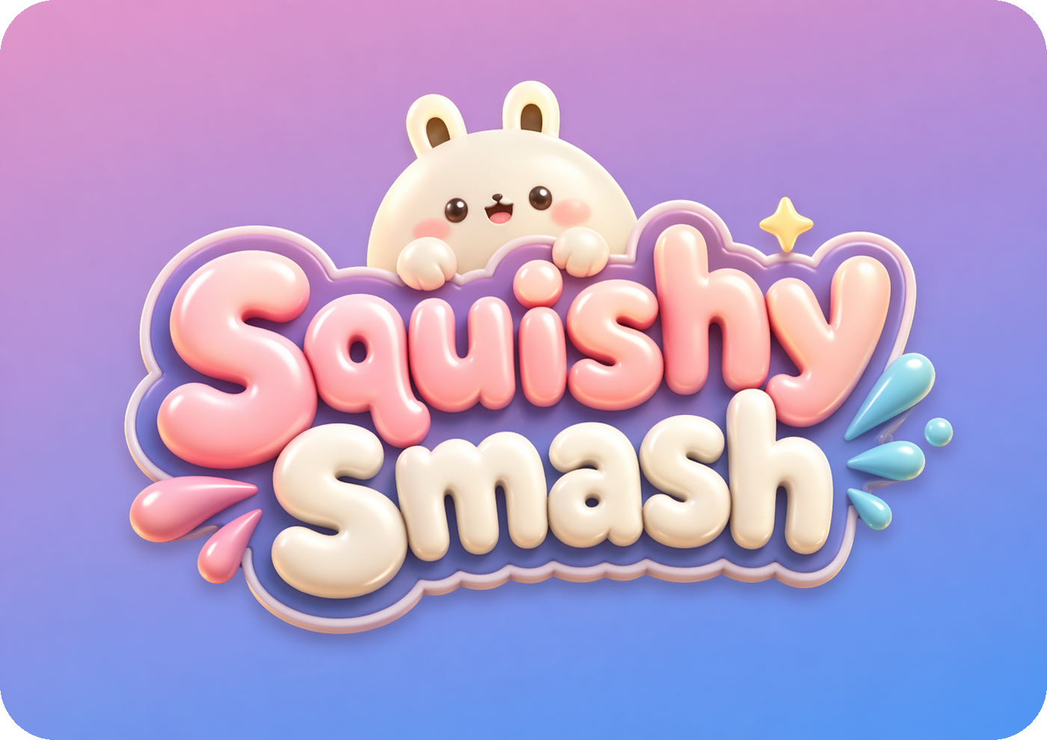
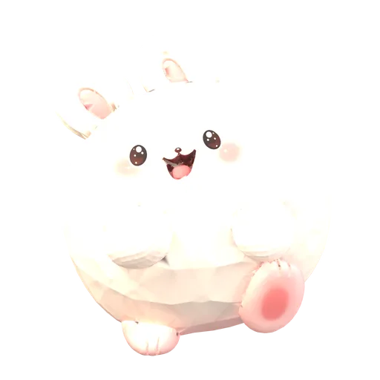
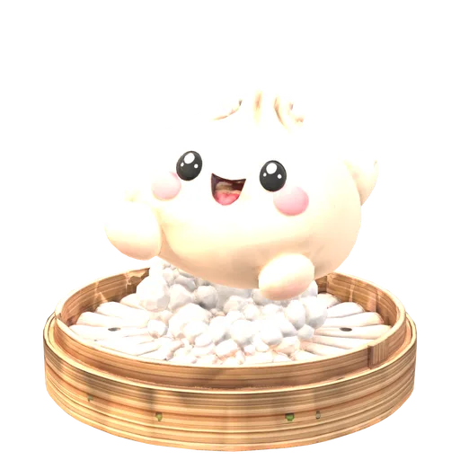
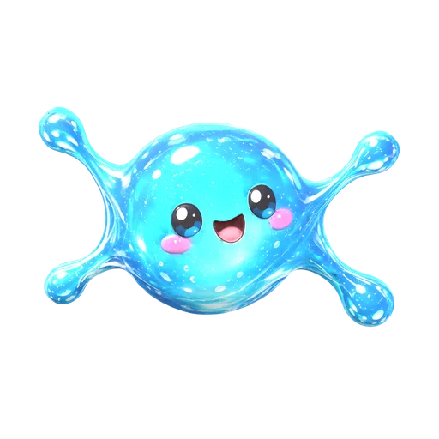
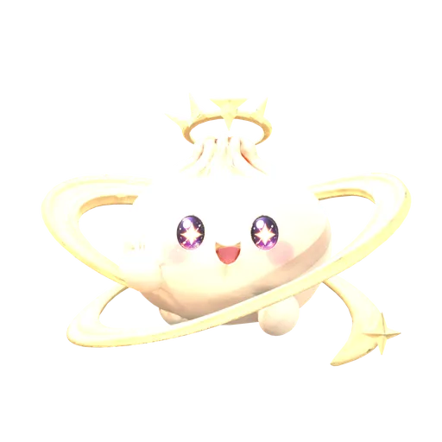
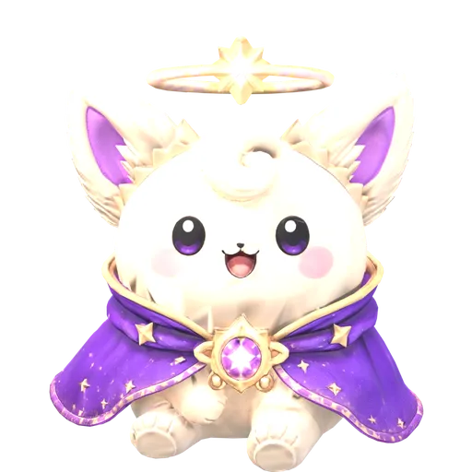
Licensing & Manufacturing Opportunity
An original character universe ready to become a physical collectible toy line.
Squishy Smash | Confidential Concept Presentation

Slide 2
THE OPPORTUNITY
From Digital Characters to Real-World Collectibles
Squishy Smash is a developed children’s character brand with original art, two published books, trading cards, a mobile game, a Roblox experience, and 3D character models already in place.
The next step is bringing selected characters into the physical world as collectible slow-rise squishy toys.
The brand foundation is built. Product development can begin from existing character assets.
Squishy Smash | Confidential Concept Presentation
1

Slide 3
BRAND ECOSYSTEM
A Connected Character Universe
Storybook
The Lost Sparkle
Physical Toys
Character Book
Proposed next step
Meet the Squishies
SQUISHY
SMASH
3D Models
Trading Cards
6 characters modelled
48 collectible cards
Roblox Game
iOS App
Live experience
Live on the App Store
Every part of the brand reinforces the others. Physical squishies can connect directly to the books, games, and cards.
Squishy Smash | Confidential Concept Presentation
2

Slide 4
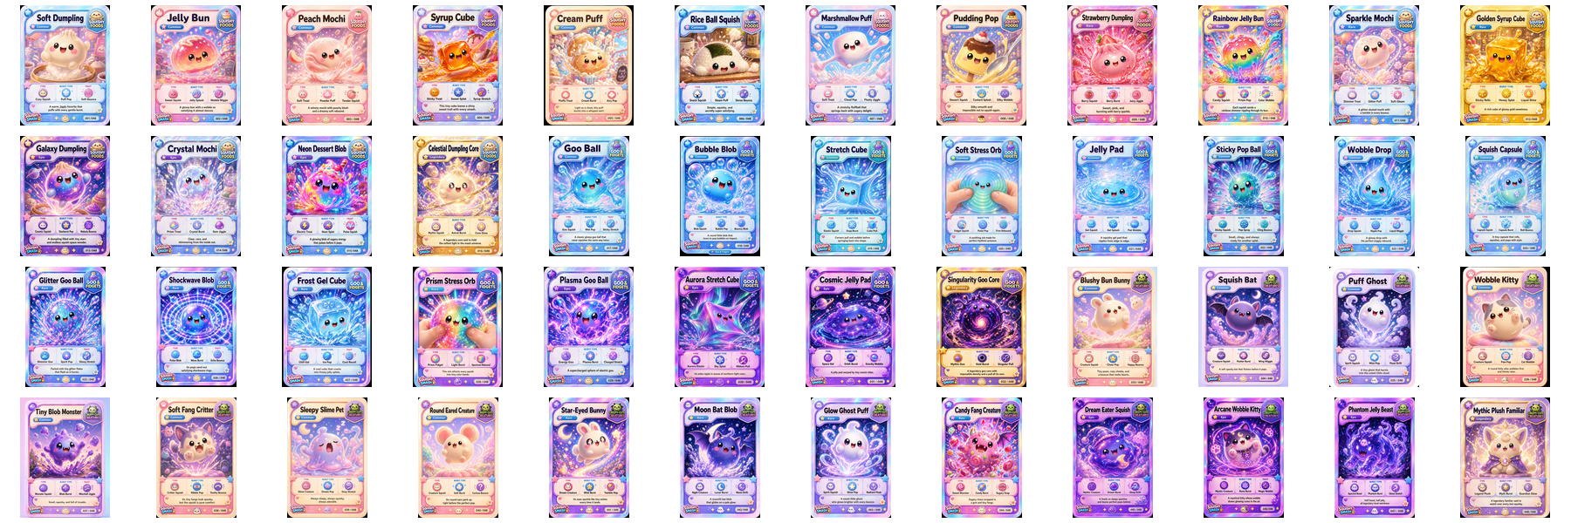
EXISTING INTELLECTUAL PROPERTY
48 Original Characters
Squishy Smash includes 48 original characters with distinct names, personalities, artwork, and collectible rarity tiers.
All 48 characters shown · 24 Common · 12 Rare · 9 Epic · 3 Legendary
Original character names and artwork
Consistent visual identity across every surface
Existing 2D artwork for all 48 characters
Three themed packs, designed for expansion
Squishy Smash | Confidential Concept Presentation
3

Slide 5
MANUFACTURING READINESS
Built for a Faster Path to Prototype
Six characters already have 3D models generated from their original card art. These are a starting point for design-for-manufacturing review — not finished tooling geometry.
Existing 3D Model
›
Manufacturing Review
›
Mold-Ready Geometry
›
Prototype
›
Production Sample
GLB models available; OBJ, FBX or STL can be supplied
High-resolution colour references for all 48 characters
Front, side and back views can be rendered on request
Design-for-manufacturing adjustments are expected and welcomed
Existing 3D models, rendered from the GLB files
Existing models are concept geometry. Mold-ready files would be produced with the manufacturer.
Squishy Smash | Confidential Concept Presentation
4

Slide 6
PROPOSED PRODUCT
Collectible Slow-Rise Squishy Characters
CONSTRUCTION
RESPONSE
Soft polyurethane foam
Slow-rise squeeze
SIZE
FINISH
Approx. 4–6 inches tall
Durable painted coating
OPTIONS
PACKAGING
Scent, glitter, glow or colour-change
Window box, polybag or blind box
Initial target specifications for manufacturer discussion. Nothing here is final — all specifications are open to your recommendations.
Squishy Smash | Confidential Concept Presentation
5

Slide 7
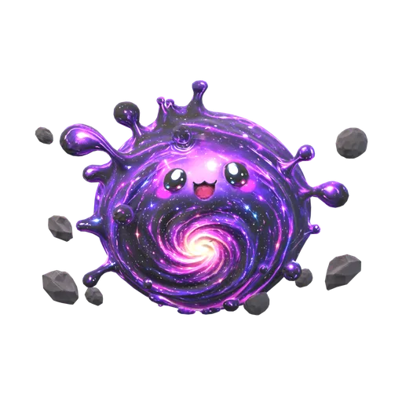
PILOT COLLECTION
Proposed First Release
Squishy Smash Founders Series
Launching with six hero characters rather than all 48. These six are proposed first because each already has an existing 3D model, and together they cover all three packs and both ends of the rarity range.
Soft Dumpling
Goo Ball
Blushy Bun Bunny
Celestial Dumpling Core
Singularity Goo Core
Mythic Plush Familiar
001/048
017/048
033/048
016/048
032/048
048/048
COMMON
COMMON
COMMON
LEGENDARY
LEGENDARY
LEGENDARY
✓ Lower tooling investment
✓ Faster testing
✓ Clearer customer feedback
✓ Easier quality control
✓ Builds anticipation for later series
Proposed selections. Final lineup to be confirmed with the manufacturing partner.
Squishy Smash | Confidential Concept Presentation
6

Slide 8
COLLECTIBILITY
Designed to Encourage Repeat Discovery
Built-in collectible structure
Potential finishes and variants
Four rarity tiers per character
Glow-in-the-dark
Numbered series (001/048 – 048/048)
Scented
A matching collectible card for every character
Glitter and metallic
Character profile and story for each
Colour-changing
Three themed packs
Seasonal and holiday editions
Chase variants
Every character is individually named and numbered, so collections are transparent — a buyer always knows exactly what they are purchasing.
Squishy Smash | Confidential Concept Presentation
7

Slide 9
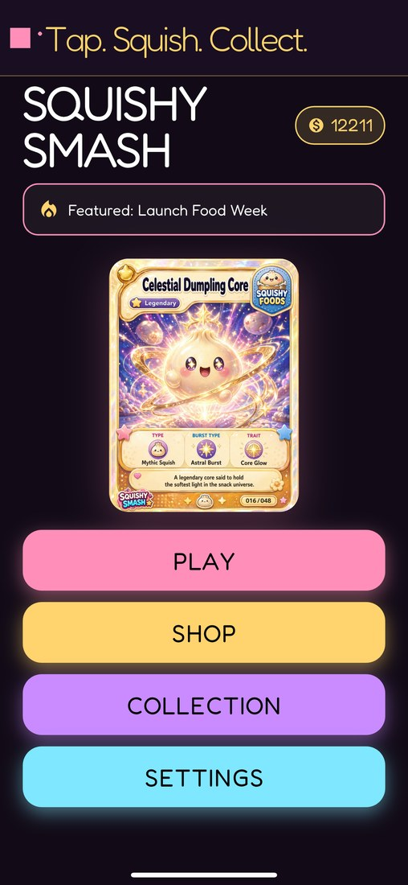
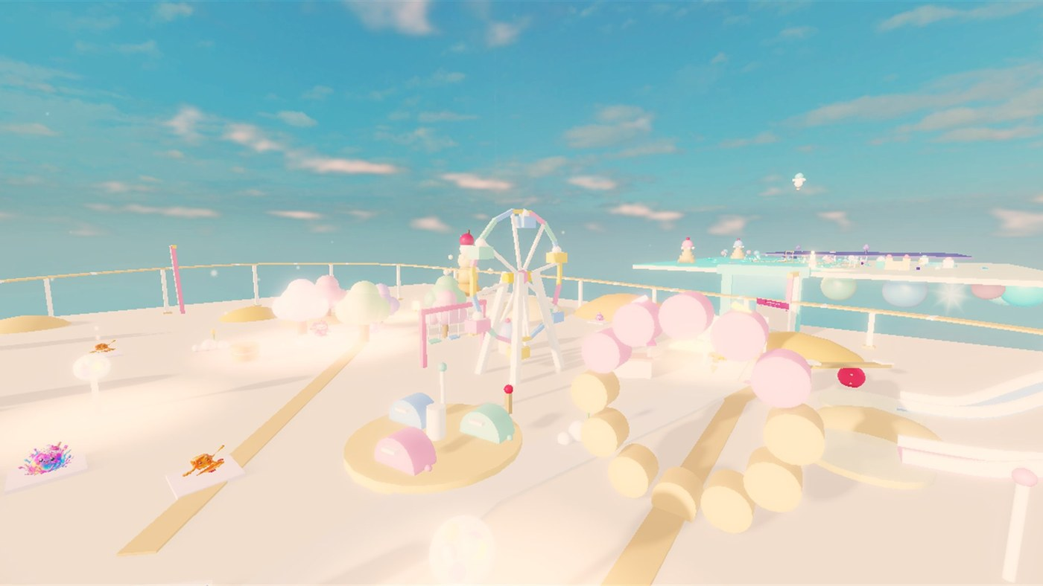
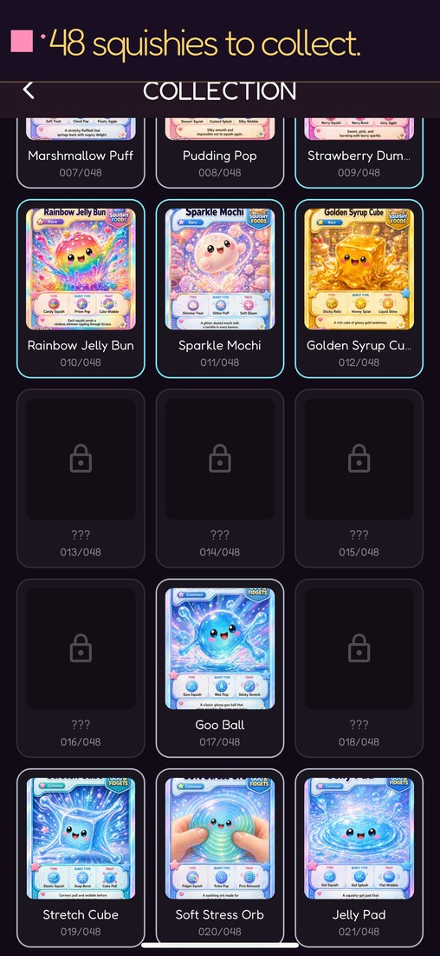
CROSS-PLATFORM CONNECTION
Every Toy Can Unlock More of the World
The physical product can become a bridge between the books, games and cards. The digital surfaces below are live today; the toy-to-digital connections are planned features, not shipped ones.
iOS App
Roblox Experience
Collection Album
Live on the App Store
Live — "The Lost Sparkle"
48-card in-app album
Planned toy-to-digital connections (not yet implemented)
· QR code to the brand site
· Roblox cosmetic bonus
· iOS app reward
· Character profile page
· Printable activities
Squishy Smash | Confidential Concept Presentation
8

Slide 10
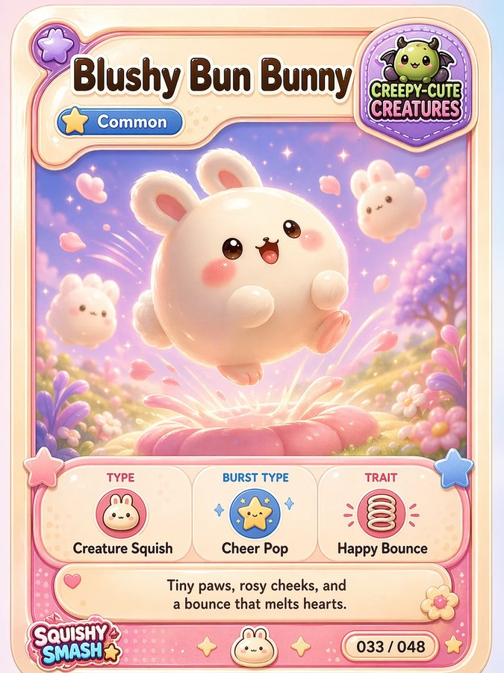
PACKAGING DIRECTION
Retail-Ready Storytelling
The existing trading-card design already contains every element a retail package needs — name, number, rarity, artwork and character description. It is a natural basis for packaging artwork.
PACKAGING COMPONENTS
Squishy Smash logo
Character artwork
Character name
Short personality description
Series number
QR code area
Rarity badge
Safety and compliance panel
FORMATS
Window box
Branded polybag
Blind box
Existing trading card — design reference
Multi-character collector set
Concept direction only. Existing trading card shown as a design reference, not as final packaging artwork.
Squishy Smash | Confidential Concept Presentation
9

Slide 11

TARGET AUDIENCE
Who Squishy Smash Is Built For
PURCHASE OCCASIONS
PRIMARY AUDIENCE
Birthdays
Holidays
Rewards
Children approximately ages 4–10
Stocking stuffers
Book bundles
Collectible play
SECONDARY AUDIENCES
Parents buying gifts
Collectible toy fans
Roblox and mobile game players
Book readers
Teachers and family gift buyers
Proposed age range. The final age grade must be confirmed through product design, testing and applicable toy-safety standards.
Squishy Smash | Confidential Concept Presentation
10

Slide 12
PARTNERSHIP REQUEST
What We Are Seeking
Prototype development
Design-for-manufacturing review
Mold and tooling estimates
Minimum order quantities
Unit pricing at multiple volumes
Packaging capabilities
Safety testing support
Production timelines
Shipping and fulfilment options
Where feasible, we would appreciate pricing at 250, 500, 1,000 and 5,000 units per design.
Squishy Smash | Confidential Concept Presentation
11

Slide 13
WHY SQUISHY SMASH
More Than a Single Toy
Original, expandable IP
Published presence
Existing card designs
48 characters across three themed packs
Two books available on Amazon
A finished collectible card for every character
Live digital surfaces
3D foundation
Room to grow
iOS app and Roblox experience
Six characters already modelled
Multiple future product categories
A physical squishy line would join an ecosystem that already exists.
Squishy Smash | Confidential Concept Presentation
12

Slide 14
FUTURE EXPANSION
Long-Term Product Possibilities
Broader licensing potential
Collectible Squishies
Additional squishy series
Plush toys
The immediate focus
Mini figures
Keychains
Backpacks & accessories
Activity kits
Stickers
Apparel
Classroom & party products
Concept categories illustrating licensing breadth. No timeline is proposed for these.
Squishy Smash | Confidential Concept Presentation
13

Slide 15
Let’s Bring Squishy Smash to Life
We are seeking experienced manufacturing and licensing partners to help develop the first physical Squishy Smash collection.
CONTACT
Christopher Ryan Campbell
COMPANY
Athlete Domains, LLC
EMAIL
support@squishysmash.com
WEBSITE
www.squishysmash.com
PHONE
864-606-2284
© 2026 Christopher Ryan Campbell / Athlete Domains, LLC. All rights reserved.
Squishy Smash | Confidential Concept Presentation
14

Slide 16
APPENDIX A
Full Character Gallery
All 48 characters. Every character has finished artwork, a name, a series number and a rarity tier.
24 Common · 12 Rare · 9 Epic · 3 Legendary
Squishy Smash | Confidential Concept Presentation
15

Slide 17
APPENDIX B
Manufacturer RFQ
Custom slow-rise polyurethane foam squishy based on an original Squishy Smash character.
WE CAN PROVIDE
INFORMATION REQUESTED
Existing 3D model (GLB)
1. Prototype and sample cost
8. Scent, glitter, glow or colour-change options
Colour character artwork
2. Mold and tooling cost per character
9. Packaging capabilities
Front / side / back references
3. Minimum order quantity
10. Product safety testing support
Logo and branding assets
4. Unit cost at 250 / 500 / 1,000 / 5,000 pieces
11. Shipping terms and freight options
Packaging concept
5. Development and production timelines
12. Ownership and storage of molds
6. Available foam densities and rebound speeds
13. Sample revision policy
7. Paint and coating options
14. Payment schedule
Please confirm whether you can support applicable U.S. toy-safety requirements, including age grading, labelling, tracking information and third-party testing where required.
This list is a discussion starting point, not legal advice. Compliance requirements will be confirmed with qualified professionals and accredited testing laboratories.
Squishy Smash | Confidential Concept Presentation
16

