Slide 1
iMentor
Team #22:
Chanh Nguyen, Prachi Pendse, Han Thu,
Utkarsh Garg, Sangini Shah

Slide 2
Goals and Approach
To save the staff the time and effort of reading through hundreds of emails each week
Implement an algorithm that produces an accurate score for email/curriculum pairs
To allow the staff of iMentor to easily visualize data
Present trends in the data:
Average scores for individual curriculums, schools, and mentees
Trend in mentee progress

Slide 3
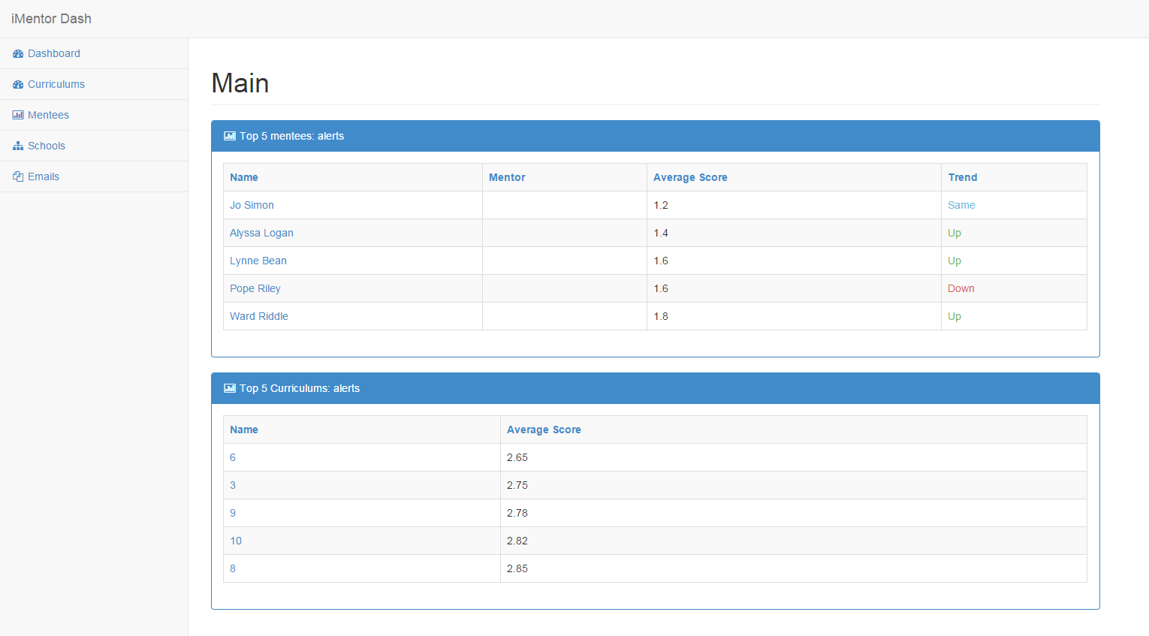
Demo!
http://104.131.125.9:3000/

Slide 4
Future Roadmap
Increase accuracy
Wordnet Princeton University- thesaurus of words
More sample anonymized data for algorithm
Better html sanitization
User Interface
Incorporate mentors and mentees

