Slide 1
Log into Amazon EC2 and launch an Ubuntu Server 14.04 instance with instance type m4.large. (You can choose another instance type instead, but I recommend that it have at least 8 GB of RAM for this installation step.)
I recommend creating a new security group called "zcash" that you'll use with all of your instances. To that security group, add an inbound rule with type: Custom TCP Rule, Protocol: TCP, Port Range: 18232, and Source: Anywhere (0.0.0.0/0). This will allow other nodes to connect to your node.

Slide 2
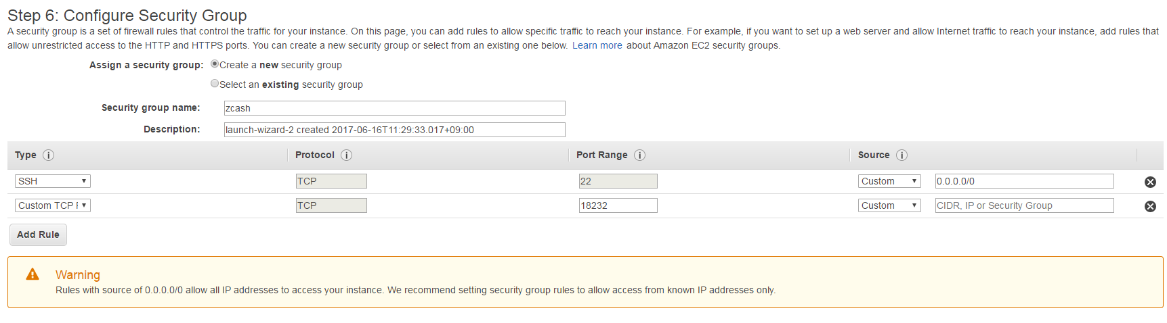

Slide 3
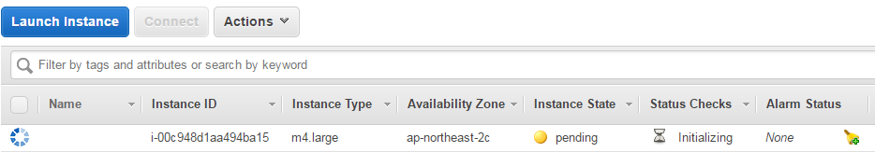

Slide 6
https://aws.amazon.com/ko/cli/

Slide 7
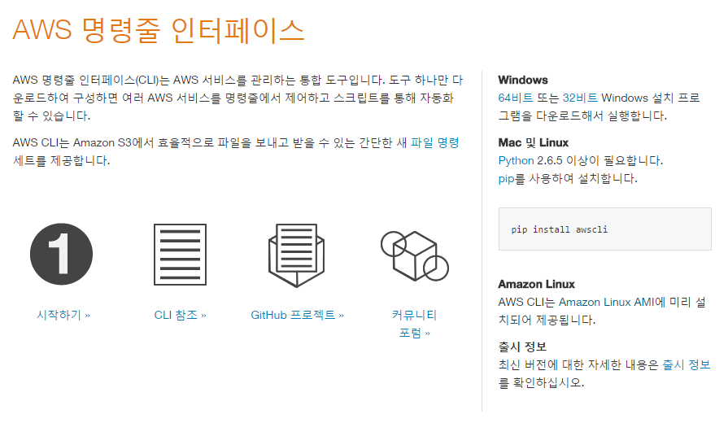

Slide 9
sudo apt-get update
sudo apt-get install build-essential pkg-config libgtest-dev libc6-dev m4 g++-multilib autoconf libtool ncurses-dev unzip git python zlib1g-dev wget bsdmainutils automake

Slide 10
git
$ git clone https://github.com/zcash/zcash.git
cd zcash/
git checkout origin
./zcutil/fetch-params.sh

Slide 11
Compiling
./zcutil/fetch-params.sh

