Slide 1



White-box filtering attacks breaking SEL masking: from exponential to polynomial time
Alex Charlès, Aleksei Udovenko

Slide 2
General overview of White-box Cryptography

Slide 3

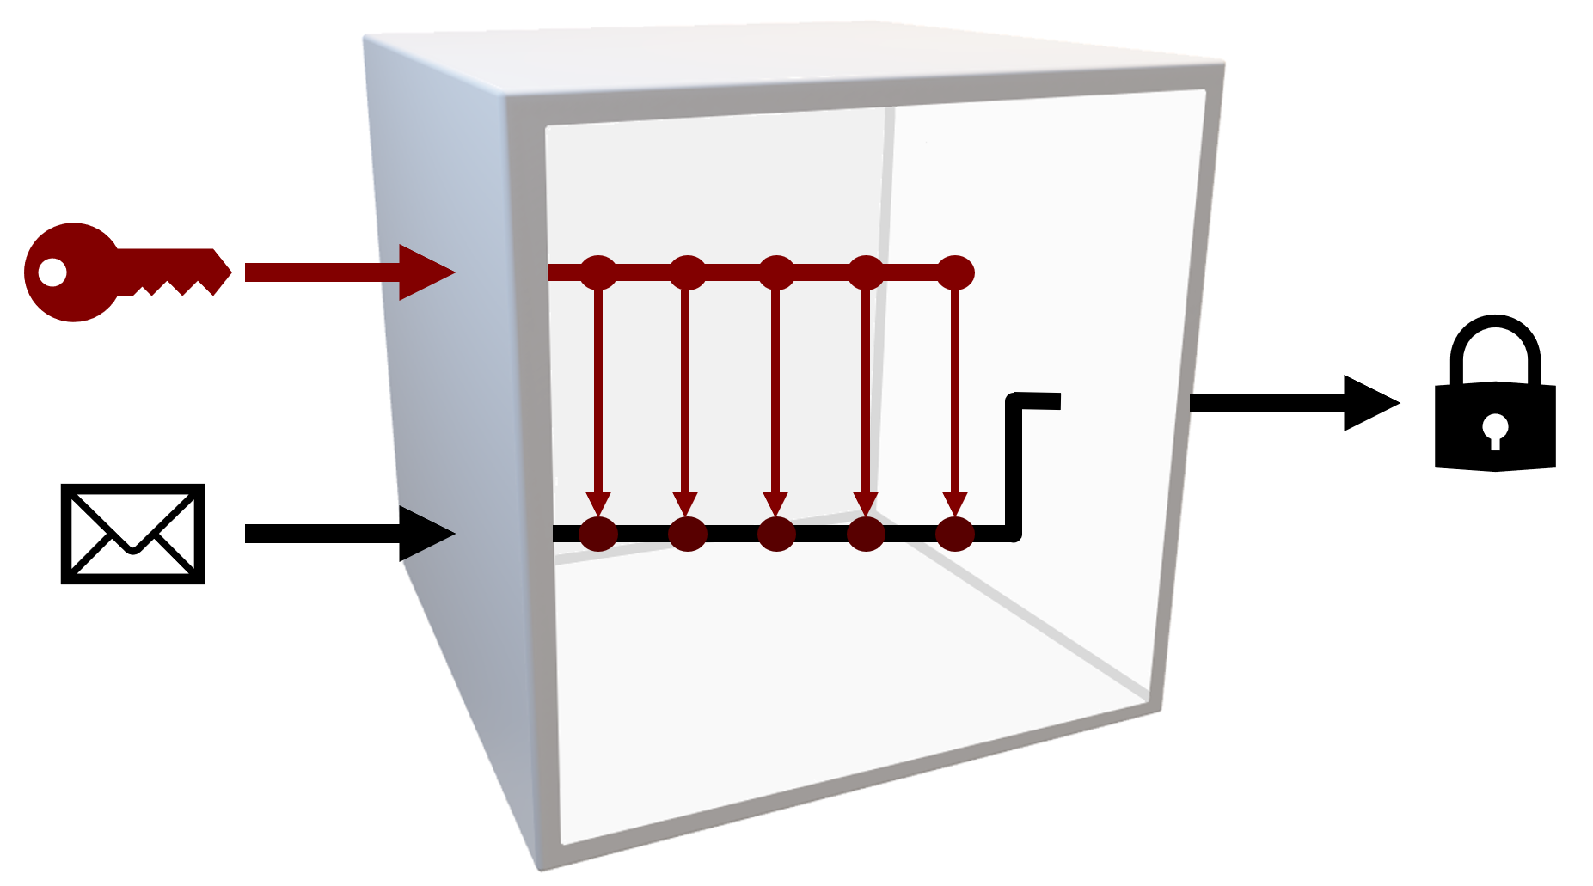
Black-box and White-box model
Black-Box Model
White-Box Model

Slide 4
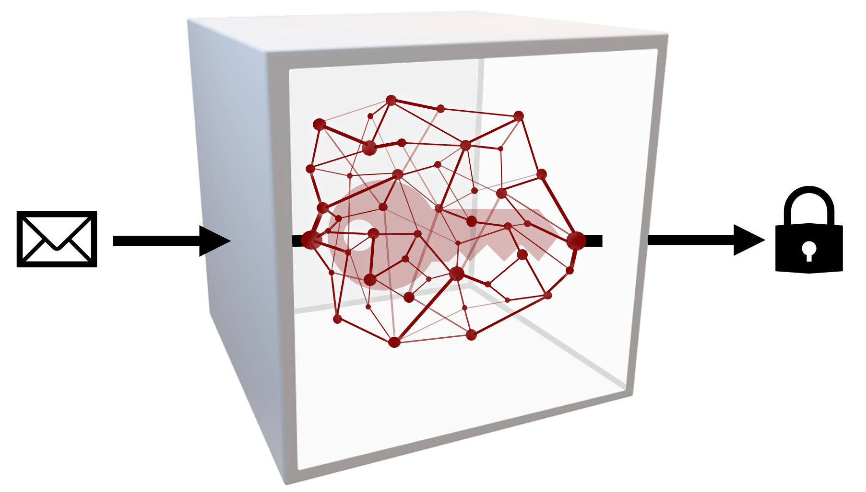
White-box model
Unprotected implementation
Protected implementation

Slide 5
White-box model
Protected implementation
Code obfuscation
Encoding
Masking schemes

Slide 6
Side channel attacks in the white-box model

Slide 7









Traces generation
$$a_{1}$$
$$b_{1}$$
$$a_{2}$$
$$f$$
$$b_{2}$$
$$a_{3}$$
$$b_{3}$$
$$a_{4}$$
$$b_{4}$$

Slide 8




Traces generation
$$a_{1}$$
&
&
$$b_{1}$$
$$⊕$$
$$a_{2}$$
$$b_{2}$$
$$⊕$$
$$a_{3}$$
$$b_{3}$$
$$⊕$$
&
$$⊕$$
$$a_{4}$$
$$b_{4}$$

Slide 9







Traces generation
$$a_{1}$$
&
&
$$b_{1}$$
$$n_{6}$$
$$n_{1}$$
$$⊕$$
$$n_{4}$$
$$a_{2}$$
$$b_{2}$$
$$⊕$$
$$n_{2}$$
$$a_{3}$$
$$b_{3}$$
$$⊕$$
&
$$n_{5}$$
$$a_{4}$$
$$n_{3}$$
$$⊕$$
$$b_{4}$$
$$n_{7}$$

Slide 10




















Traces generation
$$a_{1}$$ | $$a_{2}$$ | $$a_{3}$$ | $$a_{4}$$ | $$n_{1}$$ | $$n_{2}$$ | $$n_{3}$$ | $$n_{4}$$ | $$n_{5}$$ | $$n_{6}$$ | $$n_{7}$$
$$a_{1}$$
&
&
$$b_{1}$$
$$n_{6}$$
$$n_{1}$$
$$⊕$$
$$n_{4}$$
$$a_{2}$$
$$b_{2}$$
$$⊕$$
$$n_{2}$$
$$a_{3}$$
$$b_{3}$$
$$⊕$$
&
$$n_{5}$$
$$a_{4}$$
$$n_{3}$$
$$⊕$$
$$b_{4}$$
$$n_{7}$$

Slide 11








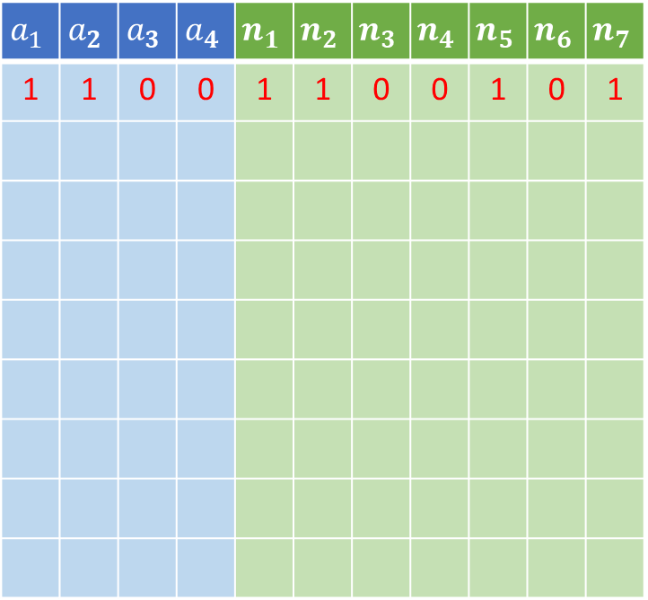



Traces generation
$$a_{1}$$ | $$a_{2}$$ | $$a_{3}$$ | $$a_{4}$$ | $$n_{1}$$ | $$n_{2}$$ | $$n_{3}$$ | $$n_{4}$$ | $$n_{5}$$ | $$n_{6}$$ | $$n_{7}$$
1 | 1 | 0 | 0 | 1 | 1 | 0 | 0 | 1 | 0 | 1
$$1$$
&
$$b_{1}$$
&
$$0$$
$$1$$
$$⊕$$
$$0$$
$$1$$
$$b_{2}$$
$$⊕$$
$$1$$
$$0$$
$$b_{3}$$
$$⊕$$
$$1$$
&
$$0$$
$$0$$
$$⊕$$
$$1$$
$$b_{4}$$

Slide 12




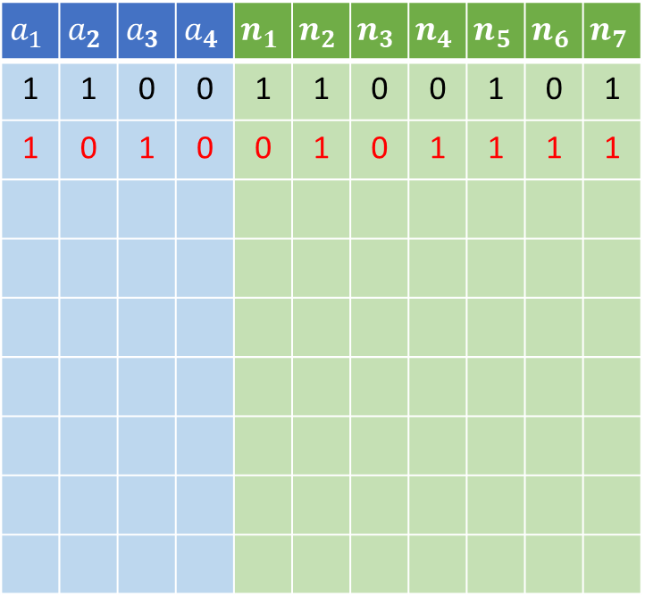

Traces generation
$$a_{1}$$ | $$a_{2}$$ | $$a_{3}$$ | $$a_{4}$$ | $$n_{1}$$ | $$n_{2}$$ | $$n_{3}$$ | $$n_{4}$$ | $$n_{5}$$ | $$n_{6}$$ | $$n_{7}$$
1 | 1 | 0 | 0 | 1 | 1 | 0 | 0 | 1 | 0 | 1
1 | 0 | 1 | 0 | 0 | 1 | 0 | 1 | 1 | 1 | 1
$$1$$
&
$$b_{1}$$
&
$$1$$
$$0$$
$$⊕$$
$$1$$
$$0$$
$$b_{2}$$
$$⊕$$
$$1$$
$$1$$
$$b_{3}$$
$$⊕$$
$$1$$
&
$$0$$
$$0$$
$$⊕$$
$$1$$
$$b_{4}$$

Slide 13

Traces generation
$$a_{1}$$ | $$a_{2}$$ | $$a_{3}$$ | $$a_{4}$$ | $$n_{1}$$ | $$n_{2}$$ | $$n_{3}$$ | $$n_{4}$$ | $$n_{5}$$ | $$n_{6}$$ | $$n_{7}$$
1 | 1 | 0 | 0 | 1 | 1 | 0 | 0 | 1 | 0 | 1
1 | 0 | 1 | 0 | 0 | 1 | 0 | 1 | 1 | 1 | 1
0 | 0 | 0 | 1 | 0 | 0 | 0 | 0 | 0 | 0 | 1
1 | 0 | 1 | 1 | 0 | 1 | 1 | 1 | 0 | 1 | 1
1 | 0 | 0 | 1 | 0 | 0 | 0 | 0 | 0 | 0 | 1
0 | 0 | 1 | 1 | 0 | 1 | 1 | 1 | 0 | 0 | 1
1 | 1 | 0 | 1 | 1 | 1 | 0 | 0 | 1 | 0 | 0
1 | 1 | 1 | 1 | 1 | 0 | 1 | 1 | 1 | 1 | 0
0 | 1 | 1 | 0 | 0 | 0 | 0 | 0 | 0 | 0 | 0
$$a_{1}$$
&
&
$$b_{1}$$
$$n_{6}$$
$$n_{1}$$
$$⊕$$
$$n_{4}$$
$$a_{2}$$
$$b_{2}$$
$$⊕$$
$$n_{2}$$
$$a_{3}$$
$$b_{3}$$
$$⊕$$
&
$$n_{5}$$
$$a_{4}$$
$$n_{3}$$
$$⊕$$
$$b_{4}$$
$$n_{7}$$

Slide 14

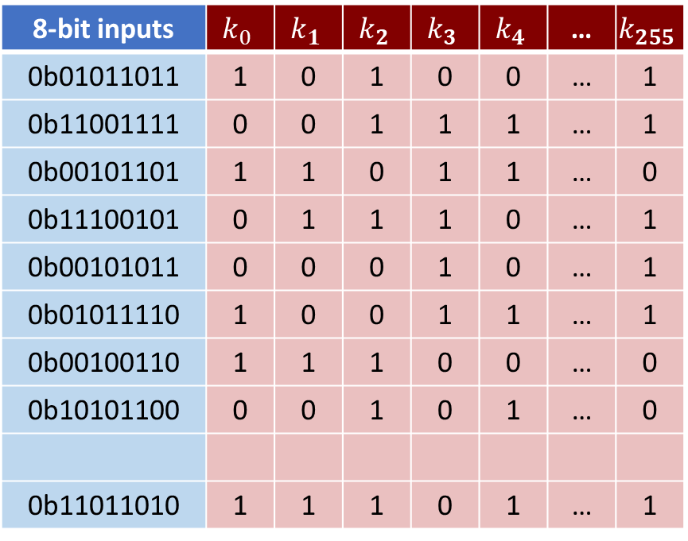

Selection function
8-bit inputs | $$k_{0}$$ | $$k_{1}$$ | $$k_{2}$$ | $$k_{3}$$ | $$k_{4}$$ | … | $$k_{255}$$
0b01011011 | 1 | 0 | 1 | 0 | 0 | … | 1
0b11001111 | 0 | 0 | 1 | 1 | 1 | … | 1
0b00101101 | 1 | 1 | 0 | 1 | 1 | … | 0
0b11100101 | 0 | 1 | 1 | 1 | 0 | … | 1
0b00101011 | 0 | 0 | 0 | 1 | 0 | … | 1
0b01011110 | 1 | 0 | 0 | 1 | 1 | … | 1
0b00100110 | 1 | 1 | 1 | 0 | 0 | … | 0
0b10101100 | 0 | 0 | 1 | 0 | 1 | … | 0
0b11011010 | 1 | 1 | 1 | 0 | 1 | … | 1
8-bit input
8
$$k_{guess}∈\{0,…,255\}$$
AES Sbox
First bit of the output
…
…
…
…
…
…
…
…

Slide 15
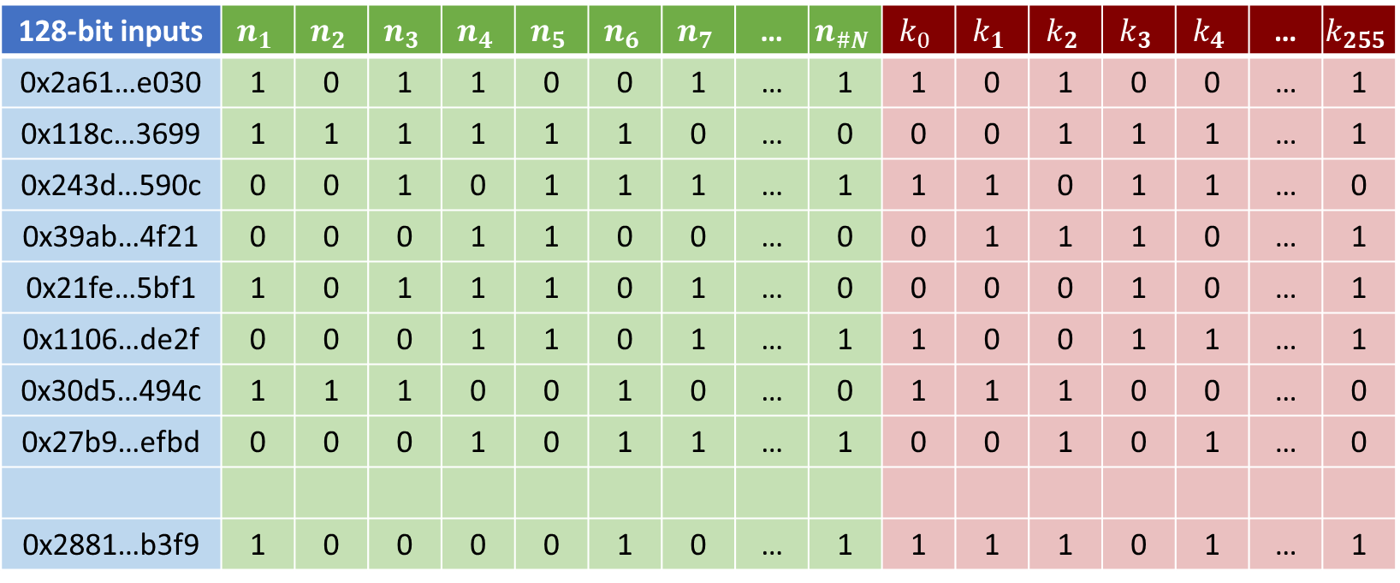
Selection function
128-bit inputs | $$n_{1}$$ | $$n_{2}$$ | $$n_{3}$$ | $$n_{4}$$ | $$n_{5}$$ | $$n_{6}$$ | $$n_{7}$$ | … | $$n_{\#N}$$ | $$k_{0}$$ | $$k_{1}$$ | $$k_{2}$$ | $$k_{3}$$ | $$k_{4}$$ | … | $$k_{255}$$
0x2a61…e030 | 1 | 0 | 1 | 1 | 0 | 0 | 1 | … | 1 | 1 | 0 | 1 | 0 | 0 | … | 1
0x118c…3699 | 1 | 1 | 1 | 1 | 1 | 1 | 0 | … | 0 | 0 | 0 | 1 | 1 | 1 | … | 1
0x243d…590c | 0 | 0 | 1 | 0 | 1 | 1 | 1 | … | 1 | 1 | 1 | 0 | 1 | 1 | … | 0
0x39ab…4f21 | 0 | 0 | 0 | 1 | 1 | 0 | 0 | … | 0 | 0 | 1 | 1 | 1 | 0 | … | 1
0x21fe…5bf1 | 1 | 0 | 1 | 1 | 1 | 0 | 1 | … | 0 | 0 | 0 | 0 | 1 | 0 | … | 1
0x1106…de2f | 0 | 0 | 0 | 1 | 1 | 0 | 1 | … | 1 | 1 | 0 | 0 | 1 | 1 | … | 1
0x30d5…494c | 1 | 1 | 1 | 0 | 0 | 1 | 0 | … | 0 | 1 | 1 | 1 | 0 | 0 | … | 0
0x27b9…efbd | 0 | 0 | 0 | 1 | 0 | 1 | 1 | … | 1 | 0 | 0 | 1 | 0 | 1 | … | 0
0x2881…b3f9 | 1 | 0 | 0 | 0 | 0 | 1 | 0 | … | 1 | 1 | 1 | 1 | 0 | 1 | … | 1
…
…
…
…
…
…
…
…
…
…
…
…
…
…
…
…
…

Slide 16
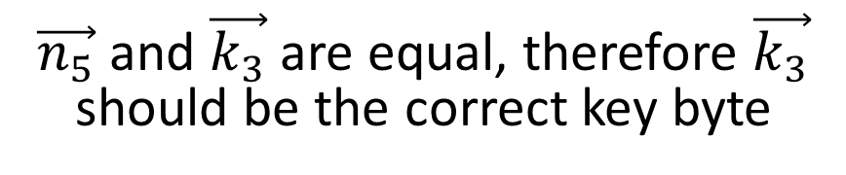
Selection function
128-bit inputs | $$n_{1}$$ | $$n_{2}$$ | $$n_{3}$$ | $$n_{4}$$ | $$n_{5}$$ | $$n_{6}$$ | $$n_{7}$$ | … | $$n_{\#N}$$ | $$k_{0}$$ | $$k_{1}$$ | $$k_{2}$$ | $$k_{3}$$ | $$k_{4}$$ | … | $$k_{255}$$
0x2a61…e030 | 1 | 0 | 1 | 1 | 0 | 0 | 1 | … | 1 | 1 | 0 | 1 | 0 | 0 | … | 1
0x118c…3699 | 1 | 1 | 1 | 1 | 1 | 1 | 0 | … | 0 | 0 | 0 | 1 | 1 | 1 | … | 1
0x243d…590c | 0 | 0 | 1 | 0 | 1 | 1 | 1 | … | 1 | 1 | 1 | 0 | 1 | 1 | … | 0
0x39ab…4f21 | 0 | 0 | 0 | 1 | 1 | 0 | 0 | … | 0 | 0 | 1 | 1 | 1 | 0 | … | 1
0x21fe…5bf1 | 1 | 0 | 1 | 1 | 1 | 0 | 1 | … | 0 | 0 | 0 | 0 | 1 | 0 | … | 1
0x1106…de2f | 0 | 0 | 0 | 1 | 1 | 0 | 1 | … | 1 | 1 | 0 | 0 | 1 | 1 | … | 1
0x30d5…494c | 1 | 1 | 1 | 0 | 0 | 1 | 0 | … | 0 | 1 | 1 | 1 | 0 | 0 | … | 0
0x27b9…efbd | 0 | 0 | 0 | 1 | 0 | 1 | 1 | … | 1 | 0 | 0 | 1 | 0 | 1 | … | 0
0x2881…b3f9 | 1 | 0 | 0 | 0 | 0 | 1 | 0 | … | 1 | 1 | 1 | 1 | 0 | 1 | … | 1
…
…
…
…
…
…
…
…
…
…
…
…
…
…
…
…
…
$\vec{n_{5}}$ and $\vec{k_{3}}$ are equal, therefore $\vec{k_{3}}$ should be the correct key byte
16

Slide 17
Masking schemes in the white-box model

Slide 18
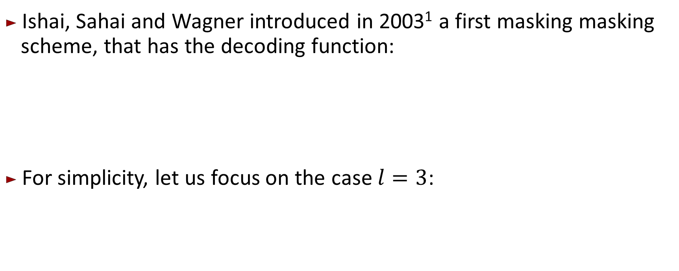
ISW Masking scheme
Ishai, Sahai and Wagner introduced in 2003¹ a first masking masking scheme, that has the decoding function:
For simplicity, let us focus on the case $l=3$:
$$s=x_{1}⊕…⊕x_{l}$$
$$s=x_{1}⊕x_{2}⊕x_{3}$$
1. Crypto 2003: Private circuits: Securing hardware against probing attacks

Slide 19
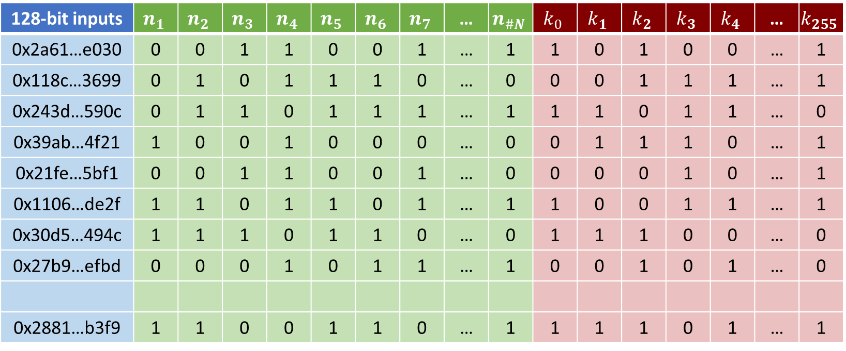
ISW Masking scheme
There exists $\vec{n_{a}}$, $\vec{n_{b}},$ $\vec{n_{c}}$and $g∈\{0,…,255\}$ such that $\vec{n_{a}}⊕\vec{n_{b}}⊕\vec{n_{c}}=\vec{k_{g}}$.
128-bit inputs | $$n_{1}$$ | $$n_{2}$$ | $$n_{3}$$ | $$n_{4}$$ | $$n_{5}$$ | $$n_{6}$$ | $$n_{7}$$ | … | $$n_{\#N}$$ | $$k_{0}$$ | $$k_{1}$$ | $$k_{2}$$ | $$k_{3}$$ | $$k_{4}$$ | … | $$k_{255}$$
0x2a61…e030 | 0 | 0 | 1 | 1 | 0 | 0 | 1 | … | 1 | 1 | 0 | 1 | 0 | 0 | … | 1
0x118c…3699 | 0 | 1 | 0 | 1 | 1 | 1 | 0 | … | 0 | 0 | 0 | 1 | 1 | 1 | … | 1
0x243d…590c | 0 | 1 | 1 | 0 | 1 | 1 | 1 | … | 1 | 1 | 1 | 0 | 1 | 1 | … | 0
0x39ab…4f21 | 1 | 0 | 0 | 1 | 0 | 0 | 0 | … | 0 | 0 | 1 | 1 | 1 | 0 | … | 1
0x21fe…5bf1 | 0 | 0 | 1 | 1 | 0 | 0 | 1 | … | 0 | 0 | 0 | 0 | 1 | 0 | … | 1
0x1106…de2f | 1 | 1 | 0 | 1 | 1 | 0 | 1 | … | 1 | 1 | 0 | 0 | 1 | 1 | … | 1
0x30d5…494c | 1 | 1 | 1 | 0 | 1 | 1 | 0 | … | 0 | 1 | 1 | 1 | 0 | 0 | … | 0
0x27b9…efbd | 0 | 0 | 0 | 1 | 0 | 1 | 1 | … | 1 | 0 | 0 | 1 | 0 | 1 | … | 0
0x2881…b3f9 | 1 | 1 | 0 | 0 | 1 | 1 | 0 | … | 1 | 1 | 1 | 1 | 0 | 1 | … | 1
…
…
…
…
…
…
…
…
…
…
…
…
…
…
…
…
…

Slide 20



ISW Masking scheme
$$\vec{n_{1}} ⊕ \vec{n_{3}} ⊕ \vec{n_{5}}$$
$$=\vec{k_{1}}$$
128-bit inputs | $$n_{1}$$ | $$n_{2}$$ | $$n_{3}$$ | $$n_{4}$$ | $$n_{5}$$ | $$n_{6}$$ | $$n_{7}$$ | … | $$n_{\#N}$$ | $$k_{0}$$ | $$k_{1}$$ | $$k_{2}$$ | $$k_{3}$$ | $$k_{4}$$ | … | $$k_{255}$$
0x2a61…e030 | 1 | 0 | 1 | 1 | 0 | 0 | 1 | … | 1 | 1 | 0 | 1 | 0 | 0 | … | 1
0x118c…3699 | 1 | 1 | 0 | 1 | 1 | 1 | 0 | … | 0 | 0 | 0 | 1 | 1 | 1 | … | 1
0x243d…590c | 0 | 1 | 0 | 0 | 1 | 1 | 1 | … | 1 | 1 | 1 | 0 | 1 | 1 | … | 0
0x39ab…4f21 | 1 | 0 | 0 | 1 | 0 | 0 | 0 | … | 0 | 0 | 1 | 1 | 1 | 0 | … | 1
0x21fe…5bf1 | 0 | 0 | 1 | 1 | 1 | 0 | 1 | … | 0 | 0 | 0 | 0 | 1 | 0 | … | 1
0x1106…de2f | 1 | 1 | 0 | 1 | 1 | 0 | 1 | … | 1 | 1 | 0 | 0 | 1 | 1 | … | 1
0x30d5…494c | 1 | 1 | 1 | 0 | 1 | 1 | 0 | … | 0 | 1 | 1 | 1 | 0 | 0 | … | 0
0x27b9…efbd | 1 | 0 | 0 | 1 | 1 | 1 | 1 | … | 1 | 0 | 0 | 1 | 0 | 1 | … | 0
0x2881…b3f9 | 1 | 1 | 1 | 0 | 1 | 1 | 0 | … | 1 | 1 | 1 | 1 | 0 | 1 | … | 1
…
…
…
…
…
…
…
…
…
…
…
…
…
…
…
…
…

Slide 21
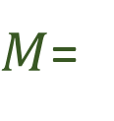
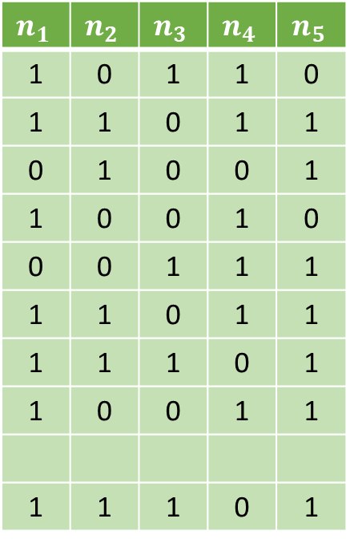

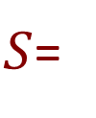
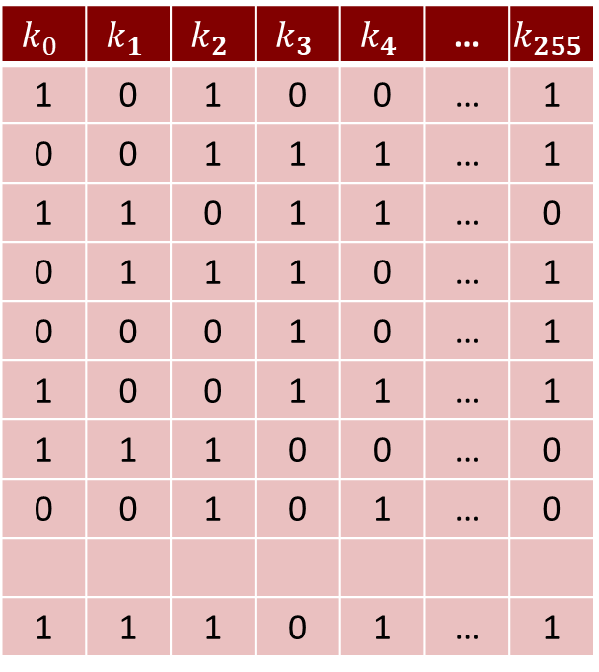
Linear Decoding Attack¹
$$W=5$$
$$n_{1}$$ | $$n_{2}$$ | $$n_{3}$$ | $$n_{4}$$ | $$n_{5}$$
1 | 0 | 1 | 1 | 0
1 | 1 | 0 | 1 | 1
0 | 1 | 0 | 0 | 1
1 | 0 | 0 | 1 | 0
0 | 0 | 1 | 1 | 1
1 | 1 | 0 | 1 | 1
1 | 1 | 1 | 0 | 1
1 | 0 | 0 | 1 | 1
1 | 1 | 1 | 0 | 1
$$k_{0}$$ | $$k_{1}$$ | $$k_{2}$$ | $$k_{3}$$ | $$k_{4}$$ | … | $$k_{255}$$
1 | 0 | 1 | 0 | 0 | … | 1
0 | 0 | 1 | 1 | 1 | … | 1
1 | 1 | 0 | 1 | 1 | … | 0
0 | 1 | 1 | 1 | 0 | … | 1
0 | 0 | 0 | 1 | 0 | … | 1
1 | 0 | 0 | 1 | 1 | … | 1
1 | 1 | 1 | 0 | 0 | … | 0
0 | 0 | 1 | 0 | 1 | … | 0
1 | 1 | 1 | 0 | 1 | … | 1
$M$=
$S$=
…
…
…
…
…
…
…
…
…
…
…
…
1. Journal of Cryptographic Engineering 2020: How to reveal the secrets of an obscure white-box implementation

Slide 22


Linear Decoding Attack
$$n_{1}$$ | $$n_{2}$$ | $$n_{3}$$ | $$n_{4}$$ | $$n_{5}$$
1 | 0 | 1 | 1 | 0
1 | 1 | 0 | 1 | 1
0 | 1 | 0 | 0 | 1
1 | 0 | 0 | 1 | 0
0 | 0 | 1 | 1 | 1
1 | 1 | 0 | 1 | 1
1 | 1 | 1 | 0 | 1
1 | 0 | 0 | 1 | 1
1 | 1 | 1 | 0 | 1
$$k_{0}$$ | $$k_{1}$$ | $$k_{2}$$ | $$k_{3}$$ | $$k_{4}$$ | … | $$k_{255}$$
1 | 0 | 1 | 0 | 0 | … | 1
0 | 0 | 1 | 1 | 1 | … | 1
1 | 1 | 0 | 1 | 1 | … | 0
0 | 1 | 1 | 1 | 0 | … | 1
0 | 0 | 0 | 1 | 0 | … | 1
1 | 0 | 0 | 1 | 1 | … | 1
1 | 1 | 1 | 0 | 0 | … | 0
0 | 0 | 1 | 0 | 1 | … | 0
1 | 1 | 1 | 0 | 1 | … | 1
$$\vec{x}$$
?
?
?
?
?
$$=$$
…
…
…
…
…
…
…
…
…
…
…
…

Slide 23

Linear Decoding Attack
$$n_{1}$$ | $$n_{2}$$ | $$n_{3}$$ | $$n_{4}$$ | $$n_{5}$$
1 | 0 | 1 | 1 | 0
1 | 1 | 0 | 1 | 1
0 | 1 | 0 | 0 | 1
1 | 0 | 0 | 1 | 0
0 | 0 | 1 | 1 | 1
1 | 1 | 0 | 1 | 1
1 | 1 | 1 | 0 | 1
1 | 0 | 0 | 1 | 1
1 | 1 | 1 | 0 | 1
$$k_{0}$$ | $$k_{1}$$ | $$k_{2}$$ | $$k_{3}$$ | $$k_{4}$$ | … | $$k_{255}$$
1 | 0 | 1 | 0 | 0 | … | 1
0 | 0 | 1 | 1 | 1 | … | 1
1 | 1 | 0 | 1 | 1 | … | 0
0 | 1 | 1 | 1 | 0 | … | 1
0 | 0 | 0 | 1 | 0 | … | 1
1 | 0 | 0 | 1 | 1 | … | 1
1 | 1 | 1 | 0 | 0 | … | 0
0 | 0 | 1 | 0 | 1 | … | 0
1 | 1 | 1 | 0 | 1 | … | 1
$$\vec{x}$$
1
0
1
0
1
$$=$$
…
…
…
…
…
…
…
…
…
…
…
…

Slide 24
Linear Decoding Attack
$$n_{1}$$ | $$n_{2}$$ | $$n_{3}$$ | $$n_{4}$$ | $$n_{5}$$
1 | 0 | 1 | 1 | 0
1 | 1 | 0 | 1 | 1
0 | 1 | 0 | 0 | 1
1 | 0 | 0 | 1 | 0
0 | 0 | 1 | 1 | 1
1 | 1 | 0 | 1 | 1
1 | 1 | 1 | 0 | 1
1 | 0 | 0 | 1 | 1
1 | 1 | 1 | 0 | 1
$$k_{0}$$ | $$k_{1}$$ | $$k_{2}$$ | $$k_{3}$$ | $$k_{4}$$ | … | $$k_{255}$$
1 | 0 | 1 | 0 | 0 | … | 1
0 | 0 | 1 | 1 | 1 | … | 1
1 | 1 | 0 | 1 | 1 | … | 0
0 | 1 | 1 | 1 | 0 | … | 1
0 | 0 | 0 | 1 | 0 | … | 1
1 | 0 | 0 | 1 | 1 | … | 1
1 | 1 | 1 | 0 | 0 | … | 0
0 | 0 | 1 | 0 | 1 | … | 0
1 | 1 | 1 | 0 | 1 | … | 1
$$\vec{x}$$
1
0
1
0
1
$$=$$
…
…
…
…
…
…
…
…
…
…
…
…

Slide 25
SEL Masking scheme

Slide 26
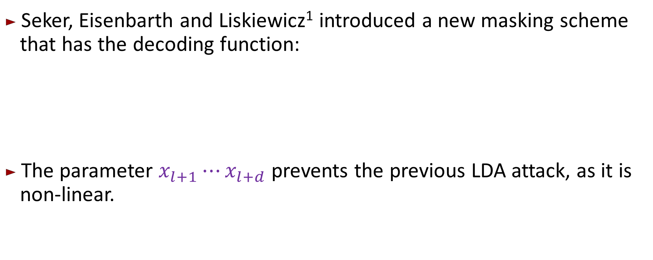
SEL masking scheme
Seker, Eisenbarth and Liskiewicz¹ introduced a new masking scheme that has the decoding function:
The parameter $x_{l+1}⋯x_{l+d}$ prevents the previous LDA attack, as it is non-linear.
$$s=x_{1}⊕…⊕x_{l}⊕x_{l+1}⋯x_{l+d}$$
1. CHES 2021: A White-Box Masking Scheme Resisting Computational and Algebraic Attacks

Slide 27
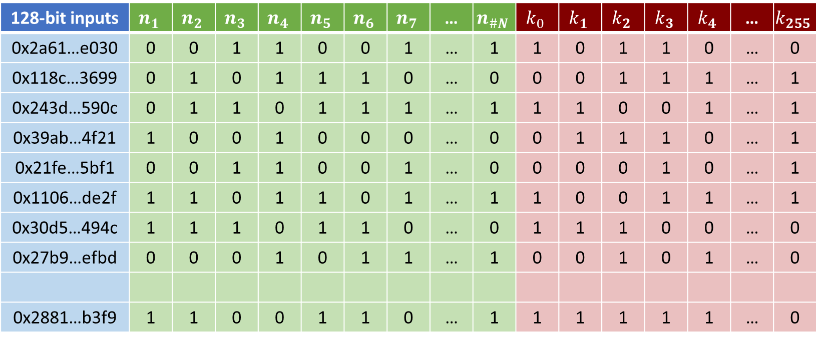
SEL masking scheme
There exists $\vec{n_{a}}$, $\vec{n_{b}},$ $\vec{n_{c}},\vec{n_{d}}$and $g∈\{0,…,255\}$ such that $\vec{n_{a}}⊕\vec{n_{b}}⊕\vec{n_{c}} \vec{n_{d}}=\vec{k_{g}}$.
128-bit inputs | $$n_{1}$$ | $$n_{2}$$ | $$n_{3}$$ | $$n_{4}$$ | $$n_{5}$$ | $$n_{6}$$ | $$n_{7}$$ | … | $$n_{\#N}$$ | $$k_{0}$$ | $$k_{1}$$ | $$k_{2}$$ | $$k_{3}$$ | $$k_{4}$$ | … | $$k_{255}$$
0x2a61…e030 | 0 | 0 | 1 | 1 | 0 | 0 | 1 | … | 1 | 1 | 0 | 1 | 1 | 0 | … | 0
0x118c…3699 | 0 | 1 | 0 | 1 | 1 | 1 | 0 | … | 0 | 0 | 0 | 1 | 1 | 1 | … | 1
0x243d…590c | 0 | 1 | 1 | 0 | 1 | 1 | 1 | … | 1 | 1 | 1 | 0 | 0 | 1 | … | 1
0x39ab…4f21 | 1 | 0 | 0 | 1 | 0 | 0 | 0 | … | 0 | 0 | 1 | 1 | 1 | 0 | … | 1
0x21fe…5bf1 | 0 | 0 | 1 | 1 | 0 | 0 | 1 | … | 0 | 0 | 0 | 0 | 1 | 0 | … | 1
0x1106…de2f | 1 | 1 | 0 | 1 | 1 | 0 | 1 | … | 1 | 1 | 0 | 0 | 1 | 1 | … | 1
0x30d5…494c | 1 | 1 | 1 | 0 | 1 | 1 | 0 | … | 0 | 1 | 1 | 1 | 0 | 0 | … | 0
0x27b9…efbd | 0 | 0 | 0 | 1 | 0 | 1 | 1 | … | 1 | 0 | 0 | 1 | 0 | 1 | … | 0
0x2881…b3f9 | 1 | 1 | 0 | 0 | 1 | 1 | 0 | … | 1 | 1 | 1 | 1 | 1 | 1 | … | 0
…
…
…
…
…
…
…
…
…
…
…
…
…
…
…
…
…

Slide 28

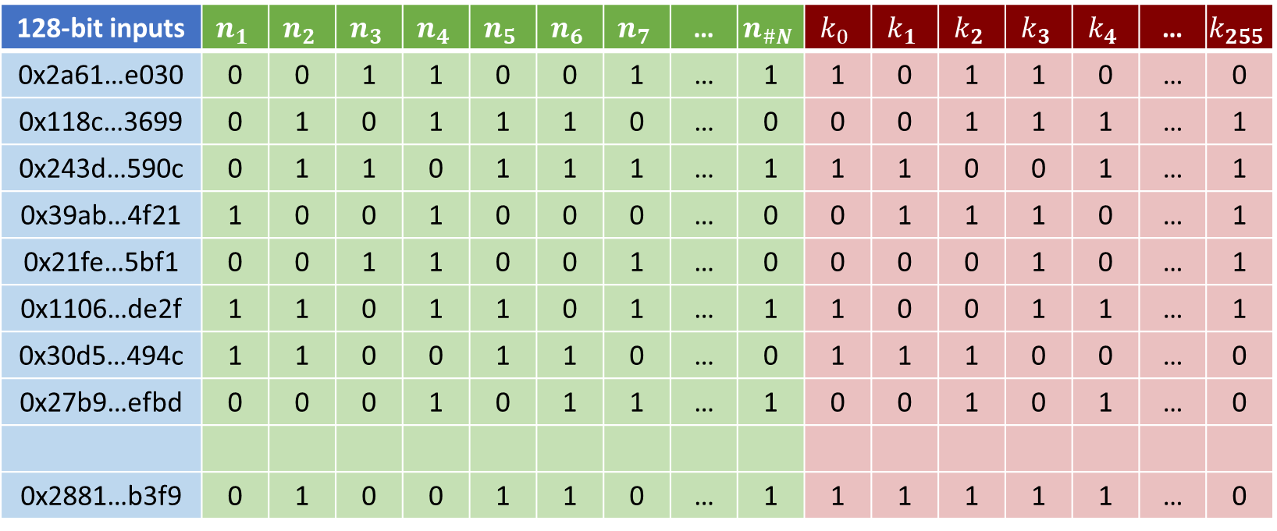

SEL masking scheme
$$\vec{n_{1}} ⊕ \vec{n_{3}} ⊕ \vec{n_{5}} \vec{n_{6}}$$
$$=\vec{k_{3}}$$
128-bit inputs | $$n_{1}$$ | $$n_{2}$$ | $$n_{3}$$ | $$n_{4}$$ | $$n_{5}$$ | $$n_{6}$$ | $$n_{7}$$ | … | $$n_{\#N}$$ | $$k_{0}$$ | $$k_{1}$$ | $$k_{2}$$ | $$k_{3}$$ | $$k_{4}$$ | … | $$k_{255}$$
0x2a61…e030 | 0 | 0 | 1 | 1 | 0 | 0 | 1 | … | 1 | 1 | 0 | 1 | 1 | 0 | … | 0
0x118c…3699 | 0 | 1 | 0 | 1 | 1 | 1 | 0 | … | 0 | 0 | 0 | 1 | 1 | 1 | … | 1
0x243d…590c | 0 | 1 | 1 | 0 | 1 | 1 | 1 | … | 1 | 1 | 1 | 0 | 0 | 1 | … | 1
0x39ab…4f21 | 1 | 0 | 0 | 1 | 0 | 0 | 0 | … | 0 | 0 | 1 | 1 | 1 | 0 | … | 1
0x21fe…5bf1 | 0 | 0 | 1 | 1 | 0 | 0 | 1 | … | 0 | 0 | 0 | 0 | 1 | 0 | … | 1
0x1106…de2f | 1 | 1 | 0 | 1 | 1 | 0 | 1 | … | 1 | 1 | 0 | 0 | 1 | 1 | … | 1
0x30d5…494c | 1 | 1 | 0 | 0 | 1 | 1 | 0 | … | 0 | 1 | 1 | 1 | 0 | 0 | … | 0
0x27b9…efbd | 0 | 0 | 0 | 1 | 0 | 1 | 1 | … | 1 | 0 | 0 | 1 | 0 | 1 | … | 0
0x2881…b3f9 | 0 | 1 | 0 | 0 | 1 | 1 | 0 | … | 1 | 1 | 1 | 1 | 1 | 1 | … | 0
…
…
…
…
…
…
…
…
…
…
…
…
…
…
…
…
…

Slide 29
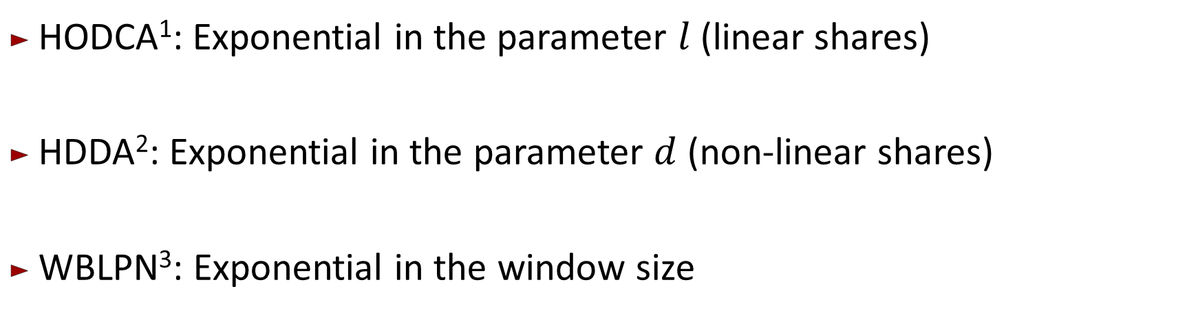
Existing attacks against SEL
$$s=x_{1}⊕…⊕x_{l}⊕x_{l+1}⋯x_{l+d}$$
HODCA¹: Exponential in the parameter $l$ (linear shares)
HDDA²: Exponential in the parameter $d$ (non-linear shares)
WBLPN³: Exponential in the window size
COSADE 2019: Higher-order DCA against standard side-channel countermeasure
Journal of Cryptographic engineering 2020: How to reveal the secrets of an obscure white-box implementation
CHES 2023: LPN-based attacks in the white-box setting

Slide 30
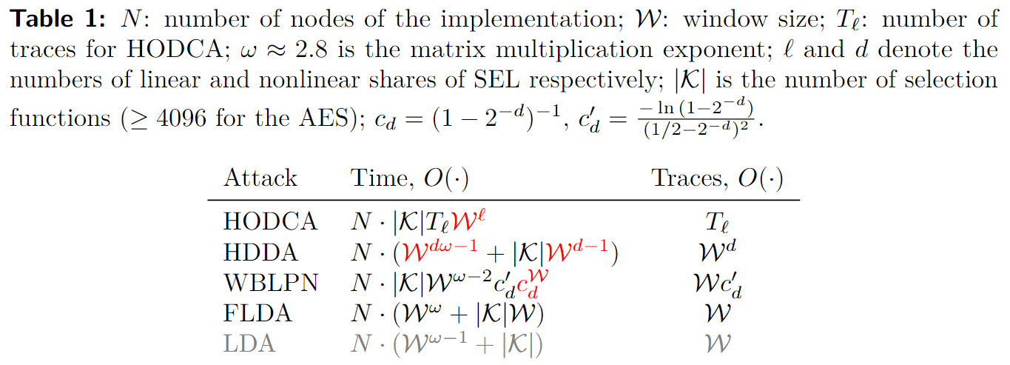
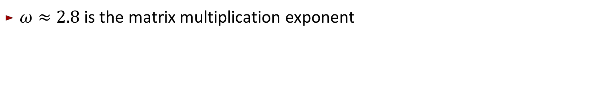
Comparison on complexity of the attacks on SEL
$ω≈2.8$ is the matrix multiplication exponent

Slide 31
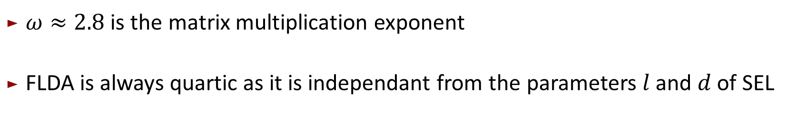
Comparison on complexity of the attacks on SEL
$ω≈2.8$ is the matrix multiplication exponent
FLDA is always quartic as it is independant from the parameters $l$ and $d$ of SEL

Slide 32
Filtering Linear Decoding Analysis against SEL

Slide 33
Filtering Linear Decoding Analysis against SEL
$$s=x_{1}⊕…⊕x_{l}⊕x_{l+1}⋯x_{l+i}⋯x_{l+d}$$
$$s=x_{1}⊕…⊕x_{l}⊕x_{l+1}⋯ 0 ⋯x_{l+d}$$
$$s=x_{1}⊕…⊕x_{l}$$

Slide 34

Filtering Linear Decoding Analysis against SEL
$$\vec{n_{1}} ⊕ \vec{n_{3}} ⊕ \vec{n_{5}} \vec{n_{6}}$$
$$=\vec{k_{3}}$$
128-bit inputs | $$n_{1}$$ | $$n_{2}$$ | $$n_{3}$$ | $$n_{4}$$ | $$n_{5}$$ | $$n_{6}$$ | $$n_{7}$$ | … | $$n_{\#N}$$ | $$k_{0}$$ | $$k_{1}$$ | $$k_{2}$$ | $$k_{3}$$ | $$k_{4}$$ | … | $$k_{255}$$
0x2a61…e030 | 0 | 0 | 1 | 1 | 0 | 0 | 1 | … | 1 | 1 | 0 | 1 | 1 | 0 | … | 0
0x118c…3699 | 0 | 1 | 0 | 1 | 1 | 1 | 0 | … | 0 | 0 | 0 | 1 | 1 | 1 | … | 1
0x243d…590c | 0 | 1 | 0 | 0 | 1 | 0 | 1 | … | 1 | 1 | 1 | 0 | 0 | 1 | … | 1
0x39ab…4f21 | 1 | 0 | 0 | 1 | 0 | 1 | 0 | … | 0 | 0 | 1 | 1 | 1 | 0 | … | 1
0x21fe…5bf1 | 0 | 0 | 1 | 1 | 0 | 0 | 1 | … | 0 | 0 | 0 | 0 | 1 | 0 | … | 1
0x1106…de2f | 1 | 1 | 0 | 1 | 1 | 0 | 1 | … | 1 | 1 | 0 | 0 | 1 | 1 | … | 1
0x30d5…494c | 1 | 1 | 0 | 0 | 1 | 1 | 0 | … | 0 | 1 | 1 | 1 | 0 | 0 | … | 0
0x27b9…efbd | 0 | 0 | 0 | 1 | 0 | 1 | 1 | … | 1 | 0 | 0 | 1 | 0 | 1 | … | 0
0x2881…b3f9 | 0 | 1 | 0 | 0 | 1 | 1 | 0 | … | 1 | 1 | 1 | 1 | 1 | 1 | … | 0
…
…
…
…
…
…
…
…
…
…
…
…
…
…
…
…
…

Slide 35

Filtering Linear Decoding Analysis against SEL
$$\vec{n_{1}} ⊕ \vec{n_{3}} ⊕ 0 \vec{n_{6}}$$
$$=\vec{k_{3}}$$
128-bit inputs | $$n_{1}$$ | $$n_{2}$$ | $$n_{3}$$ | $$n_{4}$$ | $$n_{5}$$ | $$n_{6}$$ | $$n_{7}$$ | … | $$n_{\#N}$$ | $$k_{0}$$ | $$k_{1}$$ | $$k_{2}$$ | $$k_{3}$$ | $$k_{4}$$ | … | $$k_{255}$$
0x2a61…e030 | 0 | 0 | 1 | 1 | 0 | 0 | 1 | … | 1 | 1 | 0 | 1 | 1 | 0 | … | 0
0x118c…3699 | 0 | 1 | 0 | 1 | 1 | 1 | 0 | … | 0 | 0 | 0 | 1 | 1 | 1 | … | 1
0x243d…590c | 0 | 1 | 0 | 0 | 1 | 0 | 1 | … | 1 | 1 | 1 | 0 | 0 | 1 | … | 1
0x39ab…4f21 | 1 | 0 | 0 | 1 | 0 | 1 | 0 | … | 0 | 0 | 1 | 1 | 1 | 0 | … | 1
0x21fe…5bf1 | 0 | 0 | 1 | 1 | 0 | 0 | 1 | … | 0 | 0 | 0 | 0 | 1 | 0 | … | 1
0x1106…de2f | 1 | 1 | 0 | 1 | 1 | 0 | 1 | … | 1 | 1 | 0 | 0 | 1 | 1 | … | 1
0x30d5…494c | 1 | 1 | 0 | 0 | 1 | 1 | 0 | … | 0 | 1 | 1 | 1 | 0 | 0 | … | 0
0x27b9…efbd | 0 | 0 | 0 | 1 | 0 | 1 | 1 | … | 1 | 0 | 0 | 1 | 0 | 1 | … | 0
0x2881…b3f9 | 0 | 1 | 0 | 0 | 1 | 1 | 0 | … | 1 | 1 | 1 | 1 | 1 | 1 | … | 0
…
…
…
…
…
…
…
…
…
…
…
…
…
…
…
…
…

Slide 36

Filtering Linear Decoding Analysis against SEL
$$\vec{n_{1}} ⊕ \vec{n_{3}}$$
$$=\vec{k_{3}}$$
128-bit inputs | $$n_{1}$$ | $$n_{2}$$ | $$n_{3}$$ | $$n_{4}$$ | $$n_{5}$$ | $$n_{6}$$ | $$n_{7}$$ | … | $$n_{\#N}$$ | $$k_{0}$$ | $$k_{1}$$ | $$k_{2}$$ | $$k_{3}$$ | $$k_{4}$$ | … | $$k_{255}$$
0x2a61…e030 | 0 | 0 | 1 | 1 | 0 | 0 | 1 | … | 1 | 1 | 0 | 1 | 1 | 0 | … | 0
0x118c…3699 | 0 | 1 | 0 | 1 | 1 | 1 | 0 | … | 0 | 0 | 0 | 1 | 1 | 1 | … | 1
0x243d…590c | 0 | 1 | 0 | 0 | 1 | 0 | 1 | … | 1 | 1 | 1 | 0 | 0 | 1 | … | 1
0x39ab…4f21 | 1 | 0 | 0 | 1 | 0 | 1 | 0 | … | 0 | 0 | 1 | 1 | 1 | 0 | … | 1
0x21fe…5bf1 | 0 | 0 | 1 | 1 | 0 | 0 | 1 | … | 0 | 0 | 0 | 0 | 1 | 0 | … | 1
0x1106…de2f | 1 | 1 | 0 | 1 | 1 | 0 | 1 | … | 1 | 1 | 0 | 0 | 1 | 1 | … | 1
0x30d5…494c | 1 | 1 | 0 | 0 | 1 | 1 | 0 | … | 0 | 1 | 1 | 1 | 0 | 0 | … | 0
0x27b9…efbd | 0 | 0 | 0 | 1 | 0 | 1 | 1 | … | 1 | 0 | 0 | 1 | 0 | 1 | … | 0
0x2881…b3f9 | 0 | 1 | 0 | 0 | 1 | 1 | 0 | … | 1 | 1 | 1 | 1 | 1 | 1 | … | 0
…
…
…
…
…
…
…
…
…
…
…
…
…
…
…
…
…

Slide 37

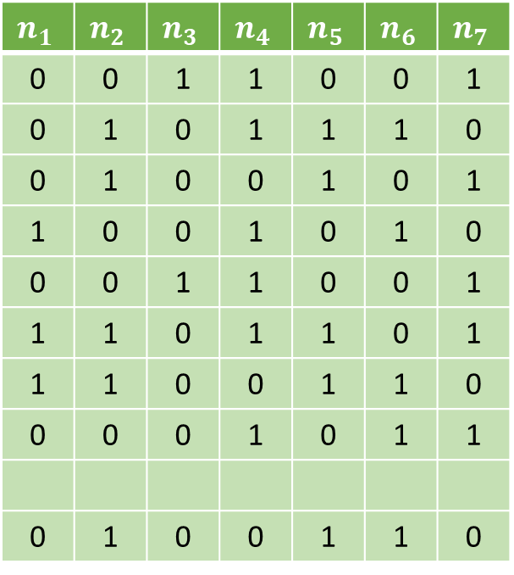
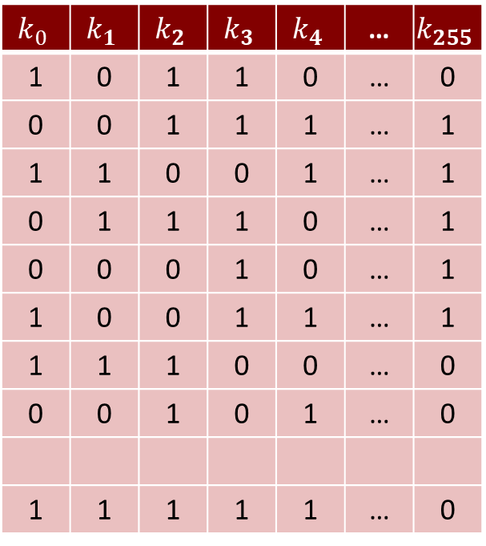

Filtering Linear Decoding Analysis against SEL
$$W=7$$
$$n_{1}$$ | $$n_{2}$$ | $$n_{3}$$ | $$n_{4}$$ | $$n_{5}$$ | $$n_{6}$$ | $$n_{7}$$
0 | 0 | 1 | 1 | 0 | 0 | 1
0 | 1 | 0 | 1 | 1 | 1 | 0
0 | 1 | 0 | 0 | 1 | 0 | 1
1 | 0 | 0 | 1 | 0 | 1 | 0
0 | 0 | 1 | 1 | 0 | 0 | 1
1 | 1 | 0 | 1 | 1 | 0 | 1
1 | 1 | 0 | 0 | 1 | 1 | 0
0 | 0 | 0 | 1 | 0 | 1 | 1
0 | 1 | 0 | 0 | 1 | 1 | 0
$$k_{0}$$ | $$k_{1}$$ | $$k_{2}$$ | $$k_{3}$$ | $$k_{4}$$ | … | $$k_{255}$$
1 | 0 | 1 | 1 | 0 | … | 0
0 | 0 | 1 | 1 | 1 | … | 1
1 | 1 | 0 | 0 | 1 | … | 1
0 | 1 | 1 | 1 | 0 | … | 1
0 | 0 | 0 | 1 | 0 | … | 1
1 | 0 | 0 | 1 | 1 | … | 1
1 | 1 | 1 | 0 | 0 | … | 0
0 | 0 | 1 | 0 | 1 | … | 0
1 | 1 | 1 | 1 | 1 | … | 0
$M$=
$S$=
…
…
…
…
…
…
…
…
…
…
…
…
…
…

Slide 38

Filtering Linear Decoding Analysis against SEL
$$W=7$$
$$n_{1}$$ | $$n_{2}$$ | $$n_{3}$$ | $$n_{4}$$ | $$n_{5}$$ | $$n_{6}$$ | $$n_{7}$$
0 | 0 | 1 | 1 | 0 | 0 | 1
0 | 1 | 0 | 1 | 1 | 1 | 0
0 | 1 | 0 | 0 | 1 | 0 | 1
1 | 0 | 0 | 1 | 0 | 1 | 0
0 | 0 | 1 | 1 | 0 | 0 | 1
1 | 1 | 0 | 1 | 1 | 0 | 1
1 | 1 | 0 | 0 | 1 | 1 | 0
0 | 0 | 0 | 1 | 0 | 1 | 1
0 | 1 | 0 | 0 | 1 | 1 | 0
$$k_{0}$$ | $$k_{1}$$ | $$k_{2}$$ | $$k_{3}$$ | $$k_{4}$$ | … | $$k_{255}$$
1 | 0 | 1 | 1 | 0 | … | 0
0 | 0 | 1 | 1 | 1 | … | 1
1 | 1 | 0 | 0 | 1 | … | 1
0 | 1 | 1 | 1 | 0 | … | 1
0 | 0 | 0 | 1 | 0 | … | 1
1 | 0 | 0 | 1 | 1 | … | 1
1 | 1 | 1 | 0 | 0 | … | 0
0 | 0 | 1 | 0 | 1 | … | 0
1 | 1 | 1 | 1 | 1 | … | 0
$M$=
$S$=
…
…
…
…
…
…
…
…
…
…
…
…
…
…

Slide 39

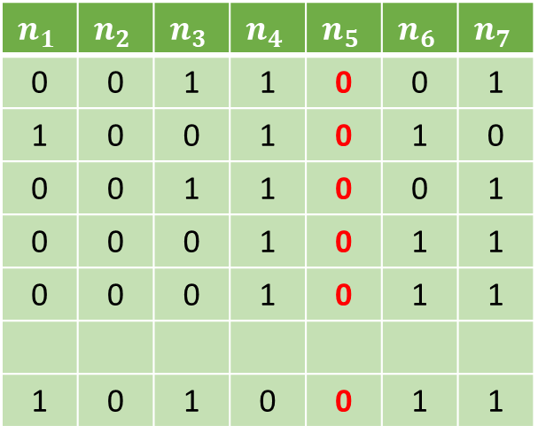

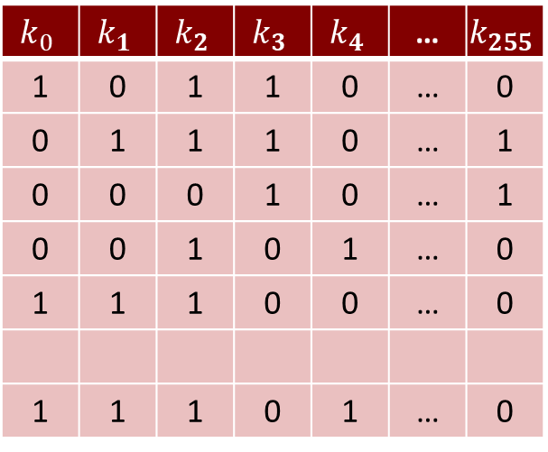
Filtering Linear Decoding Analysis against SEL
$$W=7$$
$$n_{1}$$ | $$n_{2}$$ | $$n_{3}$$ | $$n_{4}$$ | $$n_{5}$$ | $$n_{6}$$ | $$n_{7}$$
0 | 0 | 1 | 1 | 0 | 0 | 1
1 | 0 | 0 | 1 | 0 | 1 | 0
0 | 0 | 1 | 1 | 0 | 0 | 1
0 | 0 | 0 | 1 | 0 | 1 | 1
0 | 0 | 0 | 1 | 0 | 1 | 1
1 | 0 | 1 | 0 | 0 | 1 | 1
$$k_{0}$$ | $$k_{1}$$ | $$k_{2}$$ | $$k_{3}$$ | $$k_{4}$$ | … | $$k_{255}$$
1 | 0 | 1 | 1 | 0 | … | 0
0 | 1 | 1 | 1 | 0 | … | 1
0 | 0 | 0 | 1 | 0 | … | 1
0 | 0 | 1 | 0 | 1 | … | 0
1 | 1 | 1 | 0 | 0 | … | 0
1 | 1 | 1 | 0 | 1 | … | 0
$M$=
$S$=
…
…
…
…
…
…
…
…
…
…
…
…
…
…

Slide 40
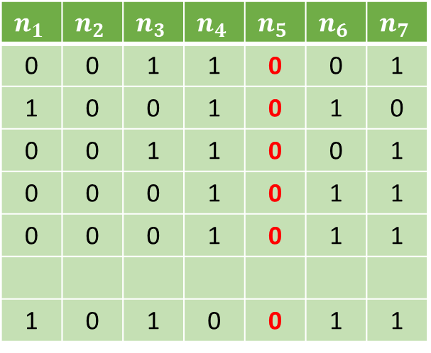

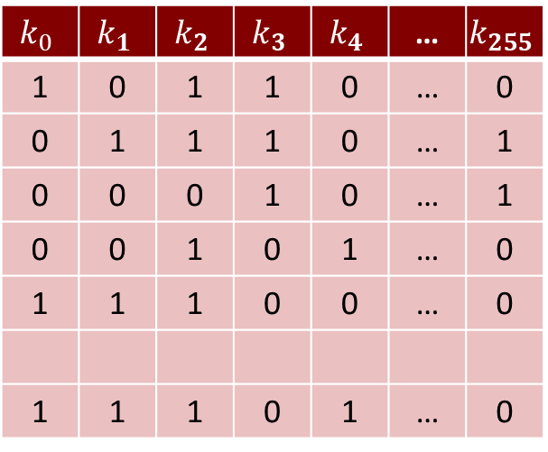
Filtering Linear Decoding Analysis against SEL
$$n_{1}$$ | $$n_{2}$$ | $$n_{3}$$ | $$n_{4}$$ | $$n_{5}$$ | $$n_{6}$$ | $$n_{7}$$
0 | 0 | 1 | 1 | 0 | 0 | 1
1 | 0 | 0 | 1 | 0 | 1 | 0
0 | 0 | 1 | 1 | 0 | 0 | 1
0 | 0 | 0 | 1 | 0 | 1 | 1
0 | 0 | 0 | 1 | 0 | 1 | 1
1 | 0 | 1 | 0 | 0 | 1 | 1
$$\vec{x}$$
?
?
?
?
?
?
$$k_{0}$$ | $$k_{1}$$ | $$k_{2}$$ | $$k_{3}$$ | $$k_{4}$$ | … | $$k_{255}$$
1 | 0 | 1 | 1 | 0 | … | 0
0 | 1 | 1 | 1 | 0 | … | 1
0 | 0 | 0 | 1 | 0 | … | 1
0 | 0 | 1 | 0 | 1 | … | 0
1 | 1 | 1 | 0 | 0 | … | 0
1 | 1 | 1 | 0 | 1 | … | 0
$$=$$
…
…
…
…
…
…
…
…
…
…
…
…
…
…
…

Slide 41
Filtering Linear Decoding Analysis against SEL
$$n_{1}$$ | $$n_{2}$$ | $$n_{3}$$ | $$n_{4}$$ | $$n_{5}$$ | $$n_{6}$$ | $$n_{7}$$
0 | 0 | 1 | 1 | 0 | 0 | 1
1 | 0 | 0 | 1 | 0 | 1 | 0
0 | 0 | 1 | 1 | 0 | 0 | 1
0 | 0 | 0 | 1 | 0 | 1 | 1
0 | 0 | 0 | 1 | 0 | 1 | 1
1 | 0 | 1 | 0 | 0 | 1 | 1
$$\vec{x}$$
?
?
?
?
?
?
$$k_{0}$$ | $$k_{1}$$ | $$k_{2}$$ | $$k_{3}$$ | $$k_{4}$$ | … | $$k_{255}$$
1 | 0 | 1 | 1 | 0 | … | 0
0 | 1 | 1 | 1 | 0 | … | 1
0 | 0 | 0 | 1 | 0 | … | 1
0 | 0 | 1 | 0 | 1 | … | 0
1 | 1 | 1 | 0 | 0 | … | 0
1 | 1 | 1 | 0 | 1 | … | 0
$$=$$
…
…
…
…
…
…
…
…
…
…
…
…
…
…
…

Slide 42
Filtering Linear Decoding Analysis against SEL
$$n_{1}$$ | $$n_{2}$$ | $$n_{3}$$ | $$n_{4}$$ | $$n_{5}$$ | $$n_{6}$$ | $$n_{7}$$
0 | 0 | 1 | 1 | 0 | 0 | 1
1 | 0 | 0 | 1 | 0 | 1 | 0
0 | 0 | 1 | 1 | 0 | 0 | 1
0 | 0 | 0 | 1 | 0 | 1 | 1
0 | 0 | 0 | 1 | 0 | 1 | 1
1 | 0 | 1 | 0 | 0 | 1 | 1
$$\vec{x}$$
?
?
?
?
?
?
$$k_{0}$$ | $$k_{1}$$ | $$k_{2}$$ | $$k_{3}$$ | $$k_{4}$$ | … | $$k_{255}$$
1 | 0 | 1 | 1 | 0 | … | 0
0 | 1 | 1 | 1 | 0 | … | 1
0 | 0 | 0 | 1 | 0 | … | 1
0 | 0 | 1 | 0 | 1 | … | 0
1 | 1 | 1 | 0 | 0 | … | 0
1 | 1 | 1 | 0 | 1 | … | 0
$$=$$
…
…
…
…
…
…
…
…
…
…
…
…
…
…
…

Slide 43
Filtering Linear Decoding Analysis against SEL
$$n_{1}$$ | $$n_{2}$$ | $$n_{3}$$ | $$n_{4}$$ | $$n_{5}$$ | $$n_{6}$$ | $$n_{7}$$
0 | 0 | 1 | 1 | 0 | 0 | 1
1 | 0 | 0 | 1 | 0 | 1 | 0
0 | 0 | 1 | 1 | 0 | 0 | 1
0 | 0 | 0 | 1 | 0 | 1 | 1
0 | 0 | 0 | 1 | 0 | 1 | 1
1 | 0 | 1 | 0 | 0 | 1 | 1
$$\vec{x}$$
?
?
?
?
?
?
$$k_{0}$$ | $$k_{1}$$ | $$k_{2}$$ | $$k_{3}$$ | $$k_{4}$$ | … | $$k_{255}$$
1 | 0 | 1 | 1 | 0 | … | 0
0 | 1 | 1 | 1 | 0 | … | 1
0 | 0 | 0 | 1 | 0 | … | 1
0 | 0 | 1 | 0 | 1 | … | 0
1 | 1 | 1 | 0 | 0 | … | 0
1 | 1 | 1 | 0 | 1 | … | 0
$$=$$
…
…
…
…
…
…
…
…
…
…
…
…
…
…
…

Slide 44

Filtering Linear Decoding Analysis against SEL
$$n_{1}$$ | $$n_{2}$$ | $$n_{3}$$ | $$n_{4}$$ | $$n_{5}$$ | $$n_{6}$$ | $$n_{7}$$
0 | 0 | 1 | 1 | 0 | 0 | 1
1 | 0 | 0 | 1 | 0 | 1 | 0
0 | 0 | 1 | 1 | 0 | 0 | 1
0 | 0 | 0 | 1 | 0 | 1 | 1
0 | 0 | 0 | 1 | 0 | 1 | 1
1 | 0 | 1 | 0 | 0 | 1 | 1
$$\vec{x}$$
1
0
1
0
0
0
$$k_{0}$$ | $$k_{1}$$ | $$k_{2}$$ | $$k_{3}$$ | $$k_{4}$$ | … | $$k_{255}$$
1 | 0 | 1 | 1 | 0 | … | 0
0 | 1 | 1 | 1 | 0 | … | 1
0 | 0 | 0 | 1 | 0 | … | 1
0 | 0 | 1 | 0 | 1 | … | 0
1 | 1 | 1 | 0 | 0 | … | 0
1 | 1 | 1 | 0 | 1 | … | 0
$$=$$
…
…
…
…
…
…
…
…
…
…
…
…
…
…
…

Slide 45
Filtering Linear Decoding Analysis against SEL
$$n_{1}$$ | $$n_{2}$$ | $$n_{3}$$ | $$n_{4}$$ | $$n_{5}$$ | $$n_{6}$$ | $$n_{7}$$
0 | 0 | 1 | 1 | 0 | 0 | 1
1 | 0 | 0 | 1 | 0 | 1 | 0
0 | 0 | 1 | 1 | 0 | 0 | 1
0 | 0 | 0 | 1 | 0 | 1 | 1
0 | 0 | 0 | 1 | 0 | 1 | 1
1 | 0 | 1 | 0 | 0 | 1 | 1
$$\vec{x}$$
1
0
1
0
0
0
$$k_{0}$$ | $$k_{1}$$ | $$k_{2}$$ | $$k_{3}$$ | $$k_{4}$$ | … | $$k_{255}$$
1 | 0 | 1 | 1 | 0 | … | 0
0 | 1 | 1 | 1 | 0 | … | 1
0 | 0 | 0 | 1 | 0 | … | 1
0 | 0 | 1 | 0 | 1 | … | 0
1 | 1 | 1 | 0 | 0 | … | 0
1 | 1 | 1 | 0 | 1 | … | 0
$$=$$
…
…
…
…
…
…
…
…
…
…
…
…
…
…
…

Slide 46
Filtering Linear Decoding Analysis
1
Receive a window M
M

Slide 47
Filtering Linear Decoding Analysis
1
Receive a window M
2
For each column c:
M
3
Filter c

Slide 48

Filtering Linear Decoding Analysis
1
Receive a window M
2
For each column c:
M
x
k
$$=$$
3
Filter c
4
Apply LDA

Slide 49
Filtering Linear Decoding Analysis
1
Receive a window M
2
For each column c:
M
x
k
$$=$$
3
Filter c
4
Apply LDA

Slide 50
Filtering Linear Decoding Analysis
1
Receive a window M
2
For each column c:
M
x
k
$$=$$
3
Filter c
4
Apply LDA

Slide 51

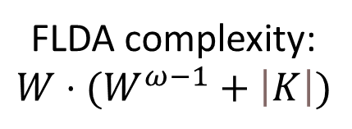
Filtering Linear Decoding Analysis
1
Receive a window M
Negligible cost
2
For each column c:
$W$ columns
FLDA complexity:
$$W⋅(W^{ω−1}+\left|K\right|)$$
3
Filter c
Negligible cost
4
Apply LDA
$W^{ω−1}+\left|K\right|$

Slide 52
Comparison on complexity of the attacks on SEL
$ω≈2.8$ is the matrix multiplication exponent
FLDA is always quartic as it is independant from the parameters $l$ and $d$ of SEL

Slide 53
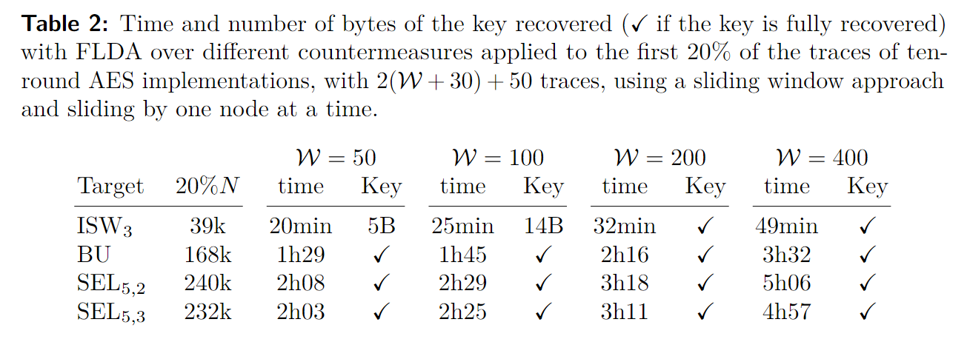
Time measurments of FLDA

Slide 54
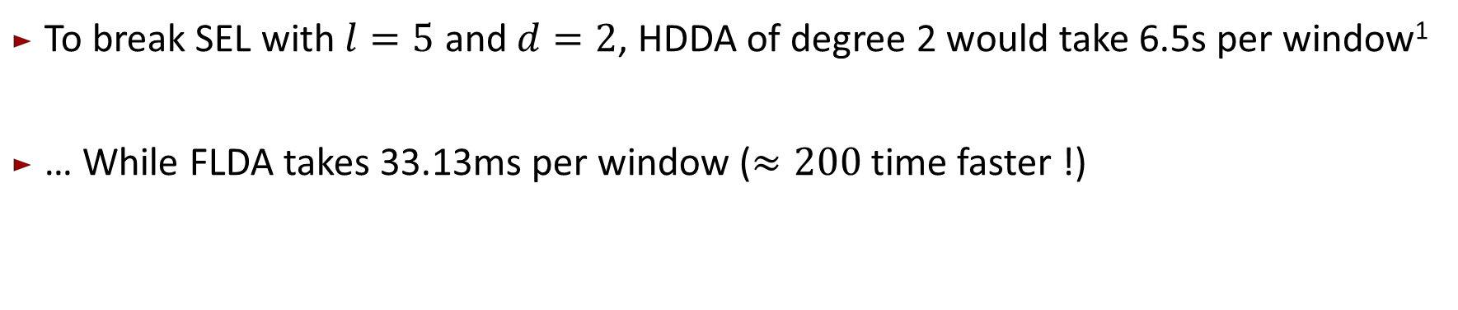
Time measurments of FLDA
To break SEL with $l=5$ and $d=2$, HDDA of degree 2 would take 6.5s per window¹
… While FLDA takes 33.13ms per window ($≈200$ time faster !)
CHES 2023: LPN-based attacks in the white-box setting

Slide 55
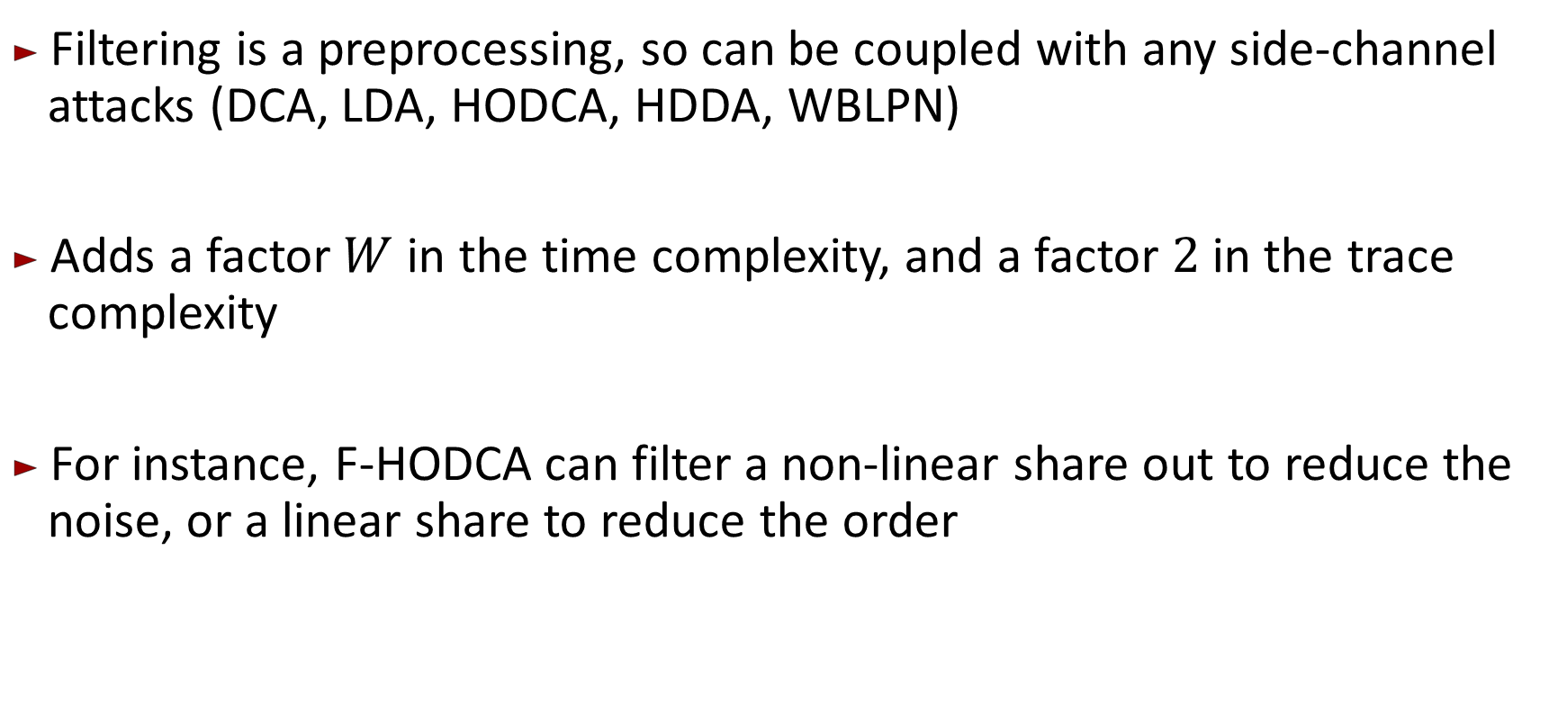
Filtering other attacks
Filtering is a preprocessing, so can be coupled with any side-channel attacks (DCA, LDA, HODCA, HDDA, WBLPN)
Adds a factor $W$ in the time complexity, and a factor $2$ in the trace complexity
For instance, F-HODCA can filter a non-linear share out to reduce the noise, or a linear share to reduce the order

Slide 56
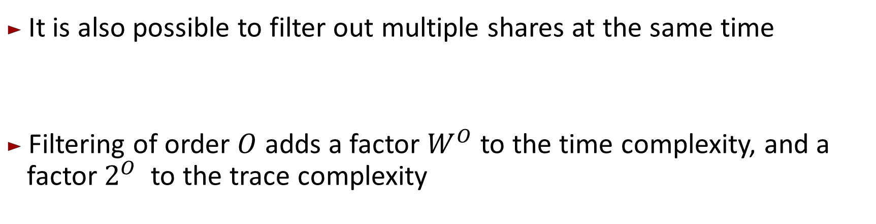
Higher order filtering
It is also possible to filter out multiple shares at the same time
Filtering of order $O$ adds a factor $W^{O}$ to the time complexity, and a factor $2^{O}$ to the trace complexity

Slide 57
Further general optimizations available in the paper
Usage of the parity check matrix to reduce the complexity of LDA (and therefore FLDA, HDDA and WBLPN)
A new algorithm RNR (Redundant Node Removal) to reduce the number of nodes N for algebraic attacks (halve them in practice)
A Chosen Plaintext Filtering (CPF) method to filter plaintexts to attack only precise parts of the implementation.

Slide 58
Conclusion
SEL¹ alone is not safe
Instead, use a combination of linear and non-linear masking schemes, such as ISW² and BU³/SEL, even if it is heavier and slower
Need for proofs of security for composed masking schemes
CHES 2021: A White-Box Masking Scheme Resisting Computational and Algebraic Attacks
Crypto 2003: Private circuits: Securing hardware against probing attacks
AsiaCrypt 2018: Attacks and countermeasures for white-box designs

Slide 59
Thank you for your attention !
White-box filtering attacks breaking SEL masking: from exponential to polynomial time
Alex Charlès, Aleksei Udovenko
https://github.com/cryptolu/whitebox-filtering

