Slide 1
CrypTool
A free software program
■ for creating awareness of IT security issues
■ for learning about and obtaining experience of cryptography
■ for demonstrating encryption algorithms and analysis procedures
www.cryptool.de
www.cryptool.com
www.cryptool.org
Claudia Eckert / Thorsten Clausius
Bernd Esslinger / Jörg Schneider / Henrik Koy

Slide 2
Contents
Introduction
  1. What is CrypTool?
  2. Why CrypTool?
  3. Audience
CrypTool Overview
  1. Features
  2. Software package contents
  3. New in release 1.3.xx
Examples of use
  1. Hybrid encryption visualised
  2. Digital signature visualised
  3. Attack on RSA encryption with short RSA modulus
  4. Analysis of encryption used in the PSION 5 PDA
  5. Demonstration of weak DES keys
  6. Locating key material (keyword: NSAKEY)
  7. Attack on digital signature
Contact addresses

Slide 3
Introduction
1. What is CrypTool?
  a freeware Program with graphical user interface
  a tool for applying and analysing cryptographic algorithms
  with extensive online help, understandable without deep crypto knowledge
  contains nearly all state of the art crypto algorithms
  “playful” introduction to modern and classical cryptography
  not a “hacker tool”
2. Why CrypTool?
  origin in Deutsche Bank’s IT security awareness program
  developed in co-operation with universities
  improve IT security related courses in universities and companies
3. Audience
  target group: students of computer science, commercial IT and mathematics
  also aimed at: interested computer users and application developers
  prerequisites: secondary school mathematics or programming skills

Slide 4
CrypTool Overview
1. Features
Cryptography
Cryptanalysis
Classical algorithms
  Caesar
  Vigenère
  Hill
  Monoalphabetic substitution
  Homophonic substitution
  Playfair
  Permutation
  Addition
  XOR
  Vernam
To facilitate performing text book examples with CrypTool
  alphabet can be configured
  treatment of white space etc. configurable
Attacks on classical algorithms
  ciphertext only
    Caesar
    Vigenère
    Addition
    XOR
  known plaintext
    Hill
    Playfair
  manual
    mono-alphabetic substitution
Supporting analysis procedures
  entropy, floating frequency
  histogram, n-gram analysis
  auto-correlation
  ZIP compression test

Slide 5
CrypTool Overview
1. Features
Cryptography
Cryptanalysis
Modern symmetric algorithms
  IDEA, RC2, RC4, DES, 3DES
  last round AES candidates
  AES (=Rijndael)
Asymmetric algorithms
  RSA with X.509 certificates
  RSA demonstration
    to facilitate performing text book examples with CrypTool
    alphabet and block length configurable
Hybrid encryption
  RSA combined with AES encryption
  visualised by an interactive data flow diagram
Brute-force attack on symmetric algorithms
  implemented for all algorithms
  assumption:
  entropy of the plain text is small
Attack on RSA encryption
  factor RSA modulus
  workable for bit lengths <= 250
Attack on hybrid encryption
  attack on RSA (see below) or
  attack on AES (see above)

Slide 6
CrypTool Overview
1. Features
Cryptography
Cryptanalysis
Digital Signature
  RSA with X.509 certificates
    signature procedure visualised by an interactive data flow diagram
  DSA with X.509 certificates
  Elliptic curve DSA, Nyberg-Rueppel
Hash functions
  MD2, MD4, MD5
  SHA, SHA-1, RIPEMD-160
Random generators
  SECUDE
  X^2 modulo N
  Linear Congruence Generator (LCG)
  Inverse Congruence Generator (ICG)
Attack on RSA Signature
  RSA modulus factorisation
  workable up to approx. 250 bit
Attack on hash function/digital signature
  Generation of hash collisions
  to ASCII texts
Random data analysis
  FIPS-PUB-140-1 test battery
  periodicity, Vitany, entropy
  histogram, n-gram analysis
  auto-correlation
  ZIP compression test

Slide 7
CrypTool Overview
2. Software package contents
completely bilingual
English
German
CrypTool program
  all functions integrated in one program with
  uniform graphical user interface
  platforms: Win32 and Linux with WINE emulator
  cryptography based on Secude library (www.secude.com)
  arbitrary precision arithmetic: Miracl library (http://indigo.ie/~mscott/)
AES-Tool
  standalone program for AES encryption (self extracting)
Extensive online help (Winhelp)
  context sensitive online help for all program functions and all menu items
  detailed examples of usage for many program features
Script (PDF) with background information on
  encryption algorithms • prime numbers • digital signature
  elliptic curves • public key certification • elementary number theory
Short story “Dialogue of the Sisters” by Dr. C. Elsner

Slide 8
CrypTool Overview
3. New in release 1.3.xx
Most important changes (details: see ReadMe-en.txt):
Release 1.3.00 published January 2002
  completely bilingual English/German
  improved dialog box consistency and comprehensibility
  Windows 9x file size limit removed
  homophonic and permutation encryption
  random generators, random data analysis (FIPS-140-1, periodicity, n-gram)
  AES-Tool: create self-decrypting files (AES)
  demonstration: number theory and RSA crypto system (further improved in 1.3.02)
  PKCS#12 export/import for PSEs
Release 1.3.02 published September 2002
  visualisation of hybrid encryption and decryption
  visualisation of signature creation and verification
  hash value calculation of large files (without loading them into memory)
  visualisation of the sensitivity of hash functions to changes in the hashed data
  short story “Dialogue of the Sisters” by Dr. C. Elsner included

Slide 9
CrypTool Overview
3. New in release 1.3.xx
Release 1.3.04 published July 2003
  visualisation of Diffie-Hellman key exchange
  attack on digital signature using hash-collisions (birthday paradox)
  brute-force attack on symmetric ciphers improved
  script updated (primes, factorization) and extended (hash functions, ECC, CrypTool menu tree)
  many small improvements (especially online help) and bug fixes
Release 1.3.05 published August 2003
  small bug fixes

Slide 10
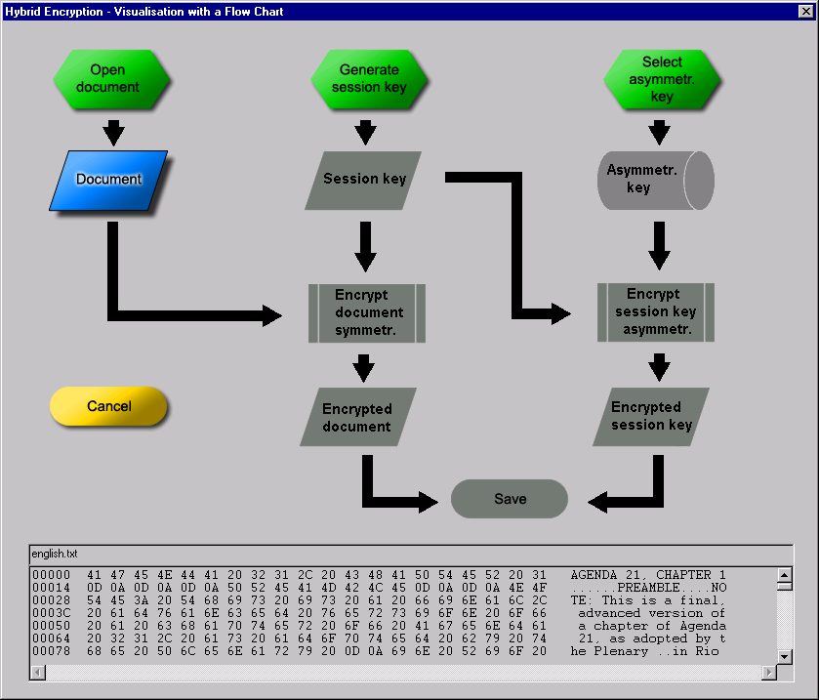
Examples of use
1. Hybrid encryption visualised
grey = missing precondition
Hybrid encryption
  combines advantages of symmetric
  and asymmetric encryption
    speed
    simple and scalable key management
  widely used in practice
    e-mail (S/MIME, PGP) and file encryption
    SSL (https)
Visualisation by an interactive
data flow diagram
  playful learning leads
  to deeper understanding
preliminary steps
data
operation
display area

Slide 11
Examples of use
1. Hybrid encryption visualised: Preparation
1. select file
2. click on document
3. contents
displayed here

Slide 12
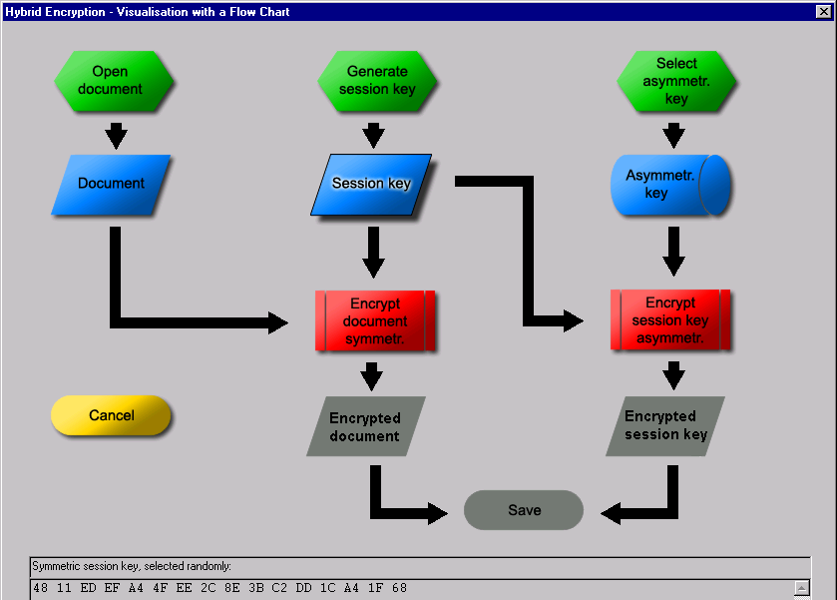
Examples of use
1. Hybrid encryption visualised: Cryptography
4. create random key
5. select asymmetric
key
6. now document and
session key can
be encrypted

Slide 13
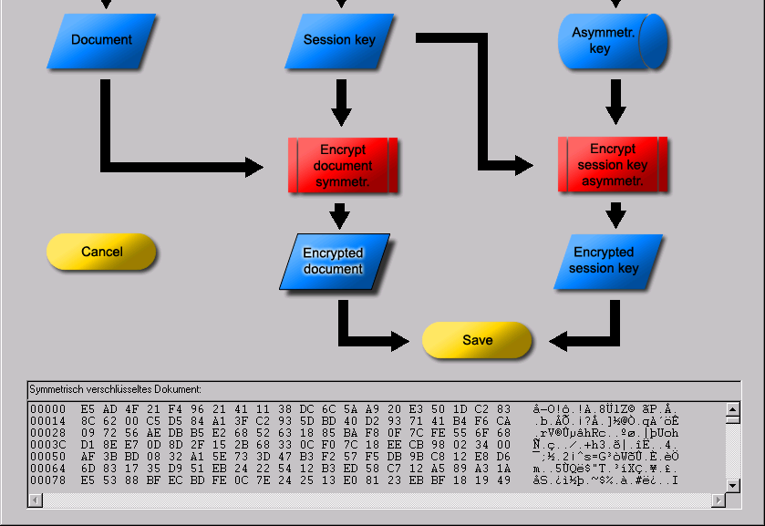
Examples of use
1. Hybrid encryption visualised: Result
7. encrypted document and
encrypted session key
are now available and
can be displayed or
written into a file

Slide 14
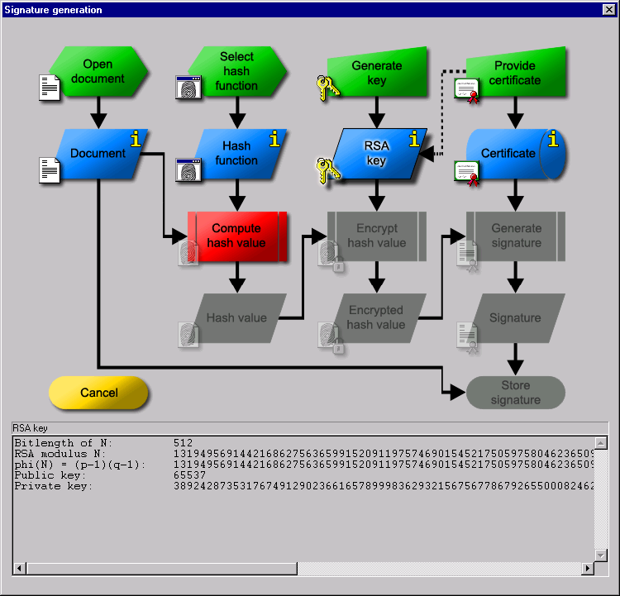
Examples of use
2. Digital signature visualised
Digital signature
  increasingly important
    equivalence with manual signature (digital signature law)
    increasingly used by industry,
    government and consumers
  few people know how it works
Visualisation in CrypTool
  interactive data flow diagram
  similar to the visualisation of
  hybrid encryption

Slide 15
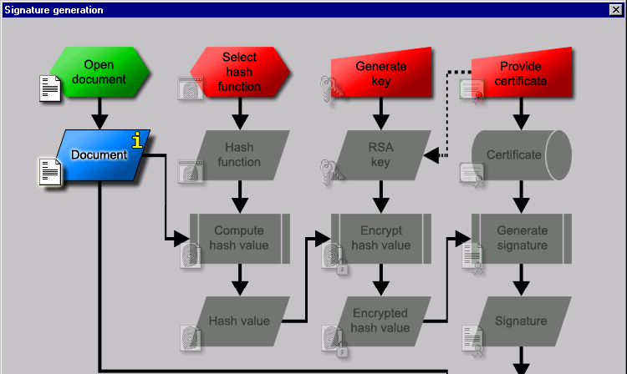
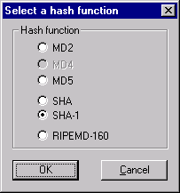
Examples of use
2. Digital signature visualised: Preparation
2. provide key and
certificate (not shown here)
1. select hash function

Slide 16
Examples of use
2. Digital signature visualised: Cryptography
3. calculate
hash value
4. encrypt
hash value
5. generate
signature
3.
4.
5.

Slide 17
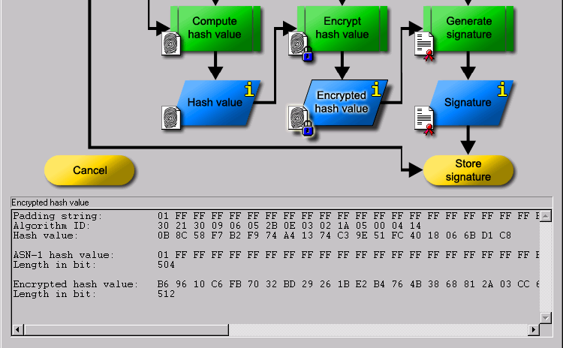
Examples of use
2. Digital signature visualised: Result
The signed document can
now be saved.
The operations can be per-
formed in any order, as per-
mitted by data dependencies.

Slide 18
Examples of use
3. Attack on RSA encryption with short RSA modulus
Example from Song Y. Yan, Number Theory for Computing, Springer, 2000
  public key
    RSA modulus N = 63978486879527143858831415041 (95 bit, 29 decimal digits)
    public exponent e = 17579
  cipher text (block length = 14):
    C₁ = 45411667895024938209259253423,
    C₂ = 16597091621432020076311552201,
    C₃ = 46468979279750354732637631044,
    C₄ = 32870167545903741339819671379
  the text shall be deciphered!
Solution using CrypTool (more detailed in online help examples section):
  enter public parameters into “RSA cryptosystem” (menu indiv. procedures)
  button “factorise the RSA modulus” yields prime factors pq = N
  based on that information private exponent d=e⁻¹ mod (p-1)(q-1) is determined
  decrypt the cipher text with d: M_{i} = C_{i}^{d} mod N
The attack with CrypTool is workable for RSA moduli up to 250 bit

Slide 19
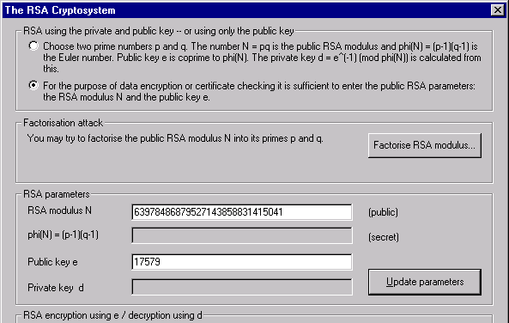
Examples of use:
3. Short RSA modulus: enter public RSA parameters
2. factorise
1. enter RSA para-
meters N and e

Slide 20
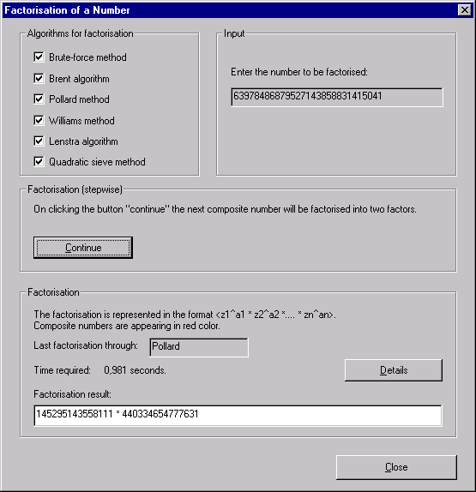
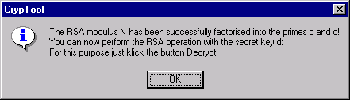
Examples of use:
3. Short RSA modulus: factorise RSA modulus
3. factorisation
yields p and q

Slide 21
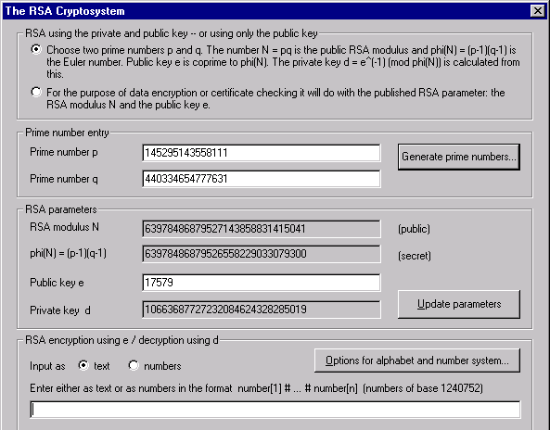
Examples of use:
3. Short RSA modulus: determine private key d
4. p and q have
been entered
automatically
and secret key d
has been
calculated
5. adjust options

Slide 22
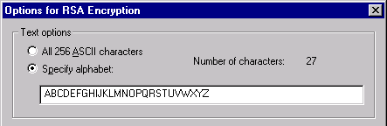
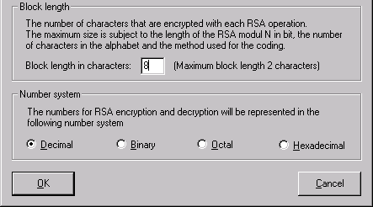
Examples of use:
3. Short RSA modulus: adjust options
6. select alphabet
7. select coding method
8. select block length

Slide 23
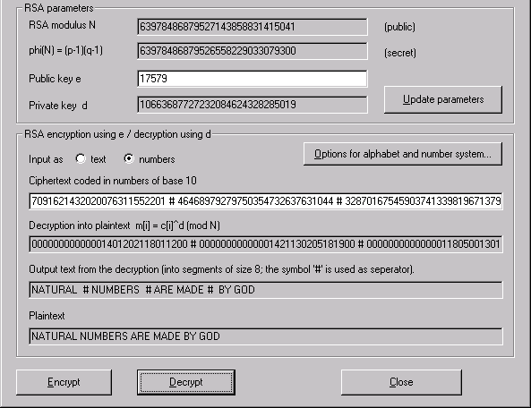
Examples of use:
3. Short RSA modulus: decrypt cipher text
9. enter cipher text
10. decrypt

Slide 24

Examples of use
4. Analysis of encryption used in the PSION 5 PDA
Attack on the encryption option in the PSION 5 PDA word
processing application
Starting point: an encrypted file on the PSION
Requirements
  encrypted English or German text
  depending on method and key length, 100 bytes up to several kB of text
Procedure
  pre-analysis
    entropy
    floating entropy ⇒
    compression test
  auto-correlation
  try out automatic analysis with classical methods
probably classical encryption algorithm
Notes:
8
Ein Beispiel von vielen, wo in Anwendungsprogrammen Cryptography mit Hilfe von klassischen oder Ad-Hoc-Verfahren eingeführt wird.
Die Textverarbeitungsapplikation des PSION 5 ist bezüglich der verwendeten schwachen Cryptography nichts Besonderes, sondern dokumentiert eher die Regel als die Ausnahme.
Die Voraussetzung ermöglicht einen erfolgreichen ciphertext only Angriff, sofern man das Verfahren richtig errät.

Slide 25
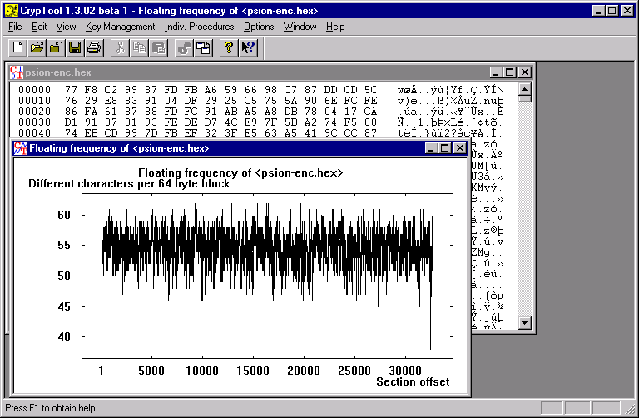
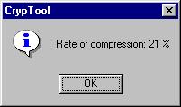
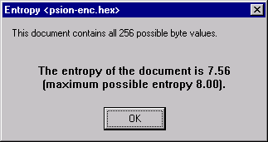
Examples of use
4. PSION PDA: determine entropy, compression test
compressibility:
clear indicator for
weak cryptography
(size was reduced
by 21%)
Notes:
9
Die Entropie liegt zwar nur leicht, aber doch signifikant unter dem Maximum von 8 bit/Zeichen. Die Komprimierbarkeit ist ein deutliches Indiz dagegen, daß starke Cryptography vorliegt.
An der gleitenden Häufigkeit (oder durch Hinsehen) erkennt man, daß die Datei mit einem nicht verschlüsselten Abschnitt beginnt und endet.

Slide 26
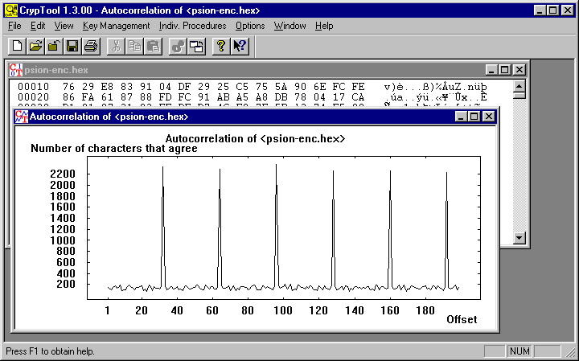
Examples of use
4. PSION PDA: determine auto-correlation
distinctive comb pattern:
typical for Vigenère,
XOR and binary addition
Notes:
10
Die typische Kammstruktur spricht für Verschlüsselung mit Vigenère, XOR oder binärer Addition (= Vigenère Verfahren, jedoch mit Bytes, statt mit Buchstaben).
Das klassische Vigenère-Verfahren scheidet aus, da andere Zeichen außer den Buchstaben vorkommen.

Slide 27
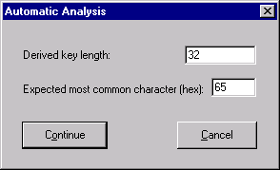
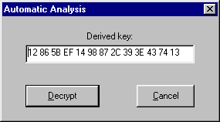
Examples of use
4. PSION PDA: automatic analysis
Automatic analysis using XOR: does not work
Automatic analysis using Binary Addition:
  CrypTool calculates the key length
  using auto-correlation: 32 bytes
  The user can choose which character
  is expected to occur most frequently:
  “e” = 0x65 (ASCII code)
  Analysis calculates the most
  likely key (based on the assumptions
  about distribution)
  Results: good, but not perfect
Notes:
11
Die automatische Analyse für das XOR-Verfahren liefert kein lesbares Ergebnis.
Die Schlüssellänge kann vom Benutzer geändert werden, was hier nicht nötig ist.

Slide 28
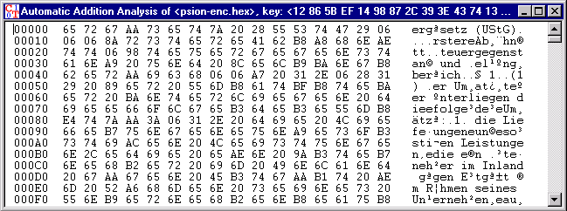
Examples of use
4. PSION PDA: results of automatic analysis
Results of automatic analysis with assumption “binary addition”:
  results good, but not perfect: 24 out of 32 key bytes correct.
  the key length was correctly determined.
  the password entered was not 32 bytes long.
  ⇒ PSION Word derives the actual key from the password.
  manual post-processing produces the encrypted text
  (not shown)
Notes:
12
Im Ergebnis der automatischen Analyse für die binäre Addition kann man einzelne Wörter lesen oder erraten. Zählen ergibt, daß 3/4 der Schlüsselbytes richtig ermittelt wurden.
Das Analyseergebnis ist beim Vigenère-Verfahren meist besser, häufig perfekt.
Auch die Analyse für binäre Addition liefert häufig bessere Ergebnisse. Störfaktor: der unverschlüsselte Abschnitt am Anfang und am Ende. Zur Erleichterung der Analyse hätte man die unverschlüsselten Teile entfernen können.

Slide 29
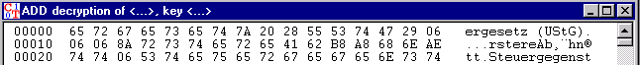
Examples of use
4. PSION PDA: determining the remaining key bytes
Copy key to clipboard during automatic analysis
In automatic analysis hexdump,
  determine incorrect byte positions, e.g. 0xAA at position 3
  guess and write down corresponding correct bytes: „e“ = 0x65
In encrypted initial file hexdump,
  determine initial bytes from the calculated byte positions: 0x99
  calculate correct key bytes with CALC.EXE: 0x99 - 0x65 = 0x34
Correct key from the clipboard
  12865B341498872C393E43741396A45670235E111E907AB7C0841...
Decrypt encrypted initial document using binary addition
  bytes at position 3, 3+32, 3+2*32, ... are now correct
Notes:
13
Die Bestimmung der restlichen Schlüsselbytes wird von CrypTool bei binärer Addition nicht gut unterstützt.
Bei anderen Verfahren hat der Anwender mehr Hilfe: z. B. bei der Analyse für die Substitution.

Slide 30
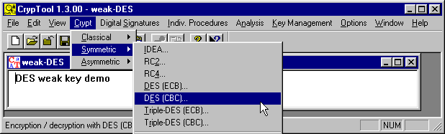
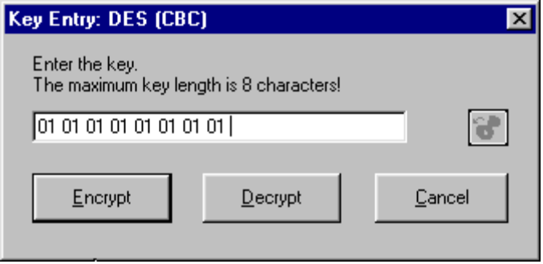
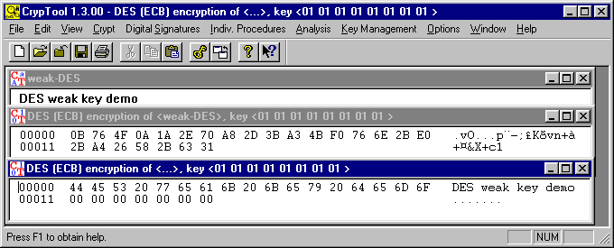
Examples of use
5. Weak DES keys
encrypt 2× with
Notes:
14
Es gibt genau vier sogenannte schwache DES-Schlüssel. Diese haben folgende Eigenschaft: K ist genau dann ein schwacher Schlüssel, wenn
DES_K(DES_K(M)) = M,
d. h., wenn zweifache Verschlüsselung mit demselben Schlüssel wieder die Ausgangsnachricht ergibt.
Beispiel: 0101010101010101 (hex)

Slide 31
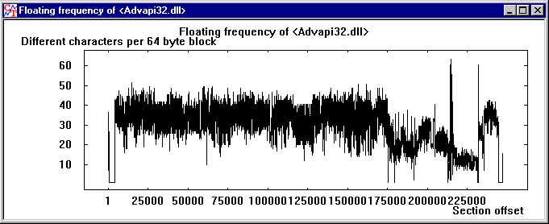
Examples of use
6. Locate key material
The function “Floating frequency” is suitable for locating key material and encrypted areas in files.
Background:
  key data is “more random” than text or program code
  can be recognised as peaks in the “floating frequency”
  example: the “NSAKEY” in advapi32.dll
Notes:
15

Slide 32
Examples of use
7. Attack on digital signature: idea
Attack on the digital signature of an ASCII text based on hash collision search
Idea:
  ASCII-Texts can be modified by changing/inserting non-printable characters, without changing the visible content
  modify two texts in parallel until a hash collision is found
  exploit the birthday paradox (birthday attack)
  generic attack applicable to all hash functions
  can be run in parallel on many machines (not implemented)
  implemented in CrypTool by Jan Blumenstein as part of his bachelor thesis “Methods and tools for attacks on digital signatures” (German), 2003.

Slide 33
Examples of use
7. Attack on digital signature: idea (2)
1. Modification: starting from a message M create N different messages M₁, ..., M_{N} with the same “content” as M.
2. Search: find modified messages M_{i}^{H} und M_{j}^{S} with the same hash value.
3. Attack: the signatures of those two documents M_{i}^{H} und M_{j}^{S} are the same.
1.
3.
harmless message M ^{H}
2.
Compare hashes
Identical signatures
1.
3.
evil message M ^{S}
We know from the birthday paradox that for hash values of bit length n:
  search collision between M^{H} and M₁^{S}, ..., M_{N}^{S} : N ≈ 2^{n}
  search collision between M₁^{H}, ..., M_{N}^{H} and M₁^{S}, ..., M_{N}^{S} : N ≈ 2^{n/2}

Slide 34
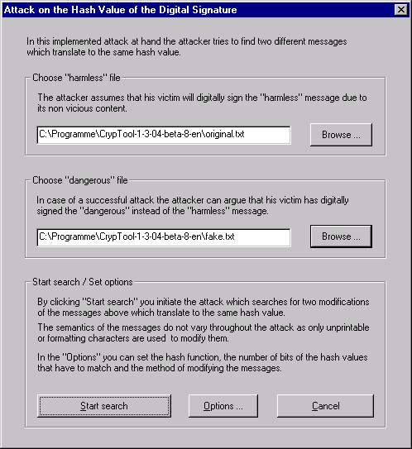
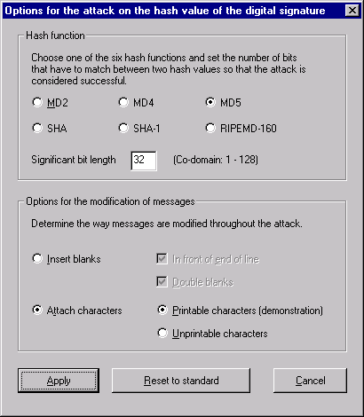
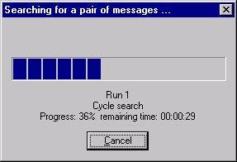
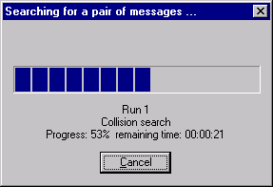
Examples of use
7. Attack on digital signature: attack
1.
2.
4.
3.

Slide 35
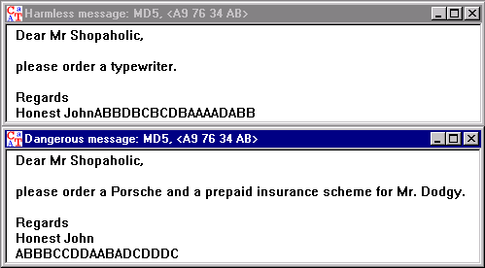
Examples of use
7. Attack on digital signature: results
Experimental results
  72 Bit partial collision (equality of the first 72 hash value bits) were found in a couple of days on a single PC.
  Signatures using hash values of up to 128 bit can be attacked today using massive parallel search!
MD5: A9 76 34 AB
65 53 37 21 6F 70
1F 6C 6C 3F 2F 6D
MD5: A9 76 34 AB
AC 10 96 30 CC 47
24 D5 70 D8 84 71
The first 32 bits of the hash values are identical.

Slide 36
Further development
Work in process
  visualisation of challenge-response authentication
  attack on single-sided authentication with CR and weak encryption
  mass pattern search
Planned for near future
  visualisation of SSL protocol
  visualisation of Man-in-the-Middle attack
  demonstration of a side-channel attack
Planned for remote future
  visualisation of different security protocols (e.g. Kerberos)
  visualisation of attacks on these different security protocols
  port to Linux or Java
  many more ideas can be found in the readme file, chapter 6
Notes:
Visualisierung von Man-in-the-Middle-Attacks

Slide 37
Contact addresses
Prof. Dr. Claudia Eckert Bernhard Esslinger
Technical University Darmstadt - University of Siegen
Faculty of Computer Science Faculty of Economics
IT Security - Deutsche Bank AG
Wilhelminenstr. 7 Information Security
64283 Darmstadt, Germany bernhard.esslinger@db.com
claudia.eckert@ besslinger@web.de
sec.informatik.tu-darmstadt.de
Thorsten Clausius Jörg Cornelius Schneider
Technical University Darmstadt Deutsche Bank AG
thorsten.clausius@ joerg-cornelius.schneider@db.com
sec.informatik.tu-darmstadt.de js@joergschneider.com
www.cryptool.de
www.cryptool.org
www.cryptool.com
Mailing list: cryptool-list@sec.informatik.tu-darmstadt.de

