Slide 1

Parrot ,
Desktop voice Assistance
Your voice is my command, your needs are my priority.

Slide 2

Second Presentation.
By,
Parrot ,
Parrot ,
Pratik P Holkar
Shrinek B Mungari
Vrushali R Patil
Desktop voice Assistance
Guide -
Prof. Chaya Sateri.
Your voice is my command, your needs are my priority.
Your voice is my command, your needs are my priority.

Slide 3
By,
Introduction
Pratik P Holkar
Shrinek B Mungari
Vrushali R Patil
Desktop voice assistance is used to run machines like laptop or personal computers on your own commands.
Desktop voice assistance is an application program that understand the natural language and voice commands to complete tasks for users.
Desktop voice assistance is used to perform a typical task like showing date & time, managing emails, openings apps etc. on your commands.
Prof. Chaya Sateri.
Guide -

Slide 4
Introduction
Description of System
Desktop voice assistance is used to run machines like laptop or personal computers on your own commands.
Desktop voice assistance is an application program that understand the natural language and voice commands to complete tasks for users.
Desktop voice assistance is used to perform a typical task like showing date & time, managing emails, openings apps etc. on your commands.
Main module
USER : The main module handles the overall interaction with the user.

Slide 5
Description of System
Design and Implementation
Sub Modules.
Audio Input/Output Management:
This module handles the recording and processing of audio input from the user.
1.Speech Recognition
2. Natural Language Understanding (NLU):
3. Dialogue Management:
4. Natural Language Generation (NLG):
5. Speech Synthesis:
This module converts spoken words or phrases into text. It analyses the audio input and transcribes it into a format that can be understood by the system.
Also known as Text-to-Speech (TTS), this module converts the generated text responses into spoken words
This module manages the flow of conversation with the user.
NLG generates human-like responses based on the system's understanding of the user's input.
The NLU module processes the transcribed text and extracts the meaning and intent behind the user's input.
USER : The main module handles the overall interaction with the user.
Voice should be very clear.
Activities might get delayed if there is no immediate and clear commands from users of the system with proper internet connectivity.
System with proper working is necessary.

Slide 6
2. Error Handling and Exception Management:
This module handles errors and exceptions that may arise during the voice interaction process.

Slide 7
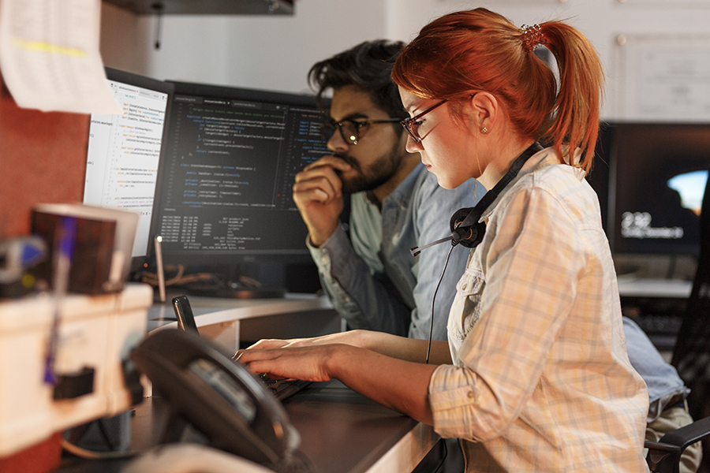
Design and Implementation
Voice should be very clear.
Activities might get delayed if there is no immediate and clear commands from users of the system with proper internet connectivity.
System with proper working is necessary.

Slide 8
1
When log in is successful only after that next working of project is done.
3.Assumption and Dependencies
2
Error is displayed when user do something wrong.
3
Warning messages are displayed when voice of user is not recognized.
4
If user ask to do unauthorized activities system will be respond that it will be not able to do that task.

Slide 9
External Interface Requirement
1. User Interface.
Screen Name | Description
Log in | User needs to enter the username and password
Voice input | Takes input through voice commands
Process and executes the required command | Executes tasks.
Response/output | Gives output.

Slide 10

2.Communication Interface
We are using microphones as a communication medium to interact with the system.

Slide 11

Performance Requirement
Tasks are performed within seconds if their proper internet connectivity.
Tasks are delayed with slow internet connectivity
Non Functional Requirements
2. Security Requirements
Only authorized persons can access the features.
3. Software Quality Attributes
Reliability.
Usability.
Maintainability.
Efficiency.

Slide 12
Data Flow Diagrams
Effective communication and collaboration make the remote work setup successful.
DFD Level ‘0’
Virtual
Assistant
User
Sends Request through voice
Receives Response

Slide 13
DFD Level ‘1’
Task Executer
Speech Recognition
user
Open
browser
Automate
WhatsApp
Response /
output
Voice commands
Voice to text
Run Programs
Wikipedia
Reply

Slide 14
DFD Level ‘2’
Speech
recognition
Voice to text
User
Voice Command
Command
Interpreter
Data Set
Query Executer
Task Executer
Task process
Wikipedia
Response/Output

Slide 15






























Thank You,

