Slide 1
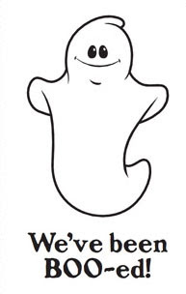
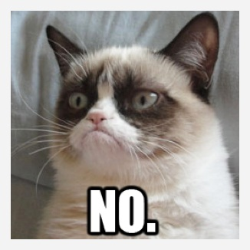
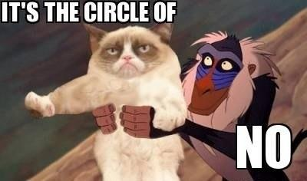
My Response to
GETTING
BOOED
Thanks for leaving a treat! That was very kind of you!
(I wish I knew who you were though, but that’s another story.) However, I won’t “pass it along.” If you knew me well, you’d already know that …
I don’t do chain letters.
Chain
Letters
Chain letters are spam, pure and simple. Spam is a waste of time and energy. You have to ask yourself, if you want to do something nice for someone, why do you have to infer some obligation then on your recipient? And that’s what makes the chain letter a bad kind of spam, and not conducive to freedom or being nice to your neighbor. ☹ So, just don’t do it. If everyone followed this advice, there would never again be chain letters, and the world would be a better place. Just say no. ☺

