Slide 1
A Hybrid Approach for Cervical Cancer Detection: Combining D-CNN, Transfer Learning, and Ensemble Models.
Abu Hanzala
ID : 211-15-4022
And
Tanjila Akter
ID : 213-15-4334
Department of CSE
Daffodil International University
Md. Sadekur Rahman
Assistant Professor
Department Of CSE
Daffodil International University

Slide 2
Outline
Introduction
Problem Statement
Motivation and Objective
Related Works
Comparison Between Existing Works
Gap Analysis
Proposed Methodology
Q & A

Slide 3
Introduction
Cervical cancer is a major global health concern and a leading cause of cancer-related deaths among women, especially in low-resource settings, despite being preventable with early screening and treatment.

Slide 4
Problem Statement
Manual diagnosis
Resource Constraints
Late Diagnosis
Data Complexity
Need for Automation

Slide 5
Motivation and Objectives
Improve early detection
Enhance Diagnostic Accuracy
Support Resource-Limited Areas
Efficient Image Analysis
Build Robust Models

Slide 6
Related Work
(Kaur et al, 2025) applied a deep transfer learning model to classify cervical cancer. The author used a Herlev and dataset for cervical cancer classification. The author used 16 pre-trained CNN models. The model achieved 95% accuracy for ResNet50, 99.95% for VGG16, and 97.65% for DenseNet121. (Ahmed et al, 2024) proposed a Deep Learning Transfer model for early detection and classification of cervical cancer cells. The author used SIPaKMeD dataset. The author used pre-processing, feature reduction, feature extraction & fusion, and classification models. The model achieved 97% accuracy.
(Alsmariy et al, 2020) developed a machine-learning model for diagnosing cervical cancer. The author used a UCI cervical cancer risk factor dataset. The author used a Voting classifier model. The model achieved 0.93% to 5.13% accuracy. (Dhawan et al, 2021) developed a cervical cancer model to classify cervix images. The author used an open-source Kaggle dataset. The author presented a deep learning model with transfer learning techniques. The model achieved 96.01% accuracy.

Slide 7
Comparison Between Existing Works
Author | Dataset | Method | Result | Contribution
Kaur et al. (2025) | Herlev dataset | 16 pre-trained CNN models | 99.95% | Deep transfer learning classification
Ahmed et al. (2024) | SIPaKMeD dataset | Feature reduction, extraction & fusion | 97% | Early detection & classification
Alsmariy et al. (2020) | UCI dataset | Voting classifier model | 93% | Diagnosis using ML
Dhawan et al. (2021) | Kaggle dataset | Deep learning, transfer learning | 96.01% | Cervical cancer classification

Slide 8

Gap Analysis
Previous studies using individual deep learning models lacked high classification accuracy for cervical cancer detection.
Most research focused on CNN's or transfer learning, with few exploring a combined ensemble approach for improved performance.
Few studies have conducted a thorough comparison of various deep learning architectures for cervical cancer classification.

Slide 9
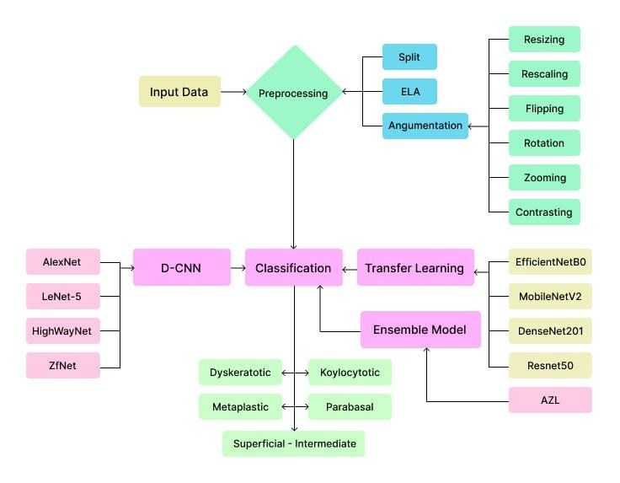
Proposed Methodology
Cont…

Slide 10

Proposed Methodology
Data Collection & Processing:
Collected cervical cancer image dataset.
Applied Error Level Analysis (ELA) to detect inconsistencies and enhance data quality.
Performed data augmentation (resizing, rescaling, flipping, rotation, zooming, and contrast adjustments).
Performance Evaluation:
Conducted comparative analysis of models based on accuracy, precision, recall, and F1-score.
Used cross-validation to ensure model generalization.
Tested model performance on unseen data for real-world applicability.
Model Selection & Training:
Implemented pre-trained transfer learning models:
EfficientNetB0, MobileNetV2, DenseNet201, ResNet50.
Deep Convolutional Neural Networks (D-CNNs):
AlexNet, LeNet-5, HighWayNet, ZfNet.
Developed an ensemble model
(AZL: AlexNet + ZfNet + LeNet-5) for improved accuracy.

Slide 11
References
R. Ahmed, N. Dahmani, G. Dahy, A. Darwish, A. Ella Hassanien, Early detection and categorization of cervical cancer cells using smoothing cross entropy-based multi-deep transfer learning. IEEE Access. 12, 157838–157853 (2024).
H. Kaur, R. Sharma, J. Kaur, Comparison of deep transfer learning models for classification of cervical cancer from pap smear images. Scientific Reports. 15 (2025), doi:10.1038/s41598-024-74531-0.
R. Alsmariy, G. Healy, H. Abdelhafez, Predicting cervical cancer using machine learning methods. International Journal of Advanced Computer Science and Applications. 11 (2020), doi:10.14569/ijacsa.2020.0110723.
S. Dhawan, K. Singh, M. Arora, Cervix image classification for prognosis of cervical cancer using deep neural network with transfer learning. EAI Endorsed Transactions on Pervasive Health and Technology. 7 (2021), doi:10.4108/eai.12-4-2021.169183.

Slide 12
THANK YOU

