Slide 1

AQUO
"Create Asset Liquidity, Unleash Derivatives, Empower Stakeholders."
TL Oakley

Slide 2
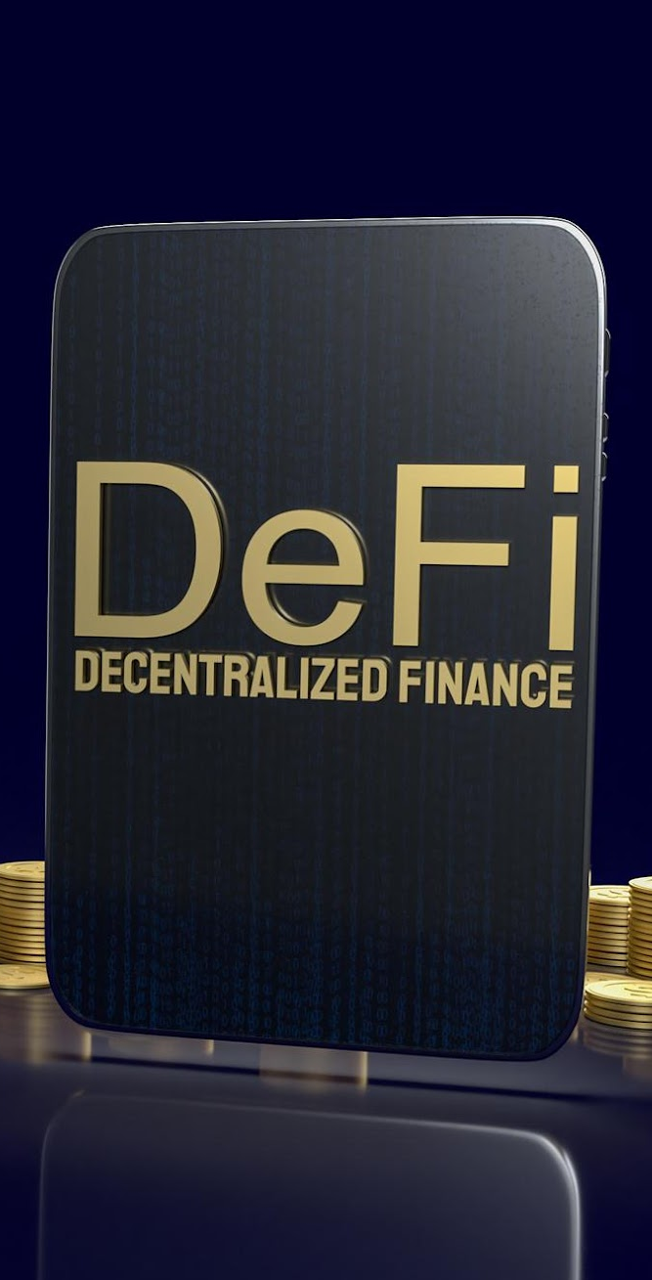

AQUO
Revolutionizing Financial Instruments
Boosting Liquidity
Empowering Asset Tokenization and Derivatives
Blockchains
Smart Contracts

Slide 3

PROBLEM
Illiquid Real Assets
High Transaction Costs
Lack of Transparency
Limited Access to Asset Markets

Slide 4
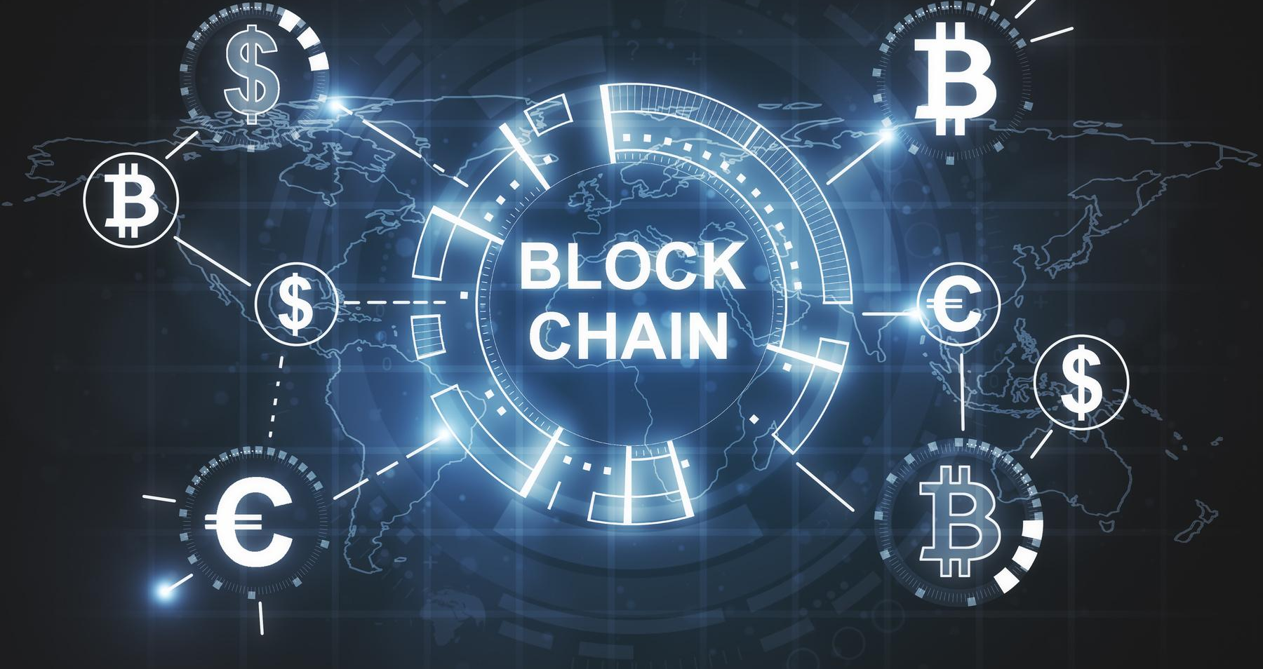

SOLUTIONS
TOKENIZATION
CONTRACTS
POOLS
Tokenization of real-world assets
SPV based
Pegged Price to Asset Value
Smart Contracts
OTC Based
Derivatives
Customized
Investment Pools
Investor Criteria
Customization

Slide 5

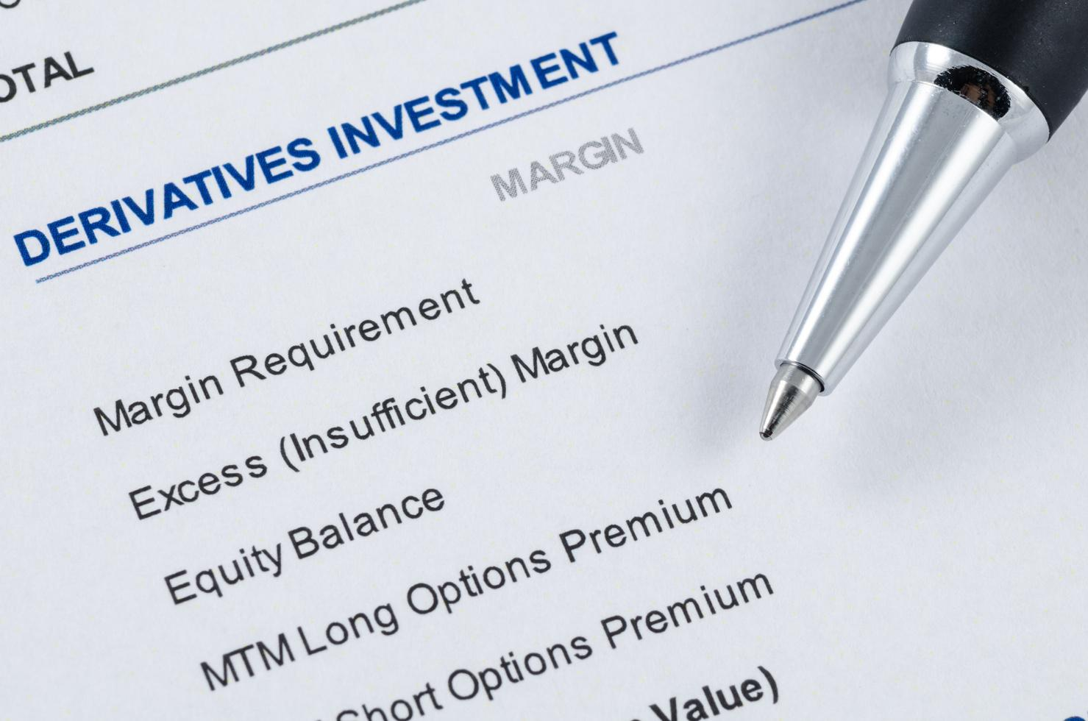
TARGET MARKET
Sellers of Assets
Investors
Subscription models
Individuals
Companies
Asset Equity and Debt Finance
Derivatives Investments

Slide 6

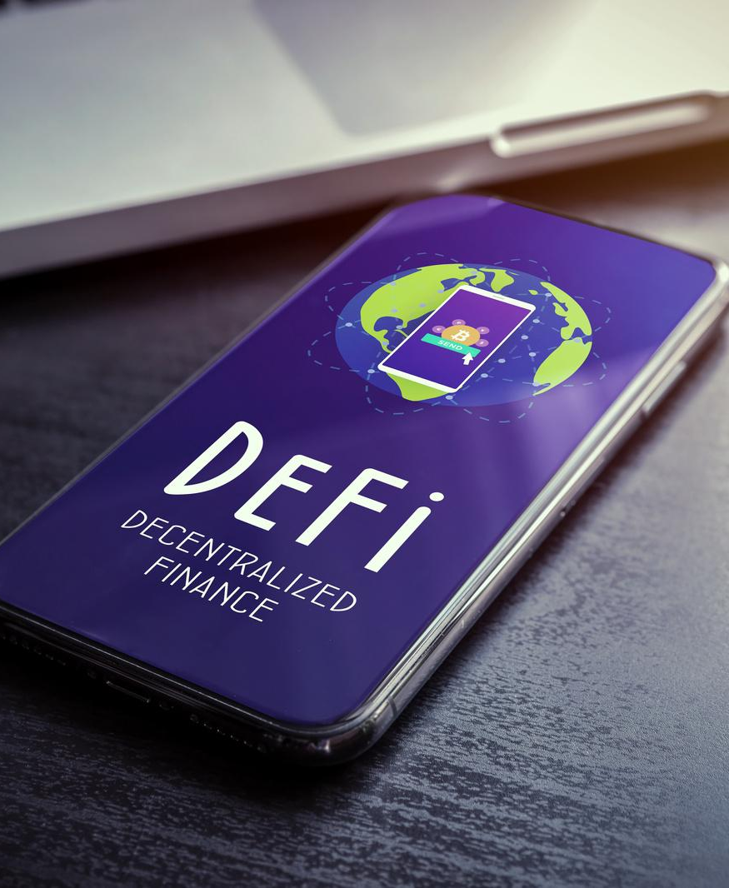
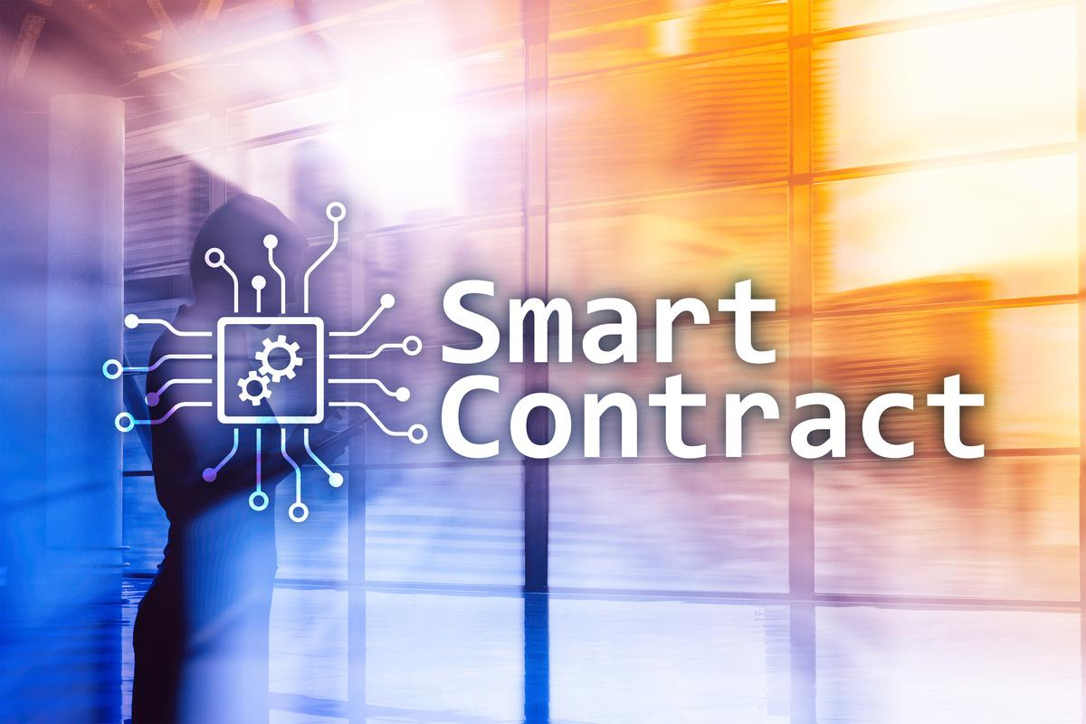
Marketplace for Investor Proposals
Investment framework off-chain and on-chain
Investment Novel Framework
ABOUT AQUO

Slide 7




AQUO PLATFORM
The Aquo Platform will list investment opportunities with due diligence document; and also management of investments; OTC smart contracts will be optional.
Liquidity
Derivatives
New Asset Classes
Listing Service for Investment Proposals
Creation of new financial instruments (contracts)
For Liquidity and Derivatives

Slide 8




COMPETITIVE ADVANTAGE
TIMING
SPEED
AGILE
EXPERTISE
Many of the competitors are large companies characterized by slow decision-making, slow moves into the market, a strong focus on current operations in established markets, and limited use of emerging technologies; unlike us.

Slide 9

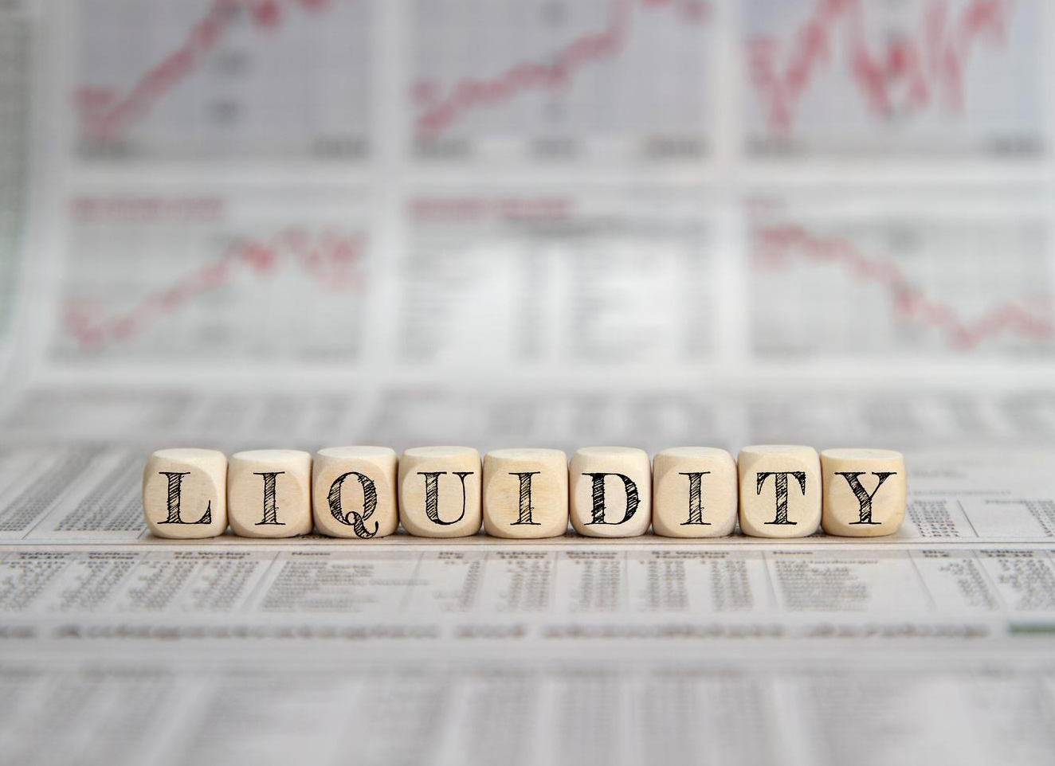
Facilitate asset acquisition and Liquidity
OUR VISION
Customization of Derivatives to meet investor demand
New Market Financial Instruments
Enable Globalization of Asset Markets
Minimal barriers to entry

Slide 10
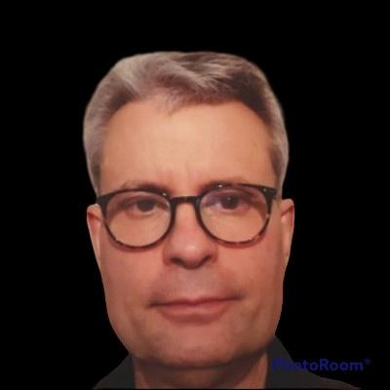



TL Oakley
TBA
TBA
TBA
Founder
CMO
CFO
CIO(Infrastructure)
TEAM
The core team will have skills in marketing, finance, infrastructure, compliance, and investor confidence.

Slide 11

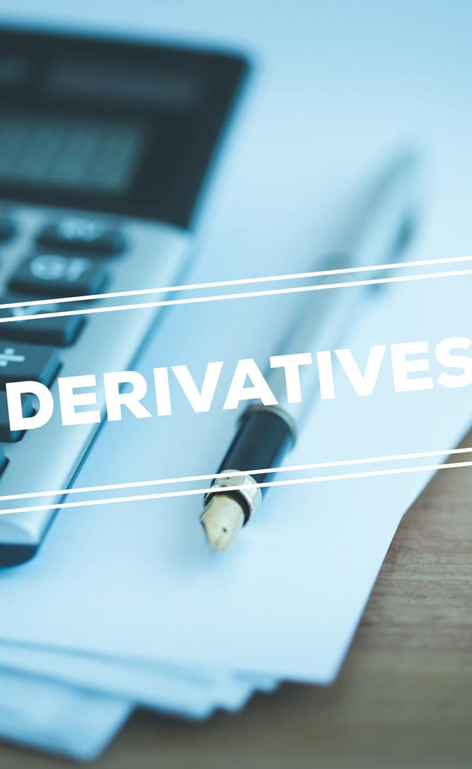

ROADMAP
The roadmap will start with just asset tokenization which will lead into asset pooling, and derivatives; and finally more asset classes will be considered. An ERC20 utility token is planned in month 4.
Asset Tokenization (0-3 months)
Derivatives (3-15 months)
New Asset Classes (15-36 months)

Slide 12


CONTACT US
https://aquo.world

