Slide 1

Encode Club – ZK Bootcamp – Q2 - 24
Group 7 Team
u6Xp6Q - @cryptphi
xUlUrs - @The Doc
Sflv07 - @pedroluisff
O8GYZv - @arcadiogm#

Slide 2



PoC – Proof of Concept >>> Summary / Purpose statements
The ZKLottoGame is a game of Lottery where a user can select 6 numbers of their choice during the duration of the current Lotto Game week.
At the end of the Game week, the game ends by end of day 6 of the start of the current game and the Lottery Winning numbers are randomly generated.
The user with the winning lotto entry will verify their valid lotto numbers and be able to claim their winnings.
New game starts at end of day 7 of previous game week start

Slide 3

Technology >>> MINA
Constant-Sized Blockchain (22k) Mina’s blockchain remains approximately 22KB in size by using recursive zk-SNARKs to compress the entire blockchain history into a single succinct proof. Benefits: - the state of the game is handled without increasing the data load for the player - smooth gameplay and seamless interaction for users
Efficient verification zk-SNARK proofs allow for quick verification of the blockchain state. Nodes can verify the entire blockchain's validity with minimal computational resources. Benefits: - quick verification of lottery results and player entries - fast and responsive game interactions, reduced waiting times
Decentralization Efficiency and small size of zk-SNARK proofs make it easy for more users to run a full node. Benefits: - fair and transparent lottery game by decentralizing validation
- increased trust among players as the game state is verified by multiple independent nodes
Security and Privacy zk-SNARKs enable confidential transactions providing strong security guarantees. Benefits:
- Player entries are handled privately using zkSNARKs - Increased trust in the game’s fairness and integrity

Slide 4


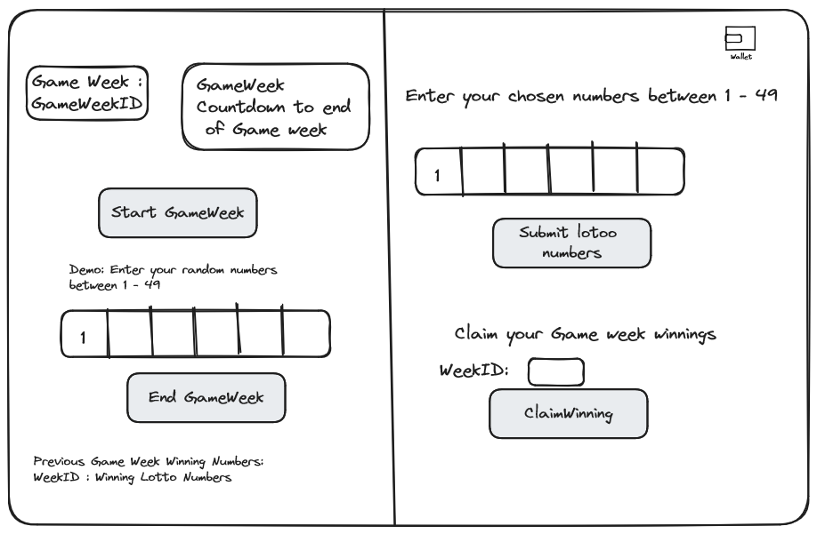
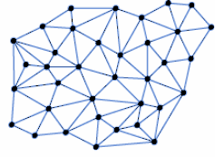
PoC – Proof of Concept >>> Diagram
Mina - zkApp
UI - User Interface
TRANSACTION
.
Verification
KEY
Smart
Contract
PROVER
Function
VERIFIER
Function

Slide 5


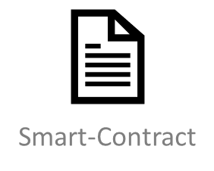
PoC – Proof of Concept >>> Front-End
Verifier
Prover

Slide 6
PoC – Proof of Concept >>> Architecture
Logic:
Initialize ZKLottoGame Contract
Start New Lotto Game week -> duration (6 days)
Player selects numbers of their choice between 1 - 49, and passed along with current game week number for player to sign with their wallet private key.
Player submits the signed selection as their lotto entry
Game week ends 6 days after start of current game week.
Lotto winning numbers randomly generated
Start New Game for new week 7 days after previous game started.
Successful winner can claim their winnings by verifying their lotto entry.

Slide 7
GitHub code
Functions:
init() -> initialize ZKLottoGame contract
startLottoWeek() -> start new lotto week
play() -> players submit lotto entries
endLottoWeek() -> end lotto week, generate winning lotto numbers, start new lotto week
ClaimWinning() -> User verifies their entry to claim winnings
Github Repo:
https://github.com/cryptphitraining/encodeClubZKBootCamp

Slide 8

Thank you

Slide 9
Resources and References
https://airtable.com/appuEtalPCFNL5bBW/shrtYELG3qdeOlrUq

