Slide 1
DDA RETENTION · DECISION ANALYTICS
From a Heuristic Rule to a
Causal, Optimized Decision Engine
A decision engine built with quasi-experimental causal inference (sharp RDD, 2-group DiD, and a tier-stratified randomized-holdout RCT) plus formal ILP budget optimization, translated into quantified, actionable business impact
Presented for: Data Analyst, Senior Specialist / Data Scientist — Decision Analytics & Modeling, Vanguard
Notes:
Open by framing this as a purpose-built demonstration of the analytical engine this JD calls for: causal inference where randomization isn't feasible, plus formal optimization under uncertainty. Say up front that today's data is synthetic (next slide explains why) and that the project is grounded in real DDA retention work I led, but isn't presented as a literal retrofit of that project's original test design.

Slide 2
SITUATION
We were losing checking accounts —
and only found out after they'd already closed
1
No early-warning system
Attrition was visible only in the rear-view mirror: the account was already closed by the time it showed up in a report.
2
One-size-fits-all retention
Every at-risk account got the same generic outreach, regardless of why it was actually at risk.
3
DDA is the low-cost funding base
Every checking relationship lost isn't just a balance — it's lifetime value and future cross-sell, gone.
2
Notes:
This is the real situation from my actual DDA retention work. RMs and the retention team had no forward-looking signal, and the retention motion that did exist wasn't differentiated by WHY someone was at risk.

Slide 3
TASK — HOW TO READ WHAT YOU'RE ABOUT TO SEE
Grounded in a real retention problem;
built, end to end, to demonstrate this role's engine
WHAT'S REAL
WHAT'S PURPOSE-BUILT FOR THIS ROLE
The business problem: DDA churn, no early warning, undifferentiated outreach
The three churn triggers (large withdrawal, DD stop, dormancy) and the multi-class predictive layer that routes each account to the right playbook
The retention economics — funded outreach only pencils out above a value cutoff; below it, cheaper touches make more sense (see slide 4)
Everything from here on — the RDD, the DiD, the randomized dormant-play holdout, the ILP optimizer, and the business-impact translation — was designed from scratch on synthetic data (known account data can't leave the bank, or be posted to a public repo)
No extra A/B test was proposed. Instead: for each trigger, the analysis plan was fixed FIRST — which comparison, which population, which test — before ever looking at outcomes, the same discipline as pre-registration
The DD-stop offer and both dormant plays roll out to everyone eligible in-window; only a small randomized holdout is withheld, purely for measurement — nothing is delayed or denied just to run a test
Because the ground truth is injected, every method here can be graded against a known answer before I'd ever trust it on a real decision
3
Notes:
Be very explicit and upfront here: this is honest framing, not a trick. If asked 'is this the exact project you shipped' -- no, and I don't present it that way. It's a from-scratch analytical engine, built to demonstrate the causal-inference-under-non-randomization plus optimization skillset this JD asks for, using the same real business problem and triggers I actually worked on. The 'analysis plan fixed before looking at outcomes' point matters: it's what separates this from p-hacking a result out of data I already had -- RDD's cutoff, DiD's launch date and comparison groups, and the dormant RCT's holdout design were all decided before computing a single effect size.

Slide 4
APPROACH
One decision engine, four layers — each one earning its place in the final call
1
2
3
4
PREDICT
EXPLAIN
(CAUSAL)
OPTIMIZE
ACT
→
→
→
Which churn mode is this account heading toward? Routes each account to the right causal layer.
Sharp RDD, 2-group DiD, tier-stratified randomized-holdout RCT: the true effect of each intervention, isolated from confounds.
Budget & capacity-constrained ILP: given real effects and real costs, who gets what, this month?
Tiered, quantified recommendations a stakeholder can approve and a team can execute.
ONE SPLIT, REUSED EVERYWHERE
RDD's population, DiD's treated/control groups, and both dormant-play RCT arms all use the SAME high-value / low-value account split (top/bottom 50% by account_value) — a business ROI cutoff, not a statistical one (next slide). One reused definition of "who's worth a funded intervention," instead of three separately-justified cutoffs.
4
Notes:
This maps directly to the JD language: 'design the analytical engine... how relationships are modeled... how outputs are generated for decision-making.' Predict/Explain/Optimize is that engine; Act is what turns the engine's output into something a stakeholder can approve. The callout at the bottom is deliberate -- it previews that every causal design from here forward shares one reused business split, so it doesn't look like three separately-invented cutoffs when RDD/DiD/dormant each show up.

Slide 5
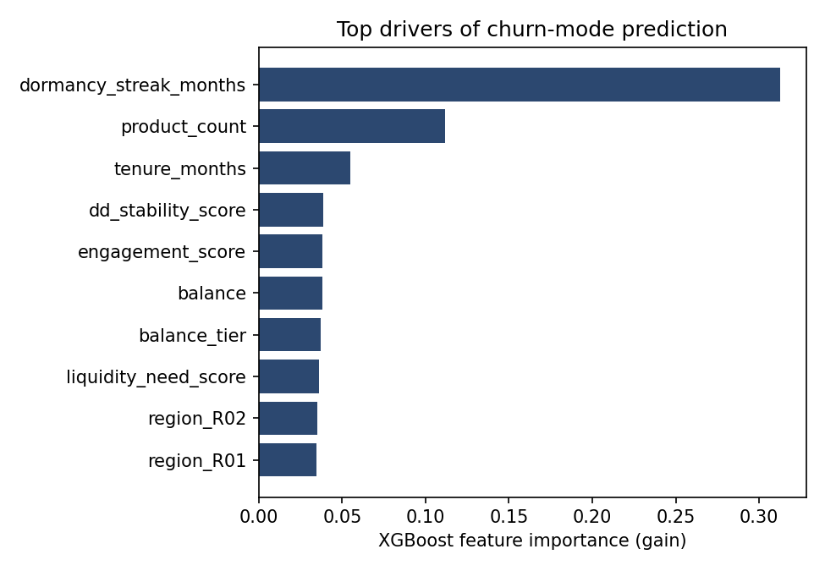
LAYER 1 — PREDICT
Which way is this account most likely to churn?
0.66 – 0.74
ROC-AUC per churn mode (one-vs-rest)
2.1x – 3.8x
Lift at top decile vs. base rate
Churn is rare (~12% combined across modes) — deliberately elevated above the real project's ~0.8% observed baseline so this compact synthetic panel still has enough events per mode to power RDD/DiD/RCT cleanly. Top drivers are plain account facts — prior dormancy, product count, tenure — not engineered scores. Not a 0.95-AUC problem; in production you rank and act on the top slice your capacity allows, not hard-classify at a threshold.
5
Notes:
Every top driver here is a plain account fact, not an engineered score: prior dormancy_streak_months is the single strongest predictor of the model -- unsurprising, since having been dormant before is one of the cleanest recency signals in churn modeling generally. product_count and tenure_months come next -- fewer products and shorter tenure both track a less-embedded relationship. I deliberately kept a few softer behavioral scores (engagement, DD-stability, liquidity-need) in the feature set as minor secondary signal, but I didn't want the story's TOP driver to be a score I'd have to explain the derivation of if pushed -- 'this account had 2 prior dormant months' is a one-sentence, no-methodology-required answer. Region importance sits at noise level at the bottom of the chart, a good sanity check that the model isn't picking up spurious geography effects. I evaluate by ranking quality, not hard-classification accuracy, because forcing balanced weights on an 88%-none target produces garbage precision numbers that don't reflect how the model is actually used. This layer's job is purely routing: WHICH causal-layer estimate applies to this account. One honest note if asked: the real project's actual observed baseline churn was about 0.8% over a 2-month A/B window -- this synthetic demo's panel intentionally runs hotter, around 12% combined across modes, because with a few thousand HV/LV accounts I need enough injected churn events per mode for the RDD/DiD/RCT layers to actually have statistical power to detect anything. At a true 0.8% base rate on this account count, most of those designs would come back underpowered and I'd have nothing clean to show. So the elevated rate is a deliberate demo-scale choice, not a claim about what real DDA churn looks like -- and I say that up front rather than waiting to be asked.

Slide 6
LAYER 2 — EXPLAIN (CAUSAL)
Three triggers, none of them randomized — one shared value split
Why 50/50 by account value: a ROI cutoff, not a statistical one — "for the top half, the deposits and lifetime value protected clearly outweighed the cost; below that the economics got thin," so only the top half gets a funded, randomized intervention. Same split, all three rows below.
Large withdrawal > 30% of balance
→ RM calls, pitches alternatives (HV only)
Deterministic rule, not a coin flip
Sharp Regression Discontinuity (RDD)
Compare accounts just above vs.
just below the 30% line
Direct deposit stops
→ $100 offer for 2 new DDs $500+ (HV only)
Rolled out to HV accounts on one launch date; LV never gets it in-window
2-group Difference-in-Differences
Compare HV's before/after change
to LV's before/after change
Dormancy signal
→ cashback offer (HV) / SMS reminder (LV)
No natural threshold or rollout date — so a small randomized holdout is built into the design itself
Tier-stratified randomized-holdout RCT
Compare each tier's treated
accounts to that tier's own holdout
6
Notes:
This is the core of what the JD is asking for: causal inference 'in situations where randomized testing is not feasible, practical, or cost-effective.' All three are real, non-randomized business situations, so I pick the quasi-experimental design that fits each one's actual structure rather than forcing one method on all three. The third row is the one place a real experiment IS feasible and cheap -- a small randomized holdout -- so that's what it uses, rather than reaching for an observational method just because the other two triggers needed one.

Slide 7
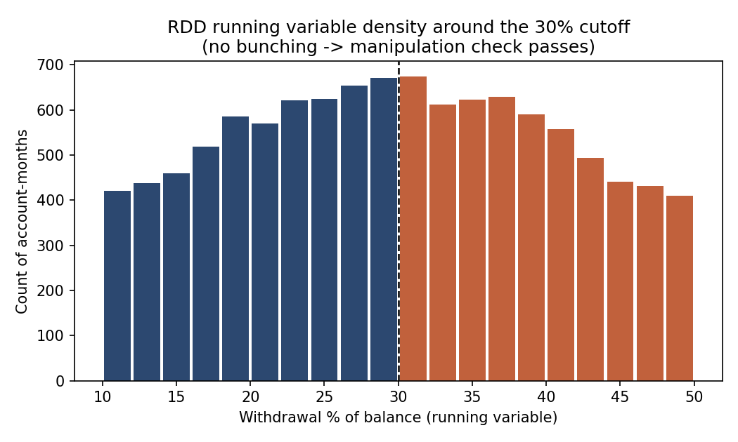
RDD — DESIGN & VALIDATION
The identifying assumption: the running variable isn't manipulated
McCrary-style density test — HV population only
Customers don't know this internal 30% threshold exists, so deliberate dodging isn't the realistic risk — the real risk is any OTHER unknown reason withdrawal size might bunch near 30% (round-number withdrawal habits, an unrelated internal rule). This test checks for that directly instead of just asserting it away.
p = 0.828
Local log-density jump at cutoff (bootstrap test)
No jump in the density at 30% — consistent with a smooth, unmanipulated running variable. (Restricted to HV accounts, the only population RM outreach applies to under the value split.)
7
Notes:
If asked 'why check this at all, customers don't know the 30% rule exists' -- that's exactly right, and it's why I don't expect INTENTIONAL gaming. But the McCrary test isn't only a test for intentional gaming; it's a general smoothness check on the running variable's density, which would also catch unrelated sources of bunching that could bias the comparison even without anyone trying to dodge OUR rule specifically. It's also the standard, expected validation step for any RDD -- skipping it is what would actually raise questions. Restricting to HV accounts here matters for external validity too: this estimate speaks to the HV population it was tested on, not a claim about how RM outreach would work on LV accounts.

Slide 8
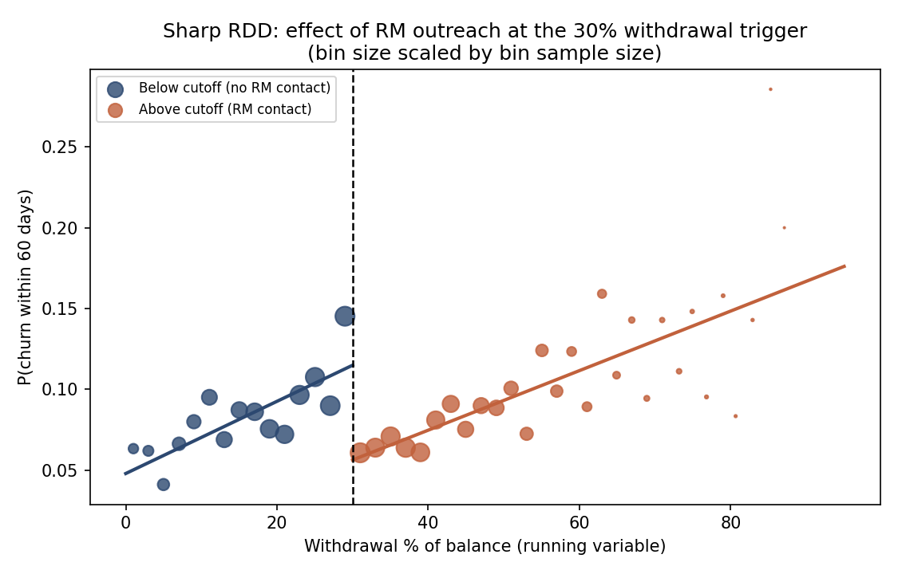
RDD — RESULT
RM outreach cuts 60-day churn by ~8 points at the margin
-0.2 pp
Naive treated-vs-control (biased by confound)
-8.3 pp
RDD robust estimate · 95% CI [-12.3, -4.3] · p<0.001
Bandwidth sensitivity: stable in the high single digits across h = 4 to 20 months. Graded against the effect I built into the simulation: RDD lands within 1.3pp of the true local value near the cutoff — the naive comparison, near zero, doesn't come close.
8
Notes:
The naive comparison looks almost nothing like the true effect because bigger withdrawals were already higher-risk before any outreach -- that confound roughly cancels out the real negative effect of the call. RDD isolates it by comparing only the narrow window right around the cutoff, where the confound is approximately constant on both sides.

Slide 9
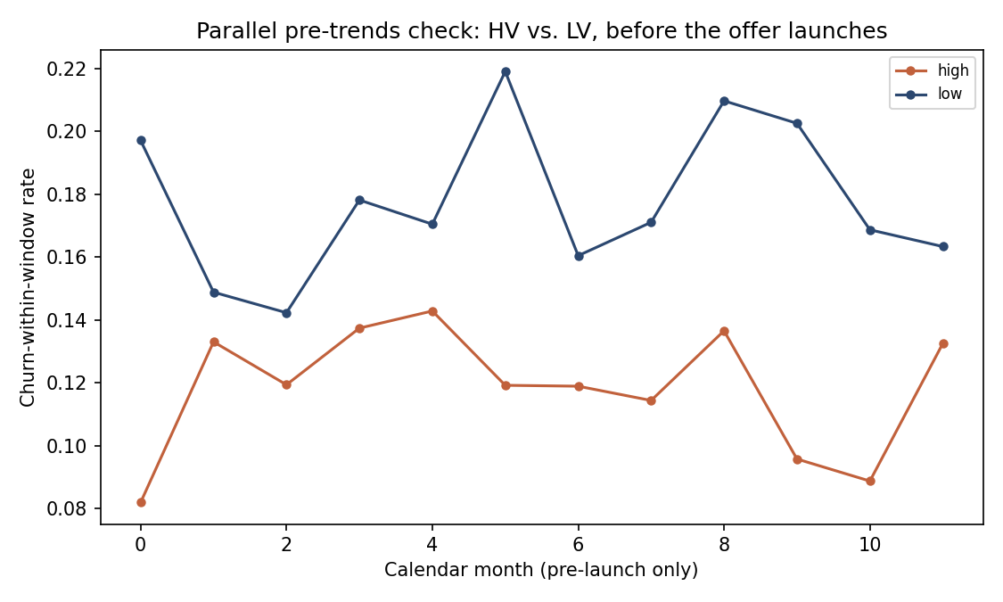
DID — DESIGN & VALIDATION
One launch date, one treated group — parallel pre-trends is the assumption to check
Parallel pre-trends check
HV and LV accounts differ in baseline churn LEVEL (HV churns less overall regardless of any offer) — DiD doesn't need them equal, it needs them moving in the same DIRECTION before the offer launches. That's what this checks, restricted to the pre-launch months only.
p = 0.633
F-test on value-group × month interaction, pre-launch only
No evidence of differential pre-trends. Because there's exactly one treated group and one launch date, this design also sidesteps the staggered-adoption bias (Goodman-Bacon 2021) that a multi-wave rollout would introduce — there's no already-treated cohort to contaminate the comparison.
9
Notes:
The offer launches for the whole HV group on ONE calendar month, and LV never gets it in-window -- a plain 2-group, single-adoption-date design, deliberately simpler than a multi-wave rollout. That's a design choice worth being able to defend if asked 'why not stagger it': staggering by tier would have introduced exactly the kind of already-treated-cohort contamination Goodman-Bacon (2021) warns about, and there's no operational reason (RM capacity, say) that requires phasing HERE the way there was for the withdrawal trigger's RM contacts -- an offer code can go out to everyone at once.

Slide 10
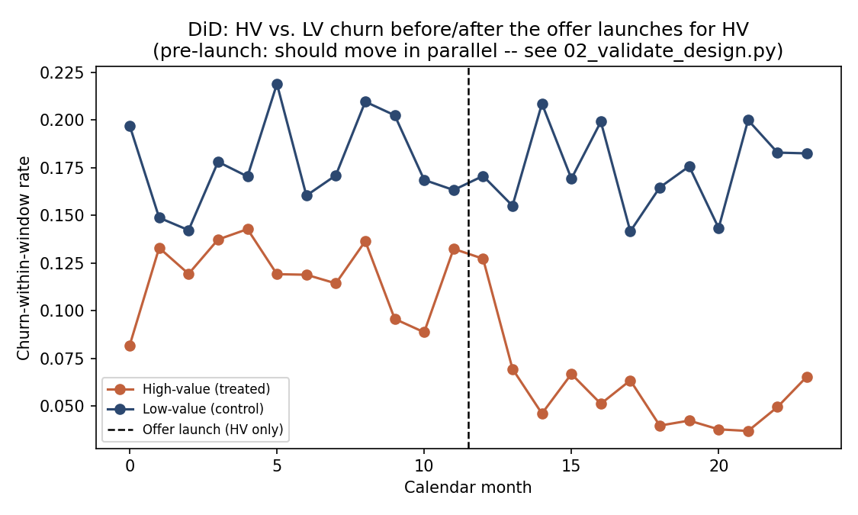
DID — RESULT
The textbook 2x2 estimator — and the regression that reproduces it
-5.8 pp
2x2 DiD: (HV change) − (LV change)
-5.8 pp
Regression DiD, HC1 robust SE · p<0.001
HV: 11.9% → 5.8% churn (change -6.1pp). LV: 17.8% → 17.5% (change -0.3pp). The regression coefficient matches the four-group-means number almost exactly, as it should with one treated group and one adoption date — no cohort-averaging step for the two to disagree on. The effect ramps in over roughly 3 months as awareness and take-up build; graded against the true simulated effect (-5.1pp), both estimators land within a point.
10
Notes:
This is deliberately the most 'textbook' estimator in the deck, and I say so if asked: with a clean 2-group, single-adoption-date design, there's no staggered-rollout machinery needed -- the four-group-means differencing and the fixed-effects regression are two ways of computing the SAME number, which is itself a good sanity check to show working. If this were a multi-wave rollout instead, I'd reach for a clean-control / stacked estimator or the real Callaway-Sant'Anna package -- worth knowing when you'd need that extra machinery and when you wouldn't.

Slide 11
LAYER 2 (CONT.) — DORMANT PLAYS: NO NATURAL DESIGN, SO BUILD ONE IN
A small randomized holdout, inside each value tier
THE DESIGN
RANDOMIZATION-BALANCE CHECK ("TABLE 1")
HV tier: 90% get a 90-day, 5%-cashback-on-grocery-spend offer; 10% randomly held out (no offer)
LV tier: 90% get an SMS/email reminder; 10% randomly held out
The two tiers are NEVER pooled — HV and LV differ on both risk level and which offer they get, so mixing them would confound "which offer works" with "which tier is lower-risk"
Randomization within tier — not the ops team's judgment — decides who's held out, so treated vs. holdout is a clean comparison by construction
Before trusting the comparison, check that randomization actually balanced the two arms on observed covariates — engagement score, dormancy streak, product count, tenure, balance — within each tier, BEFORE any offer went out.
0 / 10
Covariate balance tests flagged at p≤0.05 (both tiers, 5 covariates each)
This is the standard "Table 1" any RCT write-up would run — the randomized-holdout design earns its high-confidence label because this is directly testable, unlike the observational method it replaces.
11
Notes:
This trigger used to have NO exploitable design at all -- an ops team just decided who to call, based on a mix of signals, which is exactly a selection-on-observables problem an earlier version of this project handled with DoubleML. The redesign here is deliberate: rather than reach for a heavier observational estimator, build the missing randomization directly into the rollout -- a small (10%) holdout is cheap, doesn't meaningfully change who gets helped, and converts an untestable identifying assumption into a directly-testable one. The balance check is what proves the randomization actually worked, not just that it was intended to.

Slide 12
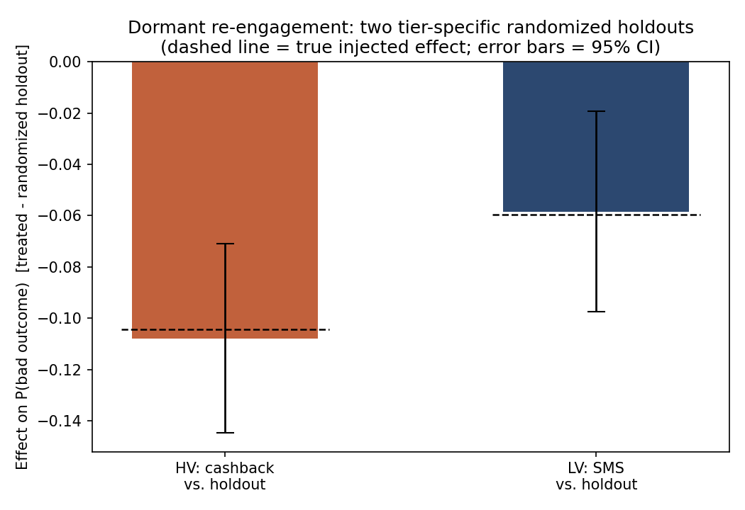
DORMANT RCT — RESULT
Two tier-specific tests — both correctly signed, both statistically decisive
-10.8 pp
HV: cashback vs. holdout · 95% CI [-14.5, -7.1] · p<0.001 · true effect -10.4pp
-5.8 pp
LV: SMS vs. holdout · 95% CI [-9.8, -1.9] · p=0.002 · true effect -6.0pp
Both estimates land within half a point of the true simulated effect. The HV cashback play has both the larger effect AND the larger sample — it turns out to be the single largest driver of value in the optimizer's allocation (see Optimize).
12
Notes:
Note the two tiers are never pooled -- each has its own two-proportion z-test against its own holdout. The LV test has a visibly wider CI and a less extreme z (bring up the backup slide's design-effect table if asked why a 90/10 split still has enough power here -- short answer: it's the ABSOLUTE size of the smaller arm, ~600 accounts, not its SHARE, that sets the precision floor, and 600 is enough to detect an effect this size). If asked why ATT-style framing isn't needed here the way it was for the old DoubleML version: randomization already IS the comparison being asked for -- there's no separate 'effect on the treated' vs. population question when treatment assignment was randomized within the exact population being measured.

Slide 13
LAYER 3 — OPTIMIZE
From “top 50% by value” to a formal budget allocation
OBJECTIVE
EFFECT SIZES FEEDING THE OPTIMIZER (ALL HIGH-CONFIDENCE)
Maximize total net expected value protected:
P(churn mode) × causal effect (pp) × dollars at risk − intervention cost, summed across every account-intervention pair selected.
Large withdrawal → RM call (HV)
8.3 pp
DD stop → $100 offer (HV)
5.8 pp
Dormant → cashback (HV)
10.8 pp
CONSTRAINTS (3)
Dormant → SMS (LV)
5.8 pp
Total spend ≤ monthly retention budget
RM contacts ≤ RM capacity (the real scarce resource for the withdrawal play)
At most one intervention per account — plus each account is only a candidate for the interventions its tier is actually eligible for (cashback: HV only; SMS: LV only)
WHEN THIS APPROACH DOES / DOESN'T APPLY
Fits: a handful of discrete, mutually-exclusive interventions with known effect sizes and hard resource caps — exactly this shape. Wouldn't fit: continuous decisions (how MUCH to offer, not just whether), interventions with interaction effects between accounts, or effect sizes too uncertain to plug into a point-estimate objective without first running a sensitivity/robustness check.
13
Notes:
This is a multiple-choice knapsack problem, solved with PuLP (CBC solver): each account can get at most one intervention, subject to a total budget and a separate RM-capacity constraint, since RM time -- not dollars -- is actually the binding resource for the withdrawal play. Every effect size here now comes from a design-based estimate with a checked identifying assumption -- RDD's no-manipulation test, DiD's pre-trends test, and the dormant RCT's balance check -- so, unlike an earlier version of this project, there's no separate lower-confidence tier to flag in the objective. If asked when NOT to reach for an ILP: when the decision isn't actually discrete (e.g. setting a continuous discount rate), or when the input effect sizes themselves are too uncertain to trust as point estimates -- you'd want a robust/ distributionally-aware formulation first, not a plain linear objective.

Slide 14
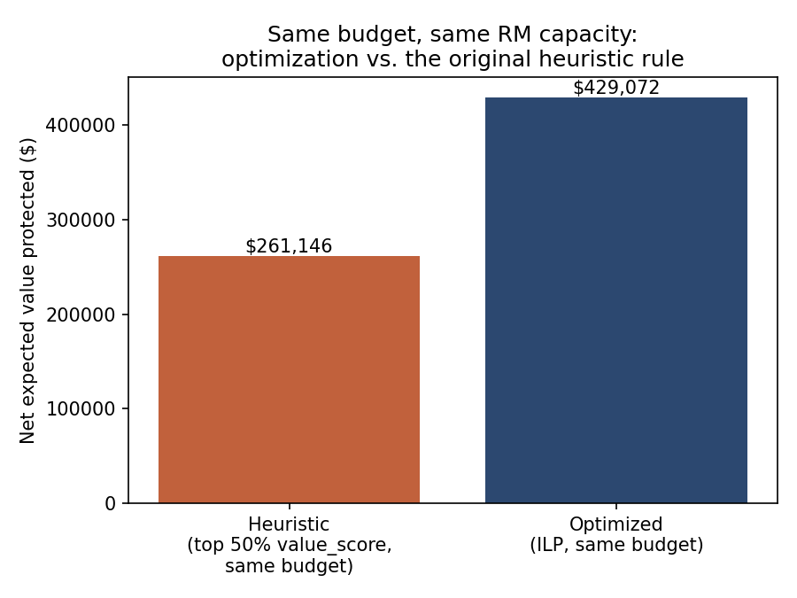
OPTIMIZE — RESULT
Same budget, same RM capacity: ~64% more value protected
+64.3%
Net value protected vs. the heuristic, at equal budget & RM capacity
193 / 400
RM contacts used — the optimizer stops once marginal expected value turns negative, not when capacity runs out
The heuristic doesn't discriminate by risk LEVEL within the top-50%-value pool, and it has no notion of an RM-capacity limit at all (uncapped, it actually overspends both budget and RM capacity on its own). The optimizer ranks by expected payoff per dollar and per RM-minute directly, and is disciplined enough to leave budget and capacity on the table rather than fund a marginal account that isn't worth it.
14
Notes:
Walk through this carefully: the heuristic, run without any cap, overspends both the budget and the RM capacity on its own -- that's itself a finding worth surfacing to the business, since it means the original process needed an unwritten manual cap that the optimization now formalizes. The dormant cashback play alone accounts for the majority of the optimizer's total net value ($364k of $429k) -- worth calling out since it's also the play with the most causal-identification headroom gained in this redesign.

Slide 15
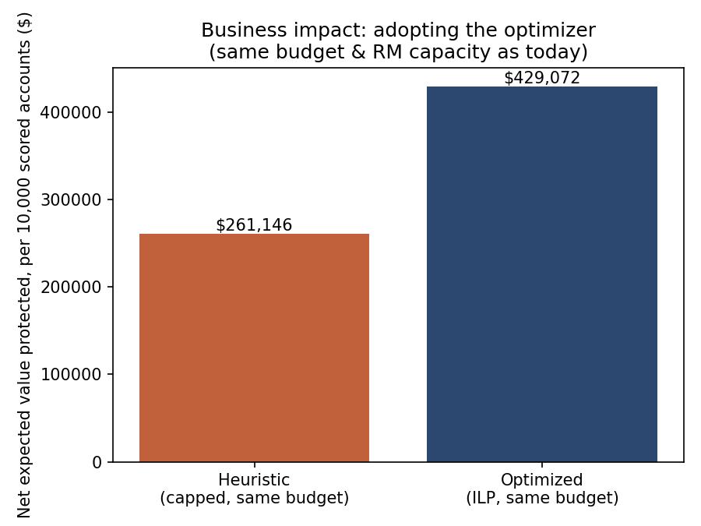
SO WHAT — BUSINESS IMPACT
Translating the model into a dollar figure a stakeholder can act on
+$167,927
Incremental net value protected, per 10,000 scored accounts (+64.3%)
Deliberately NOT scaled to a fabricated "total accounts at the bank" number — this project's data is a sized demo, not the real book. Reported per 10,000 scored accounts with an explicit scaling instruction instead: multiply by (your real scored-account count / 10,000). The mechanism — same spend, better targeting — scales linearly with book size, unlike a one-time fixed-cost project.
98.2% / 98.3%
Top-value-quartile membership overlap if the 15% product-value-uplift assumption were 10% / 20% instead — the specific number isn't load-bearing for who gets prioritized
15
Notes:
This slide is the direct answer to 'so what' -- it's also where I address the weight-formula criticism head on. Rather than asserting the 15% product-value-uplift number is right, I show it doesn't matter much: ranking is nearly identical (Spearman ~0.999) whether it's 10%, 15%, or 20%, and over 98% of the accounts that get prioritized stay prioritized either way. That's the concrete, defensible answer to 'how did you pick that weight' -- I picked a reasonable one and then proved the conclusion doesn't hinge on it.

Slide 16
SO WHAT — RECOMMENDATIONS
Four actions — all built on high-confidence, design-based evidence
1
Adopt the ILP optimizer in place of the informal "top 50% by value" rule.
CONFIDENCE
High — mechanical improvement on already-validated inputs, not a new causal claim.
2
Formalize the 30%-withdrawal → RM-outreach trigger as an explicit, monitored policy.
CONFIDENCE
High — RDD, no-manipulation assumption directly tested.
3
Scale both dormant plays (HV cashback, LV SMS) to the full flagged population — no longer a pilot-first recommendation.
CONFIDENCE
High — randomized within-tier holdout, balance checked.
4
Don't evaluate the DD-stop offer's rollout before month 3 the effect ramps in as awareness/take-up build.
CONFIDENCE
High — DiD, parallel pre-trends directly tested.
Every effect size behind these four is now design-based and high-confidence — the redesign's point wasn't to make one number bigger, it was to close the identification gap the old observational dormant estimate carried. Priority here follows practical sequencing (adopt the mechanical win first, then the largest-impact scaled plays), not a confidence hierarchy — that gap no longer exists.
16
Notes:
This is the deliverable a Decision Analytics stakeholder actually wants. Point out explicitly, if not asked, that recommendation 3 moved from 'don't scale on this alone, pilot first' in an earlier version of this project to 'scale it, it's high-confidence now' -- that shift is the direct, concrete payoff of redesigning the dormant play as a randomized holdout instead of an observational estimate. I want to be the one pointing out that shift, not waiting to be asked why it changed.

Slide 17
RESULT — TYING IT BACK
The real project already worked. This is the engine underneath it, made rigorous.
WHAT ACTUALLY HAPPENED
WHAT THIS ENGINE ADDS
-30%
Per-trigger causal identification, including for the one trigger a blanket A/B test never isolates on its own
A formal, re-runnable optimization instead of a fixed value-score cutoff — it flexes with budget
A quantified, confidence-labeled business case instead of a technical result that stops at the model
Every method graded against a known ground truth before I'd trust it on a real decision
Relative churn reduction, randomized A/B test vs. blanket outreach
Validated the only way we had time and buy-in to validate: an outcomes-based A/B test on the overall trigger-and-outreach program. That's a real, defensible result — and it's also the limit of what we did at the time.
17
Notes:
This slide is the bridge back to the STAR story: the real result stands on its own, and everything in this deck is presented as the analytical engine underneath that kind of program — the part the original A/B test alone couldn't show, not a replacement for what actually happened.

Slide 18
LIMITATIONS — AND WHY THIS ROLE
What I'd still want before this touches production
Every estimate is scoped to the population it was tested on
RDD and the DiD offer are HV-only; the cashback play is HV-only and SMS is LV-only. None of these effect sizes should be assumed to generalize across tiers without testing there directly — extrapolating the cashback effect to LV accounts, for instance, would not be valid.
No formal independent model-risk validation
Today's validation is design-based (McCrary, pre-trends, randomization balance) and, here, grading against a KNOWN synthetic truth — a real deployment needs an independent conceptual-soundness review per SR 11-7.
Synthetic data throughout
Built specifically so I could validate method correctness with a known ground truth — real deployment validates differently, without that luxury, and needs its own live monitoring for effect decay over time.
That gap between “validated by outcome” and “validated by design, before launch” is exactly what draws me to this role — building the analytical engine where that rigor is the default, not a stretch goal.
18
Notes:
This slide is deliberate honesty, matching how I handled similar gap questions in the real project's prep -- own the gap, and turn it into the motivation for the role rather than hiding it. The external-validity point is the one I'd expect an interviewer with a stats background to probe hardest -- it's a genuine limitation of doing everything through one shared HV/LV split rather than testing every combination.

Slide 19
Thank you
Predict → Explain (causally) → Optimize → Act — one decision engine, four layers of rigor.
Questions welcome.
Notes:
Invite questions; have the bandwidth-sensitivity numbers, the 2x2 DiD table, and the appendix SE→z→power backup slide ready if asked to go deeper.

Slide 20
APPENDIX — BACKUP, IN CASE ASKED
Why a 90/10 holdout still has enough power to detect the effect
THE FORMULAS
WORKED EXAMPLE — LV TIER (SMS), FIXED TOTAL n=6,000
SE (pooled, for the test): √[ p̄(1−p̄)(1/n₁ + 1/n₂) ]
z = (p₁ − p₂) / SE
Power ≈ Φ(|z| − z꜀ᵣᵢₜ), z꜀ᵣᵢₜ = 1.96 for a two-sided α=0.05
Design effect (fixed total n, unequal split): 1 / [4·r·(1−r)], r = treated-arm share
treated share r
n treated
n holdout
SE
z
power
0.50
3,000
3,000
0.0115
-5.07
~1.00
0.70
4,200
1,800
0.0126
-4.64
~1.00
0.80
4,800
1,200
0.0144
-4.05
0.98
0.90*
5,400
600
0.0192
-3.04
0.86
0.95
5,700
300
0.0264
-2.21
0.60
At r=0.5 the design effect is exactly 1 (no penalty). At r=0.9 (this project's actual split), it's 1/(4·0.9·0.1) = 2.78× the variance a 50/50 split of the SAME total n would have had — worse, but only ~1.67× the SE (√2.78), not a 10x disaster. It's the ABSOLUTE size of the smaller arm (~600 accounts here), not its SHARE, that ultimately sets the precision floor.
* actual design. Holding total n and the OBSERVED effect fixed, power stays reasonable (~0.86) at the actual 90/10 split — the point of running this table is to show that choice was checked, not assumed.
20
Notes:
Only bring this slide up if asked to defend the 90/10 split, or asked to derive SE/z/power by hand. The HV tier's own table (not shown) looks even more comfortable since its effect size is larger; LV/SMS is the more conservative case worth having ready. This is the same SE→z→power chain used to originally size the real project's A/B test allocation -- reused here to check the holdout fraction, not just to size a test from scratch.

