Slide 1
UPLIFT MODELING
Targeting the Persuadables:
The X-Learner Approach
From two outcome models to a single ranked uplift score — how it's built, why X-Learner over S/T-Learner, and how it's validated.
Credit Card Prescreen Targeting · Methodology Walkthrough · Synthetic-Data Demo

Slide 2
ROADMAP
What We'll Walk Through
01
Why an uplift model
Response models waste budget on people who'd act anyway — uplift targets who the offer actually changes.
02
Three ways to estimate it
S-Learner, T-Learner, X-Learner — what each one does, and why X-Learner wins here.
03
X-Learner, layer by layer
Two outcome models → pseudo effects → two effect models → weighted fusion, with a worked numeric example.
04
Validation & business impact
Qini curve, a ground-truth check only synthetic data allows, and what it means for targeting decisions.
Uplift Modeling — X-Learner Deep Dive
2

Slide 3
THE CORE IDEA
Not “Who Responds” — “Who Responds Because of Us”
A response model predicts who's likely to respond — but that includes people who'd apply on the existing offer anyway. An uplift model predicts the incremental effect of switching someone to the new offer, so targeting can focus on the one segment where the new offer actually changes the outcome.
Persuadables
Sure Things
Apply only with the new offer (Y=1 under T=1, Y=0 under T=0) — switching the offer changes their decision. This is the target segment.
Apply on either offer (Y=1 regardless of T). Giving them the new offer is wasted — the old one would've worked too.
τ(x) = P(Y=1 | X=x, T=1) − P(Y=1 | X=x, T=0)
In our prescreen example: Y (our Applied column) = 1 if the customer applies for the credit card, 0 if not. T (our new_offer column) = 1 if they received the new offer variant (treatment), 0 if they received the existing offer (control) — everyone gets an offer, this is old vs. new.
Lost Causes
Sleeping Dogs
τ(x) — our uplift score — is the treatment effect we're trying to estimate, not the raw response probability.
Never apply, old or new offer (Y=0 regardless of T). Nothing to gain.
Apply LESS often with the new offer than they would have with the old one — the new offer backfires.
Uplift Modeling — X-Learner Deep Dive
3

Slide 4
ESTIMATION STRATEGIES
Three Ways to Estimate an Uplift Score
1
2
3
Used here
S-Learner
T-Learner
X-Learner
SINGLE MODEL
TWO MODELS
CROSS-LEARNING
One model, new_offer (old vs. new offer, 1/0) as just another input feature. τ(x) = f(x,1) − f(x,0) — our uplift score — where 1/0 flips which offer they got.
Two fully separate outcome models, one per arm. τ(x) = μ̂₁(x) − μ̂₀(x), where μ̂₁ is the new-offer outcome model and μ̂₀ is the old-offer (control) outcome model.
Two outcome models feed two effect models, combined by a weight g(x). Same Applied and new_offer columns as above.
Uplift Modeling — X-Learner Deep Dive
4

Slide 5
ESTIMATOR 1 OF 3
S-Learner, In Our Prescreen Example
TRAIN pooled — ONE model, ONE fit() call
SCORE one model, run for BOTH offer scenarios on customer G
Customer | new_offer | Applied
A | 0 | 0
B | 0 | 1
C | 0 | 0
D | 1 | 1
E | 1 | 0
F | 1 | 1
Customer | new_offer
G | 1
→
Applied
0.42
Customer | new_offer
G | 0
→
Applied
0.31
τ(G) = f(G,1) − f(G,0) = 0.42 − 0.31 = 0.11
+ Pros
− Cons
One model to build and monitor. Pools all customers, so it's data-efficient even with a small treatment group.
Regularization has no reason to favor one new_offer feature over dozens of stronger predictors — the offer signal can get nearly ignored.
Why not chosen: baseline behavioral features — utilization, tenure, balances — predict response far better than which offer they got. A pooled model leans on those and treats new_offer as noise, exactly the risk we can't take when isolating the new offer's effect is the whole point.
Uplift Modeling — X-Learner Deep Dive
5

Slide 6
ESTIMATOR 2 OF 3
T-Learner, In Our Prescreen Example
TRAIN two separate models, TWO fit() calls
SCORE each model scores customer G under ITS OWN scenario
Control (A,B,C) → μ̂₀ model
Treatment (D,E,F) → μ̂₁ model
Customer | model
G | μ̂₀
→
Applied
0.19
Customer | Applied
A | 0
B | 1
C | 0
Customer | Applied
D | 1
E | 0
F | 1
Customer | model
G | μ̂₁
→
Applied
0.35
τ(G) = μ̂₁(G) − μ̂₀(G) = 0.35 − 0.19 = 0.16
+ Pros
− Cons
Each model specializes freely — no shared regularization fighting over the treatment signal. Simplest to reason about: “model B minus model A.”
Quality depends on how well each arm is estimated alone. A small arm's model is noisy, and subtracting two noisy predictions adds their variances.
Why not chosen: T-Learner isn't broken by design — if new_offer were roughly 50/50, μ̂₀ and μ̂₁ would train on comparable sample sizes and subtracting two similarly-precise models wouldn't cost much. The problem is our specific setup: about 70% of customers stay on the existing offer (control) and only ~30% are rolled out to the new offer (treatment) — a deliberately smaller test slice to limit risk before scaling a new offer design. That imbalance starves μ̂₁, the new-offer-side model, exactly where T-Learner needs it most: τ(x)=μ̂₁(x)−μ̂₀(x) inherits nearly all of μ̂₁'s extra noise. Closing that gap without needing a bigger treatment group is the reason X-Learner exists.
Uplift Modeling — X-Learner Deep Dive
6

Slide 7
ESTIMATOR 2 OF 3 · MECHANISM
Why Imbalance Breaks the Subtraction
Notation: μ̂₀(x), μ̂₁(x) = the two outcome models — predicted P(Applied) under the old offer vs. the new offer. τ(x) = μ̂₁(x) − μ̂₀(x) = the uplift score we're estimating. n₀, n₁ = how many customers trained each model (sample size). Var(·) = how noisy a model's predictions are — it shrinks as n grows.
Var(τ̂) = Var(μ̂₀) + Var(μ̂₁)
Two independently-fit models ⇒ subtracting them doesn't cancel their errors, it adds them. And a model's variance shrinks as its training sample n grows — fewer rows means a noisier model.
✓ If new_offer Were 50/50
✗ Our Real Setup — Old Offer ≈70% / New Offer ≈30%
n₀ ≈ n₁ — both models see plenty of data. Var(μ̂₀) ≈ Var(μ̂₁) — both reasonably precise. Var(τ̂) = small + small — still small. → T-Learner's subtraction is safe.
n₁ (treatment) is small — μ̂₁ trains on few rows. Var(μ̂₁) is large — μ̂₁ is noisy. Var(τ̂) = small + LARGE — dominated by μ̂₁. → every τ(x) inherits μ̂₁'s noise.
So what does X-Learner actually fix? Not a better model for the small arm — it stops asking μ̂₁ to predict outcomes for everyone. For each new-offer customer it uses their own real, observed Applied outcome, and only needs μ̂₀ (the reliable, large-sample old-offer model) to estimate what would've happened under the old offer instead. The minority arm's job shrinks from “run a whole noisy model on every customer” down to “fit one more regression on a small-but-real dataset.” Next: how that actually works, layer by layer.
Uplift Modeling — X-Learner Deep Dive
7

Slide 8
THE DECISION
Why X-Learner, Specifically
 | S-Learner | T-Learner | X-Learner
How effect is estimated | Implicit — read off one shared model's new_offer term | Difference of two independently-fit models | Directly regresses on an imputed treatment effect
Best when | Treatment effect is a strong, easily separable signal | Treatment / control groups are large and balanced | Groups are imbalanced — e.g. a small treatment group
Main risk | Regularization can shrink the treatment signal toward zero | Minority-arm model is noisy; errors compound on subtraction | More moving parts — more places to get cross-fitting wrong
Our real constraint: about 70% of customers stay on the existing offer (control) and only ~30% are rolled out to the new offer (treatment) — a deliberately smaller test slice to limit risk before scaling a new offer design. That's exactly T-Learner's weak point: μ̂₁, the new-offer-side model, is trained on the smaller group and is noisy. X-Learner's imputation step lets the new-offer-side effect estimate borrow strength from the reliable, well-estimated existing-offer-side model instead.
Uplift Modeling — X-Learner Deep Dive
8

Slide 9
ARCHITECTURE
X-Learner, End to End
1
2
3
4
Outcome Models
Pseudo Effects
Effect Models
Weighted Fusion
→
→
→
μ̂₀(x), μ̂₁(x) — one per arm, trained separately
Counterfactual predictions turn Applied into an imputed effect
τC(x), τT(x) — regressors on the imputed effect
g(x) blends the two into one uplift score τ(x)
Layers 1–3 are model training. Layer 4 happens at scoring time, for every customer.
Uplift Modeling — X-Learner Deep Dive
9

Slide 10
LAYER 1 OF 4
Two Outcome Models
Control outcome model learns μ̂₀(x) = E[Y(0) | X=x] — trained only on customers who stayed on the existing offer (control). Treatment outcome model learns μ̂₁(x) = E[Y(1) | X=x] — trained only on customers who got the new offer (treatment). (Y = 1 if they applied for the card, 0 if not.)
Both models are trained with out-of-fold / cross-fitted predictions — never a model scoring its own training rows. That avoids leakage later.
TRAIN each outcome model fit ONLY on its own arm
Control (A,B,C) → μ̂₀ model
Treatment (D,E,F) → μ̂₁ model
Customer | Applied
A | 0
B | 1
C | 0
Customer | Applied
D | 1
E | 0
F | 1
SCORE each model only scores the OTHER arm — its own arm's real outcome is already observed, no prediction needed
μ̂₀ scores the TREATMENT arm (D,E,F) — counterfactual: old offer
μ̂₁ scores the CONTROL arm (A,B,C) — counterfactual: new offer
Cust. | new_offer | Applied | μ̂₀(x)
D | 1 (new) | 1 | 0.35
E | 1 (new) | 0 | 0.25
F | 1 (new) | 1 | 0.50
Cust. | new_offer | Applied | μ̂₁(x)
A | 0 (old) | 0 | 0.55
B | 0 (old) | 1 | 0.75
C | 0 (old) | 0 | 0.30
Neither model ever scores its own training arm — A, B, C already have a real Applied outcome (they never needed μ̂₀'s guess), and D, E, F already have theirs (they never needed μ̂₁'s guess). Only the counterfactual — the arm each model never saw — gets predicted.
Uplift Modeling — X-Learner Deep Dive
10

Slide 11
LAYER 2 OF 4
Constructing Two Pseudo Effects
X-Learner doesn't use μ̂₁ − μ̂₀ directly — it first imputes each unit's likely effect using the OTHER arm's model as counterfactual. (Applied = 1 if the customer applied for the card, 0 if not.)
D̃ᵢᶜ = μ̂₁(Xᵢ) − Appliedᵢ
D̃ᵢᵀ = Appliedᵢ − μ̂₀(Xᵢ)
Control-side pseudo effect · from A, B, C
Treatment-side pseudo effect · from D, E, F
Cust. | μ̂₁(x) | Applied | D̃ᶜ
A | 0.55 | 0 | 0.55
B | 0.75 | 1 | −0.25
C | 0.30 | 0 | 0.30
Cust. | Applied | μ̂₀(x) | D̃ᵀ
D | 1 | 0.35 | 0.65
E | 0 | 0.25 | −0.25
F | 1 | 0.50 | 0.50
Why this beats a raw μ̂₁ − μ̂₀: for a new-offer customer we don't need a model to guess their outcome — we use their own real, observed Applied value, and only borrow μ̂₀ (fit on the large old-offer group) to estimate what would've happened had they stayed on the old offer instead. The minority (treatment) arm no longer needs a full noisy model of its own — just one more regression on these pseudo effects. These are continuous, signed numbers, not 0/1 labels, and each becomes a training label in Layer 3.
Uplift Modeling — X-Learner Deep Dive
11

Slide 12
A COMMON FOLLOW-UP
Training ≠ Scoring
A frequent interviewer probe: “if A is a control-group customer, does A ever touch the treatment-side model?” Yes and no — at two different stages.
✗ During TRAINING
✓ During SCORING
A is control, so A's real Applied outcome and its counterfactual μ̂₁(A) build a control-side pseudo effect. That label trains effect model C only. A never contributes a label to effect model T's training set.
Once BOTH effect models are trained, they're just functions of X. Effect model T can score A too — it was never told A's outcome, but it doesn't need to have been. A gets both τC(A) and τT(A), fused like everyone else.
Why this matters: it's what makes X-Learner one unified scorer instead of two disconnected ones — every customer, regardless of which arm they were actually in, gets a single fused uplift score at the end.
Uplift Modeling — X-Learner Deep Dive
12

Slide 13
LAYER 3 OF 4
Two Effect Models
τC and τT are regressors fit on the pseudo effects from Layer 2 — unlike μ̂ or D̃, there's no closed-form formula for their output. Each score below is simply what the fitted model returns for a customer.
TRAIN each effect model fit on its own pseudo-effect sample from Layer 2
Control pseudo effects (A,B,C) → trains τC
Treatment pseudo effects (D,E,F) → trains τT
Customer | D̃ᶜ (label)
A | 0.55
B | −0.25
C | 0.30
Customer | D̃ᵀ (label)
D | 0.65
E | −0.25
F | 0.50
SCORE both models score a brand-new customer, G — never in A–F, so this is a genuine out-of-sample prediction
τC(x) scores customer G
τT(x) scores customer G
Customer | τC(x)
G | 0.12
Customer | τT(x)
G | 0.28
What they output: “how big is this customer's incremental effect” — not “how likely are they to respond.” Why two of them: τC(G) = 0.12 and τT(G) = 0.28 are two different estimates of the same customer's uplift, each trained on a different, differently-sized sample — so neither is fully trustworthy alone. Layer 4 decides how much to lean on each.
Uplift Modeling — X-Learner Deep Dive
13

Slide 14
LAYER 4 OF 4
Weighted Fusion
τ(x) = g(x)·τT(x) + (1 − g(x))·τC(x)
g(x) is the propensity score. τC and τT were each built from a different-sized sample with a different kind of noise (previous slide) — neither is fully reliable alone. g(x) is how the model calibrates how much to lean on each, instead of trusting just one arm's estimate.
Worked example, continuing with customer G:
τT(G)
0.28
×
g(G)
0.7
=
0.196
τ(G) =
0.232
τC(G)
0.12
×
1 − g(G)
0.3
=
0.036
final uplift score
0.196 + 0.036 = 0.232 — this single number is what gets ranked, thresholded, and acted on. Everything before this slide exists to produce it responsibly.
Uplift Modeling — X-Learner Deep Dive
14

Slide 15
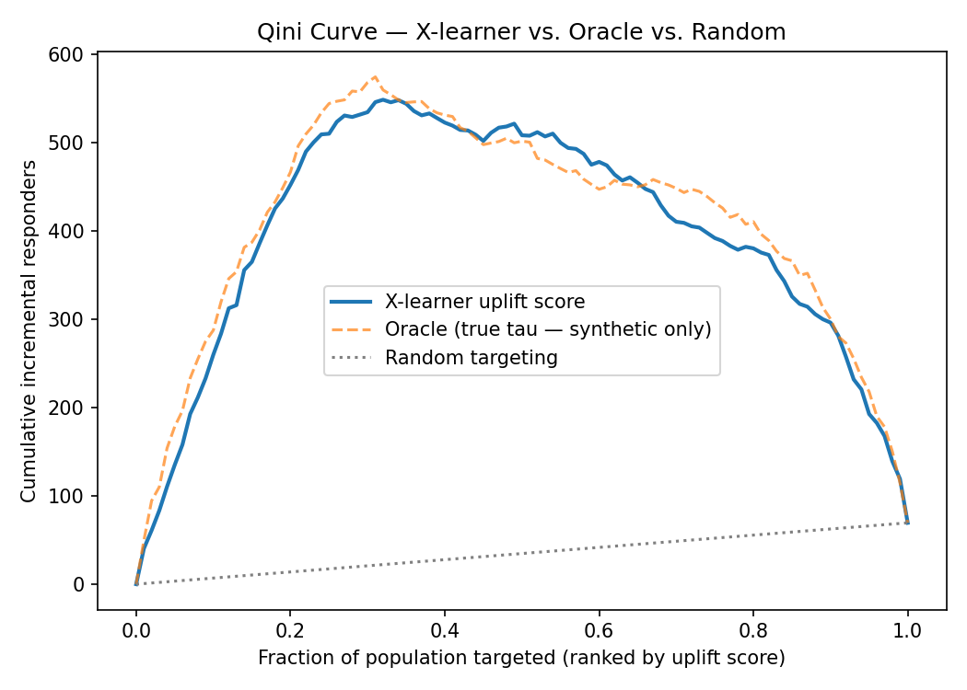
DOES IT ACTUALLY WORK?
Validation, Two Ways
You never observe both outcomes for the same person, so uplift can't be checked row-by-row like a classifier. The standard tool is a Qini curve — rank by score, then compare treated vs. control response as you move down the ranking.
0.93
Spearman correlation between estimated and true uplift — only checkable because this demo uses synthetic data with known ground truth.
96%
of the oracle's achievable Qini gain captured by the X-learner — how close the model gets to the best possible ranking.
+8.5%
incremental response in the top uplift decile — vs. a population-wide average lift near zero.
Uplift Modeling — X-Learner Deep Dive
15

Slide 16
PUTTING IT TO WORK
From Score to Decision
Customer | Final uplift τ(x) | Action
G | 0.232 | Switch to new offer — first
H | 0.05 | Borderline — only if budget allows
I | −0.02 | Keep old offer — new one likely backfires
THE ARGUMENT FOR UPLIFT MODELING
In the full simulation, switching everyone to the new offer nets an overall incremental lift close to zero — persuadable gains are offset by sleeping-dog losses.
A plain response model — or a simple before/after read — would look at that flat average and conclude the campaign doesn't work.
The final score drives three things: rank the file high-to-low, roll out the new offer down to a budget/capacity cutoff, and treat a low or negative score as a decision to keep that customer on the old offer — not just a low priority.
Uplift modeling reveals the real, exploitable heterogeneity hiding underneath that flat average.
Uplift Modeling — X-Learner Deep Dive
16

Slide 17
THE ONE-MINUTE ANSWER
If I only get one minute to explain X-Learner
1
Split & train
Split historical data into treatment / control, train one outcome model per arm.
2
Impute effects
For each unit, use the OTHER arm's model as its counterfactual to build a pseudo effect.
3
Learn the effect
Train two regressors directly on those pseudo effects — output is uplift, not a response probability.
4
Fuse & rank
Blend both effect models with propensity weight g(x) into one score; rank and target on it.
This is the estimator family behind a live prescreen campaign that lifted response 20% and cut acquisition cost 16% — this deck and notebook reproduce the method on synthetic data.
Uplift Modeling — X-Learner Deep Dive
17
Notes:
1-minute Chinese answer (verbatim, for rehearsal): X-learner 的流程是这样的： 1. 先把历史实验数据分成 treatment（新 offer）和 control（旧 offer）两组，分别训练两个 outcome model，一个学新 offer 下的结果，一个学旧 offer 下的结果。 2. 然后对每个样本做反事实预测，构造 pseudo effect：对 control 组样本，用 treatment model 预测值减真实结果；对 treatment 组样本，用真实结果减 control model 预测值。构造两类 pseudo effect（control-side pseudo effect, treatment-side pseudo effect）。 3. 接着用这些 pseudo effect 分别训练两个 effect model，effect model C 和 effect model T。它们输出的是连续的 uplift 分数，而不是回复概率。 4. 最后再用一个权重 g(x) 把两个 effect model 的结果融合，得到最终 uplift，用来排序和选人。这样做的好处是，它不只是看谁最可能回复，而是看谁因为换成新 offer 会产生最大的增量响应。 English equivalent: 1. Split historical experiment data into treatment (new offer) and control (old offer), train two outcome models — one for what happens with the new offer, one for the existing offer. 2. For each unit, do a counterfactual prediction to build a pseudo effect: for control units, treatment-model prediction minus actual outcome; for treatment units, actual outcome minus control-model prediction. Two kinds of pseudo effect result. 3. Train two effect models on these pseudo effects. Their output is a continuous uplift score, not a response probability. 4. Finally, blend the two effect models with a weight g(x) into the final uplift score, used for ranking and targeting. The benefit: you're not just looking at who's most likely to respond, but who will produce the biggest incremental response from switching to the new offer.

