Slide 1
Lightweight Coreset Construction for K-means and K-medoids Clustering and Performance Analysis
CPSC-8650 Data Mining Spring 2019
Wenxing Zhang
Ying Cai

Slide 2
Cluster analysis
Cluster analysis is a common technique for statistical data analysis, and is widely used in many fields, such as machine learning, pattern recognition, image analysis, bioinformatics, information retrieval, data compression, etc.
Two partitioning approaches: k-means and k-medoids.
Increased computational cost led by unprecedented increasing dataset size.

Slide 3
Coresets
“Coresets are a proven data summarization approach that can be used to scale clustering problems to massive data sets. Coresets are small, weighted subsets of the original data set such that models trained on the coreset are provably competitive with models trained on the full data set.”
Scalable k-Means Clustering via Lightweight Coresets.
Olivier Bachem, Mario Lucic, Andreas Krause. KDD 2018, August 19-23, 2018, London, United Kingdom.

Slide 4
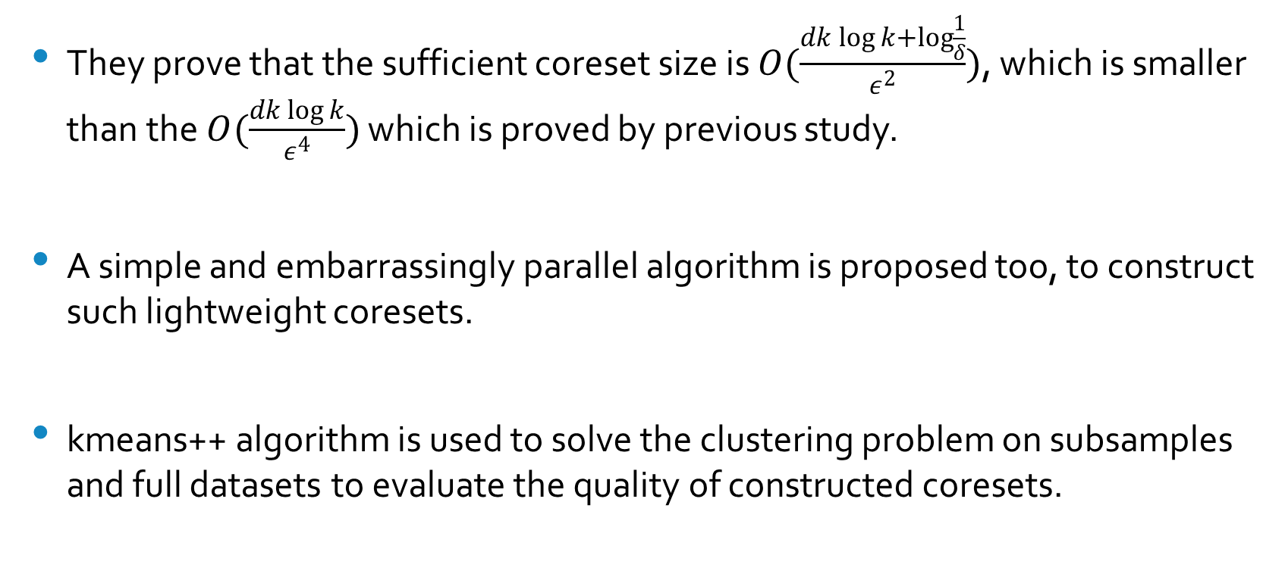
They prove that the sufficient coreset size is $O(\frac{dk\log{k}+\log{\frac{1}{δ}}}{ε^{2}})$, which is smaller than the $O(\frac{dk\log{k}}{ε^{4}})$ which is proved by previous study.
A simple and embarrassingly parallel algorithm is proposed too, to construct such lightweight coresets.
kmeans++ algorithm is used to solve the clustering problem on subsamples and full datasets to evaluate the quality of constructed coresets.

Slide 5
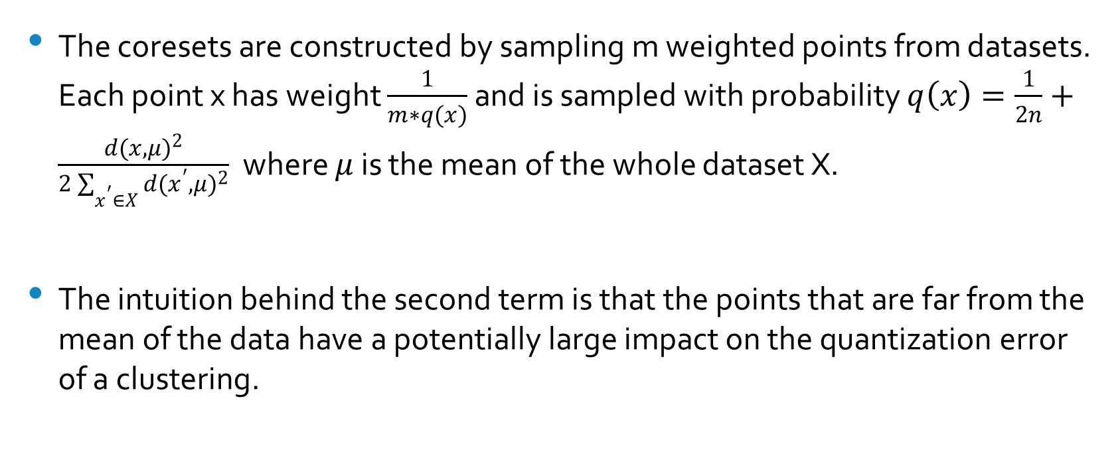
Light Weight Coresets
The coresets are constructed by sampling m weighted points from datasets. Each point x has weight $\frac{1}{m∗q(x)}$ and is sampled with probability $q\left(x\right)=\frac{1}{2n}+\frac{d{(x, μ)}^{2}}{2\sum_{x^{′}∈X}{{d(x^{′},μ)}^{2}}}$ where $μ$ is the mean of the whole dataset X.
The intuition behind the second term is that the points that are far from the mean of the data have a potentially large impact on the quantization error of a clustering.

Slide 6
Light Weight Coresets

Slide 7
CS and Uniform
Uniform sampling: uniformly subsampling the data points at random.
CS: use importance sampling.
Data points with a potentially high impact on the objective are sampled more frequently but assigned with lower weights.
The impact of a data point is measured by the maximum ratio between its cost contribution and the average contribution of all points.
Need to find a rough approximation of the optimal clustering. This can be achieved by sampling the 1st cluster uniformly at random then iteratively sampling additional points with probability proportional to the minimum squared distance to the already sampled cluster centers.

Slide 8
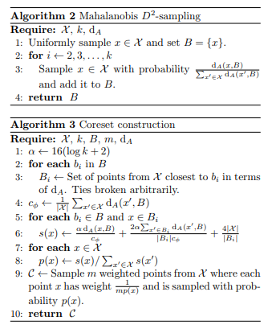

Slide 9
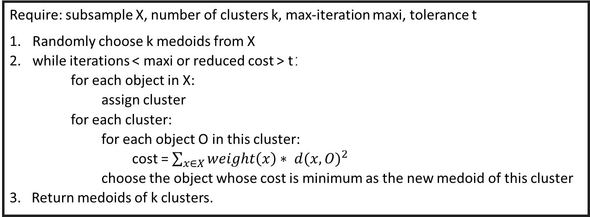
K-means and K-medoids algorithms
kmeans++: python package sklearn/cluster
k-medoids with weight
Require: subsample X, number of clusters k, max-iteration maxi, tolerance t
Randomly choose k medoids from X
while iterations < maxi or reduced cost > t：
for each object in X:
assign cluster
for each cluster:
for each object O in this cluster:
cost = $\sum_{x∈X}{weight\left(x\right)∗ {d(x, O)}^{2}}$
choose the object whose cost is minimum as the new medoid of this cluster
3. Return medoids of k clusters.

Slide 10
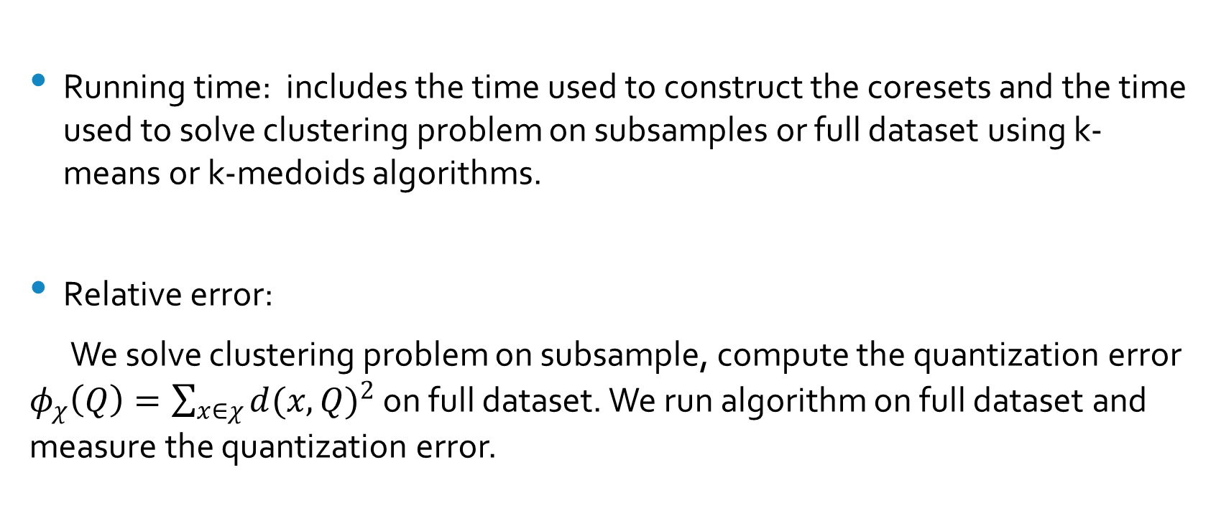
Coresets quality analysis
Running time: includes the time used to construct the coresets and the time used to solve clustering problem on subsamples or full dataset using k-means or k-medoids algorithms.
Relative error:
We solve clustering problem on subsample, compute the quantization error $φ_{χ}\left(Q\right)=\sum_{x∈χ}{{d(x, Q)}^{2}}$ on full dataset. We run algorithm on full dataset and measure the quantization error.

Slide 11
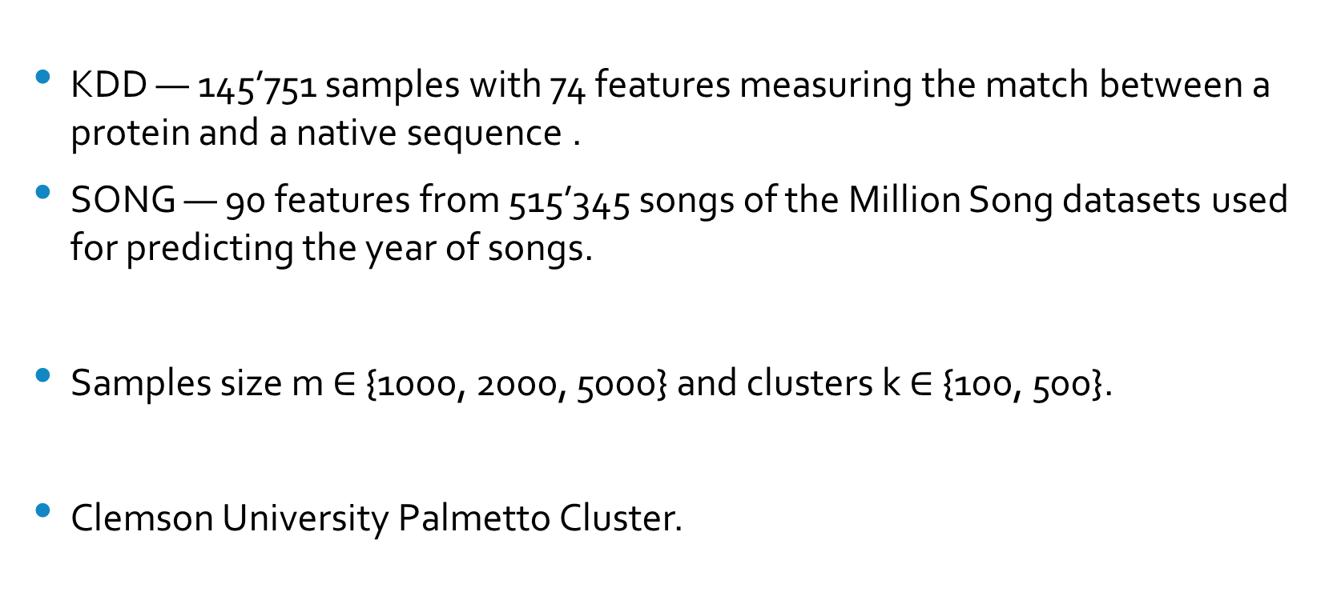
Datasets, Experimental setup and Environment
KDD — 145’751 samples with 74 features measuring the match between a protein and a native sequence .
SONG — 90 features from 515’345 songs of the Million Song datasets used for predicting the year of songs.
Samples size m $∈$ {1000, 2000, 5000} and clusters k $∈$ {100, 500}.
Clemson University Palmetto Cluster.

Slide 12
Results
Relative error and speedup of different methods vs. Full for K-means
 |  |  | Relative error vs. Full |  |  | Speedup vs. Full
k | Data | Method | m = 1000 | m = 2000 | m = 5000 | m = 1000 | m = 2000 | m = 5000
100 | KDD | UNIFORM | 1.82(1.38) | 1.13(1.02) | 1.67(0.57) | 555 | 334 | 126
 |  | CS | 0.25(0.14) | 0.14(0.06) | 0.07(0.01) | 0.1 | 0.1 | 0.1
 |  | LWCS | 0.24(0.01) | 0.16(0.01) | 0.09(0.01) | 32 | 32 | 27
 | SONG | UNIFORM | 0.22(0.01) | 0.16(0.01) | 0.10(0.01) | 1921 | 1251 | 484
 |  | LWCS | 0.21(0.009) | 0.16(0.008) | 0.11(0.005) | 30 | 30 | 28
500 | KDD | UNIFORM | 2.72(0.04) | 1.03(1.46) | 0.66(0.81) | 630 | 417 | 169
 |  | LWCS | 0.37(0.01) | 0.30(0.01) | 0.19(0.004) | 121 | 110 | 77
 | SONG | UNIFROM | 0.44(0.02) | 0.32(0.01) | 0.22(0.01) | 516 | 316 | 137
 |  | LWCS | 0.33(0.007) | 0.26(0.005) | 0.20(0.004) | 29 | 28 | 25

Slide 13
Results
Relative error and speedup of different methods vs. Full for K-medoids
 |  |  | Relative error vs. Full |  |  | Speedup vs. Full
k | Data | Method | m = 1000 | m = 2000 | m = 5000 | m = 1000 | m = 2000 | m = 5000
100 | KDD | UNIFORM | 1.48(0.69) | 1.05(0.74) | 0.42(0.55) | 82 | 21 | 6
 |  | LWCS | -0.24(0.01) | -0.25(0.04) | -0.18(0.12) | 22 | 15 | 6
500 | KDD | UNIFORM | 1.40(1.04) | 1.60(0.93) | 0.35(0.55) | 2594 | 1038 | 203
 |  | LWCS | -0.33(0.01) | -0.35(0.01) | -0.35(0.01) | 39 | 23 | 10

Slide 14
Conclusions
The CS method takes a long time to generate the coresets which largely limits its usage in practice. It might still be useful when memory is the bottleneck for performing clustering methods. A potential improvement can be implement CS algorithm in parallel. Due to time limitations, we didn’t do that in this project.
The UNIFORM method provides the best speedup, but its performances depends on different datasets. If a dataset has a small fraction of points that have a large impact on the objective function, the UNIFORM method is likely to perform poorly.
The LWCS gives the best performance in general. It gives noticeable speedup compared with full dataset. And the relative errors are smaller than UNIFORM.

Slide 15
Thank you!

