Slide 1
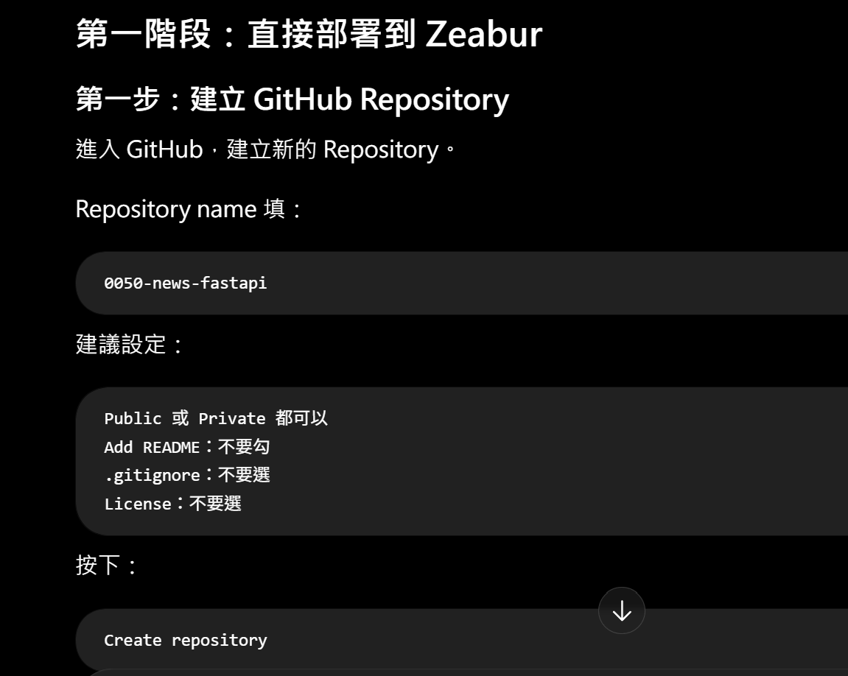

Slide 2
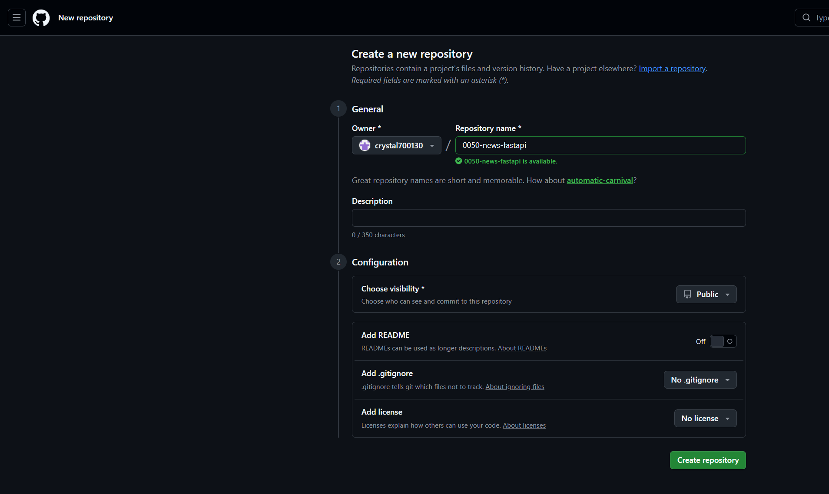

Slide 3
先將如下程式貼至main.txt 記事本，並將附檔名改為.py
建立完main.py 程式後，用VS code 開啟
from typing import Optional
import requests
import trafilatura
from fastapi import FastAPI, HTTPException
from pydantic import BaseModel, HttpUrl
app = FastAPI(
title="0050 News Extraction API",
description="使用 Trafilatura 擷取 0050 相關新聞正文",
version="1.0.0",
)
class ExtractRequest(BaseModel):
url: HttpUrl
class ExtractResponse(BaseModel):
success: bool
url: str
title: Optional[str] = None
author: Optional[str] = None
publish_date: Optional[str] = None
content: str
content_length: int
@app.get("/")
def health_check():
return {
"status": "ok",
"service": "0050 News Extraction API",
"message": "FastAPI is running",
}
@app.post("/extract", response_model=ExtractResponse)
def extract_article(request: ExtractRequest):
url = str(request.url)
headers = {
"User-Agent": (
"Mozilla/5.0 (Windows NT 10.0; Win64; x64) "
"AppleWebKit/537.36 (KHTML, like Gecko) "
"Chrome/138.0.0.0 Safari/537.36"
),
"Accept-Language": "zh-TW,zh;q=0.9,en;q=0.8",
}
try:
response = requests.get(
url,
headers=headers,
timeout=20,
)
response.raise_for_status()
except requests.RequestException as exc:
raise HTTPException(
status_code=400,
detail=f"網頁下載失敗：{exc}",
)
html = response.text
content = trafilatura.extract(
html,
url=url,
output_format="markdown",
include_comments=False,
include_links=False,
include_images=False,
include_tables=True,
favor_precision=True,
)
if not content:
raise HTTPException(
status_code=422,
detail="網頁下載成功，但無法擷取文章正文。",
)
metadata = trafilatura.extract_metadata(html)
cleaned_content = "\n".join(
line.strip()
for line in content.splitlines()
if line.strip()
)
return ExtractResponse(
success=True,
url=url,
title=metadata.title if metadata else None,
author=metadata.author if metadata else None,
publish_date=metadata.date if metadata else None,
content=cleaned_content,
content_length=len(cleaned_content),
)

Slide 4
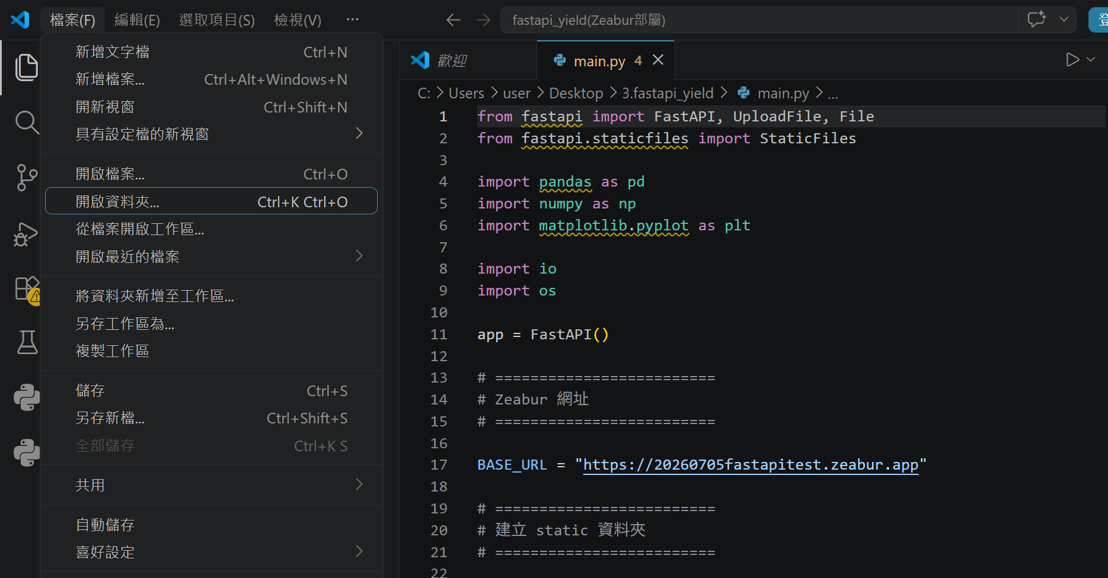
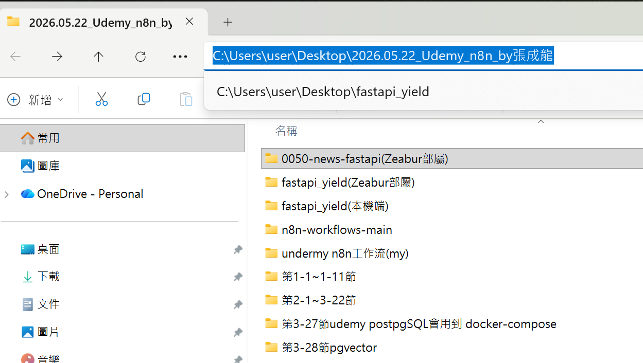
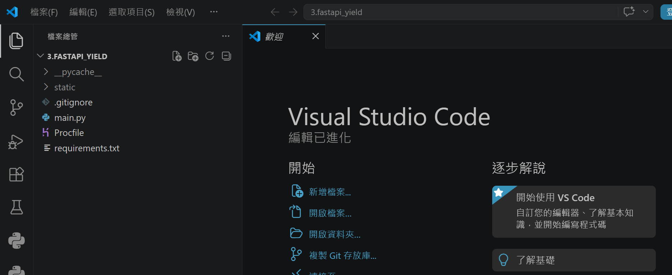
main.py 程式 ，用VS code 開啟
待會在fastapi_yield 資料夾要建立的檔案有這些
上頁已先將main.py 建好
接續建 :
2. requestments.txt
3. gitgnore( 用記事本件檔案，最後txt附檔名刪除)
4. Procfile( 用記事本件檔案，最後txt附檔名刪除)

Slide 5
建立requestments.txt
fastapi
uvicorn[standard]
trafilatura
pydantic
requests

Slide 6
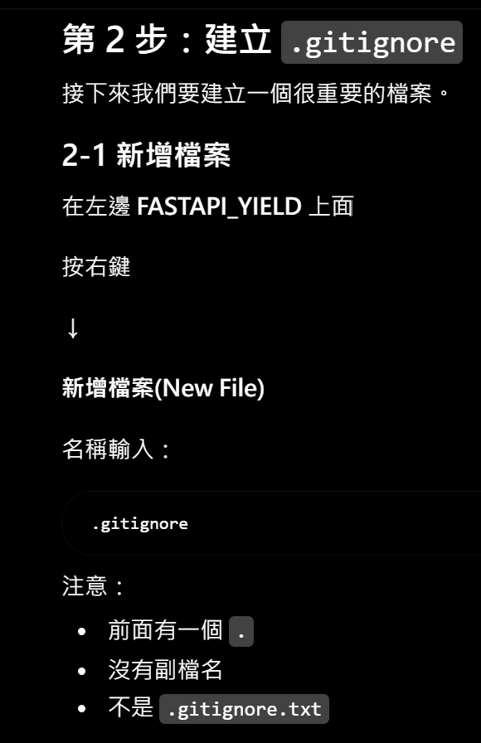
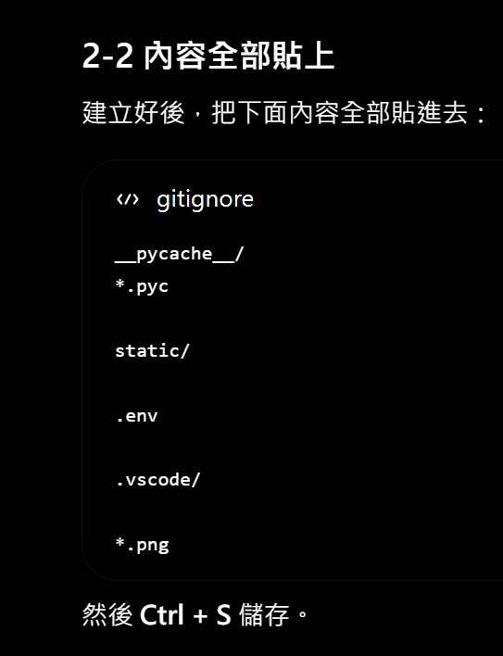
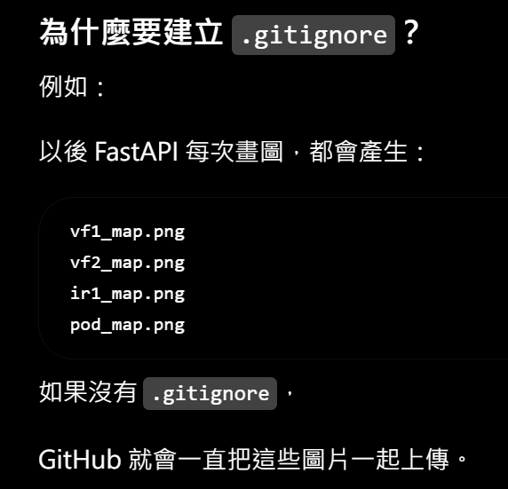
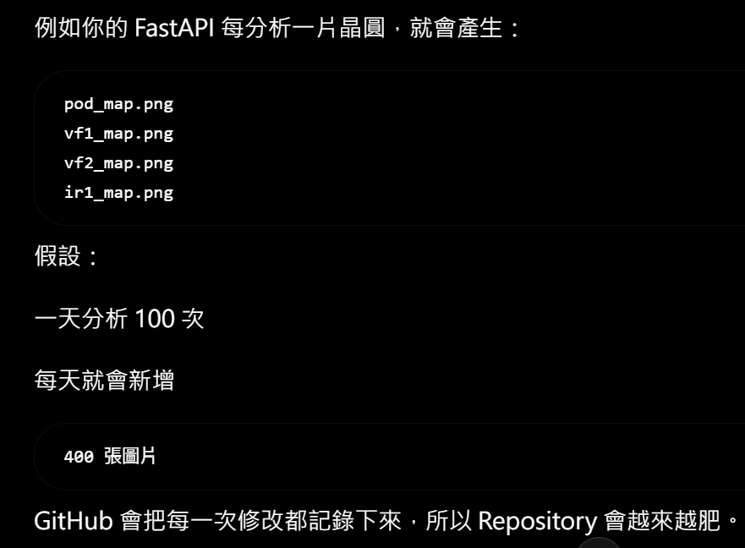
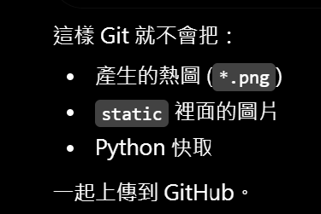
.gitignore 內容貼上如下 :
__pycache__/
*.pyc
static/
.env
.vscode/
*.png
占記憶體空間且會越跑越慢

Slide 7
建立Procfile 檔案
先用記事本將如下貼上 ，再將txt副檔名刪除
web: uvicorn main:app --host 0.0.0.0 --port $PORT

Slide 8
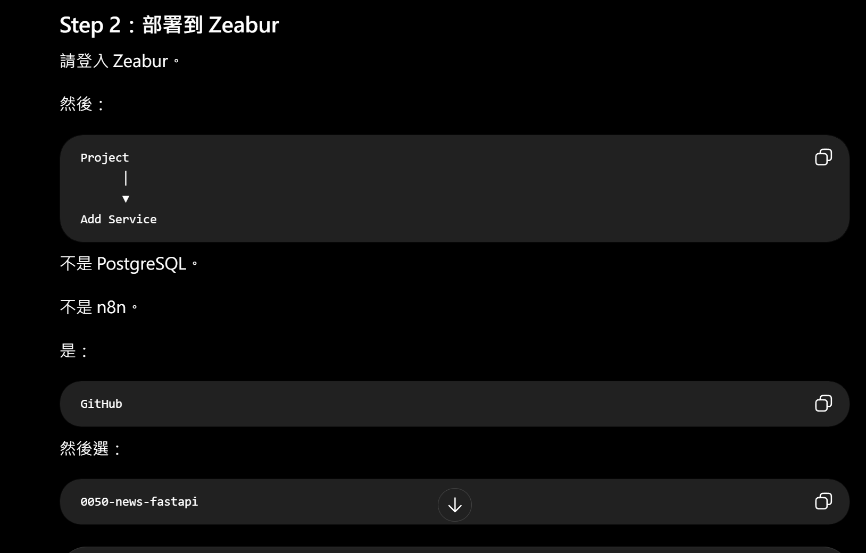

Slide 9
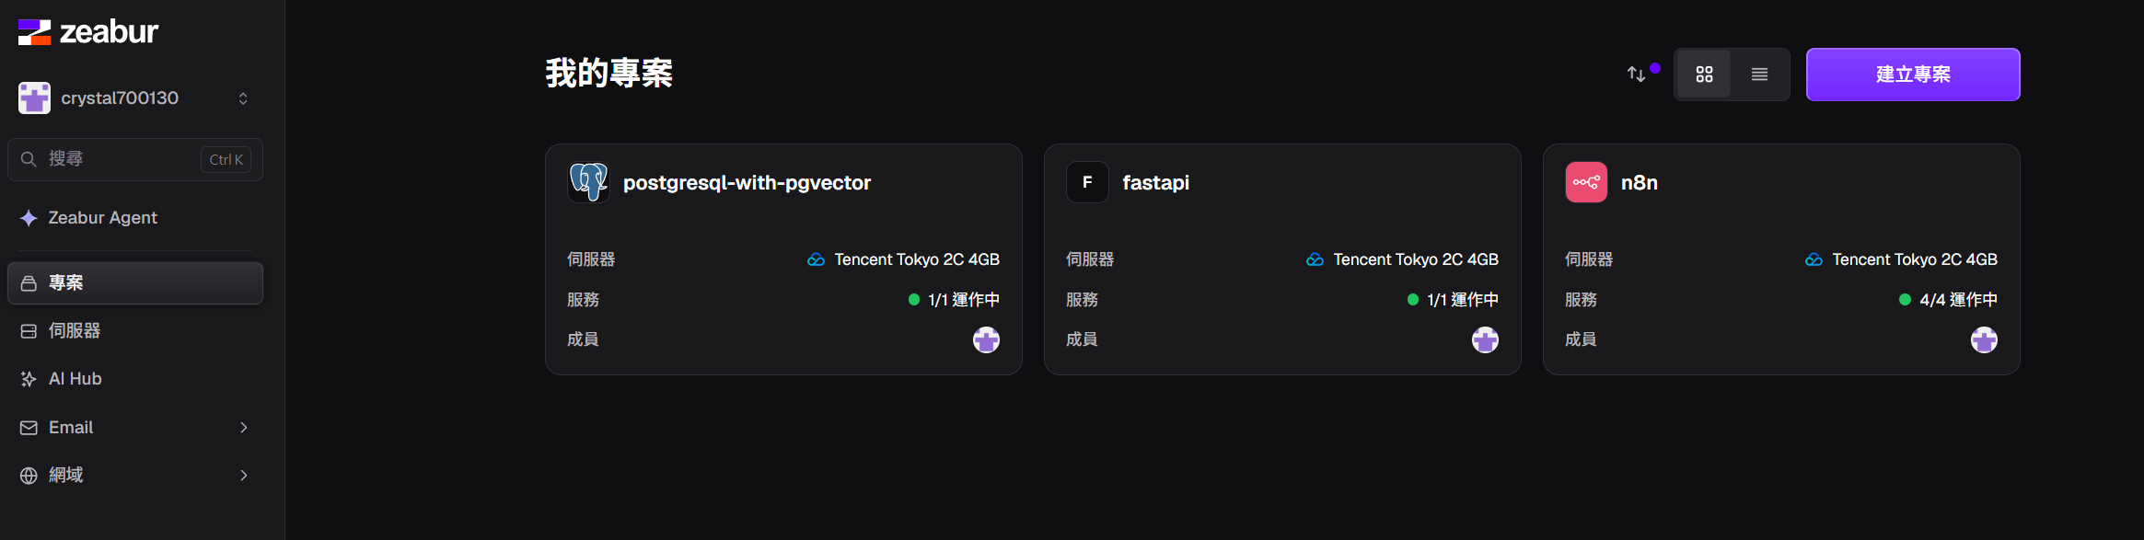

Slide 10
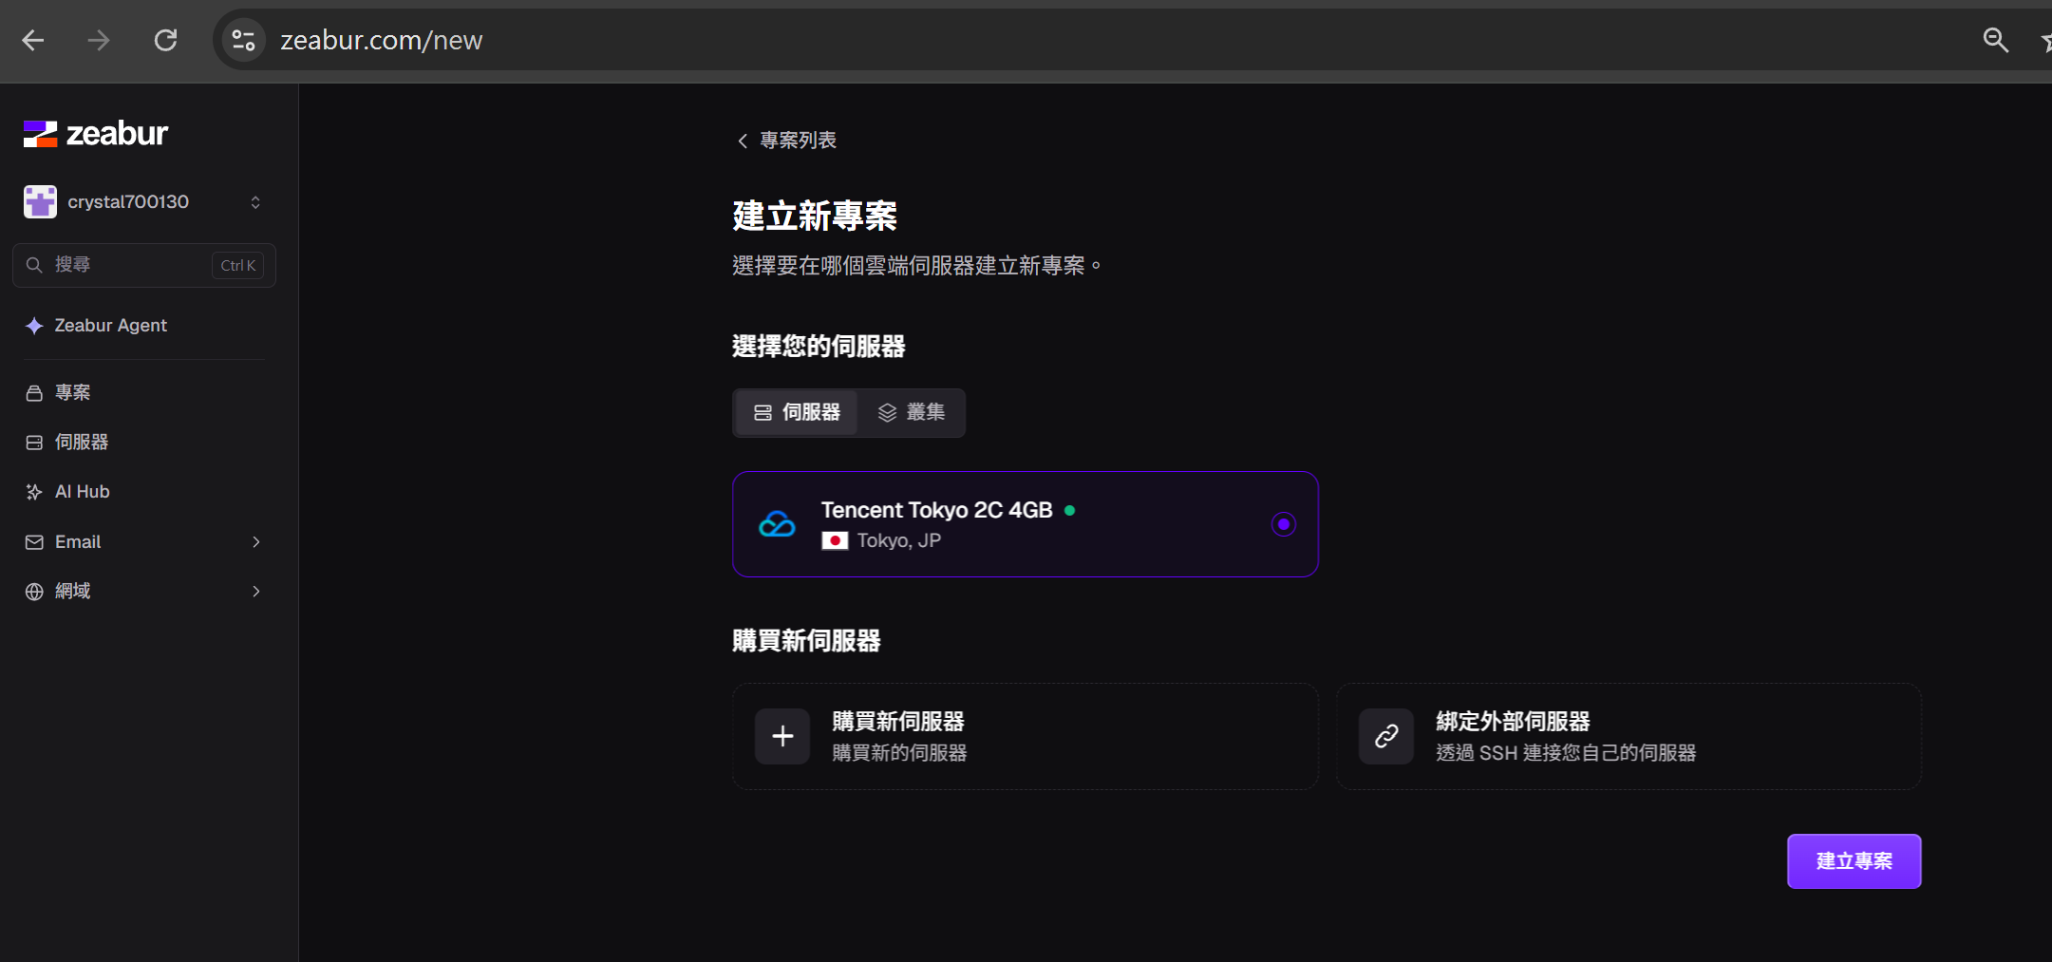

Slide 11
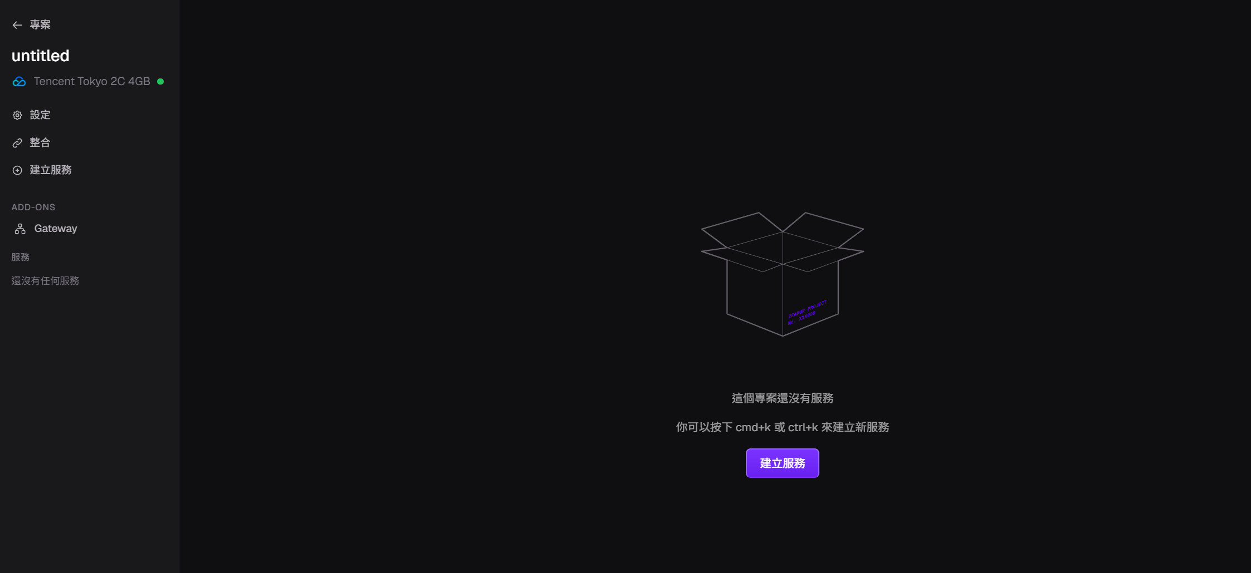

Slide 12
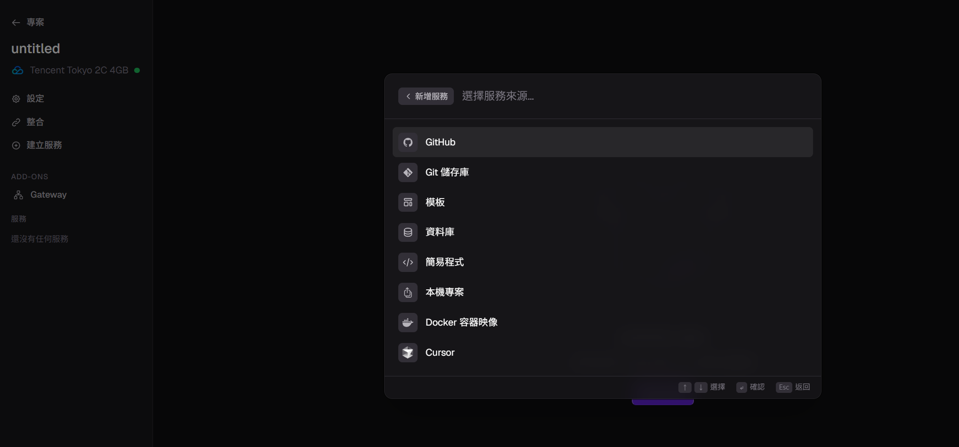
更名為0050-news-fastapi

Slide 13
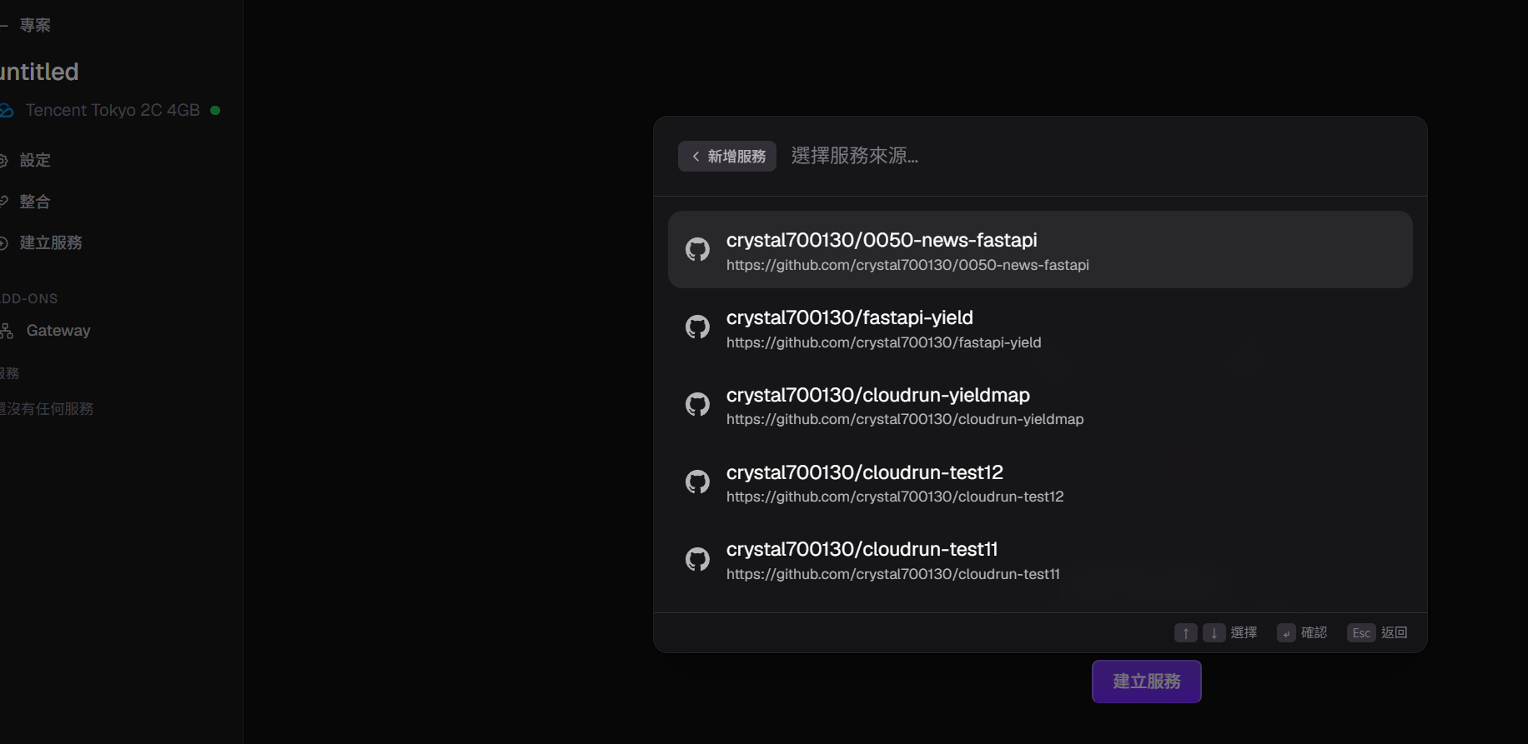

Slide 14
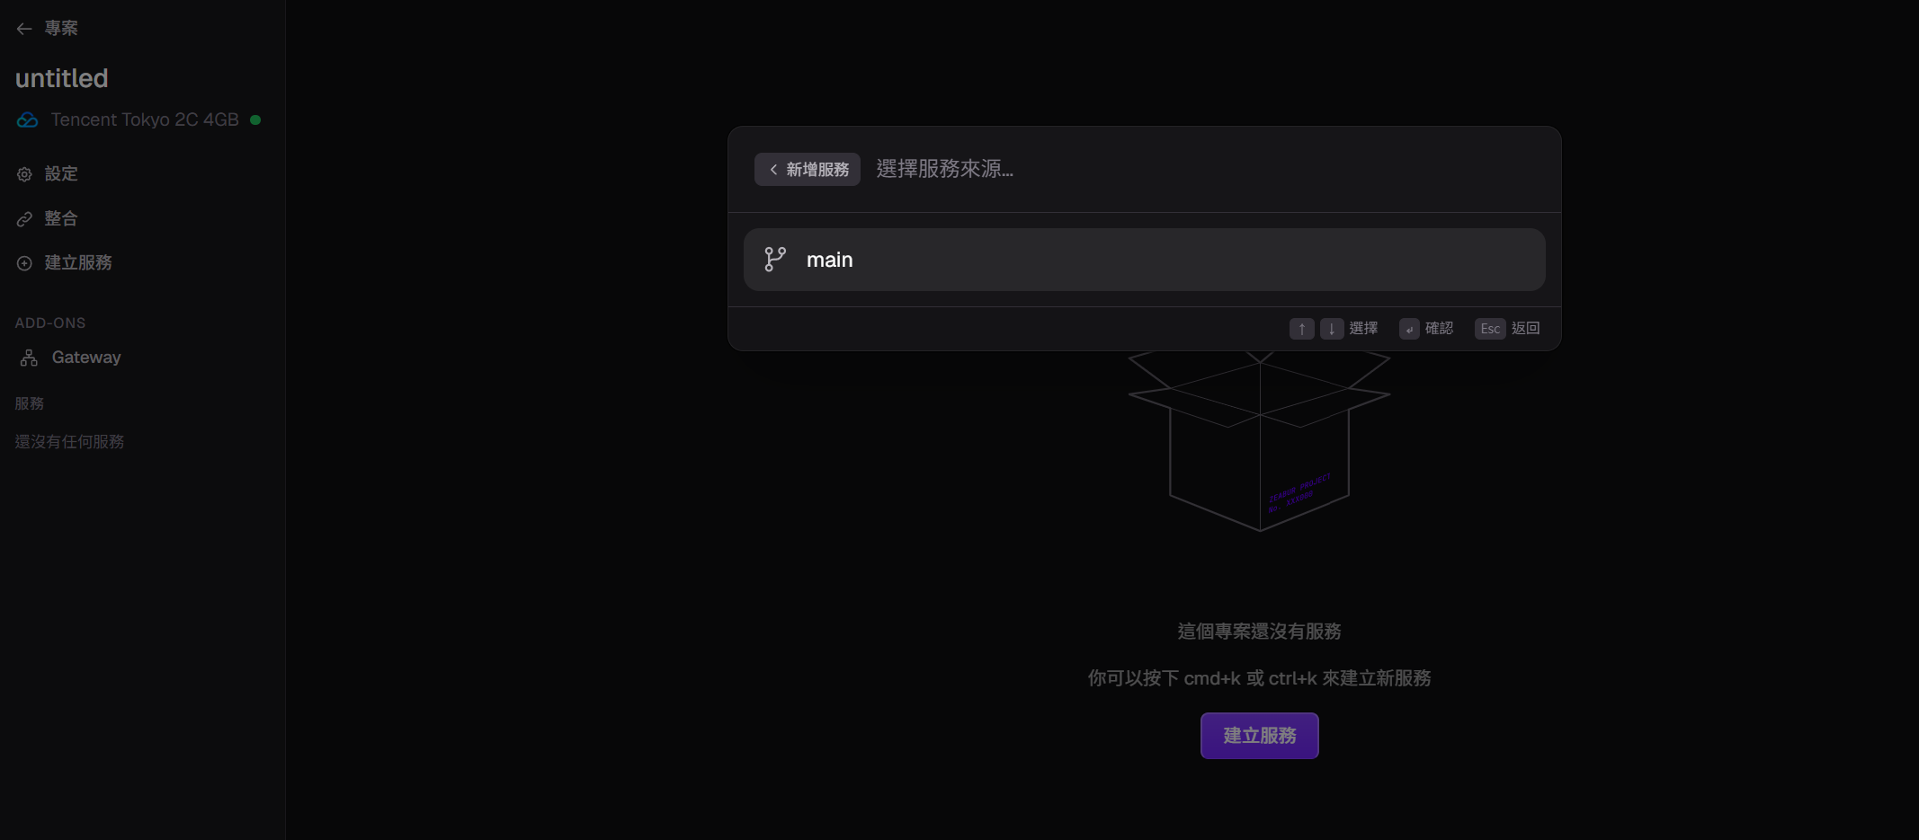

Slide 15
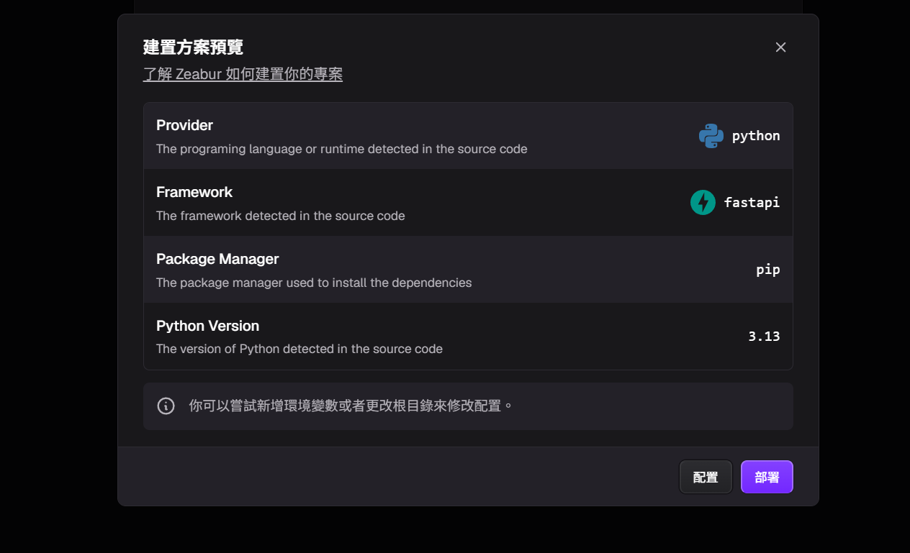

Slide 16
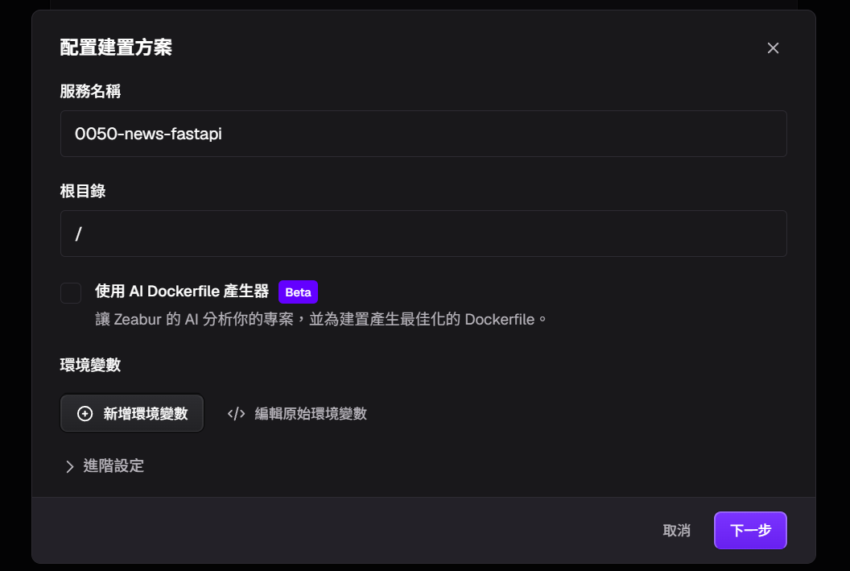

Slide 17
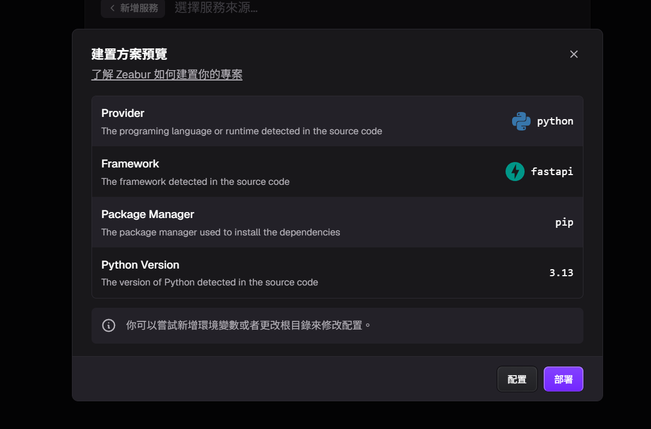

Slide 18
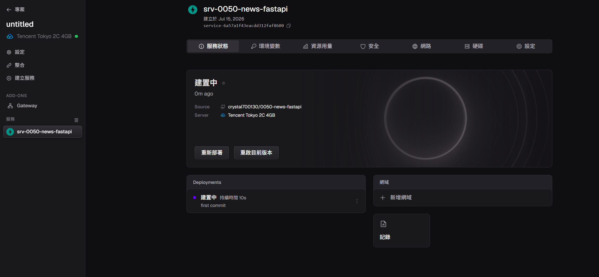

Slide 19
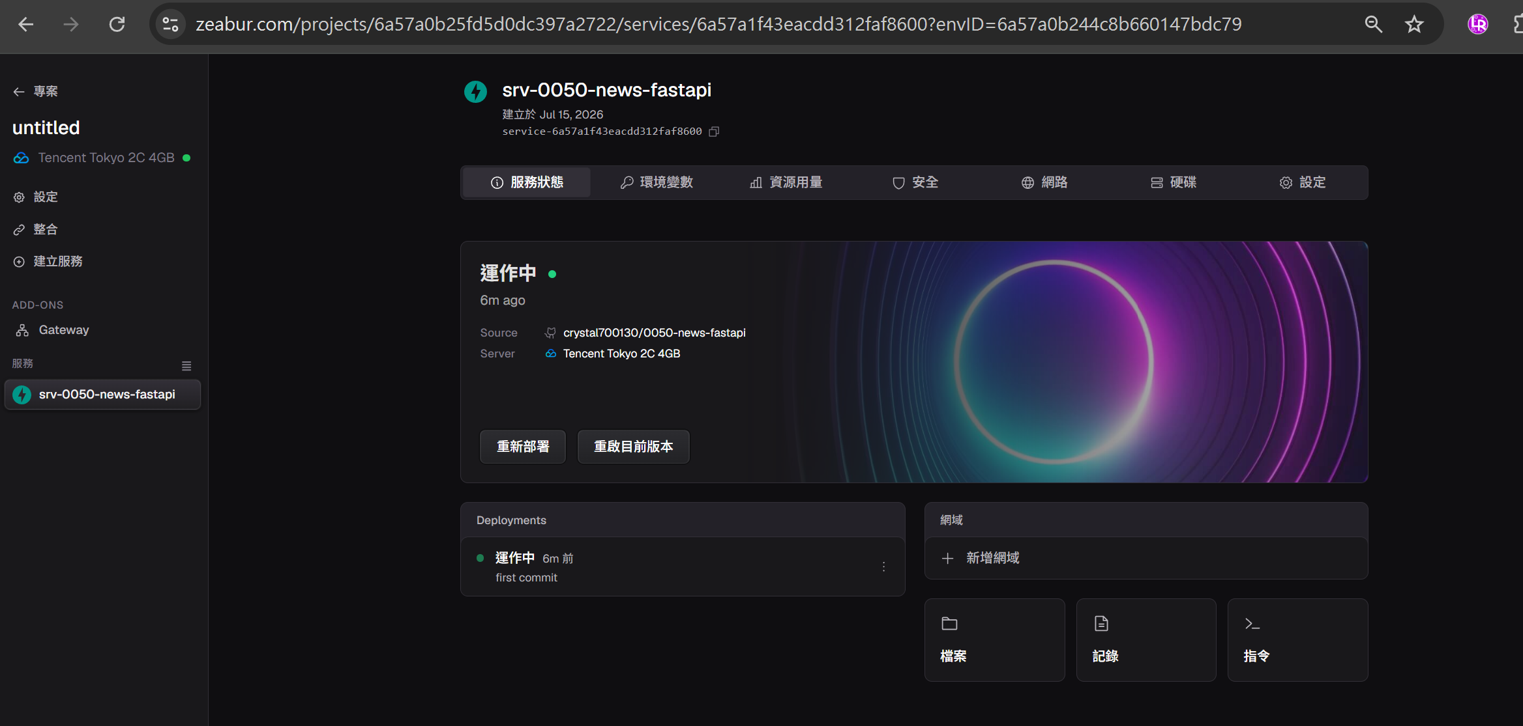

Slide 20
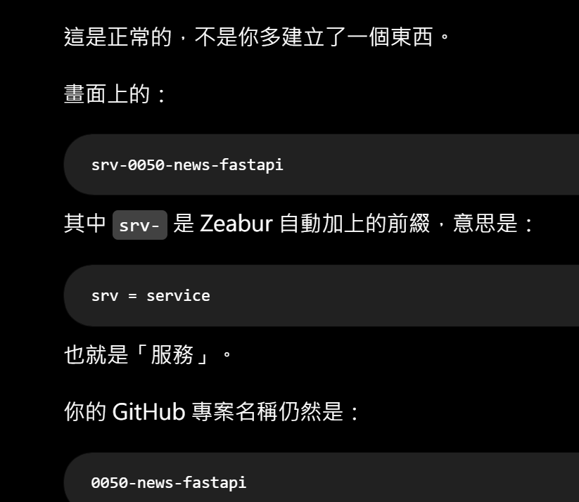
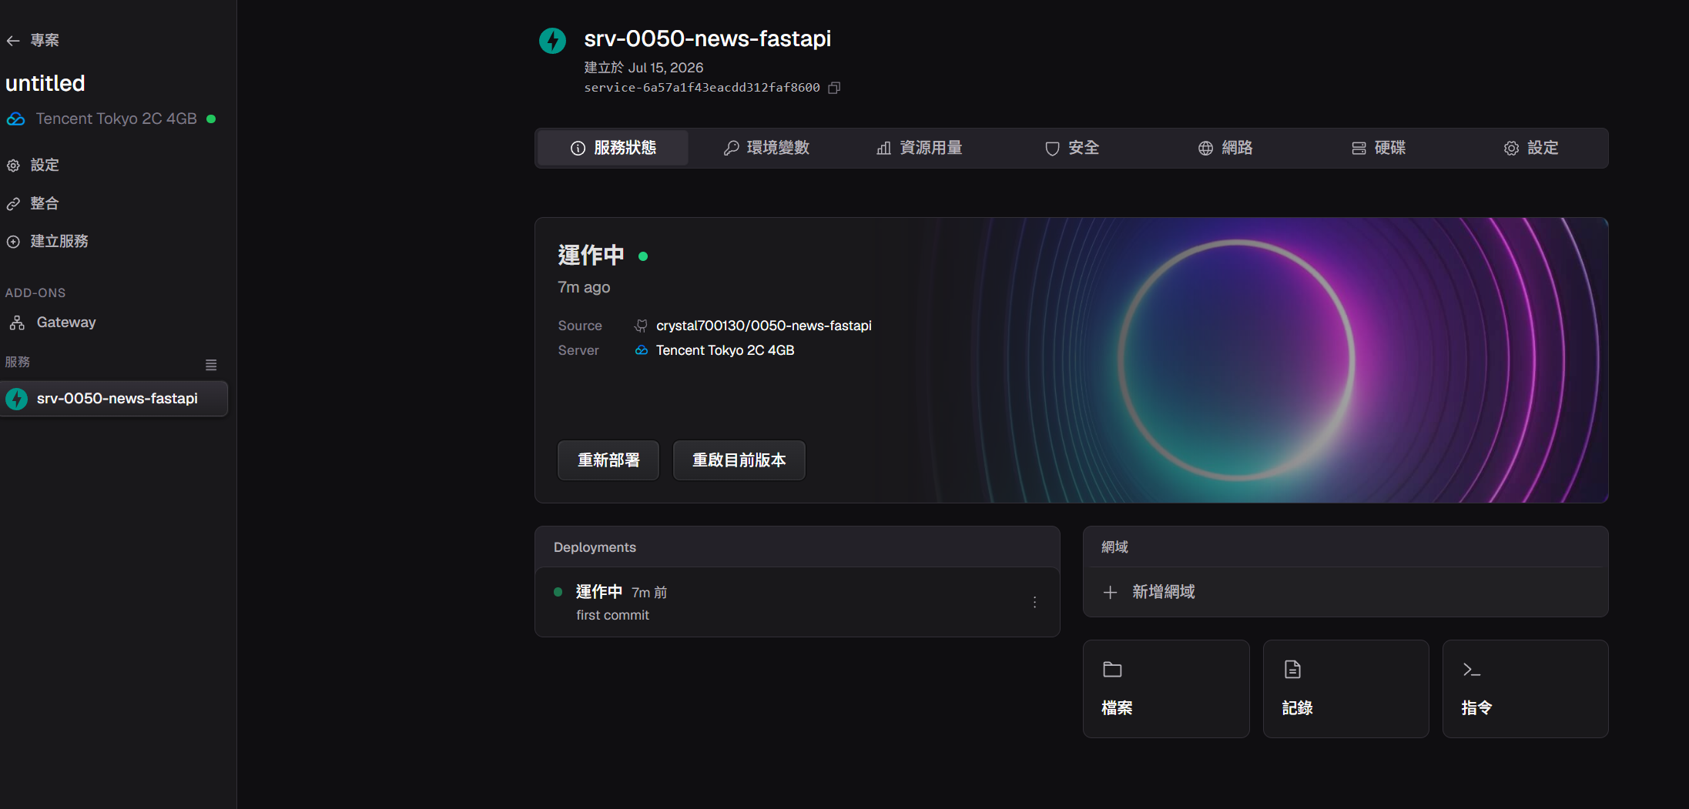

Slide 21
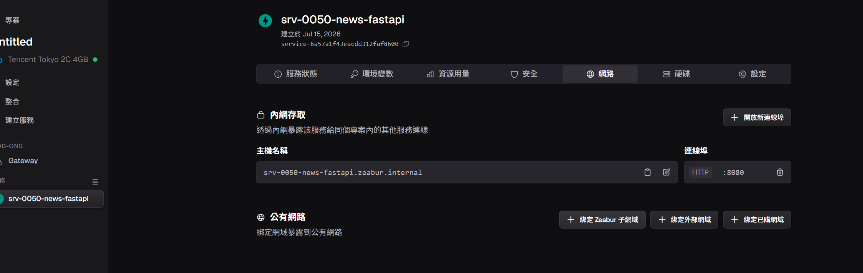

Slide 22
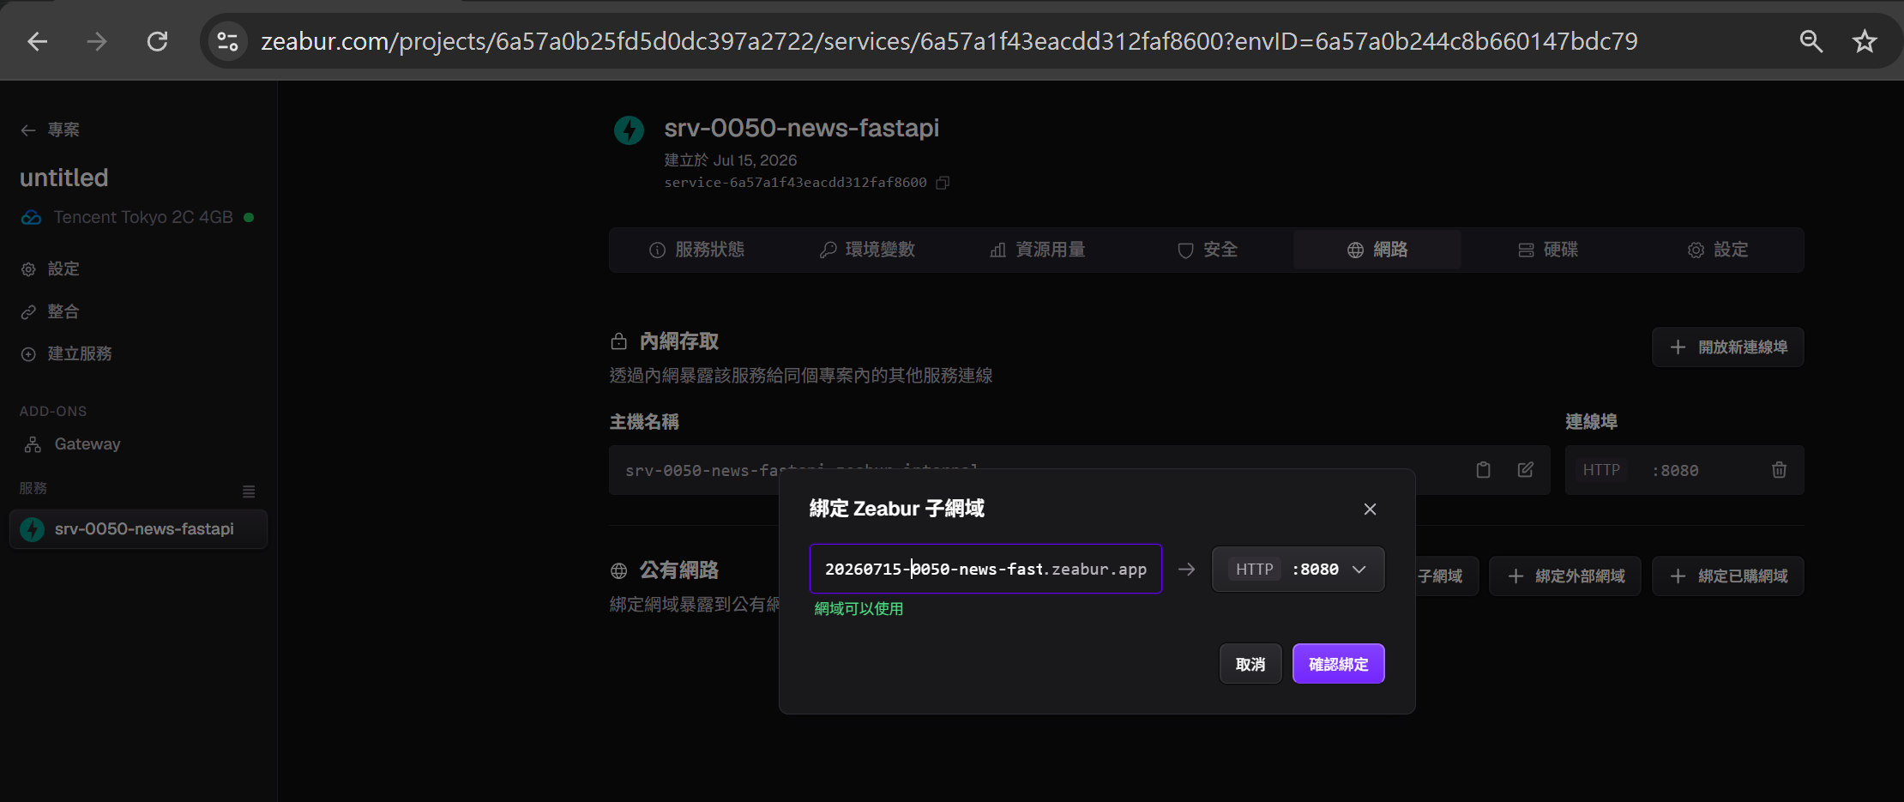
輸入20260715-0050-news-fastapi

Slide 23
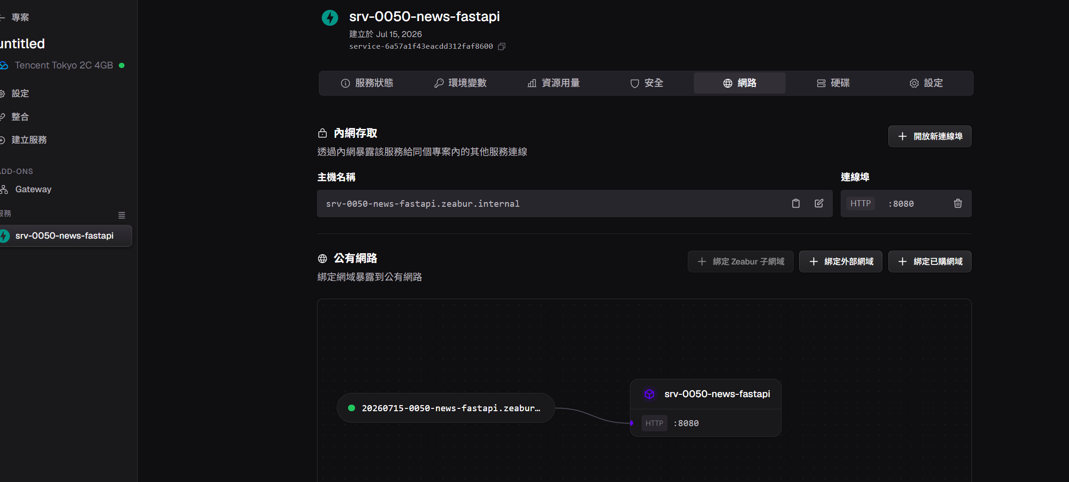

最後可更名將srv刪除
https://20260715-0050-news-fastapi.zeabur.app/

Slide 24
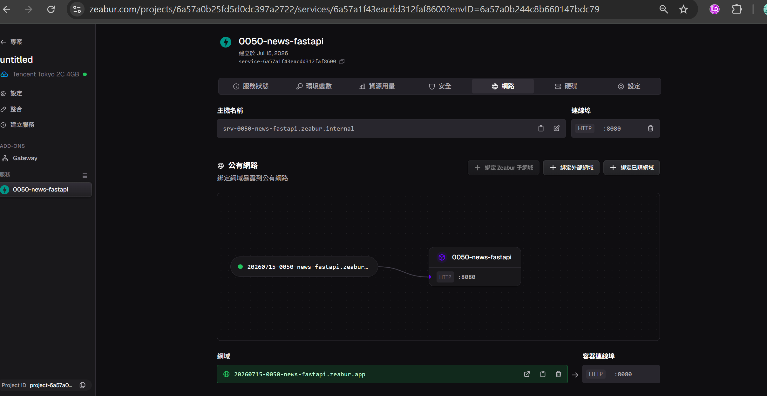
最後可更名將srv刪除
https://20260715-0050-news-fastapi.zeabur.app/

Slide 25
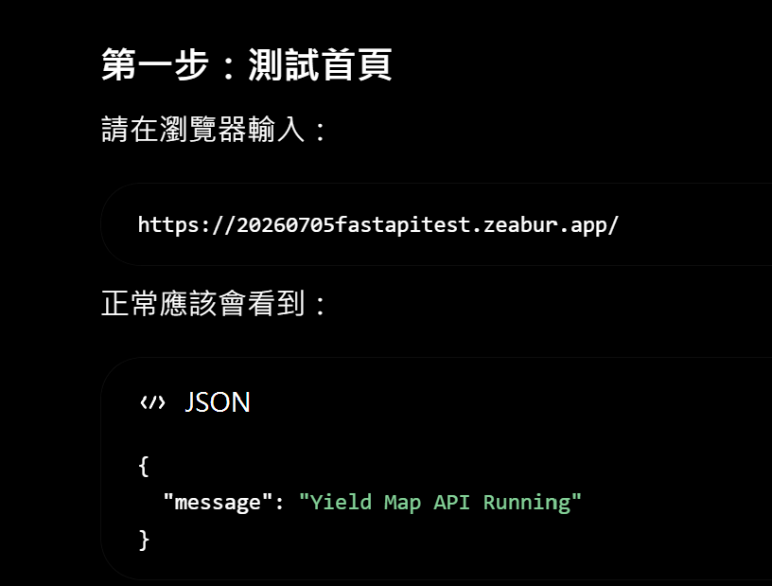
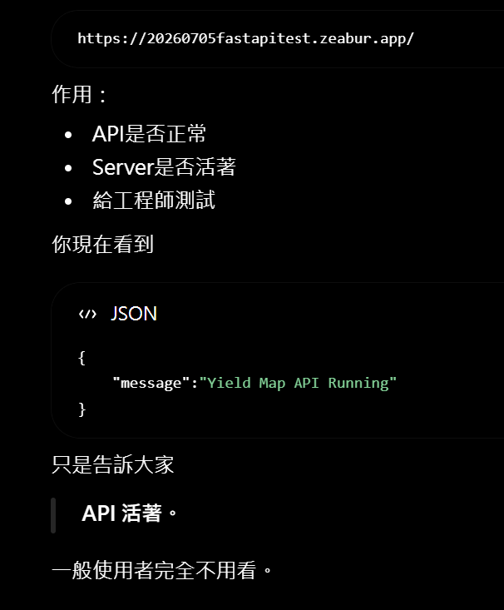
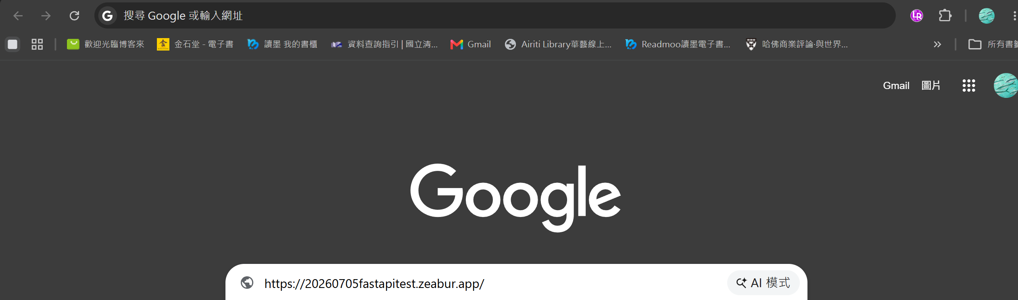
20260715-0050-news-fastapi.zeabur.app
20260715-0050-news-fastapi.zeabur.app

Slide 26
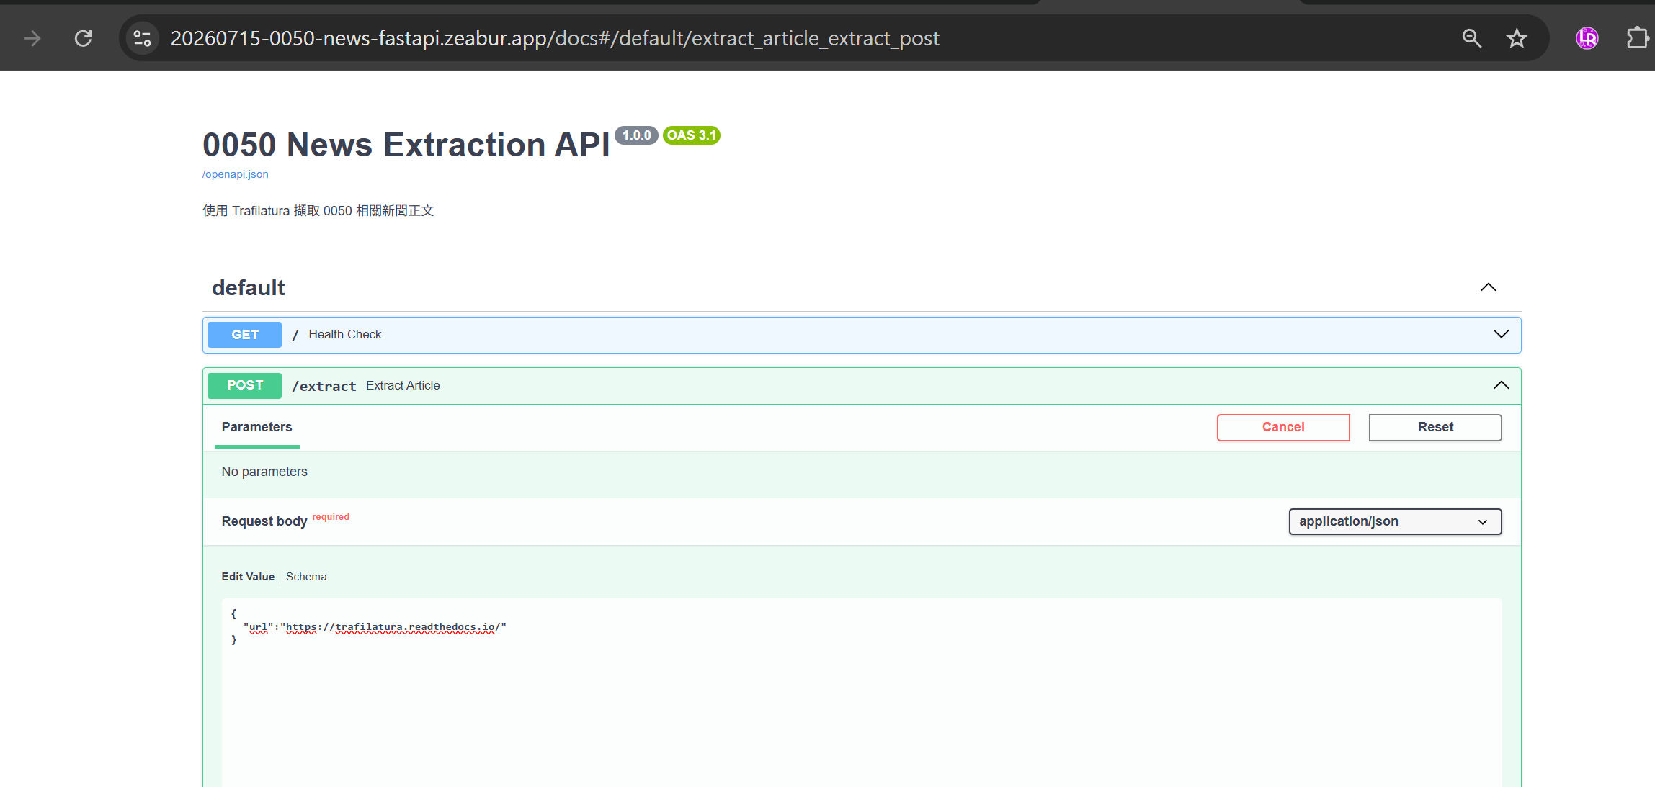
輸入 : https://20260715-0050-news-fastapi.zeabur.app/docs

