Slide 1
Probabilistic SLAM Algorithms
The EKF and FAST-SLAM Algorithms
Robotics Research Center, IIIT Hyderabad

Slide 2
Outline
The SLAM Problem: Introduction, Motivation and History
The EKF-SLAM Framework
Simulation and Experimental Results Obtained at IIITH
Issues with EKF-SLAM: Consistency and Convergence
The Fast-SLAM Framework
SLAM-Current State of the Art
Robotics Research Center, IIIT Hyderabad

Slide 3
The SLAM Problem
The simultaneous localization and mapping (SLAM) problem asks if it is possible for a mobile robot to be placed at an unknown location in an unknown environment and for the robot to incrementally build a consistent map of this environment while simultaneously determining its location within this map.
A solution to the SLAM problem has been seen as a “holy grail” for the mobile robotics community as it would provide the means to make a robot truly autonomous.
Robotics Research Center, IIIT Hyderabad

Slide 4
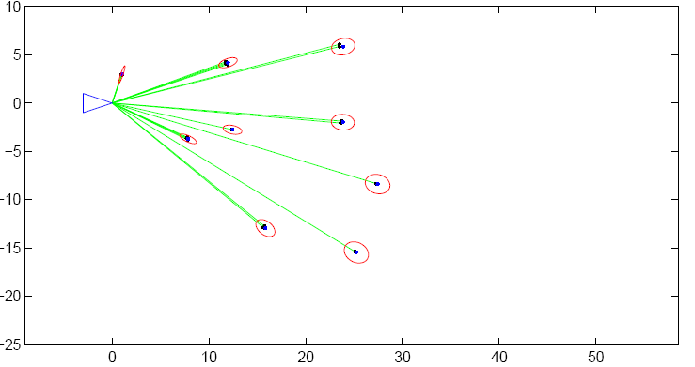
The SLAM Problem
A snapshot of the EKF SLAM algorithm: Map is characterized by point landmarks. Uncertainty of the landmark position shown by red ellipses. The green lines represent distance and bearing measurements to the landmarks
Robotics Research Center, IIIT Hyderabad

Slide 5
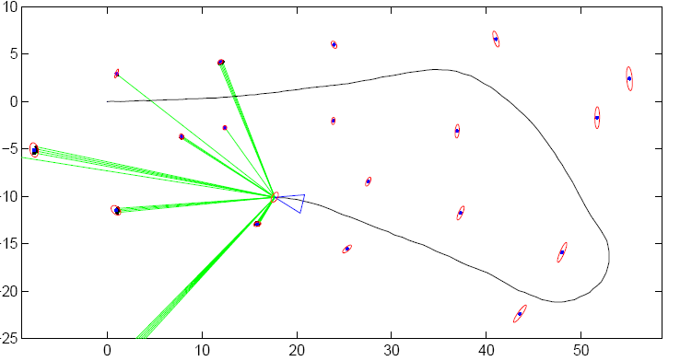
The SLAM Problem
A snapshot of the EKF SLAM algorithm: As the robot identifies a landmark seen earlier the uncertainty in its pose as well as the landmarks uncertainty decrease
Robotics Research Center, IIIT Hyderabad

Slide 6
A Brief History
1986 IEEE Robotics and Automation Conference California: The genesis of the probabilistic SLAM problem.
  The result of this conversation was a recognition that consistent probabilistic mapping was a fundamental problem in robotics with major conceptual and computational issues that needed to be addressed
Cheeseman, 1987:
  Show that there must be a high degree of correlation between estimates of the location of different landmarks in a map and that, indeed, these correlations would grow with successive observations.
Robotics Research Center, IIIT Hyderabad

Slide 7
A Brief History
Cheeseman 1990:
  showed that as a mobile robot moves through an unknown environment taking relative observations of landmarks, the estimates of these landmarks are all necessarily correlated with each other because of the common error in estimated vehicle location
The Implication:
  A consistent full solution to the SLAM problem would require a joint state composed of the vehicle pose and every landmark position, to be updated following each landmark observation
Dissanayake 2001:
  Theoretically establish convergence of KF-SLAM for linear Gaussian transition and measurement updates. Similar results obtained from other researchers
2002,04,06,08:
  SLAM summer schools held at various places in the world further push the problems to various implementation domains focusing on building maps for several kilometer square area.
Robotics Research Center, IIIT Hyderabad

Slide 8


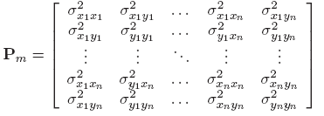
The EKF SLAM Framework: Vehicle and Map States
Vehicle State:
Vehicle Uncertainty:
Map State:
Map Uncertainty:
Robotics Research Center, IIIT Hyderabad

Slide 9
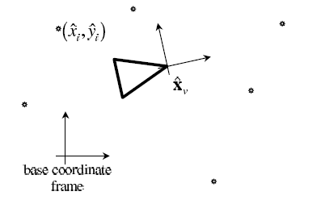
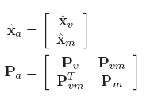
The EKF SLAM Framework:
The Augmented State
Augmented State and Uncertainty:
Robotics Research Center, IIIT Hyderabad

Slide 10
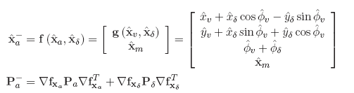
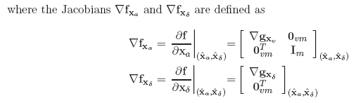
The EKF SLAM Framework:
Prediction
Robotics Research Center, IIIT Hyderabad

Slide 11
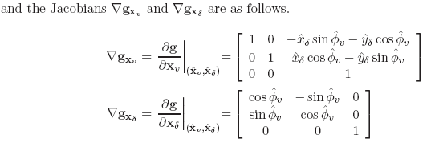

The EKF SLAM Framework:
Prediction
Then Pa⁻ can be written as
Robotics Research Center, IIIT Hyderabad

Slide 12
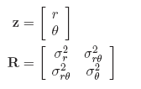

The EKF SLAM Framework:
Update
If a feature already stored in the map as estimate (x_{i}, y_{i}) is observed by a range-bearing sensor with the measurement
where (r, θ) above is the range and bearing relative to the observer and R is the observation covariance, then the sensed information is related to the map by the following equation
Robotics Research Center, IIIT Hyderabad

Slide 13
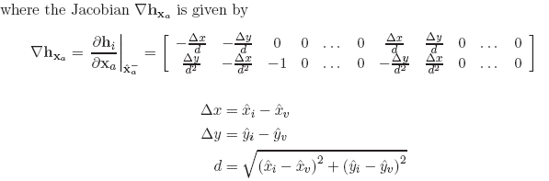


The EKF SLAM Framework:
Update
Assuming correct data association
Robotics Research Center, IIIT Hyderabad

Slide 14
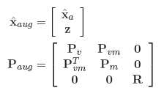
State Augmentation
As the environment is explored, new features are observed and must be added to the stored map.
First, the state vector and covariance matrix are extended (augmented) with the polar values of the new observation z, and its covariance R, as measured relative to the observer
Robotics Research Center, IIIT Hyderabad

Slide 15

State Augmentation
Upon converting to global Cartesian frame correlation terms get eventually populated as (derivation not shown)
Feature deletion from the SLAM map is straightforward. The elements are simply removed from the state vector and the associated rows and columns are deleted from the state covariance matrix
Robotics Research Center, IIIT Hyderabad

Slide 16
Results: Jun-Nov 08
MATLAB code of Tim Bailey for EKF SLAM based on point landmarks was ported on Linux with Octave libraries.
A large part of the code was rewritten in C++ in linux, Octave providing for the complex matrix operations that constitute the Extended Kalman Filter framework.
It must be noted in SLAM the measured agents as well as the system state are incorporated into one big state vector that is very different from usual EKF frameworks
In usual EKF frameworks only the system state evolves and not the measurement state. Hence interpretation of EKF results within the SLAM framework becomes more difficult to understand.
Robotics Research Center, IIIT Hyderabad

Slide 17
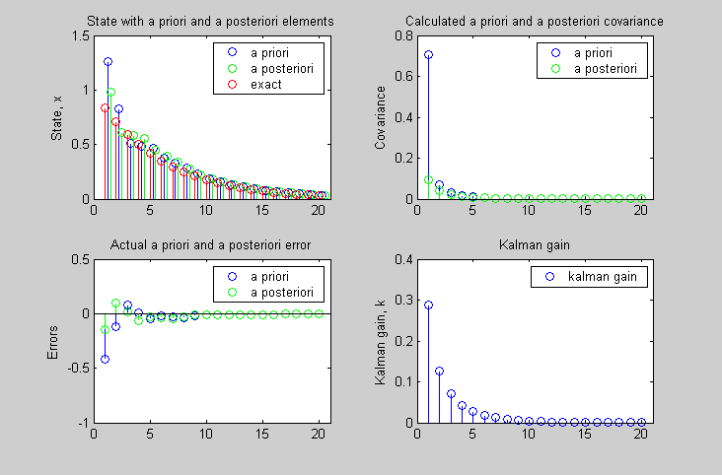
Results: Jun-Nov 08
For example in a regular KF with zero process noise akin to robot not moving the following is observed despite large measurement noise. Q = 0, R = 1 (measurement covariance)
Robotics Research Center, IIIT Hyderabad

Slide 18
Jun-Nov 08: However
In an EKF/KF SLAM if landmarks are initialized with the robot error mediated onto them, the robot being stationary, despite numerous measurements on the landmark the posterior covariance of the robot pose cannot and does not in general decrease below the starting covariance
This is because the landmarks are strongly correlated with the robot pose and this perhaps affects the parallel law of variances when two noise sources are fused in a standard KF framework.
Robotics Research Center, IIIT Hyderabad

Slide 19
Jun-Nov 08: General Observations
That in absence of SLAM the state uncertainty rapidly increases to the point of robot motion being rendered useless and so as the map constructed from it
With SLAM (by bringing in the measurement vector also as part of the state) the growth in state error, though present is generally much lesser
When the system error or uncertainty is more the correction is observed in the system state than in measurement state
When the measurement error is more than the system error, the map features are corrected than the system state
All errors continue to grow till such time the same environment is encountered again and identified so.
Robotics Research Center, IIIT Hyderabad

Slide 20
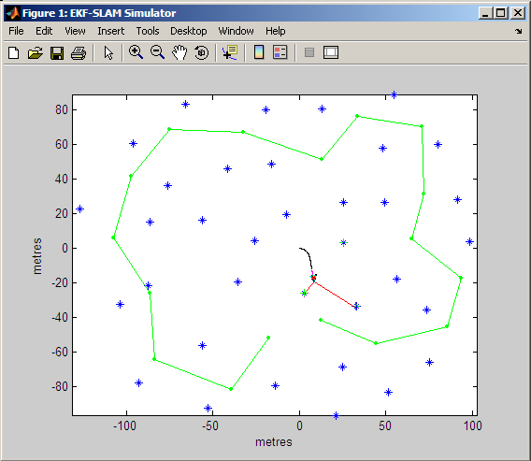
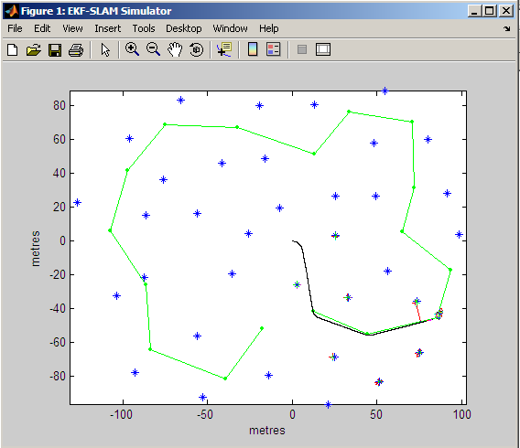
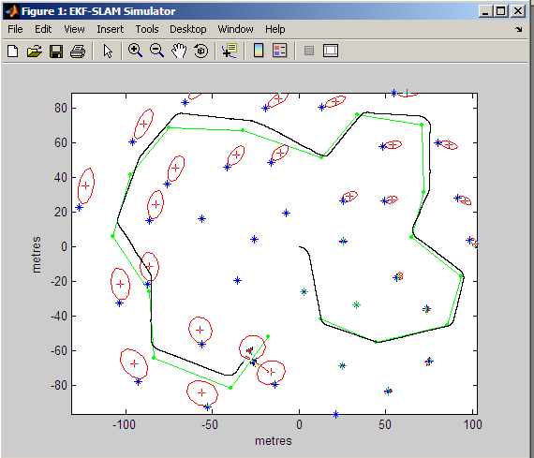
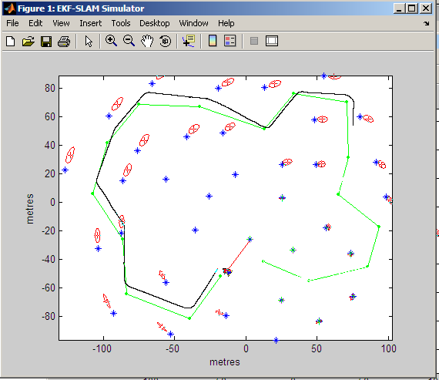
Jun-Nov 08: Simulation Results
Robotics Research Center, IIIT Hyderabad

Slide 21

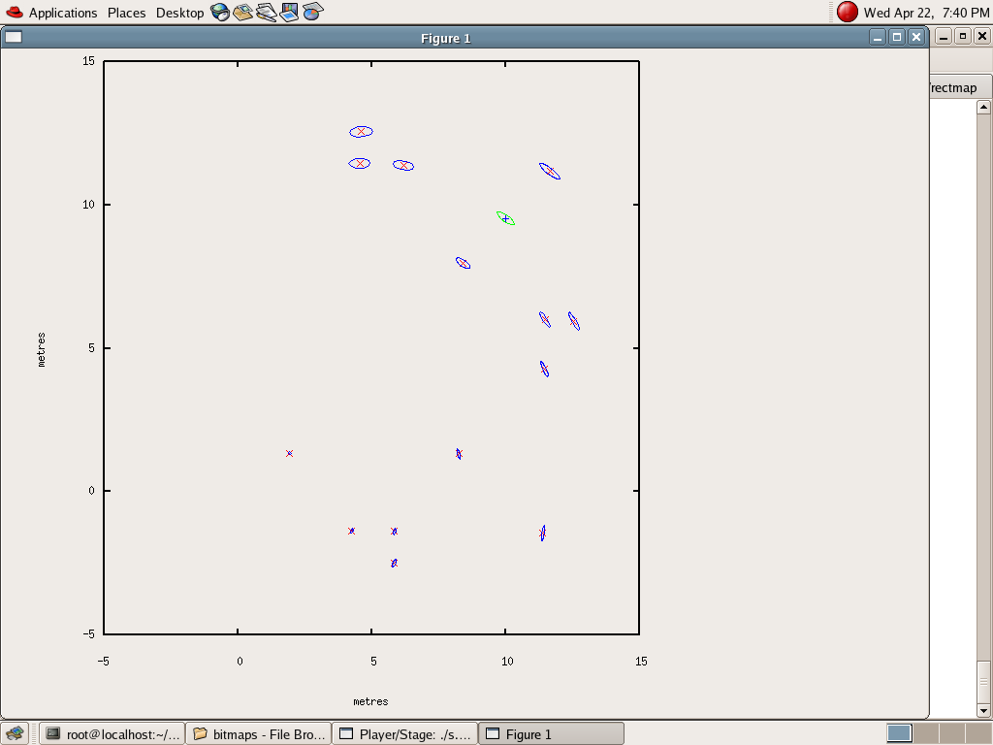
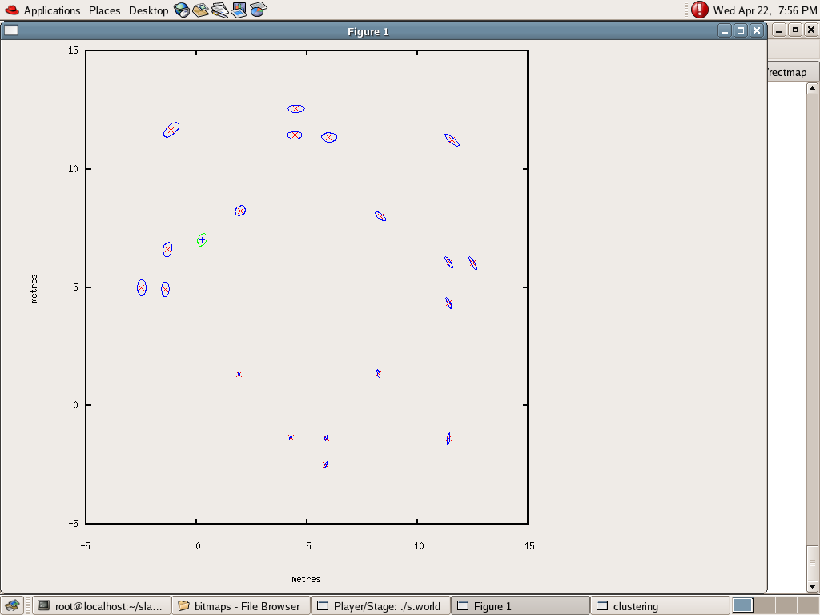
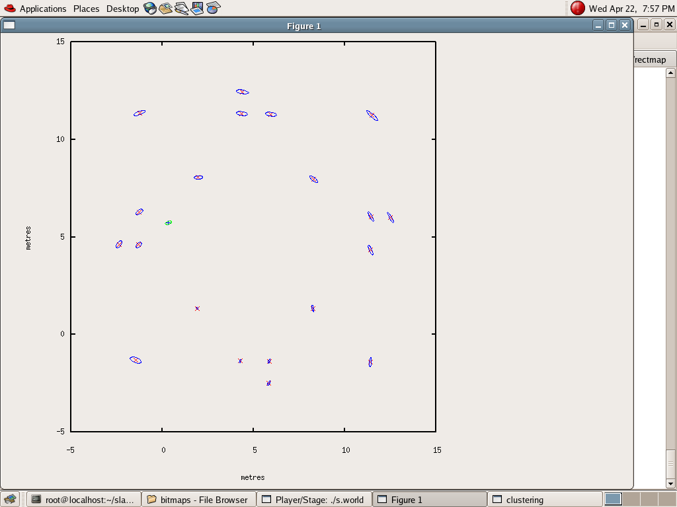
Jun-Nov 08: Realistic Maps
Robotics Research Center, IIIT Hyderabad

Slide 22
Jun-Nov 08: Real Implementations
On the Pioneer P3DX we found while results were generally satisfactory in controlled environments there were at times when unexplainable errors cropped up.
Upon pensive investigation the errors were attributed to a non-observable pitch in the laser of around 1 degree.
The pitch while largely ineffective for close range measurements can cause errors of the order of 5-10cms while measuring landmarks that are a few meters away.
Such large measurement error essentially renders SLAM correction ineffective.
More than that since the moving plane of the robot is not the same as the measuring plane the same parts of the environment are not detected in subsequent scans making data association difficult.
Most importantly a landmark can be completely missed as the robot moves due to the laser pitch that makes data association more difficult.
Robotics Research Center, IIIT Hyderabad

Slide 23
Jan-Apr 09: Real Implementations
This led us to calibrate the laser which essentially involved measuring its pitch with respect to the robot base. This was done by suitable experiments.
Once calibrated the performance of the EKF SLAM in controlled and structured environments improved.

Slide 24
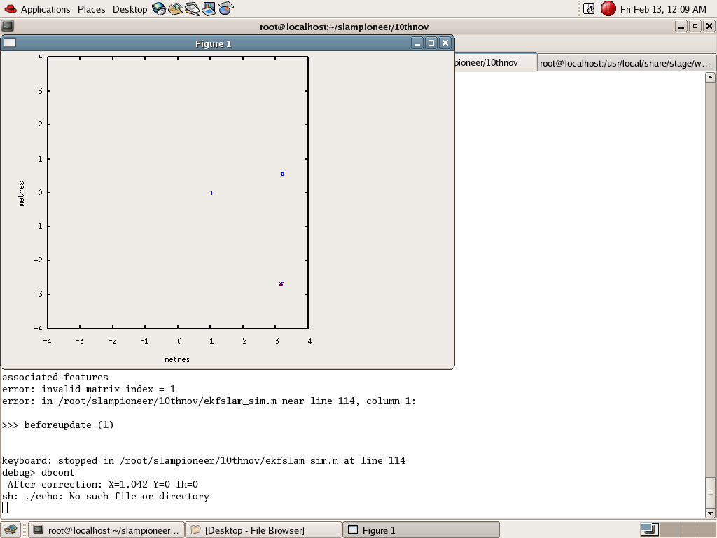
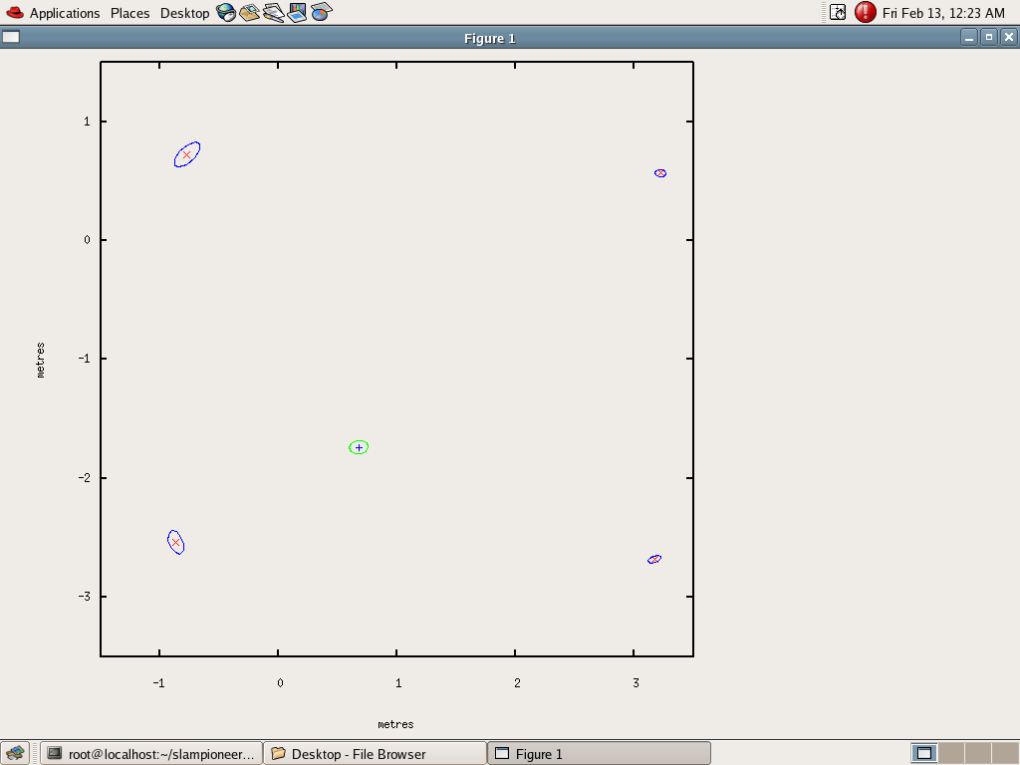
Jan-Apr 09: Real Implementations

Slide 25
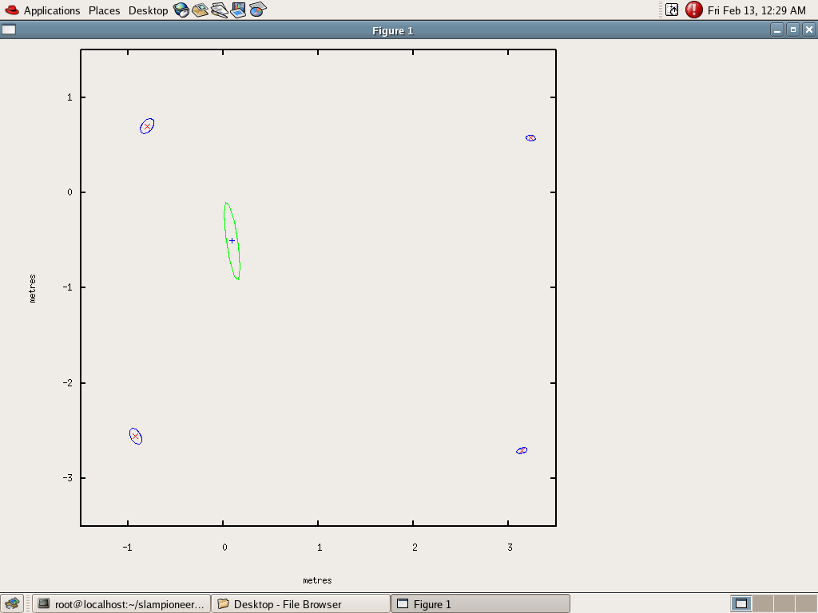

Jan-Apr 09: Real Implementations
In these experiments the process or system noise was artificially increased while moving the robot to see if the EKF SLAM corrects the robot pose

Slide 26
Jan-Apr 09: Extending to Line Segments
Realized that in realistic environment would be very difficult to work with point landmarks alone.
Extended SLAM simulations to incorporate line segments as well.
Considerable time was dwelt on deciding how to represent the line features in the state vector as well as the measurement equations and the covariances that represent the noise in these features.
There were no ready made papers delineating line segment based EKF SLAM. Most details if not all were swept under the carpet.
An EKF SLAM combining both line segments and points were successfully simulated by March 2009 though areas that require further analysis remained.

Slide 27
May 09 - :Improving Data Association
Considered using cameras for improving data association.
  Calibrated camera and laser to the same frame of reference. This took a lot of time
  Use of visibility relations in data association in unstructured environments
  Continuous mapping to alleviate data association

Slide 28
May 09-: Dr Pal’s Visit
During Dr Pal’s visit in Sep-09 we showed an implementation of EKF SLAM in a realistic lab environment
The objective was to show that the quality of the map produced in a realistic setting with SLAM was better than without SLAM
Though results indicated these there were some gray areas
It was unclear initially as to why the map without SLAM seemed more crisp and sharp as opposed to the SLAM map
Though this was explained there seemed issues with data association at large

Slide 29
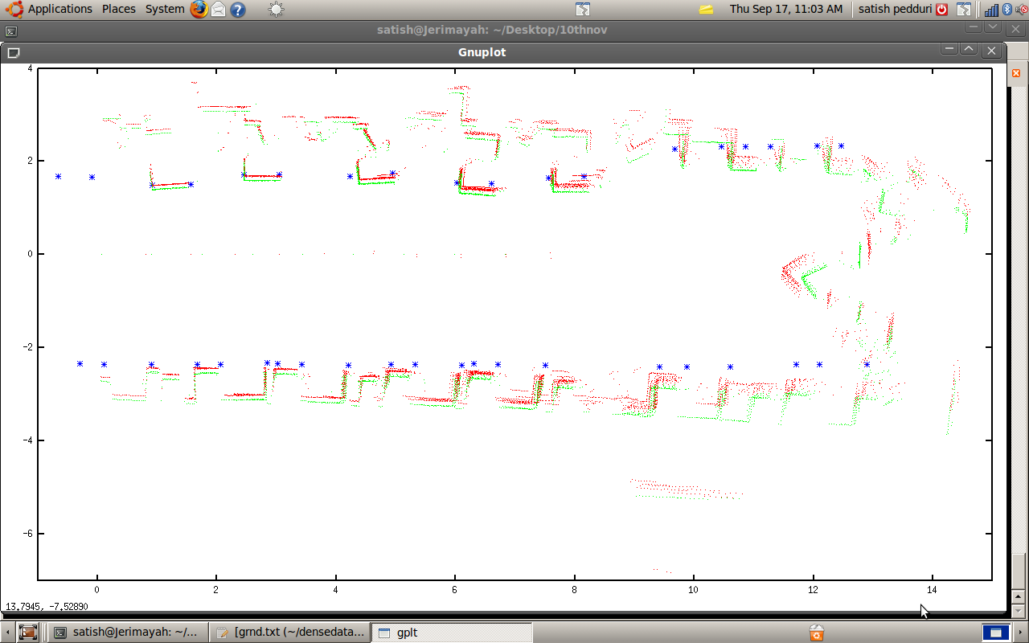
May 09-: Dr Pal’s Visit

Slide 30
May 09-: Dr Pal’s Visit
It was decided to investigate the role of system and measurement noise covariance in SLAM problem
Was decided to see how effective is SLAM in a semi realistic/ semi controlled box like environment
The dependence of posterior state covariance on the number of landmarks observed

Slide 31
May 09-: Observations
We ran simulations of EKF SLAM changing the control noise and trying to identify the effects of the change. The control noise is used in the prediction phase to balloon the covariance matrix
Overestimation : The assumed control noise covariance is taken more than the actual control noise covariance.
Underestimation : The assumed control noise covariance is taken less than the actual control noise covariance.

Slide 32
May 09 - : Empirical Conclusions
We could not observe a consistent pattern all along the experiment.
One conclusion was that underestimation fails miserably in more than fifty percent of the cases.
Noise inflation works better than taking the actual noise covariance in more than sixty percent of the cases.
Specically, for certain control values and actual control noise added with zero measurement noise while retaining the measurement variance, underestimation failed in more than ninety percent of the cases, and actual estimation failed in more than thirty percent of the cases
While overestimation of noise between 1.414 times(p2) to 4 times(i.e four hundred percentage) of the actual control noise worked better in more than ninety percent of cases.

Slide 33
May 09 - : Empirical Conclusions
Another observation was that the correction of the robot state towards the actual location would be accurate when there is a local or global loop closing and most of the other times, the correction tends to be closer to the prediction.
However, when the actual control noise added is far greater than the measurement noise variance, the correction in the robot state generally tends to be closer to the measured value than the predicted value.

Slide 34
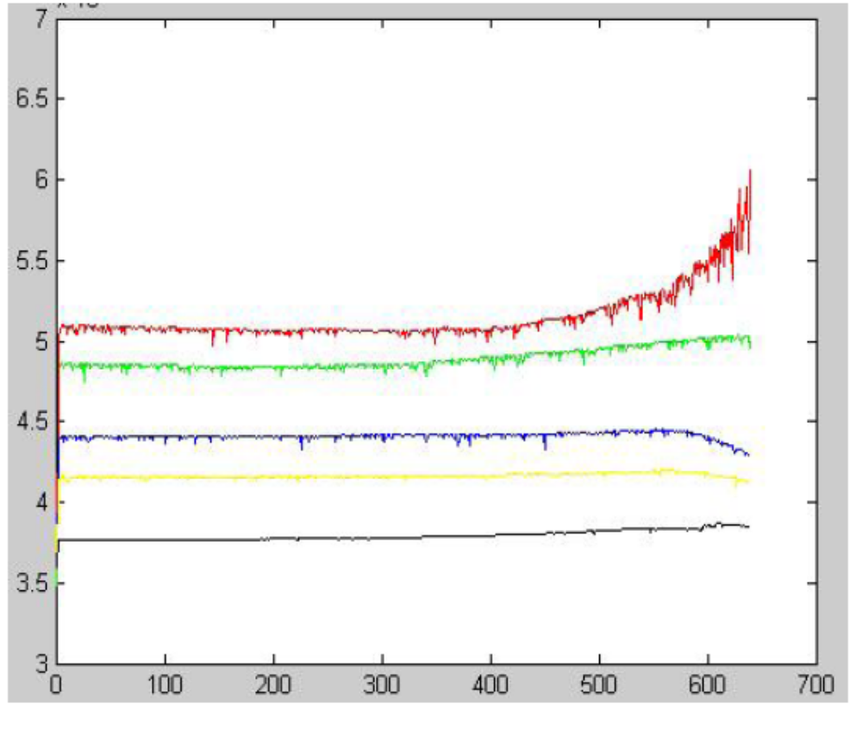
May 09 - : Effect of Landmarks on Posterior Covariance
Red = 1 landmark, green = 2, blue = 3, yellow = 4, black = 5.
The robot state uncertainty decreases slower as the number of landmarks increases

Slide 35
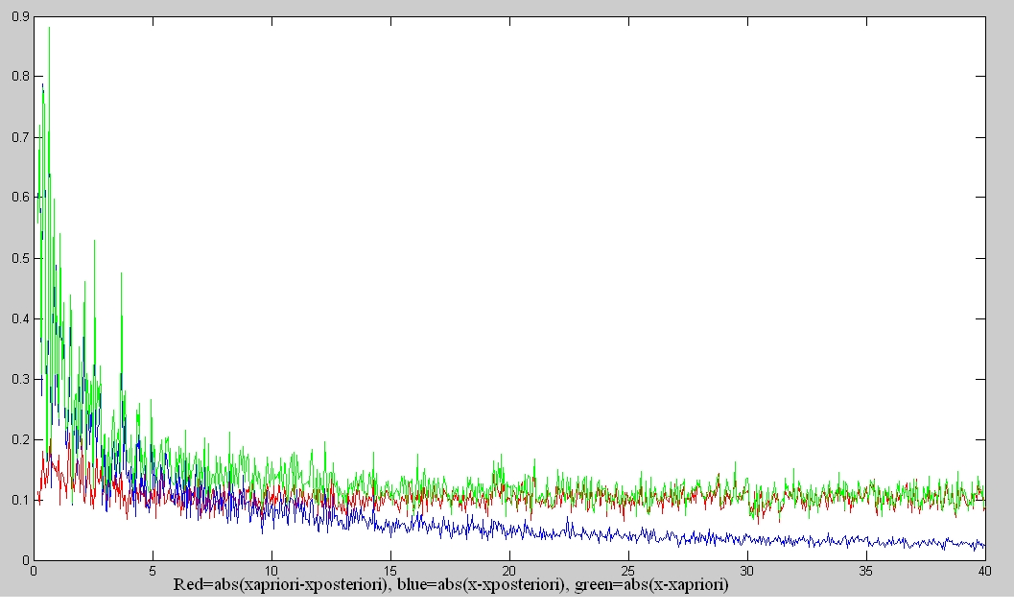
May 09-: The role of H. Simple 1D KF

Slide 36
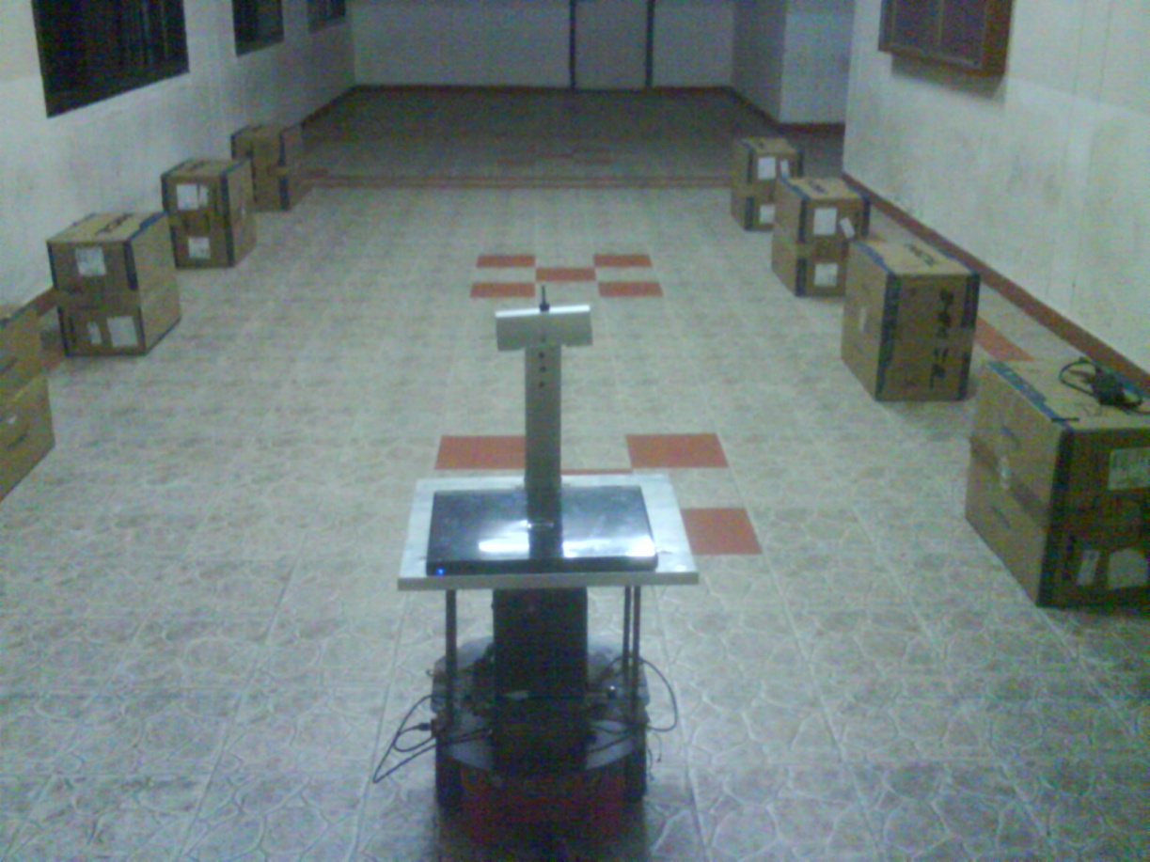
May 09-: EKF SLAM Works!

Slide 37
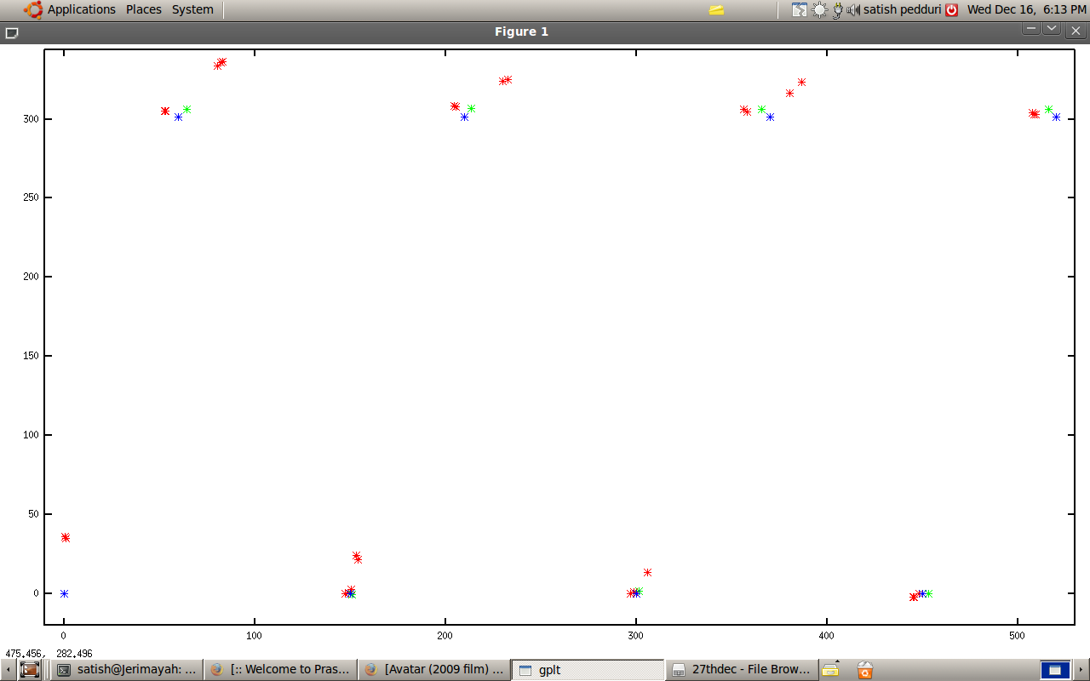
May 09-: EKF SLAM Works!
Red = Without SLAM
Green = With SLAM
Blue = Ground truth box positions

Slide 38
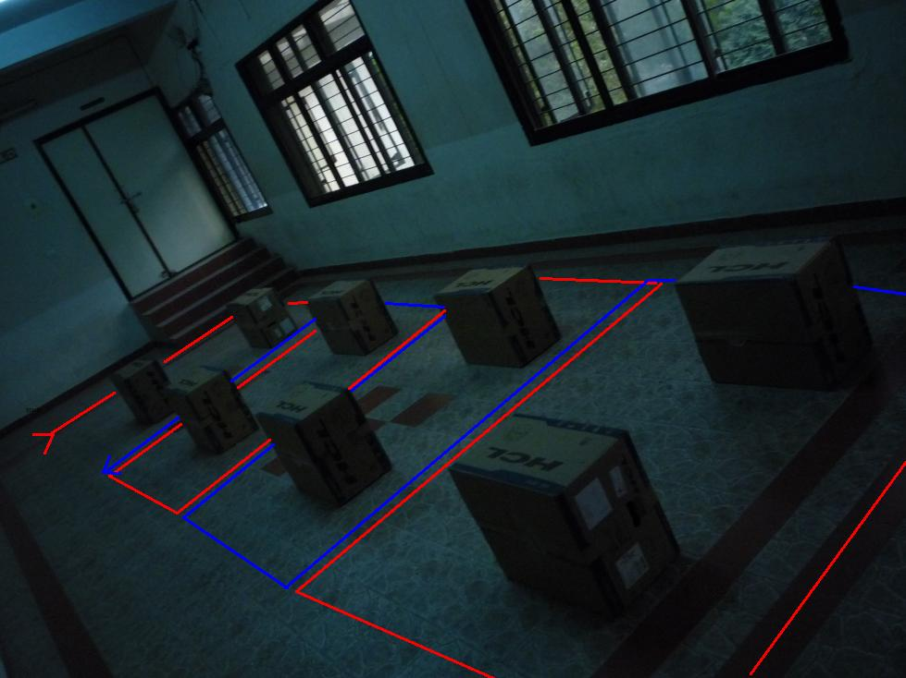
May 09-: EKF SLAM Works!

Slide 39
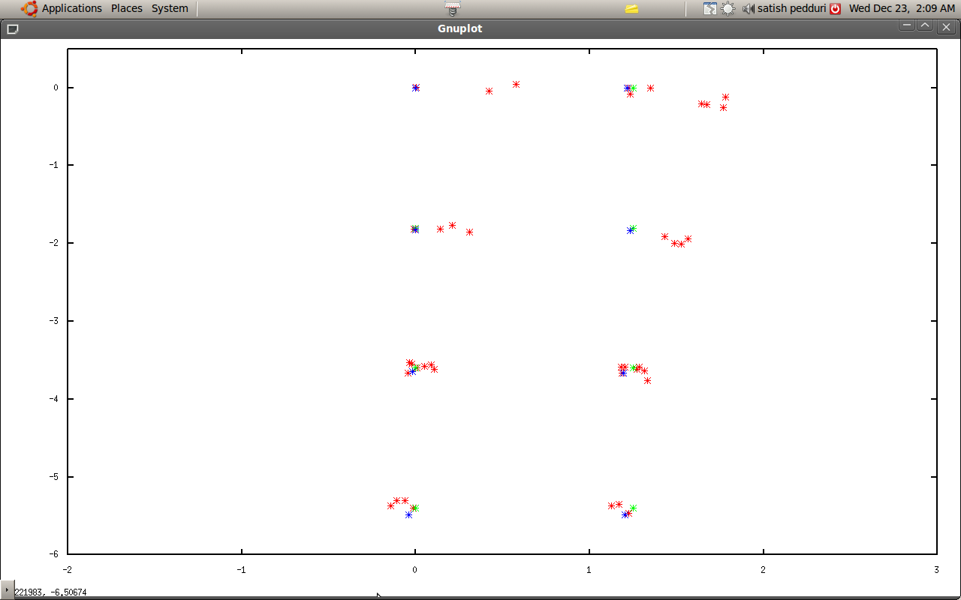
May 09-: EKF SLAM Works!

Slide 40
KF SLAM Convergence: Dissanayake et.al, TRA, 2001
In this paper the authors establish the following for a robot with linear motion and measurement models
  The determinant of any submatrix of the map covariance matrix decreases monotonically as observations are successively made.
  In the limit as the number of observations increases, the landmark estimates become fully correlated.
  In the limit, the covariance associated with any single landmark location estimate is determined only by the initial covariance in the vehicle location estimate.

Slide 41
KF SLAM Convergence: Dissanayake et.al
The authors proved only for the case where the vehicle was stationary
When the vehicle moves the authors admit that the problem is intractable, but maintain that in the limit of infinite observations the landmark covariances will solely be guided by the initial vehicle covariance, the process and measurement noise

Slide 42
EKF-SLAM Inconsistency
In 2001, Julier and Uhlman in an ICRA paper proved,
  “for the special case of a stationary vehicle (with no process noise) which uses a range-bearing sensor and has non-zero angular uncertainty, the fullcovariance SLAM algorithm always yields an inconsistent map”.
In 2005, Tim Bailey and others confirmed these observations and showed that the inconsistency was reached in a matter of few iterations especially if the angular/heading variance was large
The inconsistency is manifest in overly optimistic covariance estimate especially of the bearing that falls below the initial covariance – A direct violation of the results obtained in the 2001 paper of Dissanayake

Slide 43
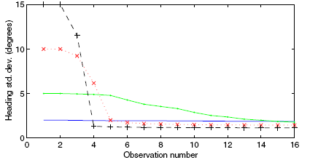
EKF-SLAM Inconsistency
These inconsistencies were attributed primarily to linearization effects as the measurement Jacobian H is not computed at the true state but rather at the predicted state of the robot. Since this Jacobian varied at every iteration it resulted in spurious information gain

Slide 44
EKF SLAM Convergence
In 2006, Dissanayake and Huang in their paper extended their convergence analysis of KF SLAM to the EKF counterpart
In this paper they showed that most of the convergence proofs of their earlier paper held true if the Jacobians were evaluated about the true states
They then admitted to the inconsistency arguments and observations put forth by others due to uncertainty in bearing and violation of some fundamental constraints governing the Jacobians when they are evaluated about the predicted/estimated states

Slide 45
SLAM: State of the Art
Building Large Scale Maps
  Place recognition: FABMAP from the Oxford Mobile Robotics Group
  6 D SLAM through scan matching
  Vision as an essential sensing modality
  Merging multiple maps: ATLAS Framework from ACFR
Single Camera SLAM or Mono SLAM: Andrew Davisson from Imperial College
SLAM and Place Recognition in Dynamic Environments:
  The GATMO and SLAMMOT architectures

Slide 46
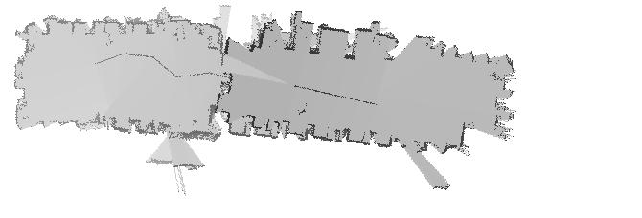
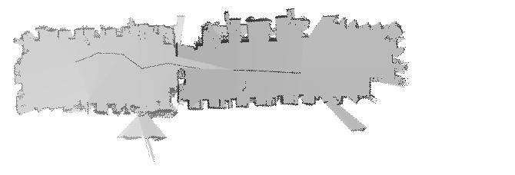
SLAM Results of Robotics Lab
Robotics Research Center, IIIT Hyderabad

