Slide 1
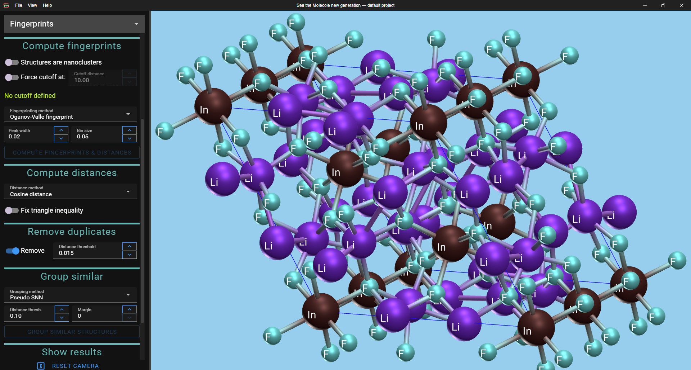
STMng

Slide 2
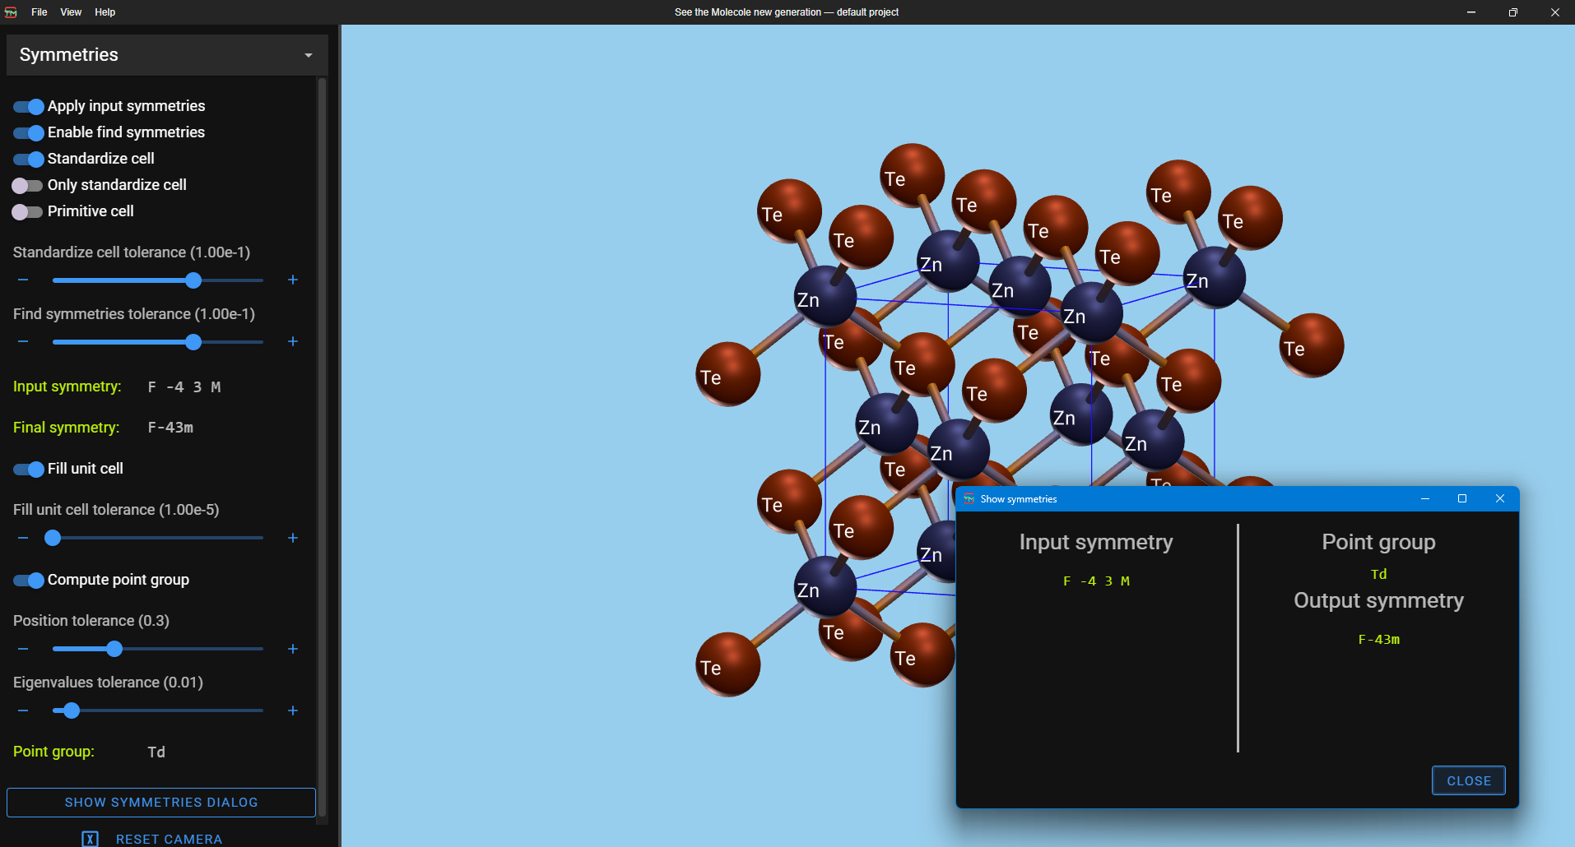
Node selector
Current project
3D Viewer
Current node parameters
Gutter
Manage camera position
A secondary window

