Slide 1
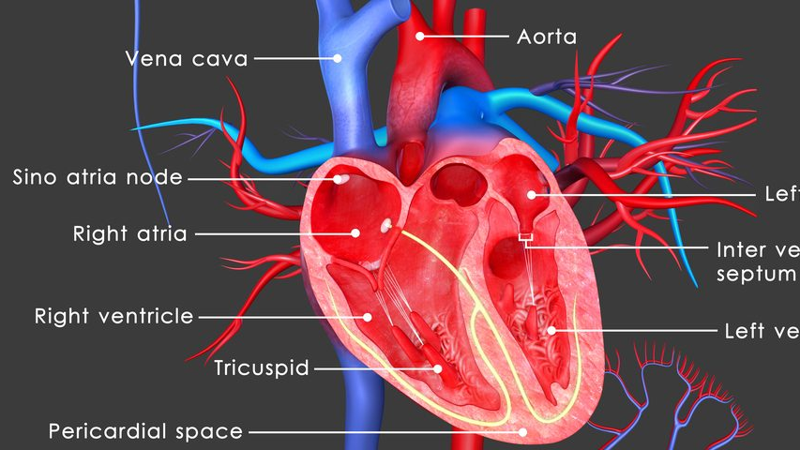
Heart Failure prediction
By a heartbreaker
2022 07 12
Trends for likelihood of a type of heart disease

Slide 2
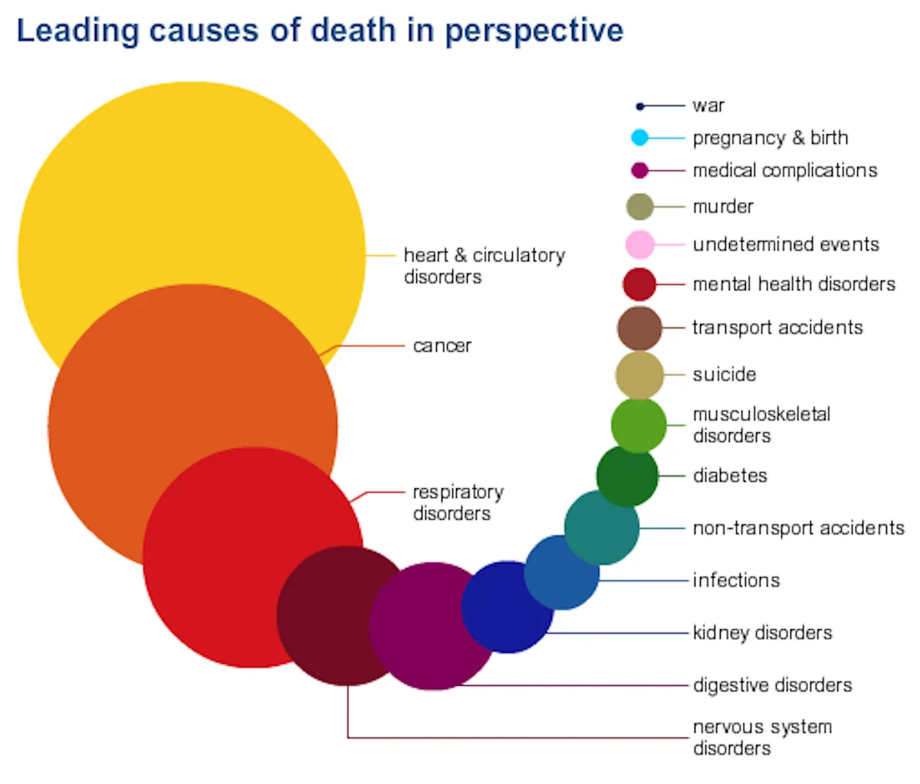
Context and key points
CVD/ Cardiovascular diseases
Factors for increased risk include sedentary lifestyle, unhealthy diet, being overweight or obese.
Notes:
Most people have not heard of heart failure yet have heard of heart disease. Heart failure is among coronary heart disease, stroke, and hypertension in that leading cause of death in America. Like you guess, this is when the heart gives out and stops pumping and includes pumping a smaller volume that happens over days.
Our sample data already has reporting on indicators of health that correlate with heart disease. People who have had coronary heart disease, heart attack, and high blood pressure are more likely to develop heart failure.

Slide 3

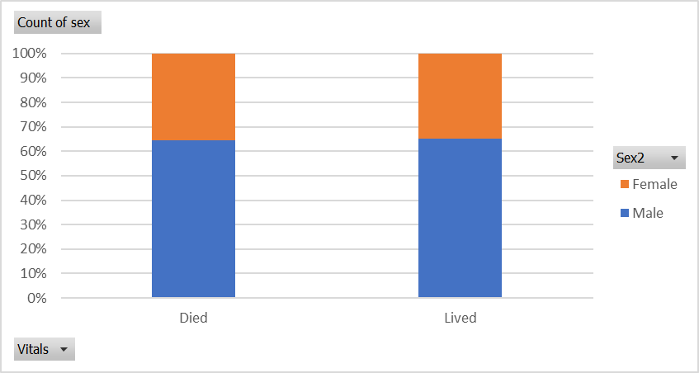
Notes:
We have data from a study done in 2020 of 299 people with groups of people with various conditions who died or did not die of heart failure.

Slide 4
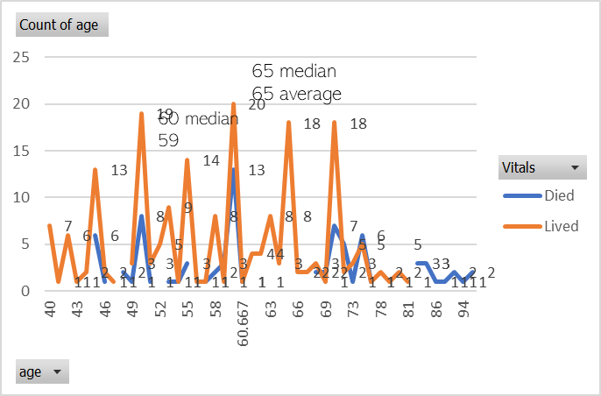

Notes:
This graph is cluttered not on purpose and shows that there were double the amount of people surveyed who lived than died of heart failure and their age distribution. This is a disease of people over 35. The many orange spikes over top smaller blue peaks help show that about double the amount of people live than die, and the spread of blue height communicates that there is steady die off centered around 60 years old.

Slide 5

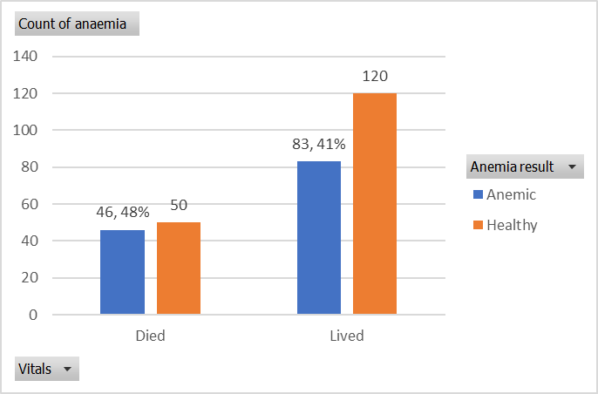
Notes:
Why would there not be enough iron in the blood? Some people say anemia is a sign of the heart not pumping enough blood and circulating it well with oxygen. Others say anemia could be a cause of heart failure.

Slide 6

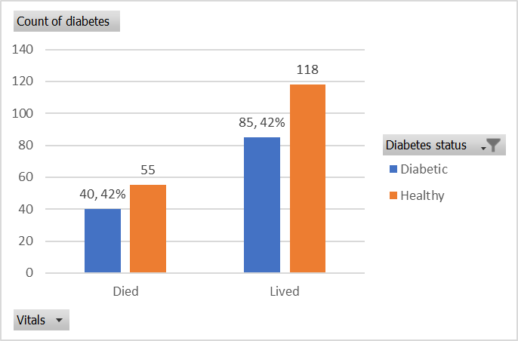
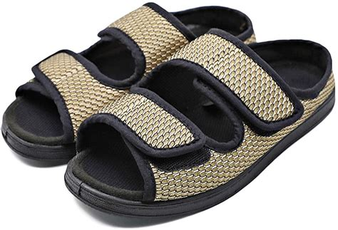
Notes:
Diabetes is used as a predictive factor to cardiovascular disease as many people who have Type 2 diabetes have high blood pressure, high cholesterol, obesity, sedentary lifestyle, and poorly controlled blood sugar. I wonder why the correlation is not higher and think there is more I do not know about heart failure in comparison to other heart diseases that makes it less common.

Slide 7
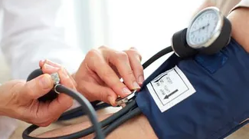
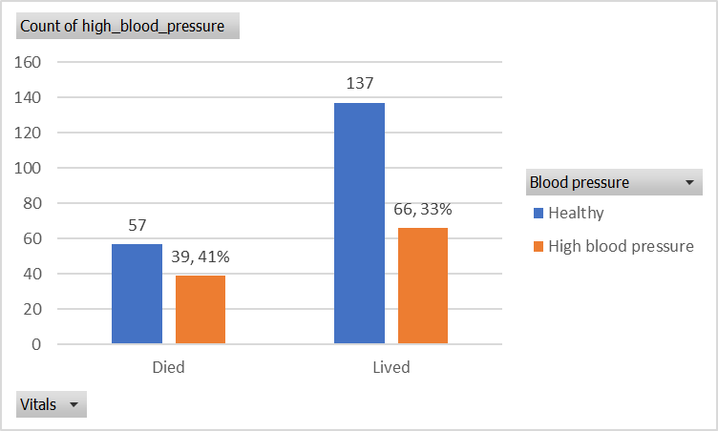
Notes:
The American Heart Association says that there is a high correlation between high blood pressure and insulin resistance and diabetes has a correlation with heart disease. 1 in 4 people die of heart disease, so I would expect most of the factors in this study to have percentages close to 25%. I think the percent of people with high blood pressure is lower in the pool of people who had not died in part due to them not having died yet or killed off by heart disease being alive.

Slide 8
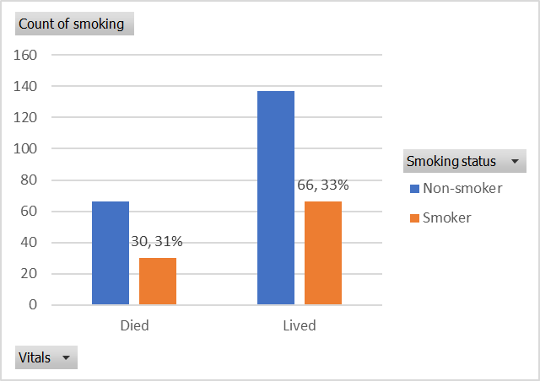

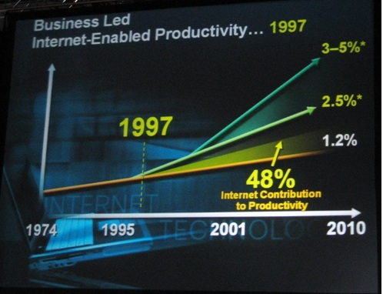
This Photo by Unknown author is licensed under CC BY-SA-NC.
Notes:
Smokers have societal pressure on them to quit especially in the city and at higher income levels. Women make up 3% of smokers and have less images about them smoking. Smoking also pairs with drinking and higher stress. Smoking having a good correlation to other host conditions for cardiovascular disease makes it a factor for men.

Slide 9
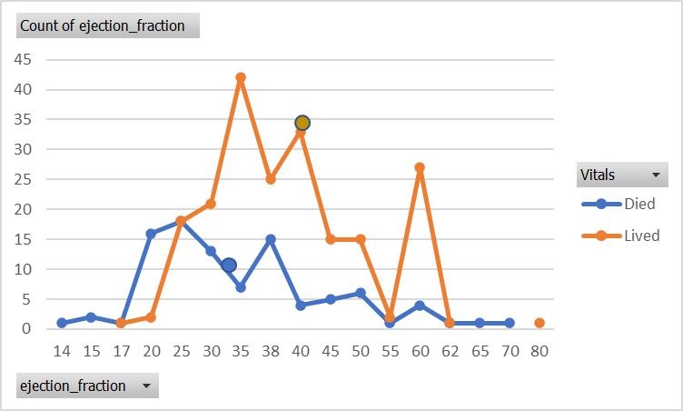

Notes:
The heart pumps strong and weaker is less healthy. The average ejection fraction is, on average for the lived or died group, what percent of potential blood the heart could pump. We have 33% average ejection rate from those who died and 40% from those who did not die. There were similar peaks in the healthy range for both groups between 40 and 80%.

Slide 10
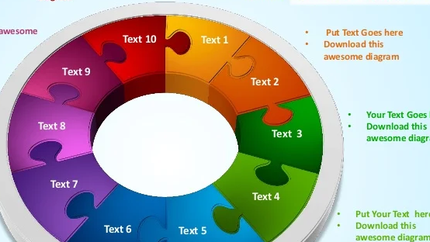
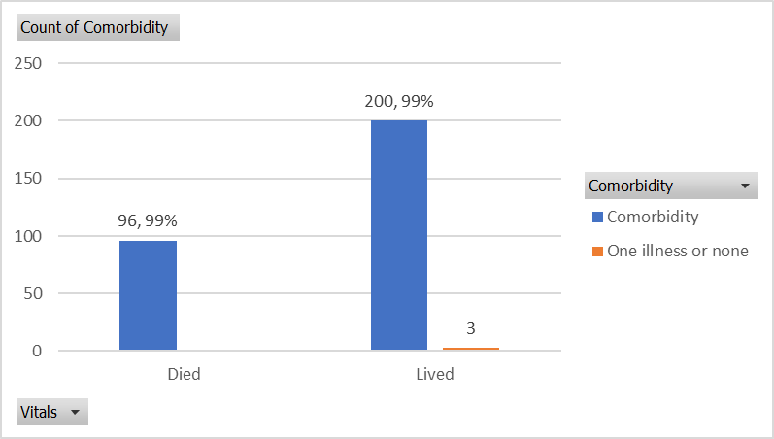
Notes:
The condition of having more than one health condition at once was a killer... and equally found in those who lived. Most everyone had multiple health risks aside from three who had only one impediment in the lived group.

Slide 11
Takeaway
Comorbidity, then Anemia were strongly associated with possible heart failure and other conditions except gender had 30-40% correlation.
Notes:
Though 1 in 4 American men die of heart disease, women were as likely to die as men of heart failure.
We can predict with some precision if a person will die of heart failure using the included tests.

Slide 12
References, Appendix
Kaggle
Business Insider
American Health Association
Center for Disease Control
Healthline
Friedrich's Ataxia News

