Slide 1

INTERNATIONAL PASSENGER AND US AIR-TRAFFIC ANALYSIS
Aaryan Bammi, Chaitali Deshmukh, Crystal Leatvanich, Junhan Chen(PM), Kuang-Ching (Amanda) Ting, Saketh Bollina
Notes:
Aaryan & Saketh

Slide 2
Introduction & Motivation
Uncover trends in passenger and freight traffic
Understand seasonal variations
Evaluate market share among carriers
Notes:
Aaryan & Saketh

Slide 3

Data Source
International Passenger
Report
AK
U.S. Airline Traffic by Airport
MA
IL
GA
CA
7,440 Rows
791,623 Rows
Bureau of Transportation Statistics, U.S. Department of Transportation
Notes:
(Aaryan & Saketh) Talk about why we chose each of the 5 states. Alaska, California, Mass, Illinois, Georgia,

Slide 4

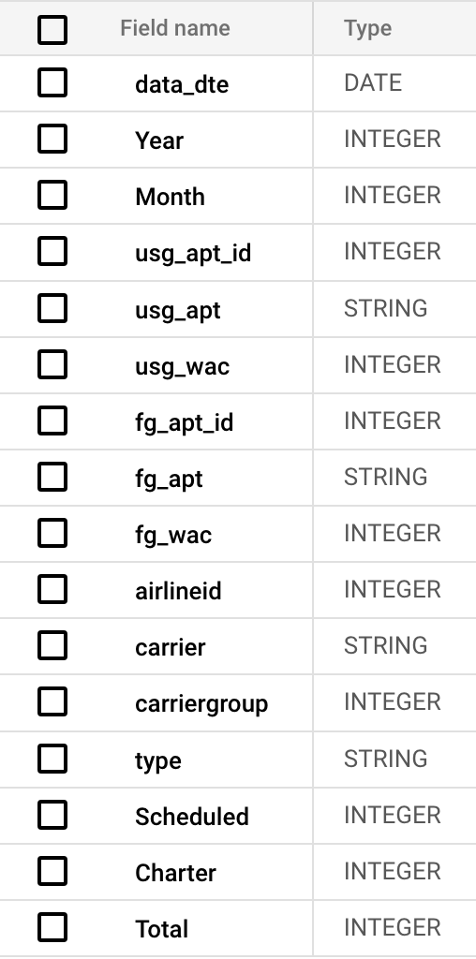

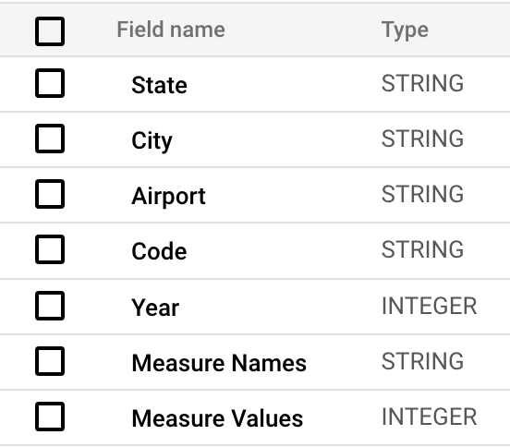
Entity Relationship Diagram
<FK>
<PK>
Notes:
(Aaryan & Saketh) primary key foreign key
IATA code as unique identifier

Slide 5
Data Cleaning
Merged Five State Datasets
Eliminated Missing Data
Adjusted Data Types
Notes:
(Aaryan & Saketh)
Analyzed U.S. airline traffic data from five key states (Alaska, California, Georgia, Illinois, Massachusetts) due to their high passenger and freight volumes
Merged into a single combined U.S. dataset
Identified null values in the Airport column (replaced with ‘unknown’)

Slide 6
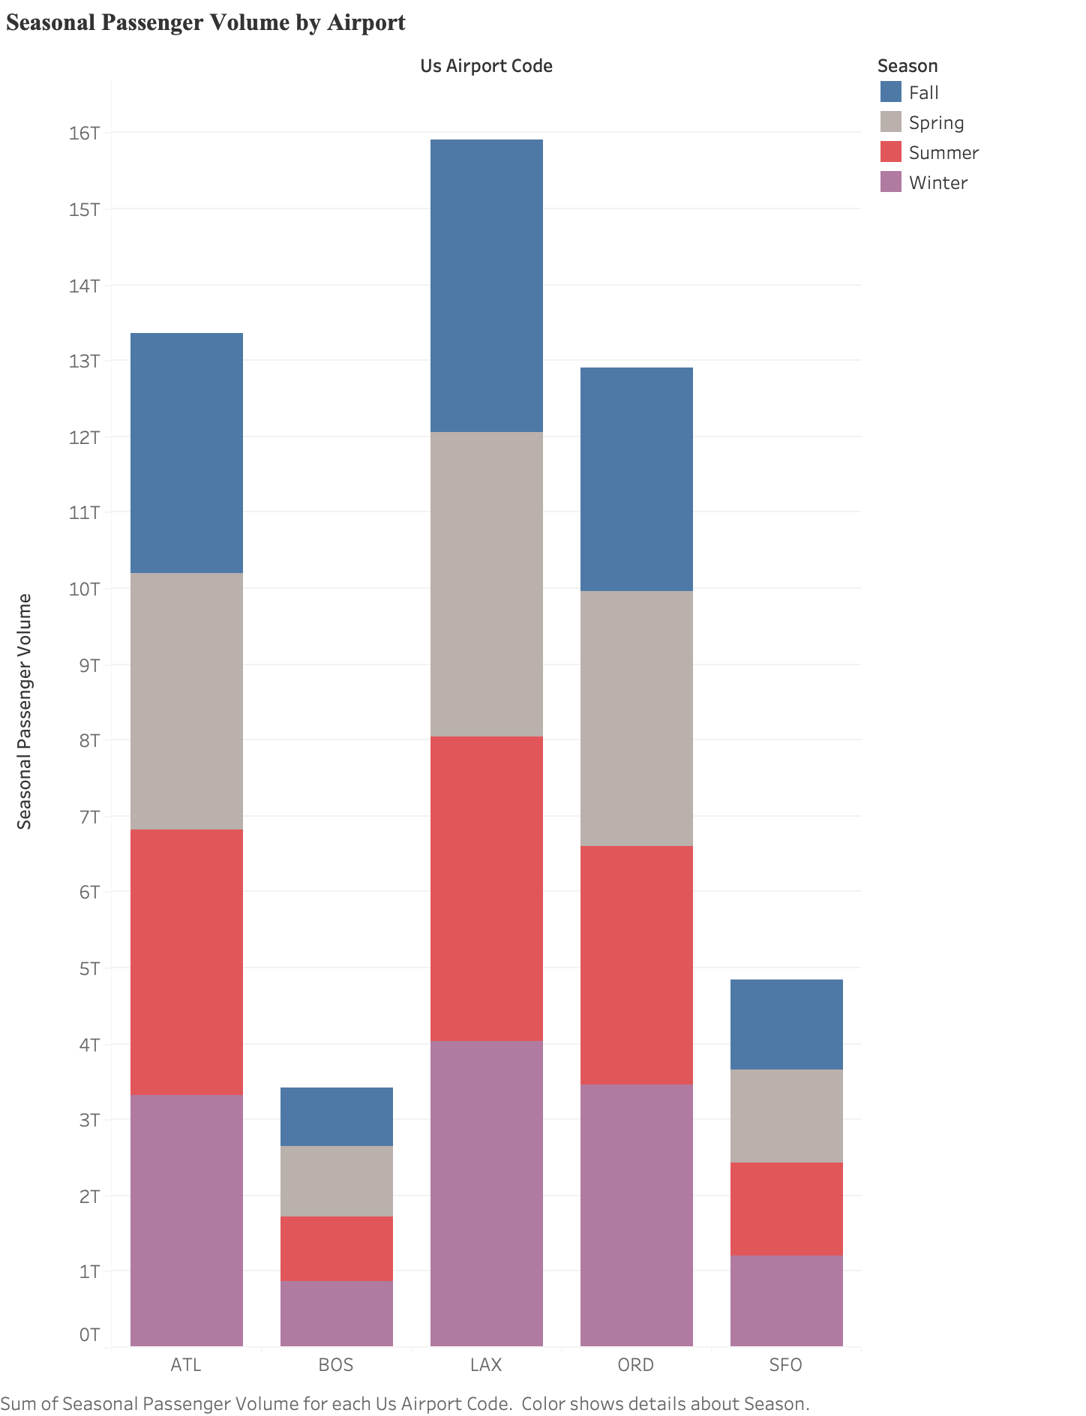
Seasonal Passenger Volumes by Airport
Summer Peaks:
ATL
LAX
Winter Peaks:
BOS
ORD
Balanced:
SFO
ATL BOS LAX ORD SFO
Notes:
(Chai)
We wanted to analyze seasonal passenger volumes by airport across our five key states
You can see from this graph that ATL and LAX have the highest passenger volumes especially in summer this is due to LAX being a popular summer tourist destination and ATL being a major hub for global travel.
Boston and Chicago have the highest peaks in the winter due to being popular holiday travel destinations and being less of summer vacation destinations
And SF international airport has a relatively balanced passenger volume across seasons

Slide 7
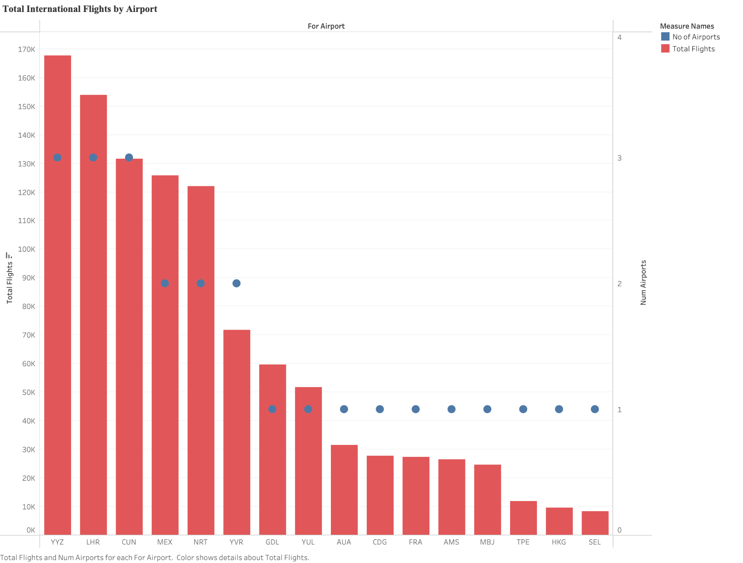
U.S. Airport Connectivity to Top International Destinations
YYZ
LHR
International Flight Volume
Geographical Factors:
West Coast Airports
Tokyo & Vancouver
East Coast Airports
Toronto & Cancun
CUN
NRT
YVZ
Notes:
The analysis highlights the top 5 U.S. airports (by state) with the highest international flight volumes over 11 years, detailing the number of flights and airlines involved for each U.S. and foreign airport pair. This provides insights into airport traffic patterns, popular routes, and carrier diversity. A deeper dive into international destinations reveals the foreign airports with the most U.S. traffic and the variety of U.S. airports serving those routes.
Flight patterns align with geographical and socio-economic factors. West Coast airports, like California and Alaska, primarily serve destinations like Tokyo (NRT) and Vancouver (YVR) due to proximity, while East Coast airports, including Georgia, Massachusetts, and Illinois, focus on Toronto (YYZ) and Cancun (CUN). Exceptions include Mexico City (MEX), concentrated in California and Illinois due to demographic factors, and London Heathrow (LHR), prevalent from California, Illinois, and Massachusetts, driven by business and tourism demand.
To optimize operations, airlines should increase capacity on high-demand routes such as LHR, CUN, and NRT while reevaluating underutilized routes. Seasonal adjustments during peak travel can further enhance profitability. By aligning flights with market trends, airlines can maximize efficiency, attract more customers, and boost revenue.
Most frequent destinations

Slide 8
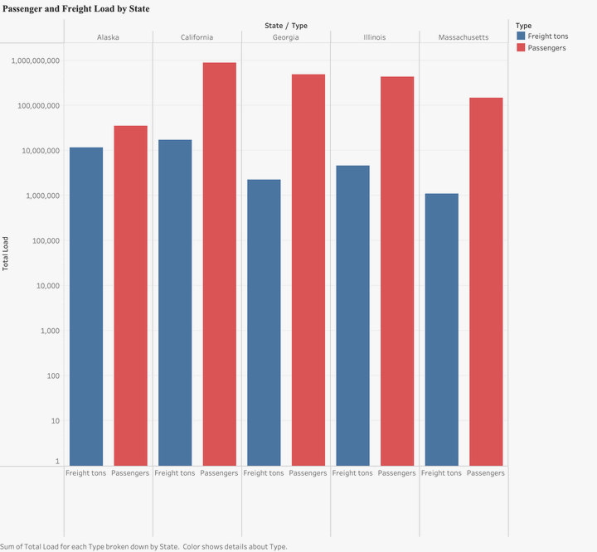
Comparison of Passenger and Freight Load by State
AK CA GA IL MA
Passenger Load
California - 887M
Georgia - 491M
Illinois - 437M
Freight Load (Tons)
California - 17M
Alaska - 12M
Illinois - 4M
1,000M
100M
10M
1M
Notes:
(Amanda)
This bar plot shows the comparison of passenger and freight load for the the five states
The y axis is set in log scale so its easier to see the comparison for both passenger and freight
As we might assume, california is the top 1 for passenger and freight
Georgia and illinois follows as the second and third around 400-500m

Slide 9
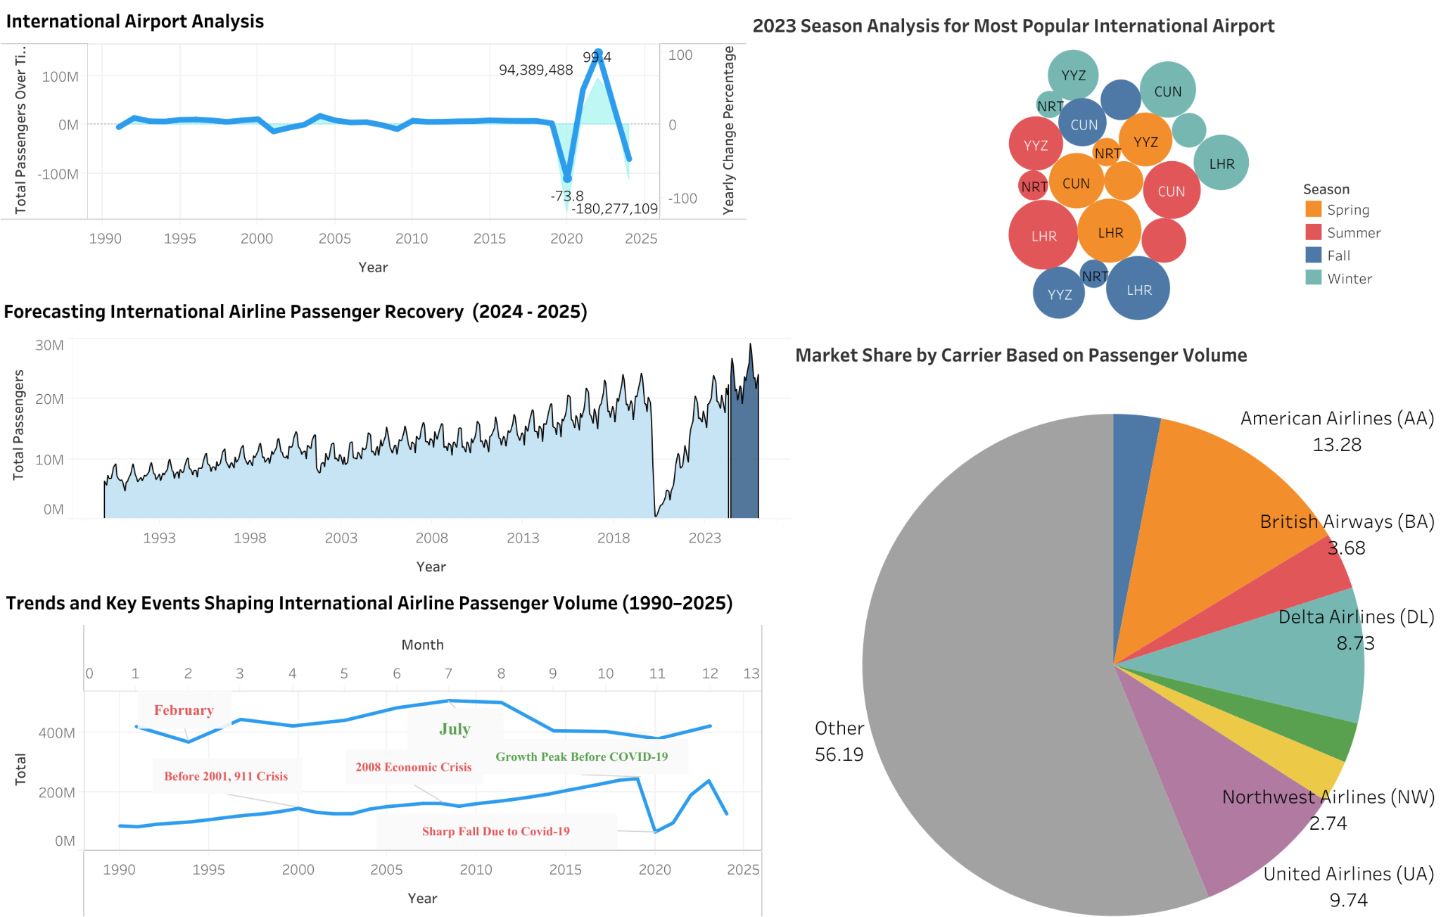
Notes:
(Chen）)https://public.tableau.com/app/profile/junhan.chen7027/viz/BA775B04InternationalAirportAnalysis20243nd/Dashboard1?publish=yes

Slide 10
Insights & Recommendations
Dashboard
Opportunity from Month Analysis
Risk & Opportunity(COVID-19)
Price and Promotion
Decision & Response Speed
Intelligent linkage between Airlines and other Industries
Notes:
(Chen)

Slide 11
Insights & Recommendations
International Flights
LHR, CUN, NRT
Increase capacity of high-demand routes
AUA & HKG
Reevaluate underutilized routes
CUN, AUA, NRT, YYZ
Seasonal adjustments to market trends
Notes:
(Crystal)
To optimize operations, airlines should increase capacity on high-demand routes such as LHR, CUN, and NRT while reevaluating underutilized routes. Seasonal adjustments during peak travel can further enhance profitability. By aligning flights with market trends, airlines can maximize efficiency, attract more customers, and boost revenue.

Slide 12
Insights & Recommendations
Five U.S. States
CA
Expand passenger handling infrastructure
GA
Optimize unused cargo space
AK
Invest in freight facilities
IL & MA
Explore freight markets, target specific industries
ALL
Focus on sustainability to meet evolving needs
Notes:
(Amanda) Airline companies should prioritize expanding passenger handling infrastructure in California and optimizing unused cargo space in Georgia. Alaska may require investments in freight facilities and partnerships with logistics companies to strengthen its role in air cargo. Illinois and Massachusetts can explore niche freight markets, targeting specific industries. Across all states, airline companies should focus on sustainability and building e-commerce partnerships to meet evolving demands, ensuring growth and competitiveness in both passenger and freight services.

Slide 13

Thank you! Questions?

