Slide 1
Youtube for Content Creators
Kapilan Mahalingam
January, 2023
Analytics and Recommendations for the Budding Youtuber

Slide 2
Motivation
Video content creation is difficult
Most youtube gamers, and twitch streamers struggle to increase viewership
Time limited, making videos is a lot of work
Record number of new games being released, difficult to keep up
Objective
Leverage youtube and steam to take a data driven approach to games
Content based and Audience based recommendation systems

Slide 3
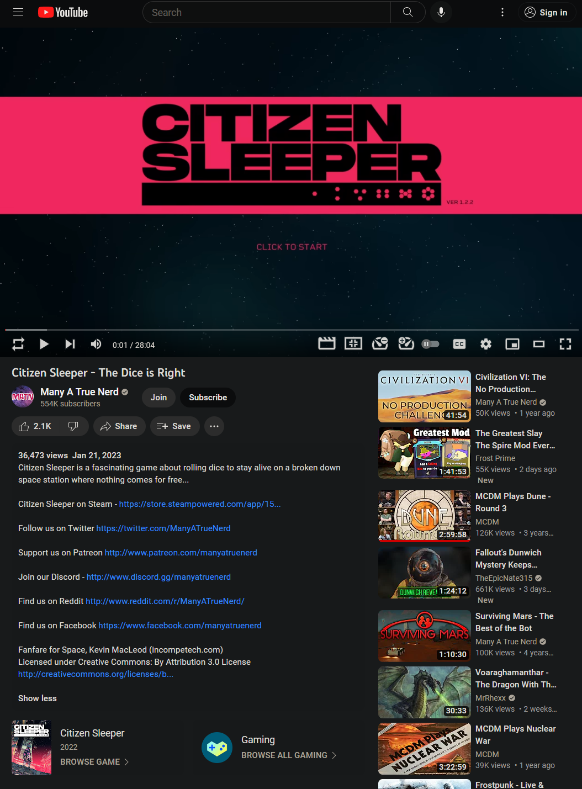
Sample Youtube Data Point
Youtube Data
List of Videos on the Channel
Youtuber subscriber count, channel age; content mix
Data per video
Sources
Youtube API
Youtube’s API is terrible
Direct Scraping
Scraping youtube is also terrible
Scraped all videos for about ~20 channels (~120,000 videos)

Slide 4
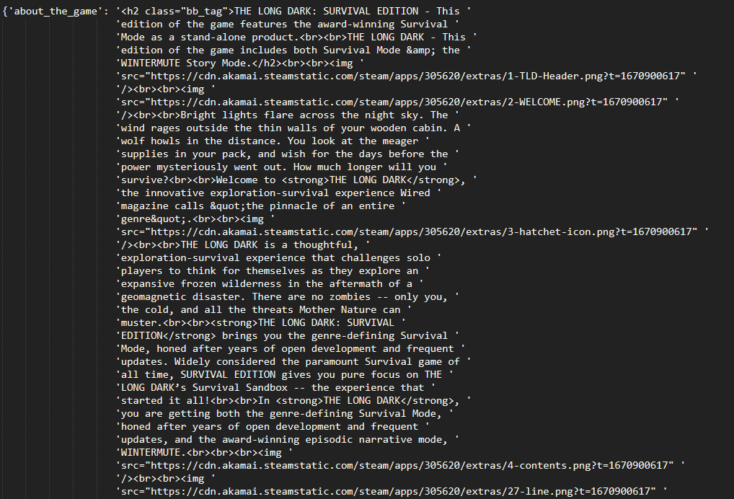
Sample Steam Data Point
Game data from Steam
Game Identification is terrible
Third party python libraries
Team Fortress (?!) API
Web scraping search suggestions
Steamspy
Multilayered ID extraction
Steam API
Surprisingly was actually pretty good

Slide 5
Preprocessing
Significant error checking
Used a secondary CNN to consistency check the data for the primary CNN
Lots of data cleaning, stripping html, url’s, emojis, non-ascii chars, unnecessary capitalization
Pruned based on several criteria
Common enough Game
Game details on Steam
Livestreams
Consolidating Versions

Slide 6
Model
Dumped data into a SQL database, and tried two different models
Content Based Model:
Similar games based on description, genres, publishers, developers, etc.
Ran both on youtuber’s ‘top’ videos, as well as their entire library
Collaborative models:
Harder due to the paucity of users, and how specialized some were
Difficult to judge recommendations
Focused on matrix factorization methods rather than CNN’s for “computational” reasons

Slide 7
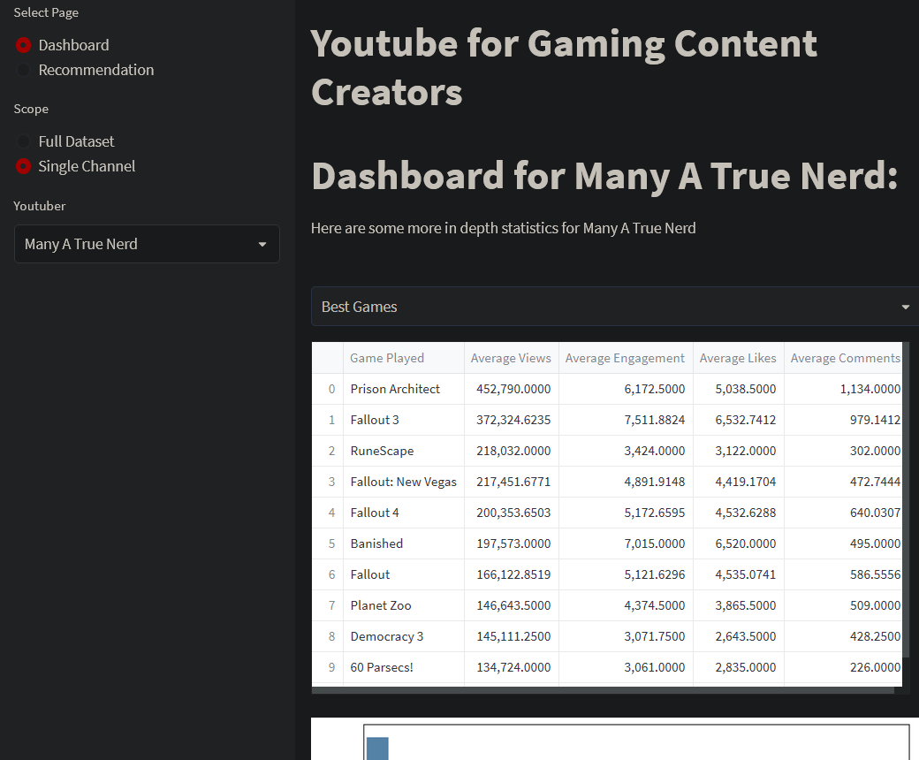
Deployment I
Deployed Webapp on streamlit
Dashboard
Youtube Gaming, in general
Views, per capita views, engagement, popular games/genres, etc.
Channel analyses
Graphs, summary statistics, trends, correlation matrices and the like

Slide 8
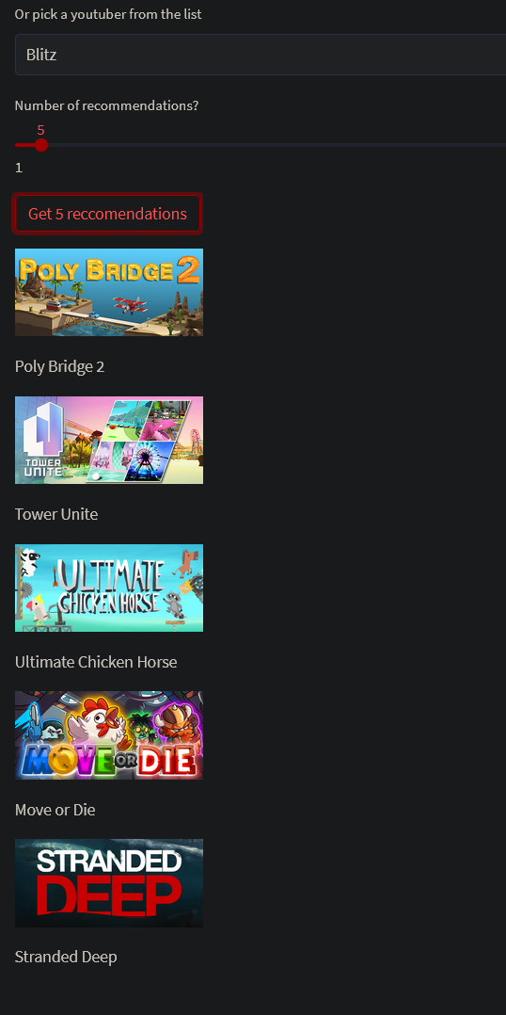
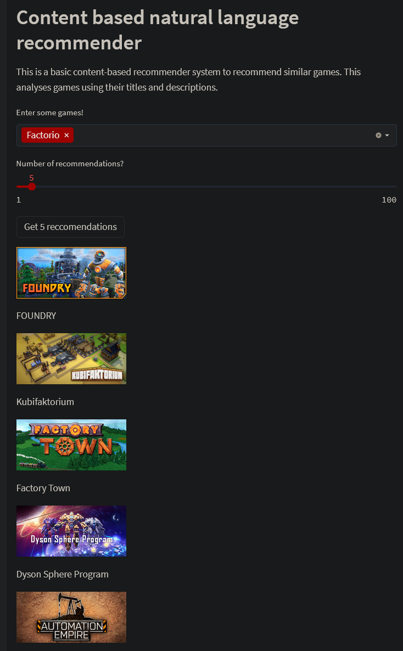
Deployment II
Recommendation System
Content based worked better
For youtubers, based on their top games rather than their entire library
Here the recommendations were done on the basis of views rather than “ratings”
Collaborative is difficult to judge

Slide 9
Road Ahead
Steam skews the data
Platforms not available
Exclusives and the like could be draws for viewership
Offload more complex parts
Streamlit cannot handle computational load
Scraping is very hacky, especially for larger youtubers
Basically streamlit isn’t great for this use case and I made a mistake
Larger samples might help collaborative filtering, but they also need success criteria

