Slide 1
Amazon Coupon Acceptance Analysis
Jing Wang
2/27/2024

Slide 2
DataSource
Coupons.csv

Slide 3
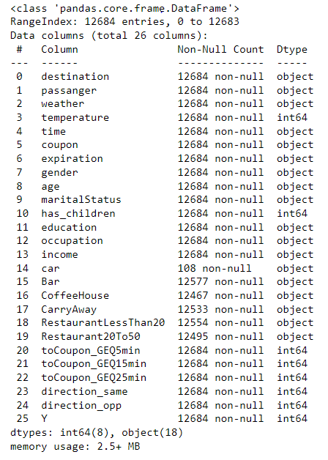
Data info()

Slide 4
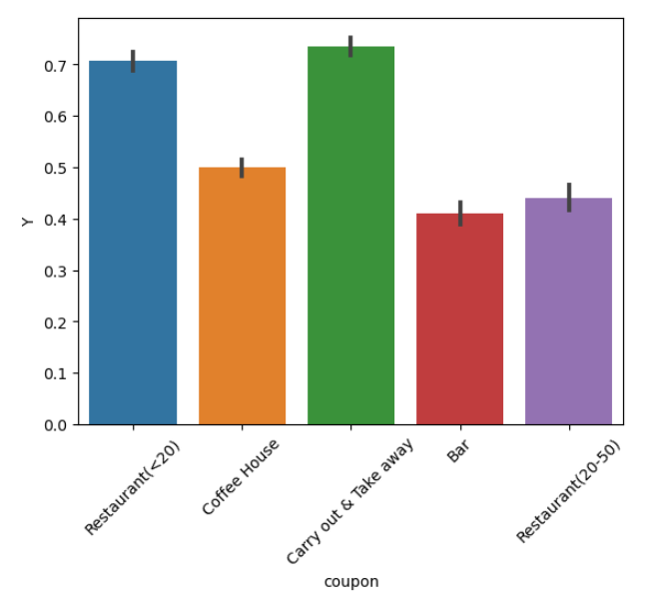
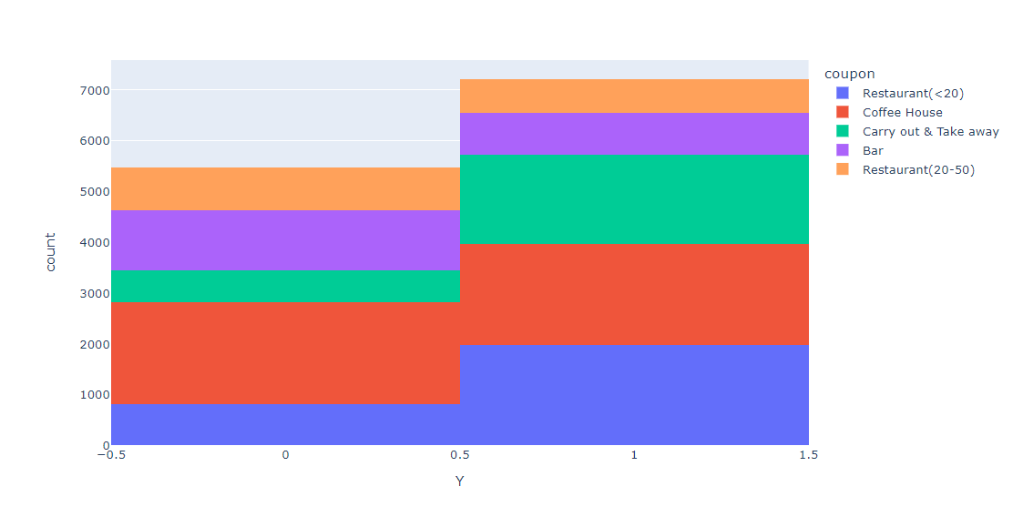
The general acceptance portion is around 0.57
During the acceptance portion, the different types of coupon distribute.
Restaurant(<20) and Carry out have relatively large amounts.

Slide 5
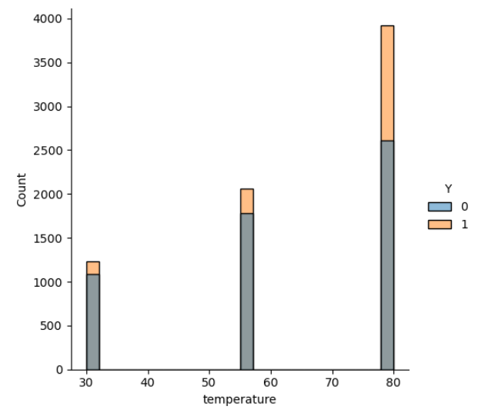
Temperature
Based on this “temperature” plot, the high temperature (80) is a factor to cause user to accept the coupon.

Slide 6
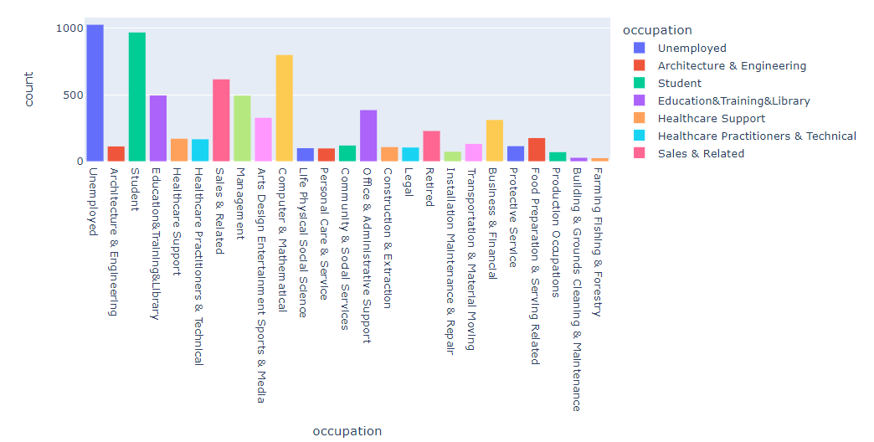
Occupation

Slide 7
“Bar” coupon

Slide 8
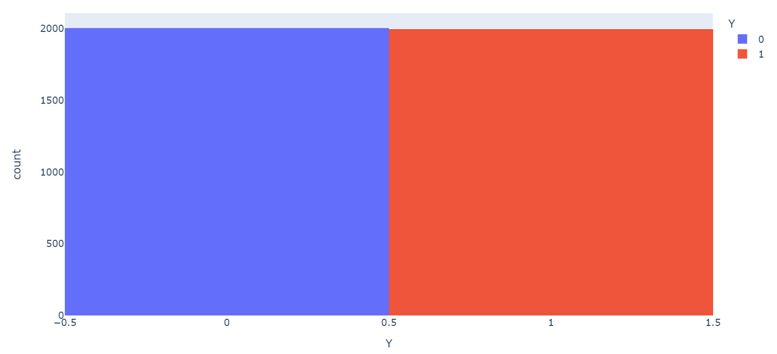
Data Analysis
What proportion of bar coupons were accepted?
49.9%

Slide 9
Data Analysis
0.37
Compare the acceptance rate between those who went to a bar 3 or fewer times a month to those who went more.
37.1% vs 76.9%
Compare the acceptance rate between drivers who go to a bar more than once a month and are over the age of 25 to the all others. Is there a difference?
68.8% vs 38.3%
Use the same process to compare the acceptance rate between drivers who go to bars more than once a month and had passengers that were not a kid and had occupations other than farming, fishing, or forestry.
68.8% vs 50.0% vs 41.0%

Slide 10
Data Analysis
Compare the acceptance rates between those drivers who:
go to bars more than once a month, had passengers that were not a kid, and were not widowed OR
go to bars more than once a month and are under the age of 30 OR
go to cheap restaurants more than 4 times a month and income is less than 50K.
68.8% vs 68.9% vs 45.3%
Based on previous analysis the people, who is under 30,used to go to bar more than once a month and with no kids in car, would be more possible to accept the bar coupon.

Slide 11
“Coffee Coupon”

Slide 12
Data Analysis
What proportion of bar coupons were accepted?
49.9%

Slide 13
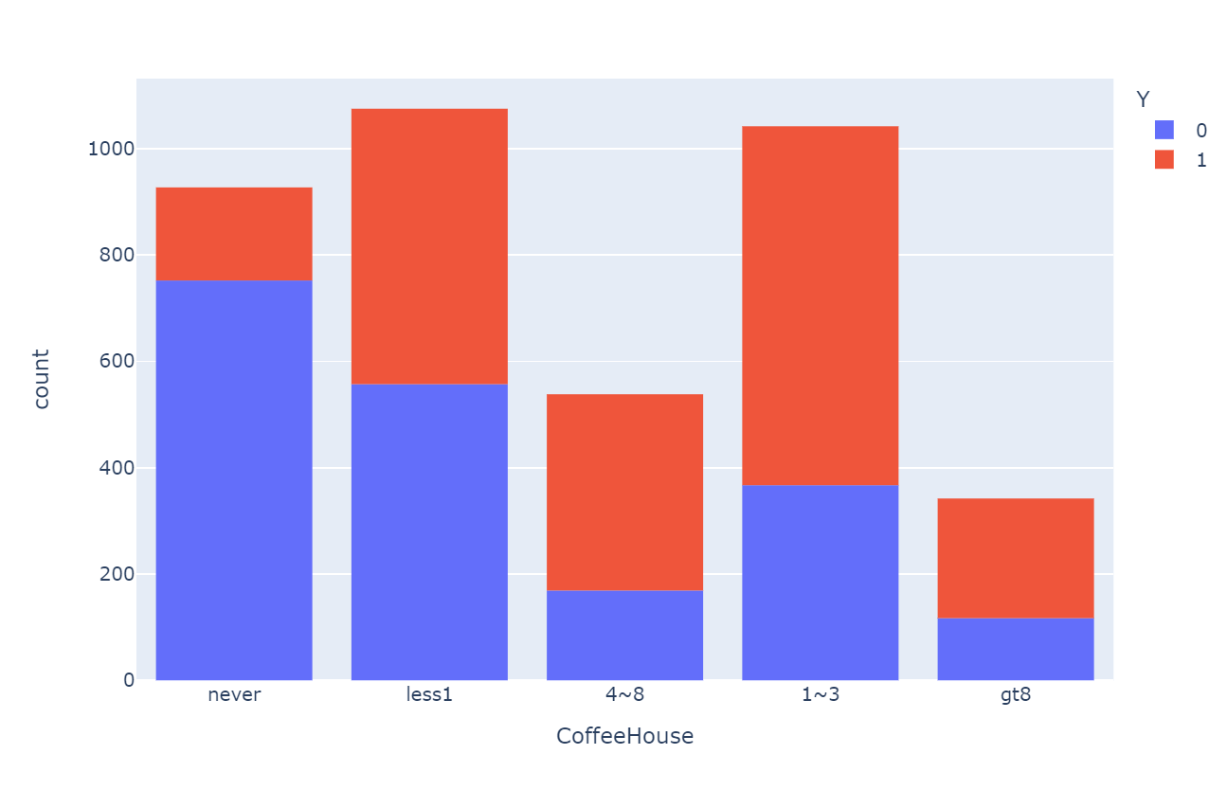
Plot of the dataset vs “CoffeeHouse”

Slide 14
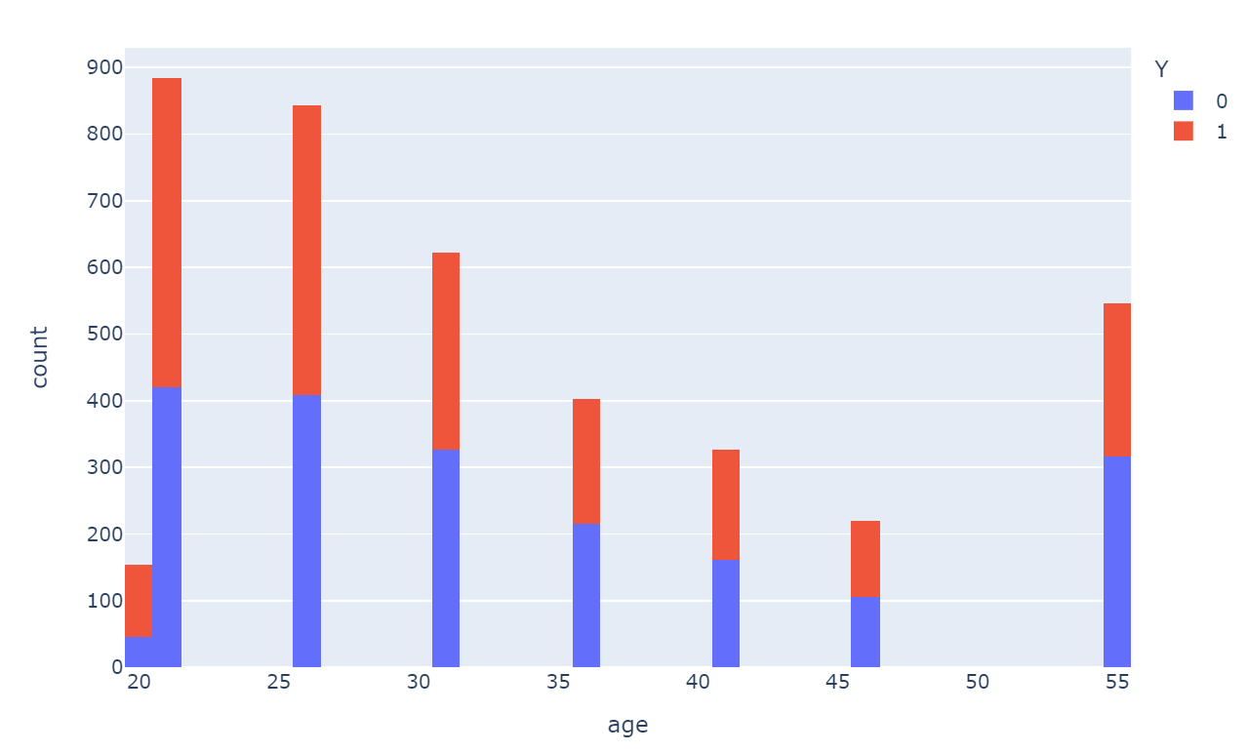
Plot of the dataset vs “age”

Slide 15
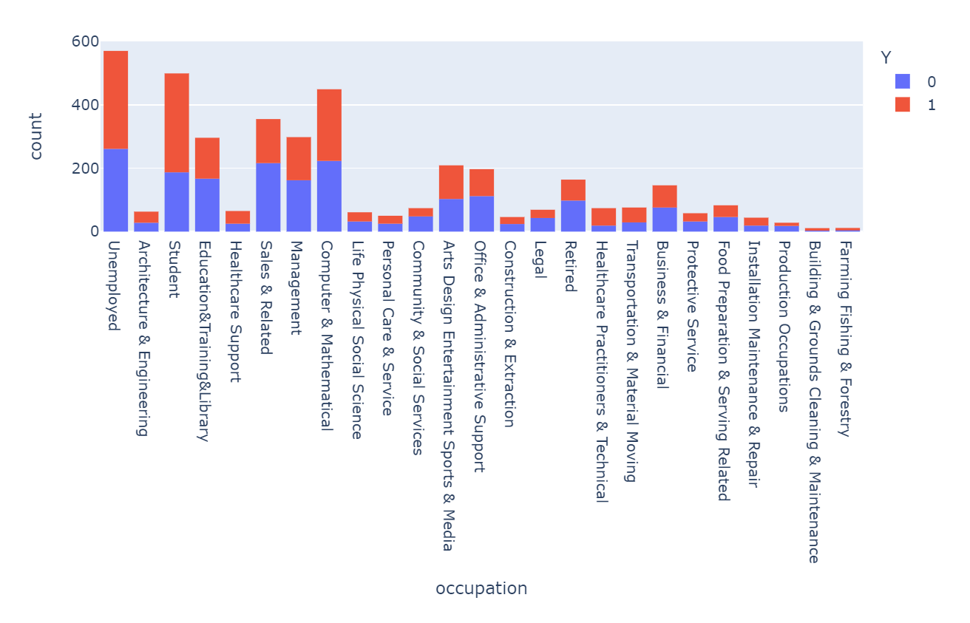
Plot of the dataset vs “Occupation”

Slide 16
Data Analysis
0.37
Compare the acceptance rate between those who went to a bar 3 or fewer times a month, but not never to those who went more.
56.4% vs 28.0%
People who never goes to Coffee House, has lowest acceptance rate. 18.9%
Compare the acceptance rate between drivers who go to a bar more than once a month and are over the age of 25 to the all others. Is there a difference?
66.0% vs 48.1%
Use the same process to compare the acceptance rate between drivers who had passengers that were not alone and had occupations are Unemployed, Student and Computer&Mathmatical.
57.9%% vs 58.1%

Slide 17
Data Analysis
Compare the acceptance rates between those drivers who:
go to bars more than once a month, had passengers that were not Alone, and were not widowed OR
go to bars more than once a month and are under the age of 25 OR
go to cheap restaurants more than 4 times a month and income is less than 50K.
75.2% vs 71.3% vs 54.3%
Based on previous analysis the people, who is under 25,used to go to coffee house more than once a month and with passenger in car not alone and were not widowed, would be more possible to accept the bar coupon.

