Slide 1
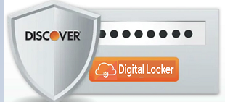
Discover dLocker
Team – “Access Denied”

Slide 2
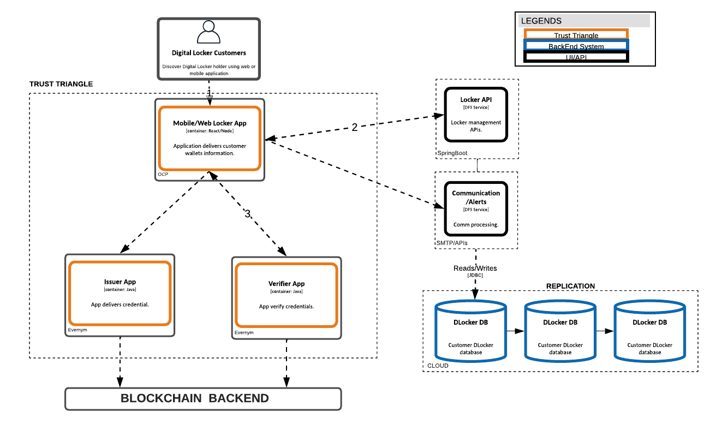
Architecture
Notes:
Tell us what the goal, value and/or benefit is

Slide 3
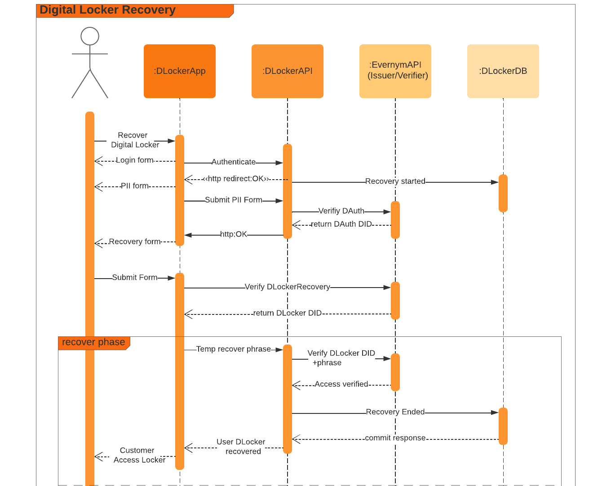
Notes:
Tell us what the goal, value and/or benefit is

Slide 4

Distributed Identities
DAuth DID – Stores Discover Universal customer Identity
DLocker DID – Stores customer dLocker Identity (DAuth + dLocker ID)
DLocker Recovery DID – Required for digital locker recovery (DAuth + Recovery phrase)
The Trust Triangle - Issue and verify process happens in decentralized identity framework

Slide 5
Thank You

